Slide 1

BCOG 100
Pattern Recognition
Lecture 7.3 — Pattern Recognition in the Cortex
Notes:
The first lecture stated the problem, and the second gave the algorithms that might solve it. This lecture is the implementational level: what tissue actually does with a smell or an image, how we know, and how sure we are.
Most of the evidence comes from mammals, with a fly, a bird, and a fish where their evidence is cleaner or makes a point. Throughout, it is worth tracking which results were measured, which come from models, and which are inferences, because this lecture’s evidence is all three.
It ends by answering the question Module 6 left open: what does a sheet that runs one circuit everywhere compute?

Slide 2
To Start: Which Answer Would a Brain Use?
In your group, three minutes.
A hidden layer’s weights can be set by passing errors back, left as random wiring with only the output trained, or set by competition with no teacher.
Which seems most plausible for a brain? What would we look for in brain tissue to tell the three apart?
Notes:
This is the last lecture’s major theme turned into a question about tissue.
Groups often favor competition, because it needs no teacher, or random wiring, because it needs no training at all. Backpropagation tends to sound least biological. The lecture will show why literal backpropagation is hard to find in the cortex, and also that the question is still open.
The second question is the useful one. Random wiring predicts connections that look random and differ from animal to animal, with learning only at the output. Competition predicts neighbors that respond to similar inputs, a map. Passing errors back predicts some way of delivering an error to cells deep in the system.
Keep the predictions the groups make. This lecture finds the first one strikingly in a fly, finds something consistent with it in a mouse, and finds the third an open question.

Slide 3
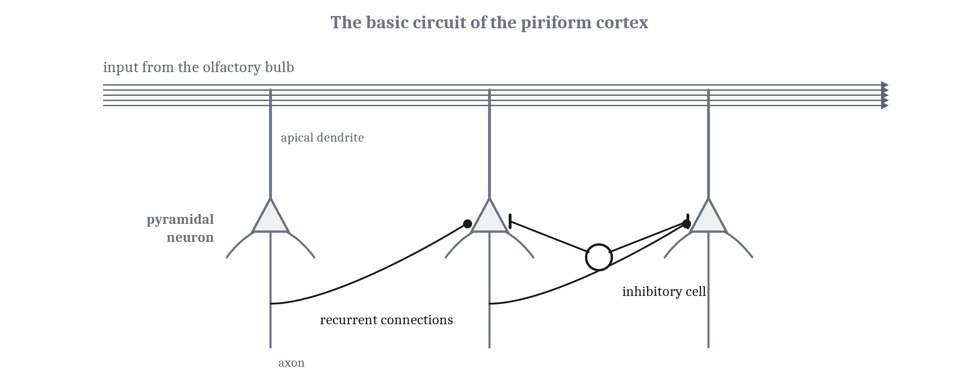
The Oldest Cortex
The piriform cortex: three layers, input straight from the olfactory bulb with no thalamic relay, built around the pyramidal neuron.
Notes:
In mammals, the first cortex a smell reaches is the **piriform cortex**. It is a sheet with three layers, older in form than the six-layered neocortex. It is also unusual in where its input comes from. Signals from the other senses reach the cortex through a relay in the thalamus. Smell does not: the olfactory bulb, the first stop for signals from the nose, sends its output straight to the piriform cortex. How the bulb’s signals are produced is a question about the senses, for Module 8.
The piriform cortex is built around the **pyramidal neuron**, which is also the main excitatory cell of the neocortex. Its cell body is roughly triangular. A long apical dendrite runs toward the surface, and shorter dendrites spread near the cell body. The bulb’s input lands on the far ends of the apical dendrites. Each cell’s axon leaves the piriform cortex, but on the way it sends side branches to neighboring pyramidal neurons, so the cells excite one another. These are recurrent connections, the kind that let a circuit in Module 4 hold a state. Inhibitory cells sit among them and damp the activity down.
The plan is old, but not every part equally old. The lamprey’s pallium also has three layers, with smell arriving on the far ends of its cells’ dendrites. But the lamprey’s cells lack the shorter dendrites near the cell body, so the full pyramidal neuron cannot be dated back that far.
Now give the circuit a job. A mouse sniffing at the mouth of a burrow needs two things from its piriform cortex: to tell apart two smells that are almost the same, its own nest and a neighbor’s, and to know a familiar smell from a faint trace of it. Those are the first lecture’s two demands, discrimination and generalization, and the piriform cortex has been studied for both.

Slide 4
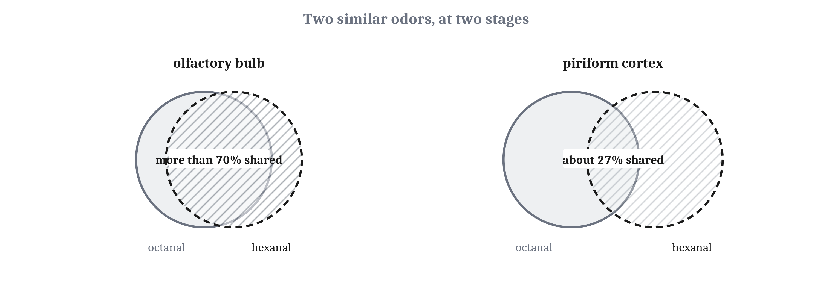
Pulling Similar Smells Apart
Pattern separation: making overlapping inputs less alike, so a later stage can tell them apart. Measured here; random wiring is a model that fits it.
Notes:
The first demand has been measured directly. In one study, researchers imaged many piriform cells at once in anesthetized mice while presenting one odor after another. Each odor activated a small set, between about 3 and 15 percent of the cells imaged. The active cells were scattered: no clustering, no map, and a cell’s neighbor was as likely to answer a quite different odor as the same one.
The telling result came from similar odors. Two odors with almost the same chemical structure share more than 70 percent of their active inputs in the olfactory bulb. In the piriform cortex, the same two odors shared only about a quarter of their active cells. Unrelated odors shared 5 to 15 percent. So two smells that look alike at the bulb look much less alike in the piriform cortex. Making overlapping inputs less alike, so a later stage can tell them apart, is **pattern separation**: the first lecture’s discrimination, carried out by a circuit.
Single cells fit. One cell could respond to two odors with unrelated structures, so no single cell stands for an odor. What identifies an odor is which set of cells is active.
The researchers proposed an explanation: if each piriform cell receives input from a random handful of the bulb’s outputs, these properties would follow. And if the wiring is random, what an odor means cannot be built into the piriform cortex; it has to come from experience. That would be the second answer from the last lecture, random wiring with a trained output, in a mammal.
Three fences. How much two odors overlap depends on how strongly a cell must respond to count as active. Random wiring is a model that fits the data, not something the study observed. And the study did not count cells, so it says nothing about whether the piriform cortex spreads its input across more cells than it receives from.

Slide 5
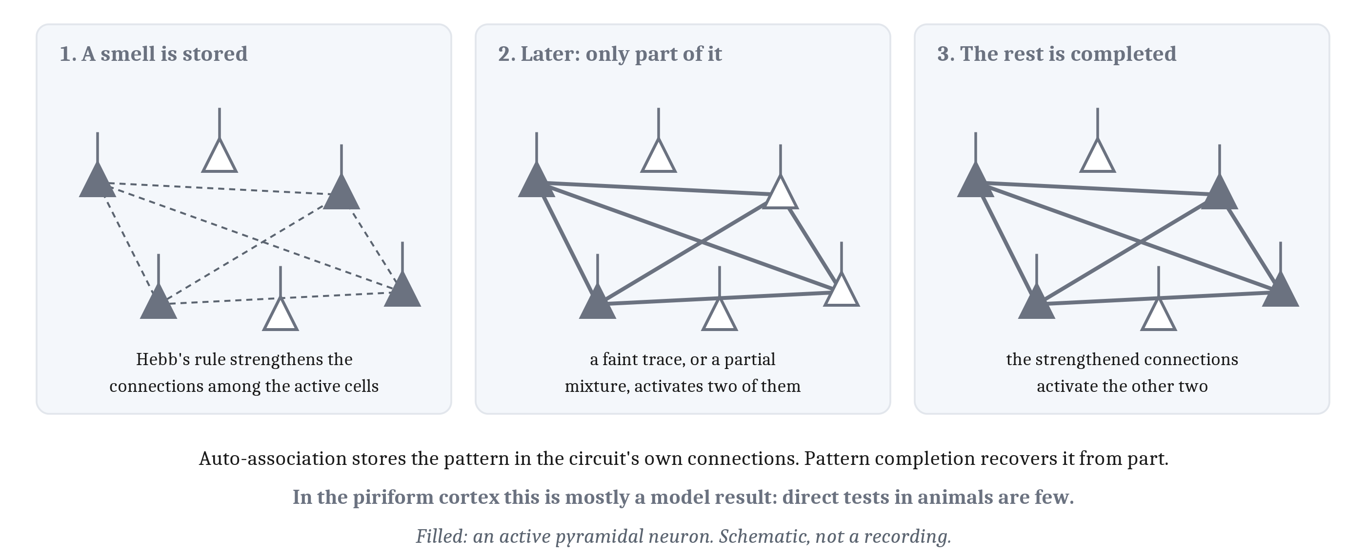
Completing a Smell from Part of It
Auto-association stores a pattern in a circuit’s own connections; pattern completion recovers it from part. In the piriform cortex, mostly a model result.
Notes:
The recurrent connections suggest a second job. Suppose that when a smell activates a set of pyramidal neurons, the connections among those active cells are strengthened, by Hebb’s rule from Module 5. The next time only part of the set is activated, the strengthened connections can activate the rest.
Storing patterns in the connections among a circuit’s own cells is **auto-association**, and recovering a whole stored pattern from part of it is **pattern completion**. It is the first lecture’s generalization, carried out by a circuit: a faint or partial version of a familiar smell produces the response the whole smell would.
The piriform cortex was proposed as a memory of this kind, because its input spreads widely and its cells excite one another, and network models built on its circuit do store patterns and complete them from partial input. But notice the grade of evidence. Separation, on the last slide, was measured. Completion in the piriform cortex comes mostly from models, and direct tests in animals are few.
For the mouse, the proposal would explain how a trace of its nest’s smell, carried on a draft, can be enough.
The hippocampus is the other place where both pattern separation and pattern completion have been proposed. Its circuits are for Modules 9 and 10.

Slide 6
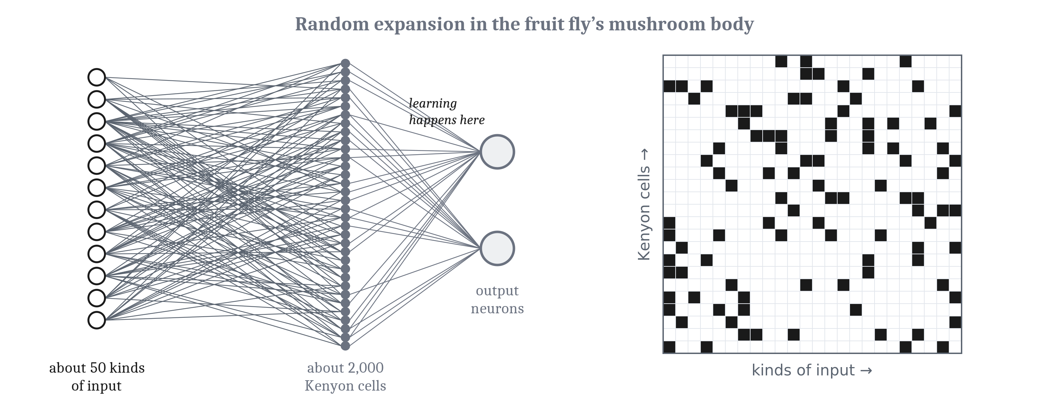
A Fly, a Bird, and a Fish
The fly’s mushroom body: about 50 kinds of input spread at random across about 2,000 cells, never trained. Learning happens downstream.
Notes:
The clearest evidence for random wiring comes from an insect. In the fruit fly, smell signals are sorted into about 50 kinds of input, which feed the **mushroom body**. There they reach about 2,000 Kenyon cells, each receiving a few of the 50. When the connections of 200 Kenyon cells were traced, the combinations looked random, and they differed from fly to fly. Kenyon cells respond sparsely, so each odor activates only a few. The grid on the right is drawn at random to show the kind of pattern the tracing found; it is not the traced data.
That is the second answer from the last lecture in its plainest form: an expansion from about 50 inputs to about 2,000 cells, wired at random and never trained. Learning happens downstream, at the connections from the Kenyon cells to the output neurons, where a dopamine signal settles which connections change. That is Module 5’s three-factor rule.
The fly and the mouse are separated by more than half a billion years, and their last common ancestor had nothing like either structure. So the resemblance between the mushroom body and the piriform cortex is best read as convergent evolution, in Module 2’s terms: two lineages arriving at a similar arrangement for a similar problem. That reading is an inference from the family tree, not something either study tested.
Vertebrates without a neocortex. Birds and turtles have cells proposed, from the genes they express, as counterparts of the neocortex’s layer-4 cells, and Module 6’s dispute over how the bird pallium relates to the mammalian one continues. And a fish can recognize objects with no neocortex, though the evidence is less clean than it sounds. Goldfish learned to choose a photograph of one toy animal over another, and still chose correctly when the photographs were rotated. But the two toys always differed in color, and the fish may have used color alone.

Slide 7
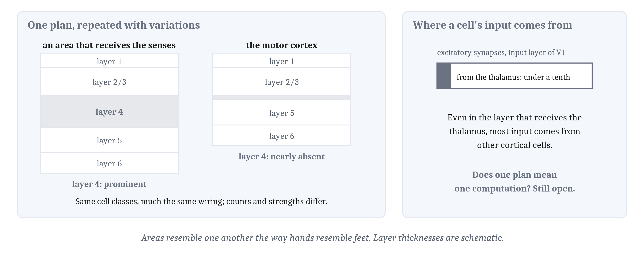
One Plan, Many Areas
Module 6’s uniform sheet, corrected: not one circuit copied identically, but one circuit plan, repeated with variations.
Notes:
In mammals, most of the pallium is neocortex. Module 6 described it as a nearly uniform sheet, and that description survives with one correction. The neocortex is not one circuit copied identically across the sheet. It is one circuit plan, repeated with variations.
Every area has the same classes of cells, connected in much the same way. Areas differ mainly in how many cells of each class they have and how strongly they connect. They resemble one another the way hands resemble feet.
The biggest differences are in layer 4, the layer that receives input from the thalamus. It is prominent in areas that receive signals from the senses, and nearly absent in the motor cortex.
And most of a cortical cell’s input comes from other cortical cells, not from outside. Even in the input layer of the visual cortex, connections from the thalamus make up less than a tenth of the excitatory synapses.
So whether one circuit plan means one computation everywhere is still an open question. The strongest evidence on it comes from an experiment that changed what an area receives.

Slide 8
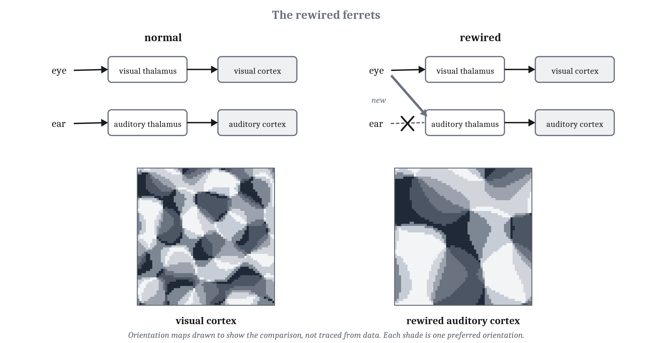
The Rewired Ferrets
Input shapes what a cortical area does. Not that areas are interchangeable, and not that the ferrets saw normally.
Notes:
In ferrets a day old, researchers cut off the auditory part of the thalamus from its normal input. Axons from the eyes then grew into it, and it passed their visual signals on to the auditory cortex along its normal connections.
As the animals grew up, the auditory cortex developed cells that responded to edges at particular orientations, like cells in the visual cortex. They were arranged in an orientation map, but a less orderly one, with larger patches and about a quarter as many of the points where all the orientations meet. The maps in the figure are drawn to show that comparison, not traced from data.
A second study asked whether the animals treated those signals as light or as sound. Ferrets rewired on one side were trained to go to one spout for a sound and another for a light. Then the normal visual pathway on the rewired side was cut, so a light in one part of the visual field could reach the cortex only through the rewired route. All three animals that were fully tested treated those lights as lights, not as sounds. When their auditory cortex was then removed, their responses fell to about chance.
So input shapes what a cortical area does. Here is what the results do not show. They do not show that areas are interchangeable, and they do not show that the ferrets saw normally. The rewired map was less orderly, the animals saw less sharply through the rewired route, and the researchers themselves describe the area as becoming more visual-like, not visual.
Still, an area that would normally have handled sound came to treat light as light, because light was what reached it.

Slide 9
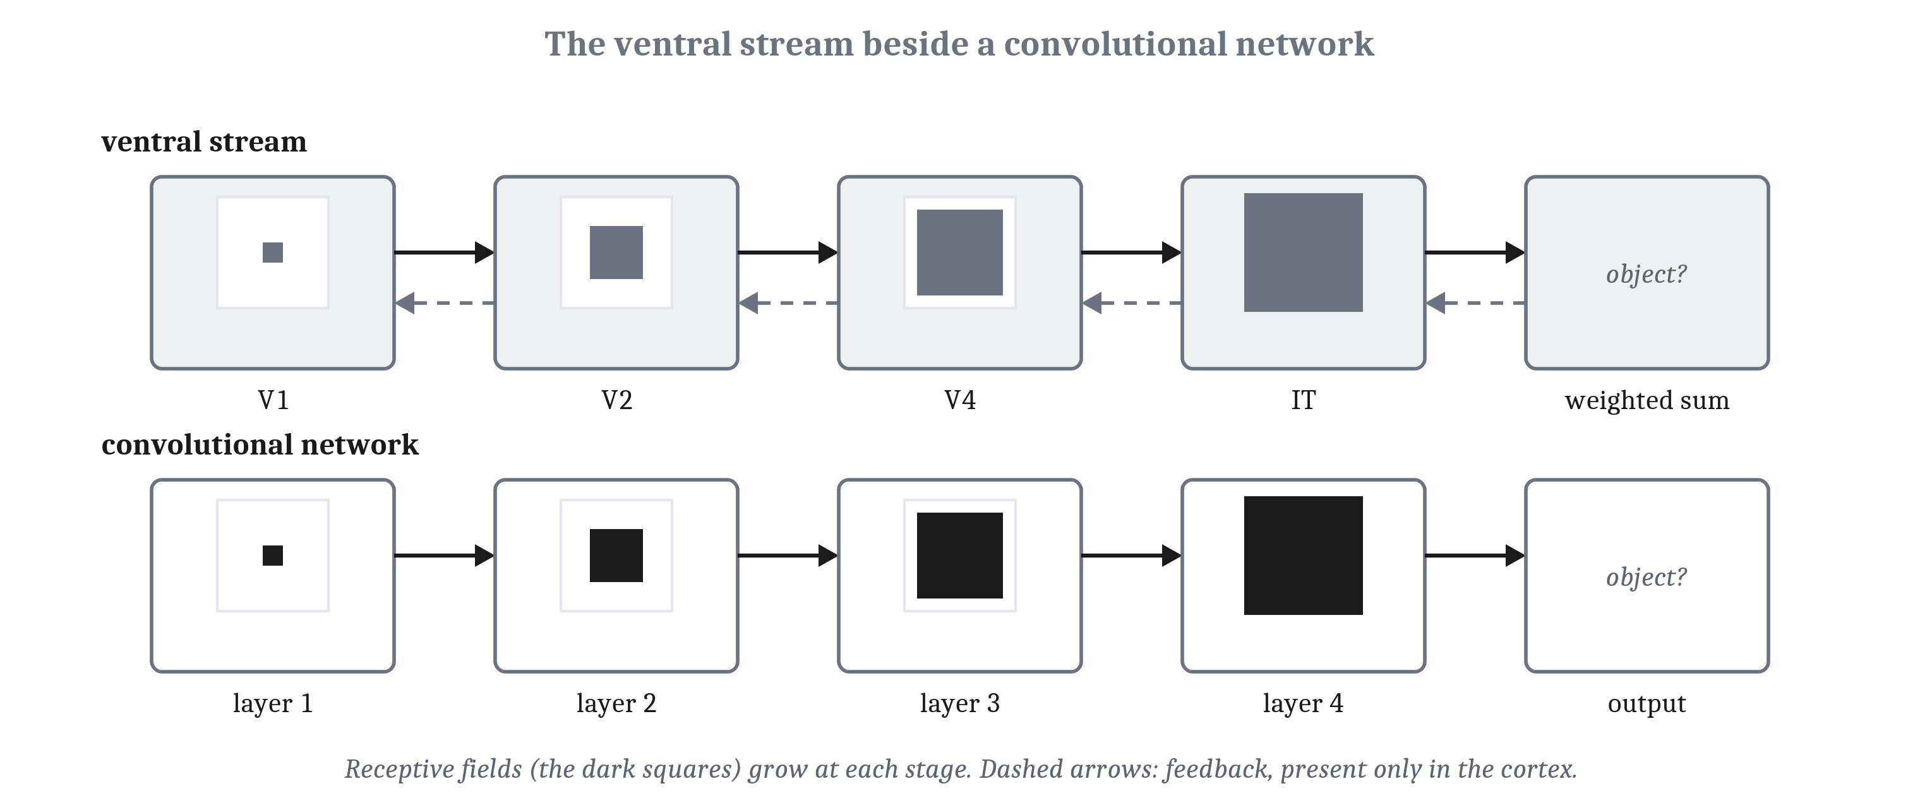
The Visual Cortex Beside a Network
Complex cells built from simple cells, as Hubel and Wiesel tentatively proposed, would be convolution then pooling. Up the ventral stream, cells gain tolerance, never full invariance.
Notes:
Module 1 followed visual signals from the eyes through the thalamus to V1. There, Hubel and Wiesel found cells tuned to edges at particular orientations, and their 1962 study in cats sorted them into two kinds, each described by its **receptive field**: the region of the visual field where a stimulus changes the cell’s activity, together with the kind of stimulus that does it. A **simple cell**’s field is divided into regions where light excites it and regions where light inhibits it, so its response to any pattern can be predicted from a map of those regions. A **complex cell** responds to an edge of the right orientation anywhere within a larger field.
They suggested a complex cell could be built by combining simple cells that prefer the same orientation at slightly different positions, and called the proposal “obviously tentative”. But it is the arrangement Fukushima built into the neocognitron, and the last lecture’s convolution followed by pooling: simple cells detect a feature at each position, and the complex cell ignores exactly where.
Beyond V1, the **ventral stream** runs along the underside of the brain, through V2 and V4 to the inferior temporal cortex, IT. Up the stream, receptive fields grow, and cells keep their preferences over wider changes in position and size. But no single cell becomes fully invariant. What a cell has is **tolerance**, keeping its response over a limited range of changes, and the cells most selective for a shape are the least tolerant of changes to it. A few hundred IT neurons are enough for a weighted sum of their activity to report which object is in view. That sum is a single unit’s straight line, at the top of a hierarchy that has re-represented the input until one line will do.
How far does the comparison go? Among convolutional networks, the better ones at categorizing objects are also better at predicting how IT neurons respond. In 2014, the best predicted about half of the variation in IT responses that could be predicted at all, and that network was not trained by backpropagation. The limits: the cortex sends feedback from each area to the one before it, and the networks in these comparisons have none. Whether fast recognition of a familiar object needs that feedback is debated. And some of the resemblance may rest on a shared sensitivity to texture.

Slide 10
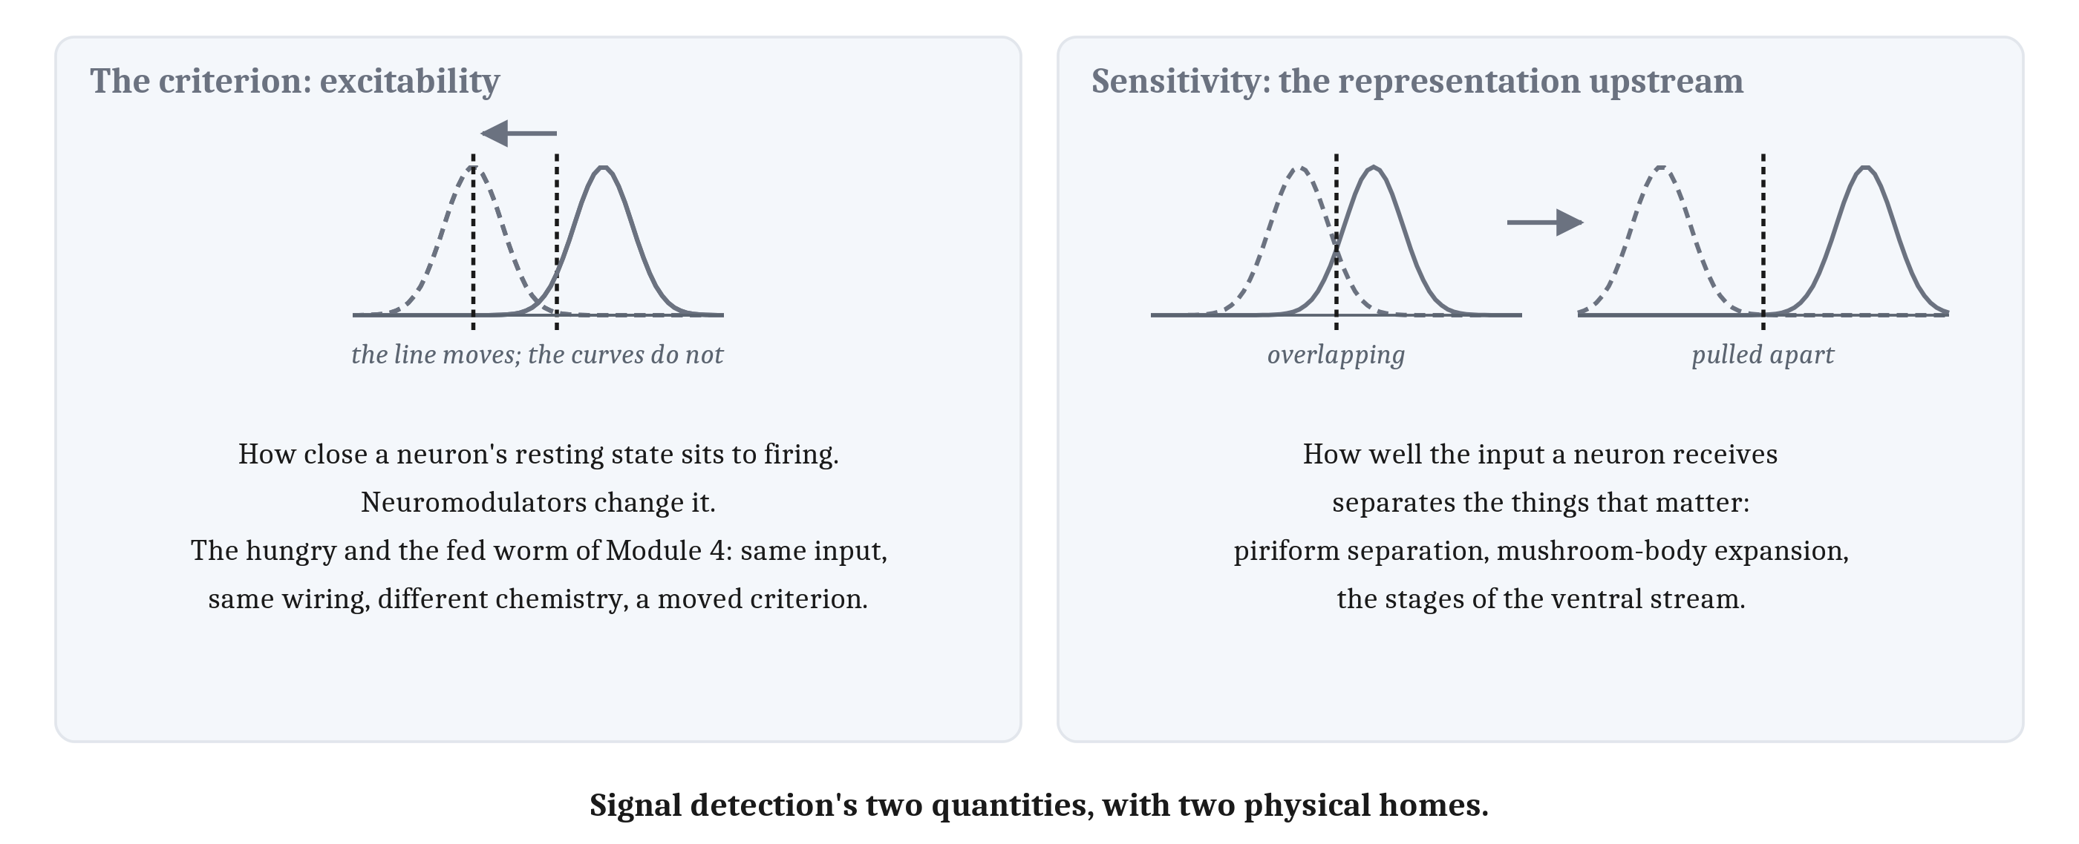
Criterion and Sensitivity, in Tissue
The criterion lives in how excitable a neuron is, which neuromodulators change. Sensitivity lives in the representation built upstream.
Notes:
That weighted-sum readout has a criterion as well as a sensitivity, and the first lecture’s distinction now gets a physical form.
In a unit, the criterion is set by the threshold or the baseline. In a neuron, the counterpart is how excitable the cell is: how close its resting state sits to firing. Excitability is what neuromodulators change. Module 4’s hungry worm and fed worm ran the same circuit with different chemistry. In this module’s terms, the worm’s condition moved its criterion, while the input and the wiring stayed the same.
Sensitivity has a different home. It depends on how well the input a neuron receives separates the things that matter. So it lives in the representation built upstream: in the pattern separation of the piriform cortex, the expansion of the mushroom body, and the stages of the ventral stream.
The criterion–sensitivity contrast from the end of the first lecture is now located in tissue. The criterion can move with no change in the representation, and a neuromodulator is one way to move it. Sensitivity improves only through a better representation, and everything else in this lecture so far has been about building one.

Slide 11
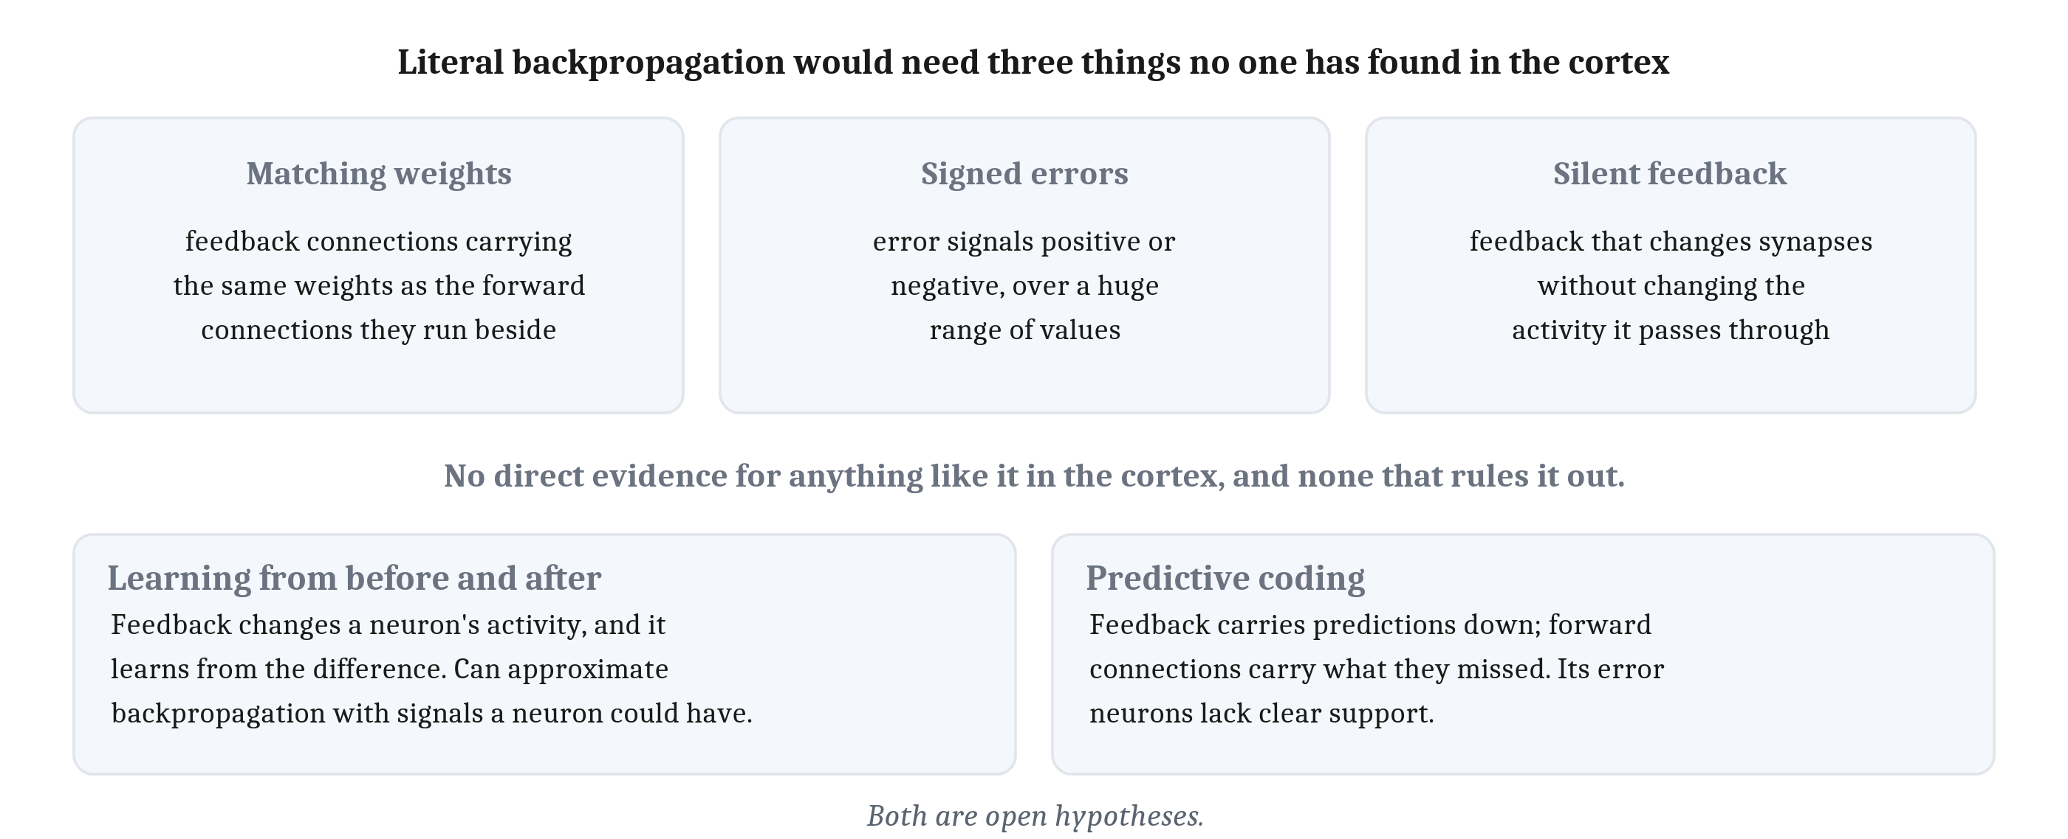
Could the Cortex Pass Errors Back?
What the pallium lacks is an external teacher, not necessarily an error. How an error would be delivered is still open.
Notes:
The last lecture left open whether a brain could learn by passing errors back. Part of the answer is already in hand.
Module 6 described the pallium as learning with no teaching signal, and noted there is no dedicated teaching pathway to find. Prediction learning fits the second point and qualifies the first. The next input arrives at the pallium anyway, so no separate pathway is needed to carry a target to it. What the pallium lacks is an external teacher, not necessarily an error.
How an error would be delivered is harder. Backpropagation, taken literally, needs three things nobody has found in the cortex. The feedback connections would have to carry the same weights as the forward connections they run beside. The error signals would have to be positive or negative over a huge range of values. And the feedback would have to change synapses without changing the activity of the neurons it passes through. The method’s own inventors wrote, in 1986, that it was not a plausible model of learning in brains.
As the evidence stands, there is no direct evidence for anything like backpropagation in the cortex, and none that rules it out.
Two proposals keep the idea and change the mechanism. In one family, feedback changes a neuron’s activity, and the neuron learns from the difference between its activity before the feedback arrived and after. Learning like that can approximate what backpropagation computes, with signals a neuron could have. In *predictive coding*, feedback carries predictions back down the hierarchy and the forward connections carry what the predictions missed. Its central prediction, neurons dedicated to carrying the error, lacks clear support, and its originator says much of it remains to be tested. Both are open hypotheses.

Slide 12
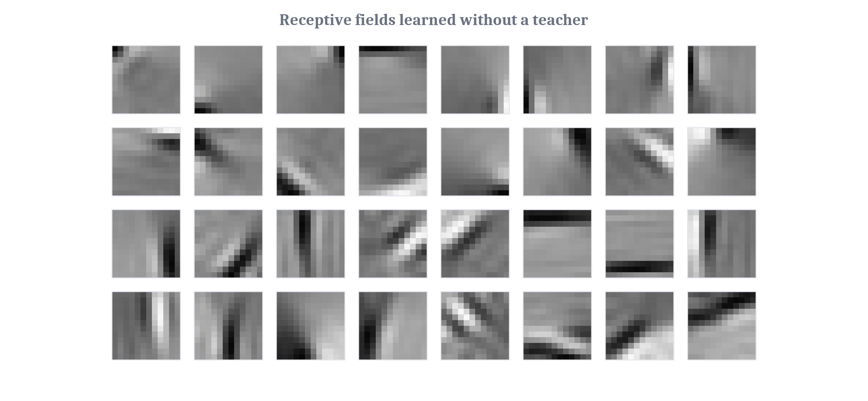
Few Active at Once
The energy budget limits how many neurons can be active at once, and a code that sparse also suits recognition.
Notes:
Module 3 found that a spike is expensive, and that the energy budget allows only a small share of cortical neurons to be strongly active at any moment. That is sparse coding, and the piriform cortex and the mushroom body both show it. What is new here is what a sparse code does for recognition, and two results connect them.
In the first, researchers gave a learning rule with no teacher a large number of small patches cut from photographs of natural scenes. The rule had two goals: describe each patch accurately, and use as few active units as possible. The units developed receptive fields like V1 simple cells: small, elongated, and tuned to edges at particular orientations. The two goals alone were enough to produce the main properties of simple cells. The fields on the slide were computed for the chapter by a closely related method, from two photographs.
Be careful with what that shows. It shows that a rule of this kind could produce what V1 has. It does not show that V1 learns this way.
The second result is from the last lecture. When only a few of many units are active for each input, many more ways of dividing the inputs can be drawn with a single straight line, so one trained layer can do what would otherwise take several.
So the direction of the argument matters. The energy budget limits how many neurons can be active at once, and a code that sparse also happens to suit recognition. How sparse cortical codes actually are is still argued.

Slide 13
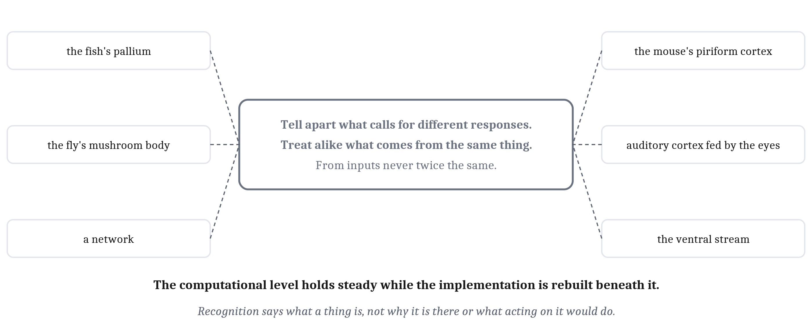
One Plan, Many Uses
A structure that does the same thing to every input is doing something very general: it re-represents whatever reaches it, until a single straight line can do the rest.
Notes:
At the end of Module 6, the question was whether a structure that does the same thing to every kind of input is doing something very general, or nothing in particular. The answer built across this module is: something very general. It re-represents whatever reaches it. Inputs that call for different responses are pulled apart, and inputs that come from the same thing are brought together, until a single straight line can do the rest.
The instances are the ones in this lecture. The mouse’s piriform cortex pulls two similar smells apart, so the cells reading its output can tell them apart. An auditory cortex fed by the eyes came to treat light as light. The stages of the ventral stream turn an object at many positions and sizes into a pattern a few hundred cells can report. The fish’s pallium faces the same problem with other circuits, and the fly’s mushroom body with a different nervous system altogether.
A fish, a fly, a mouse, and a network each have to tell apart what calls for different responses, and treat alike what comes from the same thing, from inputs that are never twice the same. Each does it with different machinery. That is Module 6’s lesson seen in a single capacity: the computational level can hold steady while the implementation is rebuilt beneath it.
Two limits. Recognizing a pattern tells an animal what a thing is. It does not, by itself, say why the thing is there, what would happen if the animal acted on it, or how the parts of a thought combine; those take more than recognition, and return in later modules. And this module took its inputs as given: a smell already turned into activity in the olfactory bulb, an image already relayed through the thalamus. Recognizing objects and recognizing words are specializations of this problem, each with demands of its own. An object has a three-dimensional shape that has to be recovered from flat images, and a word is a pattern whose meaning is set by a language. Objects and the senses that deliver them are Module 8’s, and words are Module 13’s.

Slide 14
Reading Braille with the Visual Cortex
In your group, four minutes.
In people blind from birth or early childhood, the visual cortex becomes active when they read Braille by touch. Briefly disrupting that area with magnetic stimulation disrupts their Braille reading.
Using the rewired ferrets, what do these findings suggest? And what do they not show?
Notes:
This applies the ferret results to people.
The two findings are of different strength, and Module 6 already gave us the reason. Activity in the visual cortex during Braille reading, on its own, is the reverse-inference pattern: an area active during a task does not establish that the task depends on it. The disruption result is stronger, because interfering with the area interfered with the reading.
What they suggest is the ferrets’ lesson. An area that would normally handle vision comes to take part in touch, perhaps because touch is among what now reaches it. Input shapes what a cortical area does.
What they do not show is just as important, and it mirrors the fences on the ferret slide. They do not show that the visual cortex now works the way a touch area does, or that areas are interchangeable. They do not show that the person sees anything. They do not show why the area is recruited, and it has also been reported to respond during some hearing and language tasks in people blind early. There is a disanalogy too: the ferrets had a new input rerouted into an area, while these readers lost one. And the findings say nothing on their own about whether one circuit plan means one computation, which is still open.
If the room is quiet, ask only the second question, and point back at the words “more visual-like, not visual”.

Slide 15
Image Sources (1 of 2)
Slide | Image | File | License | Source
3 | The basic circuit of the piriform cortex | fig-piriform-circuit.png | CC BY 4.0 | Jon Willits — drawn for the Module 7 reading, after Linster and colleagues (2003) · own work
4 | Two similar odors, compared at two stages | fig-odor-overlap.png | CC BY 4.0 | Jon Willits — drawn for the Module 7 reading, after Stettler and Axel (2009) · own work
5 | Storing a pattern and completing it | fig-completion.png | CC BY 4.0 | Jon Willits — drawn for this lecture · own work
6 | Random expansion in the fruit fly's mushroom body | fig-mushroom-body.png | CC BY 4.0 | Jon Willits — drawn for the Module 7 reading, after Caron and colleagues (2013) · own work
7 | One plan, repeated with variations | fig-one-plan.png | CC BY 4.0 | Jon Willits — drawn for this lecture · own work
8 | The rewired ferrets | fig-rewired-ferret.png | CC BY 4.0 | Jon Willits — drawn for the Module 7 reading, after Sharma, Angelucci and Sur (2000) · own work
9 | The ventral stream beside a convolutional network | fig-ventral-vs-cnn.png | CC BY 4.0 | Jon Willits — drawn for the Module 7 reading · own work
10 | Two quantities, two physical homes | fig-two-homes.png | CC BY 4.0 | Jon Willits — drawn for this lecture · own work

Slide 16
Image Sources (2 of 2)
Slide | Image | File | License | Source
11 | What literal backpropagation would need, and two proposals | fig-errors-back.png | CC BY 4.0 | Jon Willits — drawn for this lecture · own work
12 | Receptive fields learned with no teacher | fig-sparse-filters.png | CC BY 4.0 | Jon Willits — computed for the Module 7 reading, after Olshausen and Field (1996) · own work
13 | One problem, many machines | fig-one-problem.png | CC BY 4.0 | Jon Willits — drawn for this lecture · own work

