Slide 1

BCOG 100
Vertebrate Neural Architecture
Lecture 6.1 — Why Build Specialists
Notes:
This module is about the parts a vertebrate brain is made of, and why there are parts at all.
At the end of Module 5, one set of machinery was doing every job. Four kinds of learning ran on one principle, in one kind of tissue, wherever there were synapses. That principle is general enough to be reused anywhere. For exactly that reason, it is specialized for nothing.
A lamprey is a jawless fish, and its brain is already divided into pieces. Most of those pieces are pieces a human brain has too. The lamprey has had them for more than five hundred million years.
So this lecture asks the computational question about an arrangement of parts. When is it worth having separate structures at all, and why?
One more thing to watch for across the module. For the first time, the three levels will behave differently from one another. One of them stands almost still, while another is rebuilt again and again on top of it.

Slide 2
To Start: One Mechanism, Two Jobs
In your group, three minutes.
The brain has different parts. A thalamus, amygdala, hippocampus, brainstem, cortex. Why? What are the pros and cons of splitting up into parts, rather than one big neural network?
Notes:
This is the reading's first guiding question, asked about the brain directly. At the end of Module 5, one set of machinery was doing every job. Here the question is why a brain would not stay that way.
The pros groups usually find are the ones the lecture builds toward. A part that does one job can be tuned to it. Two jobs in two parts cannot interfere with each other. And parts that work together constantly can sit close, so their wires stay short.
The cons matter just as much, and they are easy to skip. Separate parts need wiring between them. They need some way of settling what happens when they disagree. And what one part learns is not automatically available to the others. One big network has the opposite profile: it shares everything it learns, but its jobs can get in each other's way.
Dividing work also needs something to divide. The nematode of Modules 4 and 5 has 302 neurons in its whole body, which offers little to split. An animal with vastly more neurons can set some aside for one job and others for another.
One caution about the list on the slide. It mixes structures this module covers, such as the brainstem and the amygdala, with ones later modules take up, such as the hippocampus and the cortex. And naming a part is not the same as knowing its job, which the next lecture makes a point of.
So the question for the rest of the hour is not whether splitting helps. It is when splitting is worth what it costs.

Slide 3
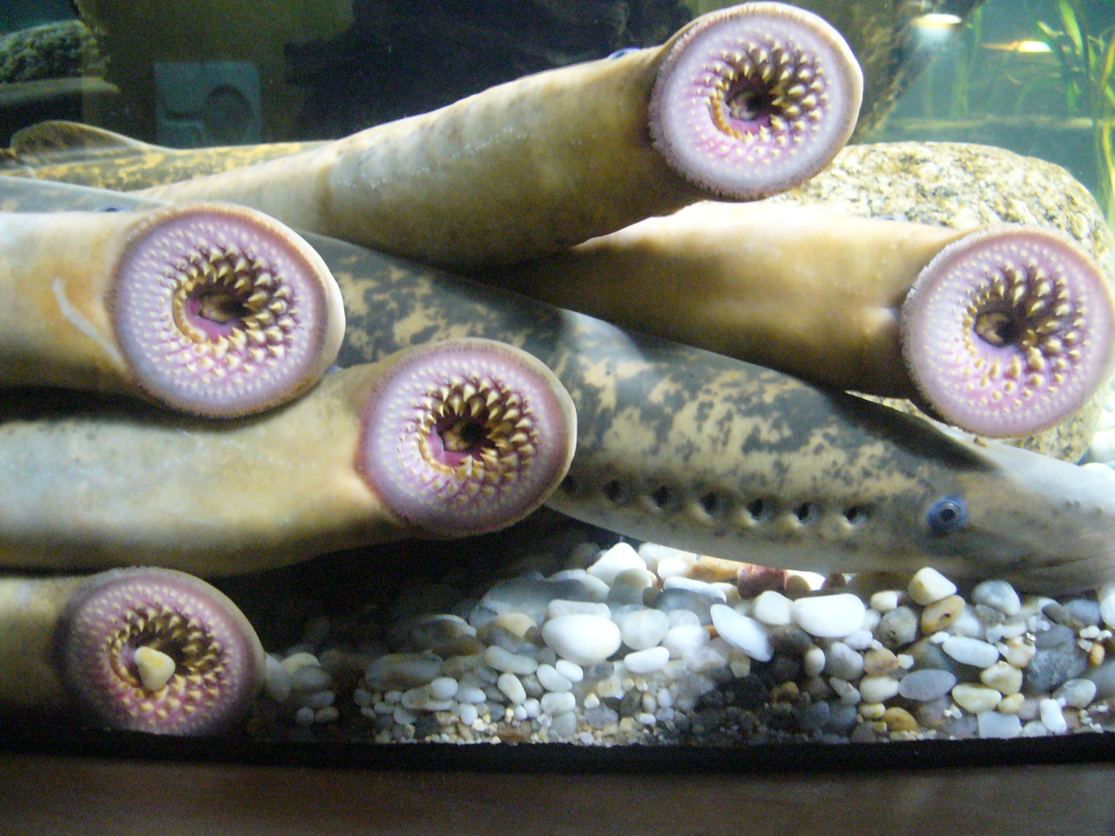
A Living Jawless Fish
Not an ancestor: a modern animal whose lineage split from ours more than 500 million years ago. What both brains share was most likely in the common ancestor.
Notes:
A sea lamprey looks at first like an eel. It is long and slender, with no paired fins, and it swims by sending a wave down its whole body, somewhat as a nematode does.
The difference is at the front. A lamprey has no jaws. In place of a jaw it has a round sucking disc lined with small, hard teeth, and the photograph shows several of those discs pressed against aquarium glass. An adult sea lamprey feeds by fastening that disc to the side of a larger fish and drawing off its blood.
Lampreys are vertebrates. A vertebrate is an animal with a skull and a backbone, or at least the beginnings of one. Lampreys and hagfishes are the only jawless fishes still alive, and their branch was the first to separate from the rest of the living vertebrates, more than 500 million years ago.
One misreading has to be blocked before it forms. A living lamprey is not an ancestor of anything. It is a modern animal. Its lineage has been evolving for exactly as long as the lineage that led to us.
So why is it evidence about an ancient brain? Because of one inference, which the whole module rests on. A part that both a lamprey's brain and a human's brain have was most likely present in their common ancestor. A part the human brain has and the lamprey's lacks most likely arose after the split, on our side.
Most of the parts a human brain is organized around are already present in a lamprey. One is conspicuously missing. We will get to which one near the end of the hour.

Slide 4
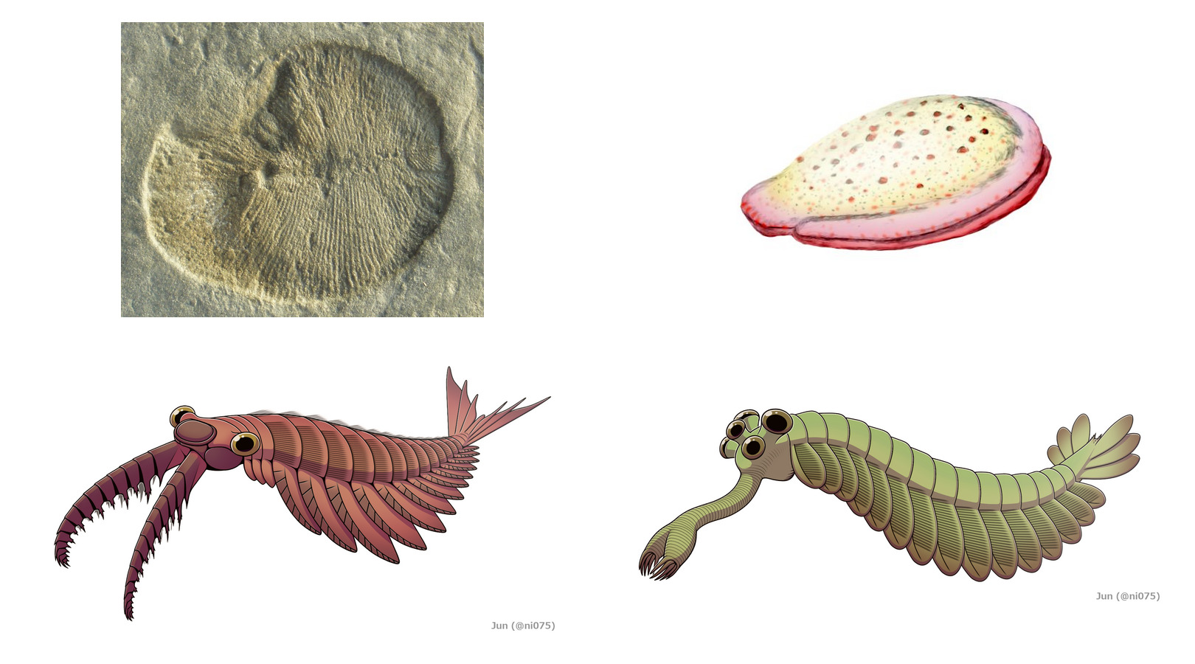
A Seafloor Where Nothing Hunted
Ediacaran (top): grazers on a microbial mat, food that lay still, no claws or shells. Cambrian (bottom): claws, and image-forming eyes to aim them.
Notes:
The first large fossils that include animals come from the Ediacaran period, which began about 635 million years ago. Before then, nearly all life was single cells. What survives of it is mostly the traces of microbial mats. The Ediacaran seafloor held something new: bodies big enough to see, some up to a meter long.
The top row is two of them. *Dickinsonia*, on the left, was flat and oval, like a bath mat. It grazed on the microbial mat, moved on, and left a row of faint body-shaped impressions behind it. *Kimberella*, on the right, was probably related to mollusks, and it scraped the mat as it crawled.
For a long time it was unclear whether any of these bodies were animals at all, since many look like nothing alive today. In 2018, researchers found *Dickinsonia* fossils that still carried traces of cholesterol, a molecule that is a hallmark of animals. That settled it for at least some of them.
There are also trails. Tracks left by small burrowing animals run to the bodies of other animals and stop there. They are the earliest fossil evidence of scavenging, and the first physical trace of movement aimed at something the animal sensed, which is Module 4's topic.
The point of the top row is what is missing. There are no half-eaten bodies. There are no claws, no spines and no shells. Food lay still on the seafloor and nothing was hunting. So the control problem was small: find food that does not move, with nothing to escape from.
The bottom row is the Cambrian, from about 540 million years ago, and its fossils look like a different world. *Anomalocaris* was a swimming predator with a pair of grasping limbs at its front. *Opabinia* had five eyes and a long snout ending in a claw. Claws, and eyes that form images to aim them.

Slide 5
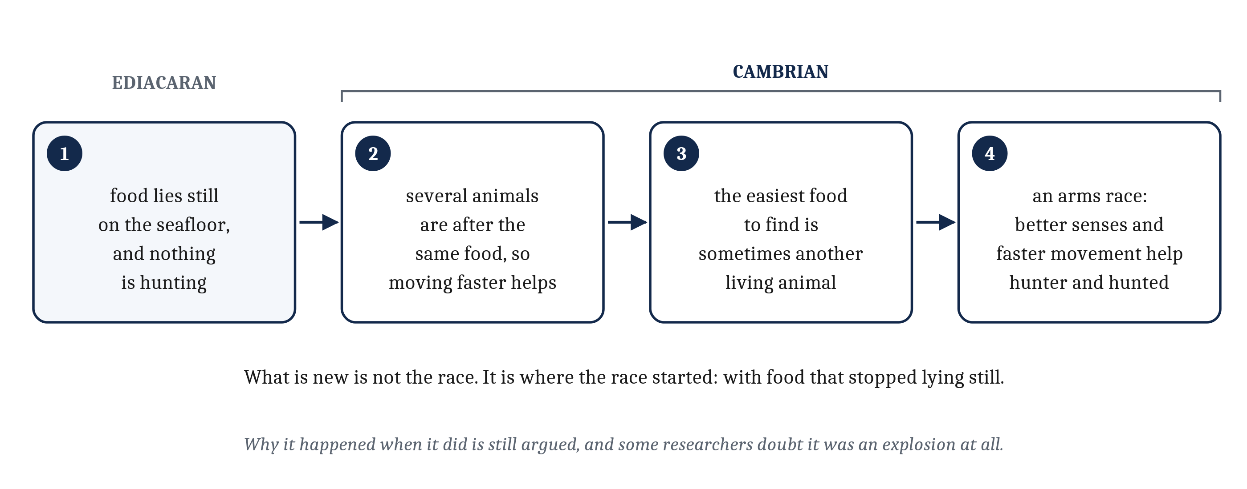
Food That Stopped Lying Still
The change that matters for nervous systems is a sequence, and it ends in the arms race from Module 3. The Cambrian explosion is where the race started.
Notes:
Over what is, geologically, a short stretch of time, a great diversity of animals appeared, with hard parts: shells, jointed legs, claws, and eyes that form images. That burst is sometimes called the Cambrian explosion.
Arthropods led it, the group that today includes insects, crabs and spiders. An arthropod's skeleton is on the outside of its body. That gives its muscles a rigid frame to pull against, so the movements of many jointed parts can be organized and repeated.
The animal list is set dressing, though. What matters for nervous systems is a sequence, and the figure lays it out.
On the Ediacaran seafloor, animals moved slowly toward food that lay still. Once several animals were after the same food, moving faster helped. The boundary between scavenging and predation is blurry, because sometimes the easiest food to find is another living animal. And once animals were hunting each other, better senses and faster movement helped the hunted as much as the hunters.
That last step is the predator–prey arms race from Module 3. What is new here is not the race. It is where the race started: with food that stopped lying still. Other animals became some animals' main source of food, and also one of their biggest threats.
Why this happened when it did is still argued. Rising oxygen, changes in ocean chemistry, and the new ecology of predators and prey have all been proposed. Some researchers doubt it was an explosion at all. On that view animals had been diversifying for a long time, and the Cambrian is when they began building hard parts that fossilize well.
Either way, the animals of the early Cambrian lived in a world the Ediacaran animals never faced.

Slide 6
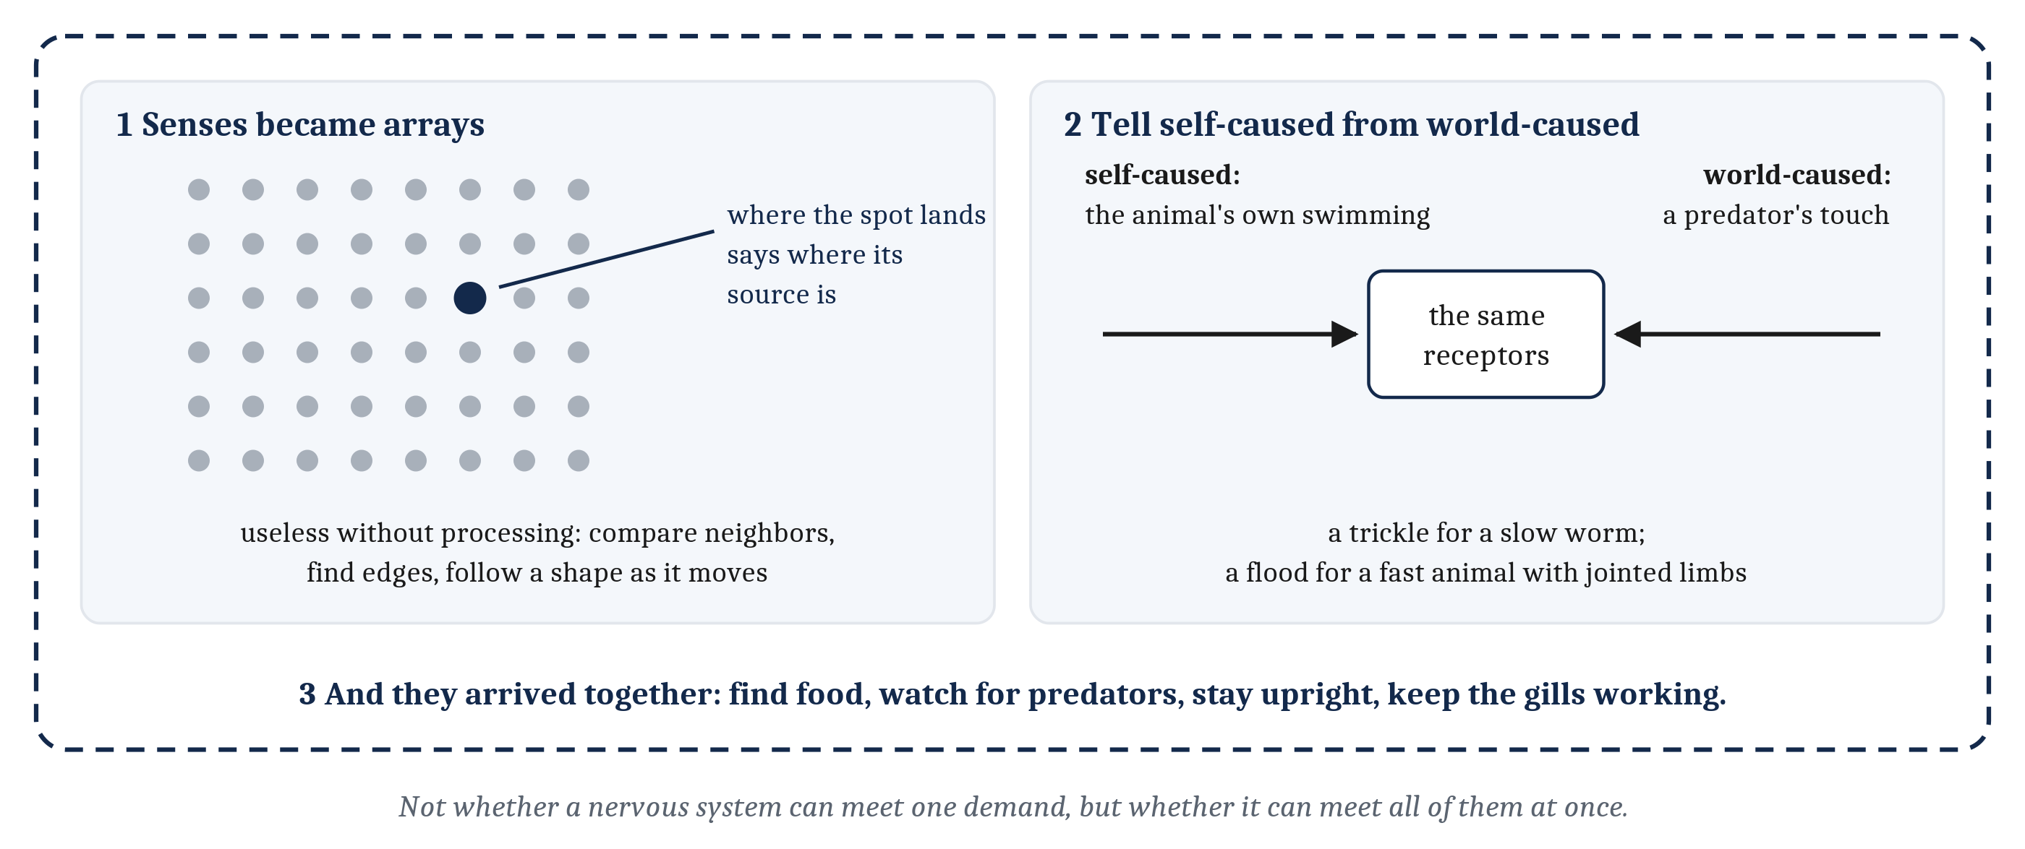
What the Cambrian Asked of a Nervous System
Two new demands, and a third that is about the other two: they all arrived at once.
Notes:
A nervous system in the Cambrian world faced demands it had not faced before. Three of them stand out, and the third is a different kind of thing from the first two.
First, senses became arrays. An image-forming eye is not one sensor but a sheet of many, and the arrangement is the point. Where on the sheet a spot of light lands says where in the world its source is. A patch of skin covered in touch receptors works the same way. But the arrangement carries information only if something downstream can use it. Something has to compare neighboring receptors, find edges, and follow a shape as it moves across the sheet. A thousand receptors wired to one cell would tell the animal little more than one receptor could.
Second, a moving animal has to tell its own doings from the world's. That problem is not new. Any animal that moves changes what its senses report, and the worm of Modules 4 and 5 already faces a version of it. What changed is scale. A slow animal with a simple body makes a trickle of self-caused signals. A fast animal with jointed limbs, a turning head and sweeping eyes makes a flood. Swimming sends water rushing past the body. A head turn sweeps the whole scene across the eyes. A limb brushing a rock fires the same receptors a predator's touch would. How nervous systems pull those apart is Module 8's question.
It is also an opportunity. An animal that acts on the world can poke at it and see what comes back, which a motionless animal cannot do.
Third, the demands arrived together. A Cambrian animal had to find food, watch for predators, stay upright and moving, and keep its heart and gills working, all at once. Each job sends its own stream of signals and calls for its own kind of response.
So the question changes. The worm meets a few of these demands one at a time. The question is what kind of nervous system meets all of them at once.

Slide 7
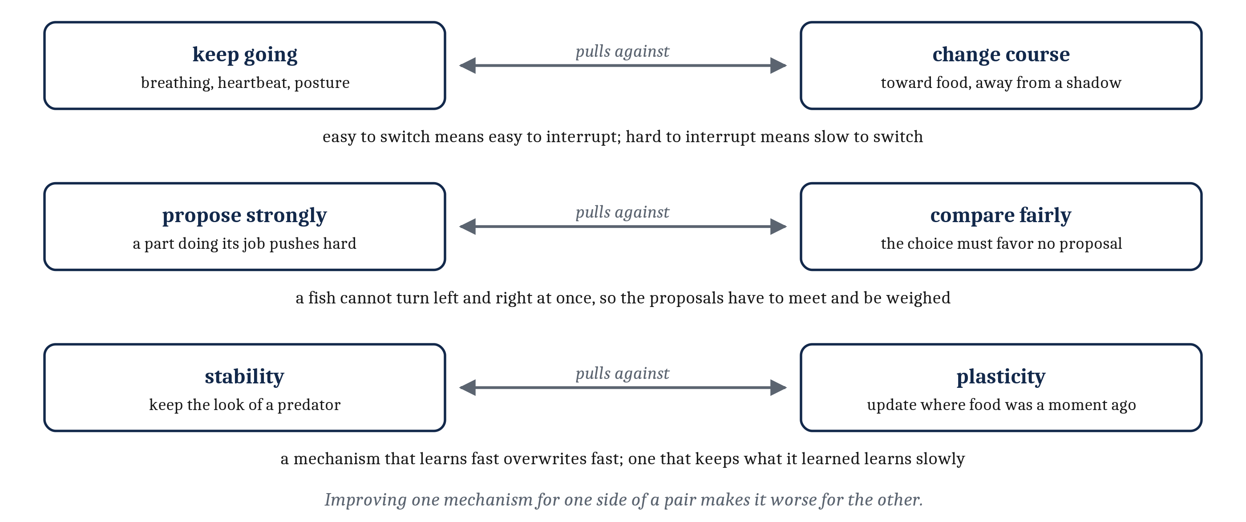
Demands That Pull One Mechanism Apart
Improve a single mechanism for one side of each pair, and it gets worse at the other.
Notes:
Modules 3 to 5 asked why a signaling cell, a circuit, and an adaptable circuit would each be favored. The same question can be asked of an arrangement of parts. The observation it rests on is that some demands pull a single mechanism in opposite directions. Three pairs matter for a Cambrian animal.
The first is keeping going against changing course. Breathing, the heartbeat, and the posture that keeps a swimming body upright cannot stop, not even briefly. Behavior switches constantly: toward food, away from a shadow, into a crevice. A mechanism that switches easily is easy to interrupt. One that is hard to interrupt is slow to switch.
The second is choosing one action when several are called for. That is not new either. Module 4 called it *sharpen and commit*, and in the worm two groups of motor neurons that inhibit each other were enough. What changed is the number of proposals and the number of body parts they come from. A fish cannot turn left and right at the same moment, yet at almost any moment its eyes, its nose and its skin are each proposing a movement. If every proposal drove the muscles directly, the result would be a tug of war between half-made movements. And there is a conflict inside the choosing itself. A part that proposes a turn toward food is working well when it proposes strongly. The comparison has to favor no one.
The third is Module 5's trade-off between plasticity and stability. The look of a predator should be kept for good. Where food was a moment ago should be overwritten constantly. A mechanism that learns quickly also overwrites quickly.
Every pair is symmetric. Neither side is the cheap one.
Module 5 gave us a rule: a problem earns its own name when it changes what a solution must have, not when it is merely harder. The same rule applies to parts. When two problems demand incompatible things, one natural answer is to give each its own structure.
That is the argument. The next slide is about what it does not prove.

Slide 8
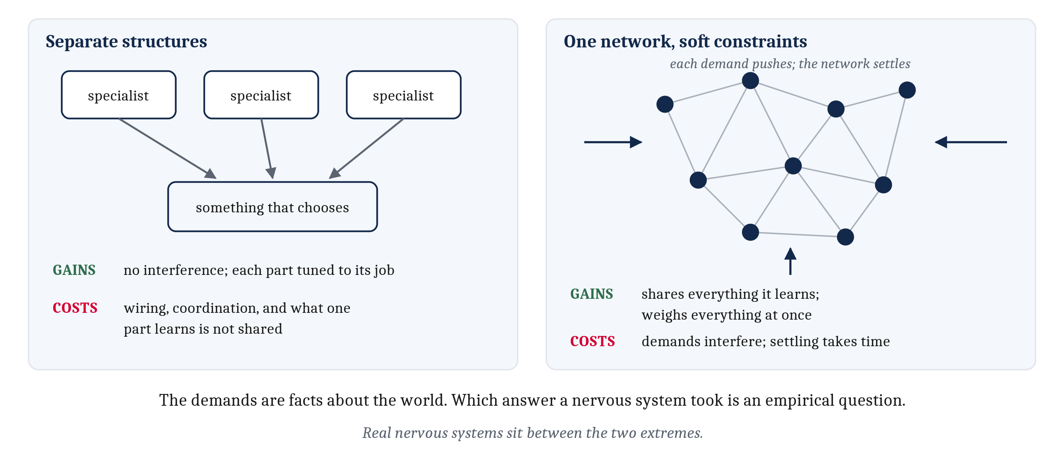
Separate Structures Are One Answer Among Others
The demands are facts about the animal's world. Whether a brain meets them with separate parts is an empirical question.
Notes:
This is the turn in the argument, and it is easy to miss.
The competing demands are computational facts. An animal in that world must keep breathing while it changes course, must end up doing one thing when several are proposed, and must keep some of what it learns while updating the rest. Those facts hold however its nervous system is built. Separate structures are one algorithmic and implementational answer to them. They are not the only one.
The rival answer is a single, richly interconnected network. Each demand acts as a soft constraint, pushing the network's activity toward some states and away from others, and the network settles into the state that best satisfies all of them together. Researchers call this *constraint satisfaction*. On that view a compromise is not a failure. When the constraints are weighted well, the compromise is the solution. A single network can even keep two demands from interfering, by giving them patterns of activity that overlap very little in the same neurons.
Each answer has a ledger, and the figure puts them side by side. Separate structures avoid interference and let each part be tuned, but they need wiring and coordination, and they cannot easily share what each has learned. One network shares everything, but its demands can interfere, and settling takes time. Real nervous systems sit in between. A region can lean toward one job while sharing inputs with its neighbors, and some specialization emerges through learning and development.
So the argument that separation would be good does not settle whether it happened. Anatomy, physiology and behavior settle that. For the structures in this module, the evidence of real separation is strong. It is clearest for choosing among actions, where vertebrates have a distinct circuit conserved since before the lamprey's lineage split from ours. Even so, those structures are densely connected and work in loops.
Two cautions keep this honest. The constraint-satisfaction side is not the anti-specialization side: researchers from that tradition argued that stability and plasticity need two interacting learning systems, one fast and one slow. And not every division was favored for a reason. In ray-finned fishes the front of the brain folds outward rather than inward, apparently because the larvae's large eyes leave too little room in the skull. Nothing about the folding itself seems to have been favored.

Slide 9
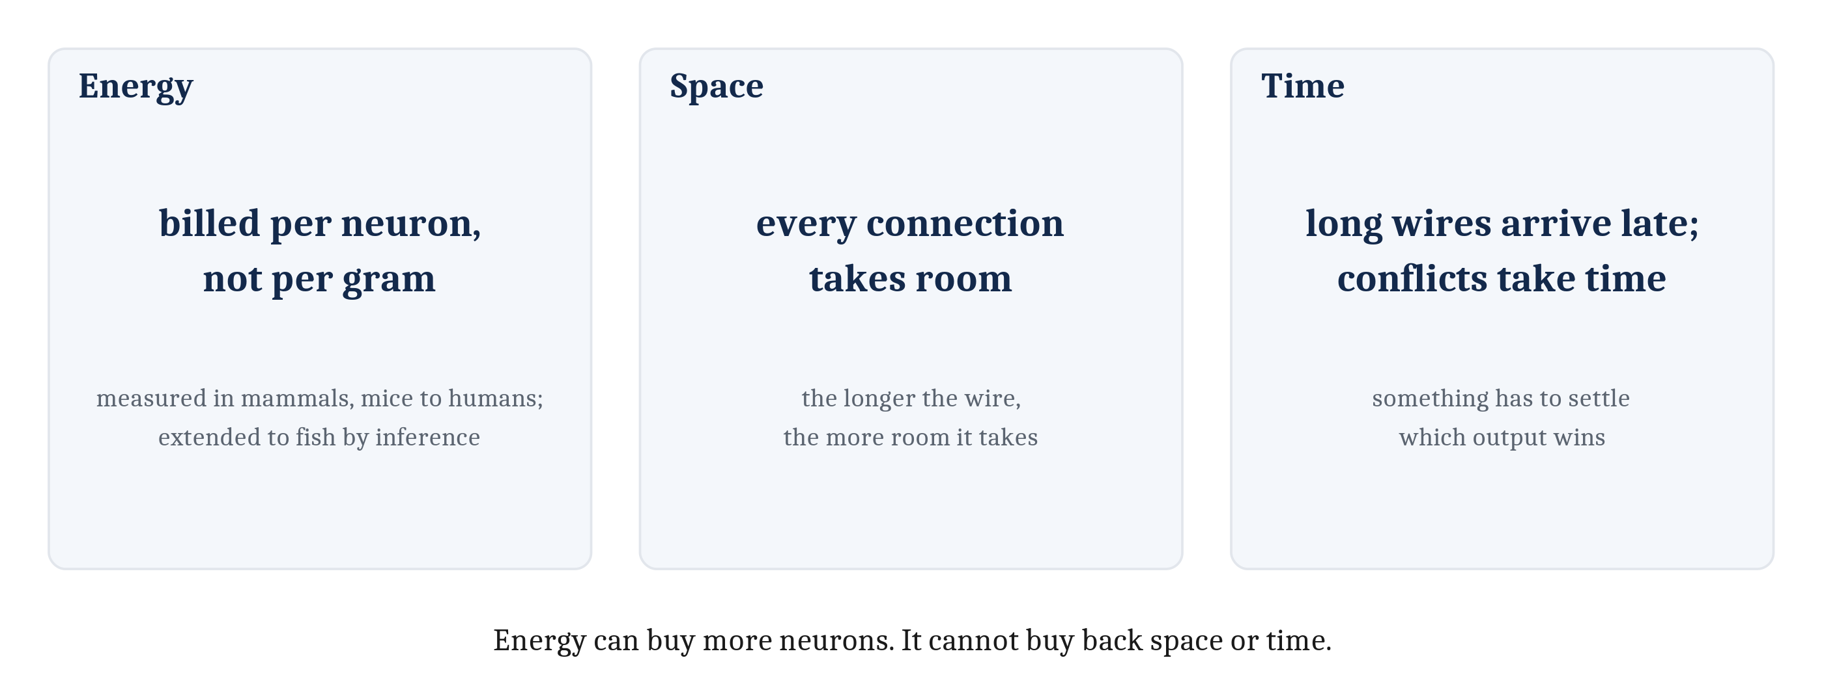
What Specialists Cost
A brain's energy bill is set by how many neurons it has, not by how much it weighs. Wiring and coordination cost space and time as well.
Notes:
Separate structures are not free, because neural tissue is expensive to run. Module 3 gave the figures: an adult human brain is about two percent of body weight and uses about twenty percent of the body's oxygen at rest.
A newer finding says where the cost comes from. Across the mammals where it has been measured, from mice to monkeys to human beings, the energy a brain uses rises in step with its number of neurons. Each neuron costs roughly the same to run, large or small, whichever brain it is in. So a brain is priced by its neuron count, not by its weight. A specialist structure usually means more neurons, and each one adds to the bill.
One honest limit. Every one of those measurements comes from mammals. Nobody has measured the cost per neuron in a lamprey or a Cambrian fish. Extending the result to them is an inference, not a finding. It is a reasonable inference, because much of what makes a neuron costly is shared by every animal that has neurons: after every signal, ions have to be pumped back across the membrane.
Separate structures also raise two problems that are about more than energy. The first is wiring. Structures that exchange signals need connections, and connections take up space and add delay, the more so the longer they are. The second is coordination. Specialists can each produce an output at the same moment, and something has to settle which one wins.
Both have an energy side, since wires and conflict-settling circuitry are made of neurons, billed one by one. But both also cost space and time, and no amount of energy buys those back. Those two costs decide where the specialists end up in the body, and how they are made to agree. That is the next slide.

Slide 10
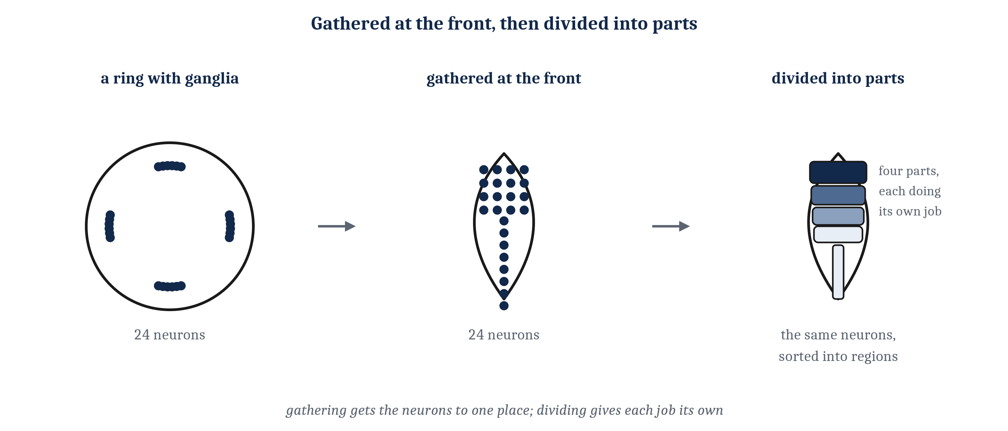
A Body That Moves as One
A fish acts with its whole body, so its specialists sit together in one organ in the head: short wires, and one place for proposals to meet.
Notes:
Much of a human body's touch sensation and muscle is not in the head. So why do the specialized systems sit together in one organ, instead of spreading out to where the jobs are?
A brain designed from scratch might spread them out. But that is not how evolution works. Natural selection is the process by which differences that are more fit are more likely to lead to survival and reproduction, so evolution is stuck building from what came before. And the human brain started from a progenitor much more like a lamprey or a fish.
A fish has no arms, claws or tentacles to act with separately. Nearly everything it does, turning, darting, striking, escaping, it does with its whole body. Its nervous system is organized around a single body acting as one, and centered in the head between the eyes. Compare the octopus from Module 2, where each arm carries a large share of the animal's neurons and runs much of its own control. Nothing in a fish works that independently.
The figure's first two panels are Module 4's story: neurons gathering at the front, near the senses, into fewer and larger clusters. The third panel is the vertebrate step, from gathering to differentiation. The same concentration of neurons is divided into distinct parts, each specialized for some jobs more than others.
The last slide's two costs now become reasons. Specialists that constantly exchange signals do better close together, since short connections take less space and carry signals sooner. And competing proposals have to meet in one place to be compared before one is chosen. The arrangement suited a fish, and later vertebrates inherited it. Independently movable limbs came much later, and they are still run from the same kind of brain, centered in the head.
That organ was fed by good camera eyes and the old chemical senses, and by one sense we have no real equivalent of: the **lateral line**, a line of small sensory organs along each side of a fish that responds to movements of the water around it. It is touch at a distance. A fish can feel the wake of another fish that passed minutes earlier. And like every sense in a moving animal, it has to separate the fish's own disturbances from the world's. Its nerves include fibers that turn the signal down when the fish's own swimming is making the disturbance.

Slide 11
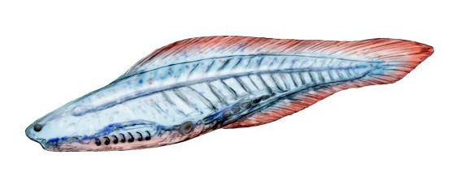
Slivers in the Sea
The first vertebrates were a few centimeters long, toothless, and most likely prey. What was new was a head, built largely by the neural crest.
Notes:
Among the animals of the early Cambrian were the first vertebrates. A **vertebrate** is an animal with a skull and a backbone, or at least the beginnings of one.
They were not impressive. The oldest fossils most researchers accept as vertebrates come from early Cambrian rocks in southern China, animals named *Haikouichthys* and *Myllokunmingia*. They were a few centimeters long, slender and toothless. They did not rule their seas. They were most likely prey for the arthropods around them.
They had a **notochord**, a stiff rod running along the back, which they shared with their closest invertebrate relatives. In most later vertebrates it is largely replaced by the backbone.
What was new was in the head, and it needs stating carefully. Having senses and neurons concentrated at the front was not new, since worms and insects have heads too. What was distinctive was a package: paired camera eyes, a nose, ears, and a front end of the nervous system enlarged to serve them, all enclosed in a braincase. The anatomists Carl Gans and Glenn Northcutt called it a *new head*.
Much of that head is built by the **neural crest**. In the embryo, these cells form along the edges of the developing nervous system, then leave it and migrate through the body. They become cartilage and bone of the face and skull, pigment cells, and most of the nerve cells outside the brain. Invertebrate relatives have cells with some of these features. Only vertebrates have the full set.

Slide 12
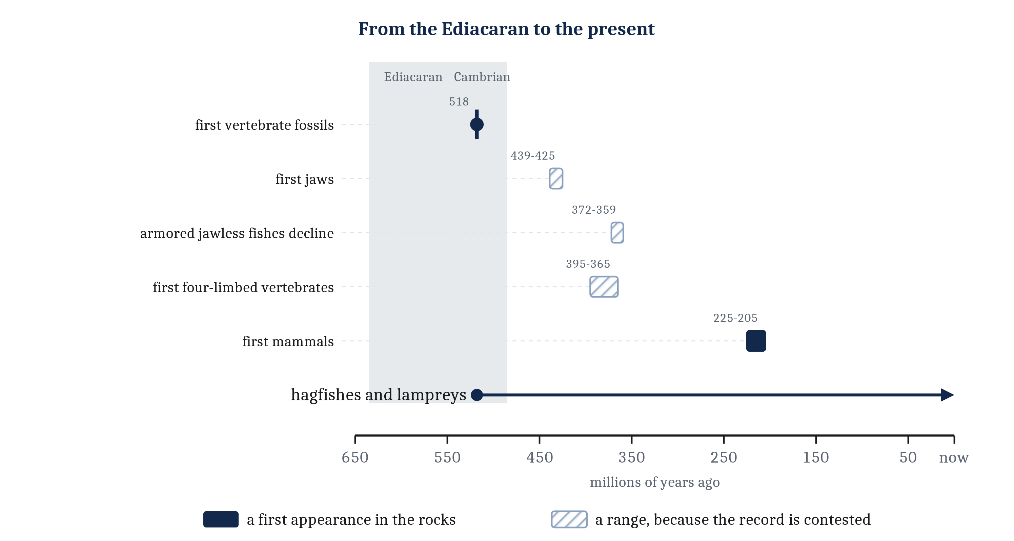
Slivers in the Sea
The first vertebrates were a few centimeters long, toothless, and most likely prey. What was new was a head, built largely by the neural crest.
Notes:
The timeline carries the rest. From the Ordovician onward, beginning about 485 million years ago, jawless fishes up to a meter long carried plates of bony armor. Some looked fearsome and had no way to bite, and probably fed by scooping, sucking or filtering. Jaws evolved more than 420 million years ago, built on the supports of the front gills. By around 360 million years ago jawed fishes had diversified and most jawless fishes were gone. Two jawless lineages survive: the hagfishes and the lampreys. That is the arrow along the bottom.
One last warning, which is Module 2's. *Vertebrate* is not another word for *complex*. Octopuses and honeybees are not vertebrates, and they are quite complex. The first vertebrates were small prey in a sea full of very complex and very formidable arthropods.

Slide 13
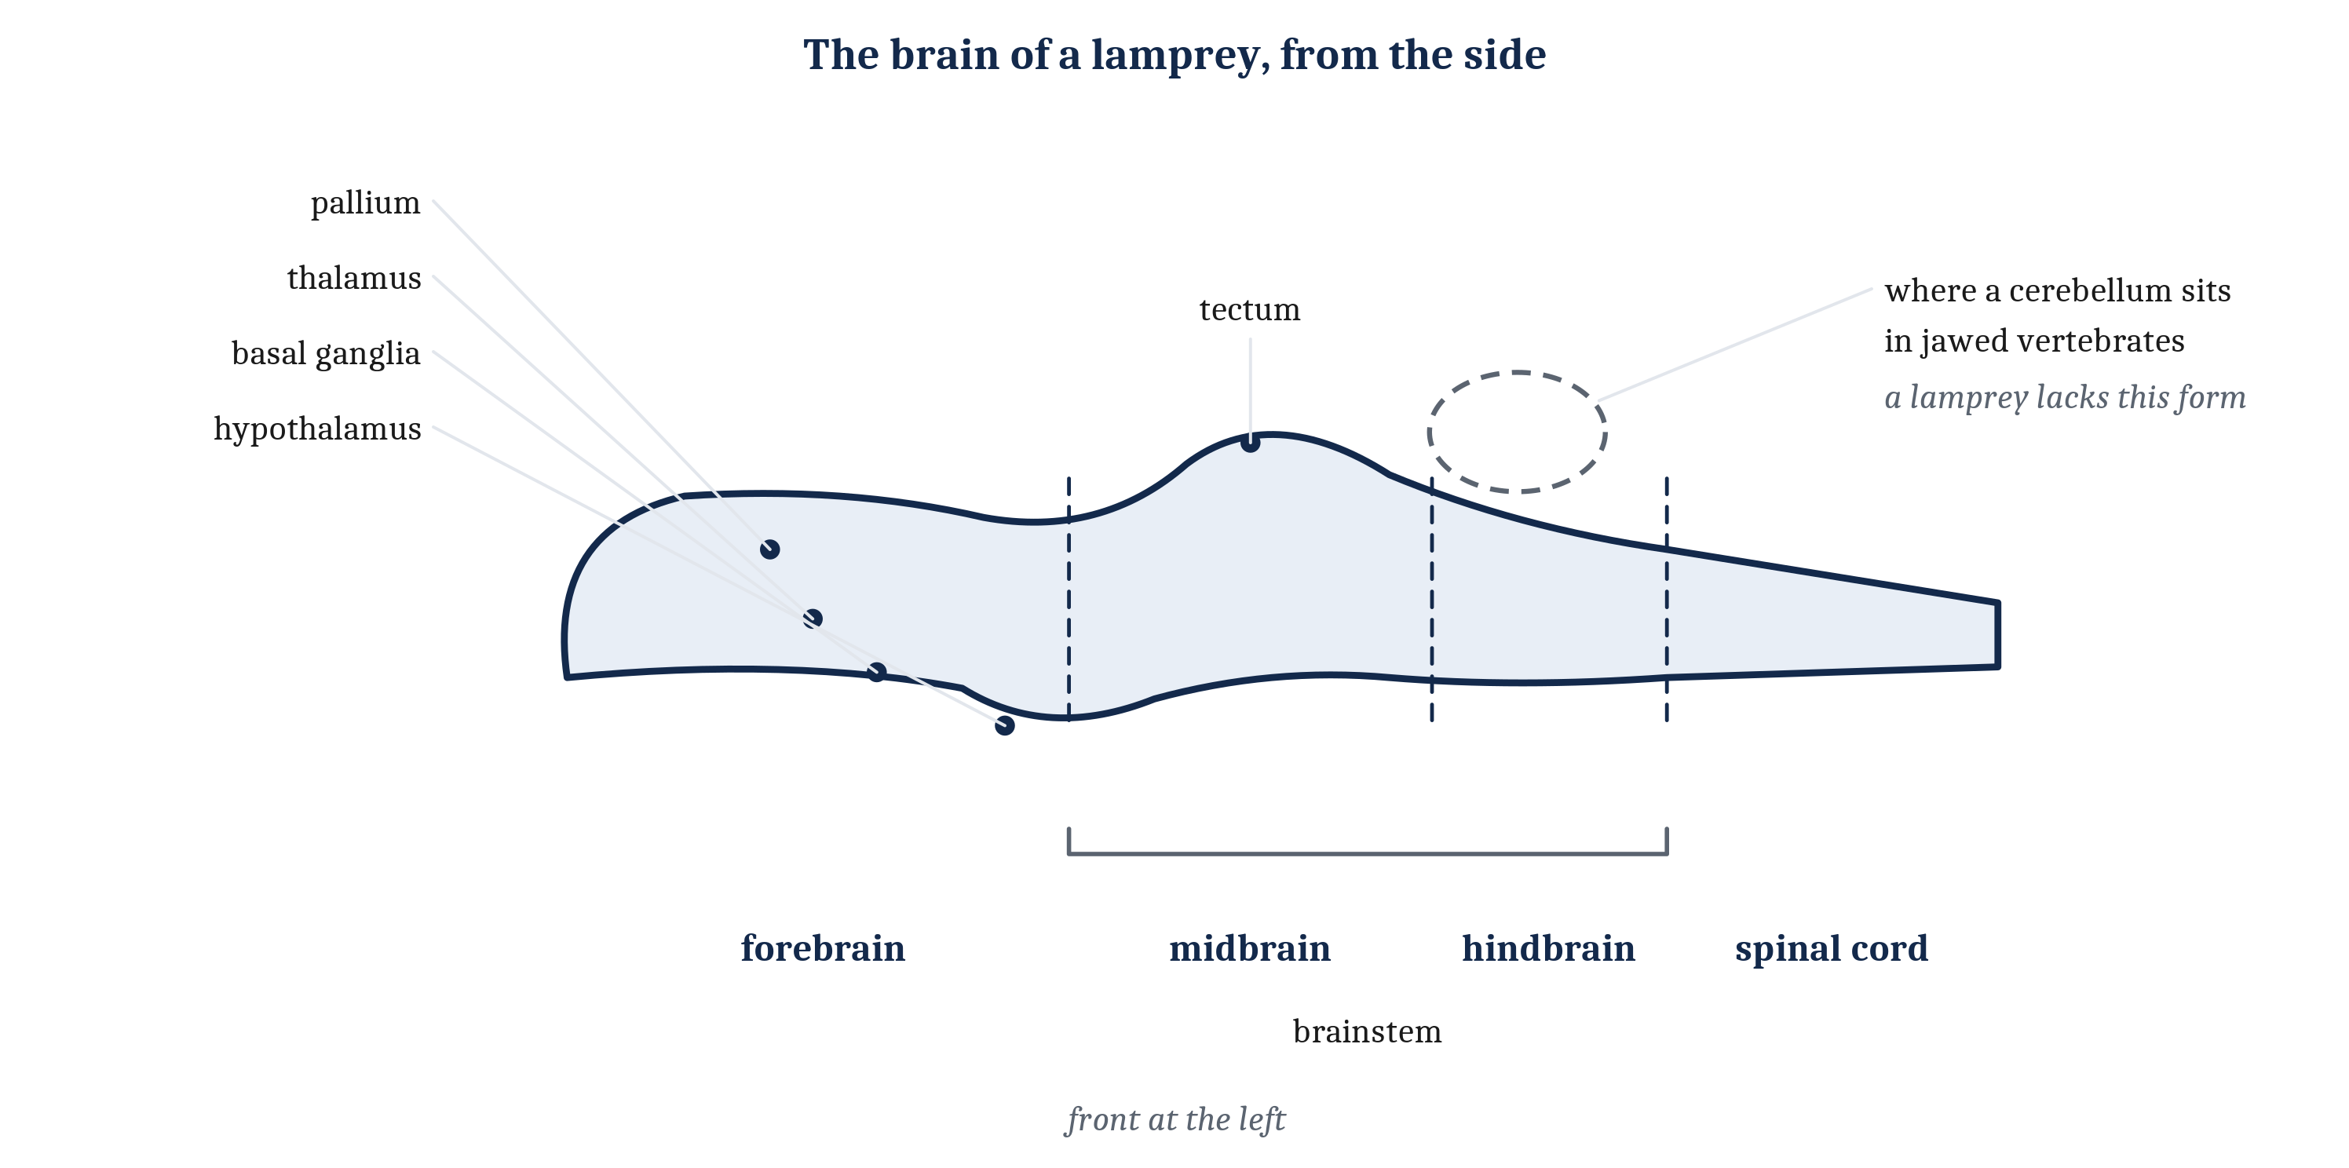
The Parts of a Vertebrate Brain, in a Lamprey
Nearly every part the module is about is already here. The conspicuous absence is the cerebellum, in the form jawed vertebrates have it, which arose after the lamprey's lineage split off.
Notes:
What a lamprey's brain shares with a mouse's is our best evidence for what their common ancestor's brain contained. So the lamprey is the place to meet the parts. Every definition here is in the reading's glossary, and we will use them for the rest of the module.
The plan is a long tail end and a swollen front end. The **spinal cord** runs along the back, carries signals between brain and body, and runs some movements on its own. At its front it widens into a brain with three divisions.
The **hindbrain** is the rearmost, continuous with the spinal cord, and it runs the jobs that keep an animal alive, such as breathing and the heartbeat. In front of it is the **midbrain**. Its roof, the **tectum**, holds a map of the space around the animal, built from what the eyes and other senses report, and it turns the head and eyes toward what appears there. It is where most of a frog's visual input went in Module 2. Midbrain and hindbrain together are the **brainstem**, the stalk joining the spinal cord to the front of the brain.
The **forebrain** holds several structures. The **hypothalamus**, at its base, keeps internal conditions such as temperature, water and energy near their set points, and drives the animal to act when they drift. The **thalamus** relays signals from the senses into the roof of the forebrain and carries signals back out. The **basal ganglia** are connected clusters deep inside, which determine which of the actions being proposed is released and which are held back. That is the something-that-chooses from the competing demands, now with a name. The **pallium** is the roof, a sheet of neurons that receives the relayed sense signals and sends commands down. In a lamprey it is thin and three-layered. In mammals it grew into the six-layered **neocortex**, most of the mammalian brain by mass.
Now the missing part. The **cerebellum** is a large structure attached to the back of the hindbrain, which in jawed vertebrates adjusts movements by learning from their errors. Every jawed vertebrate has one. Lampreys and hagfishes do not have a cerebellum like that.
The story got more interesting in 2026. A study found a small region in the same place in the lamprey's brain, containing cells much like some of those in a fish's cerebellum. But the region lacks the layered structure and the characteristic cells of a jawed vertebrate's cerebellum, and whether it counts as a simple cerebellum is still debated. So the dashed outline in the figure marks where the jawed-vertebrate cerebellum sits, and the lamprey has none of that kind.
Either way, the cerebellum that jawed vertebrates have arose with, or shortly before, the jawed fishes, after the lamprey's lineage had separated. That is a fact about when it arose. The lamprey did not lose it.
And the lamprey's brain is not a rough draft. Stimulating its pallium makes it move its eyes, mouth or body, much as stimulating the matching part of a mammal's neocortex does. Its basal ganglia match a mammal's almost connection for connection.
One caution to carry forward. Every job description on this slide is a first approximation. Each structure does more than one thing, and most of what an animal does involves several at once. The next two lectures fill that in.

Slide 14
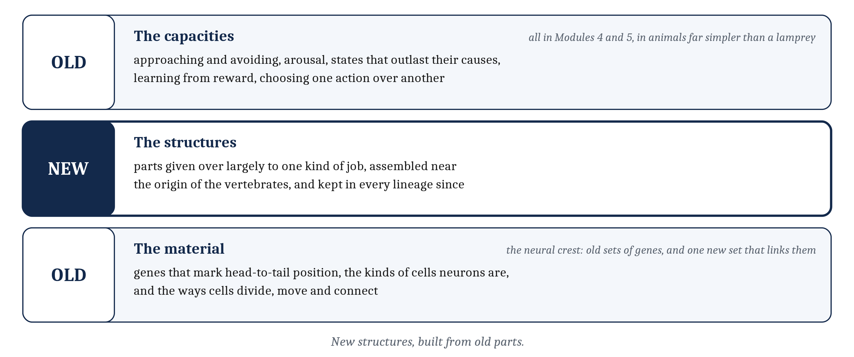
New Structures, Old Parts
Vertebrates did not invent any of these capacities. They added structures given over to them, built from material that was already there.
Notes:
It is tempting to read that list of brain parts as a list of inventions. It is not.
Vertebrates did not invent approaching and avoiding, arousal, internal states that outlast their causes, learning from reward, or choosing one action over another. Every one of those appeared in Modules 4 and 5, in animals far simpler than a lamprey. The basal ganglia did not bring choosing into the world. The worm already chose.
What vertebrates added was structures specialized for capacities that already existed. They are parts of the nervous system given over largely to one kind of job, assembled at or near the origin of the vertebrates, and kept in every vertebrate lineage since.
The structures were new. The material was not. The genes that mark positions from head to tail, the kinds of cells that neurons are, and the ways cells divide, move and connect were all present in the invertebrate relatives of the first vertebrates.
The neural crest is the clearest case. A cell becomes cartilage, or a pigment cell, by switching on a particular set of genes, and those sets are old. So is the set that marks the border of the developing nervous system, where crest cells come from. What vertebrates added is one further set of genes that links them. It switches on at that border, starts the cells migrating, and then lets one of the older sets take over wherever they end up. A new population of cells, assembled mostly out of old instructions.
That is the module's title claim in one line: new structures, built from old parts. The next lecture stops asking what each part is for, and asks what each one computes.

Slide 15
Specialists in a Machine
In your group, four minutes.
Are AI programs, as far as you know, modular, or non-modular? What does that question even mean, and how would you go about finding an answer?
Notes:
This question turns the lecture's argument on machines, and the middle part of the question is the hard one.
What would it mean for an AI program to be modular? Groups often answer by listing parts the builders designed: a language model is made of many repeated layers, and some models route each word to a few "expert" sub-networks. That is one sense of the word, and it is about the design. The sense that matters here is about the job: does one part do one job, connected to the rest through a limited set of links, so that it could be changed without redesigning everything else? A model can be divided by design and still not be divided by job. Its parts might all take part in everything.
How would we find out? The same ways we find out about a brain. Record what each part does while the system works. Damage or switch off one part and see what breaks, and what does not. Check whether a part can be swapped out without retraining the rest. These are the methods of neuroscience applied to a machine, and they come with the same trap: a part that is active during a task is not thereby the part that does the task.
For language models, what researchers mostly find is the middle ground from this lecture. Something like specialization does appear, but it emerges from training rather than being built in, and the same units take part in many jobs. The next lecture comes back to that finding. So the honest answer to the first question is "partly, and it depends on what you mean", which is the same answer the lecture gave for brains.
If the room is quiet, narrow it: a phone keyboard that suggests the next word, and a chess program. Which seems more likely to have a part for each job, and how could we check?

Slide 16
Image Sources (1 of 2)
Slide | Image | File | License | Source
3 | Sea lampreys, Petromyzon marinus | fig-lamprey.jpg | CC BY-SA 4.0 | Fernando Losada Rodríguez, via Wikimedia Commons · https://commons.wikimedia.org/wiki/File:Petromyzon_marinus.001_-_Aquarium_Finisterrae.jpg
4 | Two Ediacaran animals and two Cambrian animals | fig-early-animals.jpg | CC BY-SA 4.0 | Montage of Dickinsonia costata by Ghedoghedo (CC BY-SA 3.0), Kimberella by Nobu Tamura (CC BY-SA 3.0), and Anomalocaris canadensis and Opabinia regalis by Junnn11 (CC BY-SA 4.0), via Wikimedia Commons · https://commons.wikimedia.org/wiki/File:Dickinsonia_costata.jpg ; https://commons.wikimedia.org/wiki/File:Kimberella_NT.jpg ; https://commons.wikimedia.org/wiki/File:20191203_Anomalocaris_canadensis.png ; https://commons.wikimedia.org/wiki/File:20191108_Opabinia_regalis.png
5 | From still food to an arms race | fig-cambrian-sequence.png | CC BY 4.0 | Jon Willits — drawn for this lecture · own work
6 | Three demands on a Cambrian nervous system | fig-three-demands.png | CC BY 4.0 | Jon Willits — drawn for this lecture · own work
7 | Three pairs of competing demands | fig-competing-pairs.png | CC BY 4.0 | Jon Willits — drawn for this lecture · own work
8 | Separate structures against one network of soft constraints | fig-two-answers.png | CC BY 4.0 | Jon Willits — drawn for this lecture · own work
9 | Three currencies a specialist is paid for in | fig-three-currencies.png | CC BY 4.0 | Jon Willits — drawn for this lecture · own work
10 | Gathered at the front, then divided into parts | fig-gather-then-divide.png | CC BY 4.0 | Jon Willits — drawn for the Module 6 reading · own work

Slide 17
Image Sources (2 of 2)
Slide | Image | File | License | Source
11 | Haikouichthys, a life restoration | fig-haikouichthys.jpg | CC BY-SA 3.0 | Nobu Tamura, via Wikimedia Commons · https://commons.wikimedia.org/wiki/File:Haikouichthys_NT.jpg
11 | From the Ediacaran to the present | fig-vertebrate-timeline.png | CC BY 4.0 | Jon Willits — drawn for the Module 6 reading · own work
12 | The brain of a lamprey, from the side | fig-lamprey-brain.png | CC BY 4.0 | Jon Willits — drawn for the Module 6 reading · own work
13 | Old capacities, new structures, old material | fig-old-new-old.png | CC BY 4.0 | Jon Willits — drawn for this lecture · own work

