Slide 1

BCOG 100
Vertebrate Neural Architecture
Lecture 6.2 — The Division of Labor
Notes:
The last lecture named the parts of a vertebrate brain and gave each one a job description. Every description came with a warning: it is a first approximation.
This lecture takes that warning seriously. The obvious next question, what each part is for, turns out not to have a clean answer. So we replace it with a different question, one proposed by the neuroscientist Kenji Doya: not what each structure does, but how each one learns.
On that proposal, each structure is specialized in a method rather than a job. That is a *division of labor* of a particular kind: an arrangement in which different parts of a system take on different work, rather than each part doing everything.
This is the algorithmic level. By the end, the four kinds of learning from Module 5 will each have an address, and one question from the start of the reading will have its answer: why choosing an action, in a vertebrate, is releasing it rather than switching it on.

Slide 2
To Start: What Would Count as Evidence?
In your group, three minutes.
The last lecture ended on a claim: whether a brain gives two jobs two separate structures is an empirical question.
Suppose we wanted to know whether one part of the brain is for moving. What evidence would be convincing?
What result would cast doubt on it?
Notes:
This replaces a recap. The major theme of the last lecture was that competing demands make separate structures worth considering, and that the argument for them does not prove they exist. Something has to be looked at.
The answers groups usually give fall into three kinds. Record from the part and see whether it is active during movement. Damage the part and see whether movement suffers. Look at its wiring and see whether it connects to the muscles, or to what drives them.
All three are reasonable. The second question is where the interest is. A part active during movement and also during many other things would make most people doubt it. So would damage that affects much more than movement, or a part whose activity simply mirrors whatever it happens to be connected to.
Hold on to whatever the groups said about that second question. Every one of those doubts turns out to be real, for two of the structures in this module, and the next slide is about what they do to the question.

Slide 3
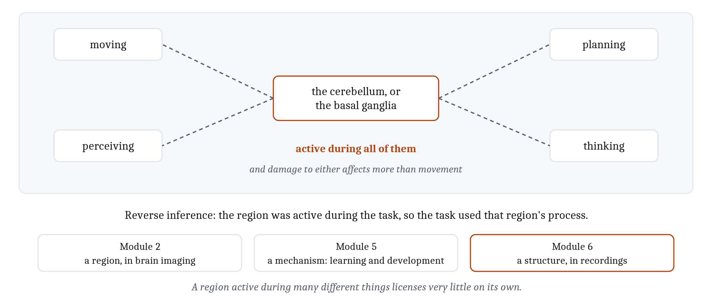
What Is Each Part For? The Wrong Question
Active during movement, perception, planning and thought: going from that activity to a job is reverse inference.
Notes:
Now that the parts have names, the natural question is what each one is for. The evidence does not answer it cleanly.
Take the cerebellum and the basal ganglia. Recordings find both active during movement. They also find both active during perception, during planning, and during thought. Damage to either affects more than movement. And when researchers record from a small piece of either, what they find tends to resemble the stretch of pallium that piece exchanges signals with.
That last finding is the one to dwell on. A structure whose activity looks like whatever it is wired to is not telling us what it is for.
The mistake this invites has a name: **reverse inference**, going from "this region was active during the task" to "therefore, the task involved the process that region does". This is the third time the book has met it. In Module 2 it was a region in brain imaging: a region active during fear is active during a great many other things, so its activation is weak evidence that fear was what mattered. In Module 5 it was a mechanism: the coincidence detection and gating that change a synapse in learning also wire a nervous system in development, so finding the mechanism at work does not tell us which job is being done.
Here it is a structure. A region active during many different things licenses very little on its own, and the structures of this module are active during many different things.

Slide 4
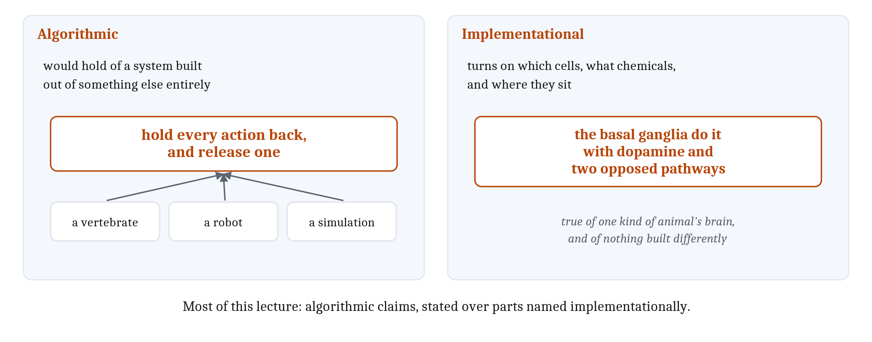
A Better Question: How Does Each Part Learn?
Doya's proposal: each structure is specialized in a method, not a job. And a test for which level a claim is at.
Notes:
Doya's proposal was to stop asking what each structure does and ask how each one learns. On that view a structure is specialized in a method rather than in a job, and the method can be used for many jobs. That fits the recordings on the last slide rather than fighting them.
Changing the question also forces care about Marr's levels. So far in this module the computational level has been clean, because the Cambrian demands are facts about what an animal had to manage, and they hold whatever its nervous system is made of. The two lower levels are harder to keep apart once the parts have names, because naming a part is already half an answer about implementation.
So here is a test. A claim is algorithmic if it would hold of a system built out of something else entirely. A claim is implementational if it turns on which cells are involved, what chemicals they use, and where they sit.
The chapter's own pair shows the difference. *Hold every action back, and release one* is algorithmic: a robot could work that way, and so could a simulation. *The basal ganglia do it with dopamine and two opposed pathways* is implementational.
Most of what follows in this lecture is the first kind of claim, stated over parts named in the second kind. It is worth noticing each time it happens.

Slide 5
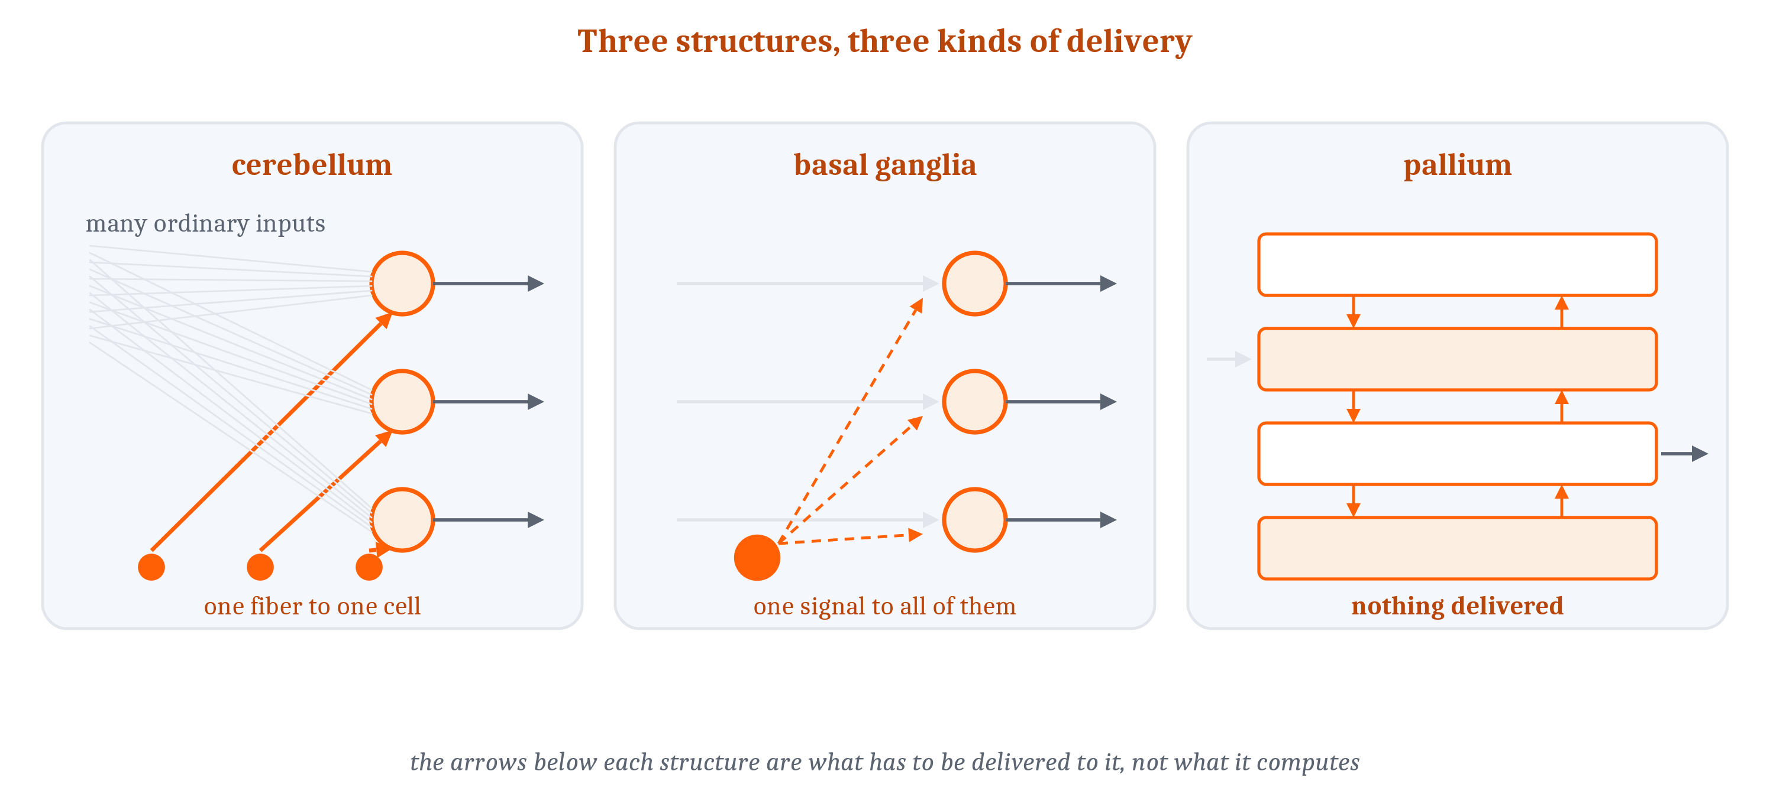
Two Levels of a Single Change
Each family of learning pairs an animal-level problem with what has to reach a synapse. Anatomy can only be asked about the second half.
Notes:
Module 5 sorted four families of learning by a single question: what has to reach a synapse before it will change. It also added a caveat. Knowing what a weight change requires says nothing about whether an animal has any way to deliver that information.
Doya's proposal answers the caveat. For each family, it names the place in a vertebrate brain where the required information actually arrives. The figure shows the three kinds of delivery: one fiber to one cell in the cerebellum, one signal to all of them in the basal ganglia, and nothing delivered at all in the pallium.
One caution first, because two different things get called learning. A *family of learning* is usually named for what the whole animal ends up able to do: find food, keep its eyes on target, avoid what hurt it last time. But the change itself happens at individual connections. A single connection cannot be told what the animal should have done. A single synapse has no way to understand the meaning of anything that complex. Whatever reaches it has to be about its own inputs and its own output.
So each family is a pairing: an animal-level problem, and the particular information that has to turn up at a synapse for that synapse to help solve it. The rest of this lecture runs on that pairing.
And it is the second half that anatomy can answer. To ask where reinforcement learning happens is not to ask where the animal's goals are. It is to ask where the machinery is that gets a verdict delivered to the synapses that produced the action.

Slide 6
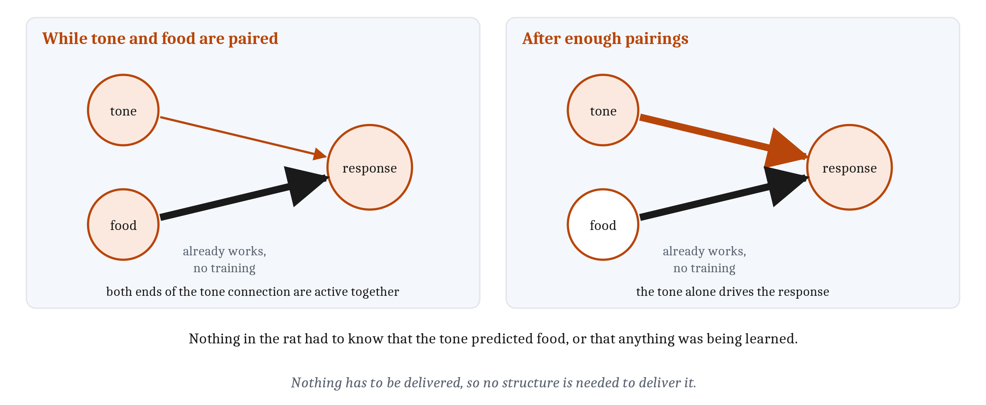
Learning Without a Teaching Signal
Unsupervised learning needs only the two cells a connection joins. The pallium gets it not because it happens only there, but because nothing else arrives there.
Notes:
The first family is the one Module 5 called Hebbian. The chapter calls it *unsupervised learning*, and it needs nothing but the two cells a connection joins.
Module 5's rat shows what a rule that local can buy. A tone sounds, and food arrives a moment later. Food already produces a response without any training, so the cells driving that response are firing when the food arrives. The cells carrying the tone contact those same response cells, and they are firing at the same moment. So both ends of the tone connection are active together, which is the entire condition Hebb's rule requires. The tone connection strengthens. After enough pairings, the tone alone drives the response. That is classical conditioning.
It is unsupervised because nothing in the rat had to know that the tone predicted food, or that any learning was going on. Read that way, an unconditioned stimulus is simply one that already makes the postsynaptic cell fire. Without that, there is no co-occurrence to detect, and nothing changes.
Run the same rule across everything an animal senses, and its connections come to mirror which things in its world turn up together. Learning what goes with what and learning the statistics of the input are one event, described at two levels.
Module 5's limits come along with the mechanism. The same rule strengthens the connection carrying the sound of the ventilation fan that happened to be running. And blocking showed that real conditioning tracks only what was not already predicted. So a co-occurrence rule is the beginning of an account of conditioning, not the whole of one.
Now the anatomy. Nothing but local information has to be delivered, so no extra circuitry is needed to deliver it, and co-occurrence-sensitive synapses are found throughout a vertebrate brain. Doya singles out the pallium anyway, and the reason is an argument from absence. The pallium is layered, heavily recurrent, receives information from everywhere, and has no dedicated teaching pathway anyone has found. What it has to learn from is the statistics of its own input.

Slide 7
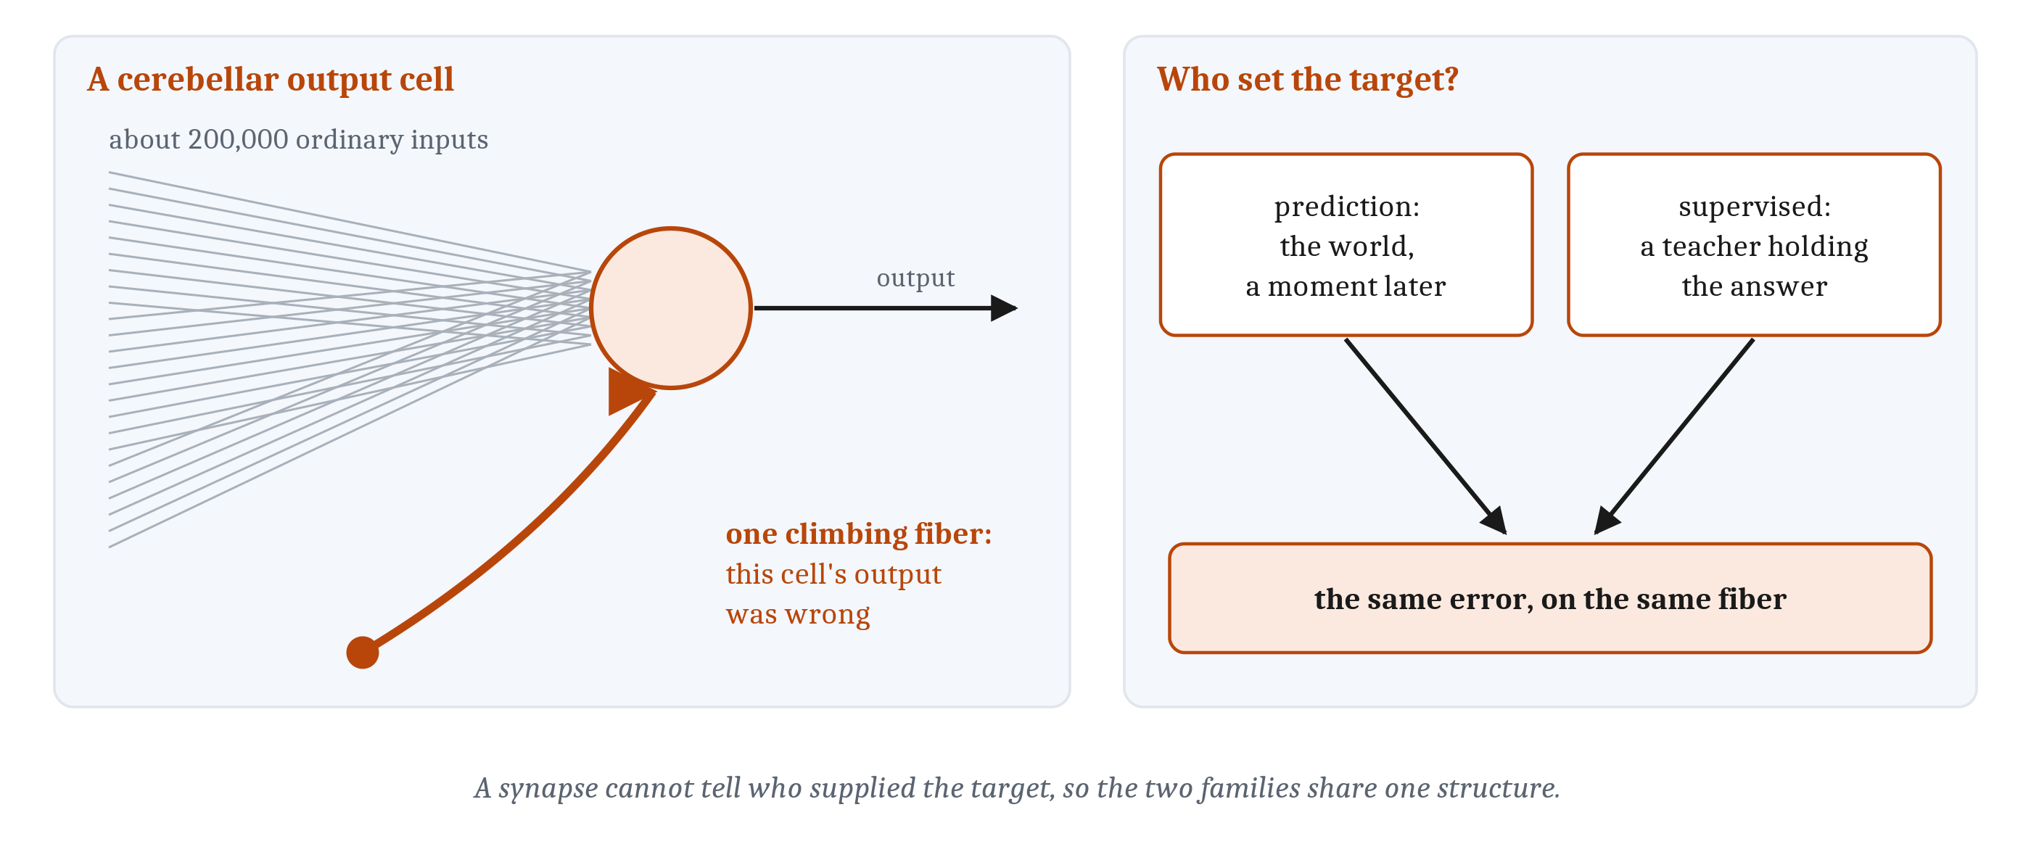
Learning from an Error, Output by Output
Prediction and supervised learning both need an error addressed to one output cell. The cerebellum's climbing fibers deliver exactly that, and cannot say who set the target.
Notes:
*Prediction learning* needs the next input, which the world delivers on its own. The case is a rabbit. A tone sounds, and a quarter of a second later a puff of air is delivered to its eye. The rabbit comes to predict the puff, and learns to close its eye at just the right time.
What it has to learn is not whether to blink but exactly when, and no teacher tells it. At the animal level this is classical conditioning, just like the rat's tone and food. What differs is what had to change. The rat needed an association, which a co-occurrence rule can deliver. The rabbit needs the timing of one output, which it cannot.
The puff supplies what is needed. Blink too soon or too late and the puff lands on an open eye. That information is specific: it has to reach the cells whose output sets the blink, and tell those cells that their own timing was wrong.
The cerebellum is built to receive exactly that. Each output cell gets roughly two hundred thousand ordinary inputs, and alongside them a single climbing fiber from one source. The climbing fiber's firing reports the error for that one cell. One fiber, one cell, one instruction. Silence the climbing fibers, and the learned blink never develops.
One subtlety. An animal watching a leaf drift past is also predicting what it will see next, but no output is involved, so there is no command that can be wrong. That prediction happens inside the pallium's own recurrent circuitry, because prediction and test are already in the same tissue. Predicting the outcome of a movement is different: the cells that issued the command are not the cells that find out how it went. The cerebellum's share of prediction learning is the part about the animal's own output.
*Supervised learning* needs a statement of what the output should have been, from something that already knows. Inside an animal that almost never exists. Module 5 ranked a teacher as the exotic case. The nearest thing is a young songbird practicing against its memory of an adult's song. But no part of the bird holds the right motor command. It sings, compares, and works from the mismatch, so the target is one it manufactured.
The punchline is on the right of the figure. What arrives along a climbing fiber is an error for one output cell, and the fiber does not say whether a teacher or the world set the target. A synapse cannot tell the two families apart, so they share a structure. And most of what the cerebellum learns from is the world's targets: a slipping image, a reach that missed, a swallow that went wrong.

Slide 8
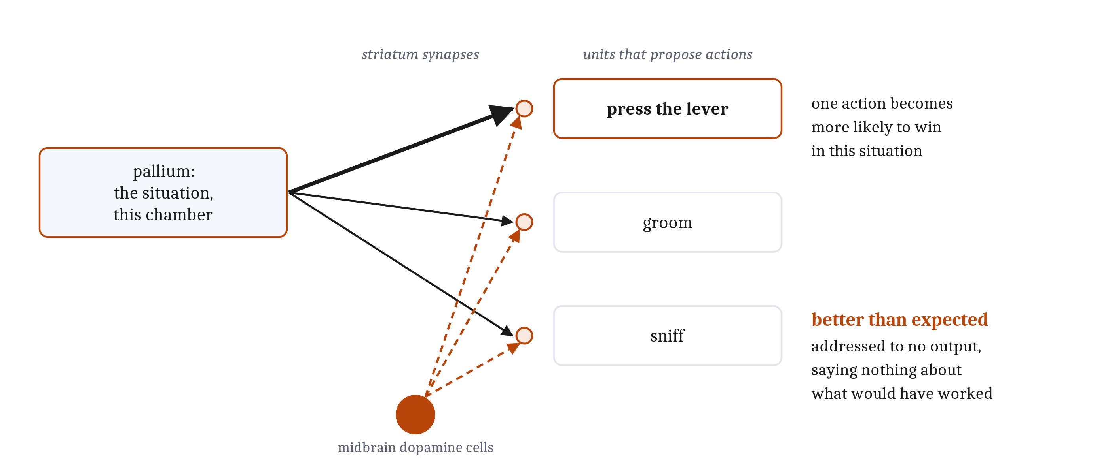
Learning from a Verdict
Reinforcement learning needs only a report of how things went. Dopamine delivers it where the pallium meets the striatum, and there it is enough.
Notes:
*Reinforcement learning* needs a report of how things went.
Module 5's rat is in a chamber with a lever on one wall and a food opening on another. Pressing the lever makes a pellet arrive, and the rat has to cross the chamber to eat it. At the animal level, the whole problem is that the rat has to end up pressing that lever more often in that chamber.
At the synapse, what arrives when the pellet is eaten is a broadcast signal reporting only that things went better than expected. It is addressed to no particular output, and it says nothing about what would have worked instead. The rat also groomed and sniffed along the way, and sorting those from the lever press is the work of Module 5's traces and its estimates of future outcomes. A body can generate a signal like this easily, from a full stomach or from an injury.
Dopamine neurons of the midbrain carry it. Their fibers arrive at the synapses where the pallium meets the **striatum**, the input stage of the basal ganglia. That gives Module 5's third factor an address: the signal from elsewhere that settles whether eligible synapses change at all.
One qualification. At the algorithmic level the signal is usually written as a single number. The anatomy is less tidy: the dopamine cells are a population, and what they report is not identical everywhere their fibers land. What survives either description is that the signal is not addressed to particular outputs, so it cannot say what any one of them should have done.
Why is so thin a signal useful? Because of what those synapses connect: on one side the pallium's report of the situation, on the other the units that propose actions. Strengthening a connection there corrects no output. It makes one action more likely to win in one kind of situation, and that is exactly what the rat has to end up doing.

Slide 9
Four Families, Three Structures
Two families make the same demand of a synapse. The three mappings are not equally well supported, and not exclusive.
Kind of learning | What has to reach the synapse | Where it comes from | Where it arrives
Unsupervised (Hebbian) | The activity of the two cells the connection joins | Nowhere else; both are already at the connection | Synapses everywhere; Doya's candidate is the pallium
Prediction (self-supervised) | An error, computed separately for each output | The world, a moment later | The cerebellum's climbing fibers, one to each output cell
Supervised | An error, computed separately for each output | A teacher that already holds the answer | The same climbing fibers; the wiring does not tell the two apart
Reinforcement | One number reporting how things went | The body, or the outcome itself | Dopamine fibers from the midbrain, where the pallium meets the striatum
Notes:
Four families, three structures. The table is Module 5's with one column added: where a vertebrate brain delivers what each family requires. The arithmetic works because prediction learning and supervised learning differ in where the target comes from, not in what has to reach the synapse. Predicting the consequences of a movement is set aside for Module 8.
The history fits. A lamprey has two of the three systems. The missing one is the structure specialized for errors delivered output by output, the cerebellum, which in the form jawed vertebrates have it arrived later, with the jawed fishes.
Doya is careful about how much of this is settled, and the three cases are not equally strong. The cerebellum is the best supported, on three grounds: the anatomy, what the climbing fibers fire for, and what happens to learning when they are silenced. The pallium rests on the weakest evidence of the three, and that is partly the point. There is no dedicated teaching pathway to find, so the case is made from what is absent.
And the mapping is not exclusive. Reward-related activity is well established where the pallium meets the striatum, and it also turns up in parts of the cortex. The table assigns each family to where its signal is delivered. It does not say that nothing else can learn that way.

Slide 10
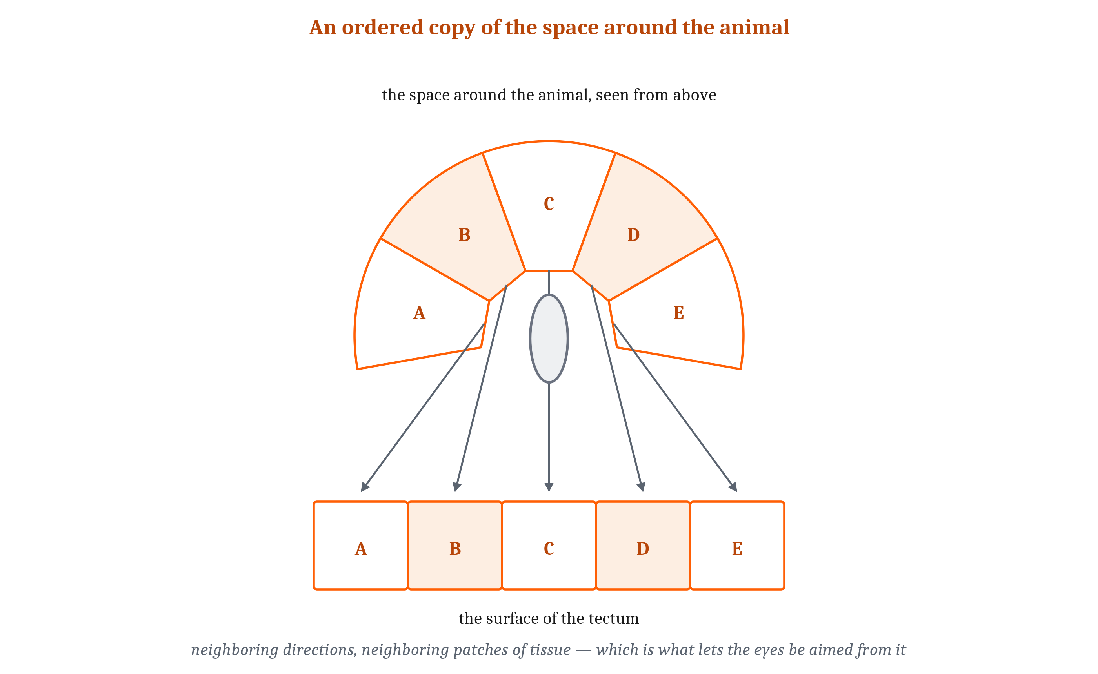
A Few Wiring Plans: Maps and Loops
A few large-scale arrangements, built from Module 4's motifs, recur across the brain. No behavior uses one structure alone.
Notes:
Module 4 built small circuits from a handful of motifs: convergence and divergence, inhibition of several kinds, and loops that keep running. The vertebrate brain reuses a few large-scale arrangements built from those motifs. Each is an algorithmic idea, and each turns up many times over.
The first is a map. In a **topographic map**, neighboring points in the world are handled by neighboring cells, so the arrangement of the tissue mirrors the arrangement of what it represents. The tectum is one: an ordered copy of the space around the animal, which is what makes it possible to turn the eyes toward the right place.
Maps buy two things. Wires stay short, because cells that compare nearby points sit near each other. And comparison is easy, because the circuitry that sharpens a difference between neighbors can be the same everywhere on the sheet.

Slide 11
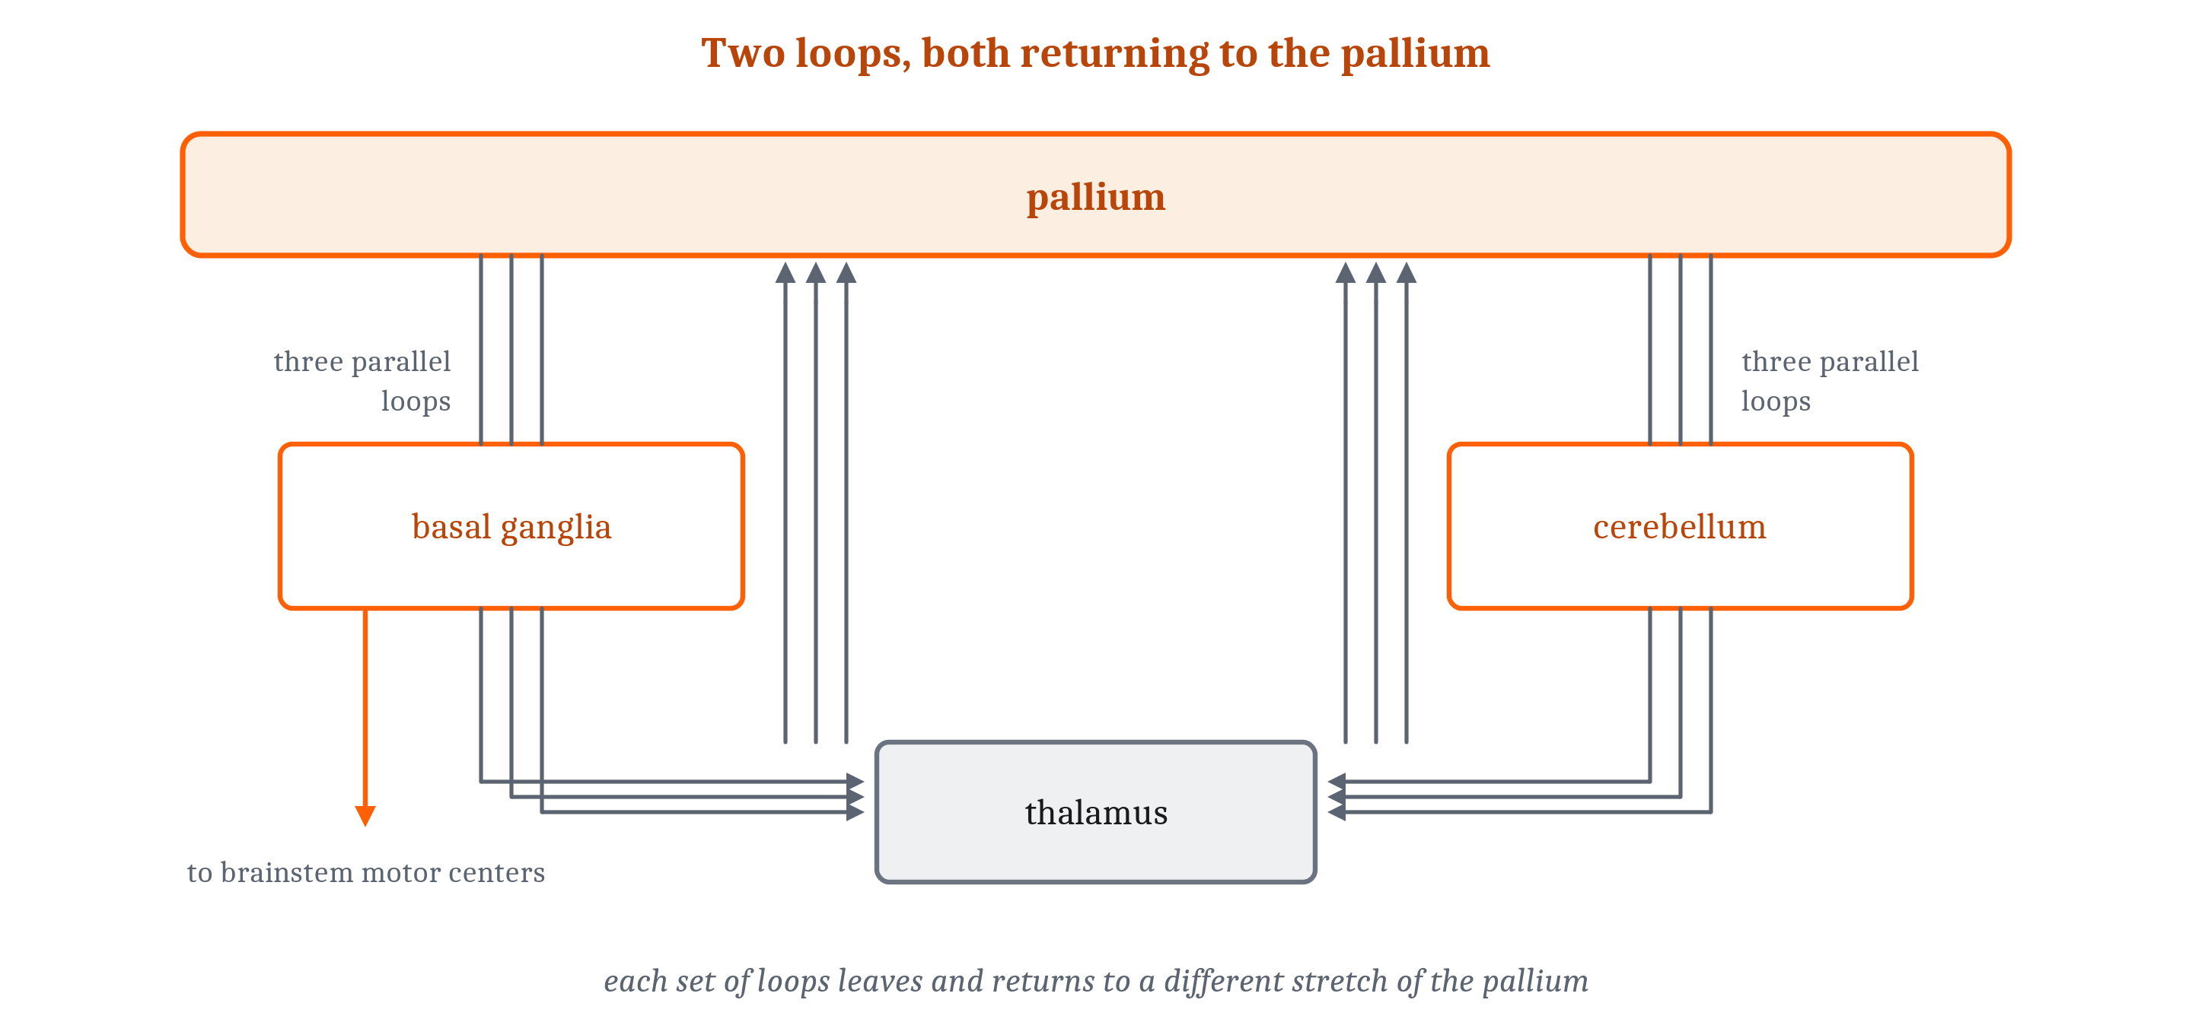
A Few Wiring Plans: Maps and Loops
A few large-scale arrangements, built from Module 4's motifs, recur across the brain. No behavior uses one structure alone.
Notes:
The second is a loop, and there are two. One runs from the pallium through the basal ganglia and back by way of the thalamus. The other runs from the pallium through the cerebellum and back, again by way of the thalamus. Neither is single. Each is a bundle of parallel loops serving different stretches of pallium, which is how one arrangement can serve movement in one channel and something quite different in another.
A caution about the picture rather than the fact. In a lamprey, most of what the basal ganglia send out goes down to the brainstem, not back up. In a mammal, much of what returns to the pallium may be a copy of the command that was sent down. A loop drawn with the pallium at the top is an incomplete mammal's version of the story.
The loops are also how the three structures work together, since no behavior uses one of them alone. The cerebellum and the basal ganglia have no direct connections to each other at all. Both exchange signals with the pallium through the thalamus, and the pallium supplies the shared representation they both work on. Module 5's actor and critic are one case: the critic learns to predict how well things will go from here, the actor holds the policy and adjusts it from the critic's errors, and both sit in the striatum, in two intermingled compartments, working through the loop. A skill handed from one system to another is a second case. Mental arithmetic, or a new sequence of movements, is worked out slowly at first. With practice, the same mappings can be copied into the cerebellum, which runs them as fast shortcuts. That is part of why a practiced skill stops demanding attention.

Slide 12
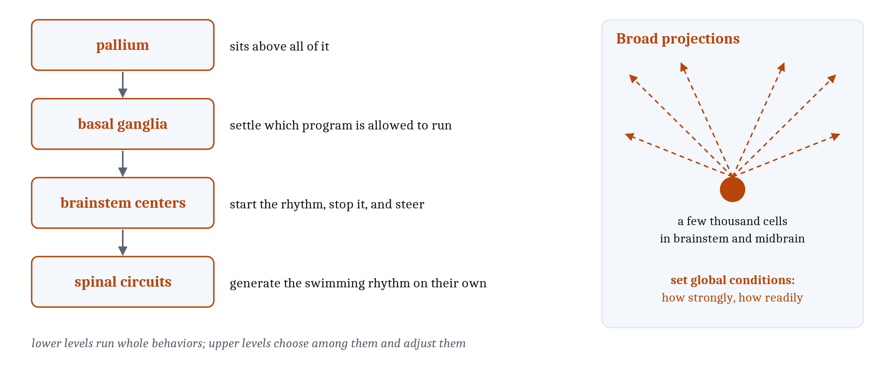
Broad Projections, and a Hierarchy of Control
A few thousand cells set conditions for the whole brain. Lower levels run whole behaviors; upper levels choose among them.
Notes:
The third arrangement is the broad projection. A few thousand cells in the brainstem and midbrain reach most of the rest of the brain. They are the sources of Module 4's modulators. They set global conditions rather than carrying specific content: how strongly the whole animal responds, and how readily it tries something new.
The word *broadcast* is only approximately right. Most of these systems divide into subsystems with separate targets, so different regions get different signals. Norepinephrine comes closest to reaching everywhere at once.
The fourth arrangement is a hierarchy of control, and the lamprey shows it most plainly. Circuits in its spinal cord generate the swimming rhythm on their own. Centers in the brainstem start those circuits, stop them, and steer. The basal ganglia settle which program is allowed to run, and the pallium sits above all of it.
What makes this a hierarchy is not that the top gives orders to the bottom. It is that the lower levels run whole behaviors by themselves, while the upper levels choose among them and adjust them.
One result shows how much the lower levels can do. A cat whose neocortex has been removed still walks, grooms and explores, so long as its basal ganglia are intact.

Slide 13
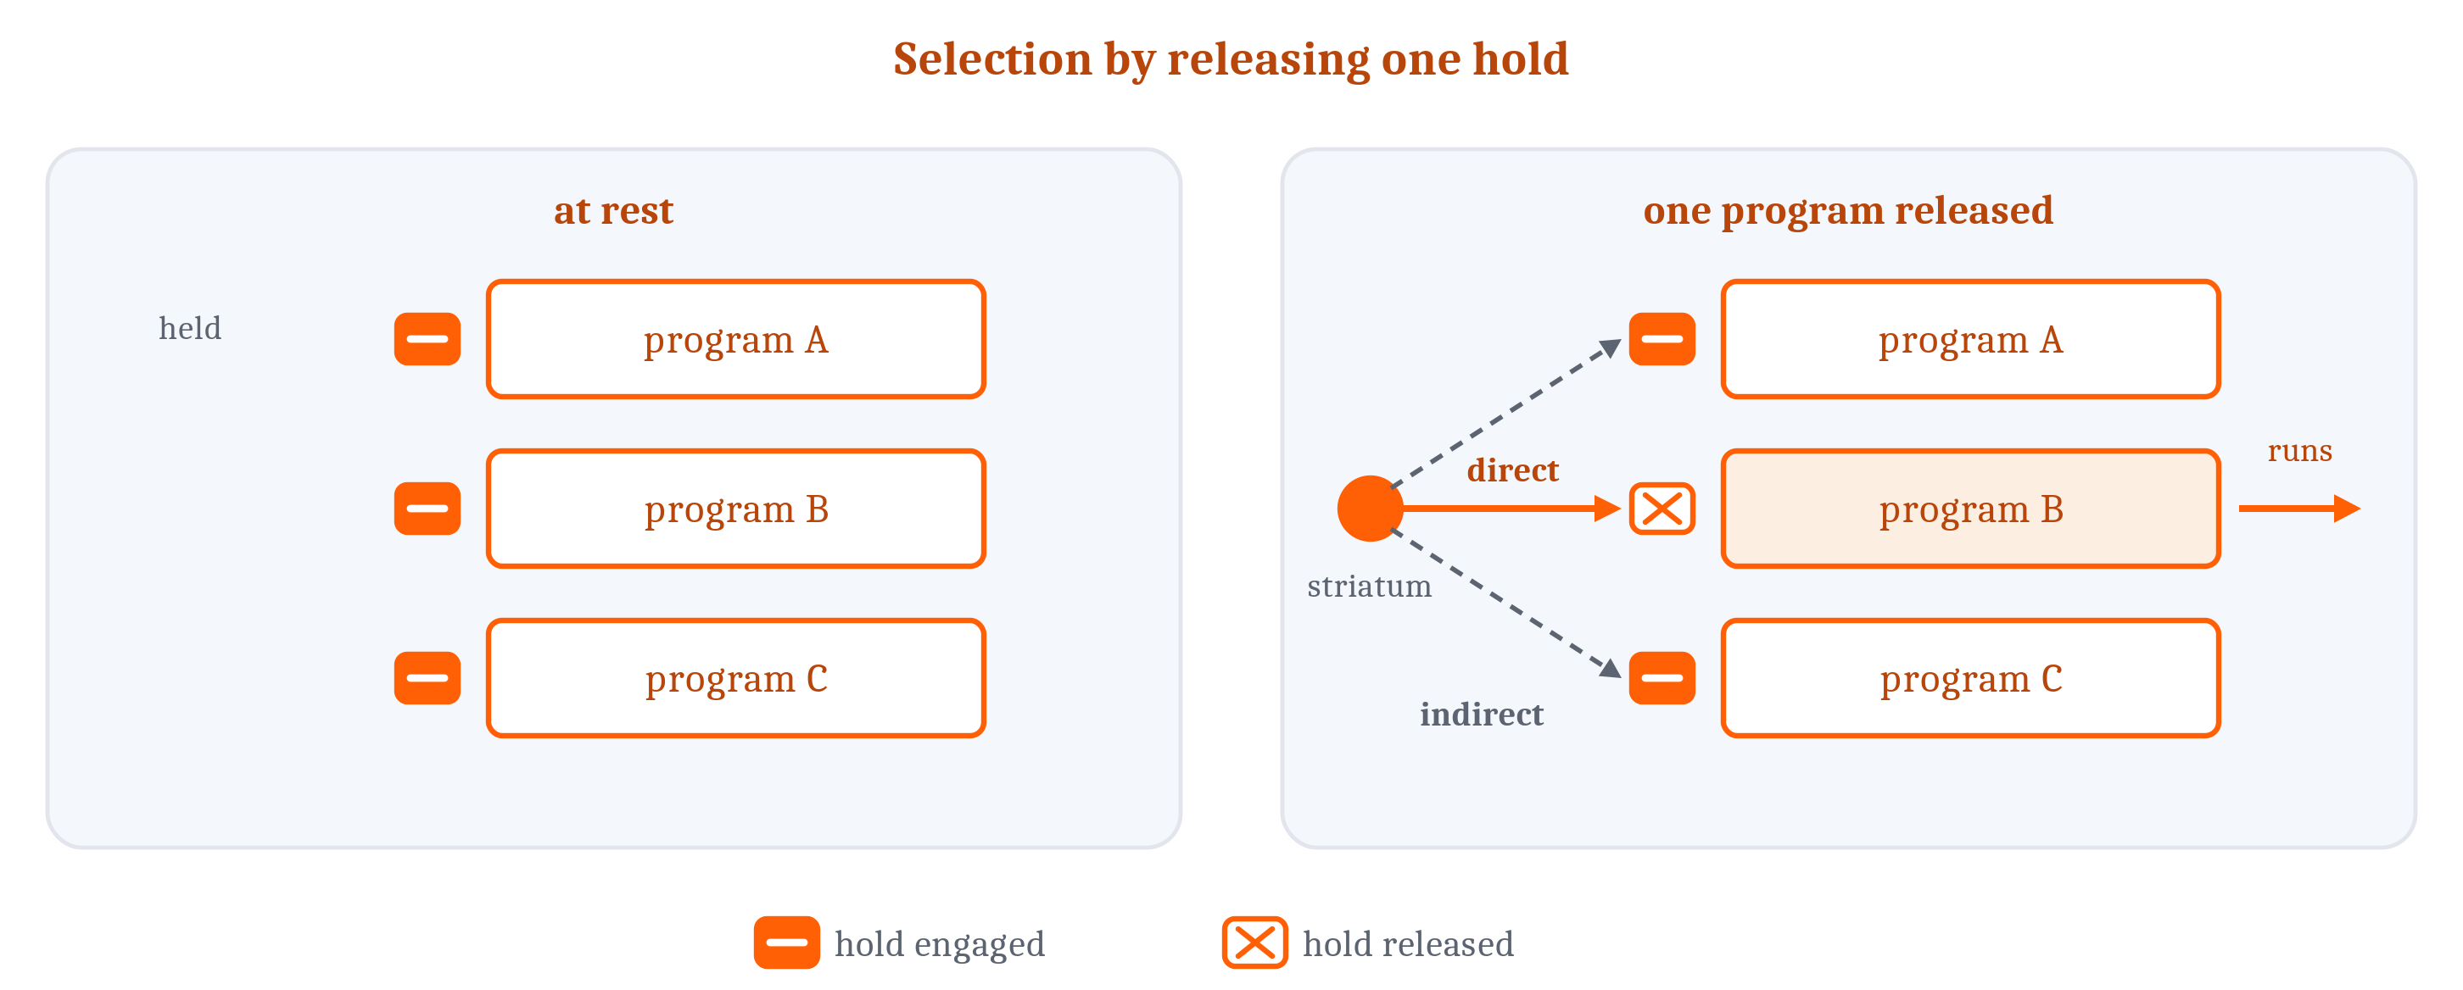
Choosing Is Releasing, Not Switching On
Action selection by disinhibition: every program is held back by default. The direct pathway releases one; the indirect pathway presses the rest down.
Notes:
Specialists create the problem from the last lecture: several parts of an animal propose actions at the same moment, and the body can only do so many things at once. **Action selection** is choosing which of the available actions is performed now.
The vertebrate answer runs the other way from what most people expect. Nothing is switched on to produce a movement. Everything is held back by default. The output cells of the basal ganglia fire steadily at rest, inhibiting the brainstem centers that would otherwise run each motor program. Choosing an action is releasing the inhibition for that one action.
The **direct pathway** runs from the striatum to those output cells and silences the ones holding back a particular program, which frees it to run. Inhibiting an inhibitor is *disinhibition*, one of Module 4's motifs, now used at the scale of whole structures. The **indirect pathway** runs through two further stops and ends by strengthening the inhibition on everything else, so releasing one program presses the others down. A third, faster route can stop a movement already underway.
Dopamine sets how easily anything is released at all. Too little, and movements are hard to start, which is what happens in Parkinson's disease, and to a lamprey whose dopamine is depleted. Too much, and unwanted movements break through. This is also where Module 5's fourth tier of learning acts in the earliest vertebrates we can study: an animal that bridges a delay between an action and a reward needs somewhere for the reward signal to change what gets released later, and the striatum is that place.
The moral comes in three negatives. There is no walking organ, no eating organ, and no talking organ. Those actions compete for the same muscles and the same body, so parts that ran them independently would pull in different directions. Shared machinery, with something to settle which program is released, is the arrangement that works when one body has to do one thing at a time.

Slide 14
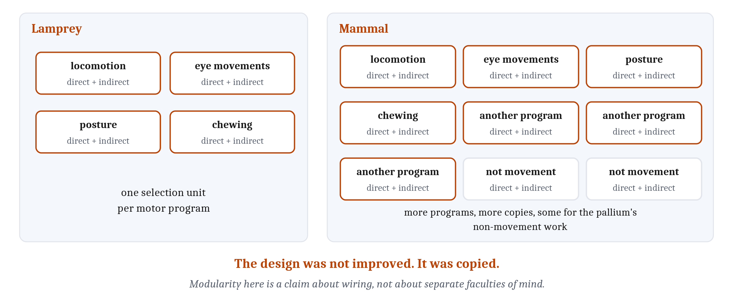
More Copies of the Same Unit
Modularity: units that do their own job, connect through limited links, and can be copied or altered without redesigning the rest. A claim about wiring, not about faculties of mind.
Notes:
A lamprey's selection circuitry and a mouse's are nearly the same: the same transmitters, the same connections, the same cell properties, the same two pathways. What differs is how many copies there are. The basal ganglia are built from one unit per motor program, one for locomotion, one for eye movements, one for posture, one for chewing, each with its own direct and indirect pathway. A mammal has more programs and more units to match, plus further units serving parts of the pallium that are not about movement at all. The design was not improved. It was copied.
That is **modularity**: units that each do their own job, connect to the rest through a limited set of connections, and can be copied or altered without redesigning everything else. Three lines of evidence arrive at it independently. The basal ganglia repeat one selection unit. Duplicating a piece of circuitry and then modifying the copy is a fast route to a new arrangement, one evolution takes often. And all three of Doya's systems are built from repeated pieces of the same kind.
Two notes on the word. The book never calls a unit of a brain a module, because its own chapters are Modules, though the term turns up elsewhere. And modularity here is a claim about wiring. It is not the stronger claim, which this book does not make, that a mind is built from separate independent faculties.
Modularity is a matter of degree, which brings back the fork from the last lecture: separate structures, or one network settling among all the demands at once. Neither is right in general, and which one a nervous system took is settled by looking. For the basal ganglia the evidence for separation is good, and even there it is partial. What is repeated is the selector, not a whole organ per behavior, and the programs it chooses among run on shared brainstem and spinal circuitry.
Large language models are an instructive case, because both answers show up in one system. Some division is deliberate: the model is built from many repeated layers of more than one kind. But none of the designed divisions matches what the model has to get right. There is no grammar part, no meaning part, no part that tracks who is speaking. Those demands compete, and one network meets them all. Where something like specialization does appear, it was not built in. It emerged from training, and it is partial: the same units serve many jobs. Research here is active and contested, and its best-supported finding is exactly that many-purposes result. Nothing in the comparison says brains and language models solved the problem the same way. It shows that the same choice arises whenever one system must meet many demands at once.
One question stays open. Choosing among actions is well understood. Choosing among whole strategies, such as working a problem out step by step or falling back on what usually works, is not.

Slide 15
Image Sources (1 of 2)
Slide | Image | File | License | Source
3 | One structure, active during everything | fig-active-everywhere.png | CC BY 4.0 | Jon Willits — drawn for this lecture · own work
4 | Telling an algorithmic claim from an implementational one | fig-level-test.png | CC BY 4.0 | Jon Willits — drawn for this lecture · own work
5 | Three structures, three kinds of delivery | fig-three-systems.png | CC BY 4.0 | Jon Willits — drawn for the Module 6 reading · own work
6 | Classical conditioning from a co-occurrence rule | fig-hebb-conditioning.png | CC BY 4.0 | Jon Willits — drawn for this lecture · own work
7 | One error for one output cell | fig-climbing-fiber.png | CC BY 4.0 | Jon Willits — drawn for this lecture · own work
8 | A verdict that is useful because of where it lands | fig-verdict.png | CC BY 4.0 | Jon Willits — drawn for this lecture · own work
10 | An ordered copy of the space around the animal | fig-tectum-map.png | CC BY 4.0 | Jon Willits — drawn for the Module 6 reading · own work
10 | Two loops, both returning to the pallium | fig-two-loops.png | CC BY 4.0 | Jon Willits — drawn for the Module 6 reading · own work

Slide 16
Image Sources (2 of 2)
Slide | Image | File | License | Source
11 | A hierarchy of control, and the broad projections across it | fig-hierarchy.png | CC BY 4.0 | Jon Willits — drawn for this lecture · own work
12 | Selection by releasing one hold | fig-selection.png | CC BY 4.0 | Jon Willits — drawn for the Module 6 reading · own work
13 | The selection unit, copied rather than improved | fig-copied-selector.png | CC BY 4.0 | Jon Willits — drawn for this lecture · own work

