Slide 1
BCOG 100
Neural Circuits
Lecture 2: Adaptation and Plasticity

Slide 2
Reading Check 5-2
Password: hebb
Question: tell me something about hebbian learning

Slide 3
Adaptation and Plasticity
Recap & Overview
Last time: Neural Circuits = building blocks of brain function
Today: circuits aren’t fixed — they adapt & learn
Notes:
“Last class, we focused on neural circuits.
We looked at how neurons connect into patterns that produce reflexes, rhythms, escape behaviors, and more.
The big idea was that circuits are the building blocks of the brain — Luo called them the ‘words’ that make up sentences.
But here’s the problem: if all circuits were just hard-wired and fixed, they couldn’t adjust to new experiences.
You’d always respond the same way, no matter what you had learned.
That wouldn’t do for an organism that needs to survive in a changing world.
So today we’re moving into adaptation and learning.
We’ll see how circuits change their responses with repeated input,
how synapses can strengthen or weaken, and how this creates learning.
We’ll also connect to the article you read by Munakata & Pfaffly,
which explains how Hebbian learning gives us a biologically plausible mechanism for how this works.

Slide 4
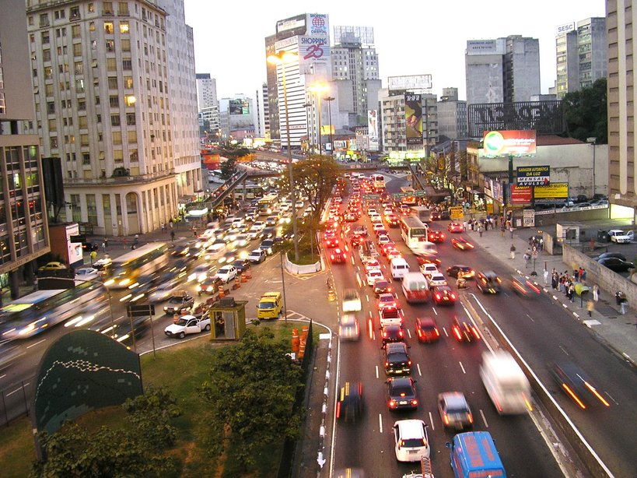
Adaptation and Plasticity
Why Hard-Wired Circuits Aren’t Enough
Fixed wiring = same response every time
Organisms need flexibility
Example: ignoring harmless, repeated touch
Notes:
If all circuits were completely hard-wired, the same stimulus would always produce the same response.
That sounds reliable — but it’s actually a problem.
Imagine a worm that jerks away every single time it’s touched, no matter how often.
The first time, it makes sense — that touch might be danger.
But after the tenth or hundredth harmless touch, it’s a waste of energy to keep reacting.
Humans are the same.
If you always reacted strongly to the sound of a dripping faucet or the feel of your shirt against your skin,
you’d never be able to focus.
This is why circuits can’t just be fixed.
They need ways to adjust their responsiveness —
sometimes dialing down, sometimes strengthening connections —
so that behavior becomes flexible and adaptive.
That’s where adaptation and learning come in.

Slide 5
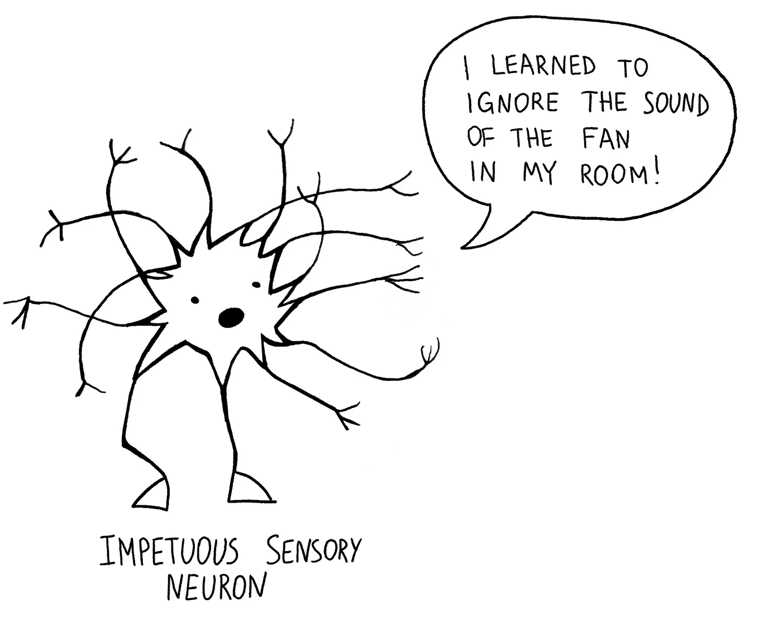
Neural Adaptation
What is Neural Adaptation?
Reduced response to repeated stimulus
Happens quickly, often reversible
Makes perception & behavior more efficient
Notes:
Neural adaptation is the brain’s way of adjusting sensitivity when a stimulus repeats.
The basic idea: the first time you experience a stimulus, neurons respond strongly.
But if it keeps happening, the response gets smaller and smaller.
This happens quickly — sometimes within seconds — and it’s usually reversible.
If the stimulus goes away for a while and then comes back, the neurons respond strongly again.
Why is this useful?
Because it prevents the nervous system from wasting energy on things that aren’t new or important.
It frees up your attention and resources to focus on changes in the environment —
the things that might matter for survival.

Slide 6
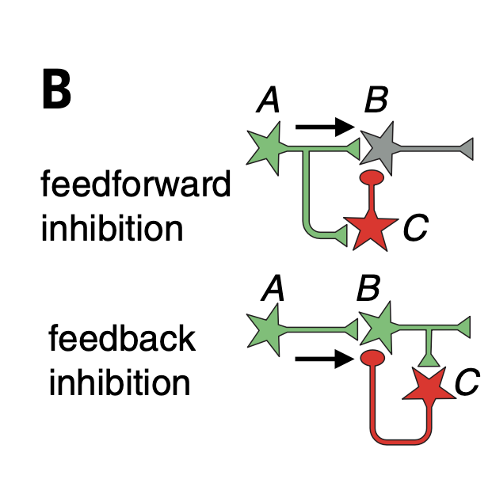
Neural Adaptation
How Does Adaptation Work?
Single neuron: reduced firing over time
Circuits: inhibitory feedback dampens response
Both mechanisms result in less response to repeated input
Notes:
So how does adaptation actually happen?
First, at the level of a single neuron, the cell itself can reduce its response over time.
A sensory neuron might fire strongly at first,
but its ion channels start to inactivate, and the firing rate slows down,
even though the stimulus hasn’t changed.
This is sometimes called cellular adaptation or neural fatigue.
Second, adaptation can also be a circuit phenomenon.
In this case, sensory neurons keep firing,
but they activate inhibitory interneurons that feed back and dampen the response.
This is how you get habituation in animals like C. elegans —
the worm stops reacting to repeated harmless touches,
not because its sensory neurons stop working,
but because the circuit shuts down the motor response.
In both cases, the result is the same:
a stimulus that stays the same produces less and less response,
so the system is free to focus on new or changing inputs.

Slide 7

Neural Adaptation
Human Examples of Adaptation
Smell: perfume fades after minutes
Touch: clothes felt at first, then ignored
Vision: afterimages & light/dark adjustment
Notes:
Adaptation is something you’ve all experienced.
Smell: When you first walk into a room with a strong odor — maybe perfume or food — your olfactory neurons fire strongly.
But after a few minutes, the smell seems to fade, even though the molecules are still in the air.
That’s olfactory adaptation.
Touch: When you put on clothes or jewelry, you feel them right away.
But after a few minutes, your touch receptors adapt, and you stop noticing them.
Vision: If you stare at a bright color, like a green square, and then look away, you see a pinkish afterimage.
That happens because the neurons that were firing strongly for green adapt and reduce their output,
leaving the opposite channel more active.
Vision also adapts when you move between a bright outdoor scene and a dark room —
at first you can’t see, then photoreceptors reset their sensitivity.
All of these examples show the same principle:
neurons and circuits tune down their response to constant input so you can focus on change,
which is usually what matters most for survival.

Slide 8
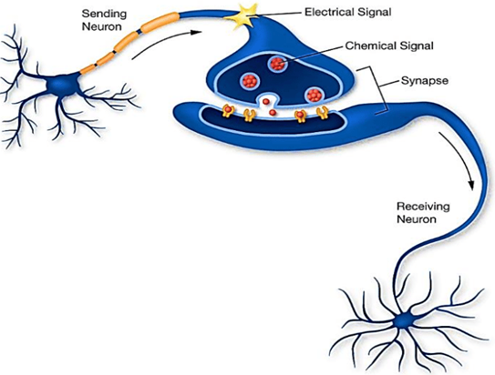
Learning and Plasticity
From Adaptation to Plasticity
Adaptation = short-term, reversible
Plasticity = longer-lasting change in connections
Circuits can be rewired by experience
Notes:
So far, we’ve talked about adaptation —
short-term changes where neurons or circuits reduce their response to repeated stimulation.
Adaptation is useful, but it doesn’t last long.
When the stimulus goes away, the system resets.
But nervous systems also need long-term change —
the ability to learn from experience.
This is where plasticity comes in. Plasticity means that the connections between neurons —
the synapses — can actually be strengthened or weakened over time.
This is more than just turning down the volume on a response for a few seconds.
It’s about changing the wiring itself so that the next time the circuit is used, it behaves differently.
Plasticity is the foundation for memory, skill learning, and development.
And it’s where we’ll bring in Hebb’s rule — the core idea from the article you read.”

Slide 9
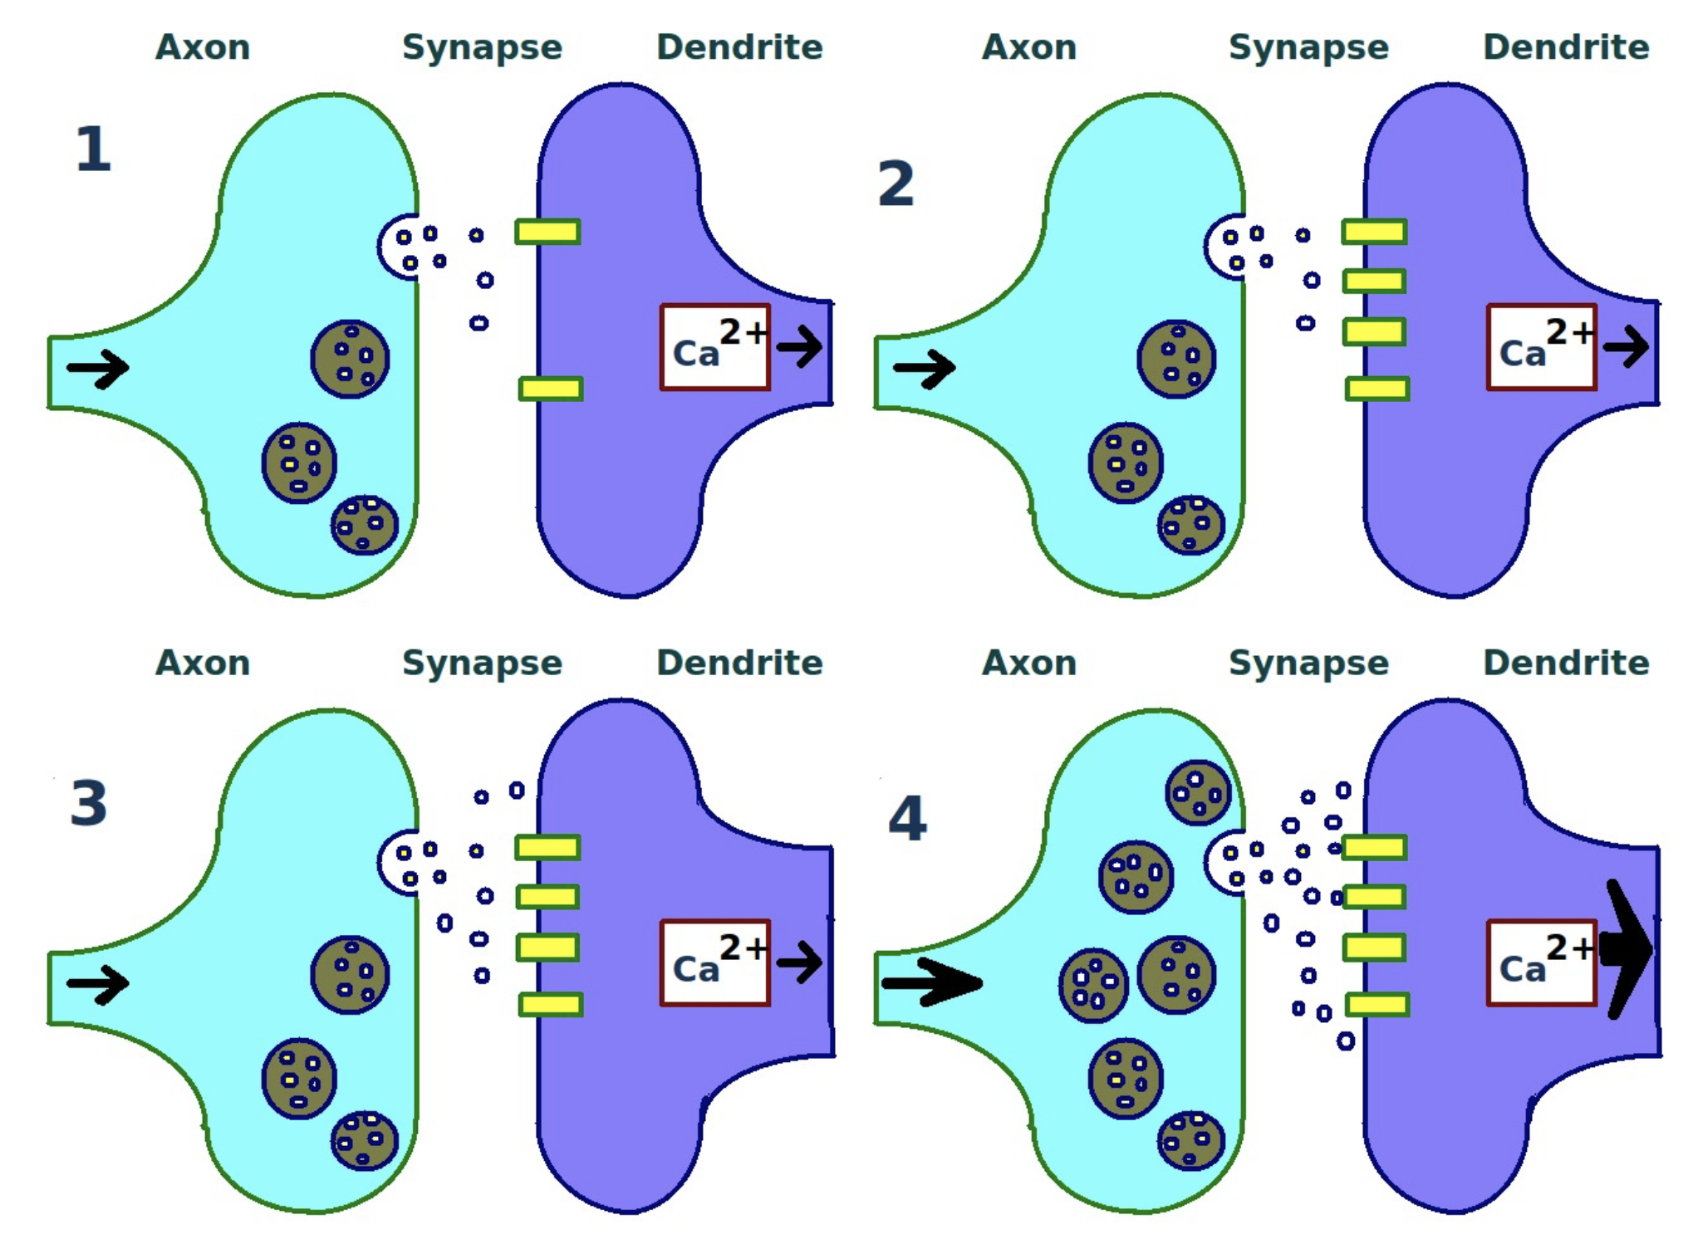
Learning and Plasticity
Repeated Stimulation
Postsynaptic Receptor Growth
Presynaptic Neurotransmitter Increase
Synaptic Plasticity Basics
Long term potentiation (LTP): repeated activity strengthens synapse
Long term depression (LDP): uncoordinated activity weakens synapse
Notes:
he most important mechanism of plasticity happens at the synapse —
the point of connection between two neurons.
When a presynaptic neuron and a postsynaptic neuron fire together repeatedly, their connection gets stronger.
This is called long-term potentiation, or LTP.
You can think of it as well-worn path: the more often you travel it, the easier it gets.
But the reverse can also happen.
If the presynaptic neuron is active but the postsynaptic neuron is not, the connection weakens.
That’s long-term depression, or LTD.
Together, LTP and LTD are the biological foundation for Hebbian learning —
the principle you read about in Munakata & Pfaffly’s article.
It’s often summarized as ‘neurons that fire together, wire together.

Slide 10
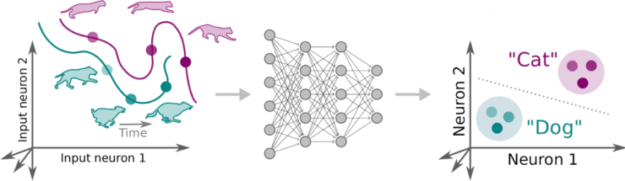
Learning and Plasticity
Hebb’s Rule
“Neurons that fire together, wire together”
Coincidence strengthens connections
Learning = capturing regularities in experience
Formula
Δw_{ij} = the change in the weight from presynaptic neuron i to postsynaptic neuron j
η = the learning rate (a small constant that controls how fast learning happens)
x_{i} = activity of the presynaptic neuron (input)
y_{j} = activity of the postsynaptic neuron (output)
Notes:
Hebb’s rule is often summed up as ‘neurons that fire together, wire together.’
Why does this matter? Because it gives the nervous system a way to build meaningful associations.
If two signals often occur together in the world, the neurons representing them will start to strengthen their connections.
That means the brain can self-organize. It doesn’t need a teacher or explicit instructions —
it simply picks up on the regularities of experience.
Over time, the wiring of the brain comes to mirror the statistical patterns of the environment.
This is what Munakata & Pfaffly highlight:
Hebbian learning is powerful because it’s simple, automatic, and it works across many systems, from worms to humans.

Slide 11
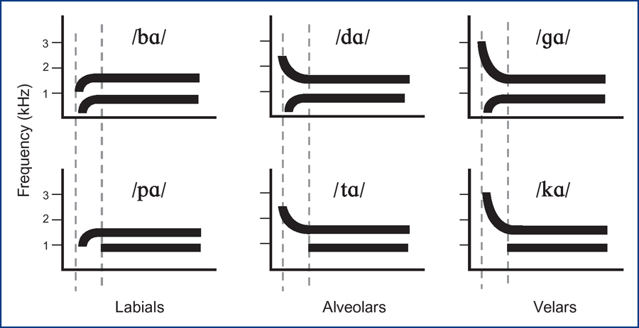
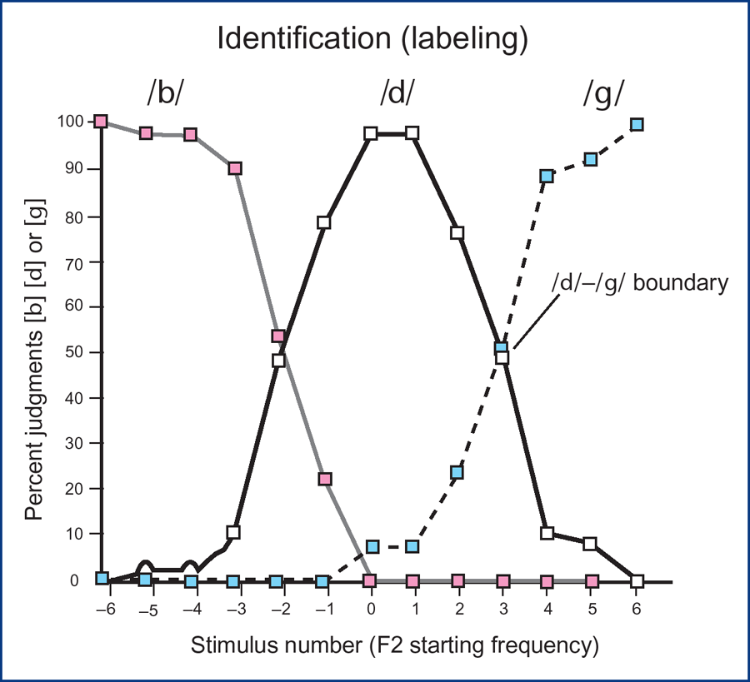
Learning and Plasticity
Hebb’s Rule in Action
C. elegans: touch → stronger withdrawal reflex
Humans: speech sounds → tuned categories
Circuits shape what gets processed
Notes:
Let’s see how this plays out in real life.
In C. elegans: If a touch-sensitive neuron repeatedly fires along with a motor neuron that drives backing up, the connection strengthens. Over time, the worm becomes quicker and more consistent at withdrawing from danger.
Hebbian learning makes the reflex more reliable.
In humans: Think about infants learning language.
When babies hear certain sounds over and over, the neurons responding to those sounds strengthen their connections.
Those categories become easier to distinguish.
But sounds they rarely hear, like English babies with Japanese /r/ and /l/, fade — the brain literally becomes less sensitive to them.
In both cases, Hebbian learning doesn’t just make neurons ‘bond.’
It sculpts what information the system processes, based on experience.

Slide 12
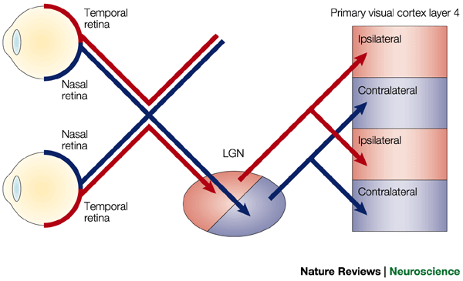
Learning and Plasticity
Developmental Examples
Critical periods: experience shapes circuits
Language: phoneme tuning in infancy
Vision: ocular dominance columns
Notes:
Hebbian learning also helps us understand developmental critical periods —
windows of time when experience has especially strong effects on the brain.
Language: Infants are born able to hear all the phoneme contrasts across the world’s languages.
But by their first birthday, they lose sensitivity to sounds they don’t hear often.
That happens because Hebbian learning strengthens the connections for the frequent sounds and lets the others fade.
Vision: In visual cortex, inputs from the left and right eyes compete for space in what are called ocular dominance columns.
If one eye is deprived of input early in life, Hebbian learning strengthens the active eye’s connections and weakens the deprived one’s.
This permanently changes vision if it happens during the critical period.
Munakata & Pfaffly emphasize that Hebbian learning doesn’t just build associations —
it shapes how the brain develops.
Experience during these sensitive windows can literally rewire circuits in lasting ways.

Slide 13

Learning and Plasticity
Limits of Hebbian Learning
Strengthens co-occurrence, but can’t unlearn
Perseveration: stuck responses
Example: AND vs. OR situations
Notes:
Hebbian learning is powerful, but it has real limitations.
One issue is that it only strengthens co-occurrence. Once two things are linked, Hebb has no way to weaken that bond, even if the world changes.
This can lead to perseveration — repeating an old response even when it’s no longer appropriate.
To see this, let’s contrast two everyday situations:
OR situation:
If you’re hungry, you might snack when you see either chips or cookies.
Hebbian learning handles this well —
every time food is present, your ‘hunger’ and ‘snack’ neurons co-activate, so the connections strengthen.
Either cue works.
AND situation:
Imagine you only want to go for a run when it’s sunny and you have free time.
That requires responding only when both conditions occur together.
But plain Hebbian learning struggles here —
it strengthens the link to each input separately,
so you’d want to start running anytime it’s sunny, even if you’re busy,
or anytime you’re free, even if it’s raining.
This shows why Hebbian learning alone isn’t enough — it works well for simple OR-type associations, but fails for stricter AND-type rules.”

Slide 14
Learning and Plasticity
Beyond Simple Hebbian Learning: Supplements
Normalization rules (e.g., Oja): balance weights: “fire together → stronger, but only if it’s a reliable co-activation. Otherwise, the weight shrinks back.”
Error-driven learning: weakens wrong predictions
Reinforcement signals: strengthen what’s rewarded
Notes:
To solve these problems, real brains use more than plain Hebb.
Normalization rules — like Oja’s rule — keep weights from growing uncontrollably and help circuits discriminate the right conditions.
Error-driven learning allows weakening of connections when predictions are wrong.
Reinforcement signals like dopamine strengthen circuits when an action is rewarded, not just when neurons co-occur.
We’ll come back to this in the next lecture, when we ask: how can neurons and networks implement AND, OR, and more complex logic?”

Slide 15
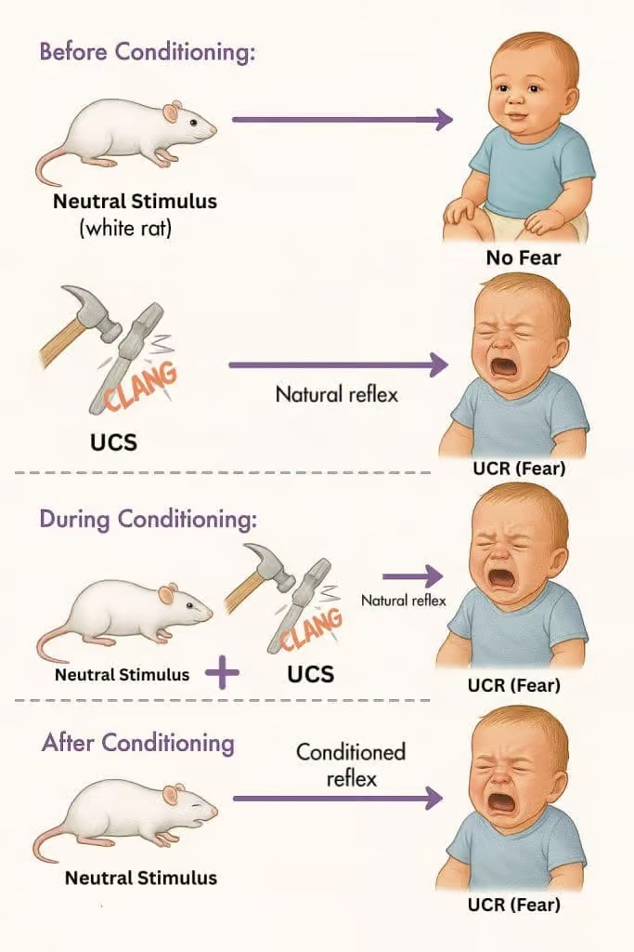
Learning and Plasticity
Hebbian Learning and Classical Conditioning
Neutral cue + important event → learned link
Pavlov’s dogs: sound + food → salivation
Hebbian principle: co-activation strengthens circuit
Notes:
Hebbian learning also helps us understand associative learning, like classical conditioning.
Take Pavlov’s famous dogs: at first, a sound means nothing.
But when the sound is repeatedly paired with food, the sound alone eventually makes the dog salivate.
In neural terms, here’s what’s happening:
A ‘sound’ circuit and a ‘food’ circuit are active at the same time.
Hebbian learning strengthens the connections between them.
Over time, the sound circuit becomes strong enough on its own to trigger the salivation response.
So classical conditioning is basically Hebb’s rule at the behavioral level:
when two things consistently fire together, the brain wires them together.”

Slide 16
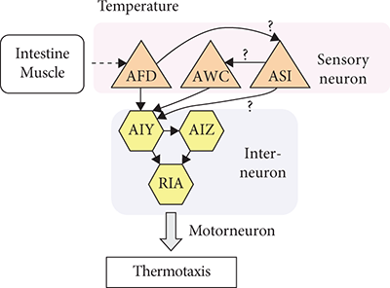
Learning and Plasticity
Conditioning in C. elegans
Worms can form simple associations
Odor + food → attraction
Touch + stimulus → altered response
Notes:
Conditioning is such a powerful principle because it shows up everywhere, across species.
Even a tiny nervous system like C. elegans, with only 302 neurons, can do associative learning.
Odor + food: If an odor is repeatedly paired with food, worms will later crawl toward that odor, even without food present. Their circuits link the smell to the positive outcome.
Touch + other cues: Worms can also adjust their responses to touch if it consistently occurs with other events. For example, repeated touch paired with no danger leads to reduced withdrawal, while pairing touch with aversive stimulation can make responses stronger.
This shows us that conditioning isn’t just a mammal thing. Even simple circuits can wire themselves to link cues and outcomes. It’s Hebb’s principle at work at the most basic level.

Slide 17

Learning and Plasticity
Classical Conditioning in Humans
Conditioning underlies complex human learning
Emotional responses: phobias, stress
Social & cultural cues: advertising, habits
Notes:
Compared to worms, humans use conditioning for far more complex behaviors — but the underlying principle is the same.
Emotional learning: If a neutral cue is paired with a frightening event, it can trigger fear later on. That’s how phobias form. A child bitten by a dog may later feel fear just seeing a dog. Stress responses can also become conditioned — certain places or sounds can bring back anxiety.
Preferences & social learning: Advertisers take advantage of this. They pair products with music, celebrities, or good feelings. Over time, we develop positive associations with the product itself.
Habits & cravings: In addiction, cues like the sight of a bar or even a time of day can trigger cravings. These cues have become strongly linked with the reward pathway.
So, while worms use conditioning to link simple cues to food or danger, humans use the same mechanism to build complex emotional and cultural associations. Hebbian learning scales from 302 neurons all the way up to billions.

Slide 18
Adaptation and Plasticity Summary
Wrap-Up & What’s Next
Today:
Circuits aren’t fixed — they adapt & learn
Adaptation: short-term, reversible
Hebbian learning: long-term, builds associations
Next: circuits as logic gates & computation
Notes:
Today we saw that circuits aren’t just static wiring diagrams — they’re dynamic.
We started with adaptation, where neurons or circuits reduce their response to repeated stimulation. That’s short-term and reversible, and it keeps organisms sensitive to change.
Then we moved to Hebbian learning, where repeated co-activation strengthens or weakens synapses. This is longer-lasting, and it explains how brains build associations — from worms learning odors to babies tuning into speech sounds, to humans developing phobias, habits, and preferences.
The big takeaway is that learning emerges naturally from the way neurons connect and fire together.
Next time, we’ll take a different perspective. Instead of asking how circuits change, we’ll ask how we can analyze circuits as logic gates — AND, OR, NOT. This abstraction lets us see circuits as the basis of computation, and it will connect what we’ve learned about neuroscience to ideas from computer science.

