Slide 1

BCOG 100
Perception and Action
Lecture 8.3 — Receptor Sheets, Maps, and the Cerebellum
Notes:
This lecture is the implementational level. In the first lecture, we stated the problems a moving animal’s senses face. In the second, we gave procedures that could solve them in any substrate. In this one, we ask how real nervous systems do it, with receptor cells, neurons, maps and circuits, and at what cost.
Throughout, we answer something from one of the first two lectures: a problem, like direction or delay, or a procedure, like a delay line or learning from mismatch. We end with the cerebellum and with a circuit in electric fish that learns to cancel the fish’s own signals, and then with what every sense does.

Slide 2
To Start: What Would It Take?
In your group, three minutes.
Every procedure in the second lecture could run in any substrate. Pick one: the delay line, a copy of the command, or learning a mapping from mismatch.
What would a nervous system need, to run it? What kind of cells, wired how, and how fast?
Notes:
In the second lecture, the theme was that the procedures are substrate-neutral. A delay line could be built from wires and clocks, a copy of the command could live in a variable, and learning from mismatch is the delta rule from Module 5. The question is what it would take to build each one from neurons.
The delay line is the most demanding. It needs signals from the two ears to travel toward each other along a row of detectors, and detectors that respond only when both arrive at once. Groups usually notice the timing problem straight away: the differences to be measured are millionths of a second, and a nerve impulse lasts about a thousandth. A copy of the command needs a pathway from wherever commands are issued to wherever the senses are compared. Learning from mismatch needs a signal that carries the error to the place where the change is made.
All three come up in this lecture. Hold on to the answers, and check them against what real nervous systems turn out to have.

Slide 3
From Receptor Sheet to Cortex
Most receptor sheets keep their layout as maps: retinotopy, tonotopy, somatotopy. Of the senses that reach the cortex, all but smell pass through the thalamus.
Sense | Receptors laid out by | What the layout gives free | Route to the cortex
Vision | Direction in the visual field | Direction, relative to the eye | Thalamus (lateral geniculate nucleus), then primary visual cortex
Hearing | Frequency | Pitch, not direction | Brainstem stations, thalamus, auditory cortex
Balance | Axis of rotation, direction of tilt | Which way the head turns or tilts | Brainstem and cerebellum; thalamus to several areas, no single primary area
Touch and proprioception | Location on the body | Where on the body | Spinal cord and brainstem, thalamus, somatosensory cortex
Smell | Scattered, then sorted by receptor type | Nothing about location | Olfactory bulb straight to olfactory cortex
Taste | Across the tongue, every region sensing every taste | Which of five basic tastes | Brainstem, thalamus, taste cortex
Lateral line and electric sense (fishes) | Along the body surface | Where along the body | Cerebellum-like structures in the hindbrain, then the midbrain
Notes:
Each sense begins with receptor cells that respond to one kind of physical signal. In most senses, those cells are laid out as a sheet, and the layout carries information before any neuron has computed anything. The table is the survey of the senses, all in one place.
Several principles run across it. Most receptor sheets keep their layout into the brain, forming the topographic maps we described in Module 6. Vision’s map is laid out by direction, which is **retinotopy**. Hearing’s is laid out by frequency, which is **tonotopy**. Touch’s is laid out by location on the body, which is **somatotopy**. This is the point about *where* from the first lecture, made physical: the retina gives direction free because its map is a map of direction, and the cochlea does not because its map is a map of pitch.
Maps are not drawn to scale. The center of gaze takes up a large share of the visual map, and the hands and lips a large share of the map of the body. A map’s proportions follow the density of receptors, and how much the animal uses that part of the sheet.
Of the senses that reach the cortex, every one but smell passes through the thalamus on the way. The visual relay in the thalamus is the **lateral geniculate nucleus**. Smell is the exception, as we noted in Module 7, because the olfactory bulb projects straight to the olfactory cortex. And balance is irregular. It has no single primary cortical area, and visual signals join it at its very first stop in the brainstem.

Slide 4
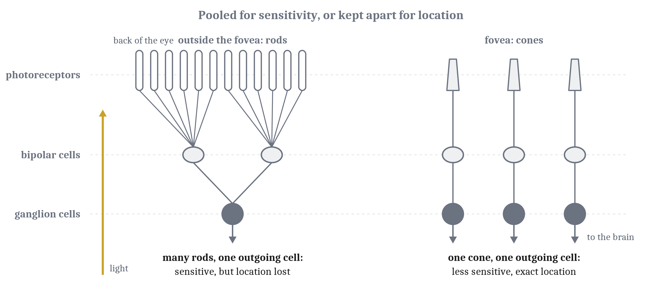
The Retina Computes
A photoreceptor is the retina’s receptor: a rod for dim light, a cone for daylight, detail and color. Wiring trades sensitivity for location.
Notes:
The retina is not a camera’s film. It grows out of the developing brain, and it processes the image before any signal leaves the eye.
Its receptor cell is the **photoreceptor**. Each one contains a pigment that changes shape when it absorbs a particle of light, which sets off a chain of reactions that amplifies a single absorption many times over. Unlike the touch and smell receptors we described in Module 4, photoreceptors respond to light by releasing less transmitter, not more. What matters for the code is not the direction of the change but its consistency.
There are two kinds. A **rod** responds reliably to a single particle of light, and rods handle dim light. A **cone** needs more than a hundred, and cones handle daylight, detail and color. A human eye has about 90 million rods and 4.5 million cones. The cones crowd into the fovea, and its very center has no rods, which is why a faint star is easier to see by looking slightly to one side.
The wiring is a trade. Many rods pool onto one cell, so faint signals add up, but the brain can no longer tell which rod caught the light. In the fovea, one cone feeds one outgoing cell, which keeps exact location but gives up sensitivity. It is the same trade pooling made in Module 7.
The retina’s output cells, the ganglion cells, have center–surround receptive fields: they respond strongly to a spot that differs from its surroundings and weakly to even light. That is lateral inhibition, from Module 4, at work. Each ganglion cell also covers only about a tenfold range of light at a time, sliding that range across the billionfold range from starlight to daylight, much as a camera adjusts its exposure. So the retina reports mostly contrast and change. That is how the retina first handles the billionfold range of light from the first lecture.
Fibers from the inner half of each retina cross to the other side, so each half of the brain receives the opposite half of the visual world, from both eyes. The two eyes’ signals first converge on single neurons in visual cortex, which is the first place disparity can be computed. Overlapping eyes do not guarantee stereo, though. Many birds with overlapping fields seem to lack the cells it needs, and the stereo circuits, though probably largely built in, need both eyes working together during a critical period, in the sense we described in Module 5.

Slide 5
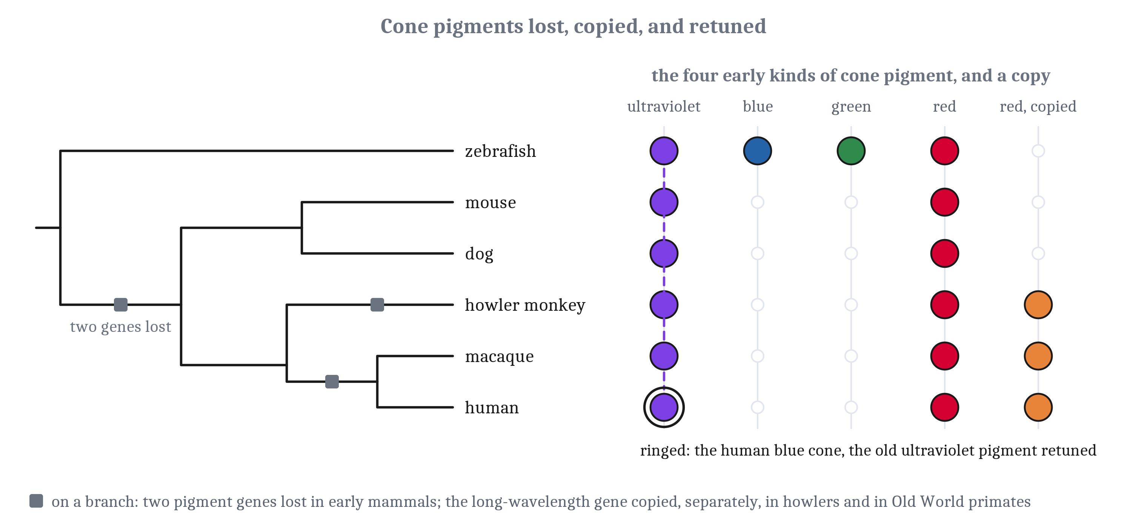
Cone Classes, Lost and Duplicated
Early vertebrates had four cone classes; mammals lost two. A third cone in our ancestors came from a duplicated gene, and the human blue cone carries the old ultraviolet pigment.
Notes:
In the second lecture, we said color needs a comparison between receptors. In the eye, those receptors are cones. A single cone reports only how much light it absorbed, not its wavelength, so color needs at least two kinds of cone. Humans have three.
The earliest vertebrates already had genes for four kinds of cone. Many shallow-water bony fish, zebrafish and goldfish among them, still use all four, including one sensitive to ultraviolet light. Mammals lost two of the four, and most mammals today have only two kinds. Many researchers link that loss to a long period when early mammals were active mainly at night, when color mattered little. That link is a well-supported hypothesis rather than a settled fact. This is the history behind the eyes for different lives from the first lecture.
In primates, the features of the eye came in steps. Forward-facing eyes came first, in primates still active at night. A fovea came later, in the ancestors of tarsiers and monkeys. Foveas also evolved separately in other lineages, including many birds.
Then a third kind of cone arose in the ancestors of Old World monkeys, apes and people. The gene for one long-wavelength pigment was duplicated, and the two copies drifted apart in the wavelengths they absorb. Most New World monkeys have a different arrangement, in which only some females have three kinds of cone, and in howler monkeys the same gene was duplicated independently. The human blue cone carries the old ultraviolet pigment of the early vertebrates, retuned to longer wavelengths.
There is a downside. The two long-wavelength genes sit side by side on the X chromosome and are easily miscopied, so about 8% of men in the United States have some red–green color deficiency.
So primate color vision did not recover the fish’s. It came from a copied gene and a retuned pigment, which is the lesson we drew about the vertebrate brain in Module 6: new structures from old parts.

Slide 6
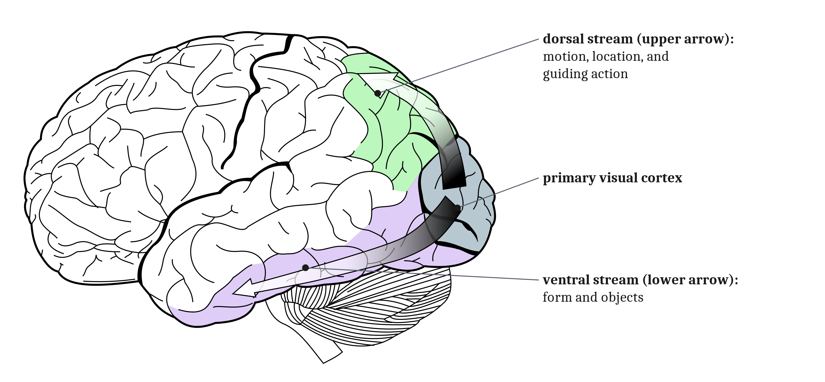
Two Streams, Specialized
The ventral stream for form and objects; the dorsal stream for motion, location and guiding action. Specialized, not independent.
Notes:
Beyond primary visual cortex lie dozens of further visual areas, usually grouped into two broad streams. The ventral stream, which we followed in Module 7, runs into the temporal lobe and is concerned with form and objects. The **dorsal stream** runs into the parietal lobe and is concerned with motion, location, and guiding action.
Some of the evidence comes from damage. In monkeys, temporal-lobe damage impairs telling objects apart, and parietal damage impairs judging where things are. One woman who lost a region of cortex specialized for motion saw tea as frozen while it poured, and cars as far away and then suddenly close. Color can be lost too: after damage to particular visual areas, a person with achromatopsia sees in dirty shades of gray although the cones work, and still knows a school bus is yellow without seeing it. But a large recent study of stroke patients found that color deficits did not map neatly onto one area, and how color and its constancy arise beyond the cones is still unclear.
A second account contrasts vision for perception with vision for action. A patient known as D.F., after damage to her visual cortex, could not say or show how a slot was tilted, yet could post a card through it. She could not tell flat shapes of different widths apart by sight, yet her grip opened wider for the wider ones. The proposal was that the ventral stream serves perception and the dorsal stream action. Parietal damage can produce **optic ataxia**: reaching badly for objects away from the center of gaze, while reaching for objects looked at directly is nearly normal.
The evidence is weaker than that first telling. D.F. was tested on objects she looked at directly, and optic ataxia mostly affects objects off to the side, so the two are not a clean mirror image. D.F. herself later showed signs of optic ataxia. And when four laboratories tested 144 people, grasping was fooled by a size illusion about as much as judgment was. So the streams are specialized, not independent, and they exchange signals throughout.
Cells in the ventral stream fit the views account from the second lecture. In monkeys trained on novel objects, of 773 cells analyzed in inferior temporal cortex, 71 responded to particular views of the trained objects and only 8 across views. For the dorsal stream, a network trained to estimate its own movement from what it sees predicts dorsal-stream responses better than one trained to recognize actions.

Slide 7
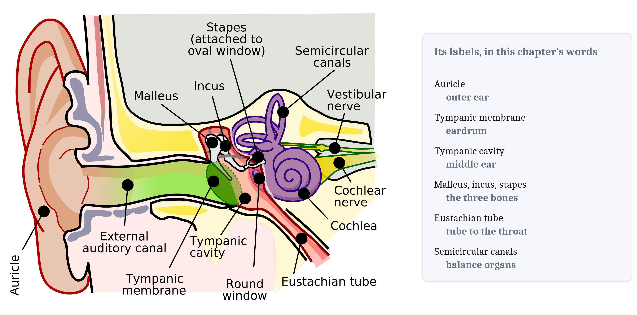
The Ear, from Old Parts
The middle ear’s bones began as a jaw brace and a jaw joint. An eardrum concentrates the force of sound in air, and eardrums evolved late, separately, at least five times.
Notes:
The ear has a long history, and most of its parts began as something else.
The inner ear is as old as the vertebrates; lampreys and hagfishes have one. It is often said to have evolved from the lateral line, but that is unresolved. The two grow from a shared patch of embryonic tissue and use the same kind of receptor cell, so they are best seen as sisters. Fish hear with the balance organs of the inner ear, which can tell which way the water near a sound source is moving, but not whether the source is in front or behind.
The middle ear’s parts began as something else. The stapes, the bone that carries sound to the inner ear, began in fishes as the hyomandibula, a bone that braced the jaw. Early fishes had a spiracle, an opening behind each eye, and in land vertebrates the pouch behind it became the air-filled middle ear. Where the pouch stays sealed by thin skin, the result is an eardrum. In mammals, two more bones joined the stapes: the malleus and incus, which once formed the joint of the jaw.
An eardrum solves a real problem. Sound in air mostly bounces off water, and the inner ear is filled with fluid. The eardrum and its bones collect force over a large area and concentrate it onto a small opening into the inner ear, the way a thumbtack concentrates the push of a thumb onto its point. That raises the pressure about two hundredfold. Even so, eardrums that catch airborne sound evolved late, separately at least five times during the Triassic, more than 100 million years after vertebrates came onto land.
Directional hearing changed along the way. In frogs, lizards and birds the eardrums are joined through the mouth or a canal, which makes each ear directional, as we said for the lizard in the first lecture. Mammals lost that link. One proposal is that mammals’ high-frequency hearing made up for it, since only high frequencies are shadowed enough by a small head to differ in level, and only high frequencies are usefully filtered by the outer ear’s folds. The hearing organ also lengthened into the mammalian cochlea, and in most mammals it coiled, which fits a long tube into a small skull.

Slide 8
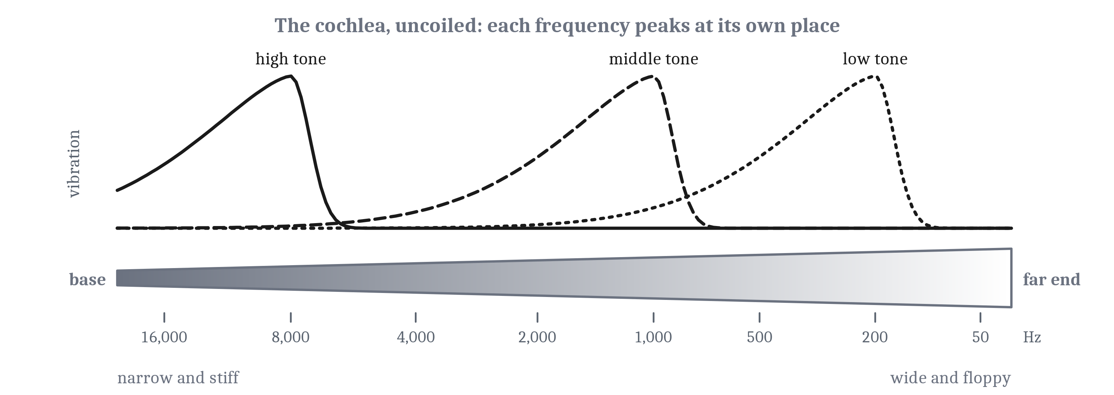
The Cochlea, the Hair Cell, and the Owl
The cochlea is a bank of filters by pitch. The hair cell opens its channels directly, fast enough for timing. The superior colliculus aligns auditory space with visual space.
Notes:
The cochlea is a coiled tube of fluid with a membrane running along it. The membrane is stiff at the base and floppy at the far end, so high frequencies vibrate it most near the base and low frequencies near the end. That gives hearing its tonotopic map, and makes the cochlea a bank of overlapping filters. This is why, in the first lecture, we said the cochlea’s receptors report pitch and not direction.
The receptor is the **hair cell**, topped with a bundle of stiff projections. Bending the bundle pulls channels in the membrane open directly, with no chemical steps in between, in as little as ten millionths of a second. That speed is what timing-based localization needs. Mammalian hair cells, unlike those of fish and birds, do not regenerate once lost.
Signals from the two ears first meet in the brainstem. One group of neurons compares their timing by coincidence detection. Another compares their levels, excitation from one ear against inhibition from the other.
Measuring timing is hard for neurons, because a nerve impulse lasts about a thousandth of a second, a hundred times longer than the differences that matter. The barn owl, which hunts mice in the dark by sound, has one solution. Axons from the two ears run in opposite directions along a row of neurons, each of which fires only when impulses from both ears arrive at once, which is coincidence detection in the sense we described in Module 5. So the owl has a delay line of the kind described in the second lecture. Whether mammals do is debated. Many of their timing neurons prefer differences larger than their own heads produce, and timed inhibition reshapes their responses, so mammals may use the two broad channels instead. A model that fits one species need not hold for another.
The computed map of sound direction ends up lined up with vision’s. The **superior colliculus**, the mammalian tectum, turns the eyes and head toward things. In it, and in the owl’s tectum, a map of auditory space sits in register with the map of visual space. Auditory cortex, by contrast, is tonotopic and has no map of space.
Hearing also handles the animal’s own sounds with both of the strategies from the second lecture. Tiny middle-ear muscles contract during vocalizing, which dims one’s own voice. Auditory cortex quiets around vocalizing. And a mouse that learned its own lever press would produce a tone came to respond less to that tone than to the same tone played at random.

Slide 9
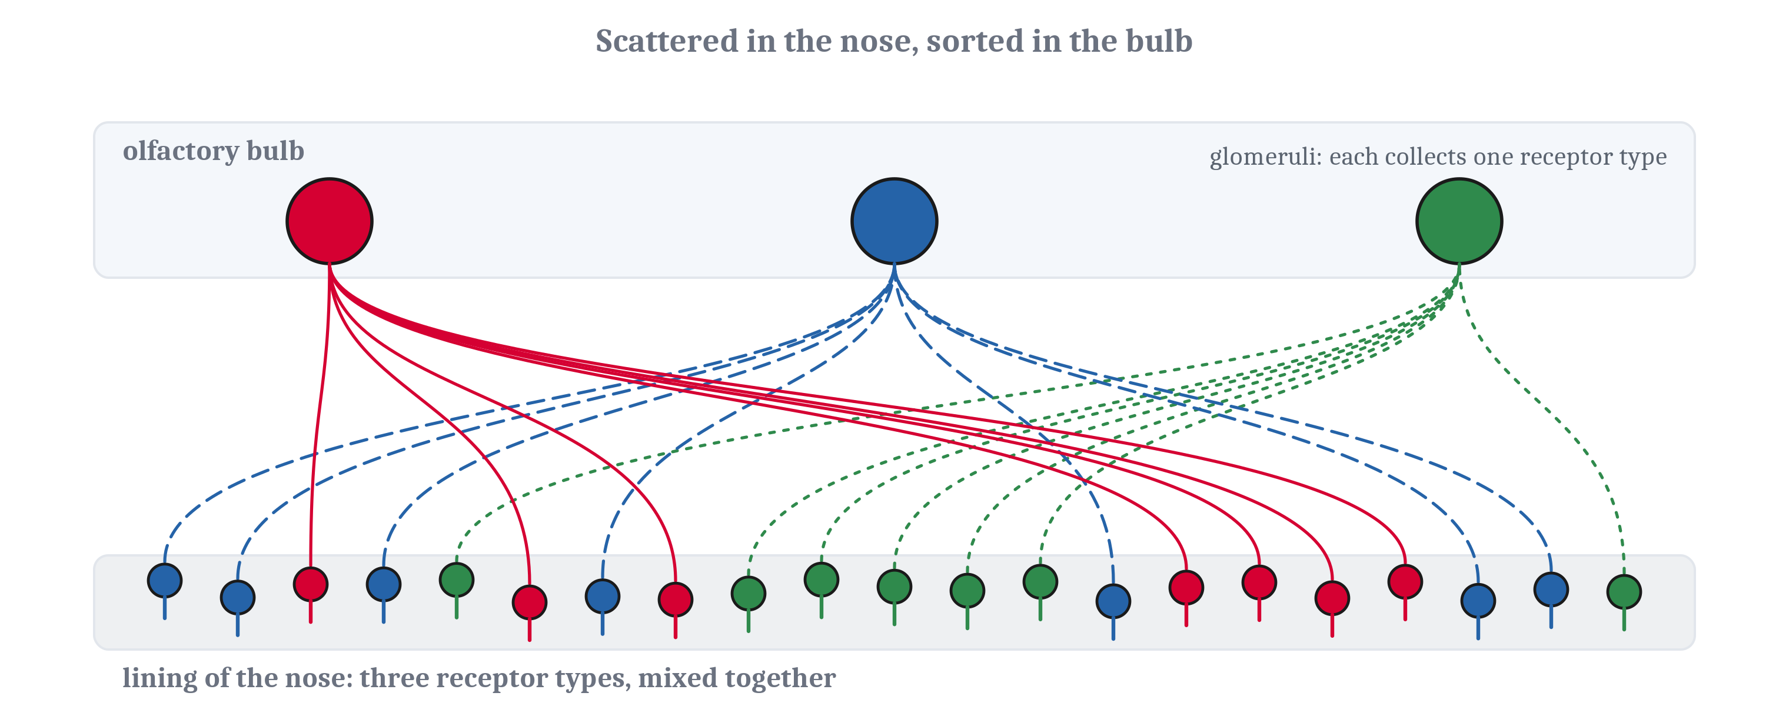
Smell and Touch
Smell neurons of one receptor type, scattered across the nose, converge on the same few glomeruli. A glomerulus is a small cluster of connections in the olfactory bulb. Touch keeps location, mapped as a homunculus.
Notes:
In Module 7, we took the activity in the olfactory bulb as given. This is how that activity is produced. The genes for smell’s receptors, a large family, were identified in the rat in 1991 by Linda Buck and Richard Axel, who argued that smell needs many narrowly tuned receptors, where color vision needs only three. Working smell receptor genes run from a few dozen in a lamprey to about 400 in a human and about 1,000 in a mouse.
Each smell neuron in a mammal makes one kind of receptor. Neurons that make the same receptor are scattered across the lining of the nose, but their axons converge on the same few glomeruli in the olfactory bulb. A **glomerulus** is a small spherical cluster of connections between incoming axons and the bulb’s own neurons. In the mouse, about 25,000 axons converge onto one glomerulus, which feeds about 25 output cells.
So the bulb turns a scattered sheet of receptors into an array sorted by receptor type. A natural odor activates only a small fraction of the glomeruli, which is sparse coding in the sense we defined in Module 7. Whether the glomeruli form an orderly map of odors is not known, and nothing about their arrangement carries location.
Touch is the opposite case. Its receptors carry location above all, because they are laid out across the skin. Several kinds act as different filters, responding best to edges, to slipping, to vibration, or to stretch, and how finely a part of the body can feel depends on how densely they are packed. Two points on a fingertip feel separate about 2 millimeters apart. On the upper arm they need to be about 40 millimeters apart.
The somatosensory cortex holds a map of the body, often drawn as a **homunculus**, a distorted figure with huge hands and lips. Other animals’ maps are distorted in their own ways: in rats, the whiskers, each with its own cluster or barrel; in raccoons, the paws; in the platypus, the bill. These maps also reorganize after the loss of a body part, or after heavy use of one.

Slide 10
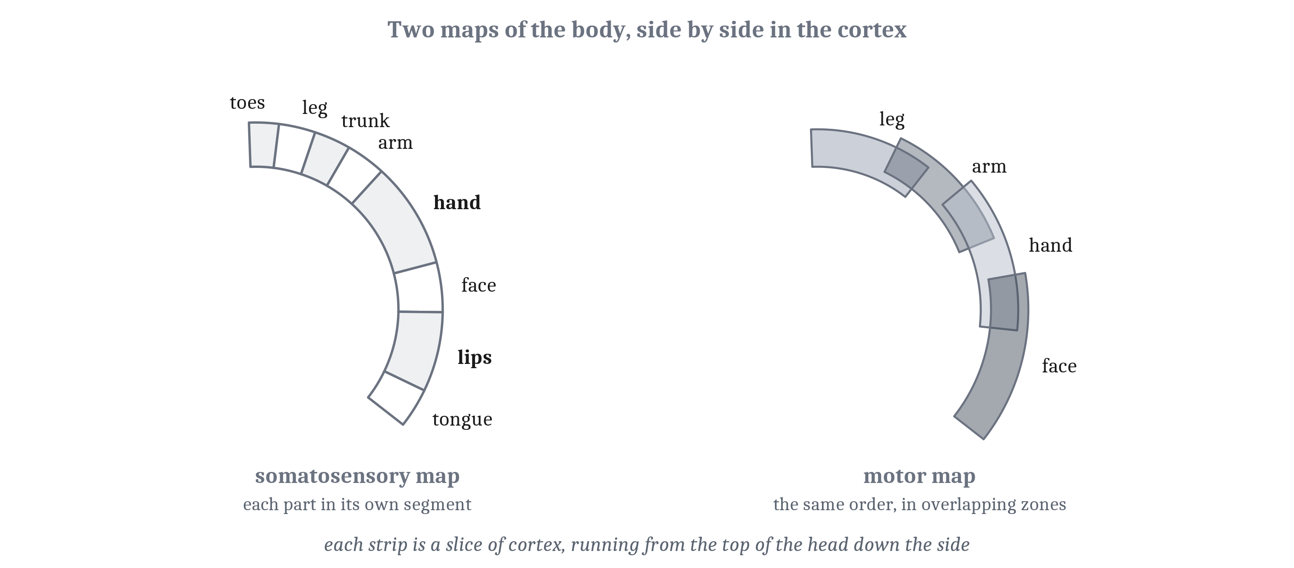
Motor Cortex Is Not a Mirror
Motor cortex maps the body coarsely, in overlapping zones organized around what the body does. Direction is a vote across many neurons.
Notes:
The **motor cortex** lies just in front of the somatosensory cortex. Its output fibers run down to the spinal cord, crossing to the opposite side on the way, and some contact the motor neurons of the hand directly, which lets the fingers move independently. Those direct connections are largest in species with skilled hands or forepaws.
The motor cortex has a map of the body too, with the same broad layout as the sensory map and the same enlarged hands and face. But the motor map is much coarser. One muscle can be activated from a patch millimeters wide, one site activates several muscles, and the zones for different body parts overlap a great deal. Longer stimulation in monkeys produces whole actions, like bringing a hand to the mouth, reaching, or raising an arm in defense. So a sensory map keeps the layout of a receptor sheet, while the motor map is organized around what the body does.
The direction of a movement is coded not by single neurons but by a vote across many of them, each preferring a different direction. That is a distributed code, of the kind we described in Module 7. A fish, for comparison, has no motor cortex at all. Its tectum and brainstem steer it.
Part of the coordinate problem from the first lecture is solved by layout. In the superior colliculus, a map of visual space sits directly above a map of eye movements, in register, so a target at one point in the visual map can drive the eyes toward that same point. Even so, the eye’s motor neurons are driven by firing rates, not places, so a place code has to become a rate code, which is likely needed wherever a sensory map drives a movement. Mappings like the simulated crab’s, from eye angles to arm angles, are thought to be carried by the strengths of many synapses, which learning and development can change. In primates, separate circuits between parietal and frontal areas handle reaching for an object and shaping the hand to grasp it.

Slide 11
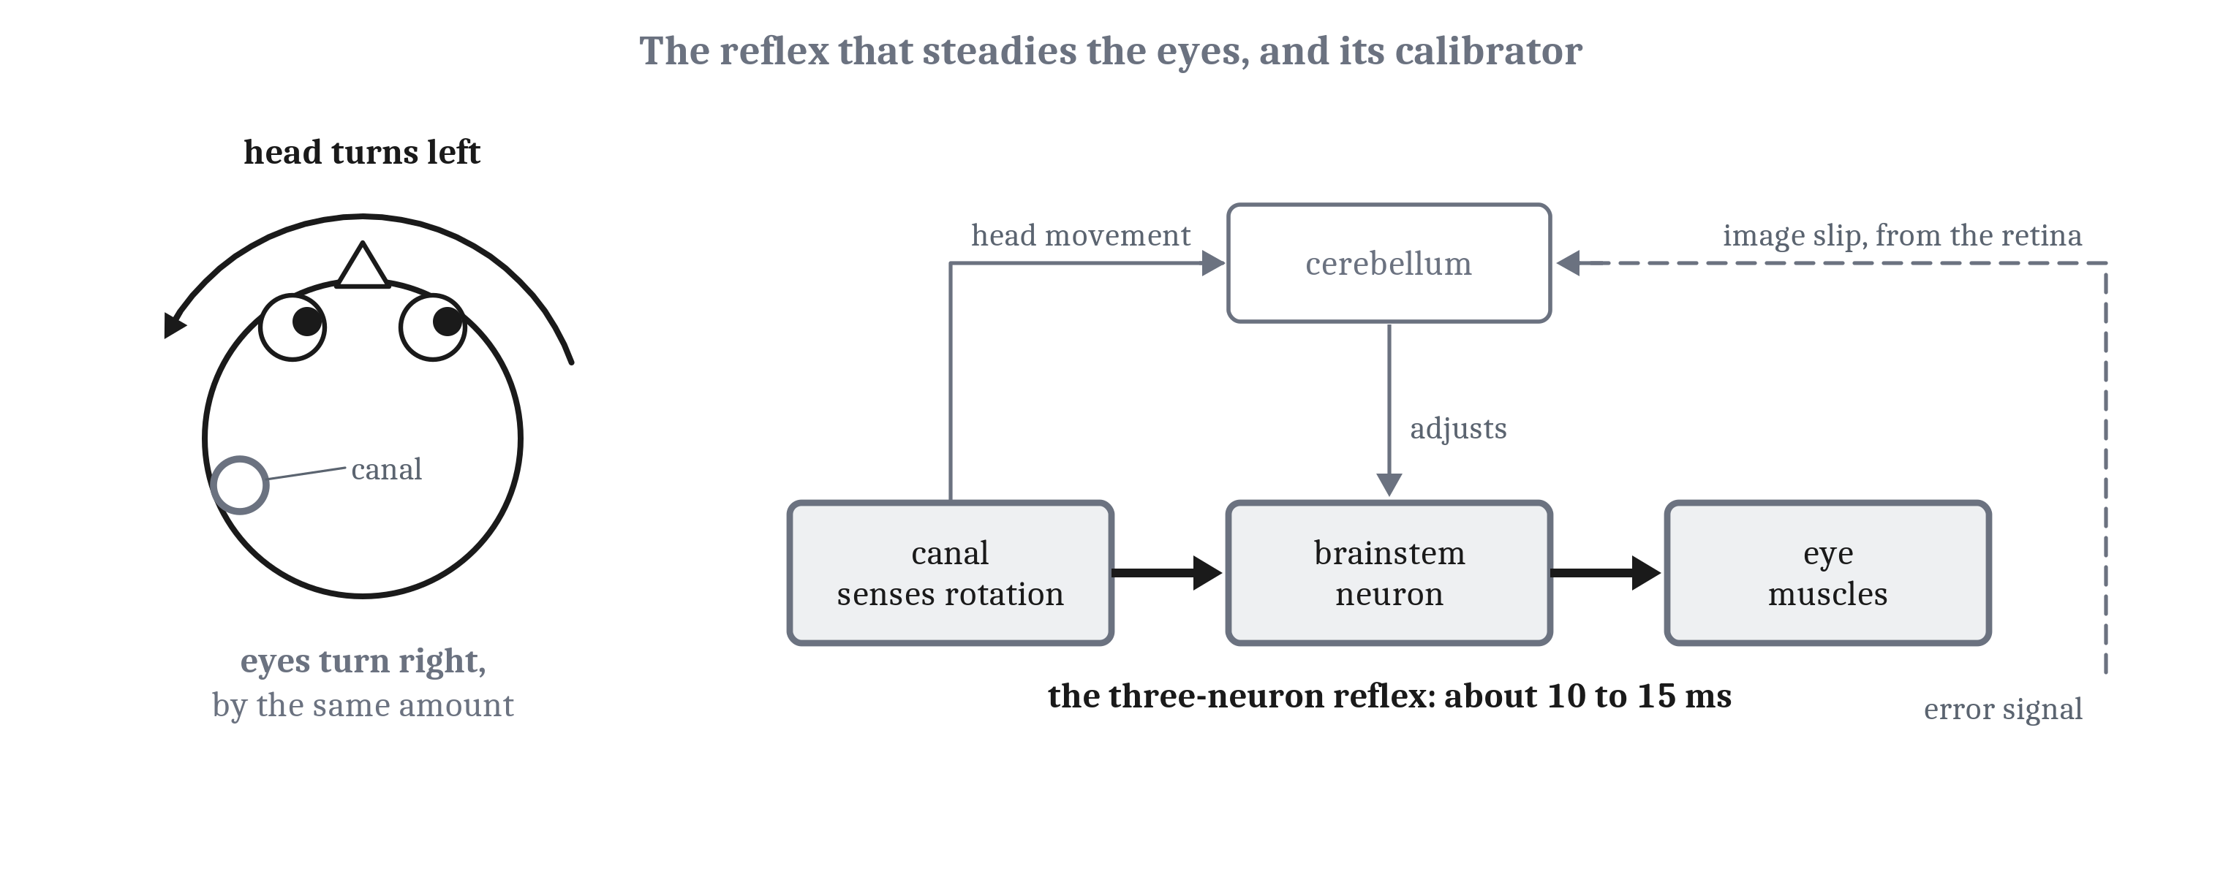
The Cerebellum Calibrates
The vestibulo-ocular reflex keeps the eyes steady as the head turns, without waiting for vision. Recalibrating it from the image’s slip needs the cerebellum.
Notes:
The **vestibulo-ocular reflex** keeps the eyes steady on a target while the head turns. Its shortest path is three neurons, from the balance organs to the eye muscles, and it runs without waiting for vision. That is the faster sense, one of the two answers to delay from the second lecture. Wave a hand quickly in front of a still head, and the fingers blur. Shake the head quickly in front of a still hand, and they stay sharp.
Because the reflex does not check its result as it goes, it has to be recalibrated whenever the eyes, the head or the optics change, like the magnifying glasses of the second lecture. That recalibration needs the cerebellum: animals without the part of the cerebellum that serves the reflex cannot adapt it to magnifying lenses. The climbing fibers of Module 6, each delivering an error to one output cell, carry the slip of the image across the retina as that error. Where the lasting change is stored is debated. The cerebellum is needed for the learning, and the change appears to involve both the cerebellum and the brainstem circuits it controls.
Prism throwing tells a similar story. People with damage to the inferior olive, the source of the climbing fibers, threw accurately but adapted slowly or not at all. People with other cerebellar damage could throw clumsily and still adapt. So learning a mapping and using it are separable. The olive is needed for the learning, though that alone does not show where the change is stored. Saccades are calibrated the same way: a monkey with one eye muscle weakened made saccades that grew over about five days until they landed on target, and cerebellar damage abolishes that learning.
At the level of the whole animal, this calibration is why a fish swimming through its stream, or a person walking down a street, keeps a steady view. The part of the cerebellum that serves the reflex is its oldest.
The cerebellum may also cancel self-caused signals. Some of its neurons respond to head movements imposed on an animal, and not to the same movements made by the animal itself. An influential idea is that it predicts the self-caused part and subtracts it, but whether it learns forward models, inverse models, or both is open. And cancellation is not confined to the cerebellum. The pufferfish of the second lecture kept circling after its cerebellum was removed, most likely through the tectum receiving the rotated eye.

Slide 12
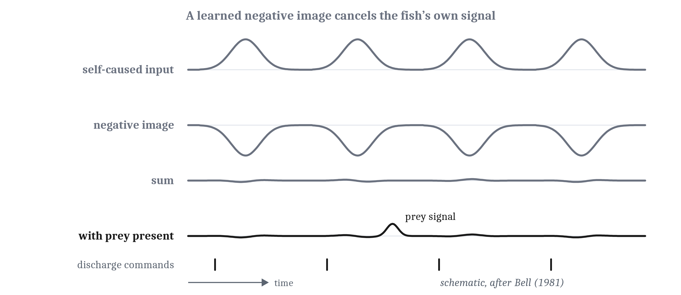
The Electric Fish’s Negative Image
A negative image, opposite in shape to the expected self-caused input and driven by the command, cancels it and leaves the prey. The rule is Hebb’s, reversed.
Notes:
The clearest case anywhere of a learned prediction subtracted from a sense comes from electric fish. An elephantnose fish senses the weak electric fields of prey hidden in mud with a passive electric sense, which only listens. But it also produces electric pulses of its own, for a separate active sense, and each pulse floods the passive one.
In a paralyzed fish, a researcher paired a pulse of input with each of the fish’s commands to discharge. At first the input excited cells in a hindbrain structure built like a small cerebellum. After two to ten minutes of pairing, the command alone produced the opposite pattern: a **negative image** of the expected input. Added to the real input, it cancels the self-caused part and leaves anything else, like the faint signal of prey. When pairing stopped, the negative image faded over minutes. It has to be learned because the fish’s own pulse feels different in different water and near different objects.
The rule was found later. An input arriving just before the cell fires is weakened, and inputs at other times are strengthened. That is Hebb’s rule from Module 5 run in reverse, an anti-Hebbian rule. Because the changes go both ways, anything predictable cancels, whether it raises the cell’s firing or lowers it. Any signal that reliably predicts the input can serve, including signals about body position, and fish whose plasticity is blocked by a drug become worse at detecting prey-like signals.
Movement is canceled the same way. A knifefish cancels the effects of bending its own tail, the signals we said in the first lecture can be ten to a hundred times larger than prey. Three groups of fish that evolved electric senses separately cancel their own signals with very similar circuits, and skates cancel the effects of their own breathing.
One difference from the cerebellum matters. Here the teaching signal is the cell’s own leftover response, not an error delivered by a climbing fiber. Whatever predictable signal remains keeps adjusting the weights until it is canceled.
And the fish from the start of the module? Its ordinary lateral line is dimmed while it swims, and cancellation like this has been reported, on thinner evidence, for the lateral line of a fish with no electric sense. In the reading, we infer, and label it an inference, that our fish very likely subtracts its own wake, which is how it can feel the eel’s.

Slide 13
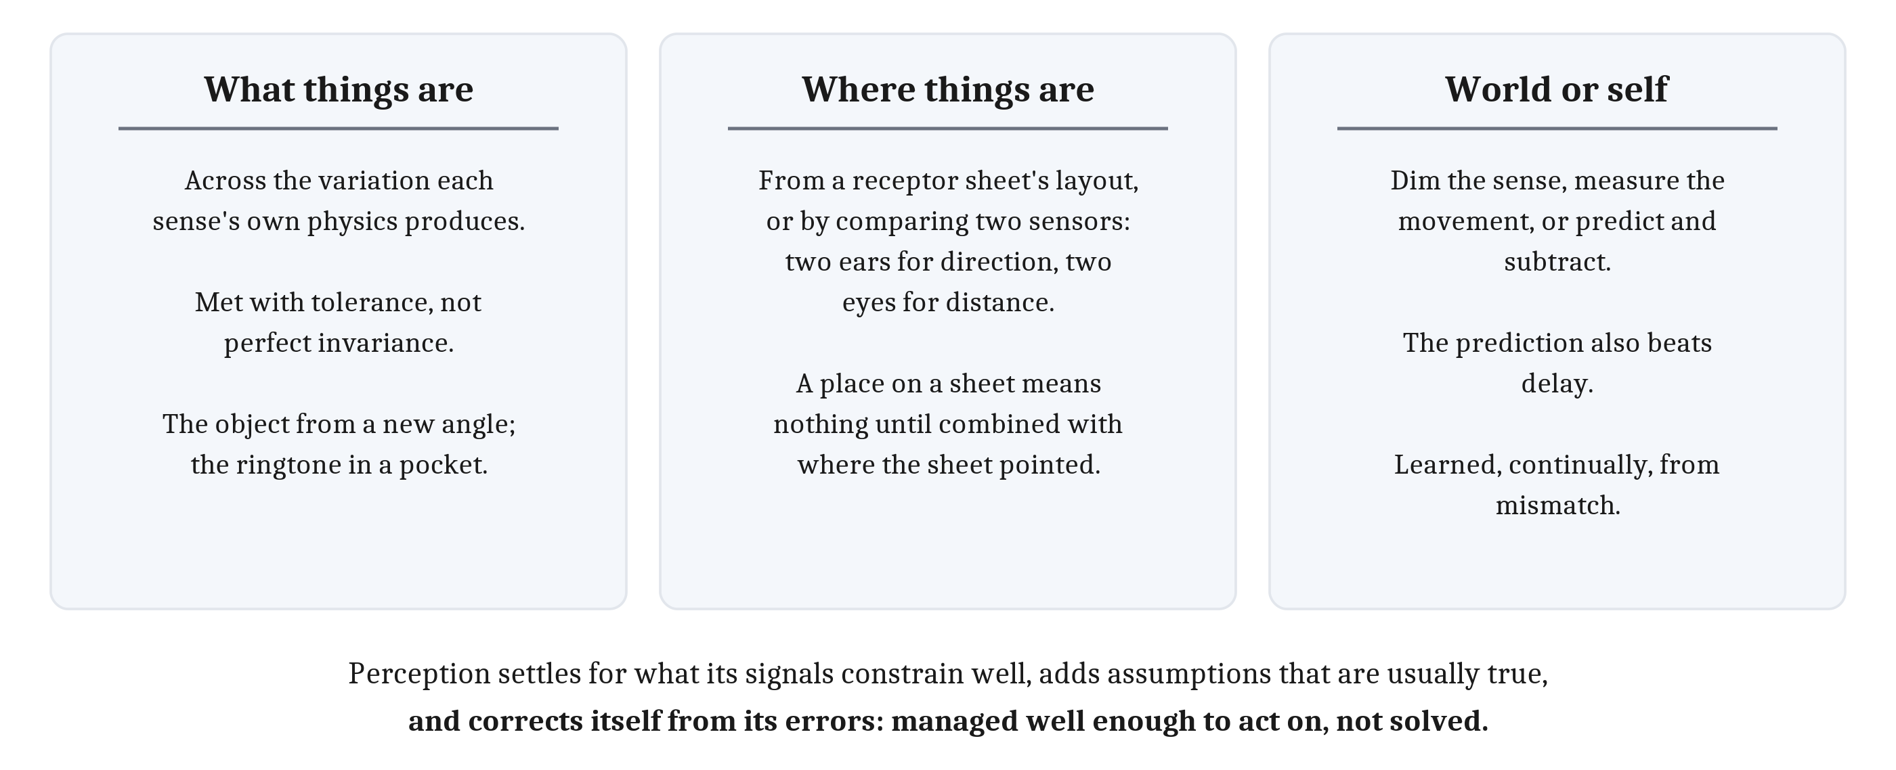
What Every Sense Does
Perception is not a recording. It manages the ill-posed problem well enough to act on.
Notes:
At the beginning of this module, a fish was swimming upstream after a smell. We can now say what each of its senses does for it, and what the senses of a mammal, a monkey or a person do too. There are three jobs.
Each sense recovers what things are, across the variation its own physics produces. That is the problem from Module 7, posed separately by each sense: an object casts different images from different angles, and the same ringtone arrives loud or soft, muffled or clear. Brains handle it with tolerance rather than perfect invariance. For vision, at least, we suggest in the reading that part of that tolerance may come from the many views a moving animal collects.
Each sense recovers where things are. Some get direction from the layout of a receptor sheet. Others compute it by comparing two sensors: two ears for the direction of a sound, two eyes for the distance of a surface. And where something falls on a receptor sheet means nothing about the world until it is combined with where the sheet was pointing.
Each sense has to separate what the world did from what the animal did. An animal can dim a sense while it moves, or measure its own movement directly. For complex and long-lasting self-caused signals, it can predict what a movement will do and subtract the prediction. The same prediction lets it act on information that would otherwise be too old. And the prediction is learned, continually, from the mismatch between what was expected and what arrived.
None of this is a recording of the world. Perception settles for what its signals constrain well, adds assumptions that are usually true, and corrects itself from its errors. That is how the ill-posed problem from Module 1 is handled in practice: not solved, but managed well enough to act on.
The same signals that let an animal cancel its own movement also let it keep track of where it has gone. That is the beginning of finding the way, which is Module 9.

Slide 14
Reading Motor Cortex
In your group, four minutes.
Brain–computer interfaces record from motor cortex to let a person with paralysis move a cursor or a robotic arm.
Why record from many neurons rather than find the one for each kind of movement in each direction?
Notes:
We can apply what we know about motor cortex and the cerebellum to a technology that turns up regularly in the news.
The first question is answered by how motor cortex codes direction. There is no single neuron for “move left”. Direction is a vote across many neurons, each preferring a different direction, and the map itself is coarse and overlapping, organized around actions rather than muscles. So a decoder has to read the vote, which means recording from many neurons at once and combining them.
The second question runs the calibration idea. The mapping from recorded activity to movement is a mapping between two coordinate systems, like the simulated crab’s, and nothing guarantees it stays fixed. Groups usually suggest that the recorded neurons change, or that the brain itself adapts as the person practices. Either way, a mapping that drifts has to be relearned from error, which is what the eye’s steadying reflex needs the cerebellum for. The interface and the person are both learning, which is part of what makes these systems hard.

Slide 15
Image Sources (1 of 2)
Slide | Image | File | License | Source
4 | Rods converge, cones do not | fig-retina-convergence.png | CC BY 4.0 | Jon Willits — drawn for the Module 8 reading · own work
5 | Cone pigments across the vertebrates | fig-cone-classes.png | CC BY 4.0 | Jon Willits — drawn for the Module 8 reading · own work
6 | The two visual streams | fig-two-streams.png | CC BY-SA 3.0 | Selket, adapted from Gray's Anatomy; labels added for the Module 8 reading · https://commons.wikimedia.org/wiki/File:Ventral-dorsal_streams.svg
7 | The human ear | fig-ear.png | CC BY 2.5 | Lars Chittka and Axel Brockmann, vectorized by Inductiveload; labels removed and a key added for the Module 8 reading · https://commons.wikimedia.org/wiki/File:Anatomy_of_the_Human_Ear.svg
8 | The cochlea's map of pitch | fig-cochlea-tonotopy.png | CC BY 4.0 | Jon Willits — drawn for the Module 8 reading · own work
9 | Scattered receptor neurons, sorted into glomeruli | fig-glomeruli.png | CC BY 4.0 | Jon Willits — drawn for the Module 8 reading · own work
10 | The sensory map and the motor map | fig-two-homunculi.png | CC BY 4.0 | Jon Willits — drawn for the Module 8 reading · own work
11 | The vestibulo-ocular reflex | fig-vor.png | CC BY 4.0 | Jon Willits — drawn for the Module 8 reading · own work

Slide 16
Image Sources (2 of 2)
Slide | Image | File | License | Source
12 | A learned negative image | fig-negative-image.png | CC BY 4.0 | Jon Willits — drawn for the Module 8 reading, schematic after Bell (1981) · own work
13 | Three jobs every sense does | fig-every-sense.png | CC BY 4.0 | Jon Willits — drawn for this lecture · own work

