Slide 1

BCOG 100
Planning and Decision-making
Lecture 12.3 — Brains, Genes, and Intelligence
Notes:
This module is about choosing among futures before living any of them. In the first lecture of this module, we asked what choosing among futures requires, which animals act now for later, and what intelligence is and how it has been measured. In the second lecture, we asked what procedures could produce acting for the future, how people choose under risk and delay, and what could produce the correlations among scores on different tests.
This third lecture is the implementational level. We ask what in the brain, and what in the genes, is associated with planning and with intelligence. On the side of the brain, we describe the prefrontal cortex and control, patients with frontal damage who score well on tests and still choose badly, neurons that fire with the value of an option, a set of regions engaged by many kinds of difficult task, and brain size. On the side of the genes, we describe heritability, what twin studies and measured genes estimate, and what that evidence can and cannot tell us about differences between groups of people.
Two limits apply throughout. Some of what we find in the brain is a candidate location for one step of a procedure, not an account of how the step is done. And a statistic about genes in a population is not a statement about any one person, or about the causes of a difference between groups. At the end, we return to the chimpanzee who gathered stones in the morning, and ask what we can now say about him.

Slide 2
To Start: Looking Inside the Brain
In your group, three minutes.
In the second lecture of this module, we described three accounts of why scores on different tests go together.
What were they, and how do they differ? If you could look inside the brain, what would you look for to tell them apart?
Notes:
In this discussion, we ask what evidence in the brain could tell apart the three accounts from the second lecture of this module. In the first lecture of this module, we described the positive manifold: people who score well on one kind of mental test tend to score well on the others. In 1904, every score among about 33 boys at one English school correlated positively with every other, from 0.40 to 0.83, and the same pattern has been found again and again since.
In the second lecture, we described three accounts that could produce that pattern. On one account, general intelligence, or *g*, is a single ability that contributes to performance on every mental test. On process overlap theory, each test draws on several processes, and executive processes are shared by most tests, so the tests correlate because the processes they draw on overlap. On mutualism, separate abilities help one another grow during development, so that they end up correlated. In simulations, mutualism produces tables that a single factor fits well, and statisticians have concluded that accounts like process overlap theory cannot be distinguished statistically from a single cause. So the three accounts cannot be told apart from the table of correlations alone.
Telling them apart takes evidence from outside the table. In the second lecture, that evidence was training. If working memory were the single ability behind the manifold, training it should raise scores on tests that were not trained. A major review judged the evidence for such benefits “inadequate”, as mutualism had predicted. That result counts against working memory as the single cause, without deciding between mutualism and process overlap theory. The brain is a second source of evidence from outside the table.
Groups usually propose looking for places in the brain that many different tests engage, or for damage that lowers some scores and leaves others alone. For each proposal, it is worth asking whether all three accounts would expect the same thing, because a piece of evidence helps only if the accounts disagree about it. In this lecture, we describe a set of regions that become more active as many kinds of task become harder, which fits the shared processes that some accounts propose. We also describe studies of damage in which the regions implicated may depend on which score was measured. By the end of the lecture, the question of what produces the positive manifold is still open.

Slide 3
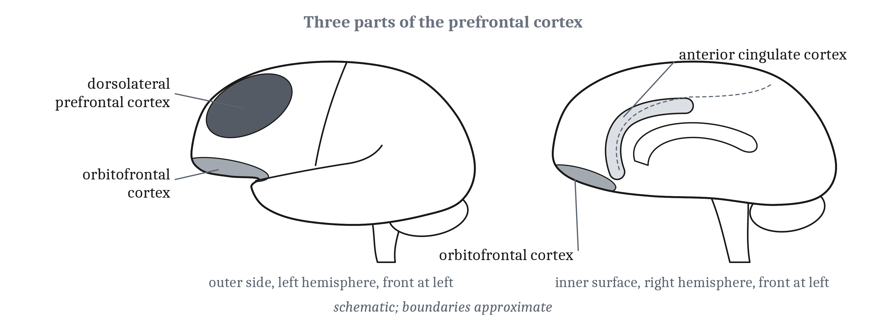
The Prefrontal Cortex and Its Parts
Prefrontal cortex: the cortex at the front of the frontal lobe, ahead of the areas that control movement. Dorsolateral prefrontal cortex: the upper part of the prefrontal cortex on the outer side of each hemisphere. Damage there can leave a person unable to change the rule they follow, without lowering their IQ more than damage elsewhere.
Notes:
Research on control and on value in the brain has concentrated on three regions in and beside the prefrontal cortex. In Module 11, we defined the prefrontal cortex as the cortex at the front of the frontal lobe, ahead of the areas that control movement. The dorsolateral prefrontal cortex is the upper part of the prefrontal cortex on the outer side of each hemisphere. The orbitofrontal cortex is its underside, just above the eyes. And the anterior cingulate cortex lies on the inner surface of each hemisphere, curving around the front of the corpus callosum, the band of fibers that joins the two hemispheres.
Each of these regions is defined by where it is, not by what it does. So what each region contributes has to be shown by evidence: by what happens to people when the region is damaged, and by recordings of its activity.
Damage to the dorsolateral prefrontal cortex can leave a person unable to change the rule they follow. Brenda Milner gave a card-sorting test to patients who had parts of the cortex removed to treat epilepsy. In the test, the rule for sorting the cards changes without warning. None of the 25 patients with dorsolateral removals got past the third sorting rule, against 51 of the 69 patients with removals elsewhere. The patients with dorsolateral removals continued to sort by the old rule.
The loss did not appear in their IQ scores. Their scores fell no more after surgery than the other patients’ scores did. And removals from the underside of the frontal lobes caused no such loss in sorting. So damage to the dorsolateral prefrontal cortex can leave a person unable to change rules, without lowering their IQ more than damage elsewhere, and an IQ score does not detect the loss.
Some of these patients could say, as they placed each card, whether the sort was right or wrong, and still did not change how they sorted. So after dorsolateral damage, knowing and doing can come apart. In the second lecture, we described the same separation in young children. A child of three, when the sorting rule changes, continues to sort by the old rule while knowing the new one. In both cases, the person knows something about the task that their sorting does not reflect.

Slide 4
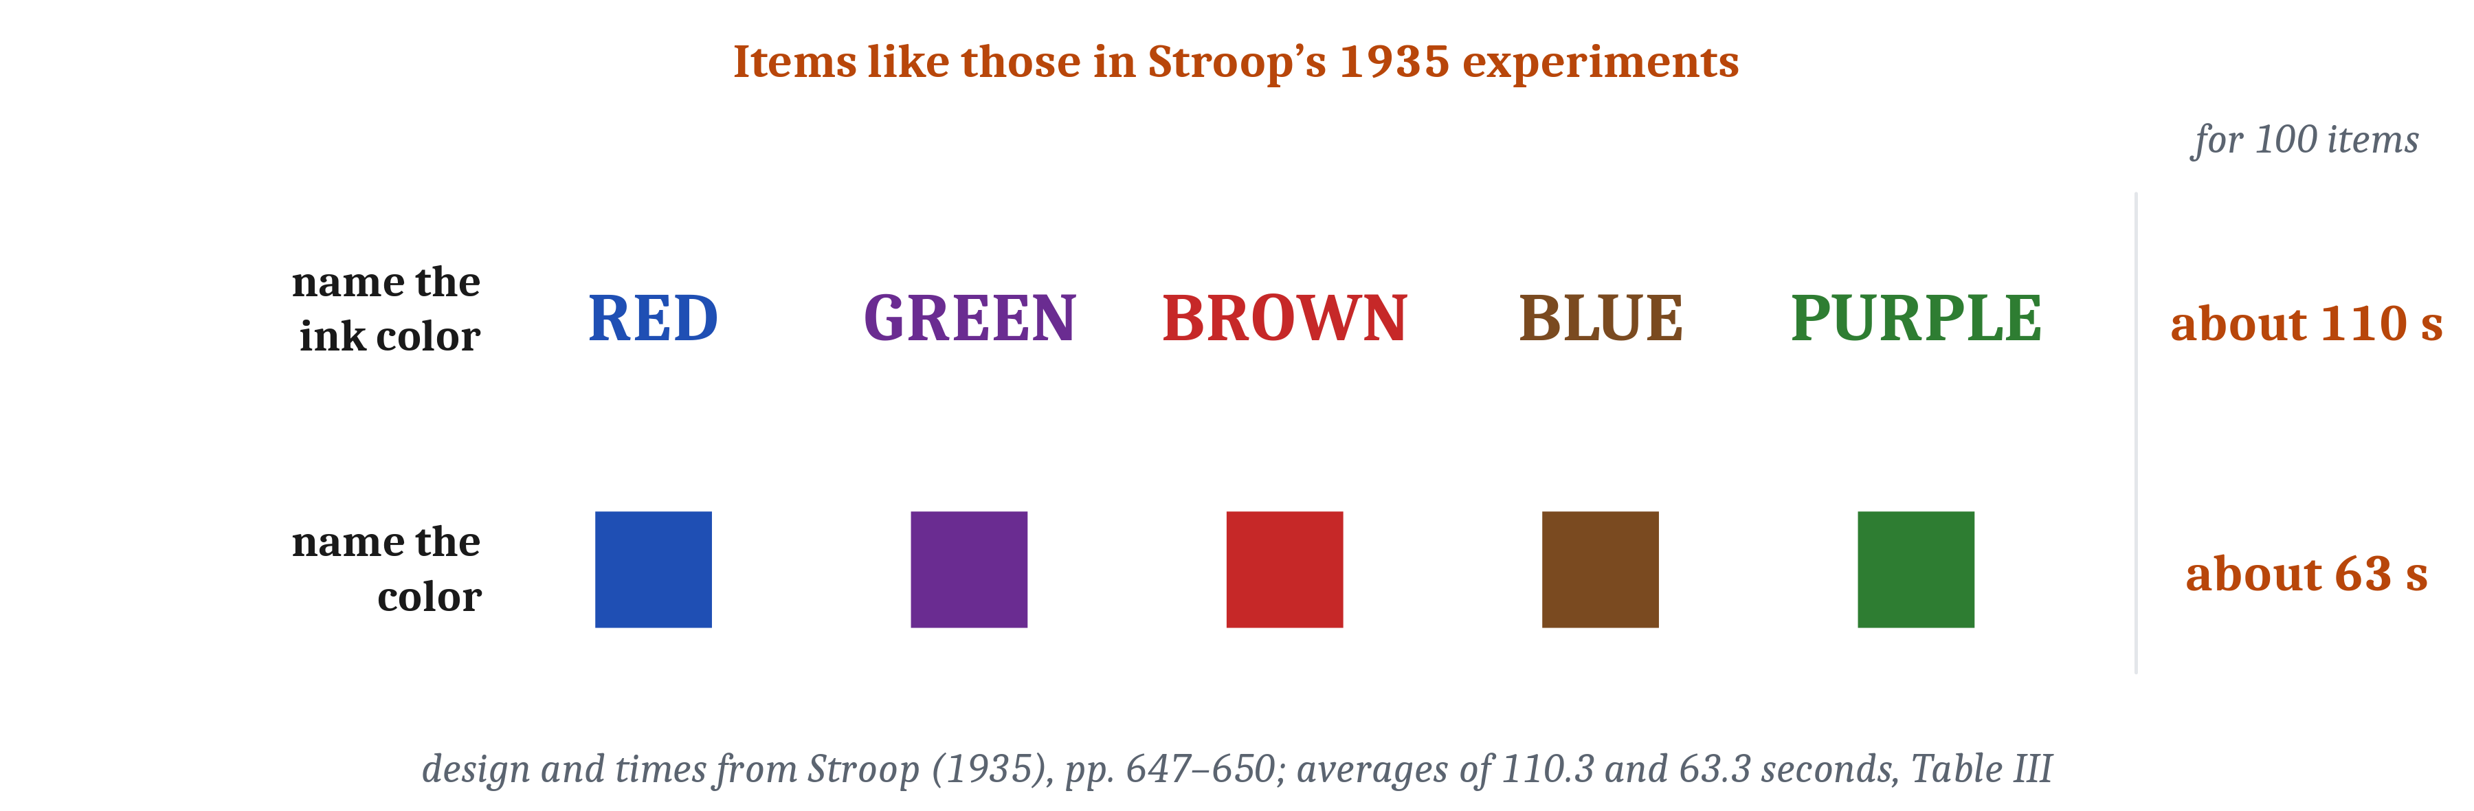
Control as a Bias
One proposal: the prefrontal cortex maintains the goal and the rules of a task, and uses them to bias processing elsewhere. On this account, the practiced response loses a competition in other regions, and once a task is well practiced, the prefrontal cortex is no longer needed.
Notes:
In the second lecture of this module, we described the Stroop task, which sets a goal against a strongly practiced response. In the original experiments of 1935, naming the ink colors of 100 color words, each printed in an ink other than the color it names, took about 110 seconds. Naming the colors of 100 squares took about 63 seconds. The experimenter explained the difference by practice: people have far more practice reading words than naming colors. So naming the ink color requires not giving the response that comes most readily, which is reading the word.
One proposal for what the prefrontal cortex does is that it maintains the goal and the rules of a task, and uses them to bias processing elsewhere. Consider an artificial neural network that performs the Stroop task. In the network, units representing the goal of naming the color add input to the color pathway. With that added input, the color pathway wins its competition with the stronger word pathway. On this proposal, prefrontal neurons play the part of those goal units.
In Module 10, we described one view on which prefrontal firing reflects control over representations elsewhere. The proposal about goal units is an account of what that control is.
The goal units that the network needs have a candidate location. When people were told before each Stroop trial which task to do, a dorsolateral region was more active while they prepared to name a color. The anterior cingulate cortex was more active on trials where the word and the ink conflicted. So dorsolateral prefrontal activity is a candidate location for the goal units.
On the same account, the prefrontal cortex biases processing elsewhere, rather than performing the task itself. On this account, the well-practiced response, reading the word, is not inhibited by the prefrontal cortex itself. It loses a competition in the regions that the prefrontal cortex biases. And once a task is well practiced, the prefrontal cortex is no longer needed for it. So control, on this account, is a bias on competitions that other regions resolve, needed only until practice makes the goal’s response the stronger one.

Slide 5
Frontal Patients Who Choose Badly
After frontal damage, a patient known as EVR scored in the top few percent on an IQ test, and still decided badly in daily life. A test score can miss abilities that such patients lose.
On a test, a person… | Decisions in life require…
solves short, well-defined problems, one at a time | organizing several goals over time
is told by the examiner what counts as success | setting one’s own goals
starts when the examiner says to start | bringing choices to an end
Notes:
Milner’s patients lost the ability to change a sorting rule, and their IQ scores did not show it. Patients with frontal damage can also score well above average on IQ tests and still decide badly in daily life. A patient known as EVR is one such case. At 35, he had a large tumor removed that had been pressing on both frontal lobes, and the surgery removed parts of his frontal cortex. Years later, he scored 129 and 135 on the verbal and performance parts of an IQ test, in the top few percent.
Yet EVR decided badly in daily life. He was fired from job after job for lateness and disorganization. He lost his savings in a partnership that his family had warned him against. And he could take hours to decide where to eat. Because his scores were so high, he was judged to be faking. His Social Security benefits were restored only after the researchers who studied him testified that brain damage explained his difficulties. So his test scores gave no sign of what the damage had done to his decisions.
Patients with frontal damage and high IQs also made far more errors than other people when they had to organize several errands over time. Three patients with frontal head injuries, and IQs of 121 to 130, were sent to an unfamiliar shopping street with a list of errands and rules. They made 12, 23, and 17 errors, against an average of fewer than 5 for people of similar age and IQ. So their difficulty was in organizing several goals over time, not in any one task.
From these cases, we can see what a test of intelligence leaves out. On a test, a person solves short, well-defined problems one at a time. The examiner says when to start, and what counts as success. Decisions in life require setting one’s own goals, organizing them over time, and bringing choices to an end. So a test score can miss abilities that these patients lost.
A test score that can miss these abilities fits the modest correlations between scores and outcomes that we described in the first lecture of this module. IQ scores correlate with performance at work at about 0.31, by a recent estimate. Squaring a correlation gives the share of the differences among people that it accounts for. So a correlation of about 0.3 accounts for about a tenth of the differences among people in performance at work.

Slide 6
Value in the Brain
Many neurons in the orbitofrontal cortex, the underside of the prefrontal cortex just above the eyes, fire in proportion to the value of an option, as measured from the animal’s own choices. Value: an estimate of how well things will go from a given situation onward.
Step of a decision based on value | What it corresponds to
Representing the options | Not discussed in this module
Assigning each a value | Orbitofrontal value cells
Selecting an action | May correspond to action selection in the basal ganglia (Module 6); little is known
Evaluating the outcome | Not discussed in this module
Learning | Reward prediction errors (Module 5)
Notes:
Many neurons in the orbitofrontal cortex fire in proportion to the value of an option, as measured from the animal’s own choices. In one study, monkeys chose between offers of two juices in varying amounts. From the monkeys’ choices, the researchers measured how much each juice was worth to them. Many orbitofrontal neurons fired with the value of the offers, or in proportion to the value of the juice the monkey went on to choose.
The firing went with value, and not with the movement that made the choice. Fewer than 5% of 931 cells depended on where the offers appeared, or on which eye movement chose one. And when a monkey’s preference between two juices changed from day to day, the firing of the cells that coded the chosen value changed with it. So the value a chooser assigns, measured from its choices, is correlated with the firing of single neurons, separately from the movement that expresses the choice.
The value that these neurons fire with may correspond to either of two quantities we have already defined. In the first lecture of this module, we defined expected value as the average of an option’s outcomes, each weighted by its probability, as in the 25% chance of $1,000, with an expected value of $250. In Module 5, we defined value as an estimate of how well things will go from a given situation onward. Expected value, and the value we defined in Module 5, are two routes to the same kind of quantity. One is stated in terms of outcomes and their probabilities, and the other is learned from experience. So the orbitofrontal neurons are a candidate for representing value in either sense.
The orbitofrontal finding locates one step of a decision. One division of a decision based on value has five steps: representing the options, assigning each a value, selecting an action, evaluating the outcome, and learning. The orbitofrontal value cells correspond to the assigning step. The selecting step may correspond to the action selection in the basal ganglia that we described in Module 6, though little is known about how the brain selects an action. The learning step corresponds to the reward prediction errors that we described in Module 5. For representing the options and evaluating the outcome, we name no location.
The brain’s valuation of options has a candidate location, but one question about it is still open. The brain might compare the values of outcomes before choosing an action, or it might compare the values of actions themselves.

Slide 7
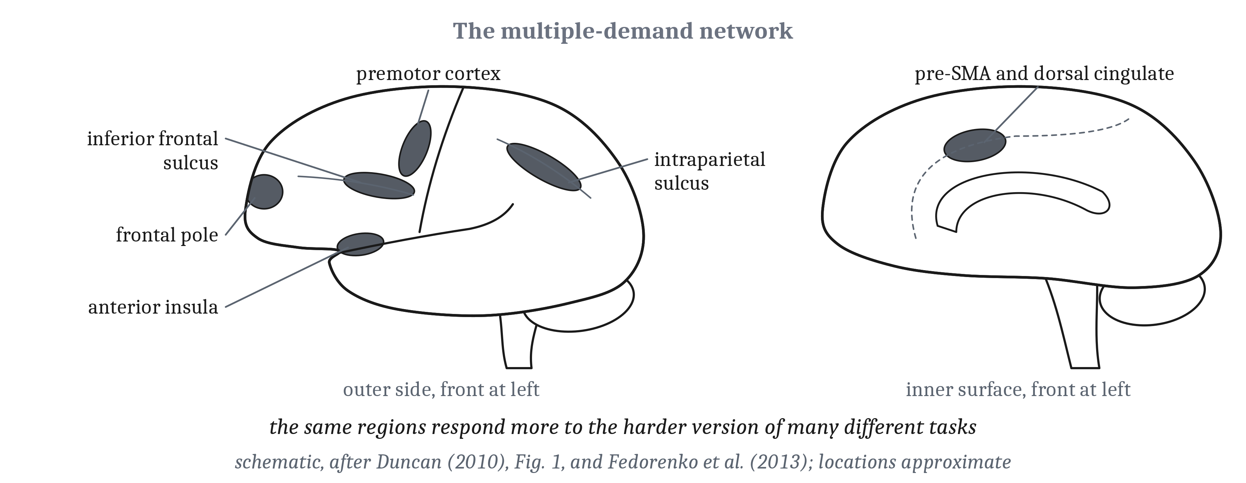
Intelligence in the Brain
The multiple-demand network: a set of regions in the frontal and parietal lobes of both hemispheres that become more active as many different kinds of task become harder. Across many studies, brain volume correlates with IQ at about 0.24, so it accounts for about 6% of the differences among people.
Notes:
We can now return to the question we asked at the start of this lecture, about what in the brain could tell the accounts of the positive manifold apart. The multiple-demand network is a set of regions in the frontal and parietal lobes of both hemispheres that become more active as many different kinds of task become harder. Evelina Fedorenko and colleagues first found these regions in each person’s brain. Then they measured the regions’ responses to harder and easier versions of seven tasks, from arithmetic to remembering locations in a grid. Most of the regions responded more to the harder version of all seven tasks, or of six of the seven. So the same regions are engaged by difficulty across many kinds of task. That fits the shared processes that some accounts of the positive manifold propose, which we described in the second lecture.
Not every nearby region became more active with difficulty. Nearby regions that respond to language responded weakly or not at all, and we return to those language regions in Module 13.
Damage inside these regions predicts a loss on tests of reasoning with new problems. In one study of 80 patients, the amount of damage inside the multiple-demand regions predicted how far their scores on such tests had fallen. The amount of damage elsewhere did not. Among the 44 patients with frontal damage, the same volume of damage went with about eight times as large a loss on one of the tests when it lay inside the regions as when it lay outside them.
But a study with a broader score found a different network. A study of 182 veterans with head injuries, which used a broader IQ score, found a network weighted to the left hemisphere that included language regions. So which regions a study of damage implicates may depend on which score it measures.
Within human beings, brain size accounts for only a small share of the differences in IQ. In Module 11, we said that brain size stands in for cognition only if cognition varies along one general dimension. Within one species, where a positive manifold exists, we can ask how well brain size predicts IQ. Across many studies, brain volume correlates with IQ at about 0.24. Squaring 0.24 gives about 0.06, so brain volume accounts for about 6% of the differences among people.
Two further facts limit what that correlation can tell us. Men’s brains are larger on average, yet men and women differ little or not at all in average IQ. And a correlation is not evidence of which way causation runs, since practice and experience can enlarge particular brain areas. So even within one species, where a positive manifold exists, brain size cannot be read as a measure of a person’s intelligence.

Slide 8
What Heritability Is, and Is Not
Heritability: the proportion of the variation in a trait, in a particular population and set of environments, that is associated with genetic variation among its members.
Heritability is… | Heritability is not…
a statistic about a population | a statement about a person
the share of variation associated with genetic variation | by itself, evidence of how, or even whether, genes act on a trait
defined for a particular population and set of environments | a fixed property of a trait
Notes:
The last of the four questions we asked at the start of this module is what in the brain and in the genes is associated with intelligence. In the first lecture of this module, we saw part of the reason the genetic half of the question matters. In the early twentieth century, psychologists who believed that low intelligence was inherited used tests in arguments for restricting immigration and for sterilizing people. The rest of this lecture is about what genetic evidence can and cannot show, and the first step is a statistic.
Heritability is a statistic about a population, not about a person. Heritability is the proportion of the variation in a trait, in a particular population and set of environments, that is associated with genetic variation among its members. Each part of that definition matters. It is about variation, the differences among people, and not about the amount of a trait that any one person has. And it is about a particular population, in a particular set of environments.
So a heritability of one half does not mean that half of anyone’s intelligence comes from genes. For one person, heritability makes no sense.
A high heritability is also not, by itself, evidence of how genes act on a trait, or even whether they do. Consider a population in which only women wore earrings. Then wearing an earring followed a chromosomal difference between people, so by the definition, wearing one was highly heritable. So a high heritability is not, by itself, evidence of how, or even whether, genes act on a trait.
Because the definition names a population and a set of environments, the same trait can have different heritabilities in different places. When we describe twin studies, we see that the heritability of IQ differs between poor and affluent families. So heritability is not a fixed property of a trait. It is a description of one population, in one set of environments.
So a heritability describes variation in one population, in one set of environments. It does not describe a person, a way that genes act, or the trait everywhere.

Slide 9
Twin Studies
A twin study compares how similar identical twins are with how similar fraternal twins are, on the assumption that the two kinds of twins share the environments that matter for the trait to the same degree. The assumption is disputed, so the twin estimates may be somewhat too high.
What was estimated | Estimate
Correlation, identical twins (higher cognitive functions) | about 0.71
Correlation, fraternal twins (higher cognitive functions) | about 0.44
Heritability: twice the difference | about 0.54
Heritability of IQ, one sample of young U.S. twins, poor families | close to zero
Heritability of IQ, one sample of young U.S. twins, affluent families | high
Notes:
Twin studies put the heritability of IQ at about one half, usually reported to be higher in adults than in children. A twin study compares how similar identical twins are with how similar fraternal twins are. It assumes that the two kinds of twins share the environments that matter for the trait to the same degree.
The numbers come from many studies over many years. Across fifty years of twin studies of higher cognitive functions, the correlations were about 0.71 for identical twins and 0.44 for fraternal twins. Twice the difference between them is a standard estimate of heritability. Twice the difference between 0.71 and 0.44 is about 0.54, or about one half. For IQ, the estimate is usually reported to rise from childhood to adulthood, though some critics dispute the rise. But the estimate is only as good as the assumption that both kinds of twins share their environments equally.
The twin method’s assumptions are disputed. Identical twins are treated more alike than fraternal twins. Studies of twins raised apart have been criticized for how separate the twins’ environments really were. The best-known early studies of this kind, by Cyril Burt, are the ones we described in the first lecture of this module as widely judged to contain fabricated data. One test of the equal-environments assumption, in a sample with no cognitive test, judged the assumption likely “not strictly valid”, with the resulting bias “likely modest”. So the twin estimates may be somewhat too high, by an amount that is not well measured for IQ.
The heritability of IQ also differs between environments. In one sample of young twins in the United States, heritability was close to zero in poor families and high in affluent ones. Across many studies, the same pattern appears in the United States, but not in Western Europe or Australia. The researchers suggest that this difference between countries may reflect national policies, though they did not test that.
Heritability can differ between environments. In poor families, almost none of the variation in IQ among young twins was associated with genetic variation. In affluent families, much of it was. So heritability is not a fixed property of a trait, which is why its definition names a particular population and set of environments.

Slide 10
Genes Measured Directly
A genome-wide association study tests millions of common genetic variants, in very many people, for association with a trait. A polygenic score is the sum of a person’s genetic variants, each weighted by its association with a trait in a genome-wide association study.
Source of the estimate | Share of the differences in scores
Twin studies | about one half
Common variants measured, in 269,867 people of European ancestry | about a fifth
A polygenic score built from those variants | up to about 5%
Notes:
Twin studies estimate heritability from the similarity of twins. Studies of measured genetic variants find many variants associated with test scores, but together the variants account for much less of the differences than twin studies do. A genome-wide association study tests millions of common genetic variants, in very many people, for association with a trait. A polygenic score is the sum of a person’s variants, each weighted by its association in such a study.
The estimates fall in steps. In one of the largest studies of intelligence, of 269,867 people of European ancestry, the common variants measured accounted for about a fifth of the differences in scores. A polygenic score built from them predicted up to about 5%. So the estimates fall from about one half from twins, to about a fifth from measured variants, to about 5% from a score. The gap between the twin estimates and what measured variants account for is called missing heritability.
Such scores also predict much less in people of other ancestries. One score built for years of education was only 11% to 15% as accurate in people of African ancestry. In the first lecture of this module, we gave three reasons for unusual caution about research on differences between groups. One was that the question is very hard to answer with current methods. The score for years of education shows one more part of that difficulty: genetic tools built in people of one ancestry predict poorly in people of other ancestries.
Part of what a population study finds comes from families and their circumstances, rather than from a person’s own genes. Variants that a parent did not pass on to a child still predict how long the child stays in school. They do so at about 30% of the strength of the variants the parent did pass on. So part of what a population study finds comes from the family and its circumstances.
Comparing siblings separates the two kinds of effect. Siblings share their parents and their home, but differ in their genes by chance. In one study of siblings, the estimated effects of variants on cognitive test scores shrank by about a fifth within families. The effects on years of education shrank by about half, and the effects on height by about a tenth. So population studies overstate the effects of a person’s own genes, by more for schooling than for test scores.
So each method gives a smaller share than the one before it. Twin studies give about one half, the measured variants about a fifth, and a score built from them up to about 5%. And part of even that smaller share reflects families rather than a person’s own genes.

Slide 11
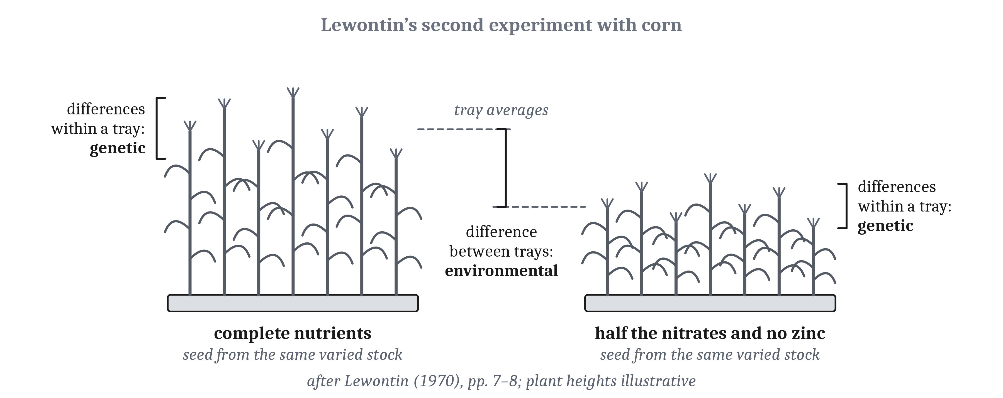
Within Groups and Between Them
Content note: claims about racial differences in intelligence. How heritable a trait is within groups gives no evidence about what causes a difference between groups, whatever the size of the heritability. Neither the logic nor the direct evidence supports the claim that the Black–white difference in average scores is genetic.
Notes:
In the first lecture of this module, we separated two claims about groups. One is that groups differ in their average scores, an observation. The other is that genes cause those differences, a claim about causes. One argument for the second claim runs from heritability: IQ is heritable within groups, so a difference between groups is probably genetic. How heritable a trait is within groups gives no evidence about what causes a difference between groups.
Richard Lewontin showed why with two experiments with corn that he described, which need not be run to make the point. In the first, two genetically uniform lines are grown in the same soil. Within each line, the plants share their genes, so the heritability within each line is zero. Yet the difference between the lines is entirely genetic, since the soil is the same.
In Lewontin’s second experiment, seed from a genetically varied stock is grown in two batches. One batch gets a complete nutrient solution, and the other gets half the nitrates and no zinc. Within each batch, the plants share their environment, so the differences among them are genetic, and the heritability within each batch is 1.0. Yet the difference between the batches is entirely environmental. Suppose a chemist restored the nitrates, and the difference remained. It would still be wrong to conclude that the difference was genetic, since the missing zinc was “the real culprit”.
Lewontin applied this logic to a 1969 claim that a difference between groups in average IQ was probably genetic because IQ is heritable within groups. Of that claim, he wrote, “It is neither likely nor unlikely. There is no evidence”. So the argument from heritability within groups to genetic causes of a difference between them does not follow, whatever the size of the heritability.
We also have an observed case of a large difference in averages that arose from the environment. In the first lecture of this module, we described the Flynn effect. In many countries, average scores rose by about a standard deviation within a few generations, faster than genes can change. Here the two groups are the same population at two times. So a difference in averages of that size can arise from the environment.
The direct evidence on whether genes cause the Black–white difference in average scores has not supported a genetic explanation. That is what the two major reviews of 1996 and 2012, which we described in the first lecture, concluded. If the difference were genetic, Black Americans with more European ancestry would be expected to score higher, and one of the 2012 review’s authors has argued that, in almost all the studies, they do not. In one adoption study, Black and mixed-race children scored about the same, and children adopted by white families scored about 13 points higher than those adopted by Black families. In Germany after the Second World War, the children of Black and of white American soldiers scored about the same.
Researchers who conclude that the difference is substantially genetic argue that indirect evidence, such as reaction time and brain size, is telling. The authors of the 2012 review reply that a correlation within groups does not establish the origin of a difference between groups. They add that the difference in brain size between men and women is much greater than the difference between races, yet men and women have the same average IQ. So neither the logic nor the direct evidence supports the claim that the difference is genetic.
The authors of *The Bell Curve*, published in 1994, stated Lewontin’s principle, but then reasoned against it. They argued that a wholly environmental explanation of the Black–white difference was implausible. Yet they accepted that the Flynn effect, a shift of about the same size, came more from the environment than from genes. So they accepted, for one population over time, the kind of environmental difference that their argument about groups treated as implausible.

Slide 12
Genes, Groups, and Beliefs
Claims about inherited differences have repeatedly been used to make existing social hierarchies look natural.
Researchers in behavior genetics and evolutionary psychology, and their critics, both reject the inference from what is inherited or evolved to what is good (the naturalistic fallacy) and the inference from inherited to inevitable, and both accept that a finding’s unwelcome uses do not make it false.
Notes:
Why have claims about inherited differences so often been recruited for particular beliefs? The record we have is a record of how such claims were used, not of why particular people made them. Claims about inherited differences have repeatedly been used to make existing social hierarchies look natural, from the eugenics we described in the first lecture of this module onward. Eugenics was the program of improving a population’s quality by controlling who has children, and claims that low intelligence was inherited were used as arguments for it.
That history gives us a reason for particular care. In Module 11, we said that an explanation that happens to fit its proposers’ own culture should be checked with particular care. In the first lecture of this module, we gave a related reason for care about research on differences between groups. Researchers repeatedly reached conclusions that their evidence did not support, so readers have good reason to examine such claims more carefully than usual before believing them.
Two fields have been charged with making existing hierarchies look natural, and the two study different things. Evolutionary psychology is about what all members of a species share. Behavior genetics is about how individuals differ. Researchers in both fields stress the difference. The charge made against each field differs with what that field studies. So the charge against hereditarian claims about intelligence, claims that genes cause differences in intelligence, has concerned race, while the charge against evolutionary psychology has concerned gender roles.
Researchers in these fields and their critics answer the charge differently. Defenders of the fields stress that genetic does not mean fixed. In the words of Kathryn Paige Harden, the behavior geneticist we quoted in the first lecture, “Genetic determinism is false”. Critics stress that overstating what findings show invites misuse, whatever the researcher intends.
But both sides separate whether a finding is true from what follows from it. Both reject the inference from what is inherited or evolved to what is good, an error philosophers call the *naturalistic fallacy*. Both also reject the inference from inherited to inevitable. And both accept that a finding’s unwelcome uses do not make it false.
Harden and two of her critics also agree on one point about how people should be treated: people’s equal claims on society do not depend on how genes act. We made a related point in the first lecture about the history of testing. The uses of intelligence tests that we described would have been wrong even if every claim the testers made had been true, and the wrong done to Carrie Buck did not depend on whether she was “feeble-minded”. Whether a finding is true is a question for evidence. How people should be treated is not settled by the answer.

Slide 13
Thinking Ahead
The chimpanzee’s stones could come from adapted actions, from learned value, or from planning. Only a test that the simpler procedures would fail can tell them apart, and for him, no such test was run.
Level | What we can now say
Computational | Possible futures multiply, and their outcomes are uncertain and delayed. Scores on many kinds of test are correlated, and testing was used to exclude and sterilize people.
Algorithmic | People plan by searching selectively, and depart from the standards of expected value and consistent choice, in ways that can be read as errors or as rules suited to their environments; how long they wait depends on what they expect. Whether one ability or several produce the correlated scores is still open.
Implementational | The prefrontal cortex may bias processing elsewhere; frontal patients can score well and still decide badly; orbitofrontal neurons fire with value. Heritability within a group is not evidence about the causes of differences between groups.
Notes:
At the start of this module, a chimpanzee at a zoo gathered stones in the morning and threw them at visitors hours later. When he gathered the stones, no visitors were there to throw them at. We can now say what behavior like that might require, and what we still cannot tell from it.
Acting for the future is a problem in which possible futures multiply, and their outcomes are uncertain and delayed. Many animals act now for later situations, and the hominins came to live slow, long lives. The same behavior could come from adapted actions, from learned value, or from planning. All three procedures can produce the same behavior in a familiar situation, and only a test that the simpler procedures would fail can tell them apart. For the chimpanzee, no such test was run. So his stones show that he acted now for later, and they do not show which procedure produced it.
At the algorithmic level, we described what people and programs do. People plan by searching selectively, and so do programs that play games. People’s choices depart from the standards of expected value and consistent choice. Those departures can be read as errors, or as rules suited to their environments. And how long people wait for a reward depends on what they expect.
At the implementational level, we found candidate locations for some steps, and evidence of what a test can miss. In the brain, the prefrontal cortex may bias processing elsewhere. Patients with frontal damage can score well on tests and still decide badly. And single orbitofrontal neurons fire with the value of what an animal chooses.
On intelligence, the conclusions are partly about evidence and partly about history. Scores on many kinds of test are correlated, but whether one ability or several produce the correlation is still open. Heritability within a group is not evidence about the causes of differences between groups. And in the history of intelligence testing, measurements were used to exclude people and to sterilize them, and researchers’ expectations shaped what they measured and how they read it.
Several questions remain for later modules. In Module 13, we take up *Homo sapiens* as a user of language, and how language models work. In Module 14, we take up symbols and reasoning, and whether language models plan. And in Module 15, we take up culture, and how human beings think together.

Slide 14
To Discuss: “Intelligence Is 50% Genetic”
In your group, five minutes.
A headline says, “Intelligence is 50% genetic”.
What does that sentence mean, and what does it not mean? What would change the number?
Notes:
We can apply what we have said about heritability to a sentence that appears in news stories and conversations.
Start with what the sentence could mean. The most defensible reading is a statement about heritability. In twin studies, the heritability of IQ is about one half: in the populations studied, about half of the variation in scores is associated with genetic variation among the people in them. That is a statement about differences among people in a particular population and set of environments.
Then ask what the sentence does not mean. It does not mean that half of any one person’s intelligence comes from genes, since for one person heritability makes no sense. It is not, by itself, evidence of how, or even whether, genes act on intelligence, as we saw with earrings. And it gives no evidence about the causes of a difference between groups. With Lewontin’s corn, we saw that a heritability within groups, whatever its size, gives no evidence about what causes a difference between them.
Then ask what would change the number. The population and its environments would change it. In one sample of young U.S. twins, heritability was close to zero in poor families and high in affluent ones, and the pattern appears in the United States but not in Western Europe or Australia. Age would change it, since the twin estimate is usually reported to be higher in adults than in children, though some critics dispute the rise. The method of estimating would change it. In one of the largest studies, of people of European ancestry, measured variants accounted for about a fifth of the differences in scores, and a polygenic score predicts up to about 5%. And the twin estimate itself may be somewhat too high, by an amount that is not well measured for IQ, because identical twins are treated more alike than fraternal twins.
Groups often go on to ask whether a higher or lower number would matter for how people should be treated. That question is different from what the number measures. As Harden and two of her critics agree, people’s equal claims on society do not depend on how genes act.

Slide 15
Image Sources
Slide | Image | File | License | Source
3 | Three regions in and beside the prefrontal cortex | fig-prefrontal-regions.png | CC BY 4.0 | Jon Willits — from the Module 12 reading · own work
4 | Items like those in the original Stroop experiments | fig-stroop.png | CC BY 4.0 | Jon Willits — from the Module 12 reading, after Stroop (1935) · own work
7 | The multiple-demand network | fig-md-network.png | CC BY 4.0 | Jon Willits — from the Module 12 reading, after Duncan (2010) and Fedorenko et al. (2013) · own work
11 | Lewontin’s second experiment with corn | fig-lewontin-seeds.png | CC BY 4.0 | Jon Willits — from the Module 12 reading, after Lewontin (1970) · own work

