Slide 1

BCOG 100
Memory, Imagination, and Generative Models
Lecture 10.2 — Storing, Reconstructing, and Simulating
Notes:
This second lecture is the algorithmic level. In the first lecture, we described problems: what an animal faces when what happened on one night matters on the next. Here we ask what procedures could solve those problems, in an animal or in a machine.
Three strands run through the lecture. The first is storing: what kinds of memory researchers distinguish, and how a system can learn new occasions without losing old ones. The second is reconstructing: why remembering rebuilds an occasion rather than playing back a copy. The third is simulating: how what is known can be run without acting, to predict what would happen. Reconstructing a past occasion, predicting from a learned model, and imagining a new situation may turn out to be different capacities, so we keep them apart.
Machines appear throughout, because a procedure that runs in a machine shows that the procedure can work. Where machines and animals differ, we say so.

Slide 2
Thread | Point | Hurt
Pin | Prick | Injection
Eye | Thimble | Syringe
Sewing | Haystack | Cloth
Sharp | Thorn | Knitting
Notes:
With the first question, groups reconstruct the main problem we described in the last lecture, rather than being told it. Most groups give an answer close to this: an animal learns facts about one occasion before it knows when, or how, it will use them. The early mammal learns which log it emptied on the night it empties it, and only later finds out whether that fact matters.
The second question looks small, and it leads to the first idea of this lecture. Groups usually think of several uses quickly. You could tell the code to a friend who needs to get in. You could notice that it matches someone’s birthday, and use that to recall it. You could write it down, or work out that the building next door probably uses a similar code. You learned the code for one known use, and yet you can use it in ways you did not plan.
Compare that with a rat that was sick once after eating a new food. The rat avoids the food. But a rat with only that tendency has no information about where or when it ate the food. The rat’s learning changed how it responds. Yours left information you can access and combine with whatever you need. We name those two outcomes next.

Slide 3
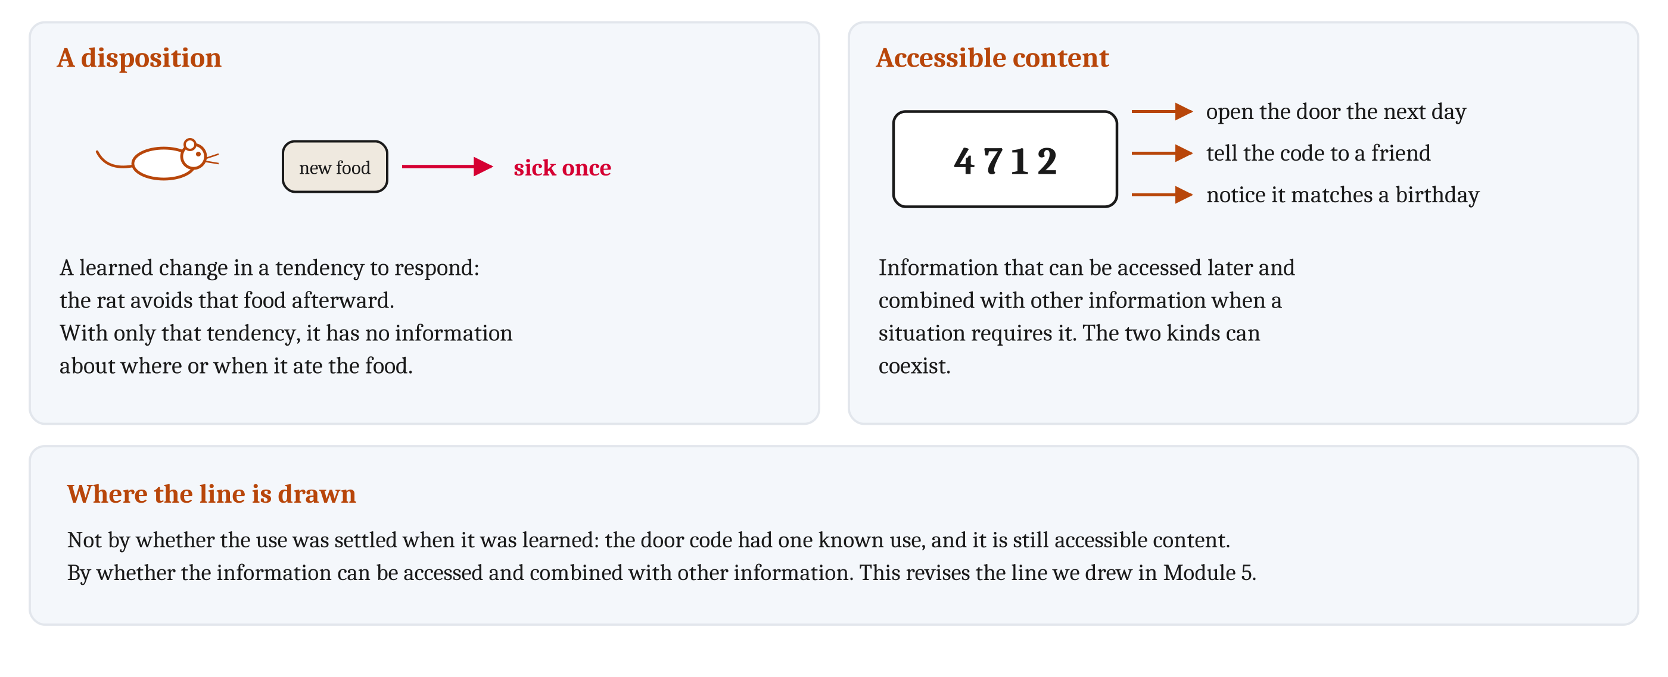
A Disposition, and Accessible Content
A disposition is a learned change in a tendency to respond. Accessible content is information that can be accessed later and combined with other information when a situation requires it.
Notes:
People often use *learning* and *memory* interchangeably. We use them for different things. **Learning** is a change, caused by experience and outlasting it, through which information from the experience can guide later processing or behavior. Fatigue, growth, and injury also change an animal. But they are not learning, because what the animal does afterward can be explained by its changed body alone. A learned change counts even if the occasion to use it never comes. **Memory** is the retention of information, and its influence, after the experience that supplied it.
Experience can guide later behavior in two ways, and the two can coexist. One is a **disposition**, a learned change in a tendency to respond, like the ones we described in Module 5. The rat that avoids a food after being sick once has a disposition. The other is **accessible content**: information that can be accessed later and combined with other information when a situation requires it. The door code is accessible content.
In Module 5, we drew the line between dispositions and what we called records by asking when the use of what was learned is settled. That criterion does not separate the two. The door code was learned for one known use, and it is still accessible content. And what a disposition does also depends on later circumstances, such as how hungry the animal is. So we now draw the line by whether the information can be accessed and combined with other information.
Two other distinctions are separate from this one, and it is worth not merging them. A disposition can come from one occasion, as the sick rat’s did, and accessible content can be general. So “one occasion” does not mean “accessible content”. And a learning rule, such as the error-driven rule from Module 5, describes how a change is made, not which kind of change results.

Slide 4
Kinds of Memory
Three kinds by how long, then long-term memory divided by what it contains.
Kind of memory | How long | An example
Sensory memory | About a second | The rustle the early mammal just heard
Working memory | Seconds to minutes in people; in some animal research, one occasion | Digits repeated back; the maze arms a rat has entered
Long-term memory | Days, months, or years | Procedural, semantic, and episodic memory
Procedural memory | Days to a lifetime | Running a familiar route
Semantic memory | Days to a lifetime | Beetles are usually found under loose bark
Episodic memory | Days to a lifetime | Where a person parked on one particular day
Episodic-like memory | Up to twelve days, in the tests from the first lecture | Scrub jays searching first for worms after four hours, and for peanuts after five days
Notes:
In the first lecture, we separated three problems by how long an animal must be able to use what it learned. Researchers name a kind of memory for each. **Sensory memory** is memory for what was just sensed, and it lasts about a second. **Working memory** is memory for what a task needs while the task is being done; in people, it lasts seconds to minutes. **Long-term memory** is memory for what was learned days, months, or years earlier. The authors of one neuroscience textbook grant that “the details are debated”, but call these three classes “generally accepted”.
Long-term memory is usually divided by what it contains. **Procedural memory** is memory for how to do something, such as running a familiar route, without memory of the occasions of learning. It includes some of the dispositions from Module 5, and the calibration of movement from Module 8. **Semantic memory** is memory for what is generally true across many occasions, without memory of any one occasion of learning. A person can know that monkeys have tails without remembering when they learned it.
Generalization, from Module 7, can be either a disposition or accessible content. It can be a disposition, a tendency to respond the same way to new members of a class. Or it can be part of semantic memory, when what is known about the class is accessible content. The authors of a recent consensus glossary write that nonverbal animals, including human infants, “exhibit concepts”.
**Episodic memory** is memory for one particular occasion: what happened, where it happened, and when. Researchers disagree about what else it requires. Notice how the two kinds of long-term memory map onto the two kinds of fact from the first lecture. Semantic memory contains facts that are true night after night. Episodic memory contains facts that are true for one night only. Both are accessible content. They differ in whether the content concerns a general relationship or one particular event.

Slide 5
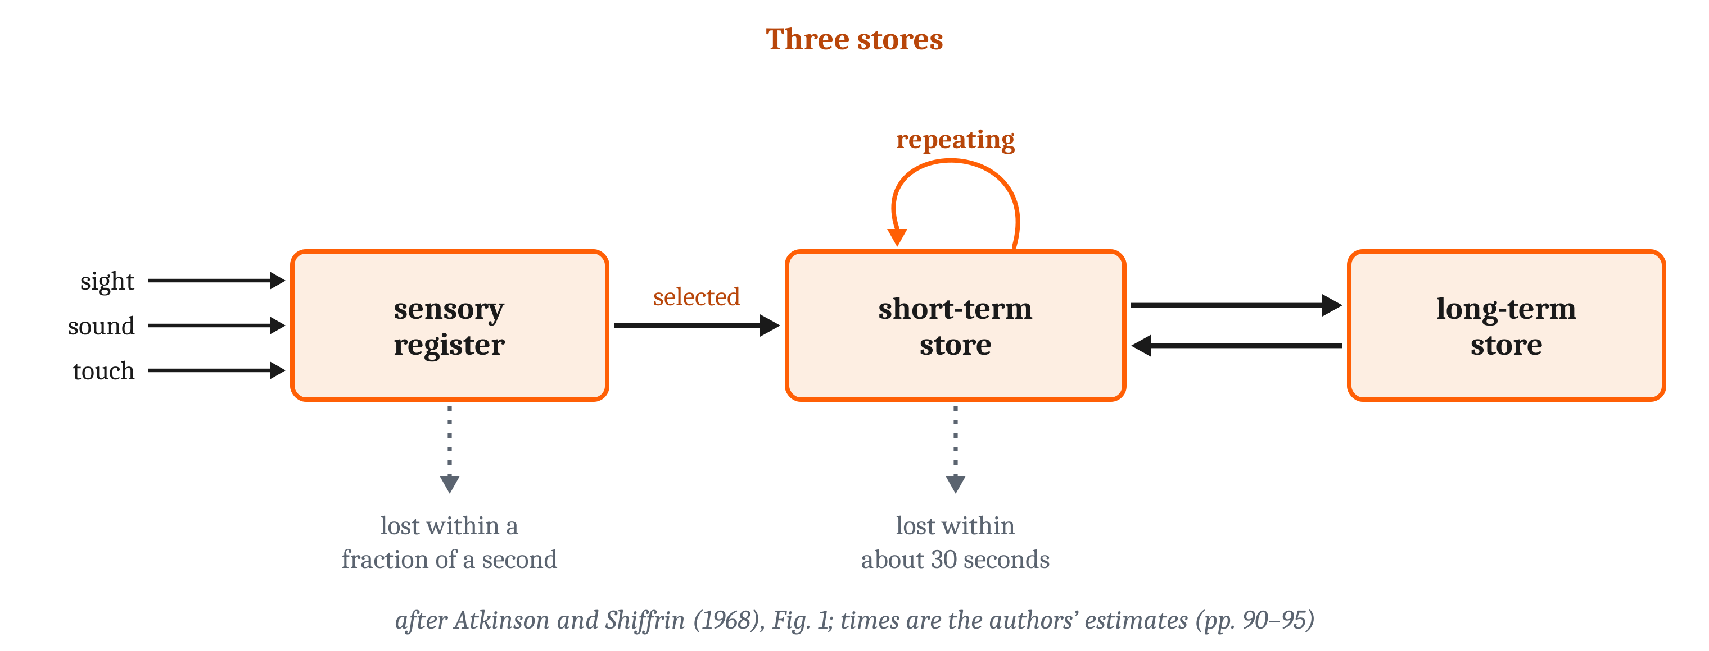
A Store That Fades, and a Few Items at a Time
Rehearsal: repeating items to oneself so they are not lost. A chunk is a group of items a person already knows as one unit.
Notes:
People shown a brief display, one researcher wrote in 1960, “enigmatically insist that they have seen more than they can remember afterwards”. Observers saw up to twelve letters and digits for a twentieth of a second. Asked for all of them, they reported about four, on average 4.3. Then the researcher asked for only one row, cued by a high, middle, or low tone just after the display ended. Observers could not know in advance which row would be cued. So the researcher could use their score on that row to estimate how much of the whole display was available: on average, at least nine of the twelve letters. When the tone was delayed, the extra letters were lost within about a second. The researcher proposed, tentatively, a brief visual image that fades. Sensory memory is a store of this kind.
In 1968, two researchers combined such findings into the three-store model. Input enters a sensory register and, on the authors’ estimate, decays within a fraction of a second. A selected part passes to a short-term store, which they called “working memory”, and is lost within about 30 seconds unless it is repeated. Some of it is copied to a long-term store, and can return.
Working memory has a small capacity. Most people can repeat back seven to nine digits. When rehearsal and grouping are prevented, young adults recall only three to five meaningful units. With rehearsal blocked, people recalled about three units, whether the units were single words or word pairs they had learned as one. And one student raised the number of digits they could repeat from 7 to 79, by grouping the digits into running times they already knew, each one a chunk.
Researchers disagree about what working memory is. On one account, it has a part that controls attention, and two stores, one for speech sounds and one for what things look like and where they are. On a rival account, it has no separate store at all, and is attention directed to what is already represented.
A system, animal or machine, can make a state last in two ways. Units that excite one another can continue to fire after their input stops, like the ring attractor from Module 9; that state ends when the activity stops. Or activity can change the connections, so the change shows only in how the units respond to the next input, and a changed connection remains after the activity has stopped. Both ways have been proposed for working memory, and we look at the evidence in the third lecture.
The name *working memory* is also used in two senses. In the first, the task lasts seconds to minutes, as with digits lost within about half a minute unless rehearsed. In the second, used in animal research, the task is one occasion. The radial-maze rats from the first lecture remembered which arms they had entered across delays of up to 20 minutes, the longest tested. At the start of each new test, the rats treated every arm as not yet entered. The early mammal’s list of logs already searched in one night is working memory in this second sense.

Slide 6
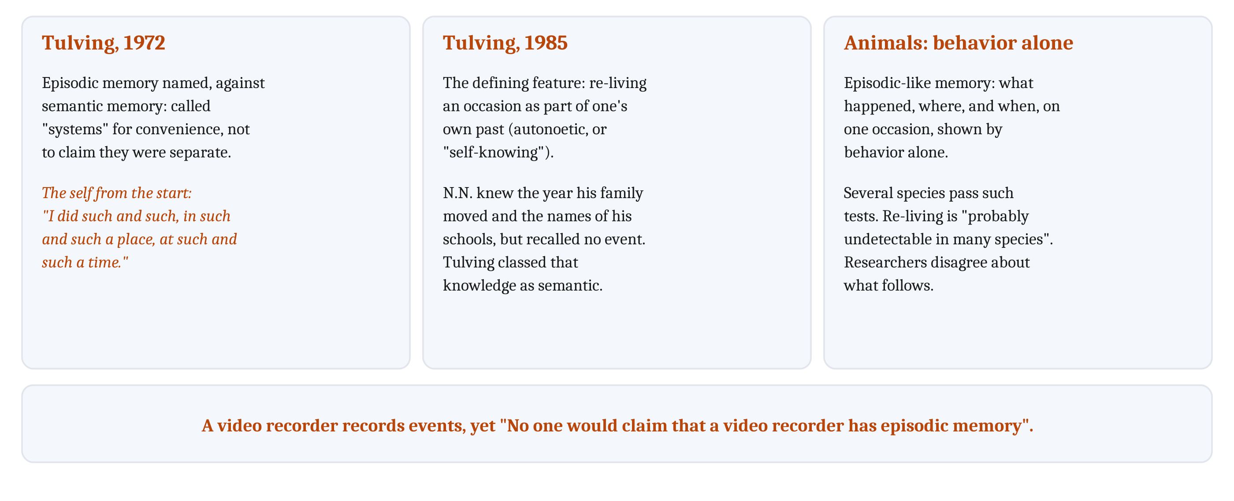
What Tulving Meant, and Can Animals Remember an Occasion?
Episodic-like memory: memory for what happened, where, and when, on one occasion, as shown by behavior alone.
Notes:
Endel Tulving named episodic memory in 1972, and set it against semantic memory. He called the two “systems”, but “primarily for the convenience of communication”, not to claim they were separate. The self was in the definition from the start. In Tulving’s first definition, episodic memory stored events “in terms of its autobiographical reference”. Most episodic claims, he wrote, could be translated as “I did such and such, in such and such a place, at such and such a time”.
By 1985, the defining feature had changed. Episodic memory was now the experience of re-living an occasion as part of one’s own past, with what Tulving called *autonoetic*, or “self-knowing”, consciousness. Facts about oneself that are known but not re-lived counted as semantic. Tulving described a young man, N.N., who knew the year his family moved and the names of his schools, but could not recall a single event from his past. Tulving classed that knowledge as semantic. So on the later view, being about oneself is not enough.
Semantic memory changed too. In 1972 it was “the memory necessary for the use of language”. By 1985 it was “symbolically representable knowledge that organisms possess about the world”, with no tie to language. A standard definition now is knowledge of facts about the world. On strong views of language and thought, some of what is called semantic memory may require symbolic thought, a debate we return to in Module 14.
One research group points out that a video recorder records events, and yet “No one would claim that a video recorder has episodic memory”. On Tulving’s later view, what a recording lacks is someone who re-lives the occasion.
That raises the question for the animals of the first lecture. Nicola Clayton and Anthony Dickinson, who ran the scrub-jay study, did not try to test for re-living. They noted that the experience of self in human recall “has no obvious manifestation” in behavior without language, so it “is probably undetectable in many species”. They called what the jays showed **episodic-like memory**, which an animal can have whether or not it re-lives anything.
Several species now pass such tests, and no researcher claims to have shown an animal re-living an occasion. Researchers disagree about what follows. Tulving called episodic memory “probably unique to humans”. Two other researchers call re-living the past and imagining the future *mental time travel*, and find “as yet no convincing evidence” of it in animals. Others compare species feature by feature, or reply that a human-only conclusion follows from a definition no animal could satisfy. And Robyn Fivush concludes that memory for what, where, and when “appears to be available across species and across human development”. The early mammal probably had episodic-like memory of which logs it had searched. Whether it re-lived those nights is probably undetectable from its behavior.

Slide 7
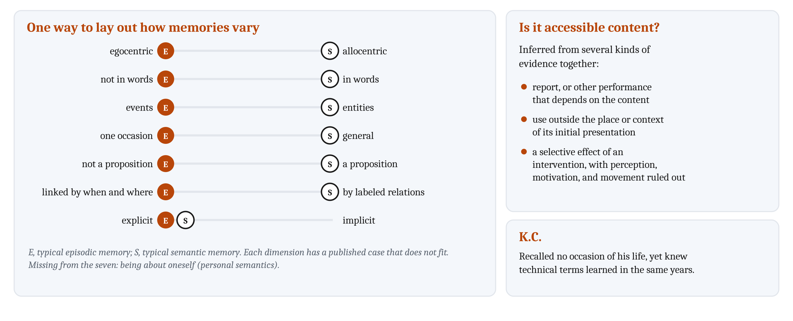
Knowing Without Being Able to Say, and Bundles of Dimensions
Declarative memory is available to consciousness and can be expressed by language. Nondeclarative memory is expressed in performance rather than recollection.
Notes:
**Declarative memory**, also called *explicit* memory, is memory that “is available to consciousness and can be expressed by language”. In people, semantic and episodic memory are classed as declarative. **Nondeclarative memory**, also called *implicit* memory, is expressed in performance rather than recollection. One leading researcher called the two “representational” and “dispositional”, which is close to accessible content and dispositions. But declarative memory is defined by consciousness and language, and accessible content need not involve either.
People can act on what they cannot report. In one study, people moved between houses in a virtual environment. They stayed in the house paired with pleasant music 84% of the time, yet denied that the music had influenced them.
So whether information is accessible content, explicit or not, is inferred from several kinds of evidence together. One is report, or other performance that depends on the content. A second is use of the information “outside the place or context of its initial presentation”. A third is a selective effect of an intervention, with effects on perception, motivation, and movement ruled out. Report is valuable but neither necessary nor conclusive. Animals “can only express their knowledge through performance”, which is why unanticipated tests matter so much, and no single result settles the question.
A difference between two tasks is not, by itself, evidence of two systems. Researchers modeled two tasks as driven by one memory signal, with separate noise for each. One task was recognizing an item, and the other was identifying it faster after seeing it before, called *priming*. With that model, they reproduced findings usually taken as evidence for two systems. David Rubin treats explicit or implicit as one continuous dimension, and grants that “empirical support for a plausible neural basis” for the distinction “is lacking”. The research group that wrote about the video recorder holds that “of extant animals, only humans have explicit memory”. That is a minority view, and its authors grant that settling the question will require “a validated nonverbal assay”. The question remains open.
Memories can vary in several ways at once, and one way to lay out the ways is as seven dimensions. Typical episodic memory sits at one end of six of them, and typical semantic memory at the other; both are typically explicit. The dimensions can vary separately, and researchers have described a case for each that does not fit, such as N.N.’s year of moving: one occasion, yet semantic. Being about oneself is missing from the seven. Knowing general facts about oneself, such as “I am a stubborn person”, without re-living any occasion, is called *personal semantics*. Rubin’s three dimensions, and the version from the research group that wrote about the video recorder, both include being about oneself.
K.C. is a possible criticism of this bundle view. He could recall no occasion of his life, from before or after his injury. Yet he knew technical terms from his work as a machinist, learned in the same years. That pattern is easier to read as two systems than as positions on several dimensions. A defender can reply that K.C. lost one feature, the re-living of an occasion, which would be one more dimension. Episodic and semantic memory may be interacting systems that “retain a measure of distinctiveness”, or regions of one space.

Slide 8
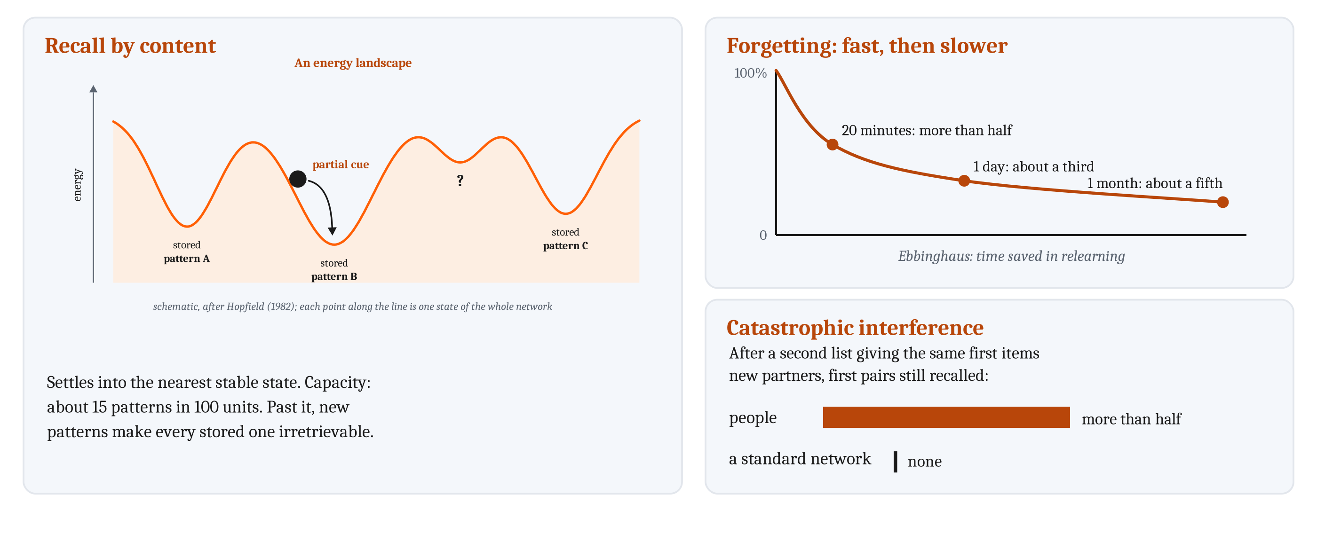
Recall by Content, and Forgetting
A content-addressable memory finds a stored item from part of the item itself. Interference is the effect of other learning on recalling something.
Notes:
A computer finds a stored item by its address, a number for where the item is stored, unrelated to what is stored there. A **content-addressable memory** instead finds a stored item from part of the item itself. That meets the first requirement from the first lecture: recall a whole occasion from part of it. John Hopfield’s example was a memory that retrieves a whole reference, “H. A. Kramers & G. H. Wannier Phys. Rev. 60, 252 (1941)”, from “& Wannier, (1941)”.
In Module 7, we described **auto-association**, storing patterns in the connections among a circuit’s own units, so that part of a pattern reactivates the rest. We also described **pattern completion**, recovering a whole stored pattern from part of it. Hopfield’s network is a machine version of both. Its on-off units are all symmetrically connected, and a Hebbian rule strengthens a connection when its two units agree in a stored pattern, and weakens it when they disagree. Whenever a unit switches, a quantity Hopfield called energy can only fall. So the network settles into a stable state, and the stored patterns are among the stable states. Started from a pattern that differed from a stored one in five or fewer units, it reached the stored pattern more than 90% of the time.
Capacity is limited. The network stores about 0.15 patterns per unit before recall errors become severe. Past that, new patterns make “all memory states irretrievable”, unless old ones are forgotten. And about one run in ten ended in a stable state matching no stored pattern, one way a network can produce something it never stored.
Completion conflicts with the second requirement from the first lecture, telling similar occasions apart. **Pattern separation**, from Module 7, is making overlapping inputs less alike, so a later stage can tell them apart. Separation makes similar occasions distinct, while completion tends to merge them, so a memory for occasions needs both, balanced.
Much of what is learned is later forgotten. In the 1880s, Hermann Ebbinghaus relearned lists of nonsense syllables and measured the time saved. He saved more than half after about twenty minutes, about a third after a day, and about a fifth after a month. Forgetting is fast at first, and slower after that. Much forgetting comes from interference: *retroactive* when new learning makes old learning harder to recall, *proactive* when old learning makes new learning harder to recall.
People and networks differ here. People who learn a list of pairs, and then a list giving the same first items new partners, still recall more than half of the first pairs. A standard network trained the same way recalls none. That is **catastrophic interference**, from Module 7: a drastic loss of old learning when a network learns new patterns after old ones. It happens because new learning moves weights that the old patterns depended on. An animal that adds each night’s events to everything it learned before has the same problem.

Slide 9
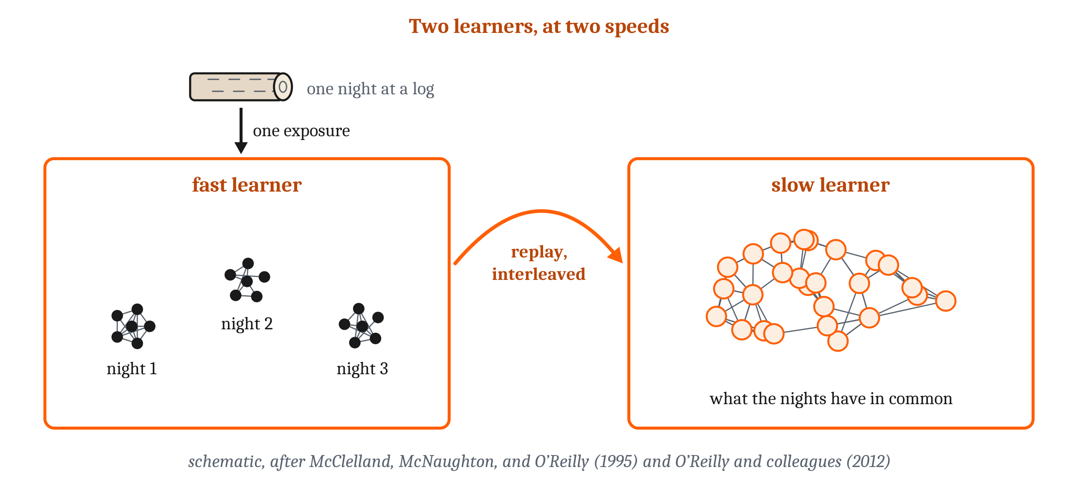
Two Learners at Two Speeds, and Machines That Learn One Thing After Another
Complementary learning systems: a slow learner of shared structure, and a fast learner of single occasions that replays those occasions to the slow learner.
Notes:
Catastrophic interference happens because items are represented by overlapping patterns of activity that share weights. The same overlap is what lets a network generalize, since what it learns about one item transfers to similar ones. Researchers have proposed several answers. Sparser patterns, with fewer units active for each item, interfere less, but they generalize less. Interleaving old items with new ones reduces forgetting, but only if the old items are still available.
A third answer combines the two. In 1995, James McClelland and colleagues proposed **complementary learning systems**. A slow learner uses overlapping patterns, and over many interleaved experiences comes to represent the structure they share. A fast learner uses sparse, separate patterns, and learns a single occasion from one exposure without disturbing the slow learner. Later, the fast learner presents the occasion again, interleaved with others. Running a stored occasion again, after it is over, is **replay**. **Consolidation** is the gradual process by which the slow learner comes to represent what the fast learner learned. In people, consolidation may take years. The authors argued that it is slow because the slow learner must take small steps to learn shared structure accurately.
A network of the slow kind can model semantic memory. One small network learned facts about eight living things, such as that a canary can fly. Its representations separated plants from animals, then birds from fish, then individual birds. Damaged, it lost specific properties before general ones, the same order of loss as in a disease that gradually destroys general knowledge. Its authors concluded that “Semantic information is not stored as such, but instead is reconstructed in response to probes”. The authors of complementary learning systems saw “no special distinction” between remembering an occasion and knowing a fact. Later, researchers found that the slow learner can learn a new fact quickly if the fact fits what it already represents.
Engineers face the same problem when a network learns one task after another, and their three kinds of solution differ in what is stored. One stores the data: a video-game program trained on random samples of stored moments, mixed with new play, called *experience replay*. A second stores a generator: a second network produces stand-ins for the old data, called **generative replay**. In one test of learning new classes, one stand-in for every 128 new examples did better than every method without replay. A third protects the weights that earlier tasks needed. With that method, networks learned some sequences of tasks without forgetting. It failed when a network had to learn new classes and tell them from old ones, a test that generative replay passed.
Some machines combine two memories. A text generator joined to a searchable store of documents changed its answers, with no further training, when the store was replaced with newer documents. Large language models can be described as memory systems in the same terms. What they learned in training is stored in their weights. The text of the current exchange is used somewhat like working memory. And some retrieve from an outside store. How they are trained and generate text we take up in Module 13.
The same training rule can produce either kind of memory. A network that labels images acquires something like a disposition, while a generator or a searchable store provides accessible content. And in most of these machines, a stored example is the same each time it is retrieved. A person’s memory of an occasion can change each time it is recalled, and retelling an event can strengthen errors as well as accurate details.

Slide 10
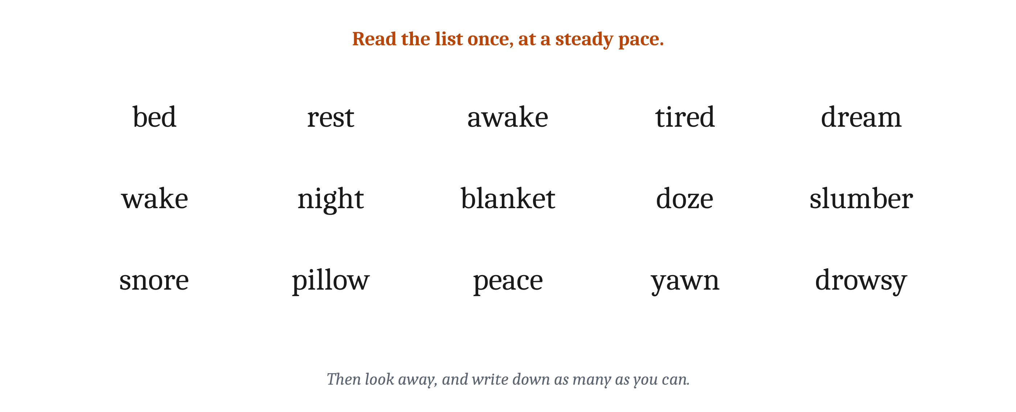
Remembering as Reconstruction
Reconstructive memory: remembering rebuilds an occasion from general knowledge and a few specifics, rather than reproducing a copy.
Notes:
It is worth trying this before reading on. Read the list once, at a steady pace, then look away and write down as many words as you can remember. The answer follows.

Slide 11
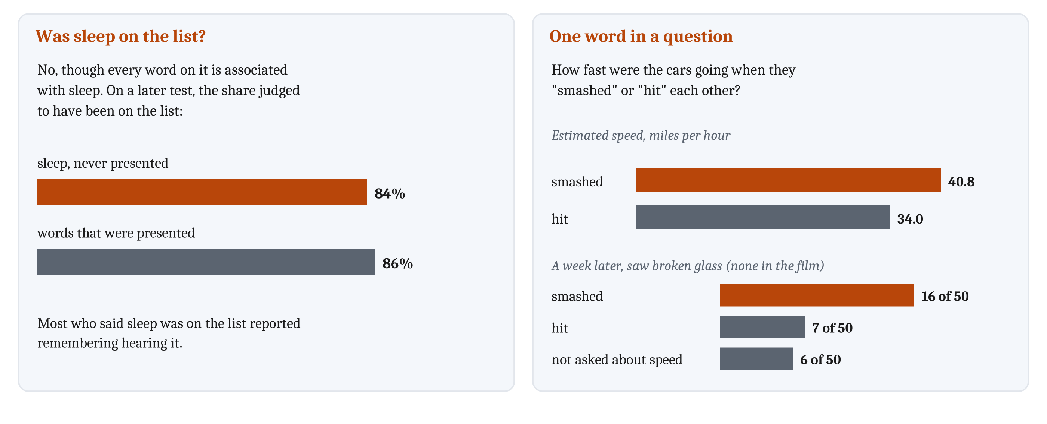
Remembering as Reconstruction
Reconstructive memory: remembering rebuilds an occasion from general knowledge and a few specifics, rather than reproducing a copy.
Notes:
Look at what you wrote down. Many people write *sleep*, and *sleep* was not on the list. Every word on it is associated with *sleep*. In 1995, Henry Roediger and Kathleen McDermott found that people recalled the missing word about as often as words from the middle of a list. On a later test, they judged it to have been on the list 84% of the time, against 86% for words that had been. Most of the time, people who said it had been on the list reported remembering hearing it, not only knowing it had been there. A memory of something that never happened is a **false memory**.
The idea is much older. Beginning in 1913, Frederic Bartlett had people read a North American folk tale, *The War of the Ghosts*, and retell it over months or years. What was strange to the readers was dropped or explained, and unfamiliar details became familiar ones, as when “canoe” became “boat”. One man, after six and a half years, added a totem and a pilgrimage, and was “most pleased and most certain” about exactly those inventions. These cases are weak evidence on their own. Bartlett did not try to make the intervals the same for different people, and for decades the results were not reproduced under controlled conditions. A study published in 1999 reported reproducing them.
Bartlett concluded that remembering “is an imaginative reconstruction, or construction”, built from a person’s attitude toward an organized mass of past experience, and toward “a little outstanding detail”. He called that mass a **schema**, though he wrote, “I strongly dislike the term ‘schema’”. Researchers now use the word more narrowly, for knowledge of how a kind of situation, such as a birthday party, usually unfolds, “devoid of specific episode details”.
Elizabeth Loftus and John Palmer showed people films of car accidents and asked how fast the cars were going when they “smashed” or “hit” each other. People asked with *smashed* gave higher estimates, 40.8 against 34.0 miles per hour. A week later, 16 of 50 people asked with *smashed* reported broken glass that was not in the film, against 7 of 50 asked with *hit*. One word in a question changed what people later reported having seen.
Errors like these matter in court. Of 375 people in the United States exonerated by DNA evidence between 1989 and 2020, 69% of the convictions “involved eyewitness misidentification”, as one contributing factor. And a witness told something that confirms an identification becomes more confident in it.
General knowledge supplies what a memory lacks. People who had lost much of their general knowledge, asked to copy a drawing from memory, drew ducks with four legs, a feature typical of animals in general, and left the hump off a camel. One researcher argues that ordinary memory errors are by-products of a memory that generalizes: general knowledge supplies what usually happens, which is not always what did happen.

Slide 12
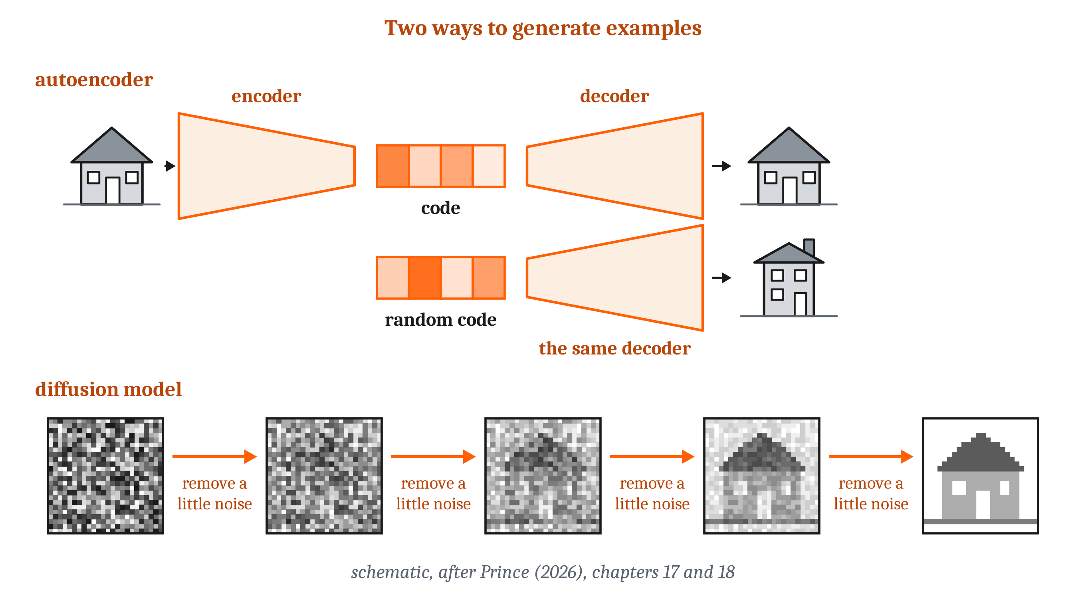
Generative Models, and What They Reproduce
A generative model learns from many examples what kinds of things occur, and can produce new examples of the same kinds.
Notes:
A machine can be built to reconstruct. A **generative model** learns from many examples what kinds of things occur, and can produce new examples of the same kinds. Many learn a short code for each example, a few numbers from which the example can be reconstructed. They produce a new example by choosing a new code and decoding it. An *autoencoder* learns to compress each example into a short code and reconstruct it. In the variational kind, codes are confined so that a code chosen at random also decodes into a plausible example. A *diffusion model* learns to remove a little noise from an image, and generates by starting from pure noise and removing it one step at a time.
Eleanor Spens and Neil Burgess built a model of memory on generative models. A fast learner stores each event after one exposure, and replayed events train a generative network to reconstruct events from short codes. Once trained, the network reconstructs consolidated events. General knowledge can be read from its codes. Random codes decode into new scenes, which the authors offered as a model of imagining. And its reconstructions shift toward the typical case, as the retellings of *The War of the Ghosts* did. It is a proof of concept, trained on simple images and on word counts from short stories, with only qualitative comparisons to people.
Their extension of complementary learning systems is that the slow learner is a generator. Remembering an occasion is then generation from general knowledge, plus the few details of that occasion the fast learner stored. Like the forward model from Module 8 and the map from Module 9, a generative model is an internal model, but it can produce whole scenes.
What a generator produces depends on its training data in two ways. First, a generator can reproduce individual training images. Researchers extracted more than a thousand near-copies from image generators, including photographs of real people. Most were images that appeared many times in the training data. So a generator is not a copy of its data, but its output is not independent of the data either.
Second, generators reproduce the patterns in their data, and can exaggerate them. Asked for “a photo of the face of” a person cleaning, one widely used generator produced only faces with stereotypically feminine features. For ten occupations, the researchers compared the generated faces with U.S. labor statistics, sorting the faces by gender with a computer model. For most of the ten, the faces were more uniform by gender than the workers in those jobs. The researchers reported that higher-paid jobs, such as software developer, were shown as more male than the workers are, and lower-paid jobs, such as housekeeper, as more female. When researchers added words that ran against a stereotype, the stereotype often remained.
Here is a comparison that is ours, not the researchers’. The readers of *The War of the Ghosts* reconstructed toward what they already knew; a generator reconstructs toward what was typical in its training data. One difference is that a person’s reconstruction can change that person’s memory, while a generator’s output can be copied and published widely.

Slide 13
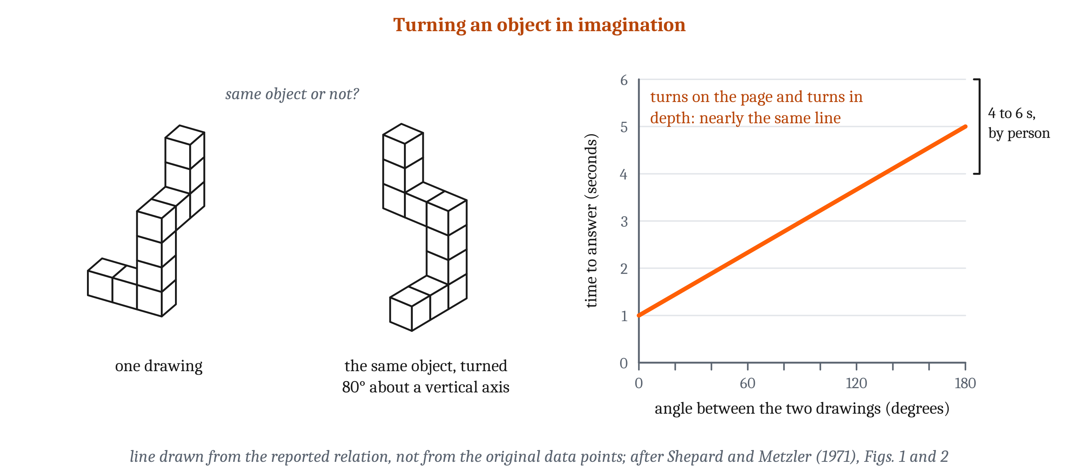
Mental Images
Mental imagery is an experience resembling perception, of something not present to the senses. Judging a turned object took longer the farther it was turned.
Notes:
Remembering and imagining are often accompanied by an experience like seeing. In 1971, Roger Shepard and Jacqueline Metzler showed people pairs of drawings of objects made of cubes, and asked whether the two showed the same object. The time people took rose in a straight line with the angle between the two, from about one second at 0° to four to six seconds at 180°. Turns in depth took no longer than turns on the page. People reported turning one object in imagination until it matched the other, which is called **mental rotation**.
Stephen Kosslyn and colleagues had people learn a map of an island, then imagine moving a small speck from one object on it to another. The time rose with the distance on the map, with a correlation of .97.
Researchers disagree about how to explain results like these. On Kosslyn’s account, images represent distance as seeing does; he called them “quasi-pictorial”. On Zenon Pylyshyn’s account, people asked to imagine something use what they know about how things look and move. On that account, what an image contains is represented in the same format as other thought. When people imagined lights switching on and off between places instead of a speck moving, distance had no effect. Pylyshyn granted that rotation is harder for his account, and Kosslyn later argued that brain evidence settled the question in his favor. We return to the debate in Module 14. On either account, though, an image is constructed from what a person knows about how things look, much as a memory is reconstructed.
Some people report no voluntary visual imagery. In 2015, Adam Zeman and colleagues named this **aphantasia**, “a condition of reduced or absent voluntary imagery”. About 1% of people give the lowest possible score on a standard questionnaire about how vivid their images are. Researchers checked those reports with a test that does not depend on what people say. When each eye is shown a different pattern, perception alternates between the two, and imagining one pattern beforehand usually makes it more likely to be seen. In people with aphantasia, imagining a pattern had no such effect. As Zeman later wrote, “lack of imagery does not imply lack of imagination”.

Slide 14
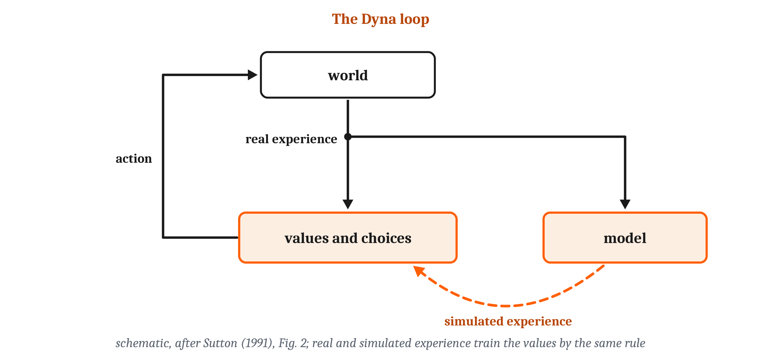
Learning from What Did Not Happen
Simulation is using stored knowledge, without acting, to predict what would happen. In Dyna, simulated experience trains the same values as real experience.
Notes:
In the first lecture, we described rats pausing at a fork and turning their heads back and forth. Tolman proposed that the rat was trying out each option in imagination. But from the pausing and turning alone, we cannot tell what, if anything, the rat imagines.
**Simulation** is using stored knowledge, without acting, to predict what would happen. Accessible content is its material, but having it is not enough. Simulation also needs processes that construct possibilities, or run through them step by step. And reconstructing a past occasion, predicting from a learned model what an action would lead to, and imagining a new situation may be different capacities.
In Module 5, we described two ways of choosing. **Model-free** choice repeats what has worked in a situation before, with no model of what the action leads to. **Model-based** choice runs a model of what leads to what, and selects on where the model ends up. Richard Sutton’s Dyna uses both. A Dyna agent learns by trial and error, and it also learns a model of what each action leads to. Between actions, it picks states it has been in, and uses the model to predict what an action there would lead to. It learns from these “hypothetical, model-generated experiences” by the same rule it uses for real ones. So in Dyna, learning from experience and learning from a model are two uses of one rule. And since simulated experience changes the values that guide the next action, using the model also changes the agent’s dispositions.
A generative model can serve as the model an agent simulates with. One agent learned a generative model of a simple video game, and was trained only inside that model. It then played the real game well, though its scores varied widely from run to run. Which experiences should be simulated? On one model, each possible update is ranked by two things: how much it would improve the choice at a place, and how often the agent expects to be at that place soon. On this model, an agent should simulate the paths behind it after a surprise. Before a choice, it should simulate the paths ahead.
For animals, this leads to a prediction. If animals learn from simulated experience, some later choices should change after outcomes they only simulated. The rats from the first lecture that looked back toward a skipped site then waited through a long delay more often than usual. Their waiting fits the prediction. But from behavior alone, we cannot tell whether the rats simulated the skipped option. In the third lecture, we look for storing, reconstructing, and simulating in the brain, and ask what each kind of evidence can and cannot show.

Slide 15
To Discuss: What Kind of Memory Does a Chatbot Have?
In your group, five minutes.
A chatbot answers questions about general facts, and about something said earlier in the same conversation.
Using the terms from this lecture: what kinds of memory does it have? Is what it has a disposition, accessible content, or both? Does it reconstruct, the way people do?
Notes:
We can apply the terms from this lecture to a machine many people use every day.
Groups usually start by sorting. Answers about general facts come from what was learned in training and stored in the weights, which looks like semantic memory. Answers about something said earlier in the conversation use the current exchange, which is used somewhat like working memory. Some chatbots also retrieve passages from an outside store of documents. When that store is replaced, their answers change with no further training. Few groups find anything that looks like episodic memory in Tulving’s later sense, since, as with animals, behavior alone could not show re-living. Whether anything is episodic-like depends on whether it can act on what happened in one particular exchange after that exchange is over.
The disposition question is harder. A network trained to label images acquires something like a disposition. A generator provides content that can be combined with a new request, which is closer to accessible content. A chatbot generates text, so a good case can be made for both.
Does it reconstruct? A generator produces output that is not a copy of its data, but is not independent of the data either. Its output also shifts toward what was typical in its training data. In the comparison we made earlier, which is ours and not the researchers’, that resembles the readers of *The War of the Ghosts*. The evidence, though, comes from image generators. And in most of the machines we described, a stored example is the same each time it is retrieved, while a person’s memory can change each time it is recalled. How these models are trained, and how they generate text, we take up in Module 13.

Slide 16
Image Sources (1 of 2)
Slide | Image | File | License | Source
3 | Two ways experience guides later behavior | fig-two-ways.png | CC BY 4.0 | Jon Willits — drawn for this lecture · own work
5 | The three-store model | fig-three-stores.png | CC BY 4.0 | Jon Willits — from the Module 10 reading, after Atkinson and Shiffrin (1968) · own work
6 | Tulving's two definitions, and episodic-like memory | fig-tulving.png | CC BY 4.0 | Jon Willits — drawn for this lecture · own work
7 | Dimensions of memory, and evidence for accessible content | fig-dimensions.png | CC BY 4.0 | Jon Willits — drawn for this lecture · own work
8 | Recall by content, forgetting, and catastrophic interference | fig-recall-and-forgetting.png | CC BY 4.0 | Jon Willits — drawn for this lecture; the energy landscape is from the Module 10 reading, after Hopfield (1982) · own work
9 | Two learners at two speeds | fig-two-learners.png | CC BY 4.0 | Jon Willits — from the Module 10 reading, after McClelland, McNaughton, and O'Reilly (1995) and O'Reilly and colleagues (2012) · own work
10 | A list to try | fig-word-list.png | CC BY 4.0 | Jon Willits — drawn for this lecture; list from Roediger and McDermott (1995) · own work
10 | A missing word, and one word in a question | fig-false-memory.png | CC BY 4.0 | Jon Willits — drawn for this lecture; data from Roediger and McDermott (1995) and Loftus and Palmer (1974) · own work

Slide 17
Image Sources (2 of 2)
Slide | Image | File | License | Source
11 | Two kinds of generative model | fig-generator.png | CC BY 4.0 | Jon Willits — from the Module 10 reading, after Prince (2026), chapters 17 and 18 · own work
12 | Mental rotation | fig-rotation.png | CC BY 4.0 | Jon Willits — from the Module 10 reading, after Shepard and Metzler (1971) · own work
13 | Dyna | fig-dyna.png | CC BY 4.0 | Jon Willits — from the Module 10 reading, after Sutton (1991) · own work

