Slide 1

BCOG 100
Learning and Plasticity
Lecture 5.2 — Rules That Change a Weight
Notes:
The first lecture of this module ended on a question: what rule could move a weight so as to meet any of the problems learning brings? This lecture is the answer, or rather four answers.
Start with a constraint that does most of the work. A weight has to change, and something inside the animal has to do the changing. Whatever does it can use only the information available where the connection is, at that moment.
A rule that needs nothing but the two cells a connection joins is one kind of answer. A rule that needs a report from somewhere else in the animal is another kind, and a great deal harder to arrange. Keep that distinction in view, because by the end of the hour it will have sorted every rule we meet.

Slide 2
Hebb's Rule: Neurons That Fire Together, Wire Together
Hebb's rule: Δb₁ = ηx₁y. The change in a weight is the product of the two cells' firing rates, scaled by the learning rate η.
Learning rate η | Input rate x₁ | Receiving rate y | Change Δb₁
1 | 40 | 40 | 1600
1 | 40 | 2 | 80
1 | 2 | 2 | 4
0.01 | 40 | 40 | 16
Notes:
Donald Hebb proposed the oldest and simplest answer in 1949. When one cell repeatedly takes part in firing another, some growth process takes place so that the first becomes more effective at firing the second. The shorthand is that neurons that fire together, wire together.
Written down, it is a change in one of the weights — the b-values we used in Module 3 to model a neuron. The connection from one input cell has weight b₁. The input cell's firing rate is x₁, and the receiving cell's rate is y. Hebb's rule makes the change in b₁ proportional to how active the two cells were at the same time: Δb₁ equals η times x₁ times y. The Δ means *the change in*, and η is the learning rate, a small number setting how much of the possible change is made on any one occasion.
The first three rows of the table hold η at 1. Both cells firing fast, forty and forty, move the weight by 1600. One cell firing slowly, forty and two, moves it by 80. Both slow, two and two, moves it by 4 — still positive, because the two cells are still correlated, only less so.
The fourth row is the one to think about. Same two cells, same forty and forty, and the weight moves by 16 instead of 1600. Nothing about the neurons changed. What changed is how much a single occasion is allowed to matter. At η of 1, two cells that happen to fire together once, for reasons that will never recur, move the weight as far as a hundred ordinary occasions would at η of 0.01.
So being slow is what lets a low learning rate ignore coincidences, and being fast is what makes a high one liable to treat an accident as a rule. The stability-versus-plasticity trade-off from the last lecture turns out, for a rule like this, to be a single number.

Slide 3
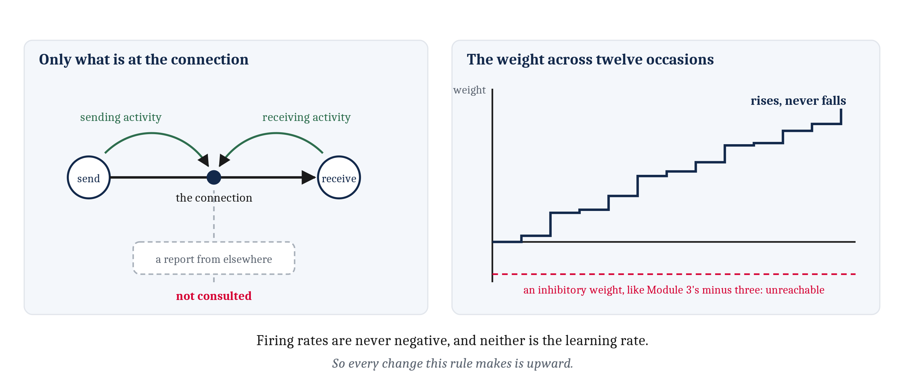
Every Term Is Local, and Every Change Is Upward
Firing rates are never negative, and neither is η, so Δb₁ never is. A Hebbian weight can grow without limit and can never shrink. And everything the rule uses is already at the connection.
Notes:
Working through those numbers raises a question the rule cannot answer. Firing rates are never negative, and neither is the learning rate, so Δb₁ is never negative either. Every occasion makes the weight grow, by a small amount or a large one.
So a connection running Hebb's rule can grow without limit and can never shrink. Nothing in it could arrive at an inhibitory connection like the weight of minus three we had in Module 3. Negative weights are not the difficulty, since Module 3 already had one. Arriving at a negative weight *by learning* is the difficulty, and the basic form of the rule has no way to do it. The first rule today that can subtract is the error-driven rule a few slides on, and the physical story of what weakens a connection is in the next lecture.
Setting that aside, look at the left panel, because it is the property that makes Hebb's rule so attractive for a nervous system. Every quantity in the rule is present at the connection. The sending cell's activity is arriving there, and the receiving cell's activity is right there. Nothing else is consulted. No signal reports whether anything good happened, and no signal says what the receiving cell should have done instead.
A connection running Hebb's rule strengthens because two cells were active together, and for no other reason. Hold on to that sentence; the rest of the lecture is about what that one reason cannot buy.

Slide 4
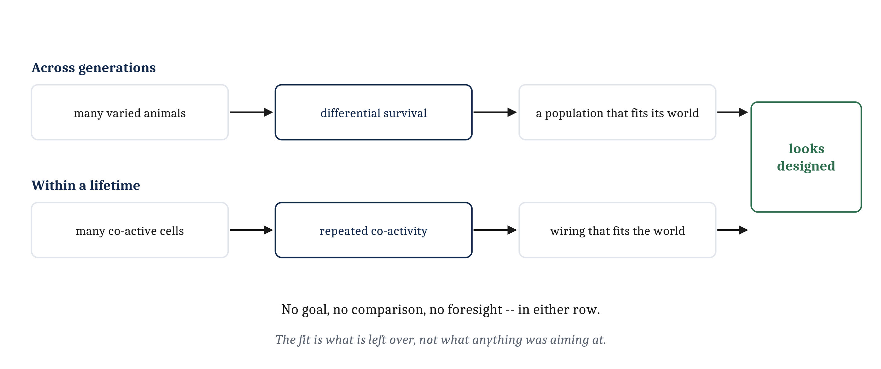
Coincidence Without a Goal
Nothing in Hebb's rule represents a goal or registers being wrong. The wiring ends up fitted to the world anyway: the shape of selection, one level down and on a far shorter timescale.
Notes:
Put a rule like Hebb's into a nervous system whose cells respond to different things, and the wiring comes to reflect which things in the world go together. A rat hears a tone a moment before food arrives at a tray. The cells responding to the tone and the cells responding to food are active at nearly the same moment, over and over, and the connection between them strengthens. After enough repetitions the tone alone drives the food cells hard enough to send the rat to the tray.
Nothing supervised that. Nothing was labeled by any kind of teacher. The tone and the food kept occurring together, and a rule that responds to co-occurrence did the rest.
This is the place where it is hardest to describe the outcome honestly. The wiring ends up fitted to the world, so the temptation is to say the rat worked out what the tone means, or that the neurons learned the relationship. But nothing in Hebb's rule represents a goal. Nothing in it registers being right or wrong. There is no comparison anywhere in the rule, because there is nothing to compare against.
We have met that shape before. In Module 2, adaptation made organisms look designed without anyone designing them, because adaptive fit is what is left over after differential survival. Hebbian learning is the same structure one level down, on a far shorter timescale. The regularity in the wiring is what is left over after repeated co-activity. Both senses of *adapt* work the same way: a process with no foresight leaves behind a result that looks like foresight.
One more point, and it sets up everything after. Hebb's rule has no term for good or bad, but an animal that does have a notion of good and bad can still use it. When a cue and a good outcome occur together, a Hebbian link forms, and it will make the animal more likely to do what it did last time. Forming the link and biasing which links count are two separable jobs. The rules that follow differ mainly in how they do the second.

Slide 5
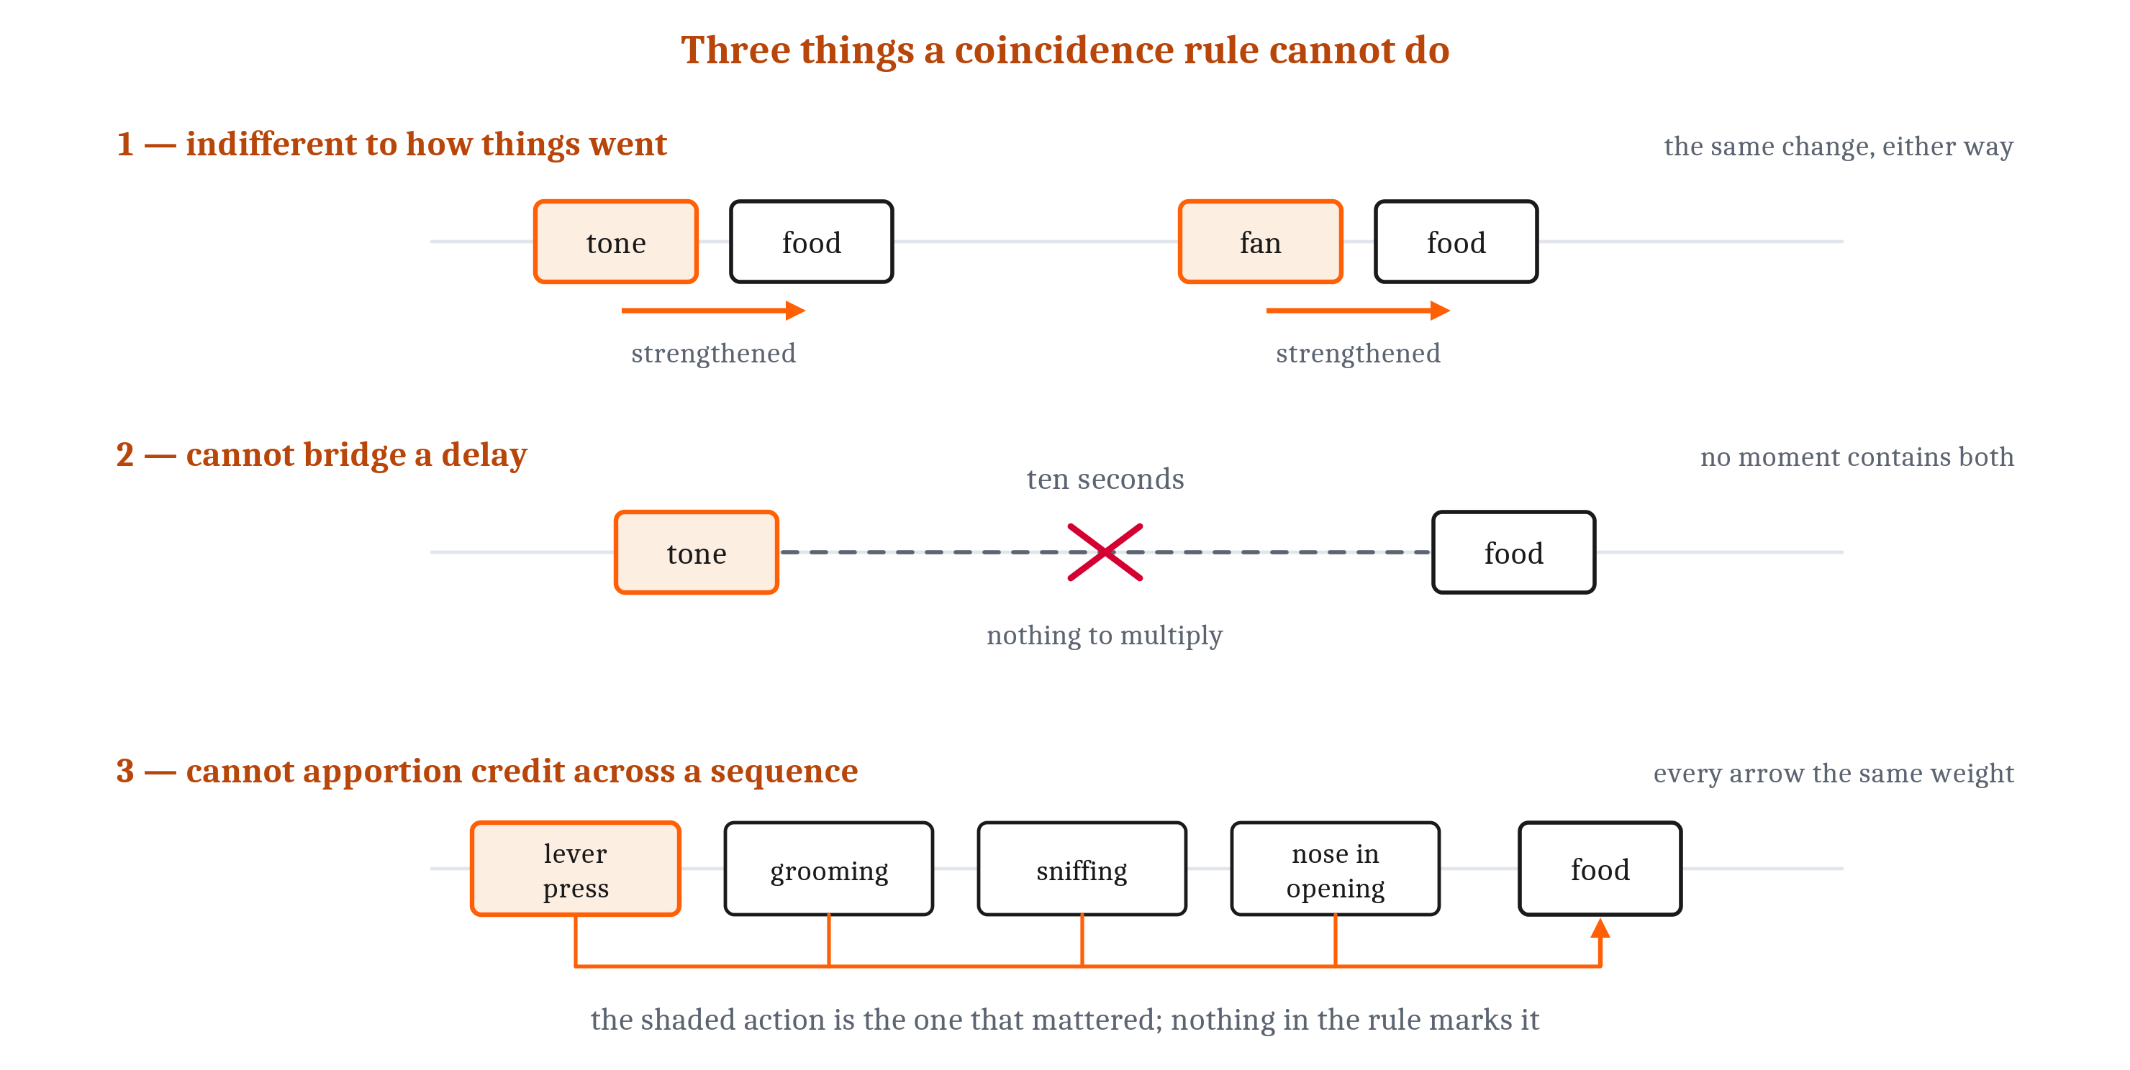
Three Things Coincidence Cannot Do
Hebb's rule is indifferent to outcomes, it cannot bridge a delay, and it cannot apportion credit across a sequence. Each one blocks something the first lecture said a learner needs.
Notes:
The figure is the chapter's, and it carries the three limitations one row each.
The first row is indifference to outcomes. Whatever was active together is wired together, whether the pairing mattered or merely happened. The rat hears a tone before food, and the link forms. The same rat hears the ventilation fan before food several hundred times, and that link forms too. Nothing in the rule, or anywhere else in the rat, marks one of them as the useful one. There is simply no term in Δb₁ = ηx₁y that refers to how things turned out.
The second row is the delay. Move the food to ten seconds after the tone, and the two populations of cells are no longer active at the same moment. Their product is near zero at every instant, so there is nothing to multiply and nothing to strengthen. Hebb's rule works on simultaneity, and a great deal of what an animal needs to learn is not simultaneous. This is the pivot of the lecture: everything after it exists because of this row.
The third row is credit. In a chamber with a lever on one wall and a food opening on another, pressing the lever drops a pellet a moment later, and the rat then crosses the chamber and puts its nose in to eat. The lever press is the action that mattered; the nose poke is the action that happened last. If learning strengthens only what was active when the food arrived, the lever press is missed entirely. If it strengthens everything in the preceding minute, the grooming and sniffing along the way get strengthened just as much. That is the credit assignment problem from the first lecture, arising here as a problem for this rule in particular.

Slide 6
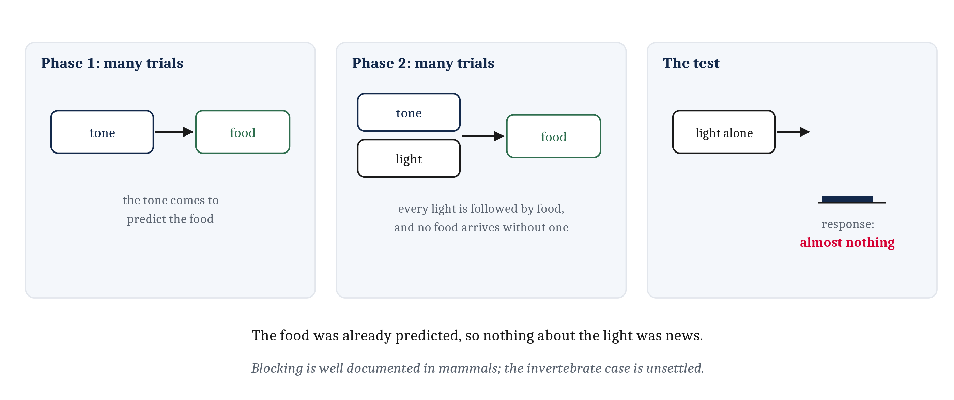
Blocking: Pairing Is Not the Point
Light and food perfectly paired, and the rat learns almost nothing about the light. Blocking: learning tracks what was not already predicted, not what merely co-occurred.
Notes:
One experiment makes the first limitation concrete. Train a rat that a tone reliably predicts food. Then add a light, so that tone and light arrive together, and the food still follows, for many trials. Light and food are now perfectly paired: every light is followed by food, and no food arrives without one.
Now test the light on its own. The rat does almost nothing. It never learned that the light signaled food.
A coincidence rule does not predict that and cannot explain it. Light and food were active together as reliably as any two things in the experiment, so a rule that strengthens what co-occurs would have strengthened that connection. What kept it from forming was that the food was already predicted by the time the light arrived. Nothing about the light was news.
That result is called blocking, and the name of the lesson is on the slide: learning tracks what was not already predicted, rather than what merely co-occurred.
One boundary is worth keeping precise. Blocking is well documented in mammals. An apparent demonstration in honeybees did not survive a later attempt to replicate it, so whether any invertebrate shows blocking is an open question — not a known yes and not a known no.

Slide 7
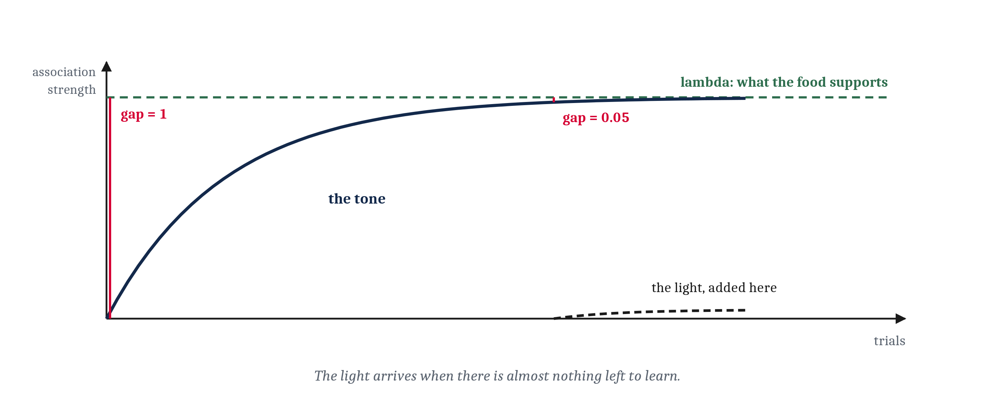
Rescorla and Wagner: Learn in Proportion to the Surprise
ΔV = αβ(λ − V). V is what the cue currently predicts; λ is what the outcome supports. Their difference is the prediction error, and when it reaches zero, nothing is left to learn.
Notes:
Explaining blocking was a major challenge, and Robert Rescorla and Allan Wagner proposed the fix in 1972.
Let an association have a strength, V, for how strongly the cue currently predicts the outcome. Let λ be the strength the association would eventually reach with this outcome — large for a large food delivery, zero for no food. Then the change on a trial is proportional to the gap between them: ΔV equals αβ times λ minus V. The two rate terms, α and β, belong to the cue and the outcome and do the job η did in Hebb's rule.
The gap, λ minus V, is the prediction error, and the name is worth unpacking. λ is a statement about the outcome that actually arrived. V is a statement about what the animal expected. They are on the same scale, so they can be subtracted, and what arrived minus what was expected is what a prediction error is. When the two match, nothing changes.
Now the numbers, which show blocking better than words do. Set λ to 1. On the first tone trial V is zero, the gap is the whole of λ, and the change is as large as the rate terms allow. After many trials the tone has driven V to about 0.95, and the gap is 0.05. Whatever the rate terms are, only a twentieth as much change is available on that trial as on the first — and that is true of every cue present, including the light that has just been added.
So the light is not ignored because the rat decided to ignore it. There is almost nothing left to learn while the outcome is already predicted.

Slide 8
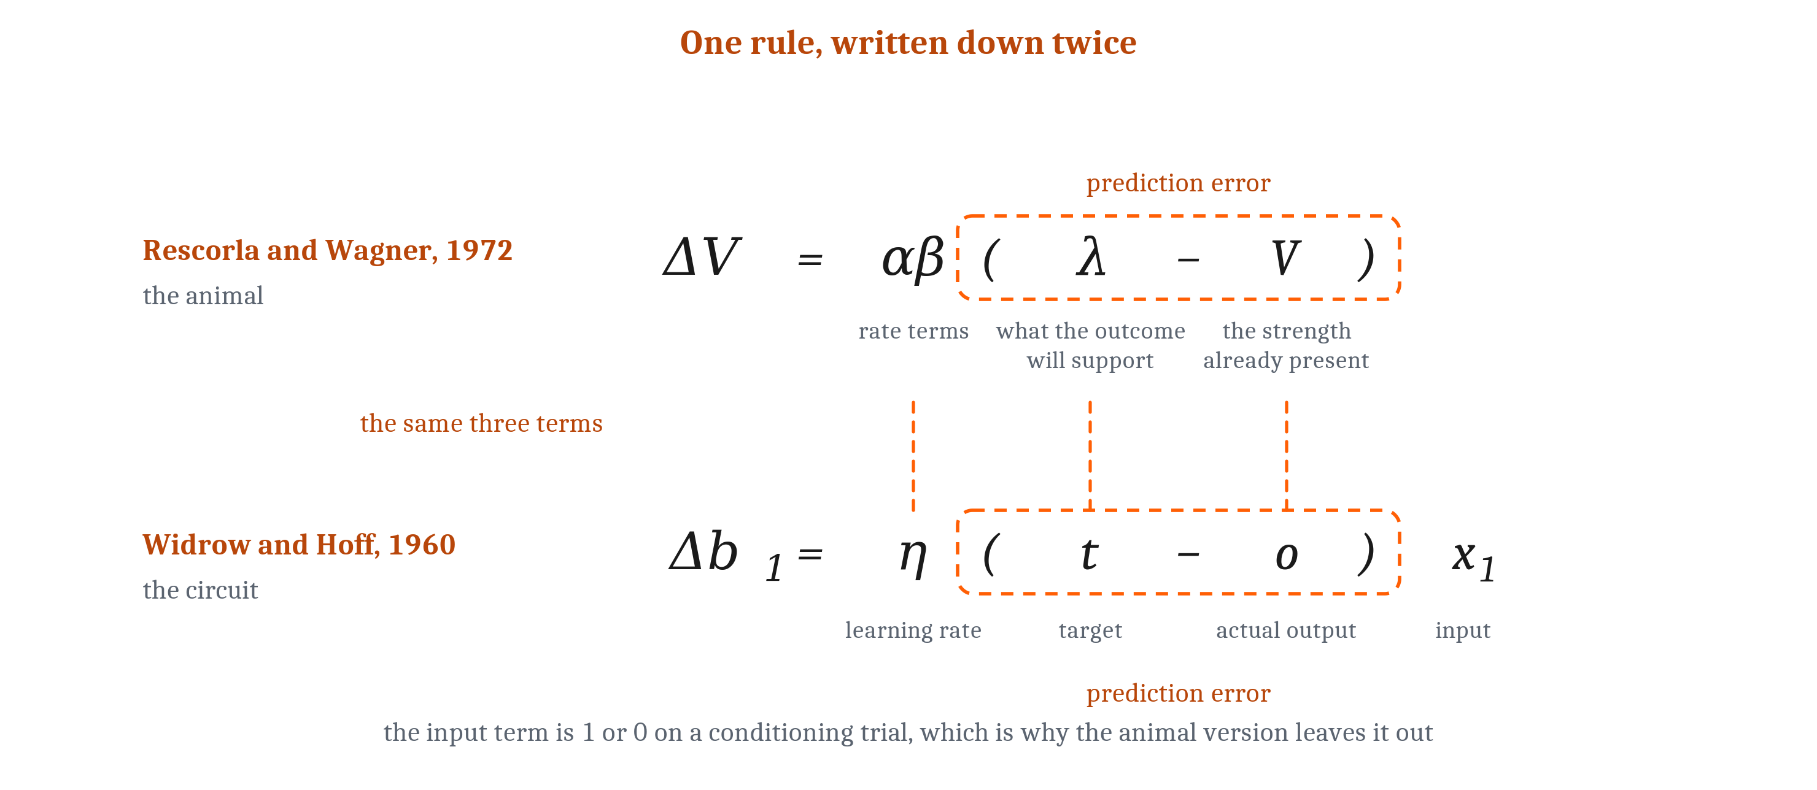
The Same Rule, Discovered Twice
The delta rule: Δb₁ = η(t − o)x₁. Hebb multiplies the input by the receiving cell's activity; the delta rule multiplies it by how wrong the receiving cell was.
Notes:
Twelve years before Rescorla and Wagner, and in a different world, Bernard Widrow and Marcian Hoff were building an adaptive electronic circuit. Their problem was to make an output match a desired output. They called the desired output t, for target, and the output the circuit actually produced o. Their rule changed each weight in proportion to the difference between the two, scaled by the input that weight carries: Δb₁ equals η times t minus o, times x₁. They called it the delta rule, delta for the difference.
Compared to Hebb's rule, it differs in exactly one place. Hebb multiplies the input rate by the receiving cell's own activity. The delta rule multiplies it by how wrong the receiving cell was.
Now set the two equations side by side, which is what the chapter's figure does, and the correspondence is exact. The outcome the world delivered, λ, is the target t. The strength already present, V, is the output o — what the animal currently produces by way of expectation. The rate terms α and β do the work of η. And the input x₁ is either one or zero on a conditioning trial, depending on whether the cue was there, which is why it does not appear in the animal version at all.
One group was explaining a rat. The other was building a circuit. Neither knew of the other, and the same algorithm was written down twice.
This is Module 1's multiple realizability in a form we can check term by term. The procedure is the same object whether it runs in a rat or in a circuit, and the description that matters at the algorithmic level mentions neither.

Slide 9
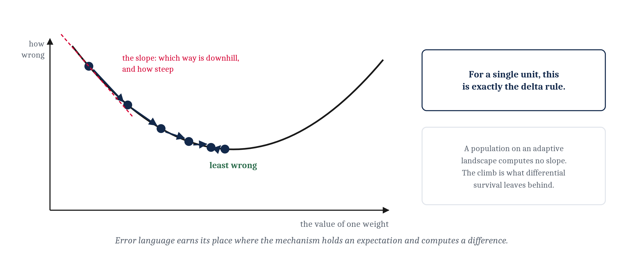
When "It Was Wrong and Corrected Itself" Is Literally True
The delta rule holds an expectation and computes a difference, so error language describes the mechanism. Gradient descent is the general method: find which way is downhill, and step.
Notes:
In the first lecture we left a question open: can a mismatch between what an animal's weights hold and what the world delivers drive its own correction? Hebb's rule and the delta rule answer it in opposite ways.
In Hebb's rule nothing holds an expectation and nothing registers a miss, which is why Hebbian wiring is not aiming at any outcome. In the delta rule there is an expectation, V, and a delivered outcome, λ, and the computed difference between them is what drives the change. So *the system was wrong and corrected itself* is not a story we lay over the mechanism. It is a description of the mechanism. That is the rule for the whole module: language about goals and errors earns its place exactly where something in the mechanism actually involves goals and errors.
There is a general method behind the delta rule. Measure how wrong the output is. Work out which direction each weight would have to move to make it less wrong. Move a small step that way. That is gradient descent. The gradient is the slope: plot one weight against how wrong the output is, and the slope at any point says both which way is downhill and how big a step is worth taking. For a single unit, gradient descent is precisely the delta rule. More than one layer of weights is a much harder problem, and it is Module 7's.
One caution, because the picture is borrowed elsewhere. Biologists draw an adaptive landscape for natural selection, with populations climbing toward greater fitness. Drawing the picture is not what makes the delta rule different. The delta rule computes the slope and moves along it. Nothing in a population computes anything at all. The landscape is in the biologist's description, and the climb is what differential survival leaves behind.

Slide 10
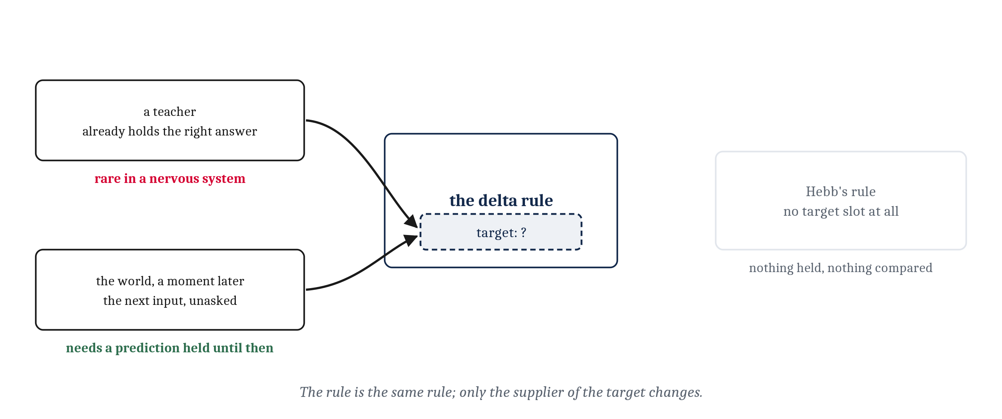
Where the Target Comes From
The delta rule needs a target. A teacher can supply one, and nervous systems have few. Or the target can be the next thing that happens: prediction learning, which holds a prediction until the answer arrives.
Notes:
The delta rule needs a target: something has to say what the output should have been, on this occasion, for this input. That is a nontrivial thing to have lying around.
The obvious source is a teacher — something that already holds the right answer and is in a position to hand it over. Nervous systems are not well supplied with teachers. Very little of what an animal needs to get right arrives with an answer attached.
There is a second source, and it needs nothing that is not already happening. Let the target be the next thing that actually occurs. A system that can make a prediction about its upcoming input, hold it until the input arrives, and then compare the two has manufactured its own target out of the world. No teacher labeled anything. The rule is the same rule; only the supplier of the target changed.
That is prediction learning, and by the naming rule from the first lecture it earns a name of its own, because it changes what a solution must have. The prediction has to be generated before the input arrives and held until it does. None of the other rules require anything to be held.
Hebb's rule is not a case of it. We could describe b₁ as a prediction, but nothing in Hebb's rule is generated in advance, nothing is held, and no difference is computed — so calling b₁ a prediction is our description, in just the way the adaptive landscape is the biologist's. Rescorla and Wagner's rule, by contrast, was prediction learning all along: the association predicts food, a moment passes, and the world answers.
The same shape turns up well away from conditioning. A moving edge crossing the visual field is somewhere slightly different a moment later, and where it actually turns up is a target for where it was predicted to be. It is also how large language models are trained, which Module 13 takes up: the next word is a target that text supplies about itself, which is why such a model can learn from text nobody annotated.

Slide 11
Four Kinds of Learning, Sorted by What a Weight Change Depends On
The four rules differ in one respect: what information has to be present for a weight to move. They are four situations an animal can be in, and nothing makes them a sequence.
Kind of learning | What the weight change depends on | Where that information comes from | How readily a nervous system could supply it
Hebbian (unsupervised) | The activity of the two cells a connection joins | Nowhere else; both quantities are already at the connection | Trivially — nothing has to be arranged
Prediction (self-supervised) | The difference between what was predicted and what then arrived | The world, which delivers the answer a moment later | Easily, provided a prediction can be held until the input arrives
Supervised | The difference between the output produced and the output specified | A teacher that already holds the correct answer | With difficulty; the answer has to exist somewhere inside the animal already
Reinforcement | One number reporting how things went | A verdict generated by the body or by the outcome itself | Readily — one broadcast quantity is enough
Notes:
This is the chapter's table, with its last two columns moved into what follows, and it is the organizing idea of the whole module. It answers the second of the two questions from the first lecture: what there is to learn from.
Hebbian learning needs the two cells a connection joins, and nothing else. Supervised learning needs a statement of what the output should have been, from a source that already holds it. Prediction learning needs the next input, which the world delivers unasked. Reinforcement learning needs one number reporting how things went, attached to no particular output and carrying no hint of what would have worked instead.
Read the second and third columns together and there is a single axis running through them: what a weight change depends on, and how far away that information has to come from. For Hebb it is right at the connection. For prediction and supervision it is a specific target for a specific output. For reinforcement it is one number, broadcast.
The machine-learning names are in parentheses. Hebbian learning is unsupervised: there is no teacher because there is no target at all, just correlated structure in the input. Prediction learning is self-supervised, the target manufactured from the input stream itself. Supervised is the teacher case, reinforcement the verdict case. The last three are often grouped as learning from a teaching signal, which is fair as long as we remember how different those three signals are.
What each can and cannot learn is the part the slide leaves out. Hebbian learning learns which things go together and nothing about whether the result was any good. Prediction learns how one moment follows another and nothing the world never reveals. Supervision learns any mapping a teacher can specify and nothing for which no answer exists. Reinforcement learns which actions lead to good outcomes, and not, directly, what should have been done instead.
And these four are not a ladder. An animal with a teacher does not thereby have a verdict on good and bad, and an animal with a verdict does not thereby have a teacher.

Slide 12
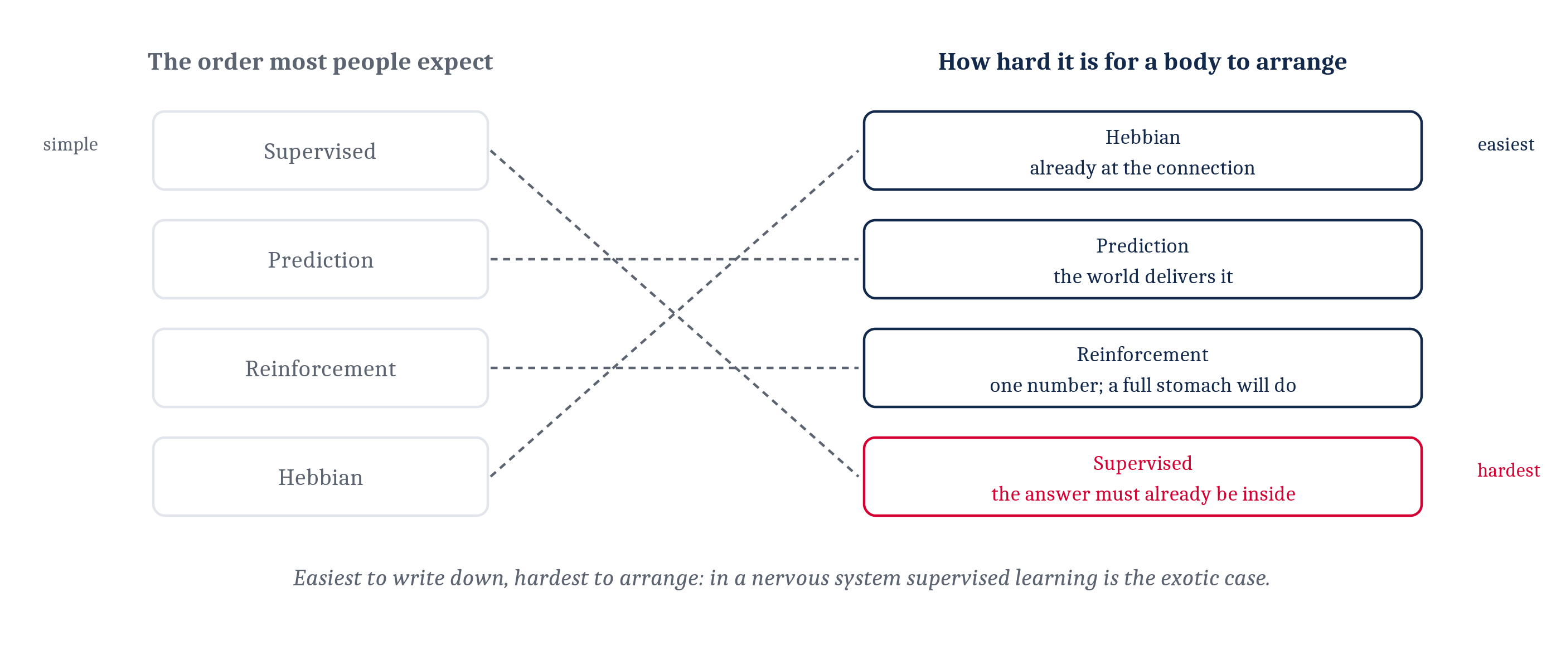
Ranked by What a Body Can Arrange, the Order Flips
A teacher is the easiest kind of learning to write down and the hardest for a body to arrange. In a nervous system, supervised learning is the exotic case.
Notes:
Now rank the four by how hard the required information is to arrange inside an animal, and the order comes out backward from the one most people expect.
Hebbian learning needs nothing that is not already at the connection. Prediction learning needs nothing the world is not already delivering. Reinforcement learning needs one number, and a body generates numbers like that easily: a full stomach, a rise in blood sugar, a pain signal.
A teacher is the hardest of the four by a wide margin. Something inside the animal would have to already hold the correct output, and be in a position to deliver it to the particular connections that produced the wrong one. Think about how much that asks.
Anyone who has met machine learning has probably met supervised learning first and most often, and expects it to be the simple case. On a computer it is: we have the labels, and we hand them over. In a nervous system it is the exotic one. That inversion is the most transferable single fact in this module, and it is worth being able to say why it holds, not just that it does.

Slide 13
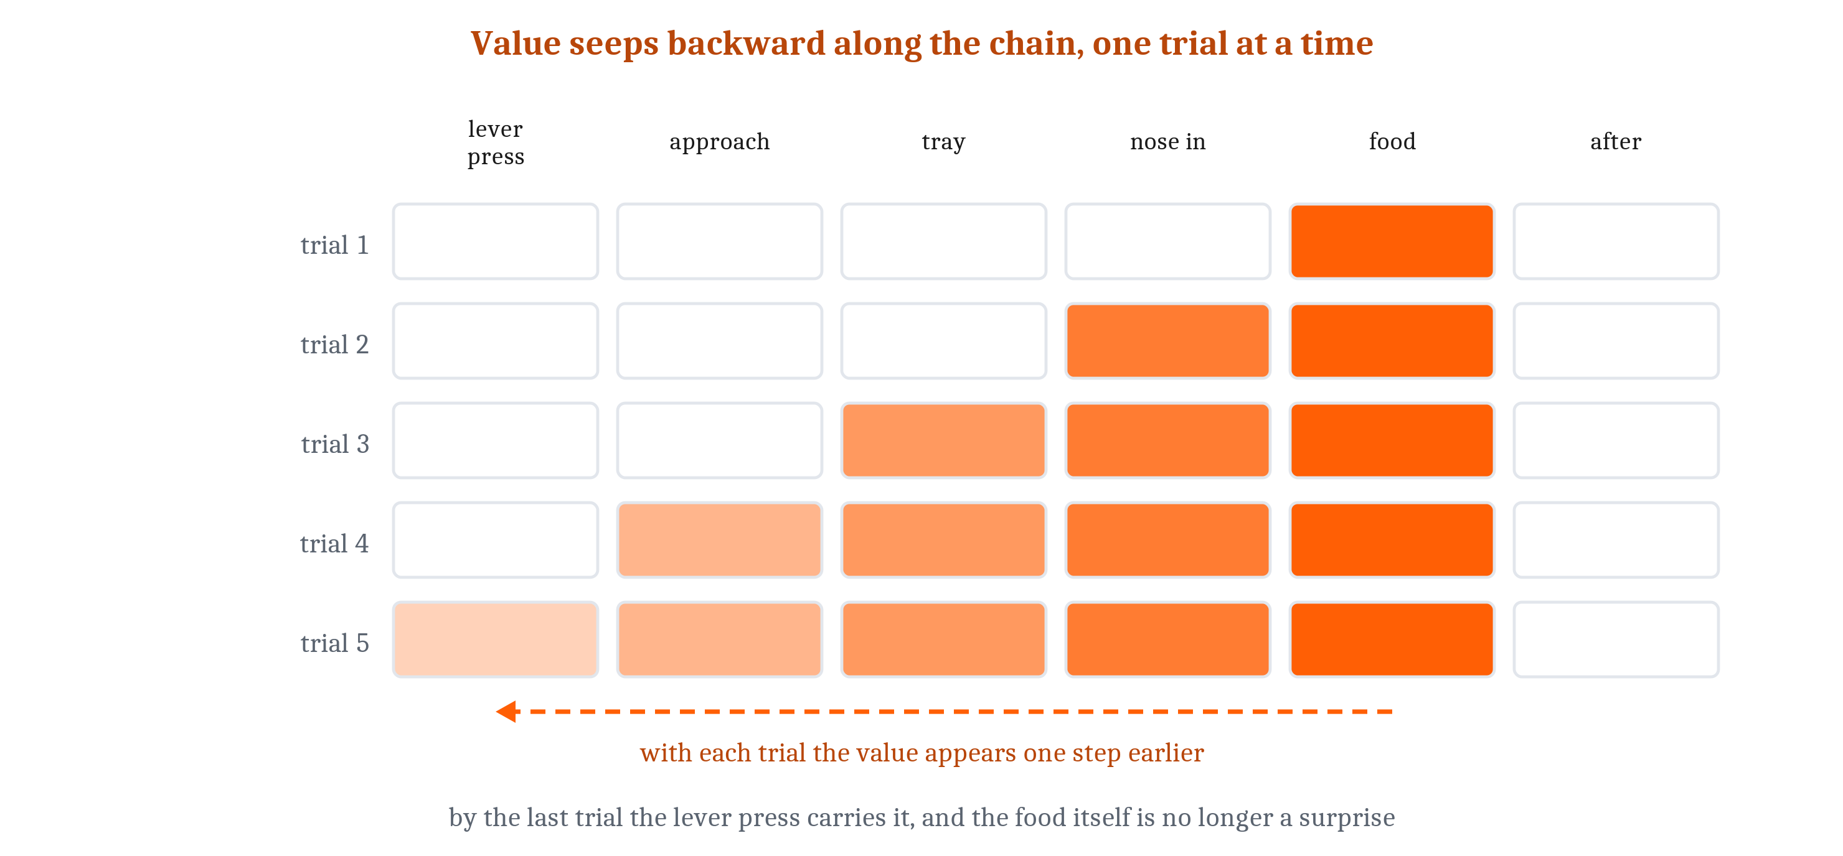
Bridging the Delay: Learn From the Next Estimate
Discounting makes a distant outcome count for less. Bootstrapping compares each estimate against the next one, so an error can move a weight right away — temporal-difference learning.
Notes:
Error-driven learning fixes the first of Hebb's limitations, indifference to outcomes. The other two — the delay and the sequence — are both problems about time, and an error term on its own cannot reach across time. At the moment an animal acts there is nothing yet to compare against, and by the time the outcome arrives the action is long over.
Take the simpler half first: how much should a delayed outcome count? Discounting writes it down as a factor, γ, a little below one, applied once for every step of delay. At γ of 0.9, an outcome ten steps away counts for about a third of the same outcome now, and one a hundred steps away counts for almost nothing.
The harder half has a solution that looks like cheating. Instead of waiting for the true outcome, compare each estimate of how well things are going against the next estimate the system itself produces. When a moment's estimate is followed by a better one, the difference is treated as an error, and it can move a weight right then. That is bootstrapping, and the family of rules built on it is temporal-difference learning.
The figure is the chapter's. On the first trial only the moment just before the food carries value. On each later trial the value appears one step earlier, until the lever press at the start carries most of it and the food itself is no longer a surprise.
Learning from an unreliable estimate works because the chain is anchored: something real happens at the end, and every estimate connects to it through however many links.
And this settles the grooming problem from the three-failures slide. What moves a weight is whether an action changed the estimate of how well things are going. Pressing the lever does — a pellet is now on its way. Grooming does not; the animal is no better placed afterward. No change, no error, nothing to strengthen. Early on, grooming may pick up some credit while the estimates are poor, and experience removes it. With discounting in force, grooming actually does slightly worse than nothing, because it leaves the same outcome one step further away.

Slide 14
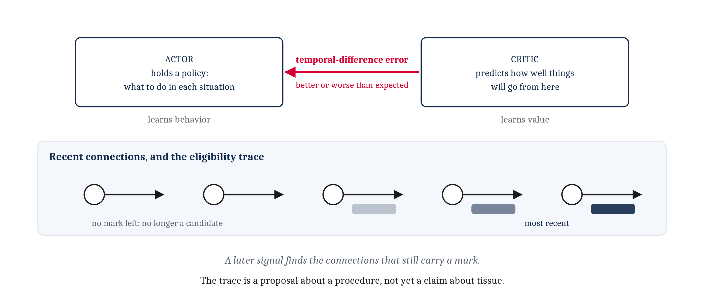
Animals Bootstrap, and Judging Can Be Separated From Choosing
The critic learns value; the actor holds a policy and adjusts it by the critic's errors — an actor–critic architecture. An eligibility trace marks which connections were recently involved.
Notes:
Animals do bootstrap, and there is a clean demonstration. Train an animal that a tone predicts a shock, until the tone alone produces fear. Then pair a light with the tone. The light becomes frightening, though it was never paired with a shock. The only thing available to teach the light was the tone, and the tone was itself nothing more than a learned predictor. A learned prediction has become a teacher in its own right, which is exactly the assumption temporal-difference learning runs on.
Two jobs have been running together in everything so far: choosing what to do, and judging how things are going. They can be separated, and a system can be good at one while still poor at the other. In machine-learning terms the part that judges is the critic. It learns to predict how well things will go from here, and its prediction errors are the temporal-difference errors. The part that chooses is the actor. It holds a policy — a mapping from situations to what to do in them — and adjusts it using the critic's errors. When things go better than the critic expected, whatever the actor just did becomes more likely in that situation afterward.
What the critic learns is value; what the actor learns is behavior. The point is computational before it is algorithmic: an animal that cannot yet act well can still be getting better at telling good situations from bad ones, and that improvement is not wasted.
That still leaves half of credit assignment unexplained. When a signal arrives later, how does it find the connections that were involved? The proposal is a fading mark left on whatever was recently active — an eligibility trace. A connection stays a candidate for a while after it has done its work, and stops being one once enough time has passed.
A trace is a proposal about a procedure, not a claim about tissue. Whether anything in a nervous system behaves like one is a separate question, and the next lecture has a striking answer.

Slide 15
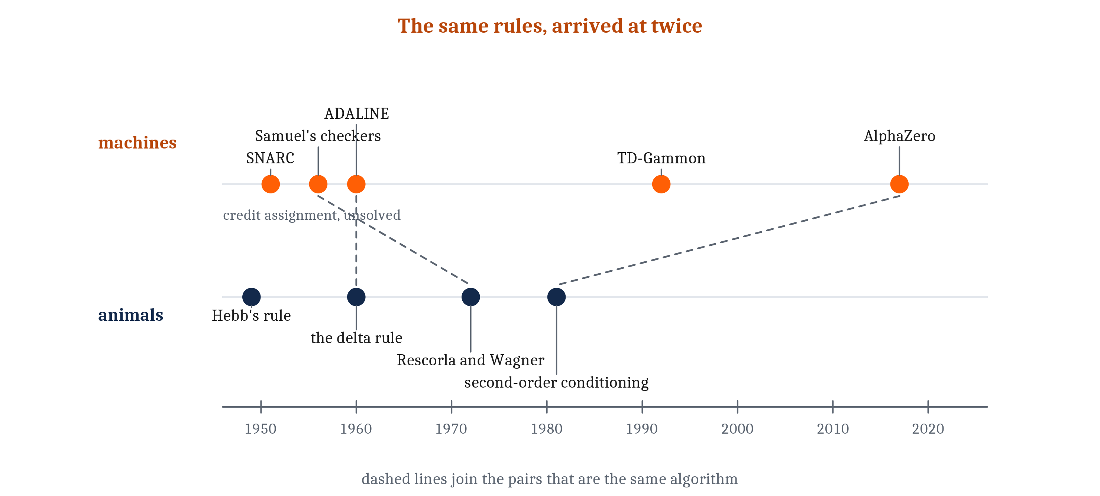
The Same Rules, Built in Machines
ADALINE ran the delta rule in 1960. SNARC hit the credit assignment problem in 1951. Samuel's checkers program ran temporal-difference learning. AlphaZero is actor and critic, made very large.
Notes:
Every one of these rules has a parallel in machines, and many go back further than people expect.
Widrow and Hoff's delta rule was not a theory about animals at all. It was the learning rule of ADALINE, a physical adaptive circuit built at Stanford in 1960, whose weights were resistances the machine adjusted itself.
An earlier attempt is the instructive one. In 1951 Marvin Minsky and Dean Edmonds built SNARC, forty units of vacuum tubes and clutches meant to model a rat finding its way through a maze. Its rule was to strengthen whatever connections had recently been active whenever the machine did well. That is the right instinct and not enough: the connections that mattered and the ones that merely happened to be on were treated identically. SNARC improved a little and then stopped. The credit assignment problem had turned up in a machine sixty years before it had a satisfying answer.
Arthur Samuel's checkers program, through the 1950s, compared each position's evaluation against the one it reached a few moves later and adjusted the earlier toward the later. That is temporal-difference learning two decades before it had the name, and the program came to play better than Samuel did. TD-Gammon took the same idea to backgammon in 1992.
AlphaZero is those two pieces made very large. It is given the rules of a game and nothing else — no human games, no opening book — and plays against itself. One part estimates how good a position is: the critic. Another proposes moves: the actor.
The resemblance to an animal is at the level of the procedure, and that is the only level at which we claim it. Nothing about AlphaZero's weights, its training schedule or its hardware resembles a nervous system, and the next lecture makes that distance wider, not narrower. What is shared is the shape of the rule — arrived at twice, once by people asking what a rat is doing and once by people trying to make a machine improve.

Slide 16
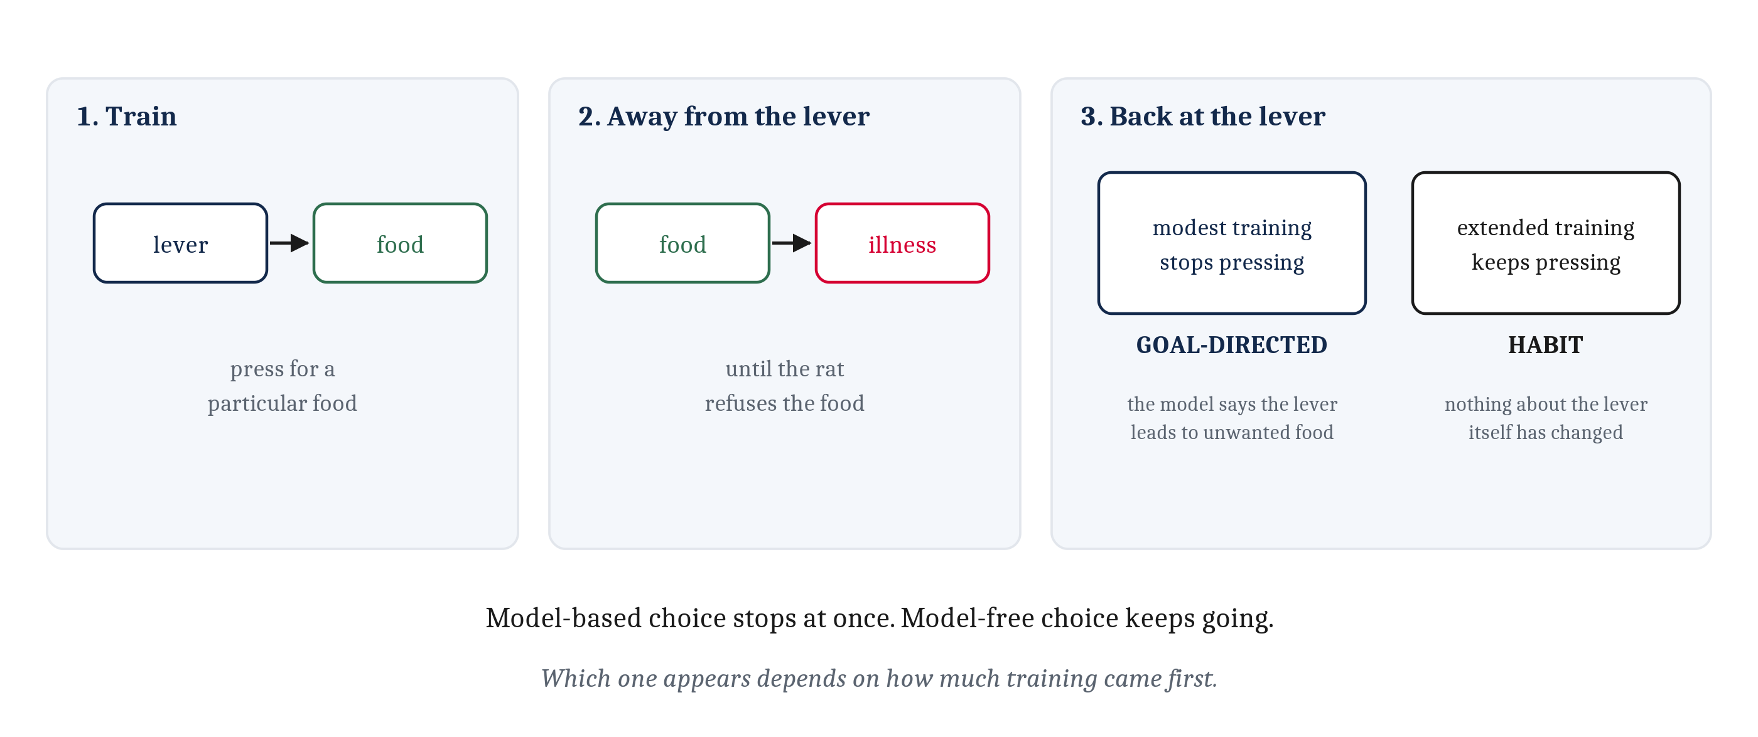
Habits and Goals
Model-free: repeat what has worked here. Model-based: run a model of what leads to what. Devaluation tells them apart, and extended training turns goal-directed behavior into a habit.
Notes:
A learner with this machinery has two ways to choose an action. One is to repeat whatever has worked in this situation before, which is what a policy adjusted by reinforcement amounts to. That is model-free. The other is to consult a model of what leads to what, run it forward, and choose by where it ends up. That is model-based.
An experiment tells them apart. Train a rat to press a lever for a particular food. Then, away from the lever, make that food sickening, pairing it with illness until the rat will not touch it. Now put the rat back at the lever.
A rat choosing on a model of what the lever leads to should stop pressing at once, because on that model the lever leads to something it now wants nothing to do with. A rat repeating what has worked should keep pressing, because nothing about the lever itself has changed.
The manipulation is called reinforcer devaluation, and which result appears depends on how much training came first. Modest training leaves the pressing sensitive to devaluation: the behavior is goal-directed. Extended training makes it insensitive: the behavior has become a habit.
That is worth recognizing from ordinary life. A habit is not a goal we have forgotten; it is a different way of choosing, and it keeps running after the goal has changed.

Slide 17
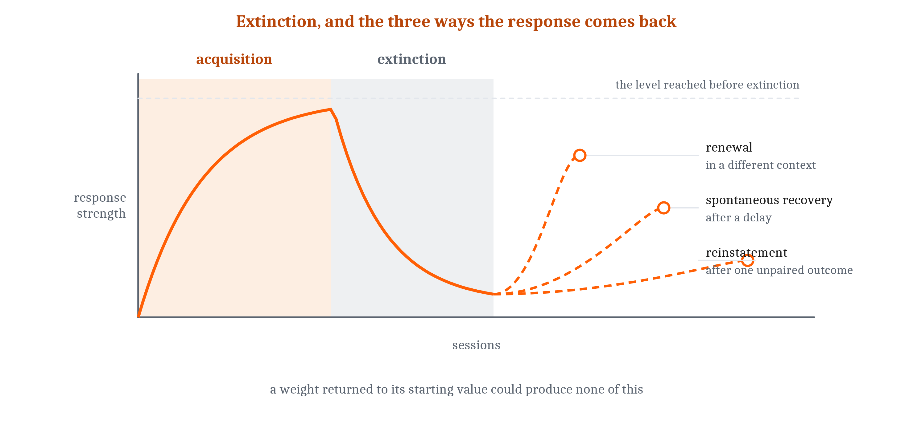
Extinction Is Not Unlearning
Spontaneous recovery, the renewal effect and reinstatement all bring an extinguished response back, which a weight that had simply gone down could not. Extinction is new learning.
Notes:
Stop delivering food after a lever press and the pressing fades. Stop pairing a tone with a shock and the fear fades. That is extinction, and the tidy story is that the weight has gone back to roughly where it started. The tidy story is wrong, and three findings show it.
Spontaneous recovery: wait a while after extinction, with no further training of any kind, and the response comes back on its own. The renewal effect: extinguish a response in one room, test it in another, and it comes back. Reinstatement: deliver the outcome once, unannounced and unpaired, and it comes back.
A weight that had just decayed to its starting value could produce none of those, because there would be nothing left to come back. So extinction adds new learning rather than removing old learning, and the new learning is about the context nearly as much as the cue. The animal does not unlearn the association. It learns a new fact: the old association does not seem to hold here. The original survives underneath, as part of that new fact.
Which fact governs behavior depends on where the animal is and how long it has been. Stated as a requirement on a rule: an update procedure cannot simply put the weight back. Something has to hold the original association and its later contradiction at the same time, and something has to arbitrate between them.
That is a real complication. It is also the most practically consequential result in this module for anyone hoping to be rid of a learned response — a rat's, a dog's, or a person's. A fear that has been extinguished in a therapist's office has not been deleted, and that is worth knowing.

Slide 18
What Cannot Be Learned, and Why That Is Not a Flaw
The rules have no preferences. The animal does, and they line up with the pairings its ancestors had reason to pick up — an inductive bias.
Paired with | Illness | Electric shock
A novel flavor | Learned in one pairing, across hours | Hardly learned at all
A noise | Nearly hopeless | Learned readily
Notes:
One more limit, and it is not a limit of the rules.
Pigeons trained to peck a key for food come, with enough training, to peck it the way they peck at grain, even where a different movement would work better. Raccoons trained to drop coins into a slot for food start rubbing the coins together instead, the way they handle food before eating. The reinforcement is arranged correctly in both cases. The animal drifts back toward something more natural for its lineage.
The table shows the same point as a difference in what can be linked at all. A rat links a novel flavor with illness across several hours after a single pairing — the taste aversion from the first lecture. The same rat links a flavor with a shock hardly at all, however carefully the pairing is arranged. And it links a noise with a shock readily, while a noise with illness is nearly hopeless.
The rules have no preferences. The animal does, and the preferences line up with the pairings its ancestors had reason to pick up. A pre-established tendency to learn one thing more easily than another is called an inductive bias. None of these rules is a blank slate running on arbitrary inputs; what they run on has already been sorted by what a lineage needed. What does the sorting is partly a question about representations, and that is Module 7's.
So we now have four kinds of rule, and each of them works, in the sense that a system running one improves at something. Whether anything in a nervous system actually does any of this is a different question. Answering it means finding something that can deliver *better than expected* to the right connections at the right moment — and that is where the next lecture starts.

Slide 19
Image Sources (1 of 2)
Slide | Image | File | Licence | Source
3 | A Hebbian weight only ever grows | fig-only-grows.png | CC BY 4.0 | Jon Willits — drawn for this lecture · own work
4 | A process with no foresight, twice | fig-no-foresight.png | CC BY 4.0 | Jon Willits — drawn for this lecture · own work
5 | Three cases in which a coincidence rule fails | fig-hebb-fails.png | CC BY 4.0 | Jon Willits — drawn for the Module 5 reading · own work
6 | The blocking design | fig-blocking.png | CC BY 4.0 | Jon Willits — drawn for this lecture · own work
7 | Blocking falls out of the prediction error | fig-rw-curve.png | CC BY 4.0 | Jon Willits — drawn for this lecture · own work
8 | Rescorla and Wagner's rule and the delta rule | fig-two-equations.png | CC BY 4.0 | Jon Willits — drawn for the Module 5 reading · own work
9 | Gradient descent on one weight | fig-gradient-descent.png | CC BY 4.0 | Jon Willits — drawn for this lecture · own work
10 | Two suppliers for the same target slot | fig-target-suppliers.png | CC BY 4.0 | Jon Willits — drawn for this lecture · own work

Slide 20
Image Sources (2 of 2)
Slide | Image | File | Licence | Source
12 | The expected ranking and the real one | fig-ranking-backward.png | CC BY 4.0 | Jon Willits — drawn for this lecture · own work
13 | Value propagating backward along a sequence | fig-td-chain.png | CC BY 4.0 | Jon Willits — drawn for the Module 5 reading · own work
14 | Actor, critic and the eligibility trace | fig-actor-critic.png | CC BY 4.0 | Jon Willits — drawn for this lecture · own work
15 | Machines and animals, arriving at the same rules | fig-ai-timeline.png | CC BY 4.0 | Jon Willits — drawn for the Module 5 reading · own work
16 | Reinforcer devaluation | fig-devaluation.png | CC BY 4.0 | Jon Willits — drawn for this lecture · own work
17 | Acquisition, extinction, and three ways a response returns | fig-extinction-return.png | CC BY 4.0 | Jon Willits — drawn for the Module 5 reading · own work

