Slide 1

BCOG 100
Learning and Plasticity
Lecture 5.3 — What Physically Changes, and What Gates It
Notes:
In the last lecture a weight was a number in a rule. In an animal it is a physical arrangement, and something physical has to move when it changes.
In Module 3 we said that the strength of a connection was one of the answers to how identical spikes can carry different amounts of information. This lecture is about how that strength actually changes, in real cells — and about what decides whether it changes at all.
One boundary before we start. What follows stops at the synapse and at the cell. Vertebrate brains also have whole structures given over to particular kinds of learning, and where those are, and why an animal ends up with separate ones, is Module 6 — next week. Before there were brain systems specialized for kinds of learning, there was learning at individual synapses, and that is the level today.
Underneath all of it is a single principle: a lasting change that is a function of activity. What varies is where the change is made — the strength of a synapse, how readily a cell fires, whether a connection exists at all — and what regulates it. Two lists of three, and every mechanism today is one entry from each.

Slide 2
To Start: The Four Kinds of Learning
In your group, three minutes.
In the last lecture, we discussed four kinds of learning algorithms used by living and artificial systems.
What are they called?
How are they different?
Which are easiest and hardest for a learner to use and implement?
Notes:
This replaces the recap. The room reconstructs the last lecture rather than being handed it.
The four are Hebbian, prediction, supervised and reinforcement, and what separates them is one thing: what information has to be present for a weight to move. Hebbian needs the two cells a connection joins, and nothing else. Prediction needs the next input, which the world delivers unasked. Supervised needs a statement of what the output should have been, from something that already holds the answer. Reinforcement needs one number reporting how things went.
The third question is the one worth waiting for. Ranked by what a body can actually arrange, the order comes out backward from the one most people expect. Hebbian is easiest, because the information is already at the connection. Supervised is hardest by a wide margin, because the correct answer would have to already exist inside the animal and be deliverable to the very connections that got it wrong. Anyone who has met machine learning met supervised learning first and expects it to be the simple case.
Three minutes in groups, then take answers. If a group gives the four names, push on the third question rather than settling for the list.
One thing to hold for later. Prediction learning gets its teaching signal from the world delivering the next input — which will matter at the end of the hour, when we ask why a window of plasticity might close.

Slide 3
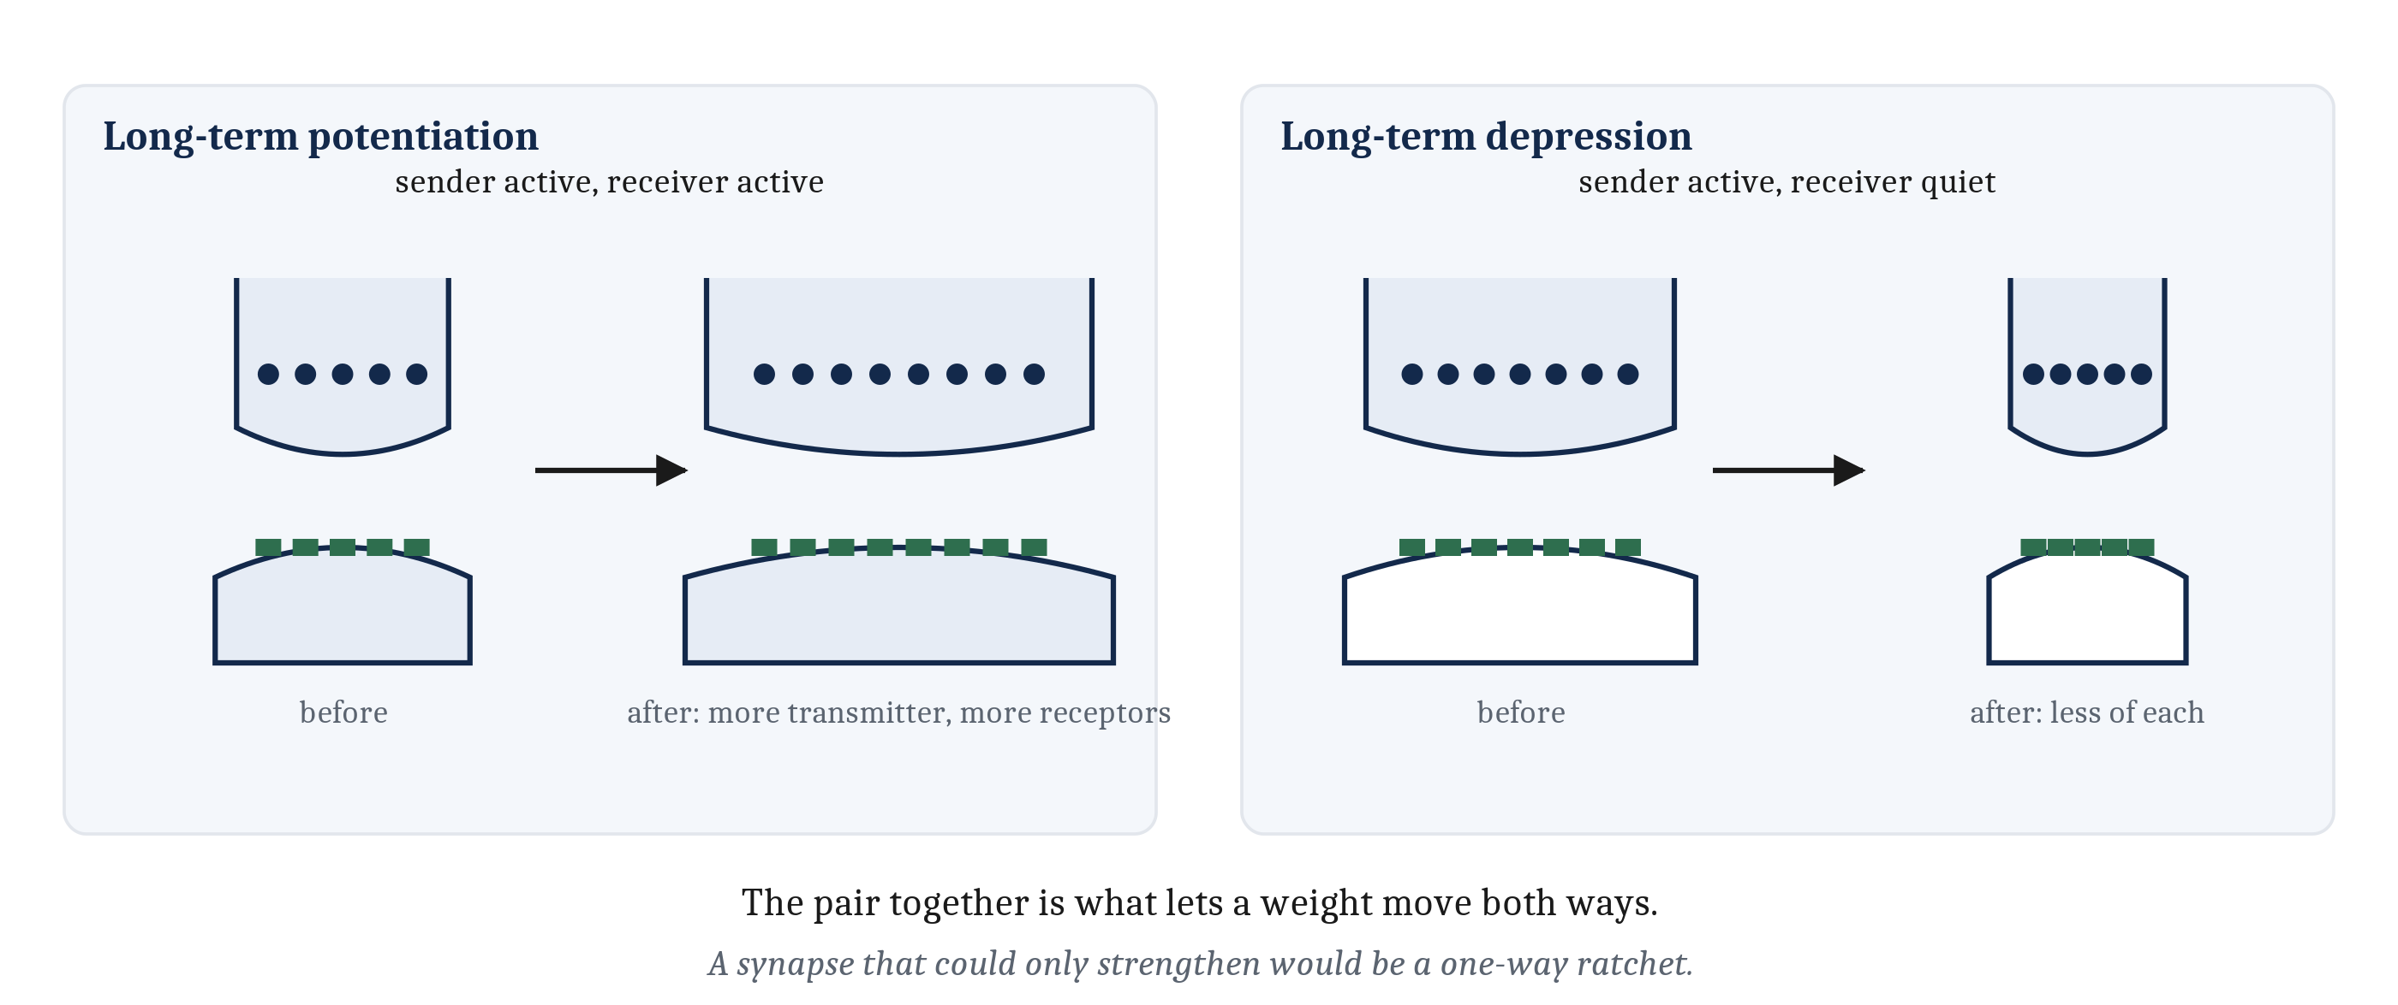
Strengthening a Synapse, and Weakening One
Fire together repeatedly and the synapse strengthens: long-term potentiation. Sender active while the receiver stays quiet, and it weakens: long-term depression — which is what keeps the rule from running away.
Notes:
Two connected cells fire together, repeatedly, and the synapse between them becomes stronger — and stays stronger, for hours or longer. That lasting increase is long-term potentiation.
Now let the sending cell fire repeatedly while the receiving cell stays quiet. The same synapse weakens instead. That is long-term depression.
Both are changes in how much an arriving spike accomplishes. More transmitter is released on the sending side and there are more receptors on the receiving side to catch it — or less of each, in the other direction.
The pair matters more than either member. A synapse that could only strengthen would be a one-way ratchet, which is exactly the limitation we found in Hebb's rule in the last lecture: every term positive, every change upward. Long-term depression is what makes a coincidence rule something that can move a weight in both directions, rather than something that can only add.
That second panel is also the answer to a problem the last lecture left open. A rule that strengthens what is already strong is a positive feedback loop, and Module 3 told us what those do: they run to completion. Left alone, a Hebbian synapse strengthens, which makes the receiving cell fire more readily, which makes the pairing more reliable, which strengthens the synapse further. Every useful connection would saturate and every cell would respond to everything.
Two things bound it. Long-term depression weakens a synapse directly. And **synaptic competition** does it indirectly: what a synapse needs in order to grow is limited, and shared among the synapses onto the same cell, so strengthening some weakens others. Competition is why an input that stops carrying signal does not merely fail to gain ground — it loses ground it already held. Hold on to that; it is the deprived eye later in the hour.
So the claim that Hebbian learning has no way to weaken a connection is false, and it is worth saying plainly, because the opposite gets repeated often.

Slide 4
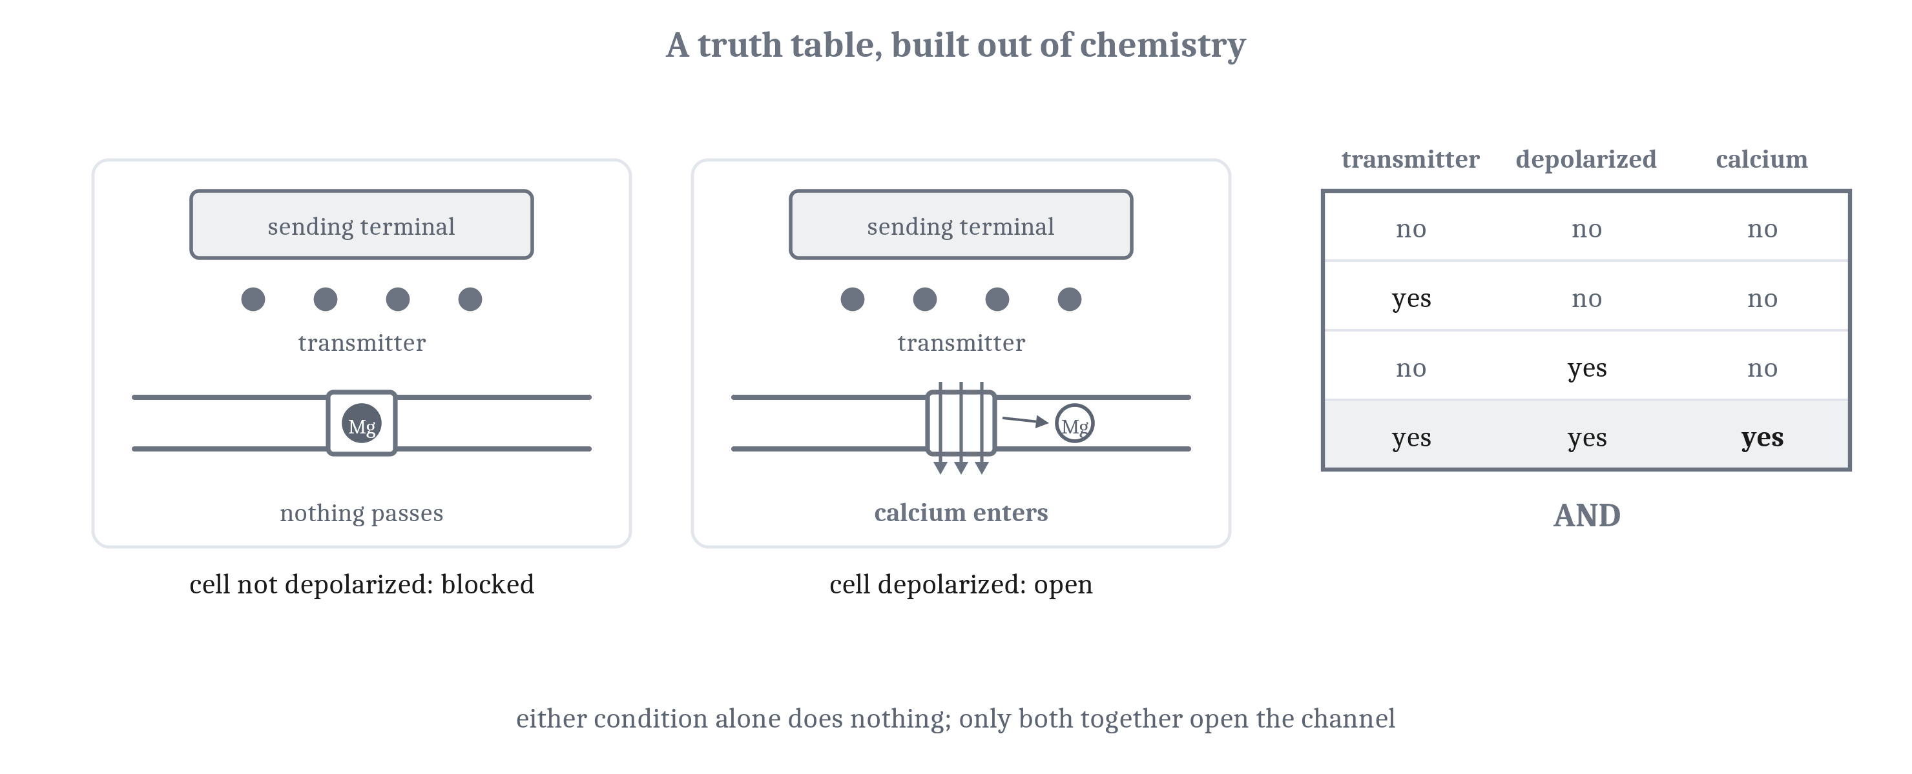
The NMDA Receptor Is an AND Gate
The NMDA receptor opens only when transmitter is bound and the receiving cell is already depolarized. That is coincidence detection, and here the name is the mechanism.
Notes:
How does a synapse detect that both of its cells were active? One answer is built into a receptor.
The NMDA receptor sits on the receiving side and opens only when two conditions hold at once. Transmitter from the sending cell has to be bound to it. And the receiving cell has to be depolarized already, enough to expel a magnesium ion that otherwise sits in the channel and plugs it. Transmitter alone does nothing, because the plug is still there. Depolarization alone does nothing, because nothing is bound. Both together, and the channel opens, calcium enters the receiving cell, and the lasting change is set in motion.
That is a truth table built out of chemistry, and the chapter's figure sets the two side by side. In Module 4 we treated AND, OR and NOT as operations a threshold unit computes, with the threshold deciding which. Here is an AND gate made of a protein, a magnesium ion and a voltage.
It is also the fourth AND gate in three modules: Module 4's threshold unit, the cnidarian stinging cell in the first lecture of this module, and now a receptor. The name for what it does is coincidence detection, and in this one case the name is not a description of the mechanism from a distance. It is the mechanism.

Slide 5
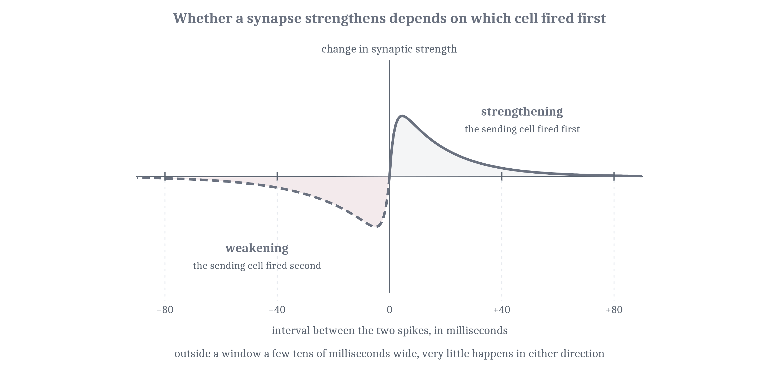
Timing, and Which One Came First
Sender fires just before the receiver: the synapse strengthens. Just after: it weakens. The window is a few tens of milliseconds — spike-timing-dependent plasticity.
Notes:
Overlap is not quite the whole story. What settles the direction of the change is order. If the sending cell fires shortly before the receiving cell, the synapse strengthens. If it fires shortly after, the same synapse weakens. The window where order matters is a few tens of milliseconds wide, and outside it very little happens either way. The whole pattern is called spike-timing-dependent plasticity.
That answers an objection that has been sitting under the last lecture since Hebb's rule was written down. A rule that responds to things happening together cannot tell a cause from a coincidence, because both show up as co-occurrence.
Except that at the synapse the two do not look alike. A cell that helped fire another cell fired first. A cell that merely happened to be active at the same moment is as likely to have fired just after as just before. So some of the difference between causing something and accompanying it is carried in a few milliseconds of order, and a synapse is sensitive to exactly that.
It also keeps a promise from the first lecture, where the rustle before the predator and the carcass after it told us that an association across time has to record which event came first. Here is that record, at a single synapse.

Slide 6
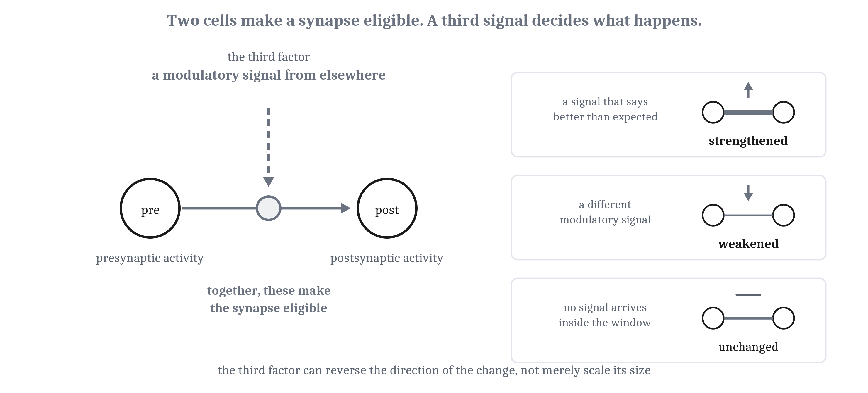
The Three-Factor Rule
Presynaptic activity and postsynaptic activity decide which synapses are eligible. A third signal, broadcast from elsewhere, decides whether they change — and in which direction.
Notes:
Presynaptic activity. Postsynaptic activity. And a third signal, broadcast from elsewhere. Together those are the three-factor rule, and the division of labor among them is the point. The local pair settles which synapses are eligible to change. The third factor settles whether they change at all, and in which direction.
That last part deserves care, because the obvious guess is wrong. The third factor is not a volume knob on a change the first two have already decided. In a number of preparations the same pairing of presynaptic and postsynaptic activity produces strengthening or weakening depending on which modulatory receptor is engaged. A modulator can reverse the sign of the change, not merely scale its size.
This is the bridge the last lecture needed. A coincidence detector on its own is Hebbian, and a Hebbian rule has no term for how things went. Add a signal that arrives when things went better than expected, and the same coincidence detector becomes a reward learner — with nothing about the coincidence detection itself altered.
The arrangement was found first in an invertebrate, and the case is worth a minute. *Aplysia* is a sea slug with roughly twenty thousand neurons, many large enough to see without a microscope. Touch its siphon and it withdraws its gill, and that one reflex carries three kinds of learning from the first lecture's tiers: habituation, sensitization, and classical conditioning. Each has been traced to particular synapses between identified cells.
Sensitization is the one that matters here. A shock to the tail makes the animal withdraw more vigorously to almost anything afterward — and what produces that is not a change inside either cell in the reflex pathway. It is a third cell, releasing serotonin onto the connection between them, changing how much transmitter the sending cell releases. A signal from outside the pair changed what the pair does.

Slide 7
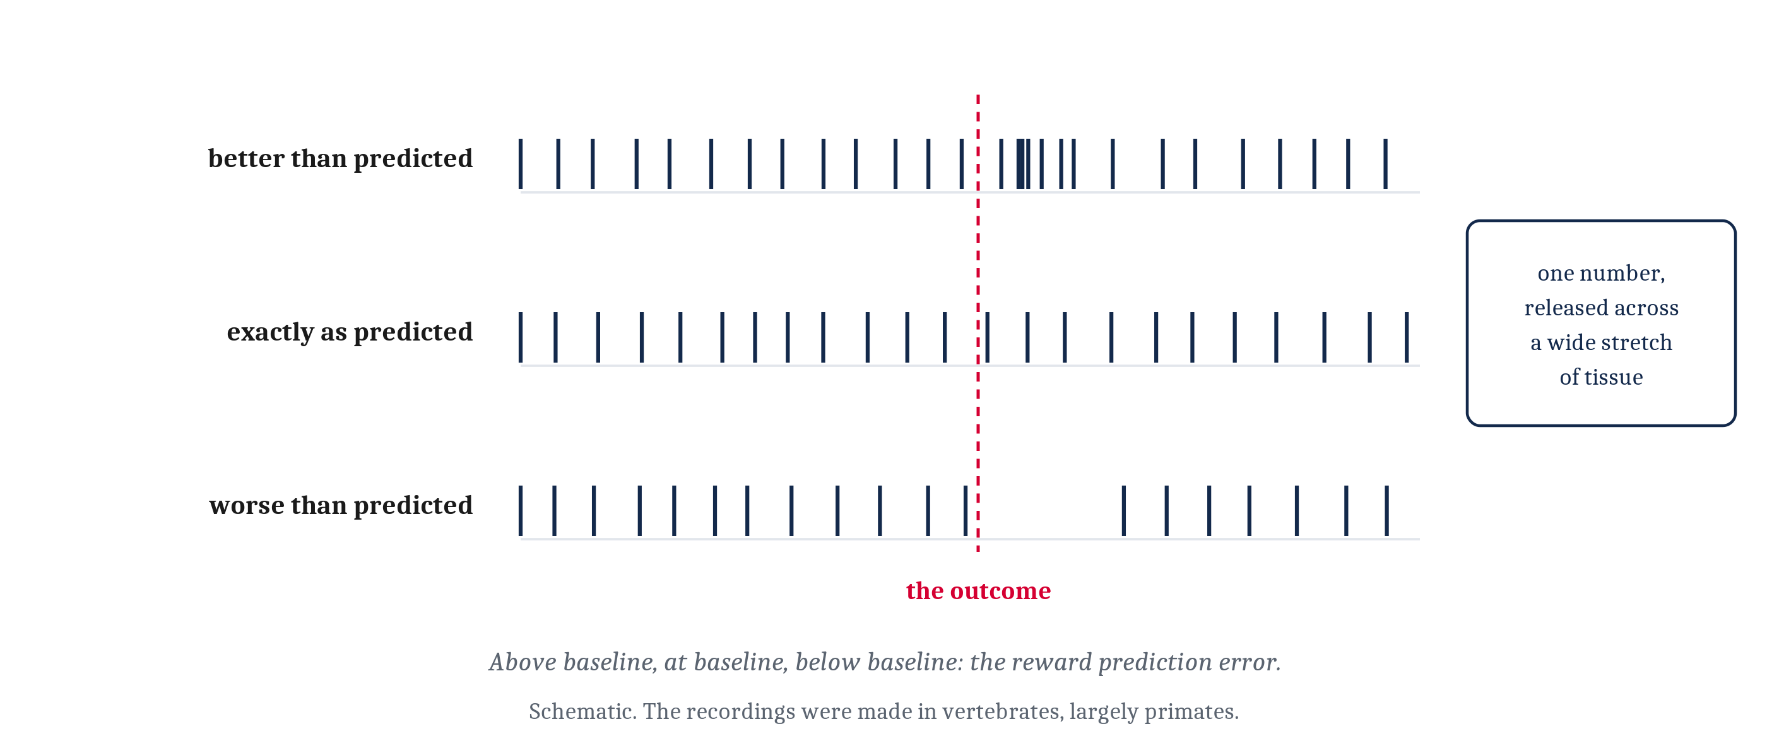
Dopamine Reports Better and Worse Than Expected
Above baseline when an outcome beats the prediction, below it when the outcome falls short, unchanged when it arrives as predicted: the reward prediction error, broadcast.
Notes:
Now the third factor can be named. Dopamine is one of the signals that does this job.
In Module 4 we gave dopamine wanting and pursuit and held the rest back. Here is the rest. Dopaminergic cells fire above their baseline when an outcome is better than predicted, fall below it when an outcome is worse, and do not change when an outcome arrives exactly as predicted.
That is the reward prediction error: the one broadcast number from the last lecture, made physical, and released across a wide stretch of tissue rather than addressed to particular cells. It is also the temporal-difference error of the critic, which is why this finding mattered so much — we will come back to that at the very end.
One honest note about the evidence. The recordings that established the dopamine result were made in vertebrates, and largely in primates. So the evidence comes from animals that arrived long after the mechanism did. How far down the tree the arrangement extends is a separate question from whether it works this way in a monkey, and this lecture does not answer it.

Slide 8
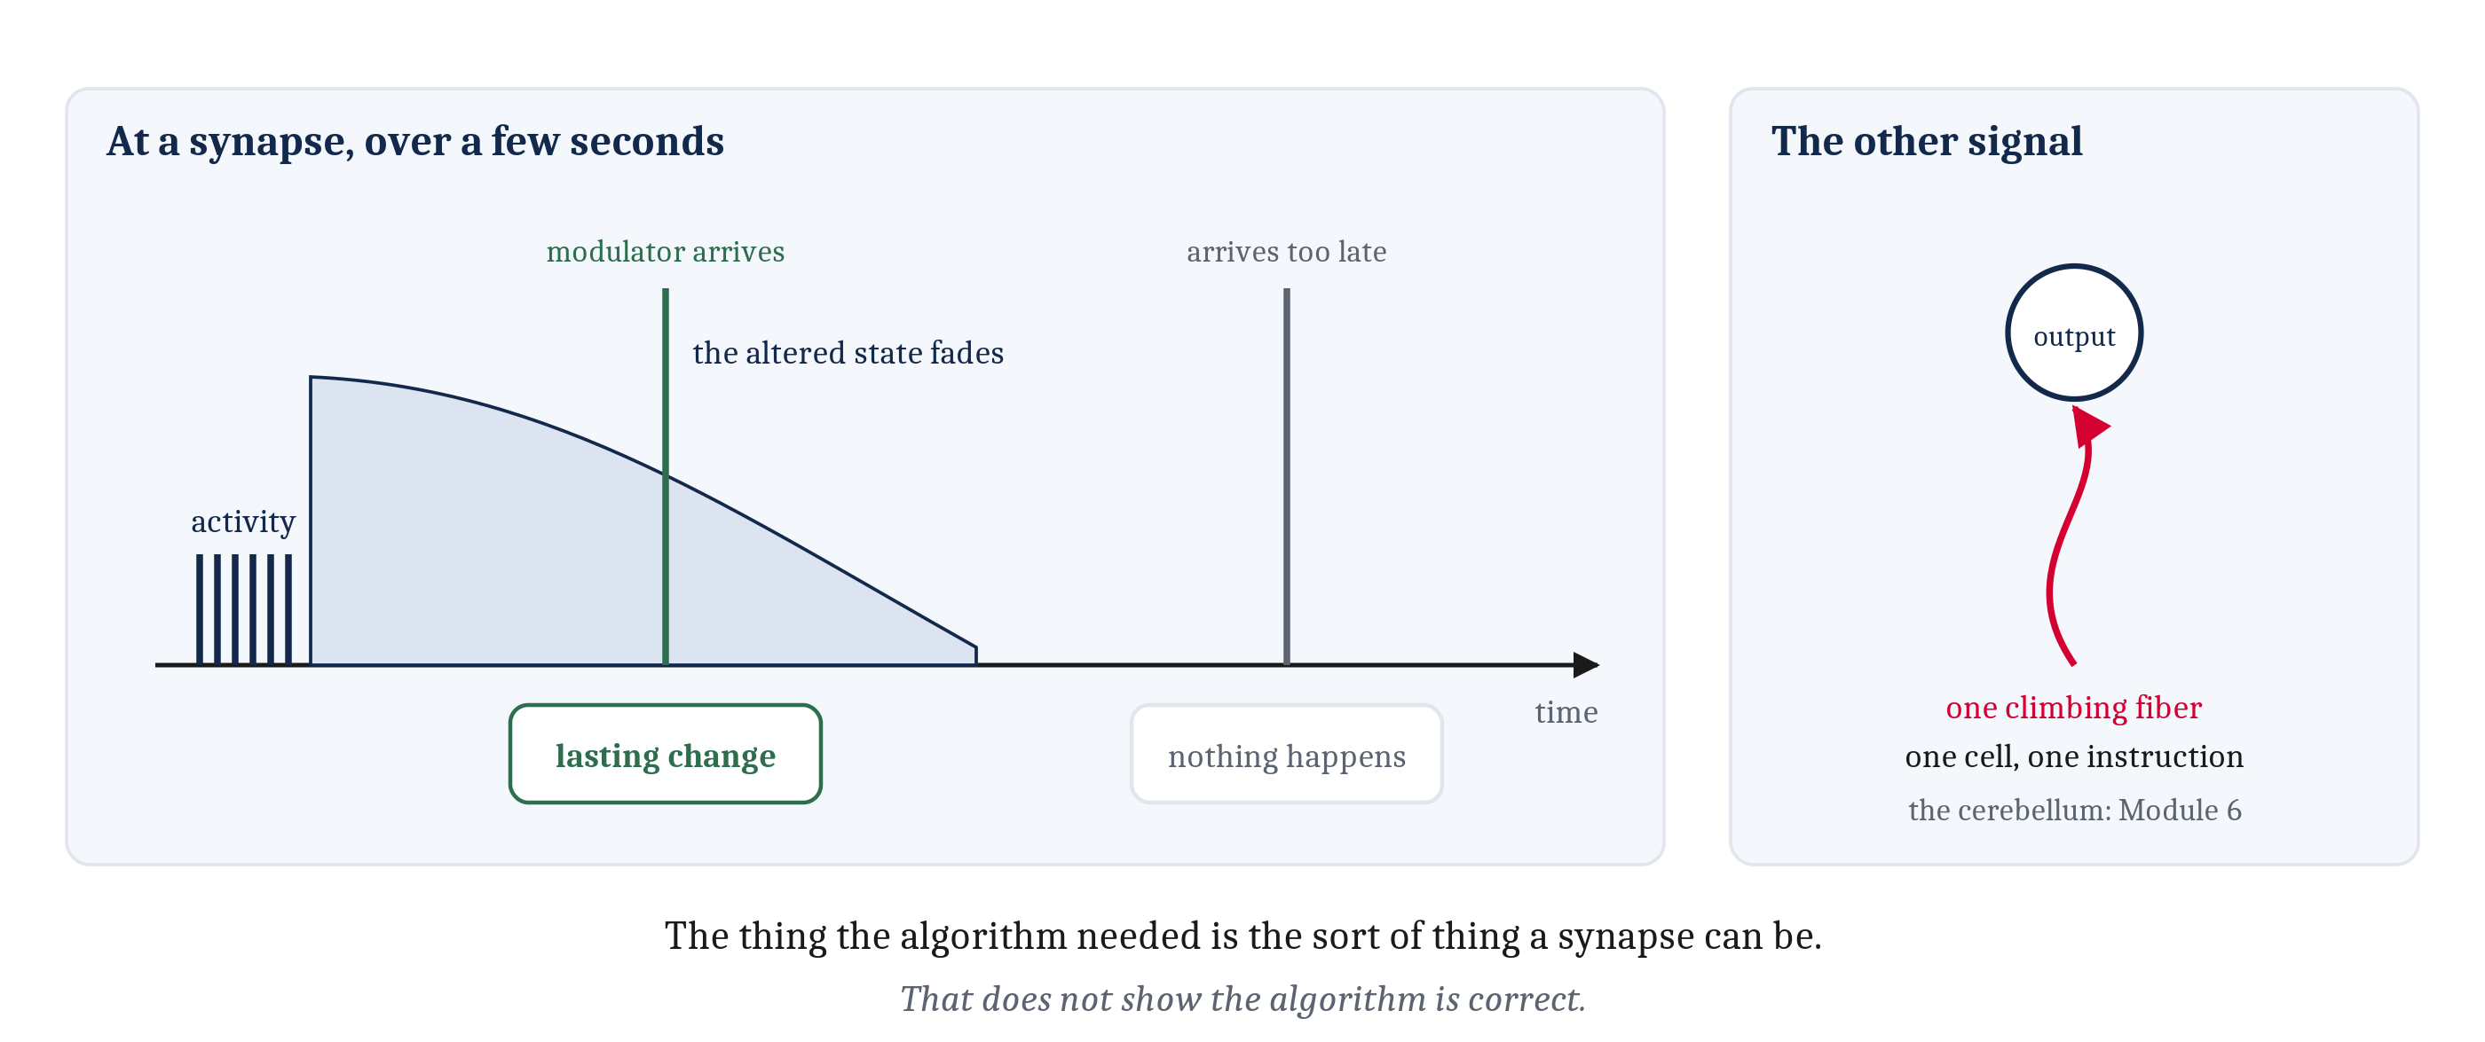
The Trace Made Physical, and the Other Signal From Elsewhere
A synapse that was just active is left in an altered state that fades over seconds. A modulatory signal inside that window makes the change last; after it, nothing happens.
Notes:
In the last lecture we needed a fading mark, so that a signal arriving after the fact could find the synapses that had been involved. Something of that kind exists. A synapse that has just been active is left in an altered state that decays over seconds. A neuromodulatory signal arriving inside that window converts the altered state into a lasting change. A signal arriving after the window has closed does not.
So an algorithmic proposal, invented to solve a timing problem, has a physical counterpart. It is worth being careful about what that shows and what it does not. It does not show the algorithm is correct. It shows that the thing the algorithm needed is the sort of thing a synapse can be.
A single broadcast number is also not the only signal a nervous system can send from elsewhere. Some learning runs on a signal that specifies a different output, item by item — the teacher from the four kinds of learning, the one we said was hardest to arrange. Vertebrates have a structure arranged around exactly that. In the cerebellum, each output cell receives a single climbing fiber from one source, and that fiber's firing is an error signal for that cell in particular. One fiber, one target cell, one instruction.
Where the different kinds of learning end up in a vertebrate brain, and what an animal gains by keeping them apart, is Module 6.

Slide 9
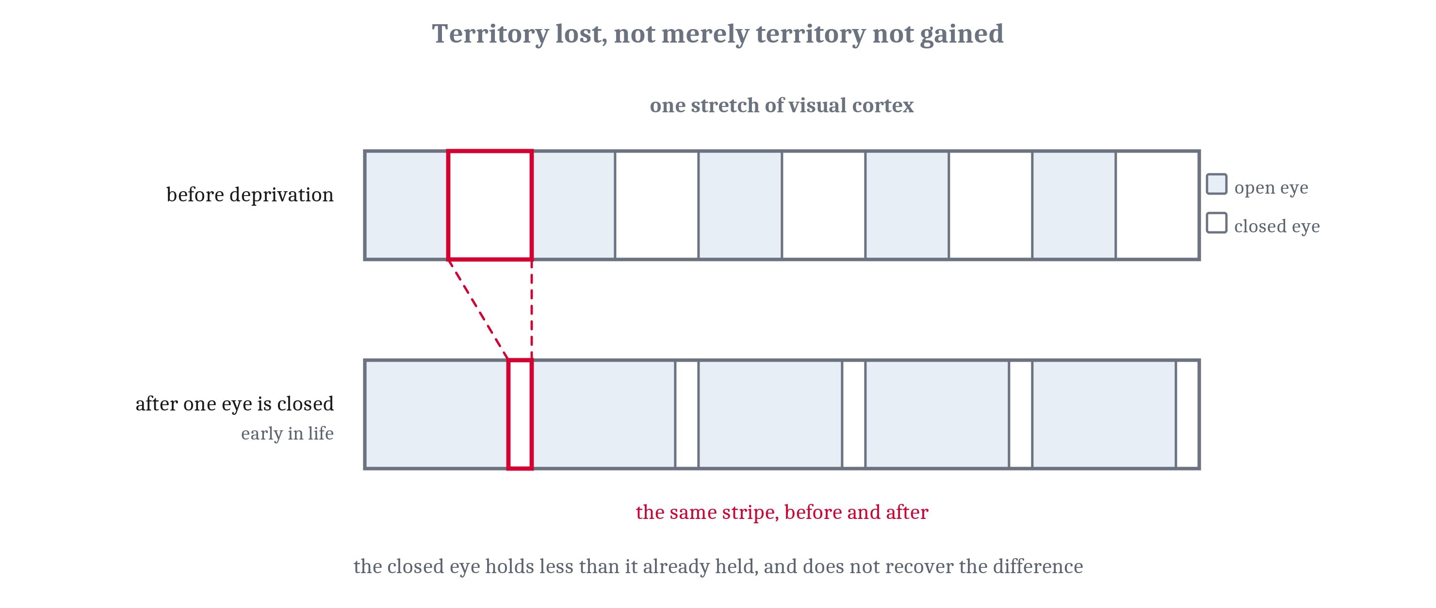
Learning Has a Schedule
Connections are made in profusion (synaptogenesis), then cut back by activity (pruning). A critical period is a window when experience has an outsized, lasting effect on wiring.
Notes:
In the first lecture we said a learner needs a setting somewhere between changing with every experience and changing with none, and probably a schedule that moves the setting across a lifetime. Nervous systems have that schedule, built from the mechanisms we have just seen.
Connections are made early in great profusion, far more than will survive. That is synaptogenesis. What follows is pruning, a cutting back in which activity decides which connections last — and the rule doing the deciding is competition, running while the animal is still being built. So early on a nervous system is not merely adjusting weights. It is settling which connections will exist to have weights at all.
A critical period is a window during which experience has an outsized and lasting effect on how some piece of nervous system ends up wired. The figure is the chapter's clearest case. The inputs from the two eyes compete for territory in visual cortex. Close one eye early in life and it ends up holding less territory than it had before — lost ground, not merely ground not gained — and it does not recover the difference when the eye is reopened. Do the same to an adult and very little happens.
The second case is in every one of us. Human infants can hear distinctions their language does not use, and lose much of that ability across the first year, as the contrasts that actually occur in what they hear come to organize how speech sounds are heard at all. In both cases the closing is an active process, not a running-down, which is why it has a schedule rather than merely a rate.
One caution before we go on. Competition is the mechanism this chapter follows, and it is not the only candidate. Intrinsic schedules of plasticity, entrenchment in distributed representations, and the simple disappearance of a signal that was driving change are all live proposals. We follow competition because it is the one built from parts already on the table. We come back to this in the discussion.

Slide 10
Name One, Then Say How It Closes
In your group, four minutes.
Name something that looks like it has a critical period — a capacity where early experience matters in a way later experience cannot match. Anything except the two cases from the reading.
Then: what would have to be true of the brain for that window to close?
Notes:
Four minutes in groups. Take three or four cases from the room before saying anything about mechanism.
What usually comes up: accents, perfect pitch, musical instruments, imprinting in birds, attachment, reading. Some of these are well supported and some are folklore, and sorting that out is not the point today. The mechanism question is.
Then the debrief, which is the part that matters. Put up the menu of things that could close a window, and note that we taught exactly one of them.
Competition for something limited is ours. An input that stops carrying useful signals loses ground it already held, and does not get it back. That is the eye case, and it is the mechanism this chapter follows.
But there are others, and they are all live. The cells' own learning rates may be on a developmental schedule set independently of experience, so the window closes because the tissue changes, not because the competition finished. Units driven to the extremes of their range produce smaller and smaller error signals, so changes get harder to make simply because the system is already committed. A distributed representation can become entrenched, where changing it for one purpose breaks everything else resting on it. And a teaching signal can disappear: while the body is growing, the mapping from muscle to outcome keeps changing, so there is constant error to learn from — and when physical maturation stops, that error goes away and so does the pressure to change.
That last one is prediction learning, from this morning's first question. The world stops delivering the next surprise.
The point to land: **a critical period does not pick out its own mechanism.** Any of those five would produce a window that closes on a schedule. We showed one mechanism that can do it, and showing that a mechanism can do a job is not showing that it is the job being done.
That is the next slide's argument arriving early, on a case they generated themselves, so it should be named as such: hold this, because it comes back in ten minutes as reverse inference.
If the room is quiet, the fallback is to hand them one case — accents — and ask only the second question.

Slide 11
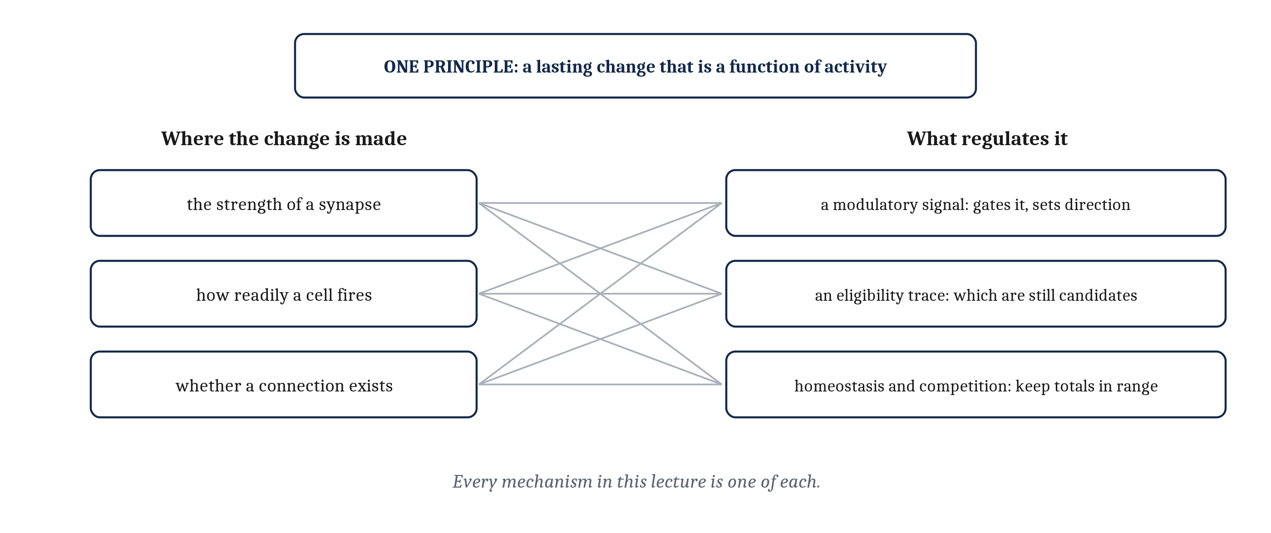
One Principle, Several Loci, Several Regulators
Three places to change: synaptic strength, intrinsic excitability, whether a connection exists. Three regulators: a modulatory signal, an eligibility trace, homeostatic plasticity with competition.
Notes:
A synapse is not the only thing a nervous system can change lastingly, and after being told many times that a weight is what moves, it is worth being told what else does. The answer tidies the lecture rather than complicating it.
There are three places a lasting change can be made. The strength of a synapse is the one we have spent most time on. Intrinsic excitability is the second: a cell can change how readily it fires at all, so the same input carries it further, or less far, than before. Whether a connection exists at all is the third, which we just saw settled by competition during development.
And there are three regulators. A neuromodulatory signal gates the change and can set its direction. An eligibility trace settles which synapses are still candidates when that signal arrives. And homeostatic plasticity, together with competition, keeps total activity and total synaptic strength within a range.
One principle, at several loci, with several regulators. Every mechanism in this lecture has been an instance of it.
The frame also dissolves a question a good student asks. It is sometimes said that Hebbian plasticity is the only real learning, and everything else is a modulation of it. On this account that is a disagreement about which word to use, not about what happens. Nobody disputes the pieces. Whether to call gating, traces and excitability changes learning, or the regulation of learning, is a naming question, and naming questions are not findings.
One hedge is owed. This is where the evidence currently sits, not a proof that nothing else could hold a lasting change. A minority argument that some of what is stored is held inside cells, in molecules rather than connections, is live, and the reading points to it.

Slide 12
A Synapse Changed and Stayed Changed. Is That a Memory?
A disposition is committed when it is laid down. A record is kept without its use being settled, and what it is for is decided at retrieval. Learning produces dispositions.
 | A disposition | A record
Committed at encoding | Yes — what the change will do is fixed by the change | No — what it is for is settled later
A separate retrieval step | Not needed; the change acts whenever the situation recurs | Required, and it is where the use gets decided
What it can report | What tends to happen | What happened, on a particular occasion
Where it is taken up | Module 5 | Module 10
Notes:
A synapse has now been shown changing, and staying changed. So is that a memory?
In one ordinary sense, yes. A persisting change caused by experience is close to what many people mean by the word, and on that reading everything in this lecture is a memory result.
But that sense does no work. On it, a piece of metal that has been bent is remembering the force that bent it, and a path worn across a lawn is remembering the people who walked it. A word that covers everything distinguishes nothing.
The distinction that does work is about when the use of a stored thing is settled. A disposition is committed at the moment it is laid down: the weight changes, and what the change will do is fixed by the change itself. A record is uncommitted: something is kept without its use being settled, and what it is for is decided later, when it is retrieved. Learning as this module has described it produces dispositions.
Two consequences follow. *Encoding, storage and retrieval* is not a deeper way of describing what we have seen; it is a decomposition that only becomes necessary once what is kept is uncommitted. That is why the vocabulary sounds strange applied to habituation — nothing is retrieved when an anemone stops withdrawing. And a weight is a residue. It can say what tends to happen. It can never say what happened. An animal whose learning is entirely dispositional cannot revisit a particular occasion, because no particular occasion was ever kept.
The distinction predicts its own hard cases, and the hard cases are the famous ones. In *sensory preconditioning*, a bell and a light are paired with each other first, with nothing following either, and only afterward is one of them paired with something that matters. The animal then responds to the other one too, though it was never paired with anything. At the moment the bell and the light were linked, nothing had settled what that link would be used for.
*Latent learning* is the same shape, larger. Rats allowed to wander a maze with no food in it appear to learn nothing. Introduce food, and they reach it about as efficiently as rats rewarded from the start. What they picked up while wandering was not committed to any use at the time.
That is where a disposition stops being enough. Something was kept that was not a disposition to act, and a later process had to put it to work. Records, retrieval, and the animals that keep them are Module 10's.

Slide 13
What Separates the Four Kinds of Learning
Not what they change: all four change a weight. What separates them is how much of the world has to reach that weight before it moves, and who supplies the answer. One synapse, given the right third factor, implements all of it.
Vocabulary about goals and errors earns its place exactly where something in the mechanism plays the part the word names.
Notes:
Pull the module together. Four kinds of learning, and what separates them is not what they change. All four change a weight.
What separates them is how much of the world has to reach that weight before it will move, and where an answer is needed, who supplies it. Nothing but the two cells a connection joins. The next input, which the world delivers without being asked. An answer from a source that already holds it. Or one number reporting how things went. Ranked by how hard that signal is to arrange inside an animal, the order runs backward from the one most people expect, and a teacher is the hardest rather than the easiest. And one synapse, given the right third factor, implements all of it.
One lesson travels further than the rest, so it is worth saying on its own. Vocabulary about goals and errors earns its place exactly where something in the mechanism plays the part the word names. Hebb's rule holds no goal and registers no miss, so reading design into it is the same mistake we refused to make about the peppered moth in Module 2. Error-driven learning holds an expectation and computes a difference against it, so the same words describe rather than decorate.
That is a test, and it applies well outside this course — to a news story about what a gene "wants", to a claim about what an AI system "believes", to anything described in the language of intention.

Slide 14
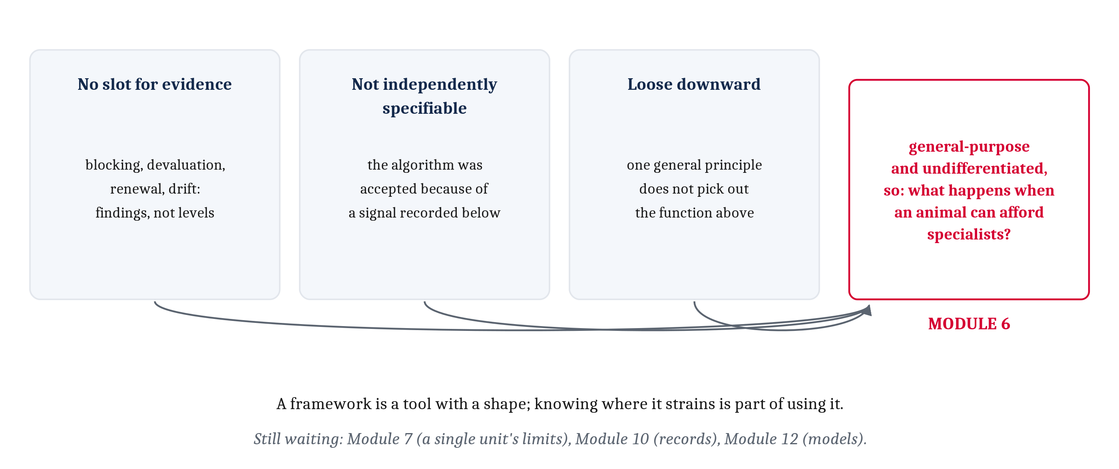
Three Places Marr's Levels Strained, and What Comes Next
The levels have no slot for evidence. They were not independently specifiable here. And the implementation did not pick out one function. A principle reusable everywhere is specialized for nothing.
Notes:
Before the three strains, one thing the last slides have been circling. Nothing in the loci-and-regulators frame is a learning-specific device. The same coincidence detection, the same gating by a signal from elsewhere, and the same competition for something limited also wire a nervous system during development, tune a sensory map, and support the memory system we just handed to Module 10. One set of parts, several architectures, several problems.
Module 1 taught multiple realizability: one function, many possible implementations. This is the converse — one implementation, many functions. And the converse is what makes an inference from a part to a job unsafe, which is **reverse inference** from Module 2. Finding that a mechanism is present does not establish which job is being done, when the same mechanism does several.
Now the three strains, with the evidence in hand to see them.
First, Marr's levels have no slot for evidence. The chapter's findings — blocking, reinforcer devaluation, renewal, instinctive drift — are not computational, algorithmic or implementational claims. Those last three are in the reading rather than in our class time, since the previous lecture ran out of hour before reaching them; read §5.2.10 through §5.2.12 with this slide in mind. They are findings, and findings are what decide between proposals at every level. A scheme that classifies explanations is silent about the things that adjudicate them.
Second, the levels were not independently specifiable here. The scheme says we should be able to settle what is computed without settling how it is done. But temporal-difference learning became the accepted account of animal learning in large part because of a finding from below it — the dopamine recordings, behaving exactly as the algorithm's error term said they should. The evidence for the algorithm came from the implementation.
Third, what turned up at the implementational level was not a mechanism for learning but a principle, sited in several places and regulated several ways. A description that general does not pick out the function above it, so the mapping between levels is loose downward as well as upward.
None of that means the levels fail. They separated *why change at all* from *by what rule* from *in what material*, and that separation is what let us compare the four families. A framework is a tool with a shape, and knowing where it strains is part of knowing how to use it.
And the handoff. Everything in this module is general-purpose and undifferentiated: the same rule, the same tissue, wherever there are synapses. A principle general enough to be reused everywhere is, for that reason, specialized for nothing. A system that does everything in one place cannot be very good at any of it, and cannot do two incompatible things at once. So what happens when an animal is large enough to build specialists? That is Module 6 — the question Module 4 asked about circuits, one level up. Three smaller threads wait further on: what a single unit cannot learn, in Module 7; records, in Module 10; and choosing by consulting a model, in Module 12.

Slide 15
Image Sources (1 of 2)
Slide | Image | File | Licence | Source
3 | Long-term potentiation and long-term depression | fig-ltp-ltd.png | CC BY 4.0 | Jon Willits — drawn for this lecture · own work
4 | The NMDA receptor beside the truth table for AND | fig-nmda-and.png | CC BY 4.0 | Jon Willits — drawn for the Module 5 reading · own work
5 | The spike-timing window | fig-stdp-window.png | CC BY 4.0 | Jon Willits — drawn for the Module 5 reading · own work
6 | The three factors that decide whether a synapse changes | fig-three-factor.png | CC BY 4.0 | Jon Willits — drawn for the Module 5 reading · own work
7 | Three outcomes and a dopaminergic cell's response | fig-dopamine-rpe.png | CC BY 4.0 | Jon Willits — drawn for this lecture · own work
8 | The eligibility trace at a synapse | fig-trace-window.png | CC BY 4.0 | Jon Willits — drawn for this lecture · own work
9 | Two eyes competing for territory in visual cortex | fig-competition.png | CC BY 4.0 | Jon Willits — drawn for the Module 5 reading · own work
11 | Three loci and three regulators | fig-loci-regulators.png | CC BY 4.0 | Jon Willits — drawn for this lecture · own work

Slide 16
Image Sources (2 of 2)
Slide | Image | File | Licence | Source
14 | Three strains, and the handoff | fig-three-strains.png | CC BY 4.0 | Jon Willits — drawn for this lecture · own work

