Slide 1
BCOG 100
Logic Lecture 2: Formal Logic

Slide 2
Reading Check 3-2
Password: truth
Question: What’s a truth table, and why are they useful?

Slide 3
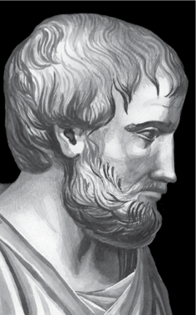
Formal Logic
To evaluate arguments, we need procedures for determining:
groundedness (are the premises true)
validity (is the conclusion necessarily true if the premises are true)
There are many ways we can make both of these kinds of mistakes. Commonly recurring mistakes are called fallacies.

Slide 4
Formal Logic
Formal logic examines what propositions necessarily follow from what other propositions because of their forms, regardless of their content
Propositions: declarative sentences that have a subject and a predicate, the thing that we are asserting about the subject.
All dogs have tails. Fido is a dog. Therefore. Fido has a tail.
All dogs have tails. Max has a tail. Therefore, Max is a dog.
All X’s have F.
x is a n X
Therefore, x has F.
All X’s have F.
x has an F.
Therefore, x is an X.
Aristotle
384-322 BCE
Notes:
We have learned that there are two criteria for acceptable arguments: well-groundedness and validity. You have also seen that there are two types of arguments: inductive and deductive. So far, you have examined some aspects of informal logic—that is, analysis of the well-groundedness of arguments—and you have looked at validity concerns for inductive arguments. What remains is deductive validity, the aspect of logic that has historically commanded a great amount of attention from logicians. In this lecture, you will be introduced to formal logic.

Slide 5
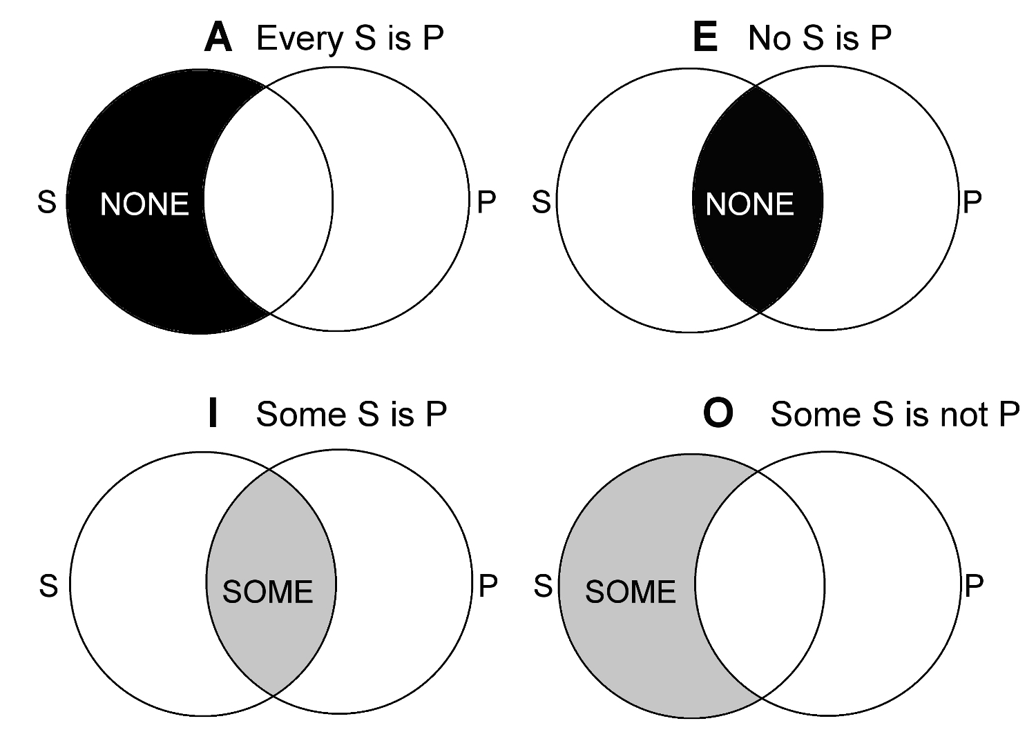
Formal Logic
Aristotle’s categorical propositions:
A proposition is true iff (if and only if) the subject has the property asserted by the predicate and is false if not. Four types of categorical propositions, presented in Aristotle’s “square of opposition”
Contradictories:
Opposite corners are negations, as in A is true iff O is false, and I is true iff E is false
Universal
Contraries:
A and E sentences cannot both be true, but can both be false
Affirmative
Negative
Subcontraries:
I and O sentences can both be true, but cannot both be false
Aristotle
384-322 BCE
Particular

Slide 6
Truth Functional Logic
Philosophy and science must be done with words, but words are ambiguous and vague
Develop an artificial language, one with exactitude required built into its very grammatical structure
By translating natural languages into this language, we could see whether they were real questions and determine their truth conditions
The German mathematician/logician/philosopher Gottlob Frege called his attempt at framing such a language Begriffschrift, or concept writing. It ultimately became truth-functional logic.

Slide 7
Truth Functional Logic
Function here means same thing as in math
y = f(x) means for every value of x there is a unique value of y
Takes in an input and spits out something well defined
But instead of numbers, truth values T and F
The goal in truth functional logic is to figure out, if we know the truth value of a particular sentence, what other sentences have to be true or false?
As with Aristotle, goal is for rules that are concerned with the form, content is irrelevant

Slide 8
Truth Functional Logic
Truth functional logic has two elements
Atomic sentences: Simple declarative sentences
Truth functional connective: a word that joins atomic sentences
The sky is blue AND I was born in 1872
A connective is truth functional iff the truth of the joined sentence can be determined as a function of its parts and the value of the connective

Slide 9
Truth Functional Logic
Truth functional connectives can be defined in truth tables
AND
P | Q | P and Q
T | T | T
T | F | F
F | T | F
F | F | F

Slide 10
Truth Functional Logic
Not all connectives are truth functional
P: Apples fall from trees
Q: Gravity pulls objects together proportional to their mass
P BECAUSE Q: Apples fall from trees BECAUSE Gravity pulls objects together proportional to their mass
P: The sky is blue
Q: Einstein was a physicist
P BECAUSE Q: The sky is blue BECAUSE Einstein was a physicist
For OR, the truth value of column can be determined regardless of the content of what P and Q stand for.
For BECAUSE, this is not true. This is what makes OR a special ”truth functional” connective.
P | Q | P because Q
T | T | ?
T | F | ?
F | T | ?
F | F | ?
Notes:
The sky is blue BECAUSE Einstein was a physicist

Slide 11
Truth Tables
OR (v +)
P | Q | P ∨ Q
T | T | T
T | F | T
F | T | T
F | F | F
AND (& ^ *)
P | Q | P & Q
T | T | T
T | F | F
F | T | F
F | F | F
IF, THEN (→ ⇒)
P | Q | P → Q
T | T | T
T | F | F
F | T | T
F | F | T
NOT (- ~ ¬)
P | -P
T | F
F | T

Slide 12
Truth Tables
IF → THEN
P | Q | P → Q
T | T | T
T | F | F
F | T | T
F | F | T
Why are the last two rows true?
P you average at least a 93% on all your assignments
Q You get at least an A in the class
If you average at least a 93% on all your assignments, you will get at least an A in the class.

Slide 13
Truth Tables
If you didn’t wash and didn’t brush your teeth, you’re not ready for bed.
P: you washed your face
Q: you brushed your teeth
R: you’re ready for bed
P | Q | R | -P | -Q | -P AND -Q | -R | (-P AND -Q) → -R
T | T | T | F | F | F | F | T
T | T | F | F | F | F | T | T
T | F | T | F | T | F | F | T
T | F | F | F | T | F | T | T
F | T | T | T | F | F | F | T
F | T | F | T | F | F | T | T
F | F | T | T | T | T | F | F
F | F | F | T | T | T | T | T

Slide 14
Truth Tables
This seems like a lot of work. What’s the point of identifying propositions and truth functional connectives, and making all these truth tables?
Logic as a model of structured thought: Truth tables give us a precise way to represent and evaluate these structures, so we can test theories about how people actually reason.
Separating form from content: This is a hallmark of higher cognition — the ability to reason abstractly, to transfer patterns across domains (“if X then Y” applies in physics, in social rules, in moral reasoning).
Normative vs descriptive reasoning: Truth tables give us a clean formal benchmark. Without a formal baseline, you can’t even measure what’s “illogical.”
Formalization as cognitive modeling: If cognition is computational, then representing propositions and operators gives us one possible model of how reasoning could be implemented in the mind or in a neural net.
Building blocks for richer systems: Once we have truth functional logic in place, there’s a lot that we can do with it.

Slide 15
Proving Validity
Truth Tables and Proving Validity
An argument is valid iff its premise set implies its conclusion
Just make a big truth table, and if all cases where all premises are true, the conclusions are true, the argument is valid

Slide 16
Proving Validity
Truth Tables and Proving Validity
Example Modus Ponens
[1] m → n [2] m
∴ [3] n
m | n | m→n
T | T | T
T | F | F
F | T | T
F | F | T
m→n | m | n
T | T | T
F | T | F
T | F | T
T | F | F

Slide 17
Proving Validity
Truth Tables and Proving Validity
The fallacy of affirming the consequent
[1] m → n [2] n
∴ [3] m
m | n | m→n
T | T | T
T | F | F
F | T | T
F | F | T
m→n | n | m
T | T | T
F | F | T
T | T | F
T | F | F

Slide 18
Proving Validity
Truth Tables and Proving Validity
Three atomic sentences
If there is precipitation and the temperature is below freezing, then there is snow. There is not not snow or the temp is below freezing. Therefore, there is precipitation or there is snow.
a | b | c | a&b | (a&b)→c | -c | -c V b | a V c
T | T | T | T | T | F | T | T
T | T | F | T | F | T | T | T
T | F | T | F | T | F | F | T
T | F | F | F | T | T | T | T
F | T | T | F | T | F | T | T
F | T | F | F | T | T | T | F
F | F | T | F | T | F | F | T
F | F | F | F | T | T | T | F
a: there is precipitation
b: it is below freezing
c: there is snow
[1] (a&b)→ c [2] –c ∨ b
∴ [3] a ∨ c

Slide 19
Proving Validity
[1] a→b [2] b→c [3] c→d [4] d→e [5] e→f [6] f→g [7] a
∴ [8] g
Truth Tables and Proving Validity
How many rows and columns would you need, just to prove this pretty clearly true thing?

Slide 20
Proving Validity
Proving Validity with Natural Deduction
Another, more powerful method for determining if arguments are logical
Think of deduction like a game.
The board is three columns
C1: Positive integers in ascending order, each line has a number
C2: Nothing but true sentences written in our truth functional language
C3: The justification that allowed a sentence to be placed in C2
We start with our premises as the first rows, with “premise” written as their justification in C3.
We are then trying to transform rows, using allowed transformation rules, until we arrive at our conclusion. If we succeed, valid argument.
Notes:
Why introduce a second validity test when we already have a perfectly good one? Truth tables are not always user-friendly, and our truth-functional language is insufficient for all of the logical work we want to do.

Slide 21
Proving Validity
line | S | justification
1 2 3 4 5 6 7 8 9 10 11 12 13 | a→b b→c c→d d→e e→f f→g a b c d e f g | premise premise premise premise premise premise premise MP1,7 MP2,8 MP3,9 MP4,10 MP5,11 MP6,12
[1] a→b [2] b→c [3] c→d [4] d→e [5] e→f [6] f→g [7] a
∴ [8] g

Slide 22
Proving Validity
The rules of inference
Rule | Premise 1 | Premise 2 | Premise 3 | Conclusion
Modus Ponens (MP) | A→B | A |  | B
Modus Tonens (MT) | A→B | -B |  | -A
Hypoth. Syllogism (HS) | A→B | B→C |  | A→C
Conjunction (Conj) | A | B |  | A&B
Simplification (Simp) | A&B |  |  | A
Addition (Add) | A |  |  | AvB
Disjunctive Syllogism (DS) | AvB | -A |  | B
Constructive Dilemma (CD) | A→B | C→D | AvC | BvD

Slide 23
Proving Validity
The rules of inference
Rule | Premise 1 | Conclusion | Premise 1 | Conclusion
Double Negation (DN) | A | - - A
DeMorgan’s Theor. (DeM) | -(AvB) | -A&-B | -(A&B) | -Av-B
Distributive (Dist) | Av(B&C) | (AvB) & (AvC) | A&(BvC) | (A&B) v (A&C)
Associative (Assoc) | Av(BvC) | (AvB)vC | A&(B&C) | (A&B)&C
Commutative (Comm) | AvB | BvA | A&B | B&A
Contradiction (Contra) | A→B | -B→-A
Exportation (Exp) | (A&B)→C | A→(B→C)
Implicature (Impl) | A→B | -AvB
Tautology Taut) | AvA | A | A&A | A

