Slide 1

BCOG 100
Planning and Decision-making
Lecture 12.1 — Choosing Among Futures
Notes:
This module is about choosing among futures before living any of them. Many animals act now for needs that arise later. Human beings do so constantly, and they often choose among several possible futures before any of them has happened.
This first lecture is the computational level. We ask what choosing among futures requires, and what standard a choice can be judged by. We describe animals that act now for later, and we follow the hominins, the species of the human line, from their split with the chimpanzee line to the appearance of *Homo sapiens*. Then we ask what intelligence is, how it has been measured, and what the measurements were used for. We name no procedure for planning in this lecture. We take up procedures in the second lecture, and the brain and the genes in the third.
People differ in how well they choose among futures, and in how well they solve problems in general. That difference is usually called intelligence. Psychologists have measured it with tests for more than a century. Those tests have also been used for social purposes, sometimes extremely morally questionable ones. In the early twentieth century, test results were used in arguments for restricting immigration, and for sterilizing people judged to be “feeble-minded”.
So in this module, we ask four questions. What does choosing among futures require? Which animals act for the future, and how did the hominins come to depend on it? What is intelligence, and what do tests of it measure? And what in the brain and in the genes is associated with intelligence?

Slide 2
To Start: Acting Now for Later
In your group, three minutes.
Name something you did recently only because of something that would happen later.
Did you choose among several possible futures before you did it? If someone had only watched you, how could they tell?
Notes:
Our opening question is the first guiding question at the start of the reading, in everyday terms. What does choosing among futures require, and which animals act now for situations that have not yet arisen?
Discussion groups usually find many examples. Packing an umbrella, charging a phone, eating before a long class, bringing the right book. Some of these were chosen among alternatives: take the bus or walk, study now or later. Others were habits that simply happen every morning. How an observer could tell is the harder question, and the important one. Someone watching us sees only what we do. They do not see whether we considered other futures, or simply did what we always do.
The same question arises for other animals. At a zoo in Sweden, keepers recorded the behavior of one chimpanzee for about ten years. He was the dominant male of a group that lived on an island. On many mornings, before the zoo opened, he gathered stones from the water, and piled them on the shore that faced the visitors. He was calm while he did this. Hours later, during agitated displays, he threw the stones at visitors. The keepers removed hundreds of his piles.
The chimpanzee took actions in the morning for a situation that arose hours later. When he gathered the stones, no visitors were there to throw them at. Scrub jays, ravens, and other apes also act now for needs that arise later. But what we can observe, in the chimpanzee as in a person watched from outside, is behavior, not whether the chooser represented the futures it was choosing among. We come back to that limit, what behavior can show, throughout this lecture.

Slide 3
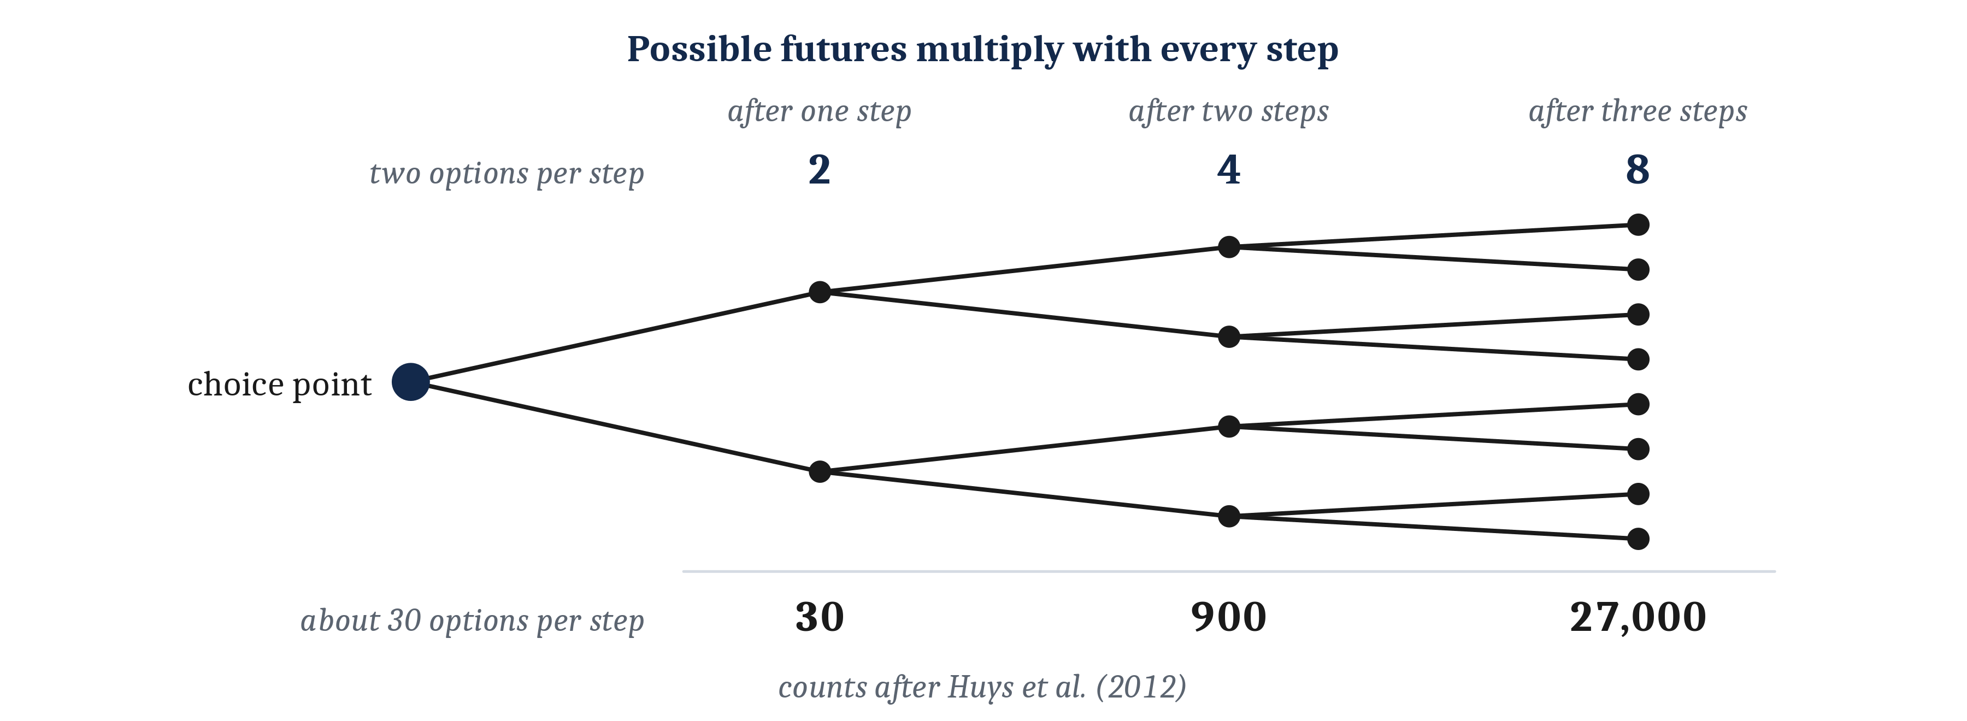
Futures Multiply
Choosing among futures is hard in three ways, whoever or whatever does the choosing: the futures multiply with each step, their outcomes are uncertain, and the outcomes arrive after different delays.
Notes:
An animal that acts now for an outcome that comes later has to choose among futures that have not happened yet. Three features of that problem make it hard. All three are true of the problem itself, however an animal, a person, or a machine goes about solving it.
First, the number of possible futures grows very quickly with each step. In a typical situation in a game of chess, a player has about 30 legal moves. So there are about 30 possible sequences of one move, about 900 sequences of two moves, and about 27,000 sequences of three moves. Every further move multiplies the number by about 30 again. Even a small puzzle has many arrangements. In the Tower of Hanoi, a stack of disks of different sizes must be moved from one peg to another, one disk at a time, without ever placing a larger disk on a smaller one. With four disks, the puzzle has 81 possible arrangements, and the shortest solution takes 15 moves.
Second, the outcomes at the end of those futures are uncertain. A forager choosing between a patch where food is nearly always found, and a patch where more food is found but only some of the time, is choosing between outcomes with different probabilities.
Third, the outcomes arrive after different delays. An animal choosing between a small meal now and a larger one later is choosing between outcomes at different distances in time. An outcome that arrives later usually counts for less to the chooser than the same outcome now. In Module 5, we called this discounting.
So before we ask how anything solves this problem, we can say what makes it hard. Futures multiply, they are uncertain, and they are spread out in time.

Slide 4
A Standard for Judging Choices
Expected value: the average of an option’s outcomes, each weighted by its probability. It is a standard for judging choices, not a description of how choices are made. Risk: a property of a choice whose outcome is uncertain but whose probabilities are known.
Option | Possible outcomes | Expected value
Sure gain | $240, with probability 1.00 | 1.00 × $240 = $240
Gamble | $1,000, with probability 0.25; nothing, with probability 0.75 | 0.25 × $1,000 + 0.75 × $0 = $250
Notes:
To say that one choice is better than another, we need a standard to judge choices by. The standard most often used is expected value: the average of an option’s outcomes, each weighted by its probability. Consider a choice between a sure $240 and a 25% chance of $1,000. The expected value of the gamble is 0.25 times $1,000, plus 0.75 times nothing, which is $250. The sure option’s expected value is $240. So by this standard, the gamble is the better choice, by $10.
Expected value averages the amounts themselves. But what an outcome is worth to the chooser need not follow its amount. In Module 4, we said that value is not a property of a thing in the world, but something a nervous system assigns to it. The same holds for money. $1,000 is worth more to someone with little money than to someone with a great deal of it.
Expected value is a standard for judging choices, not a description of how choices are made. We used signal detection theory in the same way in Module 7. We said where the best criterion lies, without saying how any animal sets one. Whether any animal or person actually works out expected values is a question about procedures, which we take up in the next lecture.
The standard has limits. It assumes that the probabilities are known, as they are in a lottery or a game of cards. A choice whose outcome is uncertain, but whose probabilities are known, is said to involve risk. Many real choices are not like that. A forager rarely knows the chance of finding food in a patch it has not tried. When the probabilities are not known, expected value cannot be calculated directly, and the chooser has to estimate them or rely on something else.
Expected value is also one reasonable standard, not the only one. A person who prefers a sure amount to a gamble with the same expected value is called *risk averse*. A strong enough preference for certainty can lead a person to turn down a gamble whose expected value is a little higher, like the 25% chance of $1,000. That choice is not necessarily a mistake or irrational. What every standard of consistent choice does rule out is choosing an option that is worse than another in every possible outcome. It also rules out changing a choice when the same options are only described in a different way.
Signal detection theory gives a second way to see why turning down a gamble with a higher expected value need not be a mistake. In Module 7, the best criterion depended on what each outcome gains or loses. When a miss is far worse for the observer than a false alarm, a low criterion is best, even though it produces more errors in total. An observer who sets the criterion there is less accurate, but chooses well, because accuracy was not the right measure of how well the observer did. Expected dollars are like accuracy in this respect. They are the obvious measure, but not necessarily a measure of what each outcome is worth to the chooser. If receiving nothing would mean missing a rent payment, the sure $240 is the choice most likely to leave the chooser able to pay the rent.
Foraging animals face the same kind of threshold. Consider a small bird on a winter evening that needs a certain amount of food to survive the night. If a sure, smaller meal would be enough, the bird does best to take it. If the sure meal would not be enough, the bird does better to gamble on the larger meal, since only the gamble gives it any chance of surviving. So whether caution or a gamble is the better choice depends on what the chooser needs, and not on expected value alone.

Slide 5
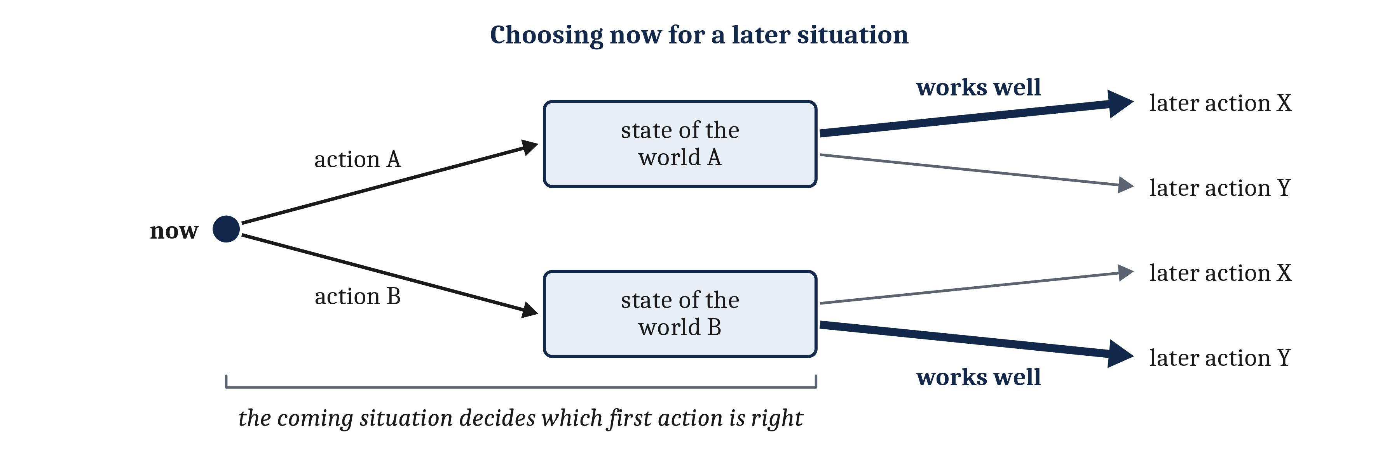
Acting Now for Later
An affordance is an opportunity for action that a place or object offers to a particular body. When there is more than one first action to choose between, which one is right depends on what the coming situation will call for.
Notes:
Taking actions now for something that happens later is not limited to human beings, or to their recent ancestors. Many animals change their world now, and act on the changed world later. Squirrels bury nuts in autumn and dig them up in winter. Harvester ants carry seeds into their nests and eat them when food outside is scarce. Birds build nests before they lay their eggs. In each case, the animal’s present action creates an affordance for later: an opportunity for action that a place or object offers to a particular body. A buried nut is food that can be dug up in winter. A nest is a place where eggs can be laid and kept warm.
What these cases share is that the first action brings about a change that later actions can take advantage of. If the first action regularly brings about the changed world, then it is adaptive to take the first action. It is also adaptive to take the later action whenever the changed world occurs. Each action suits its own situation on its own terms. That fit comes from the past, from the history of the lineage through selection or from the animal’s own experience. And the sequence need not repeat within one animal’s life. A digger wasp may dig a single burrow, stock it with paralyzed prey, and lay an egg on the prey, once in its whole life.
A harder version of the problem arises when there is more than one first action to choose between. Suppose that one action now would bring about one state of the world, and another action a different state. In the first state, one later action works well, and in the second state, a different one does. Then each first action is valuable only for the affordances it creates. Which first action is right depends on which later action the coming situation will call for. But that situation is not present when the animal acts, and it may differ from what usually follows. An action suited only to what usually follows does not solve this version of the problem.
Only part of the harder version can be observed. In Module 11, we separated what can be observed about another animal, its behavior, from what cannot, such as what it has seen and what it wants. The same separation holds here. We can observe that an animal does something now that suits a particular later situation. Whether it does so because it represents the states the world could be in, and what it could do in each of them, cannot be observed directly.

Slide 6
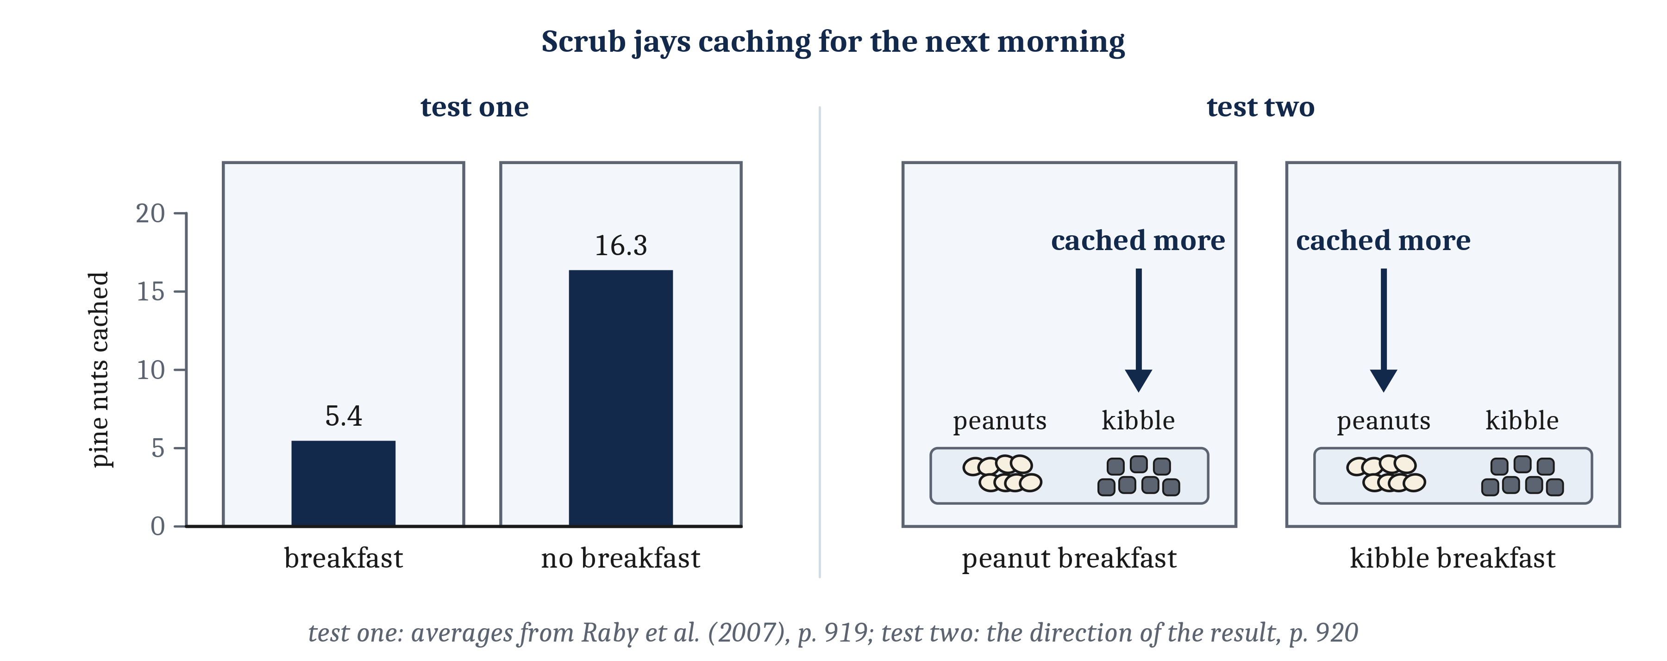
Jays, Apes, and Ravens
Scrub jays cached about three times as many nuts where they had gone without breakfast. These results are descriptions of behavior. They do not show whether the animal represents the later situation.
Notes:
Caroline Raby, Nicola Clayton, and their colleagues tested scrub jays, which cache food in the wild, to see whether they could meet the harder version of the problem. Caching means hiding food and coming back to it later. For six mornings, after a night without food, each jay spent two hours in one of two compartments. The jays alternated between a compartment where they were given breakfast and one where they were given nothing. Then, one evening, the jays were given their first chance to cache pine nuts. They cached about three times as many nuts in the compartment where they had gone without breakfast as in the other one. While they cached, they were mildly hungry, and equally hungry in both compartments. So their hunger cannot explain why they cached more in one compartment than in the other.
A second test separated two kinds of action. Each compartment now came with a different breakfast food. A jay that had simply linked each compartment with the food it was given there would have cached that food there, as would suit a morning like the ones before. The jays did the opposite. In each compartment, they cached more of the food they had not been given there, which is the food they would lack there the next morning.
Apes and ravens have been observed choosing tools for a particular task later, when the task was not currently possible or visible. Bonobos and orangutans were offered eight objects, two of which would work as a tool for getting a reward out of an apparatus they had practiced with. On many trials, they chose a suitable tool, carried it out of the testing room, and brought it back an hour later, when the apparatus was available again. An orangutan and a bonobo did the same after 14 hours, overnight. Apes rewarded only for bringing back the suitable tool, with no apparatus to use it on, brought it back far less often. Ravens, which are not habitual tool users, chose a tool, or a token they had learned to exchange for food, and used it 15 minutes or 17 hours later.
All of these results, like the zoo chimpanzee’s stones, describe behavior. Each shows an animal changing its world now in a way that suits one particular later situation. They raise two questions. Does the animal act because it represents that possible future situation, and what it will afford? And could the same behavior come from what the animal had learned before the tests? In the ape and raven studies, the animals had already been rewarded for using the very tools and tokens they later chose, so the objects themselves may have come to predict food. Both questions are about procedures, and we take them up in the second lecture.

Slide 7
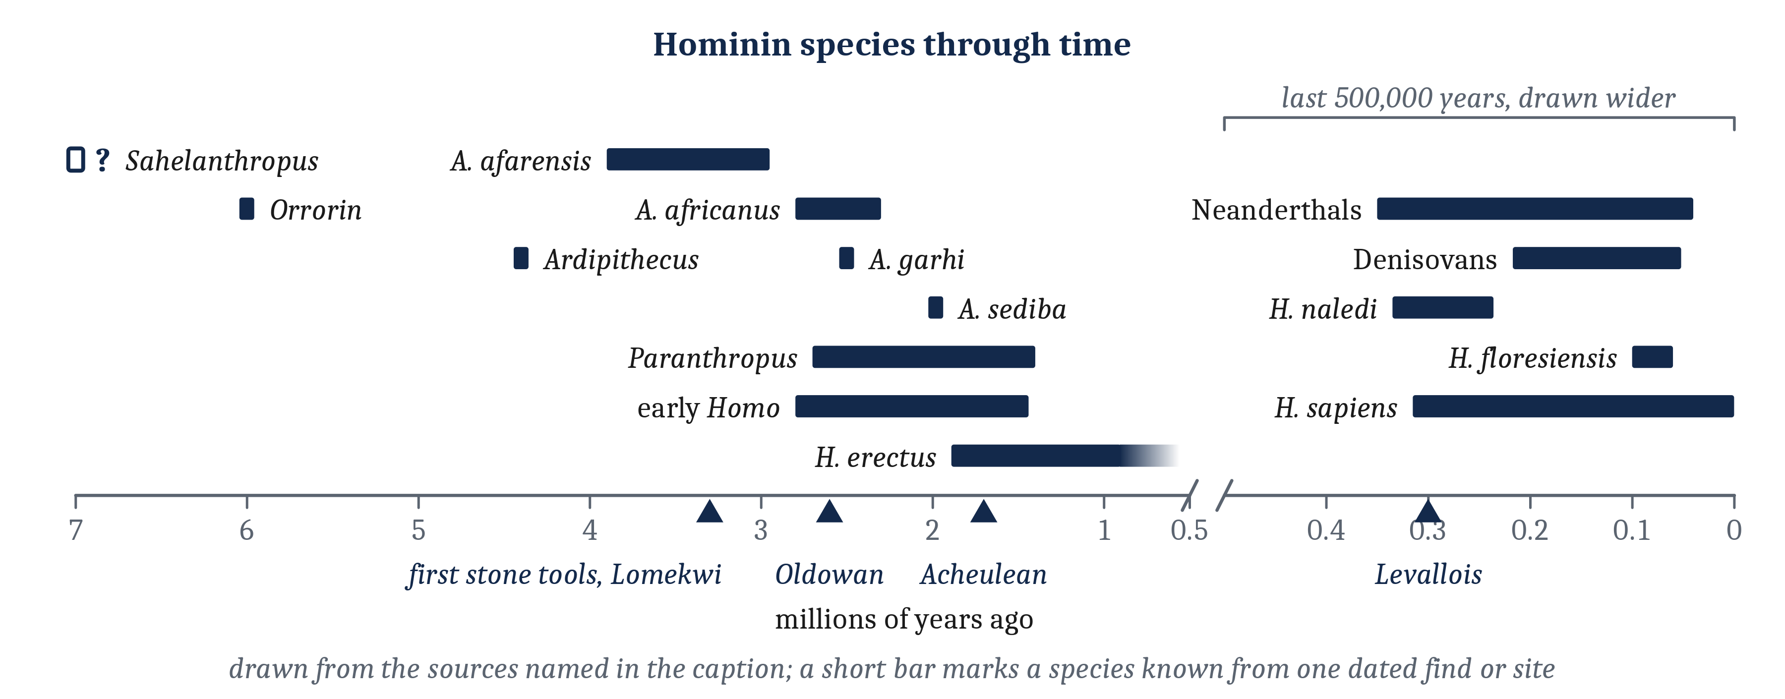
The Hominins: A Branching Tree
A hominin is a member of the human line after it split from the line leading to chimpanzees and bonobos. Bipedalism, walking habitually on two legs, came long before large brains or the first known stone tools. Later tools took longer to learn, but they are not a direct record of planning.
Notes:
The human line began when it split from the line leading to chimpanzees and bonobos, sometime between 5 and 9 million years ago, often rounded to about 7. In Module 11, we followed the primate family tree up to that split. A hominin is a member of the human line after the split: human beings, and every extinct species more closely related to human beings than to chimpanzees and bonobos. *Hominin* is not to be confused with *hominid*, which means a member of the great ape family as a whole.
A history like this one is inferred, not observed. It comes from dated fossils, from tools, and from comparisons of the DNA of living species. Each kind of evidence shows some things and leaves others out. A skull gives the size of a brain, a skeleton gives posture, and teeth give the pace of growth. A tool is evidence of what was done to a stone, but not of who did it, since several species often lived at the same time. None of them records how the making of a tool was organized, or what its maker was thinking. Which species descended from which is mostly unknown, and the earliest of these species may or may not be a hominin.
For most of the twentieth century, researchers pictured the human line as a single sequence of species, each a step closer to human beings. The fossils found since do not fit that picture. For most of hominin history, several kinds of hominin lived at the same time. So the hominins formed a branching tree, and most of its branches ended without descendants.
Walking upright came early, long before large brains or the first known stone tools. Bipedalism can be recognized in the skeleton, by the position of the opening at the base of the skull through which the spinal cord passes, and by the shape of the pelvis, the lower back, and the legs. Yet the australopiths, the hominins of the genus *Australopithecus* and their close relatives, still climbed trees, and their brains were still small. The features of the human body did not all arrive together.
Tool use is older than any known member of *Homo*. Stone tools at Lomekwi, in Kenya, are dated to 3.3 million years ago, about half a million years before the first known *Homo*, and who made them is not known. *Oldowan* tools, sharp flakes struck from a core with a hammerstone, appear from about 2.6 million years ago. By then, hominins were also carrying stone, chosen selectively, away from where they found it. That is acting now for a later situation. From the stones alone, we cannot tell whether the carrying suited one particular later situation, or only the situation that usually followed.
*Homo erectus* appears in Africa about 1.9 million years ago, with a larger body than earlier hominins. It is the first hominin whose fossils are found outside Africa, in Georgia by 1.85 million years ago and on Java by 1.66 million, and it was probably the first to leave Africa. Hominin brains grew gradually, over about two million years, to roughly three times the australopith size, or about two to two and a half times relative to body size. Most of the growth happened within lineages, rather than through larger-brained species replacing smaller-brained ones, and most of the growth beyond what body size predicts came late, between about 800,000 and 200,000 years ago.
The later tools, *Acheulean* hand axes from about 1.7 million years ago and the prepared *Levallois* cores from about 300,000 years ago, were harder to make and took longer to learn. By one experienced stone worker’s estimate, late Acheulean shaping may take hundreds of hours of practice. But one archaeologist argued that planning a hand axe in advance, to the full depth of its nested steps, is “unnecessary and unlikely”. Another argues that a stone worker’s intention is formed partly by the stone itself, so that early stone working involved “little deliberate planning”. Both agree that shaping proceeds a strike at a time, guided by how the stone responds, and they disagree about where the goal of the shaping is represented. Making a hand axe at all may be organized toward a later goal at a general level, even if each flake is worked out one strike at a time. So the sequence of tools is a sequence of tasks that are harder to learn, not a direct record of planning. How the making was organized is an inference.
Diet also changed in the time of *H. erectus*, though how and when is disputed. Most researchers accept that hominins were using fire by about 400,000 years ago. A speculative cooking hypothesis places cooking near 1.9 million years ago, partly because *H. erectus* had smaller teeth and jaws. A rival account holds that slicing meat and pounding tubers with stone tools would have reduced chewing enough that the smaller teeth and jaws did not require cooking.
*Homo sapiens* did not appear all at once, in one place, or alone. The oldest fossils that some assign to *H. sapiens*, from Jebel Irhoud in Morocco, are about 315,000 years old, with a modern face but a longer, less rounded braincase. *H. sapiens* probably arose across Africa, in connected populations, and about 300,000 years ago at least three human species lived there. Neanderthals lived in Europe and western Asia, and Denisovans, their closest relatives, in Asia. *H. sapiens* interbred with both: people whose ancestors lived outside Africa carry about 2% Neanderthal DNA, and Denisovan DNA is found especially in people of Melanesia and some groups in the Philippines. So the branching pattern, with several kinds of hominin alive at the same time, continued into the time of *H. sapiens*.
How did Neanderthals differ from *H. sapiens* in what they could do? For a long time, a common answer was that Neanderthals were less capable. Researchers reached that answer by judging Neanderthals against what later *H. sapiens* left behind in Europe, a record that, in one review’s words, “has become almost like a yardstick for modern human behavior”. The reviewers examined claims of Neanderthal inferiority one by one, and found that none of the claims they examined was supported by adequate archaeological data. From about 200,000 years ago, for example, Neanderthals made pitch, a glue that does not occur in nature, by heating bark without air, and used it to fix stone flakes to handles. None of this is evidence that Neanderthals and *H. sapiens* thought alike. What the review found is that expectations shaped how the evidence was read. We return to how expectations shape the reading of evidence when we get to the history of intelligence testing.

Slide 8
Slow Lives and Grandmothers
Life history: the timing of growth, maturity, reproduction, and death across a lifetime, in a species. Grandmother hypothesis: older women who gathered food for their daughters’ young allowed their daughters to wean earlier and give birth again sooner, so that women who lived long after menopause left more descendants.
 | Grandmother hypothesis | Hunting account
What is unusual | Long life after childbearing ends | Long life, long childhood, and a large brain together
Who supplies the extra food | Older women, gathering for their daughters’ young | Mainly men, through hunting, with others contributing
Why childhood is long | A side effect of a long life | Time to learn hard foraging skills
Main evidence | Hadza grandmothers’ work and grandchildren’s weight | Food production by age and sex across foraging societies
Notes:
Human life history is unusual among the apes. In Module 11, we described how slowly human young grow up: mothers in foraging societies give birth every three to four years, and their children cannot feed themselves for years. What is most unusual about a human life is how long women live after they stop having children.
One explanation of that long life is the grandmother hypothesis: older women who gathered food for their daughters’ young allowed their daughters to wean earlier and give birth again sooner, so that women who lived long after menopause left more descendants. Kristen Hawkes and her colleagues built the hypothesis from work among the Hadza, foragers in Tanzania. Hadza women in their sixties and early seventies work long hours in all seasons. When a new baby is born, the weight of its older brothers and sisters rises or falls with how hard a related older woman, usually their grandmother, works at gathering food. Members of the same team later placed the start of this pattern with *H. erectus*.
The hypothesis has limits. The Hadza are one group, and older Hadza women produce less food than Hadza men. And *H. erectus* still grew up at about the pace of a living great ape, with the slow growth of human children appearing only later. So when the pattern began remains uncertain.
A rival account, from Hillard Kaplan and his colleagues, centers on hunting. On this account, foods that are hard to obtain take years to learn to find and prepare. A long childhood is the time for that learning, and men’s hunting supplies much of the surplus food that children need. Its authors acknowledged weaknesses in their own account, writing that “too much emphasis has been placed on hunting large game”. The two accounts differ about why childhood is long. On the grandmother hypothesis, a long childhood is a side effect of a long life. On the hunting account, it is time to learn hard foraging skills.
For decades, accounts of human evolution, mostly from men, highlighted the importance of men hunting. In those accounts, as one anthropologist put it, “women past childbearing age were deemed irrelevant and of no theoretical interest”. The assumptions researchers start from shape which questions they ask, and these assumptions left a question unasked: what older women contributed. The grandmother hypothesis was one challenge to that framing, and the debate is still open.
Other researchers have asked how often women hunted. A 2023 study found records of women hunting in 50 of 63 societies coded as foragers. A 2024 reanalysis of the same societies found women hunting sometimes or frequently in 35 of them, but regularly hunting large game in only 9. Its authors cautioned that the 63 societies were not chosen to represent foragers in general. So what has held up is the critique of accounts that centered human evolution on men hunting, not a claim that women hunted as much as men.

Slide 9
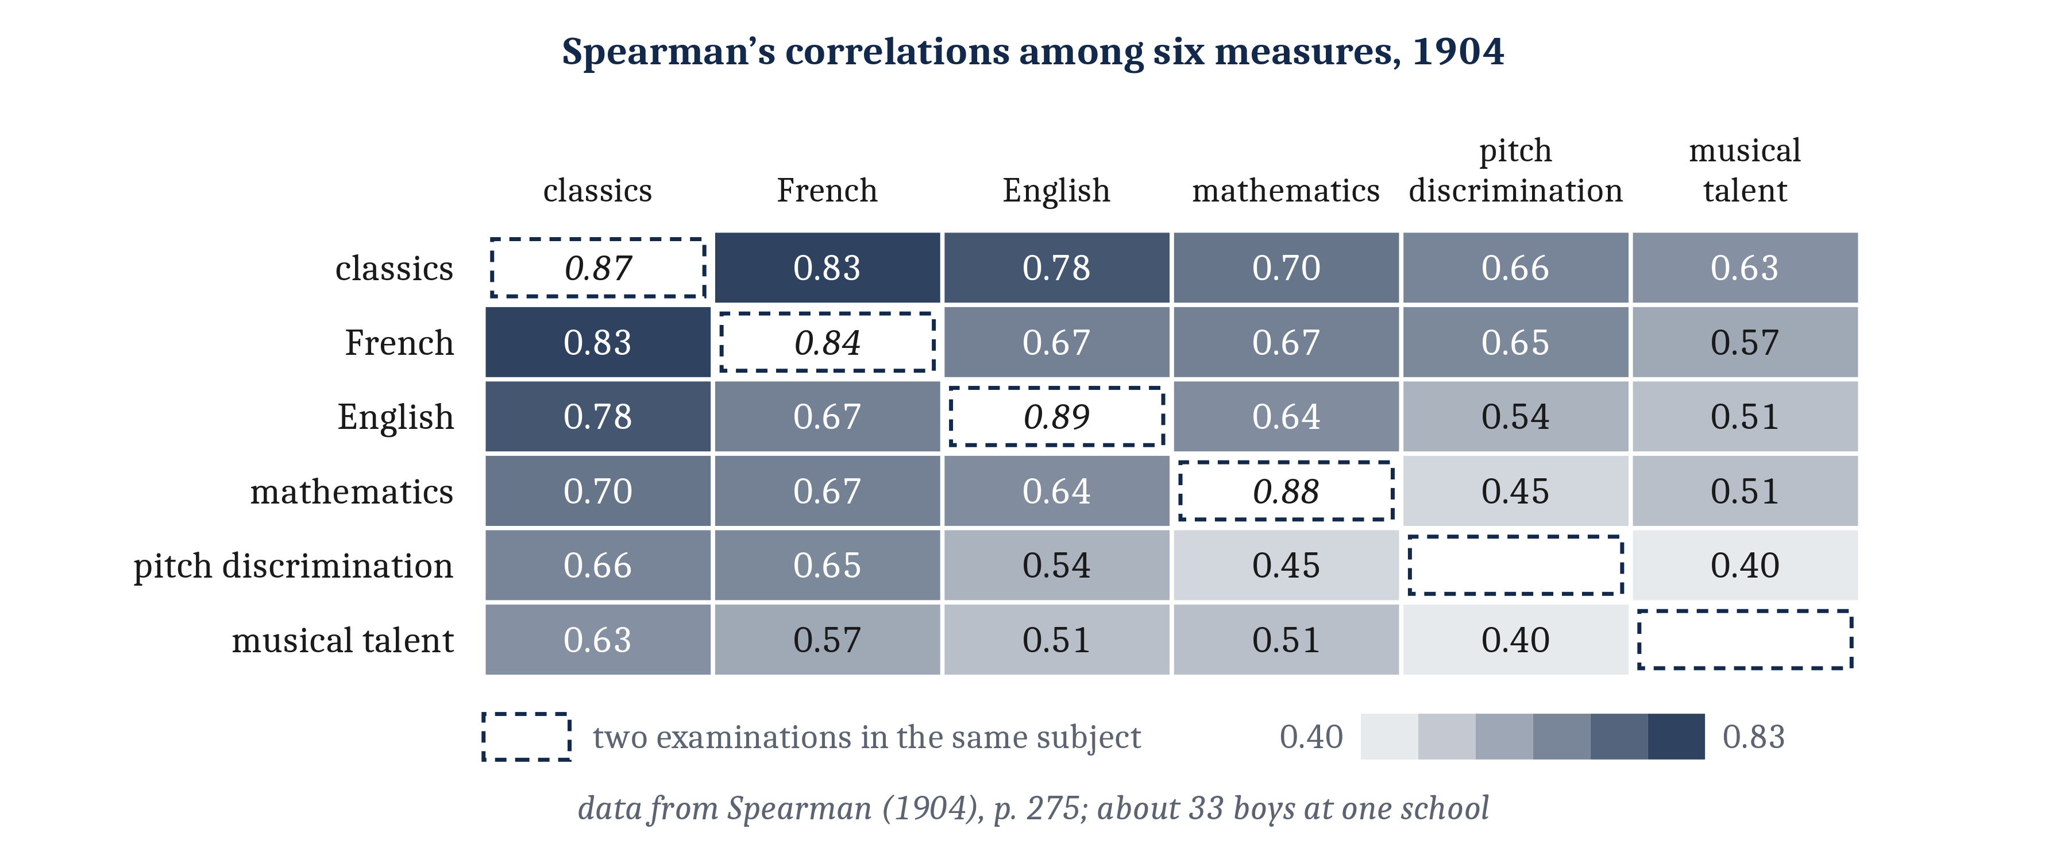
What Is Intelligence?
Intelligence: how well an agent achieves its goals across a wide range of problems and environments, or the capacities and procedures that produce that achievement. Positive manifold: people who score well on one kind of mental test tend to score well on the others; a pattern of correlations, not a cause.
Notes:
Researchers broadly agree that the later hominins changed in what they could do. Their tools took longer to learn to make, their brains grew larger, and their lives became slower and longer. Many people would describe those changes with one word: the hominins were becoming more intelligent. But what exactly was changing, and what does the word mean?
The word is used in two senses. By an **agent**, we mean any entity that acts toward goals: a person, another animal, or a machine. In one sense, intelligence describes how well an agent achieves its goals across a wide range of problems and environments. In the other sense, intelligence names the capacities and procedures that produce those achievements: what an agent represents, and how it uses what it represents to solve problems. The first sense can be measured from behavior. The second has to be inferred. Which of the two the word should name is contested, and much of the confusion about intelligence comes from moving between the two senses without saying so.
The two senses can come apart, because the same achievement can come from different procedures. AI language models are a clear current example. As we described in Module 11, they answer standard questions about what the characters in a story believe about as well as adults do. Whether they do so by representing other minds is a separate and open question. Programs that play chess and Go show why the range of problems matters to the first sense. The best of them play better than any person, but they play only their own games, and researchers disagree about whether any machine has become generally intelligent.
The two senses also matter morally. A score on a test of intelligence measures what a person achieves on particular problems, at one time, compared with a particular group of people. By itself, a score does not say how the person achieves it, what the person could achieve in other circumstances, where a difference between people comes from, or what it means morally. For more than a century, scores were often read as if they said all four.
In the achievements sense, performance on different problems does go together. In 1904, a British psychologist collected the results of about 33 boys at one English school, on school examinations and on tests of musical ability. Every score correlated positively with every other, from 0.40 to 0.83. The same pattern has been found again and again since, in many tests and many samples. It is called the positive manifold: people who score well on one kind of mental test tend to score well on the others.
The psychologist who first reported the positive manifold read it as evidence of a common function behind every test. But the positive manifold is a pattern in a table of correlations, and nothing more. Reading it as one general ability is a claim about a cause. So the question we asked in Module 0, whether intelligence is a single thing or a bundle of many different abilities, has two versions. Achievements on different problems do go together. Whether a single capacity lies behind them is a question for the second and third lectures.

Slide 10
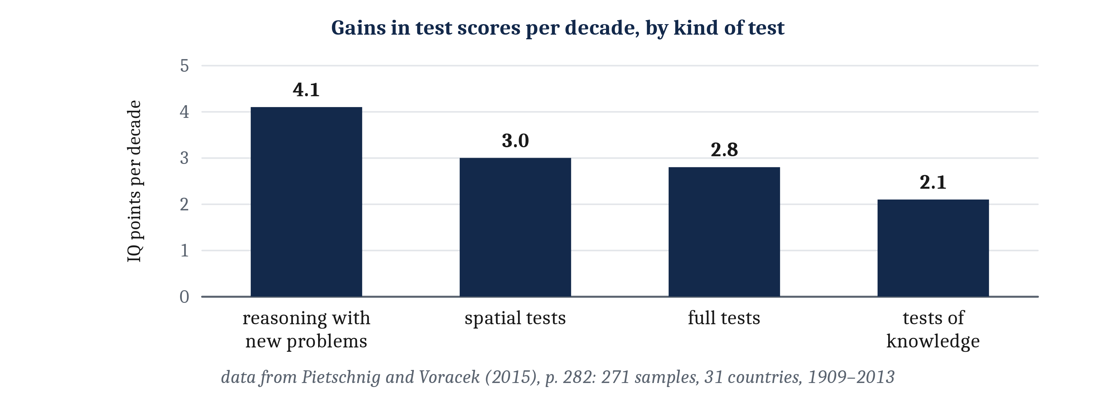
IQ Scores and What They Predict
IQ: a score scaled so that the average in a reference sample is 100; a rank within that sample, not an amount. Predictive validity: how well a score predicts an outcome measured later. Flynn effect: the rise in average scores across the twentieth century, about 3 points per decade in the United States.
Notes:
Because of the positive manifold, the tests usually called intelligence tests combine a person’s scores on many kinds of problems into one overall score, typically called IQ. An IQ is a score on a standardized test of mental abilities, scaled so that the average in a reference sample is 100, and about two thirds of people fall between 85 and 115. An IQ score is a rank, not an amount. It says only where a person stands relative to the people in the reference sample. So the same performance earns a lower score when it is compared with a newer reference sample that scores higher.
Predictive validity is how well a score predicts an outcome measured later. IQ scores correlate with school grades at about 0.50. In the best studies, which measured IQ before age 19 and the outcome after age 29, scores correlated with years of education at about 0.56 and with income at about 0.23. Scores also correlate with performance at work, at about 0.31 by a recent estimate, revised down from the 0.5 that was cited for decades. Squaring a correlation gives the share of the differences among people that it accounts for. So a correlation of 0.3 accounts for about a tenth of the differences in the outcome.
These are correlations, and they do not show that the scores cause the outcomes. People who score higher may go on to stay in school longer. But staying in school longer also raises scores, by about 1 to 5 points for each extra year. Both can be true at once, and the correlation alone cannot tell us how much of each is happening.
Part of the correlation between scores and income may run through schooling. And the social and economic standing of a person’s parents predicts both the scores and the outcomes. As one major review put it, the causal links between test scores and social outcomes “may be indirect”.
Average scores rose steadily in the United States and many other countries through the twentieth century, about 3 points per decade in the United States. That rise is the Flynn effect. Because an IQ is a rank, the rise is measured by scoring later test takers against an earlier reference sample held fixed. The rise was faster on tests of reasoning with new problems than on tests of knowledge, about 4.1 points a decade against 2.1. So it is not due purely to later test takers knowing more things.
Any account of intelligence therefore has to explain at least three observations. One is the positive manifold. A second is that scores predict grades, schooling, income, and performance at work, though far from perfectly. And a third is that average scores rose by a large amount within a few generations, which is faster than the genes of a population can change.

Slide 11
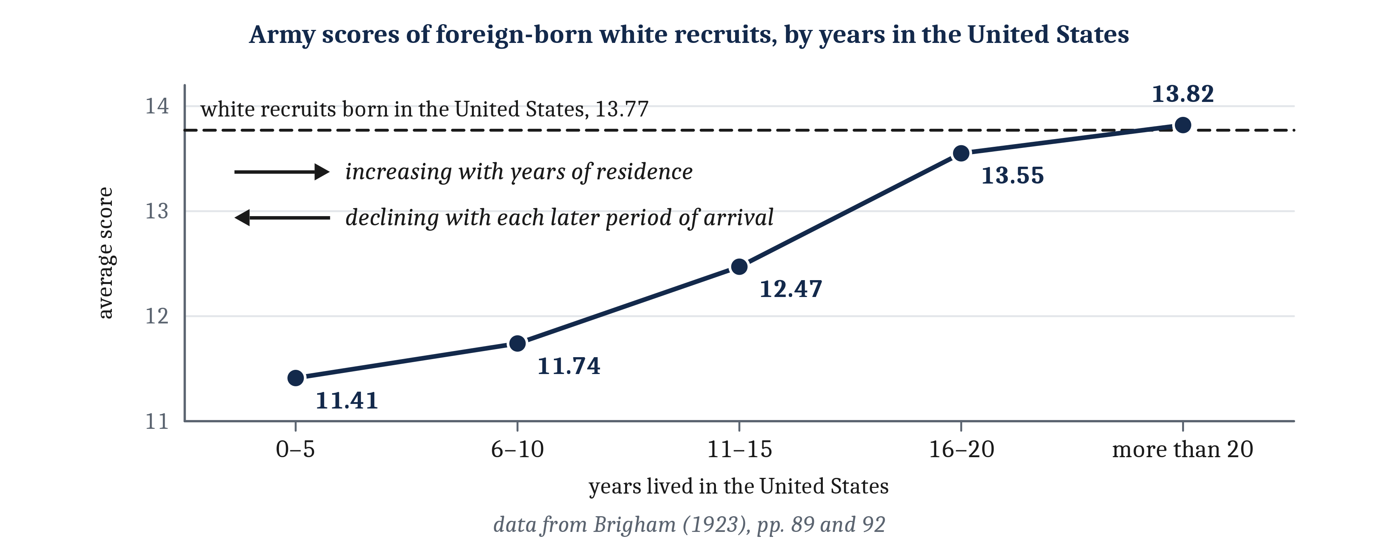
Testing and Its Uses
Content note: eugenics, forced sterilization, and racism, with offensive language quoted from the period. Eugenics: the program of improving a population’s quality by controlling who has children.
Notes:
Modern intelligence tests began with a practical problem in the schools of Paris. In 1905, the psychologist Alfred Binet and a colleague published a scale for identifying the children who needed special schooling. The scale placed each child by comparing the child’s performance with the typical performance of children at each age. Binet was cautious about what that placement meant. It described the child at the moment of testing; about the child’s future, “the prognosis is reserved”. Children who did poorly needed teaching suited to them, because they “must learn how to learn”.
Binet held that the scale ranked children rather than measuring them, but that “for the necessities of practice this classification is equivalent to a measure”. He proposed uses beyond the schools, in the courts and in examining army recruits. So the ambition to measure intelligence, and to use the measurement to make decisions about people, was present from the start.
Many of the people who took up Binet’s scale were not cautious, and what follows is a disturbing history. We include it because it shows how a measurement can be mistaken for the thing it was meant to measure, and how scientists’ expectations can shape what they measure and how they read it. It also shows what can happen when claims about whose mind counts are used to decide how people are treated.
In the United States, the scales were taken up by psychologists who believed that low intelligence was inherited. Henry Goddard brought Binet’s scale to the United States. In *The Kallikak Family*, published in 1912, his field worker Elizabeth Kite labeled people in one family line “feeble-minded”, some of them long dead, from what their neighbors remembered. Goddard concluded that “Feeble-mindedness is hereditary”. The book began to be used by some as an argument for eugenics.
In 1913, Goddard’s workers at Ellis Island tested fewer than 200 immigrants, a sample not chosen to represent immigrants as a whole, and reported that between 79% and 87% of four groups were “feeble-minded”. Goddard himself doubted that the results could “stand by themselves as valid”. He published them anyway.
The IQ test became standard with Lewis Terman’s revision of Binet’s scale in 1916. Terman predicted that testing would reveal “enormously significant racial differences in general intelligence, differences which cannot be wiped out by any scheme of mental culture”. The test arrived together with an expectation about what it would show about race.
In 1917 and 1918, about 1.75 million army recruits took an intelligence test. Carl Brigham, who analyzed the army data, ranked immigrant groups by their scores and concluded that immigration “should not only be restrictive but highly selective”. But his own data allowed a different reading. Among white recruits born abroad, those who had lived in the United States longer scored higher, and those who had lived there more than twenty years scored about as well as white recruits born in the United States. In one of his own captions, Brigham described the pattern as “Apparently increasing average intelligence with increasing years of residence”. Later in the book, he interpreted the same pattern as “The decline of intelligence with each succeeding period of immigration”. On the first reading, living in the country, and learning its language and customs, raised scores. On the second, each later group of immigrants was less intelligent than the one before. In 1930, Brigham withdrew the study as “without foundation”, without mentioning immigration law.
The testers’ claims were used to support the immigration law of 1924, whose quotas favored immigrants from northern Europe. But the prejudice used to justify the law was widespread without the tests. So the testers did not create the law. They gave the appearance of scientific support to a prejudice that was already there.
U.S. states also used the label “feeble-minded” to decide who could be sterilized without their consent, and more than 60,000 people were sterilized under such laws. The best-known case is Carrie Buck’s. In *Buck v. Bell*, in 1927, the Supreme Court upheld Virginia’s sterilization law, with the words “Three generations of imbeciles are enough”, meaning Carrie Buck, her mother, and her infant daughter, Vivian. The laws were applied disproportionately to women. The first people sterilized at Virginia’s institution were almost all women. In California, Latina women were recommended for sterilization at higher rates than other women.

Slide 12
Scientific Racism, and Two Claims
Scientific racism: work that presents claims of racial superiority as findings of science. The uses of the tests would have been wrong even if every claim the testers made had been true.
Claim | Kind of claim | Current evidence
Groups differ in their average scores | An observation about scores | U.S. averages have differed between groups defined by race; the difference is not explained by bias in prediction
Genes cause those differences | A claim about causes | Major reviews in 1996 and 2012 found that the direct evidence did not support a genetic explanation
Notes:
Scientists ranked groups of people long before intelligence tests existed. Work that presents claims of racial superiority as findings of science is often called scientific racism, and much of it began with measurements of the body. In the 1830s and 1840s, the physician Samuel George Morton measured the capacity of hundreds of human skulls and ranked human groups by their averages. His tables put the group he called “Caucasians” first. Later reanalyses concluded that his choices about which skulls to include moved the averages toward the ranking he expected. Stephen Jay Gould, who first made this charge, was later found to have made choices of the same kind in his own reanalysis. So expectations can enter how data are selected and analyzed, and not only how results are interpreted.
The cases in this lecture were not isolated. For more than a century, theories that some groups of people were born less intelligent than others rested on biased data, on data later judged to have been invented, or on no data at all. Cyril Burt’s studies of twins, cited for decades as evidence that intelligence is inherited, are widely judged to contain fabricated data. Terman predicted racial differences before any such testing had been done. In each case, the conclusions reflected what the researchers expected more than what their evidence showed.
In 2021, the American Psychological Association apologized for psychology’s part in racism against people of color, including through its tests. The apology does not mention the sterilization laws.
This history rests on two scientific claims that are still argued over. The first is that groups differ in their average scores, an observation. The second is that genes cause those differences, a claim about causes. They need different kinds of evidence. In the United States, average scores have differed between groups defined by race. When a major review was written in 1996, the average score of Black Americans was about 15 points below that of white Americans. A later review reported that the difference narrowed by about 5 points between 1972 and 2002, an estimate others dispute. The difference is not explained by bias in prediction: Black students do not do better in school than their scores predict. But a difference in scores is an observation about scores. Whether it reflects a difference in the capacities behind the scores, the second sense of intelligence, is a separate question. So is whether categories of race correspond to biological groups.
On the second claim, two major reviews, in 1996 and 2012, found that the direct evidence did not support a genetic explanation. We describe that debate in the third lecture.
The answers to these two claims matter for science, but they would not settle how people should be treated. The uses of intelligence tests that we have described would have been wrong even if every claim the testers made had been true. The wrong done to Carrie Buck did not depend on whether she was “feeble-minded”.
Whether research on differences between groups should be done at all is itself disputed. Some researchers argue that the history of how such findings were used should not stand in the way of scientific inquiry. But the history gives three reasons for unusual caution in asking and answering these questions. The first is the stakes: such claims have been used to justify sterilization and exclusion, so a mistaken claim can do unusual harm, and the harm tends to fall on people other than those making it. The second is the record we have described, in which researchers repeatedly reached conclusions their evidence did not support. The third is that the question is very hard to answer with current methods, because groups defined by race differ in their environments in many ways.
Researchers who study differences between groups also have a responsibility to say what they think their findings imply. A researcher who reports a difference and says nothing about what it means leaves its meaning to others, including people who have misused such findings before. One behavior geneticist, Kathryn Paige Harden, argues for “anti-eugenic” uses of genetics. Critics reply that good intentions are not enough. So the question is less whether such research may be done, than what it takes to do it, report it, and believe it responsibly.

Slide 13
To Discuss: A Hiring Test
In your group, five minutes.
A company screens job applicants with a test it says measures intelligence, because IQ scores predict performance at work.
What does an applicant’s score tell the company, and what does it leave out? What else could explain why scores and job performance go together?
Notes:
We can apply what we have said about scores to a decision that many students will face.
Start with what the score tells the company. An IQ is a rank within a reference sample. It measures what the applicant achieved on particular problems, at one time, compared with a particular group. Scores do predict performance at work, at about 0.31 by a recent estimate. That is real prediction, but a correlation of about 0.3 accounts for only about a tenth of the differences in performance at work. So the score tells the company something, and leaves most of the differences in performance at work unexplained.
Then ask what the score leaves out. By itself, a score does not say how the applicant reached it, what the applicant could achieve in other circumstances, or where a difference between two applicants comes from. How the applicant reached the score is a question about the second sense of intelligence, the capacities behind it. And the score measures achievement on particular problems, at one time, which is narrower than the first sense.
Then ask what else could produce the correlation. Years of schooling raise scores, and schooling may also lead to better jobs and better preparation for them. The social and economic standing of an applicant’s parents predicts both scores and later outcomes. So part of the link between scores and work may run through other things, and from the correlation alone, we cannot tell how much.
Groups often go on to ask whether the screen is fair, which is a question about how people should be treated rather than about what the score predicts. The history in this lecture gives one reason to keep the two questions apart. Whether a use of a test is right does not follow from the test being accurate.

Slide 14
Image Sources
Slide | Image | File | License | Source
3 | Possible futures branching from a choice point | fig-futures-grow.png | CC BY 4.0 | Jon Willits — from the Module 12 reading, counts after Huys et al. (2012) · own work
5 | The harder version of acting for later | fig-two-step.png | CC BY 4.0 | Jon Willits — from the Module 12 reading · own work
6 | The two scrub jay tests | fig-jays-breakfast.png | CC BY 4.0 | Jon Willits — from the Module 12 reading, after Raby et al. (2007) · own work
7 | Hominin species through time | fig-hominin-timeline.png | CC BY 4.0 | Jon Willits — from the Module 12 reading, drawn from the sources named in its caption · own work
9 | The correlations among six measures, 1904 | fig-spearman-matrix.png | CC BY 4.0 | Jon Willits — from the Module 12 reading, data from Spearman (1904) · own work
10 | Gains per decade, by kind of test | fig-flynn-gains.png | CC BY 4.0 | Jon Willits — from the Module 12 reading, data from Pietschnig and Voracek (2015) · own work
11 | Army test scores by years of residence | fig-brigham-residence.png | CC BY 4.0 | Jon Willits — from the Module 12 reading, data from Brigham (1923) · own work

