Slide 1

BCOG 100
Planning and Decision-making
Lecture 12.2 — Searching, Choosing, and General Ability
Notes:
This module is about choosing among futures before living any of them. In the first lecture of this module, we described the problem at the computational level. Possible futures multiply with each step, their outcomes are uncertain, and they arrive after different delays. We described animals that act now for needs that arise later, and we described the positive manifold, the pattern in which people who score well on one kind of mental test tend to score well on the others. We left two kinds of question open. One was which procedure an animal uses when it acts for the future. The other was what produces the positive manifold.
This second lecture is the algorithmic level. We ask which procedures could produce acting for the future, choosing, and general ability, and what behavioral evidence tells those procedures apart. We start with what it would take to plan, and how a planner can search among possible futures without trying them all. Then we ask how people actually choose under risk and delay, what controls a person’s responses when a habit would not reach the goal, and how people and animals reason about causes. We end with the positive manifold, in people, in other animals, in Neanderthals, and in machines. We take up the brain and the genes in the third lecture.

Slide 2
To Start: Did the Jays Plan?
In your group, three minutes.
Scrub jays cached more nuts in the compartment where they had gone without breakfast.
What would it take to show that they planned, rather than repeating what had been rewarded before?
Notes:
This question returns to the scrub jays from the first lecture of this module, and to the question we left open about them. For six mornings, each jay spent two hours in one of two compartments, alternating between one where it was given breakfast and one where it was given nothing. Then, one evening, the jays were given their first chance to cache pine nuts. They cached about three times as many nuts in the compartment where they had gone without breakfast. In a second test, each compartment came with a different breakfast food, and in each compartment the jays cached more of the food they had not been given there.
Discussion groups usually notice two things. The first is that the jays’ behavior suits one particular later situation, the morning to come. The second is harder to answer: whether the jays acted because they represented that coming morning, or because of something they had learned before. The same question arose for the apes and ravens. In those studies, the animals had already been rewarded for using the very tools and tokens they later chose, so the objects themselves may have come to predict food.
So a good answer to the question names a test. What would an animal have to do that it could not do by repeating what had been rewarded before? In this lecture, we describe three procedures that could produce the same behavior, and the test that tells them apart.

Slide 3
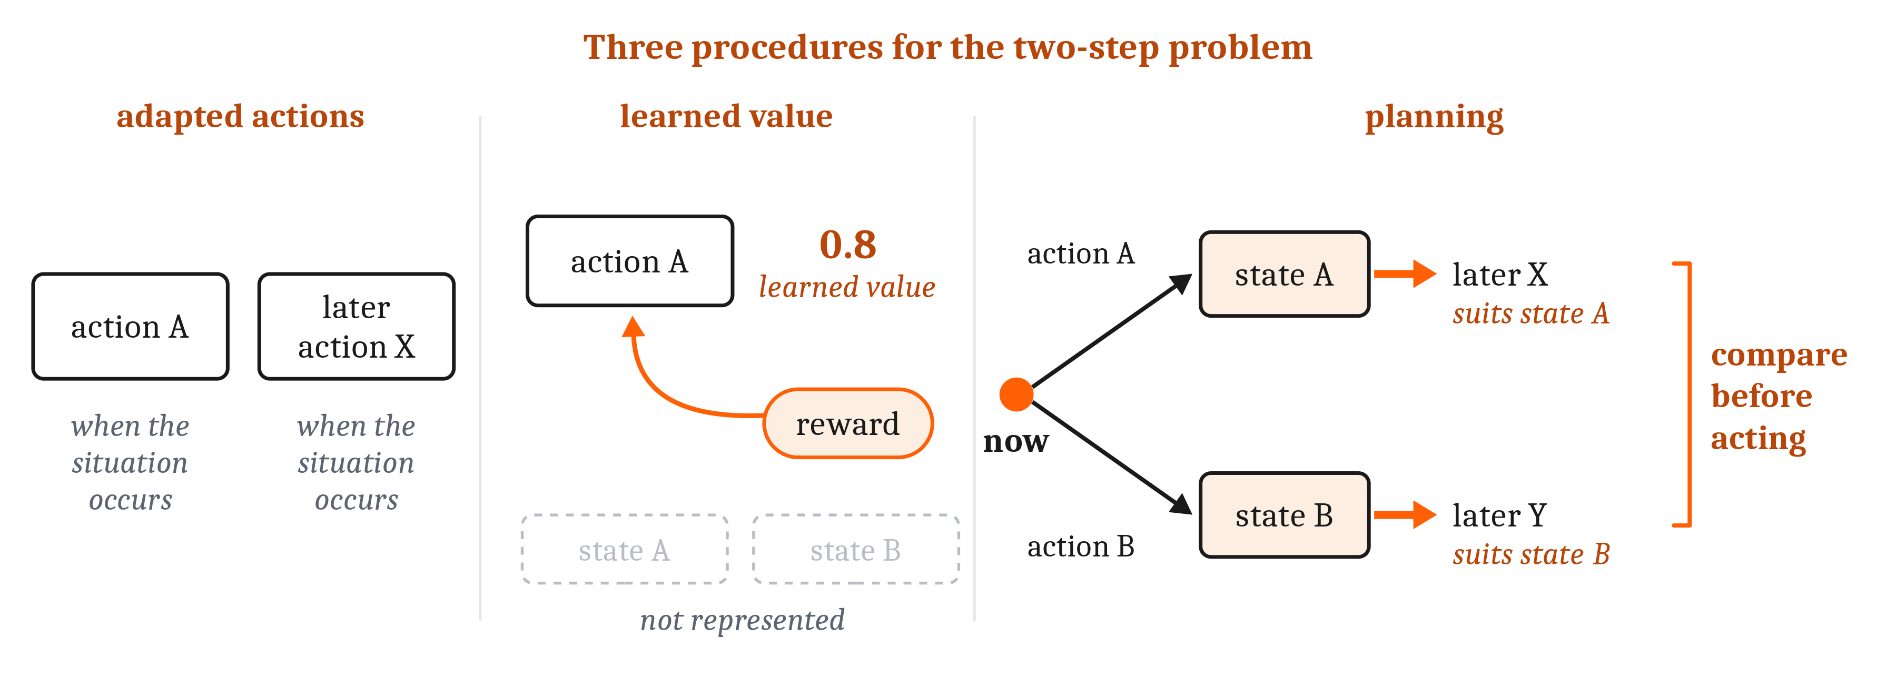
Three Procedures, One Behavior
Model-free: choosing an action by repeating what has worked in that situation before, with no model of what the action leads to. Model-based: choosing an action by running a model of what leads to what, and selecting on the basis of where the model ends up. Planning: choosing a sequence of actions by working through their predicted consequences before acting.
Notes:
In the first lecture of this module, we described animals acting now in a way that suits one particular later situation. That kind of behavior can come from at least three different procedures. The procedures differ in how much of the problem the animal represents. So asking which procedure an animal uses is asking what it represents.
In the simplest procedure, an animal is adapted to take the first action, and adapted to take the later action whenever the changed world occurs, with nothing linking the two. The digger wasp, which digs one burrow, stocks it with paralyzed prey, and lays an egg on the prey, once in its life, might use this procedure. Selection could have favored each step in the situation that the step before brings about, without the wasp representing the larva that will need the food. Each action suits its own situation, because the pairing reliably benefited ancestors in the past. So the animal acts for the future without representing the future, and its actions suit only the situation that usually follows.
In a second procedure, the animal learns that the first action has value, because reward has followed it. It can do this without representing the state of the world that the action brings about. Choosing by values learned in this way is called model-free choice: repeating what has worked in that situation before, with no model of what the action leads to. In Module 5, we described learning rules of this kind, which pass value back along a chain of steps to an early action. But a learned value reflects the rewards and punishments that followed an action in the past. So a choice made from it cannot change with a coming situation that differs from the past.
In the third procedure, the animal predicts which state of the world each first action brings about. It also predicts which later action suits each state, and it compares the paths before choosing an action. This is model-based choice, as we defined it in Module 5, where the model is the animal’s own representation of what leads to what. When model-based choice works through a sequence of actions, it is planning: choosing a sequence of actions by working through their predicted consequences before acting. Only planning represents the coming states of the world, and the affordances each one offers. So only planning meets the harder version of the problem from the first lecture, in which the coming situation differs from what usually follows.
The contrast between the first two procedures and planning parallels one we drew in Module 11, about other minds. There, we set predicting another animal’s behavior from categories of behavior, however learned, against representing its mental states. In both cases, the richer procedure represents something that cannot be observed: another animal’s mental state, or a future state of the world. And in both cases, the richer procedure lets an agent act appropriately when the situation differs from the ones that shaped the simpler procedures.

Slide 4
Telling the Procedures Apart
All three procedures can produce the same behavior in a familiar situation. Telling them apart takes a test that the first two would fail.
Procedure | What the animal represents | When the coming situation differs from what usually follows
Adapted actions | Nothing about the later situation; each action is attached to its own situation | Its actions suit only the situation that usually follows
Learned value (model-free) | The value of the first action, not the state it brings about | The choice cannot change with the coming situation
Planning (model-based) | The state each first action brings about, and the later action that suits each state | Only planning meets this harder version of the problem
Notes:
All three procedures can produce the same behavior in a familiar situation. When the coming situation is the one that usually follows, an adapted animal, an animal choosing by learned value, and a planner may all take the same first action. So telling them apart takes a test that the first two procedures would fail. Such a test asks an animal to act for a need that will arise later, with nothing present that it has been rewarded for choosing. The three procedures differ in what the animal represents, and so in what each can do when the coming situation differs from what usually follows.
The ape and raven studies from the first lecture do not meet that standard. On many trials, bonobos and orangutans chose a suitable tool and brought it back an hour later, and ravens chose a tool or a token and used it 15 minutes or 17 hours later. But those animals had already been rewarded for using the tools and tokens they later chose, and they were rewarded for correct choices throughout the studies. One computer program that learns by passing value back along a chain of steps, the model-free way, reproduced the main results of the ape and raven studies. So those results do not tell choosing by learned value apart from planning.
The jays come closest to the test. Of the studies we described in the first lecture, only in the jays’ study did the researchers vary the need that would arise later, and where. The jays cached more where they had gone without breakfast. In the second test, they cached more of the food they would lack in each compartment the next morning. The jays also had no history of caching in either compartment, and their result lies beyond what that learning program covers.
Even so, the jays’ result does not settle the question. Critics have asked whether a learning adaptation that is specific to food caching could produce the same result. So the jays’ result comes closest to the test that the simpler procedures would fail, though it does not settle which procedure produced it. That is the answer to the opening question about the jays. To show that an animal planned, we would need a test that the simpler procedures would fail, in which nothing present is something the animal has been rewarded for choosing.
The same limit applies to the zoo chimpanzee who gathered stones in the morning and threw them at visitors hours later. His behavior suited a later situation. What we can observe, in the chimpanzee as in the jays, is behavior. Which procedure produced the behavior is an inference, and for the chimpanzee, no test of this kind was run.

Slide 5
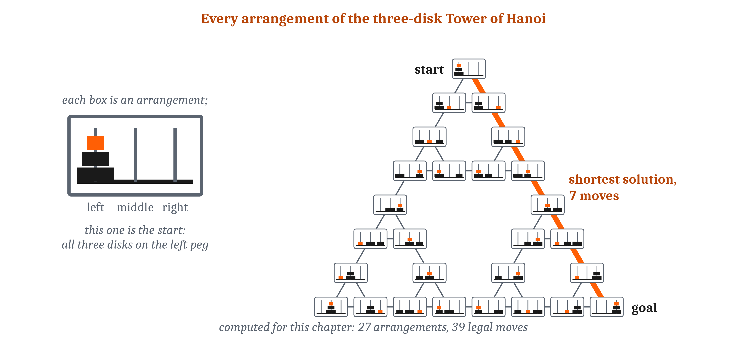
Problems as Spaces to Search
A problem space is the set of states a problem can be in, as the solver represents them, with a starting state, a goal, and moves that lead from one state to another. Search: trying sequences of moves in a problem space to find one that reaches the goal. A heuristic is a rule of thumb that directs search toward small, promising parts of a problem space, so that the rest can be ignored.
Notes:
Herbert Simon and a colleague described solving a problem as moving through a space of states. A problem space is the set of states a problem can be in, as the solver represents them, with a starting state, a goal, and moves that lead from one state to another. In the first lecture of this module, we described the Tower of Hanoi, in which a stack of disks must be moved from one peg to another, one disk at a time, without ever placing a larger disk on a smaller one. The 81 arrangements of the four-disk puzzle are the states of one such space. The three-disk puzzle has 27 arrangements, each joined to the arrangements one legal move away. They form a triangle, with the three arrangements that have all the disks on one peg at its corners. The shortest solution, from one corner to another, takes 7 moves along one side.
Search is trying sequences of moves in a problem space to find one that reaches the goal. In the first lecture, we described how quickly possible futures multiply: in chess, about 30 sequences of one move, about 900 of two, and about 27,000 of three. In the terms of a problem space, that growth in possible futures is growth in the number of paths a searcher could try.
On any but the smallest problems, people cannot try every path. People thinking aloud while solving a problem work through something like ten states a minute. At that rate, visiting the 27,000 positions reached by three chess moves would take about 45 hours. So search has to be selective, guided by a heuristic: a rule of thumb that directs search toward small, promising parts of a problem space, so that the rest can be ignored.
One heuristic chooses each move by the difference between the current state and the goal. In means–ends analysis, a searcher finds a move that would reduce the most important difference. If that move cannot be made yet, the searcher makes the conditions for it a subgoal, and pursues the subgoal in the same way. So means–ends analysis turns one problem into goals nested within goals.
A problem with few states can still be hard, and the procedures that solve it can differ in what they require. Even the four-disk Tower of Hanoi, with only 81 arrangements, is not trivial for adults. Simon described several strategies that could solve it. One strategy breaks the goal into smaller subgoals, and the number of subgoals to be remembered grows with the number of disks. Another strategy repeats a memorized pattern of moves, and needs to remember almost nothing. But for many kinds of problems, patterns that solve a simple version do not generalize. In the Tower of Hanoi, a memorized set of patterns that succeeds with four disks fails for five. So the size of a problem space does not determine how hard a problem is for a person, or which procedure solves it.

Slide 6
Search in Machines and on Maps
Game-playing programs choose moves by searching ahead, guided by estimates they have learned.
AlphaZero’s values are learned from experience, as in model-free choice. Its search runs through positions predicted from the rules, as in model-based choice.
MuZero searched through a representation of the game that it had learned. Choosing a route on a map is search in a problem space whose states are places.
Notes:
Game-playing AI programs choose moves by searching ahead, guided by estimates they have learned. In Module 5, we described AlphaZero, the AI that learned to play games like chess by playing against other copies of itself. AlphaZero has both an actor, which learns to take good moves, and a critic, which learns which states are good states to get to.
AlphaZero’s search is selective, much as a person’s has to be. At each move, it uses its actor’s suggestions and its critic’s estimates to decide which continuations to look at. It scores the position at the end of each continuation with its critic, rather than playing the game to its end. In chess, it examined about 60,000 positions a second, against about 60 million for a conventional program, Stockfish. Yet in 1,000 games against Stockfish, AlphaZero won 155, lost 6, and drew the rest. So a search guided by learned estimates examined far fewer positions than a conventional program, and still won 155 games to Stockfish’s 6.
AlphaZero combines model-free and model-based choice, learned value and planning, two of the three procedures that could produce the jays’ caching. Its values are learned from experience, as in model-free choice, while its search runs through positions predicted from the rules, as in model-based choice. A later program, MuZero, learned what it searched through as well. It searched through its own learned representation of how the game responds to moves, rather than through the rules, though it was still told which moves were legal in the position it searched from. MuZero played chess as well as AlphaZero. So learned estimates can guide a program’s search much as heuristics guide a person’s, and the representation of the world that a planner searches through can itself be learned, rather than given.
The same vocabulary applies to finding a way through space. Choosing a route by searching a map is search in a problem space whose states are places, and whose moves are steps between them. In Module 9, we described the cognitive map, which relates places to one another, so that a route never taken can be found. In one experiment, people acting as travel agents planned routes through a map of connected cities, trying to make the total price of the hotels along the way as low as possible. Each city was a state, and each step to a connected city was a move. So the same vocabulary of states and moves applies to puzzles, games, and routes.

Slide 7
Limiting Search
A large loss roughly doubled the chance that people stopped searching down that branch, even when a larger gain lay beyond it.
On a resource-rational account, a searcher weighs what further thinking would gain against the time or points that each step of thinking uses up.
How an agent chooses between planning and habit remains open.
Notes:
People cut their search short along a branch that begins with a large loss, even when doing so loses them money. In one task, people planned sequences of moves in which each move won or lost money. A large loss roughly doubled the chance that a person stopped looking further down that branch, even when a larger gain lay beyond it. Stopping at the loss is pruning: removing a branch from the search. So pruning a search makes it smaller, and can make it miss the best sequence.
People also choose how far to search, and when to stop, much as a resource-rational account predicts. On such an account, a searcher weighs what further thinking would gain against the time or points that each step of thinking uses up. In one series of experiments, people uncovered the values of possible moves by clicking, and each click deducted points. Their choices about where to look came close to the account’s predictions, and their choices about when to stop went in the predicted direction. So stopping a search early can be a sensible choice, and not only a limit on what a searcher can do.
Pruning and stopping early both make a search smaller, and only pruning can make it miss a better sequence.
Whether to plan at all, rather than act from what usually works, is a further choice, and only part of it has been tested. In Module 6, we left open how an agent chooses between working a problem out step by step and falling back on what usually works. In the terms of this lecture, those are model-based and model-free choice. In the clicking experiments, the only alternative to thinking further was acting on the current plan. So the experiments did not test the choice between planning and acting from what usually works. How an agent chooses between planning and habit remains open.

Slide 8
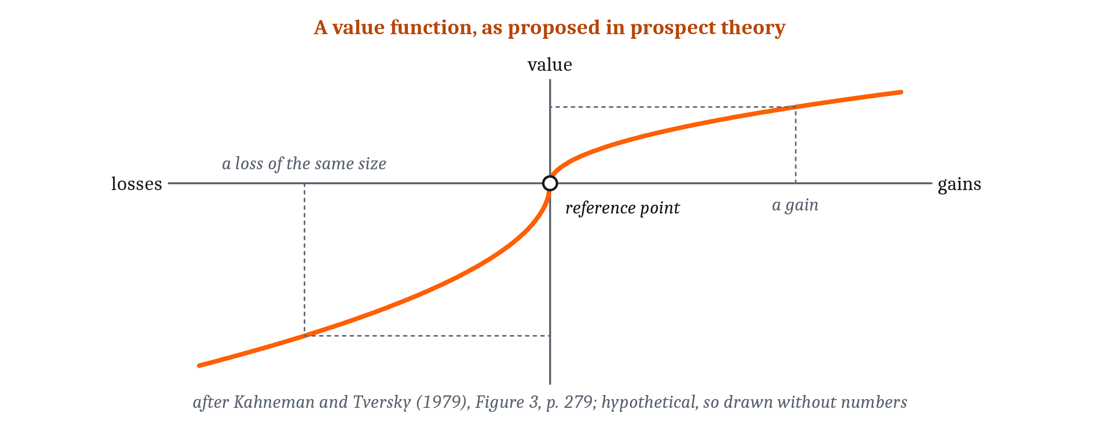
Choosing Under Risk
Bounded rationality: the view that choices are made by procedures suited to a chooser’s limited knowledge, time, and ability to compute. Reflection effect: the reversal of attitudes toward risk when the same choices are put as losses rather than gains. Loss aversion: the tendency for a loss to count for more than a gain of the same size. Framing effect: a change in choice when the same options are described differently.
Notes:
In the first lecture of this module, we described expected value as a standard for judging choices, and we left open whether anyone works expected values out. Herbert Simon argued that people do not. He proposed that there is “a complete lack of evidence” that people perform the computations of the classical rules of choice in real situations of any complexity. Instead, he proposed, a chooser with limited knowledge and time looks for an option that is good enough. Bounded rationality is the later name for this view: that choices are made by procedures suited to a chooser’s limited knowledge, time, and ability to compute. So the question becomes which procedures people do use, and the evidence comes from how their choices depart from the standard.
When people choose between gambles, their attitude toward risk reverses between gains and losses. Daniel Kahneman and Amos Tversky asked people to choose, hypothetically, between a sure gain of 3,000 Israeli pounds and an 80% chance of gaining 4,000. Of the people asked, 80% took the sure gain, a choice like taking the sure $240 over a 25% chance of $1,000. But offered a sure loss of 3,000, or an 80% chance of losing 4,000, 92% took the gamble, though its expected loss is larger. In a replication with 4,098 people in 19 countries, the same reversal appeared, though most of the effects were smaller than in the original. This reversal of attitudes toward risk, when the same choices are put as losses rather than gains, is called the reflection effect.
In prospect theory, Kahneman and Tversky described these choices with a “value function”, measured from a reference point, such as what the chooser has now. It flattens as gains grow, and as losses grow. That shape, together with how people weight probabilities, helps produce the reversal. The curve is also steeper for losses than for gains, because “losses loom larger than gains”. Loss aversion, the later name for this asymmetry, is the tendency for a loss to count for more than a gain of the same size.
Choices also change when the same options are described differently, which every standard of consistent choice rules out, as we said in the first lecture. In the disease problem, a choice concerned 600 people expected to die. When the options were described as lives saved, 72% of people chose to save 200 for certain, rather than take a one-in-three chance of saving all 600. When the same options were described as deaths, only 22% chose the program under which 400 people would die for certain. A change in choice when the same options are described differently is a framing effect. Since the outcomes and their expected values are the same under both descriptions, the change violates the rule that a choice should not depend on how the options are described.
Researchers read these departures in two ways. On the heuristics-and-biases reading, the departures are evidence of the shortcuts people use, and of the errors that follow. In one study, people’s estimates of a quantity moved toward an irrelevant number from a wheel of fortune. On the fast-and-frugal reading, simple rules that ignore most information can do as well as complex ones, in the environments they suit. In judging which of two cities has the larger population, a rule that used only the best cue that told the cities apart matched a statistical method that combined every cue. So a shortcut can be read as a source of error, or as a rule suited to its environment, and the two readings rest on different tasks.

Slide 9
Waiting
Delay discounting: the tendency for a reward to count for less the longer one must wait for it. Self-control: acting for a later or larger outcome against a present temptation.
Waiting as | What the evidence shows
A choice | A reward counts for less the longer the wait, so waiting means choosing the larger reward despite the delay
Partly something a child does | Children waited longer with the treats out of sight; the longest waiters sang, talked to themselves, or invented games
Partly a belief about the world | Children waited about 3 minutes after an experimenter broke her promises, and about 12 after she kept them
Notes:
Delay changes choices, as risk does. Delay discounting is the tendency for a reward to count for less the longer one must wait for it. It is measured by offering a smaller reward sooner against a larger reward later. In Module 5, we called this discounting. So waiting for a larger reward means choosing it, even though the wait lowers its value to the chooser.
In the marshmallow test, a preschooler could have one treat at any time, or two by waiting. Waiting is a test of self-control: acting for a later or larger outcome against a present temptation. How long children waited depended partly on what they did while they waited. Children waited more than 11 minutes on average when the treats were out of sight, and less than 6 minutes when they could see them. The children who waited longest sang, talked to themselves, or invented games. So waiting was partly something a child did, and not only a fixed trait.
Waiting time correlates with later outcomes, but much of the correlation goes with family background and early abilities. In a large and varied sample, the correlation between waiting time and achievement at age 15 was 0.24. It fell to 0.08 once family background, early abilities, and the home environment were taken into account. So a child’s waiting time adds little to what family background and early abilities already predict about later achievement.
How long a child waits also depends on whether the child expects the larger reward to arrive. Celeste Kidd and colleagues first had an experimenter twice promise children better art supplies, and then either bring them or return empty-handed. In the marshmallow test that followed, children whose experimenter had broken her promises waited about 3 minutes on average, against about 12 minutes for children whose experimenter had kept them. The original researchers had listed the expectation that a delayed reward will arrive as one influence on waiting. So a waiting time can measure, in part, what a child believes about the world.
A waiting time can be read in three ways. It is a choice between a smaller reward sooner and a larger one later. It is partly something a chooser does while waiting. And it partly reflects a belief about whether the larger reward will come. So a single number, minutes waited, can reflect all three.
Chimpanzees and bonobos also wait for larger rewards. Offered one piece of food now, or three pieces after one or two minutes, they chose to wait on about half to nearly two thirds of trials. In another study, three of four language-trained chimpanzees, already familiar with the task, waited longer for accumulating candies when they had toys to play with. So waiting for a larger reward, and occupying oneself while waiting, are not specific to human beings.

Slide 10
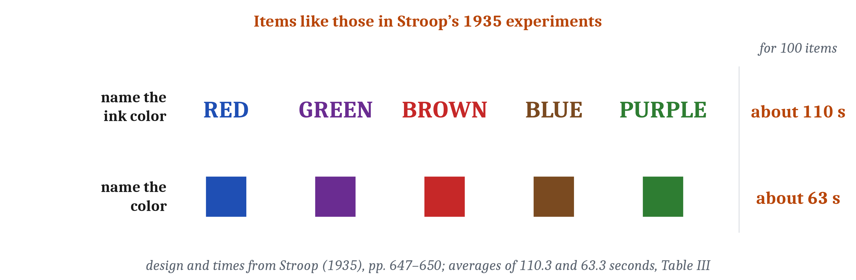
Executive Function
Executive function: the set of processes that control other mental processes in the service of a goal, needed when a habit or the most obvious response would not work. Three components are commonly named: inhibition, shifting, and updating what is in working memory, which is memory for what a task needs while the task is being done.
Notes:
Some situations need processes that control other mental processes, because the most obvious response would not reach the goal. Executive function is the set of processes that control other mental processes in the service of a goal, needed when a habit or the most obvious response would not work. The term has no agreed formal definition. So executive function is identified by the situations that need it, and what it consists of is a question for the evidence.
The Stroop task sets a goal against a strongly practiced response. In the original experiments of 1935, people named the ink colors of 100 color words, each printed in an ink of a color other than the one it names. That took about 110 seconds, against about 63 seconds for naming the colors of 100 colored squares. Conflicting ink colors slowed the reading of the words very little. The experimenter explained the difference by practice: people have far more practice reading words than naming colors. So naming the colors requires not giving the response that comes most readily, which is reading the word.
The proposed components of executive function are partly one ability and partly several. Researchers commonly name three: inhibition, not giving a dominant response; shifting, switching between tasks or rules; and updating, revising what is in working memory. Working memory is memory for what a task needs while the task is being done. Naomi Friedman and colleagues gave the same people several tasks of each kind. Performance was best described by one component common to all the tasks, plus components specific to updating and to shifting, but none specific to inhibition.
Friedman and colleagues proposed an account of what the common component is. On their account, it reflects the ability to maintain goals and use them to bias other processing. So, on their account, what inhibition tasks such as the Stroop task demand is the common part of executive function, maintaining an active goal, rather than a separate ability to inhibit. In the third lecture, we ask where in the brain this kind of control has been studied.
The components of executive function develop over different spans of childhood. A child of three can sort cards by color or by shape. But when the rule changes, the child goes on sorting by the old rule, while knowing the new one. Most children can switch rules by about age 5, but switch flexibly from one trial to the next only at about 7 to 9, and inhibition is still improving in adolescence. So knowing a rule and acting on it can come apart, most clearly in young children when the rule changes.

Slide 11
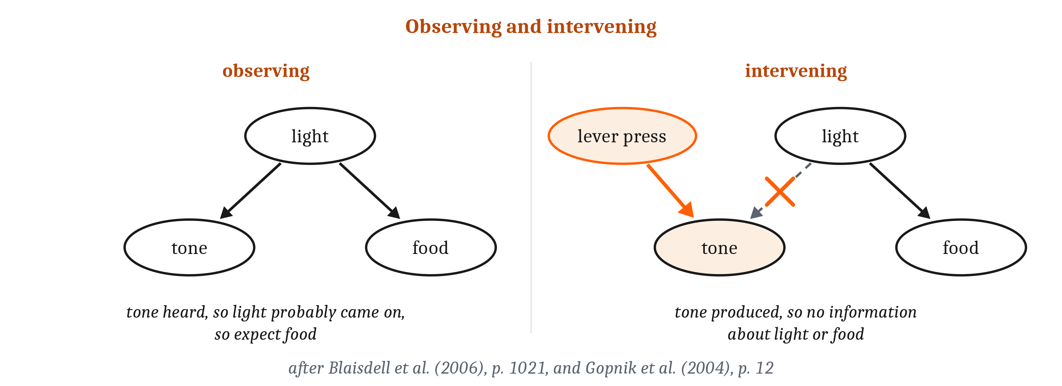
Reasoning About Causes
An intervention sets the value of one thing from outside, so that whatever usually causes it no longer does. A causal graph is a standard for correct causal reasoning, as expected value is a standard for choice.
Notes:
Knowing what causes what lets an agent predict the results of its own actions, which knowing only what goes with what does not. A barometer’s reading predicts the weather, but setting the barometer’s needle to a new reading does not change the weather. An intervention sets the value of one thing from outside, so that whatever usually causes it no longer does. Predicting the results of interventions is what an agent needs in order to choose actions that reach a goal. So causal knowledge is part of what planning requires: a prediction of the state that the agent’s own action will bring about.
A causal graph is a standard for correct causal reasoning, in the way that expected value is a standard for choice. In a causal graph, nodes stand for things that vary, and arrows for which causes which. An intervention removes the arrows into the thing it sets, so the graph gives the effect of each intervention. Consider a light that causes both a tone and food. When the tone is only observed, it is evidence that the light came on, and so that food is coming. When the tone is produced by pressing a lever, the intervention removes the arrow from the light to the tone, so the tone is no longer evidence about the light or the food. The researchers who applied such graphs to children’s learning said that they were not proposing that children have “little graphs in their heads”. So the question is whether children and other animals reason as the standard requires.
Young children treat an intervention differently from an observation. Alison Gopnik and colleagues showed 3- and 4-year-olds a machine that lit up when certain blocks were placed on it. The children saw one block do nothing, saw a second block make the machine go, and then saw the first block put back beside the second. Then the children were asked to make the machine stop, though they had never seen a block removed to stop it. Of the children, 75% took off only the second block. So young children reasoned as the standard requires of a correct learner, though the researchers cautioned that this result fits several learning procedures.
Rats may also treat their own action differently from a cue they observe, though the result is disputed. Rats learned that a light came before both a tone and food. Afterward, they checked the food cup less often after producing the tone themselves, by pressing a new lever, than after only hearing it. Critics have proposed a simpler account of that result. Even so, the rats predicted the result of an intervention they were given, and no animal has yet been shown to design a new intervention from what it learned by watching, as the children did. So, as with the jays’ caching, the behavior does not yet settle what animals represent.

Slide 12
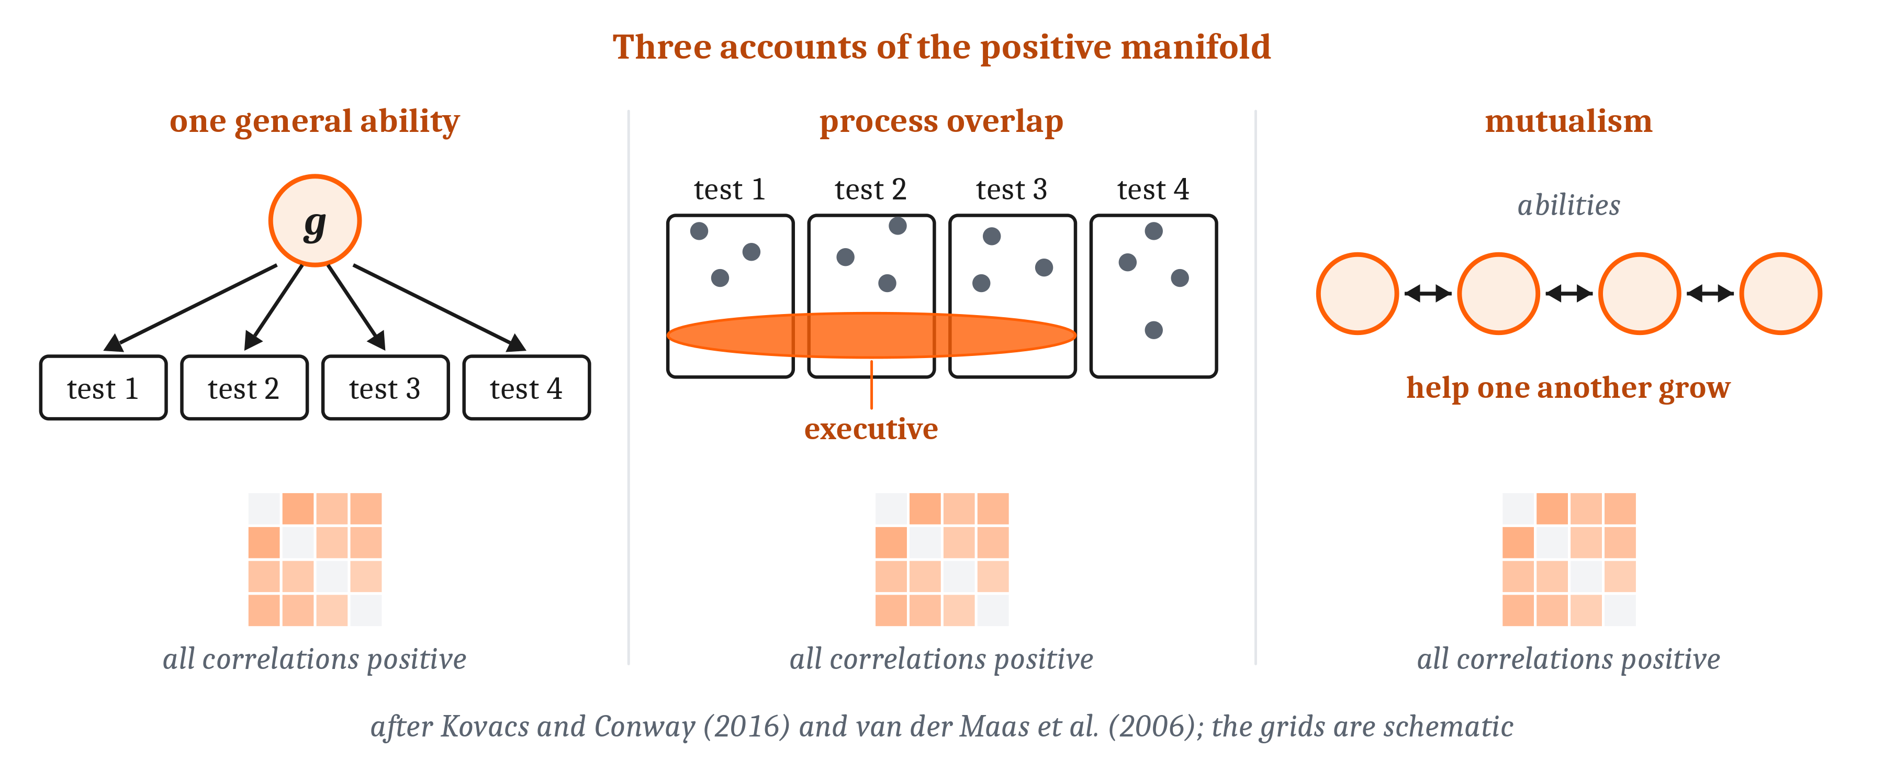
What Produces the Positive Manifold?
General intelligence (g): a proposed single ability that contributes to performance on every mental test. Process overlap theory: the proposal that each test draws on several processes, with executive processes shared by most tests. Mutualism: the proposal that separate abilities help one another grow during development, so that they end up correlated.
Notes:
In the first lecture of this module, we described the positive manifold: people who score well on one kind of mental test tend to score well on the others. We said that the positive manifold is a pattern in a table of correlations, and that reading it as one general ability is a claim about a cause. In this lecture, we ask what could produce that pattern.
That a general factor can be extracted from the positive manifold is not, by itself, evidence about what causes the manifold. A factor is a quantity, computed from a table of correlations, that accounts for part of the differences among people on many tests at once. Any table of correlations that are all positive yields a first factor on which every test has a positive weight, as a matter of mathematics. How large that factor is, is an empirical finding: in human test batteries, it accounts for about 40% to 50% of the differences. So a factor drawn from the correlations is not, by itself, evidence of what produces them.
At least three different causes could produce the same table of correlations. On one account, general intelligence, or g, is a single ability that contributes to performance on every mental test. On process overlap theory, each test draws on several processes, and executive processes like those of the Stroop task are shared by most tests, so the tests correlate because the processes they draw on overlap. On mutualism, separate abilities help one another grow during development, so that they end up correlated. In simulations, mutualism produces tables that a single factor fits well. And statisticians have concluded that accounts like process overlap theory cannot be distinguished statistically from a single cause. So the three cannot be told apart from the table alone.
Telling them apart takes evidence from outside the table, and training is one test. If working memory were the single ability behind the manifold, as has been proposed, training it should raise scores on tests that were not trained. But a major review judged the evidence for such benefits “inadequate”, as mutualism had predicted. So the training results count against working memory as the single cause, without deciding between mutualism and process overlap theory.
The question we asked in Module 0, whether intelligence is a single thing or a bundle of many abilities, can be answered only part of the way. Proposals that intelligence consists of many separate kinds have little support as usually stated. One critical review found no published studies that offer evidence of the validity of multiple intelligences. And emotional intelligence, measured as an ability, correlates about 0.30 with general intelligence. So the abilities are correlated, and whether one ability or several overlapping ones produce the correlation is still open.

Slide 13
General Intelligence in Other Animals, Hominins, and Machines
Cultural intelligence hypothesis: in one version, the proposal that human beings differ from other apes mainly in specialized skills of social cognition, rather than in a uniform advantage across all kinds of problem.
A general factor within one species does not place species on a single scale.
Language models’ benchmark scores also correlate, and a factor is not by itself evidence of what produces it.
Notes:
Positive correlations among tests appear in other species too, but researchers disagree about what they mean for the difference between human beings and other apes. Judith Burkart and colleagues argue that general intelligence evolved in many species. Their evidence includes mice and rhesus macaques, in which a first factor accounts for about a third to a half of the differences among individuals.
Esther Herrmann and colleagues read the comparison with other apes differently. They gave the same problems to children of about two and a half, to chimpanzees, and to orangutans. The children and the chimpanzees did about equally well on problems about the physical world. But on problems about other individuals, the children got about 74% right, and the apes about 35%. On the cultural intelligence hypothesis, in Herrmann and colleagues’ version, human beings differ from other apes mainly in specialized skills of social cognition. So on Herrmann and colleagues’ results, the human difference at that age lies in social problems. On Burkart and colleagues’ account, many species have a general ability, and social learning helps explain why some have more of it.
A general factor within one species does not place species on a single scale. Burkart and colleagues do report a factor that ranks primate species, but only related species given comparable tasks. What counts as doing well differs with each species’ problems, or, as one commentary put it, “a smart elephant makes a lousy bat”. So a general factor within a species does not conflict with what we said in Module 2, that there is no ladder of intelligence.
One hypothesis about later hominins concerns working memory, and it can be tested only through what they made. An archaeologist and a psychologist proposed that Neanderthals relied on expert routines learned over long practice, such as the prepared Levallois cores we described in the first lecture. Later *Homo sapiens*, on their hypothesis, had more working memory, which allowed new combinations. Among the findings that they said would refute their hypothesis were long-range social networks, and rapid, directional change in technology. The review that found the claims of Neanderthal inferiority unsupported later reported that the distances over which Neanderthals moved stone did not differ significantly from those of contemporary *H. sapiens*. It also reported that their technology changed through time much as the African record did. So the later evidence bears on two of the authors’ own criteria, and on neither does it show the difference that they predicted.
The scores of AI language models on benchmarks, which are fixed sets of test items used to compare AI systems, also correlate. In one analysis of hundreds of language models, a general factor accounted for about two thirds of the differences among them. Its authors declined to call it general intelligence, partly because the benchmarks were more alike than the tests in human batteries. Another analysis found three correlated factors, and a third found signs that the first factor’s share may have fallen in recent language models. So, in machines as in people and other animals, a factor in a table is not by itself evidence of what produces it.

Slide 14
To Discuss: A Brain-Training App
In your group, five minutes.
A brain-training app advertises that its working-memory games will raise a player’s IQ.
What would have to be true for that claim to hold? Is there evidence that it does?
Notes:
We can apply what we have said about the positive manifold to a claim that many people encounter.
Start with what would have to be true. An IQ test combines a person’s scores on many kinds of problems into one score, and the score is a rank within a reference sample. So the app’s claim is that practice on its games would move a person up that ranking on tests the games did not train. That would be expected if working memory, memory for what a task needs while the task is being done, were the single ability behind the positive manifold, as has been proposed. Then training working memory should raise scores on tests that were not trained.
Then ask whether there is evidence that it does. A major review judged the evidence that working-memory training raises scores on untrained tests “inadequate”. That result counts against working memory as the single cause of the manifold, as mutualism had predicted. It does not decide between mutualism and process overlap theory. And improvement on the games themselves is a different claim from improvement on untrained tests, so a rising score inside the app does not answer the question.
Groups often point out that scores can change. In the first lecture of this module, we said that staying in school longer raises scores, by about 1 to 5 points for each extra year. So the question is not whether scores can rise, but whether these particular games raise them. Groups also notice that the correlation between working memory and other tests is a pattern in a table. A pattern of correlations is not evidence of what produces it, and the app’s claim requires that improvement on one kind of test extend to the others.

Slide 15
Image Sources
Slide | Image | File | License | Source
3 | Three procedures on the two-step problem | fig-two-step-rungs.png | CC BY 4.0 | Jon Willits — from the Module 12 reading · own work
5 | Every arrangement of the three-disk Tower of Hanoi | fig-hanoi-states.png | CC BY 4.0 | Jon Willits — from the Module 12 reading · own work
8 | A value function of the kind proposed in prospect theory | fig-value-function.png | CC BY 4.0 | Jon Willits — from the Module 12 reading, after Kahneman and Tversky (1979) · own work
10 | Items like those in the original Stroop experiments | fig-stroop.png | CC BY 4.0 | Jon Willits — from the Module 12 reading, after Stroop (1935) · own work
11 | Observing and intervening in a simple causal graph | fig-observe-intervene.png | CC BY 4.0 | Jon Willits — from the Module 12 reading, after Blaisdell et al. (2006) and Gopnik et al. (2004) · own work
12 | Three explanations of the positive manifold | fig-manifold-accounts.png | CC BY 4.0 | Jon Willits — from the Module 12 reading, after Kovacs and Conway (2016) and van der Maas et al. (2006) · own work

