Slide 1

BCOG 100
Learning and Plasticity
Lecture 5.1 — The Advantage of Changing Within a Lifetime
Notes:
Module 4 built an animal that could steer. It evaluated what arrived at its surface, combined signals that disagreed, committed to one action rather than half of two, and held a state that outlasted its cause.
Every one of those arrangements worked because of its weights, and every one of those weights was set in advance, across generations, by differential survival.
This module is about weights that move within a single lifetime. The question for the whole week is what it takes to move one.

Slide 2
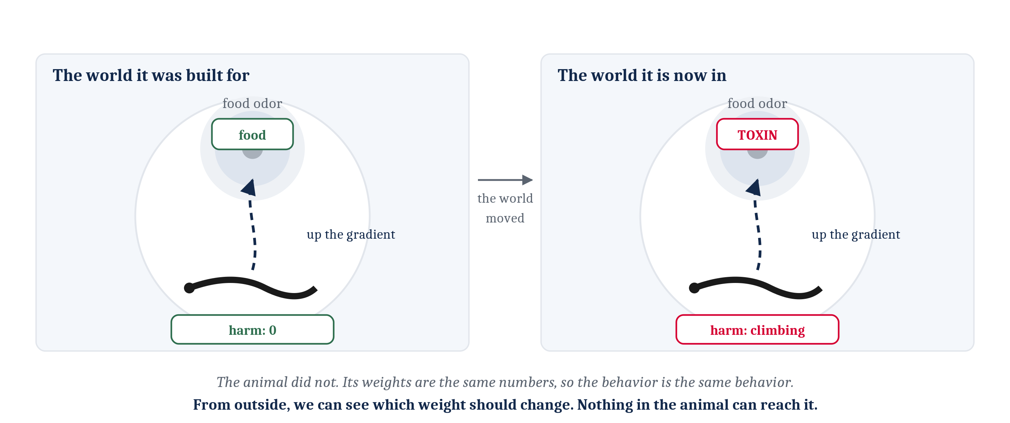
Change the World, and a Fixed Animal Fails the Same Way Every Time
Move the food. Or let a smell that has always meant a meal come to mean poison. An animal whose weights are fixed goes on producing what it was built to produce, and fails identically every time.
Notes:
Those of us who have worked through the Lab 4 closer have already done this by hand. The scene is the healthy animal, with the healthy wiring, in a dish of food odor — except that the food odor now comes from a toxin. The animal keeps swimming up the gradient, and the harm counter keeps climbing, and it does not stop.
Then the lab asks for the fix, and the fix takes a few seconds with the sliders. Lower the weight from the food sensor, or flip its sign, and the animal turns away. That is worth sitting with, because the fix was easy for us and impossible for the animal. Nothing in that worm can reach its own numbers.
One honest correction before we go on. Module 4 discussed those circuits as though their weights were hard-wired, and that was our simplification rather than a claim about the animals. A circuit is far easier to explain while its numbers are not moving. Real animals learn, and that includes the small ones in Module 4 — the nematode learns, and the evidence now says some cnidarians do too.
So the limit we are looking at is the limit of a fixed-weight design, not the limit of a worm. An animal built that way cannot come to treat an unfamiliar smell as a sign of food. It cannot come to treat a smell that has always meant food as a sign of danger. Put it in a world whose regularities have shifted and it will fail the same way indefinitely.
From the outside we can see exactly which number should change. That asymmetry between what an observer can see and what the animal can reach is the whole problem of the module.

Slide 3
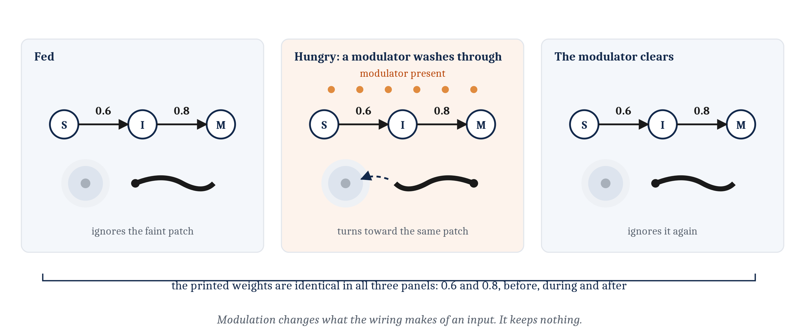
Modulation Is Real Flexibility, and It Is Not Learning
A weight sets which input counts for how much, and with what sign. A neuromodulator changes what the same circuit does with the same input. When the chemistry clears, every weight is where it was.
Notes:
Module 4's animal did have one kind of flexibility, and it is worth being exact about why that kind is not enough.
A neuromodulator washes through the tissue and changes what the same circuit does with the same input. A hungry worm pursues a faint food signal that a fed worm ignores. Nothing in the wiring moved; the modulator changed how much the existing wiring made of what arrived.
Now watch the third panel. When the chemistry clears, the animal is exactly what it was before. The weights are the numbers they always were, and nothing that happened while the modulator was present is kept. An animal can be modulated a thousand times and be no different at the end of it.
That is the line this module is about. Learning requires that something inside the animal be different afterward, and stay different.

Slide 4
Marr's Wheel, a Third Time
Module 3 asked the computational question of a cell. Module 4 asked it of an arrangement of cells. This module asks it of a change.
Level | The question it asks | Discipline | This module's example: a weight that can change
Computational | What problem is being solved, and why does solving it matter? | Evolution and ecology | Detecting contingencies that selection could not have fixed a response to: ones that change within a lifetime, ones that differ from place to place, and ones that are new to the species
Algorithmic | What is represented, and by what procedure? | Cognitive psychology and AI | Rules that move a weight — on local activity alone, on a target supplied by the world or by a teacher, or on one broadcast number reporting how things went
Implementational | By what physical means, and at what cost? | Neuroscience | A synapse that detects coincidence, a signal from elsewhere that gates what the coincidence does, and a fading mark that decides which synapses are still candidates
Notes:
The table is the one we have used in each of the last two modules, with this module's row filled in. Three of those cells are the rest of the week: today is the left-hand column's top row, lecture 5.2 is the middle row, and lecture 5.3 is the bottom.
What is new is the object the question is asked about. Module 3 asked what problem a cell solves. Module 4 asked what problem an arrangement of cells solves. Today the question is asked of a change: what problem does a change inside an animal solve, and why did an animal that could make one leave more descendants than an animal that could not?
Reading the top row carefully is worth the time, because it is not the answer most people expect. The problem is not detecting contingencies in the world. Module 4's animals already do that. The problem is narrower than that, and the next few slides are about getting to it.

Slide 5
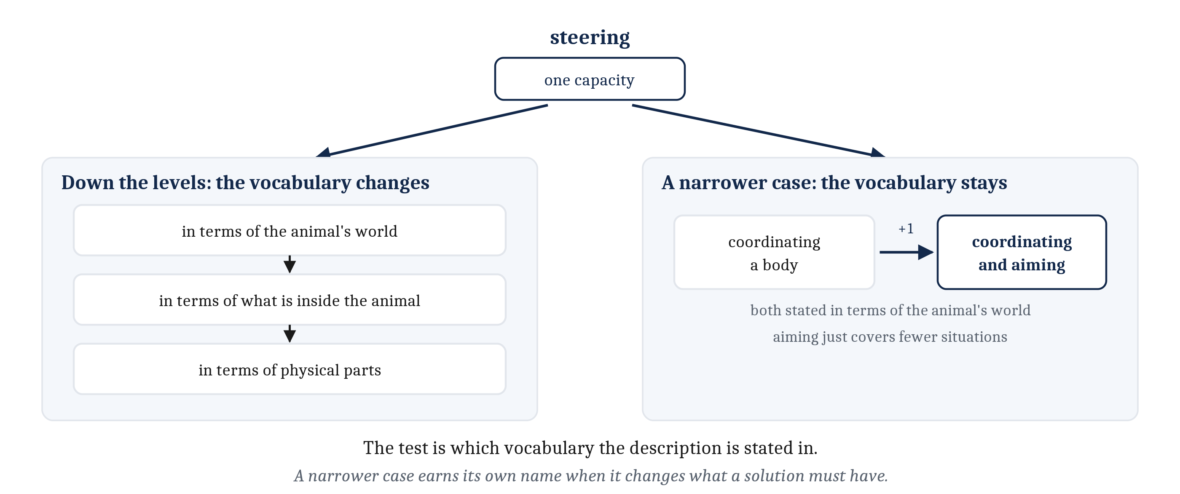
Two Different Ways a Question Gets More Specific
Moving down the levels changes the kind of question, and the vocabulary with it. A narrower case keeps both and adds a constraint. It earns its own name when it changes what a solution must have.
Notes:
We have been making a distinction all term without stating it, and Module 5 is where stating it pays.
Marr's levels are one way a question about a capacity changes. Take steering, and ask what problem is solved, by what procedure, and by what physical means. One capacity, three questions, and the capacity itself holds still.
There is a second move, and it is a different move. Hold the kind of question fixed and take a narrower case of it. A nerve net solves the problem of coordinating a whole body in time. A bilaterian solves the problem of coordinating a body and aiming it somewhere. Both of those are computational questions. Aiming is coordination with a constraint added, one notch more specific, and an account of coordinating a body is not an account of aiming one.
What tells the two moves apart is the vocabulary. Going down the levels changes it: the animal's world, then what is inside the animal, then physical parts. Taking a narrower case keeps it — coordinating and aiming are both stated in terms of the animal's world, and aiming simply covers fewer situations.
One rule goes with the second move. A narrower case earns a name of its own when it changes what a solution must have, and not when it is merely harder. We will use that rule four times today, because the four tiers of learning are exactly four narrower cases, each one changing what a solution must have.
And notice what this lets the course do. Rather than stepping forward in evolutionary time to a new animal, this module stays with the animal we have and adds a capacity it did not have. Several of the modules ahead work the same way.

Slide 6
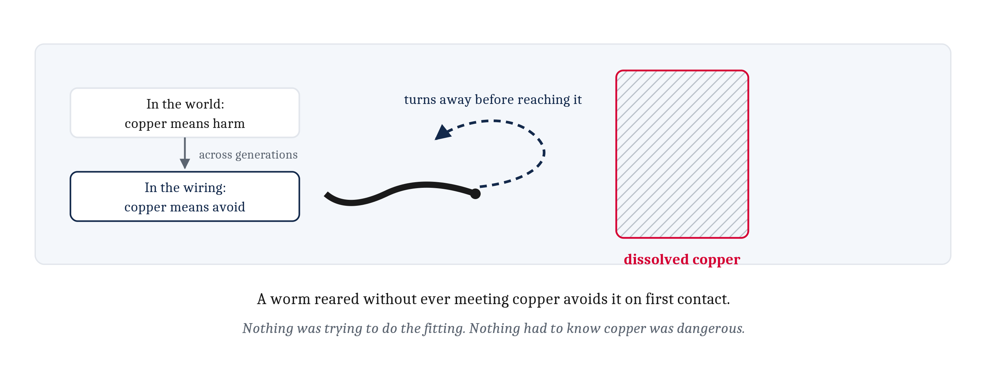
Detecting a Contingency Is Not the New Thing
A contingency is a reliable relationship between one thing and another. The worm avoids copper, and nothing in its own life taught it to: that relationship was detected across generations.
Notes:
Here is the result that reframes the module. Animals do not need learning in order to detect contingencies in the world.
A contingency is a reliable relationship between one thing and another. In the places this worm's ancestors lived, dissolved copper was a dependable sign of harm, and the worm's nervous system reflects that relationship. Copper ahead, and the animal avoids it.
Nothing in this worm's own lifetime established the relationship. It was detected across generations, by differential survival among animals whose wiring differed, and the population ended up wired the way the world is. This is the across-generations sense of *adapt* from Module 2, and the test is the reared animal: a worm that has never met copper avoids it the first time.
Now the part that is easy to say wrongly, and the chapter is careful about it. Nothing was trying to do the fitting. Nothing had to know that copper was dangerous for the avoiders to become the common kind. Selection has no foresight — that was Module 2's lesson, and we will need it intact later today.
So the new capacity in this module is not contingency detection. What is new is a second route to the same result, running on a different timescale, inside one animal, during one lifetime.

Slide 7
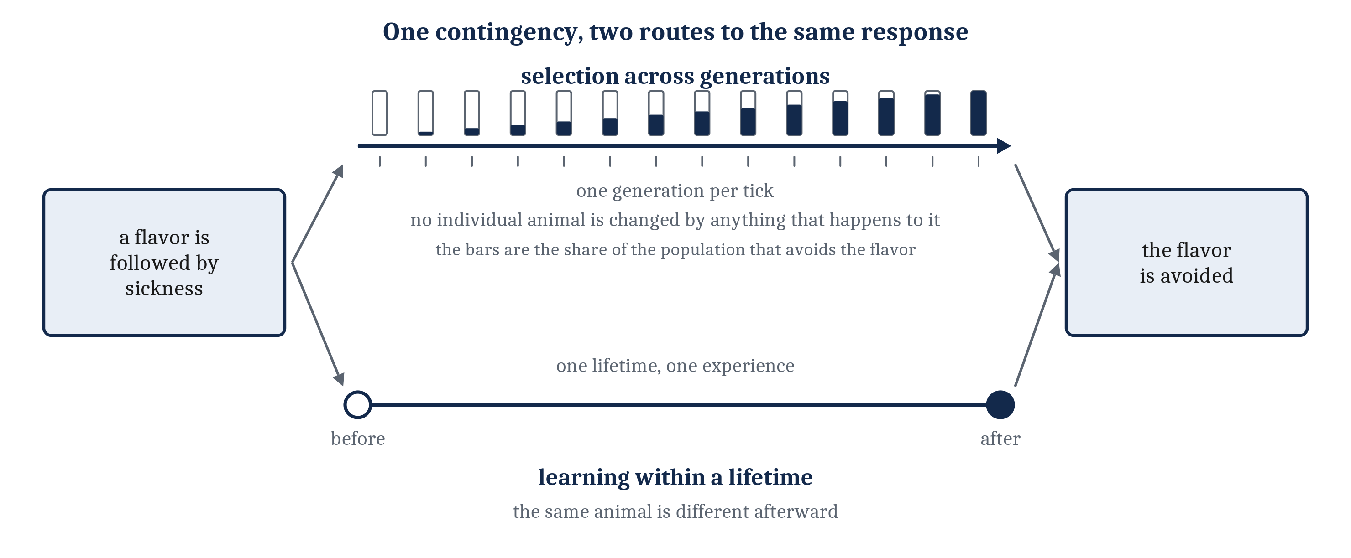
Selection Is Slow and Coarse, and Three Kinds of Relationship Slip Through
Contingencies that reverse within a lifetime, that differ from place to place, or that are new to the species cannot be met by a response fixed in advance. That is the module's problem.
Notes:
Selection is a slow filter and a coarse one. A neural response becomes common in a lineage only if the relationship it reflects held for a long time and was met by a great many individuals, because that is what it takes for a difference in survival to accumulate.
Three kinds of relationship slip through a filter of that shape. Some hold for a season and then reverse, so the response that fit last month does not fit this month. Some are true in one patch of territory and false in the next, so no single wiring fits the whole species. And some have never occurred in the lineage at all, because the flavor or the predator or the chemical is new.
Taste aversion carries two of the three at once. A rat eats something with an unfamiliar flavor, is sick several hours later, and will not touch that flavor again. The flavor may be one no rat in the lineage ever encountered, and a plant that poisons a rat in one patch may not grow in the next.
Two details of that case are worth keeping. The delay between eating and sickness rules out any moment-by-moment reflex — something has to have carried the flavor forward across hours. And the learning holds after a single experience, because the cost of a second experience is death.
The figure is the chapter's, and it says the thing I most want to leave with everyone today. One relationship in the world, two routes to the same behavior. The upper route runs across generations and the individual animal is unchanged by anything that happens to it. The lower route runs inside one animal, and that animal is different afterward.
So the module's problem, precisely: not detecting contingencies, which Module 4's animals already do, but detecting the contingencies selection could not have fixed a response to.

Slide 8
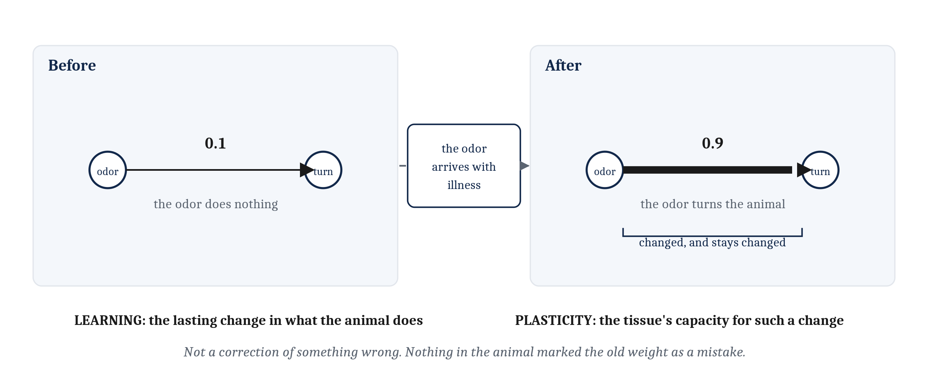
What an Acquired Response Requires
Learning is a lasting change in what an animal does, produced by experience and resting on an internal state experience can modify. Plasticity is what makes such a state possible.
Notes:
An animal that can acquire a new avoidance during its own life needs something the fixed-weight animal does not have. It needs a part of itself that changes because of experiences it has, and that thereby comes to reflect something about the world.
That gives us the module's two definitions. Learning is a lasting change in what an animal does, produced by experience and resting on an internal state that experience can modify. Plasticity is the property of nervous tissue that makes such a state possible — the capacity of a connection, or of a cell, to undergo a lasting change as a consequence of activity. Learning is the change in behavior; plasticity is what the tissue can do.
Now a temptation to refuse, and the chapter is firm about it. It is tempting to say the animal's earlier weights were *wrong*, that they were a mismatch to what the weights should have been. That is not a correct way to think about it. The world can change while a connection does not, and nothing anywhere in the animal marks the difference. An animal in that condition is still learning, by any reasonable use of the word.
Hold on to that, because lecture 5.2 will introduce a rule that genuinely does compute a difference between what happened and what was expected. When that arrives, the difference will be a real quantity in the mechanism. It is not available here, and it is not available to every kind of learning.

Slide 9
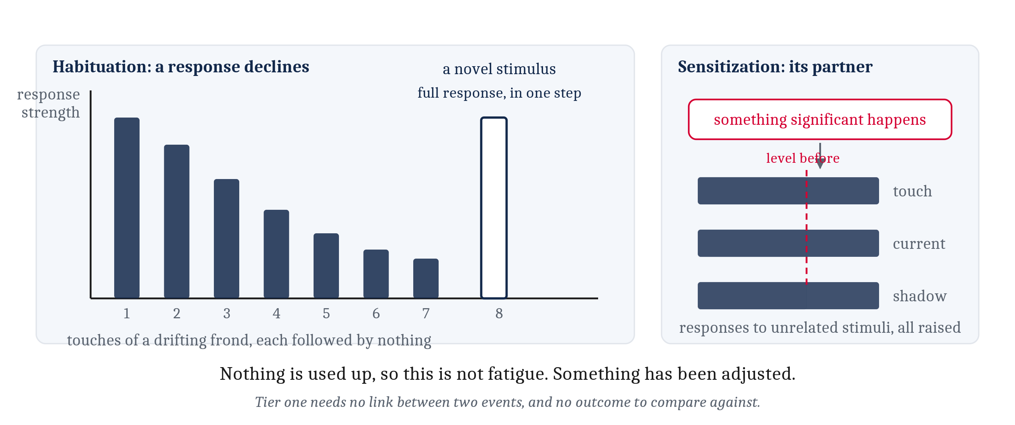
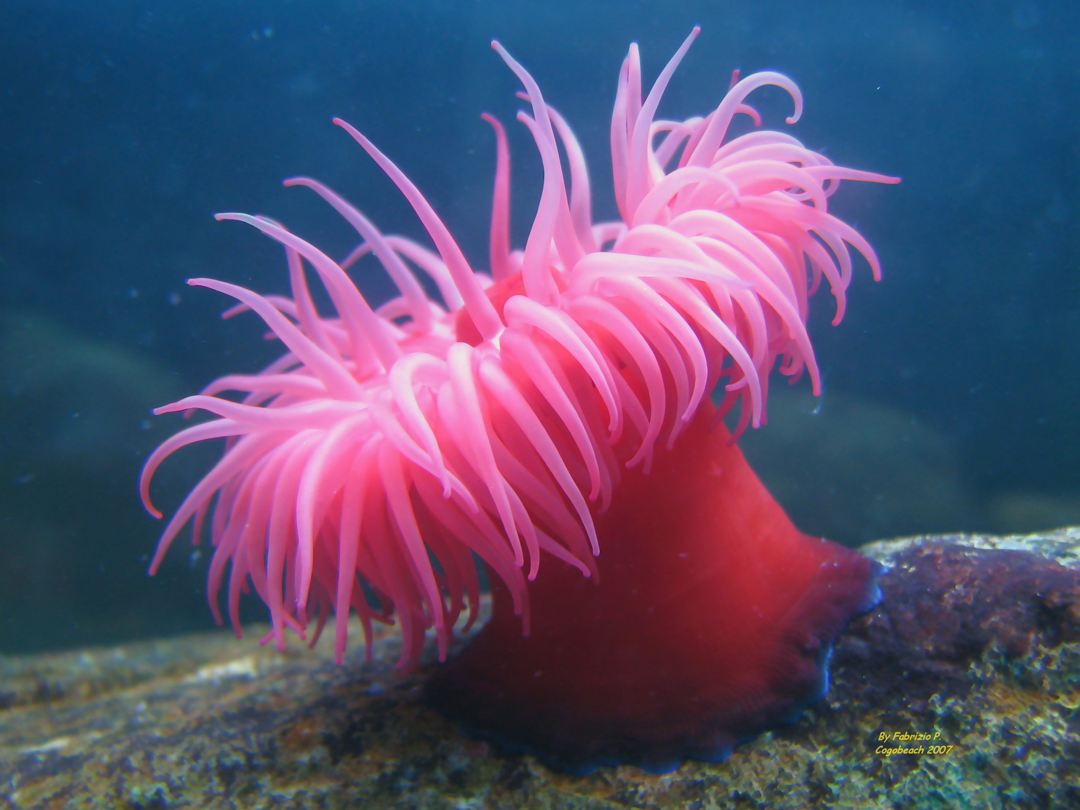
Tier One: Changing the Response to Something That Keeps Happening
Habituation is a decline in a response to a stimulus repeated without consequence. Sensitization is its partner, a rise in responsiveness after something significant happens.
Notes:
The next four slides work through the first of the module's two questions: what there is to learn. Four relationships an animal might pick up, each one asking more than the one before.
The simplest thing an animal can do with experience is change how strongly it responds to something it has met before. A sea anemone touched repeatedly by a drifting frond stops withdrawing. That is habituation, a decline in a response to a stimulus repeated without consequence.
The plot carries the objection and the answer to it. Habituation is not fatigue. Present a novel stimulus and the full response returns immediately, in one step. Nothing was used up. Something was adjusted.
Sensitization is habituation's partner: a rise in responsiveness to stimuli generally, after something significant has happened. An anemone that has just been attacked withdraws from almost anything.
Both count as learning by the definition on the previous slide, because both are lasting changes in what the animal does, produced by experience. And what tier one requires is remarkably little. There is no link between two events, no outcome to compare against, and nothing that could be called a target response. There is only a running count of how often something has happened and whether anything ever followed it.
What it buys is real, though. Attention and energy are both finite, and an animal that keeps responding to a stimulus never followed by anything is spending both on a non-event.
There is a second benefit, in an animal we already know. A cnidarian's stinging cells fire once and are spent, and a brush against the body wall might be prey or might be debris. Sensitization gates their firing, so that several independent kinds of evidence for prey have to arrive together before one cell is committed. A touch alone does not fire it. A chemical trace of prey alone does not fire it. Only both together do — which, as Ken Cheng points out in his review of this literature, behaves just like an AND gate. That is the third AND gate in three modules, after Module 4's threshold unit, and there is a fourth coming in lecture 5.3.

Slide 10
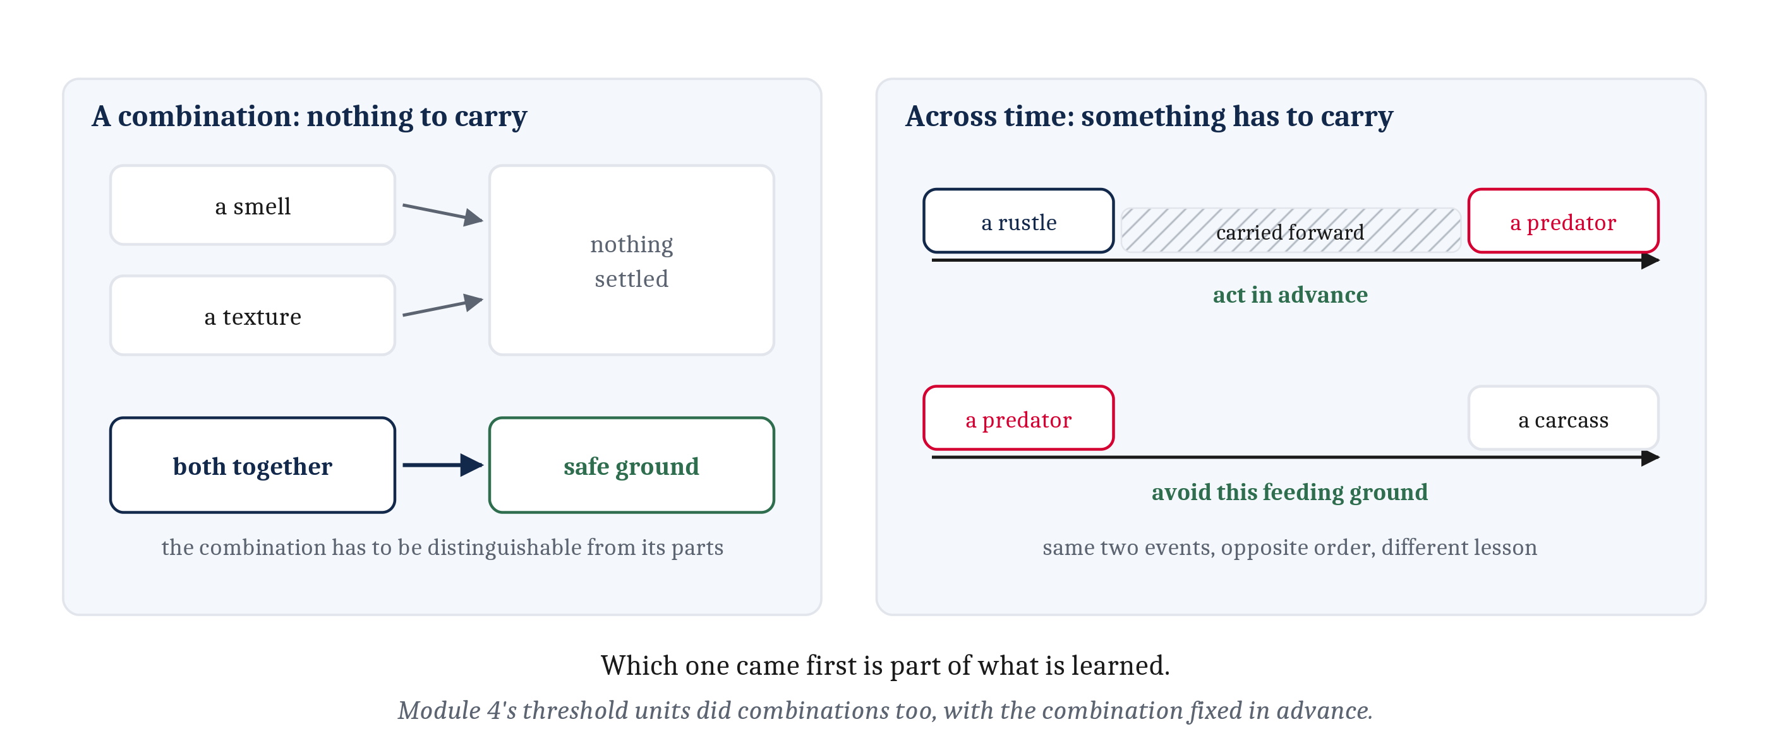
Tier Two: Linking Two Things That Occur Together
A link between two states buys two things: acting before an event, and treating a novel combination as one thing. Across time, something has to carry the first event forward.
Notes:
Tier two adds a link between two states, rather than a change in one state. An animal that can form such a link can do two things it could not do before. It can act before an event rather than waiting for it. And it can treat a novel combination of cues as a single thing, when no cue on its own would identify it.
The combination is the simpler of the two, because nothing has to be carried forward in time. A patch of ground may be safe only when a particular smell and a particular texture underfoot occur together, with neither cue settling anything alone. What such a link needs is that the combination be distinguishable from its parts, so that the response to both together is not the sum of the responses to each alone.
We have seen that requirement met twice already — Module 4's threshold units did it, and so does the cnidarian's stinging cell. In both cases the combination was fixed in advance. What tier two adds is the capacity to acquire a new one.
A link across time is harder. When the cue arrives, the thing it predicts has not happened. When the outcome arrives, the cue is over. So something in the animal has to carry the first event forward until the second one arrives, and the two have to meet somewhere. Lecture 5.3 comes back to what that carrying is made of.
Order matters too, though not quite in the obvious way. A rustle in the grass before a predator supports acting in advance. A carcass after a predator supports something different: avoiding a place where predators feed. Both links are useful, and neither does the other's job, which is why an association in time has to record which event came first.
The nematode does this. Exposed to a particular food odor together with a chemical that makes it ill, the worm afterward steers away from that odor — a link between two things its wiring did not come prepared to relate. Notice what it needs and what it does not. It needs reliable dependencies in its world. It does not need anything about its own actions.

Slide 11
Classical Conditioning, in a Reflex and in a Worm
Classical conditioning is learning in which one thing comes to be treated as a sign of another. What changes is which event sets the response off, and nothing about what the animal chooses to do.
Term | The eyeblink case | The worm case
Unconditioned stimulus | A puff of air to the eye | The chemical that causes illness
Unconditioned response | The eye blinks | The malaise
Conditioned stimulus | A tone sounded just before the puff | The food odor paired with the chemical
Conditioned response | The eye blinks to the tone alone | Steering away from the odor
Notes:
Learning in which one thing comes to be treated as a sign of another is what psychologists call classical conditioning, or Pavlovian conditioning, and it comes with a vocabulary of four terms.
The reflex case is the easiest place to see them. A puff of air to the eye makes it blink in an animal that has never been trained: the puff is the unconditioned stimulus and the blink the unconditioned response. Sound a tone just before the puff, over and over, and the tone alone comes to make the eye blink. The tone is now the conditioned stimulus, and the blink it produces the conditioned response.
The right-hand column is the worm from the previous slide, and the structure is identical. The toxic chemical is the unconditioned stimulus, the malaise it causes the unconditioned response, the odor the conditioned stimulus, and steering away the conditioned response.
One difference between the columns is worth naming, because it does not do the damage it looks like it might. Steering is a movement and blinking is a reflex. That is worth noticing, and it changes nothing about the structure of the conditioning.
Here is the sentence to take away, and it is the one most often mis-stated. What gets learned is a link between two events. The response is how we can tell the link is there — it is the evidence, not one of the two things being linked.

Slide 12
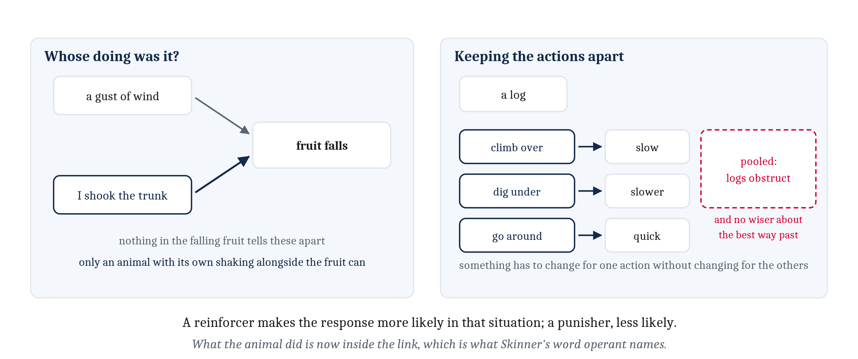
Tier Three: Linking What Happened to the Animal's Own Actions
Two new requirements: telling this happened from this happened after I acted, and keeping the actions apart. Operant conditioning, with its reinforcer and punisher.
Notes:
Tier three adds two requirements, and both are genuine additions rather than refinements.
The first is that the animal has to distinguish *this happened* from *this happened after I acted*. That distinction has no meaning at all for a purely sensory learner, which registers that two events go together without registering that its own action was one of them. Telling the two apart requires that the animal can take what it just did as a fact of its own.
The left panel is where the difference is clearest. A branch overhead dips and fruit comes down. If the branch dipped because the wind moved it, the animal has learned something about wind. If it dipped because the animal shook the trunk, the animal has learned something it can do again. Nothing in the falling fruit distinguishes those two cases. The distinction is available only to an animal that has its own shaking alongside the fruit.
The second requirement is that the animal keep information about its different actions distinct, so that something inside it can change for one action without changing for the others. The log makes the point. Climb over, dig under, go around — each is followed by a consequence, and a learner that pooled those consequences would come away knowing that logs are an obstruction and no wiser about the best way past one.
Learning in which what the animal did becomes one of the linked terms is operant conditioning, or instrumental conditioning. Its vocabulary: the situation is the discriminative stimulus, what the animal does is the response, and what follows is the consequence. A consequence that makes the response more likely in that situation afterward is a reinforcer, and one that makes it less likely is a punisher.
Thorndike stated the principle in 1911 as the law of effect, and Skinner later coined *operant* for behavior that operates on the environment rather than being drawn out of the animal by a stimulus. Skinner's word is well chosen for what this tier adds, since what the animal did is now inside the link.

Slide 13
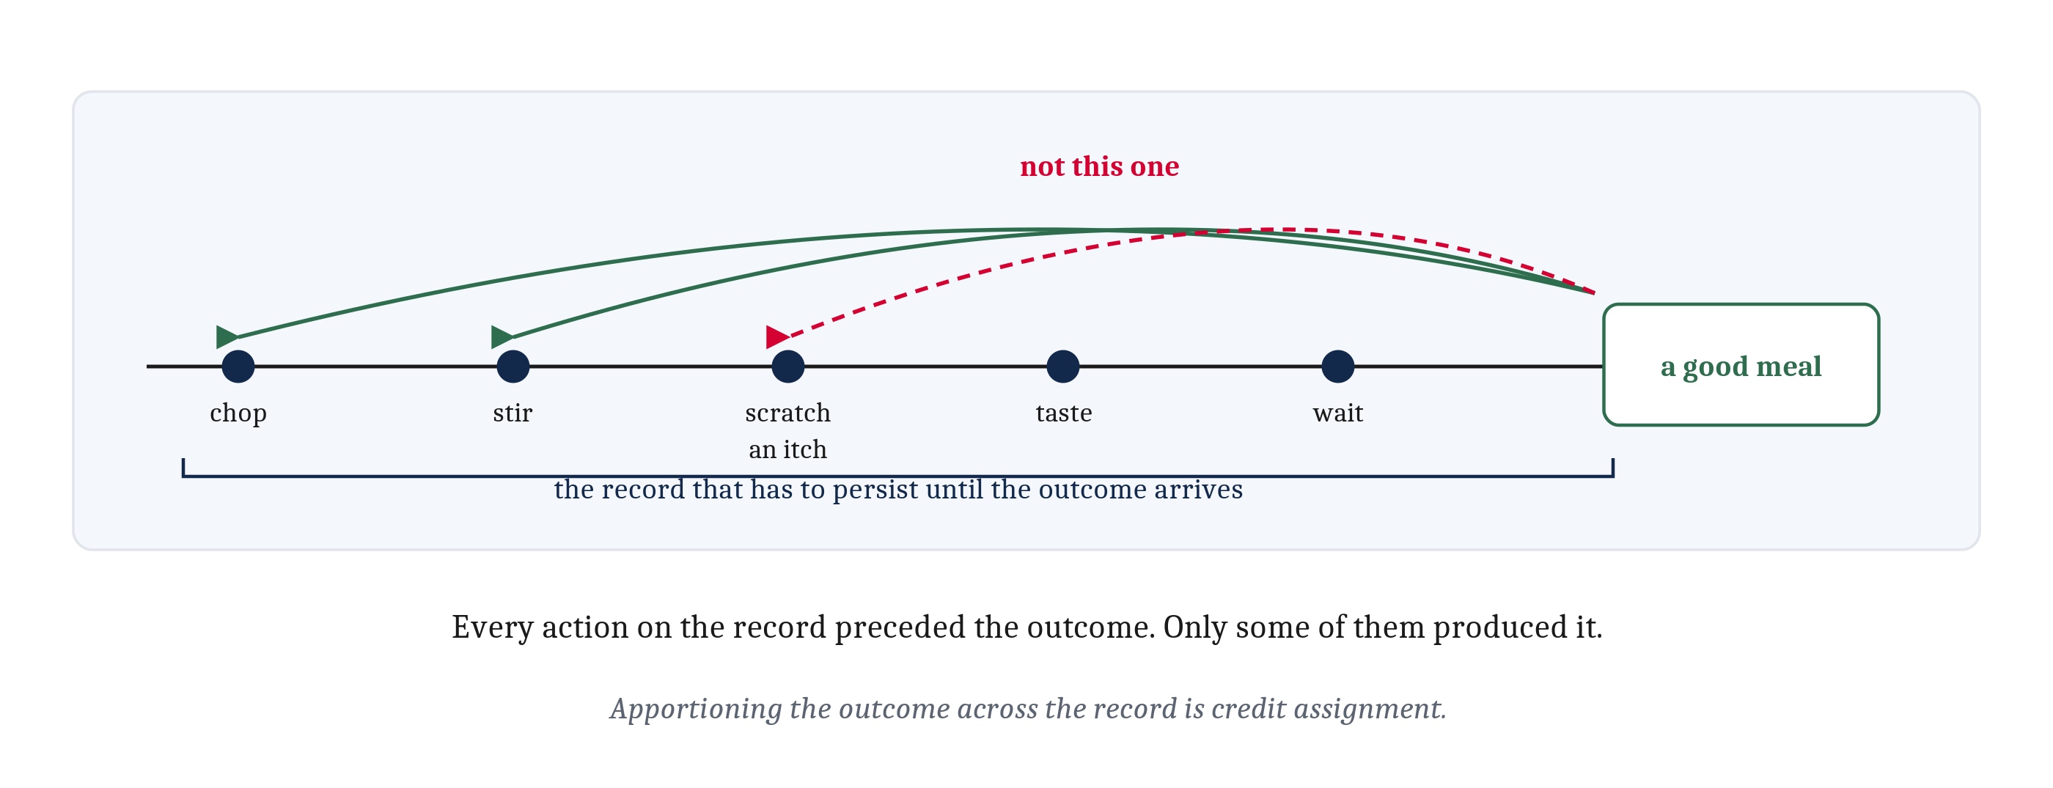
Tier Four: Bridging a Delay
Two halves. A record of what was done, persisting until the outcome arrives. Then credit assignment, apportioning the outcome across everything on the record.
Notes:
Tier four is the hardest of the four and the one that changes the most about what an animal can do. Cooking a meal, studying across a semester, practicing an instrument: the outcome arrives long after the actions that produced it, and a great many irrelevant actions happened in between.
The new requirement is a record of what was done, persisting until the outcome arrives. Without one there is nothing left to modify by the time the news comes in.
The second half of the problem is just as hard, and it is easy to read past. Even with the record, the credit has to be apportioned appropriately across the actions on it. For a tasty meal, stirring mattered and scratching an itch halfway through did not, and both preceded the reward. The arrows in the figure are the whole difficulty: the record alone cannot tell us which arrow to draw.
That problem has a name — credit assignment — and it is the problem that bedeviled the first machines built to learn. Lecture 5.2 is where those machines appear, and where we get a mechanism that makes a start on this.

Slide 14
Do Animals Without Brains Learn? And How Would We Know?
A clean adaptive argument says tier one is all a sessile filter-feeder needs: it does not choose between patches, and does not pursue. The argument predicts an absence, and the absence is not holding up.
Kind of learning | Hydras | Jellyfish | Sea anemones | What would settle the open cells
Habituation (tier one) | Amply shown | Amply shown | Amply shown | Nothing outstanding
Sensitization (tier one) | A hint only | No studies | Shown, with a neurobiological literature | Straightforward replication in the other two groups
Classical conditioning (tier two) | Not studied | Not studied | Two well-controlled demonstrations, one from 1975 and one from 2023 | Independent replication in a second laboratory; a retention test beyond ten minutes
Operant conditioning (tier three) | Not studied | One demonstration, 2023, with an isolated ganglion conditioned separately | Suggestive only, on weak controls | Replication in a second species; an acquisition curve and an extinction test
Notes:
Take the adaptive argument at its strongest first, because it is a good argument. A sessile filter-feeder has little use for associations. It does not choose between patches, it does not pursue, and most of what happens to it is not the sort of thing it could act on in advance. So a jellyfish or an anemone should have habituation and sensitization and nothing more, despite having had hundreds of millions of years in which to acquire more. That argument has been stated confidently in recent literature.
It also makes a prediction, and the prediction appears to be failing.
Start with what is not in dispute, which is the top two rows. Habituation is amply documented in hydras, jellyfish and anemones, and sensitization has been studied in detail in anemones. Tier one in non-bilaterians is not controversial at all.
Tier two is where the picture changed. Classical conditioning in a sea anemone rested for decades on one well-controlled study from 1975 and two weaker ones. In 2023 a group working on *Nematostella vectensis* — an animal we met in Module 4 — paired a light with a shock across twenty training rounds, and found considerably more retraction to the light alone in animals that had the pairing than in animals given the light alone or the shock alone.
Tier three is the row that surprises people. That same year, a study of the box jellyfish *Tripedalia cystophora* reported operant conditioning. The animals learned to stop bumping into obstacles. The effect disappeared when the obstacles were made easy to see, and disappeared again when the visual cue was removed — which is what makes it a controlled result rather than an anecdote. And a cluster of about a thousand neurons, cut away from the rest of the animal, was conditioned on its own in a dish.
The last column is the one to spend time on, and it is the reason the table is on the slide rather than a list of findings. For an open question, what would settle it is more useful to know than where the score currently stands.

Slide 15
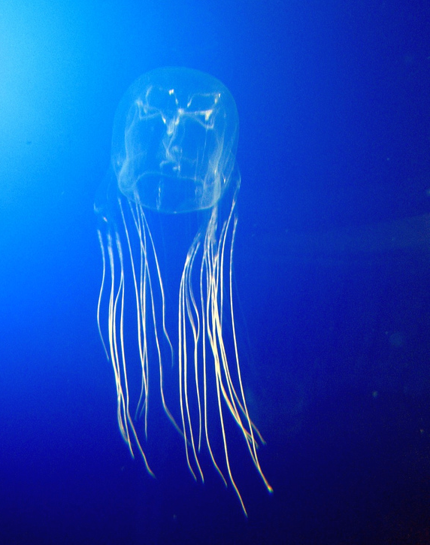
Three Lessons, All of Them Module 2's
An adaptive argument tested rather than admired. Morgan's Canon applied asymmetrically — the same controls in an insect would convince nobody to hesitate. And if cnidarians do learn: homology, or the capacity arrived twice.
The verdict is a shifted burden, not a finding. The question is open.
Notes:
Three lessons follow from the dispute, and all three use tools Module 2 already gave us.
First, this is what a well-formed adaptive argument looks like when it is tested rather than admired. The argument predicted an absence. The absence is not holding up. Module 2's warning about adaptationist stories told after the fact is precisely the warning being vindicated here — and note that the warning applies to a good argument, not only to a careless one.
Second, Morgan's Canon can be applied asymmetrically, and here it has been. Run the same suite of controls in an insect or a tardigrade and nobody would hesitate. What resists the conclusion in a cnidarian is a prior assumption about what a brainless animal ought to be able to do, doing work the data is supposed to do. The animal in the photograph is a box jellyfish, though a different species from the one in the 2023 study, and it is worth asking what exactly the prior about it rests on.
Third, if cnidarians do learn, an interesting question opens rather than closes. Cnidaria is the sister group to Bilateria, so the capacity is either ancestral to all nervous systems or it arrived twice — homology, or convergent evolution, which is the pair we did in Module 2.
One point of fairness about the book. The confident adaptive argument appeared in 2023, likely written before its author could have known about the results that contradict it. This is a field moving faster than publication can keep up with, and that is worth knowing about any confident claim in a fast-moving area, including the ones in our own chapter.
So where does that leave the question? The evidence is positive and the burden now sits with the skeptics, and the question is still open. It is worth deciding for ourselves, before reading on, what result would move us — a replication in a second laboratory, an acquisition curve, a retention test at an hour rather than ten minutes. People do not always agree about which of those would settle it, and the disagreement is the interesting part.

Slide 16
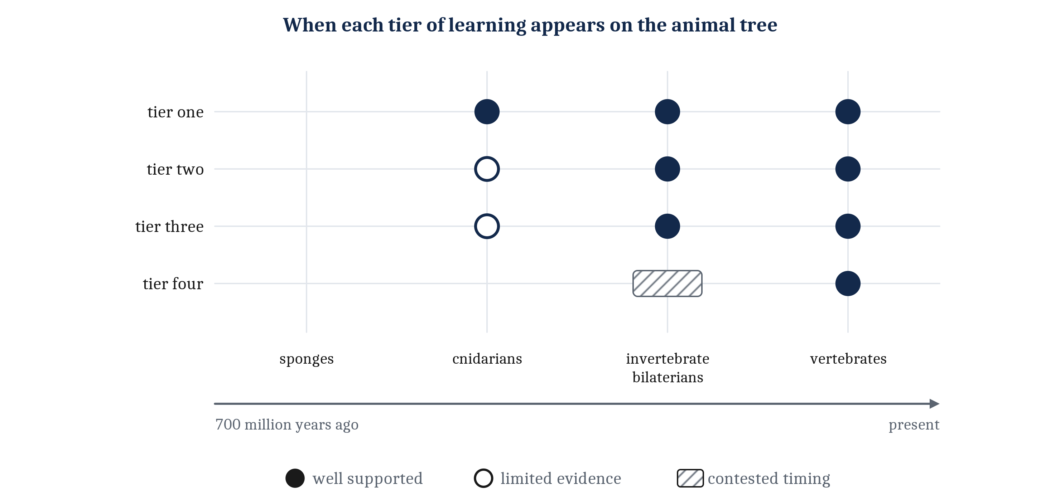
Most of Learning Is Older Than the Vertebrate
Tiers one and two are old and widespread. Tier three is documented across the bilaterians. Tier four arrives with vertebrates: what it adds is the ability to bridge a delay.
Notes:
Putting the tiers against the animal tree gives a result that is not the expected one, and the figure is the chapter's own.
Tiers one and two are old and widespread. They are present in animals with a few hundred neurons, they are present throughout the bilaterians, and on current evidence tier one extends below the bilaterians entirely. Tier three is documented across the bilaterians, and below them the evidence thins to that single 2023 result in one box jellyfish. Tier four arrives late, and it arrives with vertebrates.
So the headline is not that learning is a vertebrate invention. Most of learning is considerably older than the vertebrate, and what the vertebrate adds is the ability to bridge a delay.
Two things about how the figure is drawn. Tiers three and four are drawn as bands rather than points because the evidence for when they appear is contested, and the tier-three band is the widest for the reason the previous slide gave. And every surviving lineage is drawn as a line reaching the present, which is the convention Module 3's and Module 4's timelines both use.
That convention is doing real work here. This is a claim about when particular capacities appear, and not a ranking of animals by intelligence. Module 2's warning about reading the tree as a ladder applies here as much as anywhere: the cnidarians are not an early draft of us, they are a lineage that has been succeeding alongside ours the whole time.

Slide 17
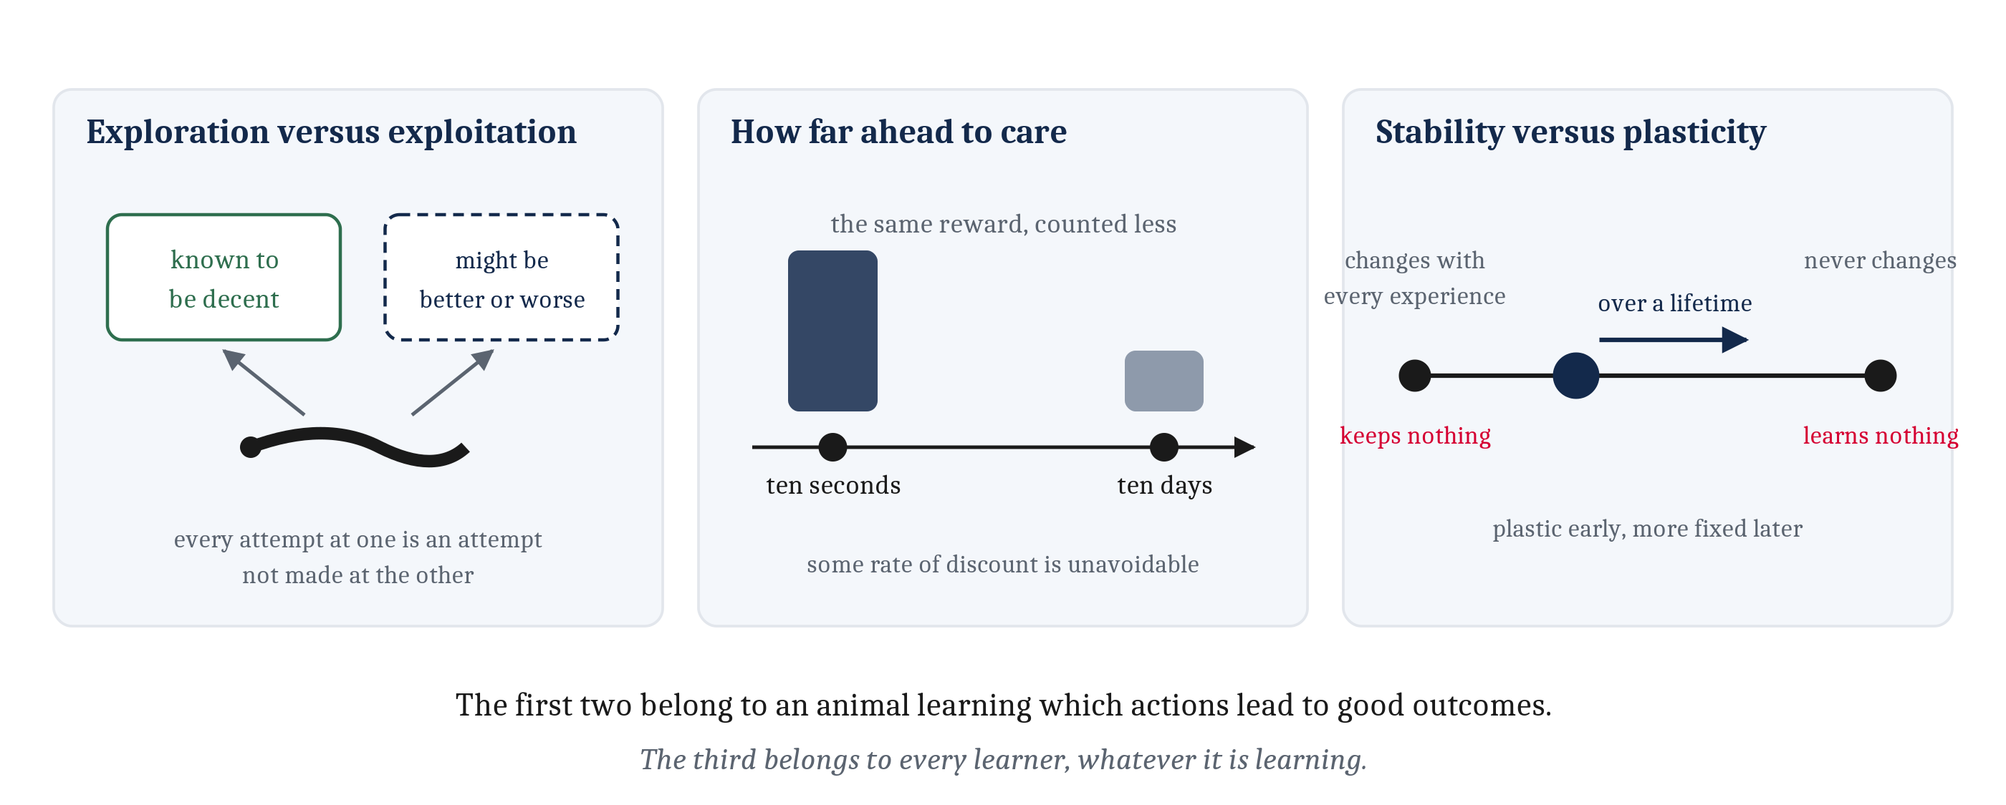
Three Problems That Come with Learning
Exploration versus exploitation. How far ahead to care, since ten seconds and ten days cannot count equally. And stability versus plasticity, which belongs to every learner.
Notes:
The capacity to learn brings three problems with it. Two of them belong to an animal learning which of its actions lead to good outcomes. The third belongs to every learner, whatever it is learning.
The first is exploration versus exploitation. Take the option already known to be decent, or sample one that might be better and might be worse? Every attempt at the uncertain option is an attempt not made at the reliable one, and an animal that never tries the uncertain one is stuck with the first adequate option it found. There is no setting of this that is right in general. There is always a trade-off at work.
The second is how far ahead to care. An outcome arriving in ten seconds and an identical outcome arriving in ten days cannot count equally, or nothing would ever favor acting now over acting later. Some rate at which distant outcomes count for less is unavoidable, and lecture 5.2 gives it a name and a number.
The third comes with learning of any kind. Change a connection with every experience and nothing from yesterday survives into this afternoon. Let a connection never change and nothing is ever learned. Every learner needs a setting between those extremes — and probably a schedule that moves the setting over a lifetime, since it is useful to be plastic early, when little of the world has been met, and more fixed later, when most of it has. That is stability versus plasticity, and it is a genuine trade-off in the Module 4 sense: two properties that cannot both be had at once. Lecture 5.3 is where it gets answered, by a developmental schedule.

Slide 18
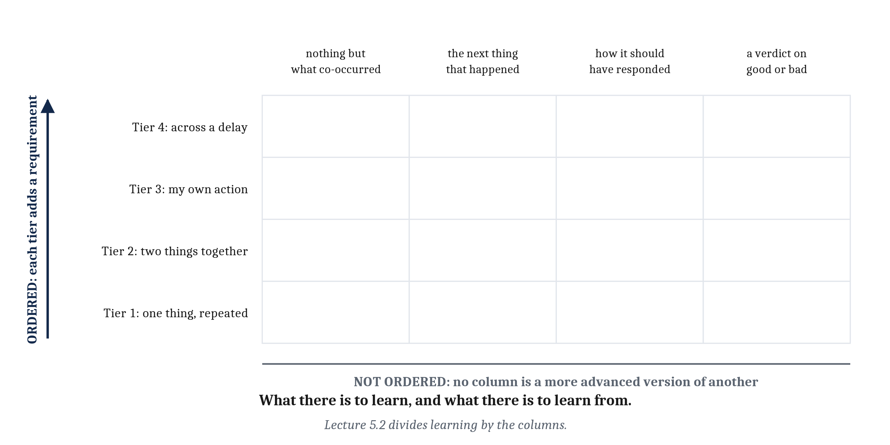
Two Questions, and They Cross Rather Than Stack
The four tiers say what has to be in the link. They say nothing about what the animal has to go on when something changes. The tiers are ordered. The four things to learn from are not.
Notes:
One thing the four tiers do not settle, and it is where this module is going next.
The tiers say what information has to be in the link, and how far apart in time its terms can lie. They say nothing about what information the animal's situation makes available at the moment something has to change. Sometimes that is nothing but what co-occurred. Sometimes it is the next thing that happened. Sometimes it is the way the animal should have responded, from some source that already knows the answer. And sometimes it is a verdict on whether the outcome was good or bad.
So there are two questions here, and they cross rather than stack. What there is to learn, and what there is to learn from. The rows of this grid are ordered, one on top of another. The columns are not. An animal with a teacher does not thereby have a verdict on good or bad, and an animal with a verdict on good or bad does not thereby have a teacher.
Good and bad in particular are not what any tier adds. Module 4's animals already tag the affect of what reaches them. An animal can learn that turning left in this burrow is followed by a draft of cold air with none of that being good or bad. Learning instead that turning left went well, or went better than expected, is a different thing altogether — and it is the thing lecture 5.2 opens with.
Which leaves the mechanical question, and it is the question for the rest of the week. What rule could move a weight so as to meet any of this? The candidates differ mainly in what they make the change depend on, which is why the next lecture is organized by the columns of this grid rather than by its rows.

Slide 19
Image Sources (1 of 2)
Slide | Image | File | Licence | Source
2 | The same gradient, a different world | fig-shifted-world.png | CC BY 4.0 | Jon Willits — drawn for this lecture · own work
3 | Modulation keeps nothing | fig-modulation-not-learning.png | CC BY 4.0 | Jon Willits — drawn for this lecture · own work
5 | Two ways a question gets more specific | fig-two-moves.png | CC BY 4.0 | Jon Willits — drawn for this lecture · own work
6 | A contingency the worm never had to learn | fig-copper-contingency.png | CC BY 4.0 | Jon Willits — drawn for this lecture · own work
7 | One contingency, two routes to a response | fig-two-timescales.png | CC BY 4.0 | Jon Willits — drawn for the Module 5 reading · own work
8 | What experience modifies | fig-what-changes.png | CC BY 4.0 | Jon Willits — drawn for this lecture · own work
9 | A response declines, and recovers in one step | fig-habituation.png | CC BY 4.0 | Jon Willits — drawn for this lecture · own work
9 | Beadlet anemone, Actinia equina | fig-sea-anemone.jpeg | GFDL 1.2 or later | Attrattorestrano at Italian Wikipedia · https://commons.wikimedia.org/wiki/File:Actinia_equina2.JPG

Slide 20
Image Sources (2 of 2)
Slide | Image | File | Licence | Source
10 | A combination, and a link across time | fig-link-across-time.png | CC BY 4.0 | Jon Willits — drawn for this lecture · own work
12 | Whose doing it was, and keeping the actions apart | fig-own-action.png | CC BY 4.0 | Jon Willits — drawn for this lecture · own work
13 | The record, and apportioning the outcome | fig-credit-assignment.png | CC BY 4.0 | Jon Willits — drawn for this lecture · own work
15 | Box jellyfish, Chironex fleckeri | fig-box-jellyfish.png | CC BY-SA 2.0 | Guido Gautsch; derivative work by Mithril · https://commons.wikimedia.org/wiki/File:Avispa_marina_cropped.png
16 | The four tiers against the animal tree | fig-tier-timeline.png | CC BY 4.0 | Jon Willits — drawn for the Module 5 reading · own work
17 | Three problems that come with learning | fig-three-problems.png | CC BY 4.0 | Jon Willits — drawn for this lecture · own work
18 | The tiers are ordered; the columns are not | fig-two-questions-cross.png | CC BY 4.0 | Jon Willits — drawn for this lecture · own work

