Slide 1

BCOG 100
Memory, Imagination, and Generative Models
Lecture 10.1 — Remembering What Happened, and Acting on What Has Not
Notes:
This module is about how animals use what happened on one occasion at a later time, for a use they could not foresee. It is also about how remembering what happened is related to imagining what has not.
This first lecture is the computational level. We ask what problems an animal faces when what happened on one night matters on the next. We look at what is new in a mammal’s life that makes those problems pressing. And we look at what animals are observed to do after a single occasion. We leave the procedures that could solve these problems to the second lecture, and the brain to the third.
Most of what is known about memory for particular occasions comes from research with rats and with humans. Machines are a third point of comparison. A computer stores exact copies of what it is given, while some newer machines generate new pictures and text from what they were trained on. By comparing both kinds with animals, we can see where machines and animals resemble each other, and where they diverge.

Slide 2
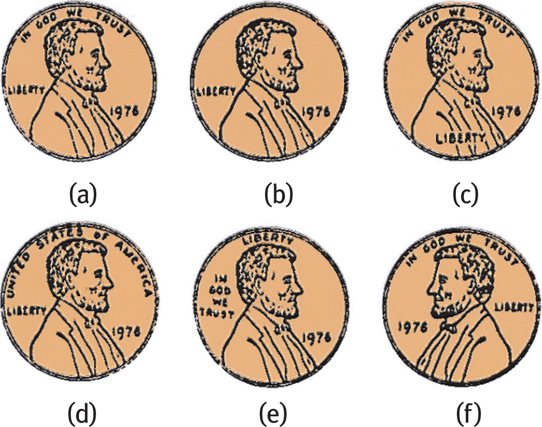
To Start: How Good is Your Memory?
Which one is the real penny?
Notes:
This is the first guiding question at the start of the reading, put in everyday terms. How does learning that changes a tendency to respond differ from learning that leaves information we can use later?
Groups usually find that the first kind of example is easy to think of. A friend mentions where they parked, and an hour later it is the one fact needed to get everyone home. A classmate says the exam room has changed, and it matters only on the day of the exam. In most such cases, nobody knew at the time that the information would be needed, or what for.
On the second question, groups are usually divided. Some people can say exactly when and where the bad meal was. Others find that they simply do not want the food, and cannot say much more about where the reaction came from. That second case is like the rat in Module 5 that was sick once after eating a new food. The rat avoids that food afterward. But a rat with only that tendency has no information about where or when it ate the food.
Those two outcomes are what this module is about. One kind of learning changes how we respond. Another leaves information that can be used later, in ways nobody planned when it was learned. In this lecture, we ask what problems the second kind solves for an animal.

Slide 3
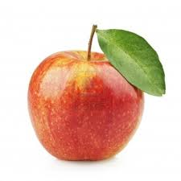
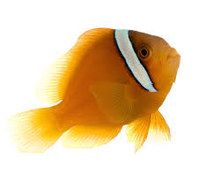
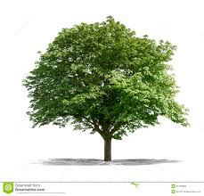
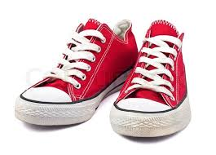

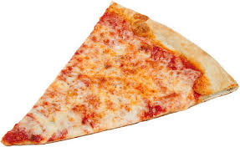

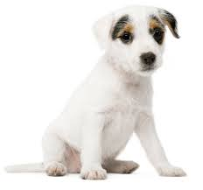

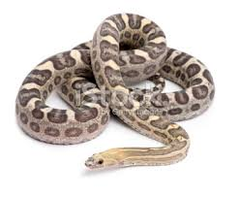
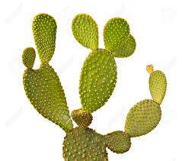
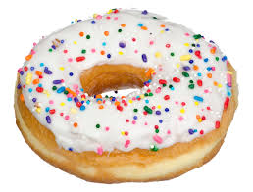
To Start: How Good is Your Memory?
Notes:
This is the first guiding question at the start of the reading, put in everyday terms. How does learning that changes a tendency to respond differ from learning that leaves information we can use later?
Groups usually find that the first kind of example is easy to think of. A friend mentions where they parked, and an hour later it is the one fact needed to get everyone home. A classmate says the exam room has changed, and it matters only on the day of the exam. In most such cases, nobody knew at the time that the information would be needed, or what for.
On the second question, groups are usually divided. Some people can say exactly when and where the bad meal was. Others find that they simply do not want the food, and cannot say much more about where the reaction came from. That second case is like the rat in Module 5 that was sick once after eating a new food. The rat avoids that food afterward. But a rat with only that tendency has no information about where or when it ate the food.
Those two outcomes are what this module is about. One kind of learning changes how we respond. Another leaves information that can be used later, in ways nobody planned when it was learned. In this lecture, we ask what problems the second kind solves for an animal.

Slide 4
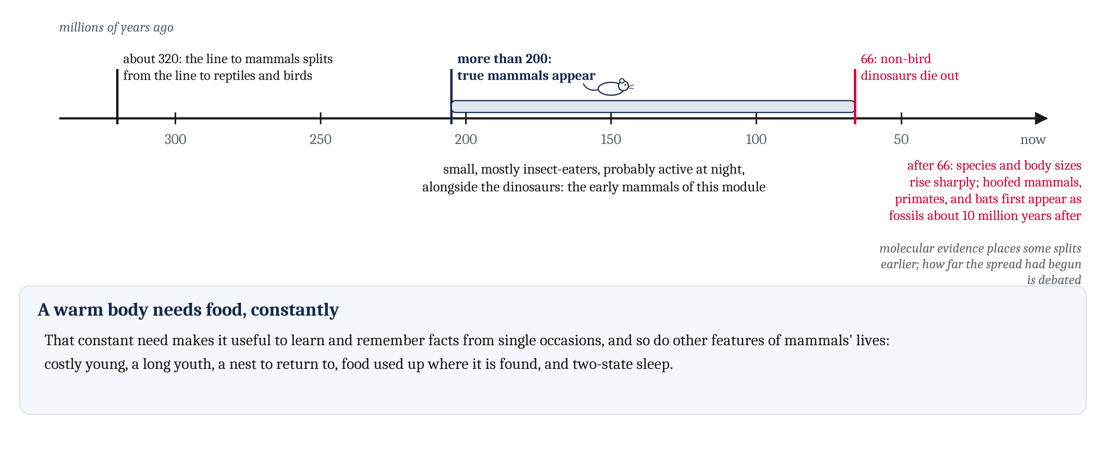
A Warm Body Needs Food, Constantly
Mammals lived alongside the dinosaurs for well over 100 million years. Their great increase in number and size came after the dinosaurs died out.
Notes:
Before the dates, a reminder of how a history like this is known at all. Nobody watched the first mammals. Dates come from fossils, dated by the rock they are found in, and from comparing genes across living species. When the two kinds of evidence disagree, researchers argue about it, and we say so where it matters.
The line leading to mammals split from the line leading to reptiles and birds about 320 million years ago. True mammals appeared more than 200 million years ago. For well over 100 million years after that, they lived alongside the dinosaurs. As we described in Module 9, they were small animals, mostly insect-eaters, that were probably active at night. The early mammals of this module lived in that long stretch, before the dinosaurs’ extinction.
About 66 million years ago, the non-bird dinosaurs died out. In the few million years that followed, the number of mammal species rose sharply, and so did their average body size. Many of today’s groups, such as hoofed mammals, primates, and bats, first appear as fossils about 10 million years after the extinction. Molecular evidence places some of the splits between today’s groups earlier, before the extinction. How far the spread had begun by then is still debated. But the great increase in the number and size of mammals came after it.
In Module 9, we described the early mammal’s warm-blooded body, which needs a lot of food. That constant need for food makes it useful to learn and remember facts from single occasions. An animal that has to eat a great deal, every night, gains from knowing which logs it emptied and which it did not.
Several other features of mammals’ lives do the same. Mammal young need a great deal of care. Young mammals stay dependent for a long time. Many mothers return to a nest. Much of what small mammals eat is used up where it is found. And mammals sleep in two different states. We take these one at a time, described from outside, as features of a life rather than as causes of anything.

Slide 5
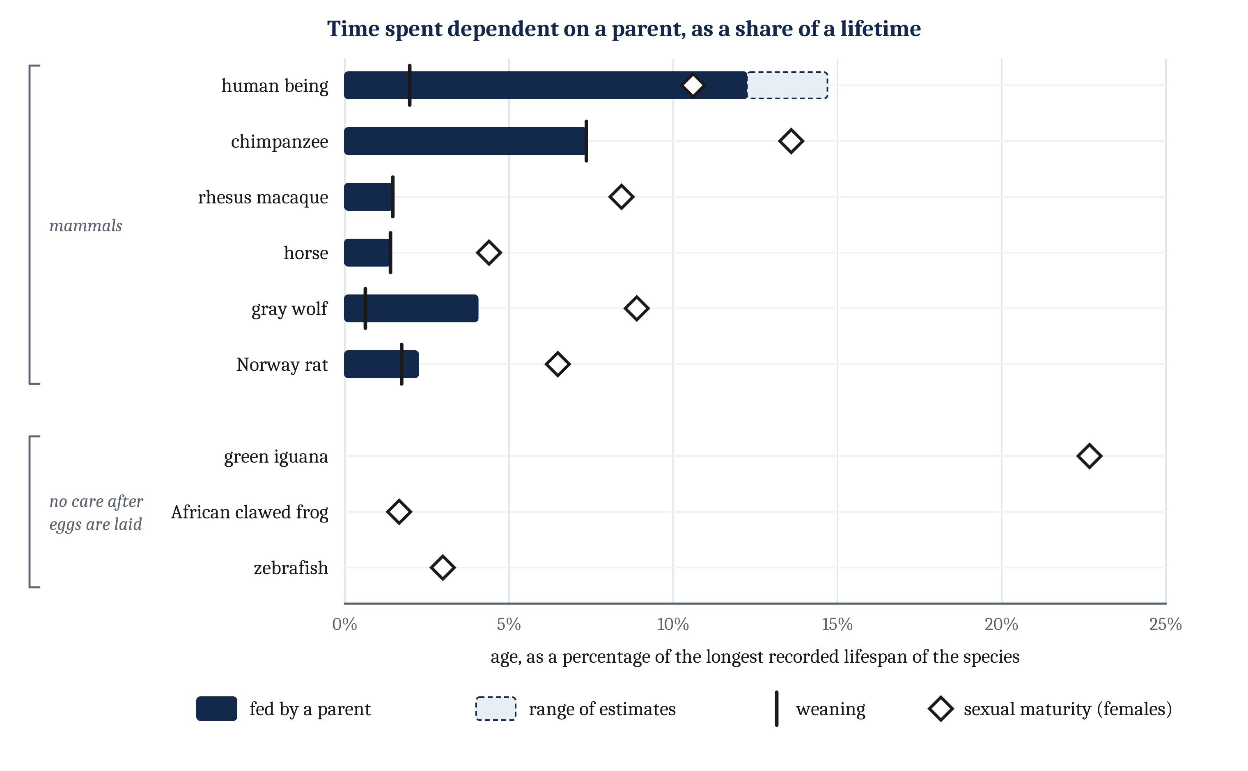
Milk, and a Long Dependence
No newborn mammal can find enough food alone, and milk is energetically expensive. Mammals stand out for a long dependence on their mother.
Notes:
Mammal young need a great deal of care from their parents. Some, such as mice and rats, are born hairless, with their eyes closed, and for some time can barely move. Others, such as foals and fawns, can walk within hours of birth. But being able to walk is not the same as being able to find food. No newborn mammal can find enough food on its own to fuel a warm body.
In every mammal species, mothers typically care for their young and feed them milk. Producing milk is energetically expensive. In humans, exclusive breastfeeding can raise a mother’s daily energy requirements by roughly 15 to 25%, compared with when she is neither pregnant nor nursing. In some other mammals, the increase is much greater. Laboratory mice may eat about four and a half times as much at peak milk production as when they are not breeding.
Those demands can reduce a mother’s chance of survival. In a long-studied population of red deer, some mothers lost their calves during the summer, usually shortly after birth. Others nursed calves that survived the summer. The mothers whose calves survived were less likely to survive the following winter themselves. Both groups had been through pregnancy. But the second group had also nursed for months. So months of nursing appear to reduce a mother’s chance of surviving the winter.
Across birds and mammals, species with a long immaturity tend also to give their young a lot of parental care, and to depend on learning. And mammals stand out from reptiles, amphibians, and fish for their long period of dependence on their mother. Dependence can be measured as a share of the longest recorded lifespan, so that a rat and a human being can be compared. Measured that way, it is about 1 to 4% of life in rats, horses, rhesus macaques, and wolves. It is about 7% in chimpanzees, and 12 to 15% in human beings. Green iguanas, African clawed frogs, and zebrafish receive no care at all after their eggs are laid. Human weaning comes near 2% of the lifespan, long before children stop depending on adults for food. Human beings depend on their parents for the longest of all, which we return to in Module 11.

Slide 6
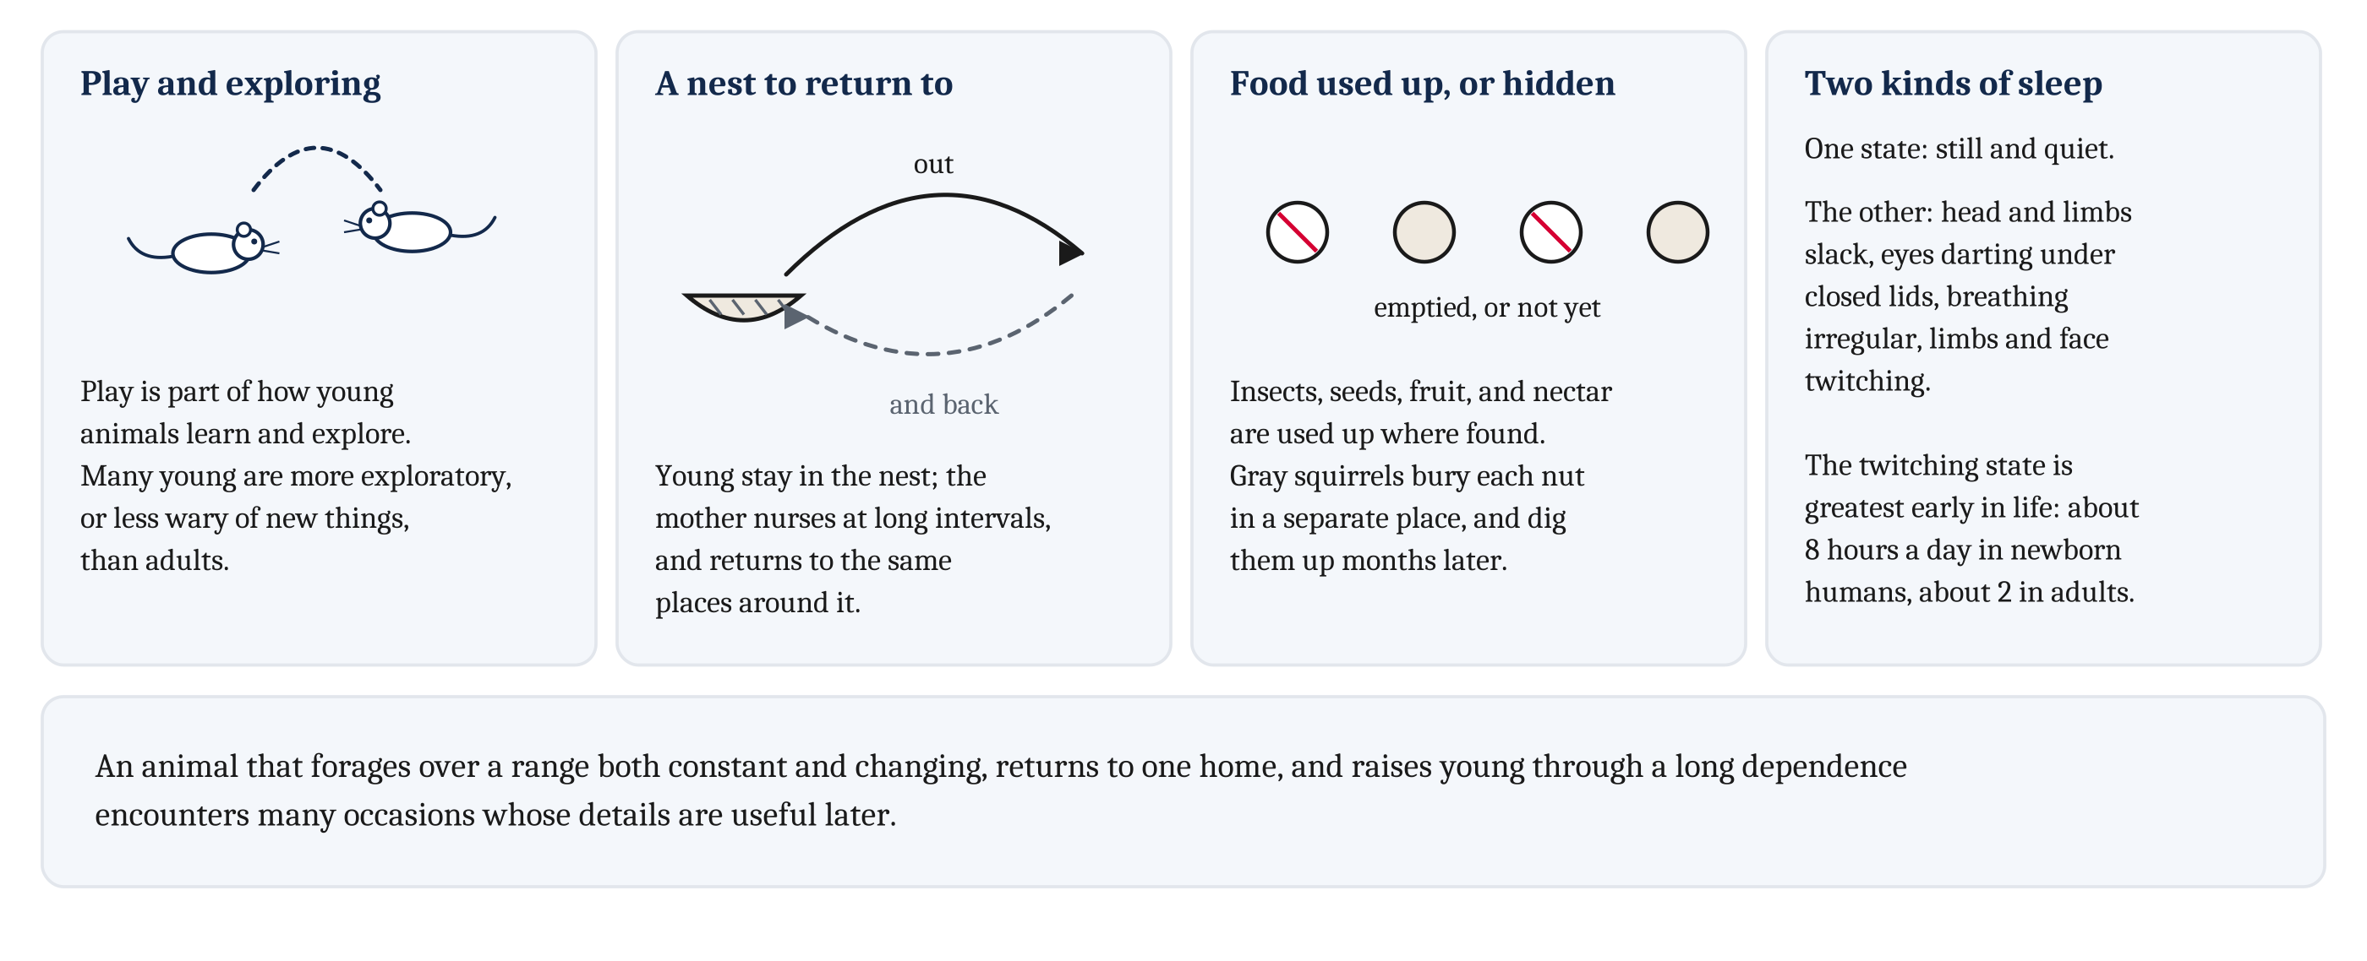
What Is New in a Mammal’s Life
A long youth, a nest to return to, food used up where it is found, and two kinds of sleep.
Notes:
The young of many species play, and play is part of how young animals learn and explore. In Module 9, we described how children explore more than adults. The young of many other species, from parrots and crows to monkeys, are also more exploratory than adults, or less wary of new things. An animal with a long youth encounters many things early in life that may be useful much later.
A mother whose young stay in a nest has to leave them to find food, and then come back. Most mammals whose young are born immature nurse them at long intervals. Their milk tends to be more concentrated than the milk of species that nurse often, so the mother can be away between feeds. Each night, an early mammal mother would have foraged out from the nest and back. The nest is a fixed home, and she returns again and again to the same places around it.
Much of what small mammals eat, such as insects, seeds, fruit, and nectar, is used up where it is found. If it is replenished at all, that happens only later. So a mammal benefits from remembering where food has run out, and where it has not. Some mammals also carry food away and hide it, a behavior called *caching*. Gray squirrels bury each nut in a separate place, and dig the nuts up months later. A caching animal returns to food it hid on one occasion, which requires remembering where it hid that food.
Mammals also sleep for much of each day, in two states that alternate and look different from outside. In one, the animal is still and quiet. In the other, its head and limbs go completely slack. Its eyes dart around beneath closed eyelids, its breathing becomes irregular, and its limbs and face twitch. Horses can sleep standing in the quiet state, but they lie down to enter the other one. Mammals are in the twitching state most early in life: newborn human beings for about eight hours a day, and adults for about two. Birds also show both states. We return to sleep in the third lecture.
Put these features together. Consider an animal that forages over a range that is partly constant and partly changing. It returns night after night to one home. It starts immature, and later raises young through a long dependence. Such an animal encounters many occasions whose details are useful later. That is the problem this lecture is about. Notice that we have not said that any of these features caused a change in how mammals remember. They describe a life in which remembering single occasions would be useful.

Slide 7
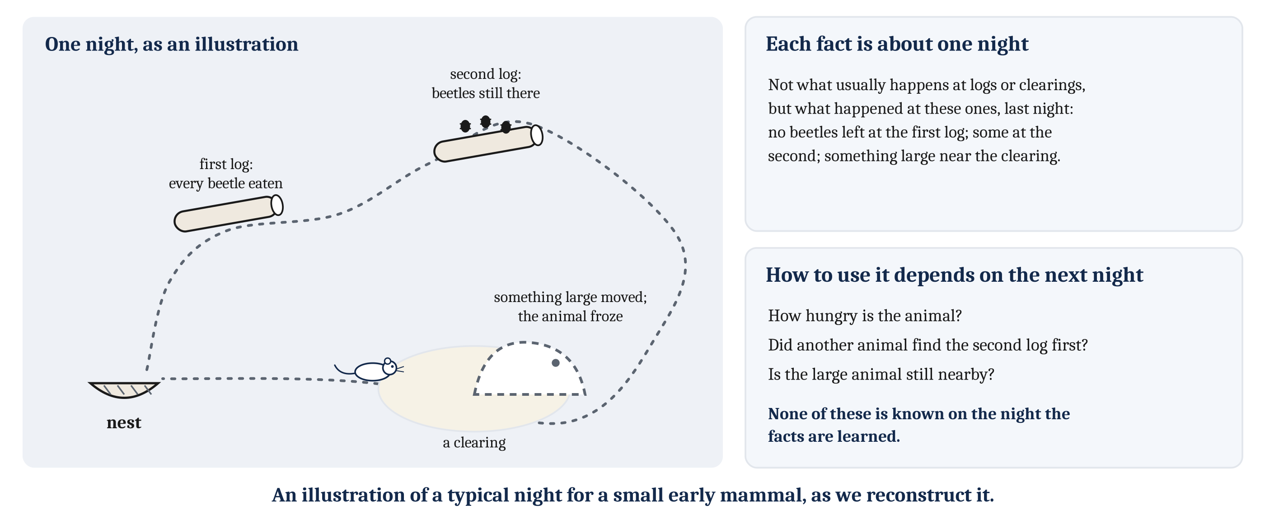
One Night
Each fact is about one night. How to use it depends on facts that will be true the next night.
Notes:
The animal we focus on in this module is the small early mammal we described in Module 9. It is an insect-eater, probably active at night. It forages out from its nest, and then comes back home. That description is our best reconstruction, from bones, genes, and living relatives.
On a typical night, it might experience something like the following. Under one fallen log, it finds beetles, and eats every one it can reach. Farther on, it finds a second log with beetles still under its bark. But it is nearly dawn, and it heads back to its nest. On the way, something large moves at the edge of a clearing, and the animal freezes.
Some of what happened that night is relevant to what the animal should do the next night. At the first log, it would find no beetles, since it already ate them all. At the second log, there may still be beetles. And staying away from the clearing for a while might be safer, since something large was moving there.
Notice that none of these facts is about what usually happens at logs or clearings. Each is a fact about one night. And how the animal should use each fact depends on other facts that will be true the next night. It depends on how hungry the animal is. It depends on whether another animal finds the second log first. And it depends on whether the large animal is still nearby. None of that is known on the night the facts are learned.
In Module 5, we described learning that changes the weights of connections, and with them how an animal responds. Learning of that kind changes a tendency to respond. But experience can also leave information that an animal can access later, and combine with whatever it then needs. Information of that second kind would let the animal use what happened in ways it cannot yet foresee.
So the module has two questions. What is required to retain information from one occasion, so that it can be accessed later, for a use not known at the time? And what more is required to recall a night that is past, or to imagine one that has not happened? Information that can be accessed is needed for both. But, as we will see over the three lectures, it is not enough.

Slide 8
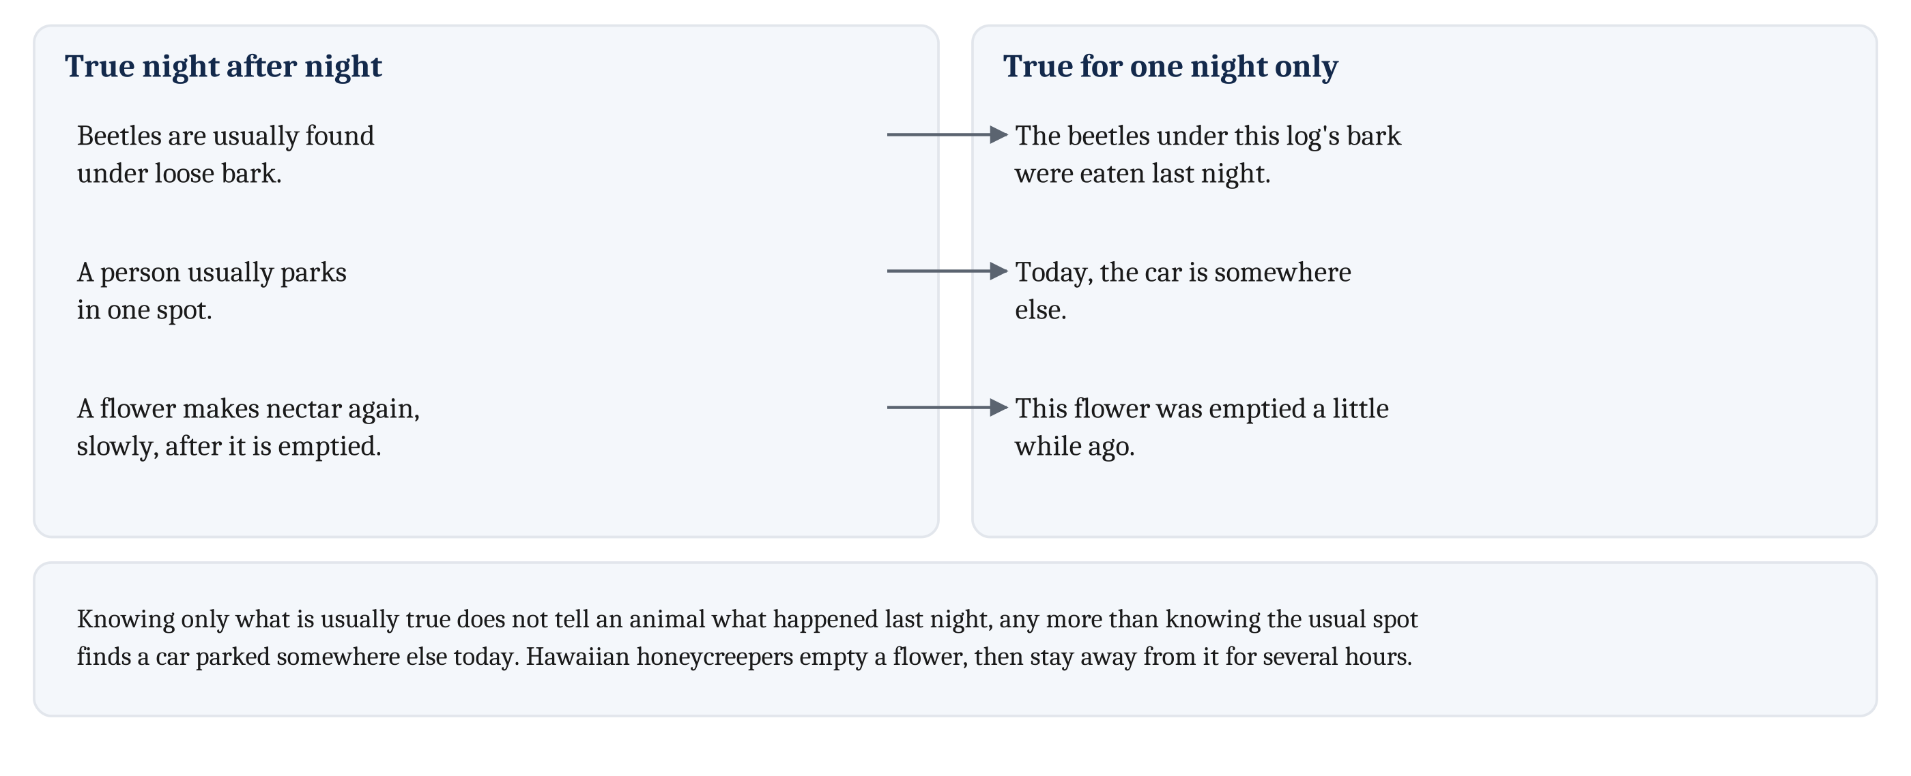
Two Kinds of Fact
Some facts are true night after night. Others are true for one night only, and the animal learns them before it knows when they will matter.
Notes:
Many animals benefit from using information about one past occasion. Some food is used up when it is eaten, and replaced later, at a rate the animal does not control. An animal may encounter a danger at a particular place only once, and have to learn from that one encounter. And some animals leave food in a place and come back for it later.
In each case, the animal can choose better later if it learned something on the earlier occasion. But it encounters the information before the circumstances in which the information will matter. The early mammal cannot know, on the night it eats the beetles under a log’s bark, whether it will be hungry when it next passes that log. So at the time it can learn, it may not know when, or how, it will use what it learned.
The world contains two kinds of facts. Some are true night after night: beetles are usually found under loose bark. Others are true for one night only: the beetles under this log’s bark were eaten last night. The place where food is usually found may have been emptied the night before. So on a particular night, the usual place may not be the best place to look.
People face the same two kinds of fact when they park a car. Someone may usually park in one spot but have parked somewhere else today. A person who remembers only the usual spot cannot find the car. In the same way, an animal that knows only what is usually true at a log does not know what happened at that log last night.
Many animals have to remember where they have fed recently. Nectar-feeding birds have to remember which flowers they have emptied. Hawaiian honeycreepers take all the nectar from a flower, which refills slowly. Then they do not return to that flower for several hours.

Slide 9
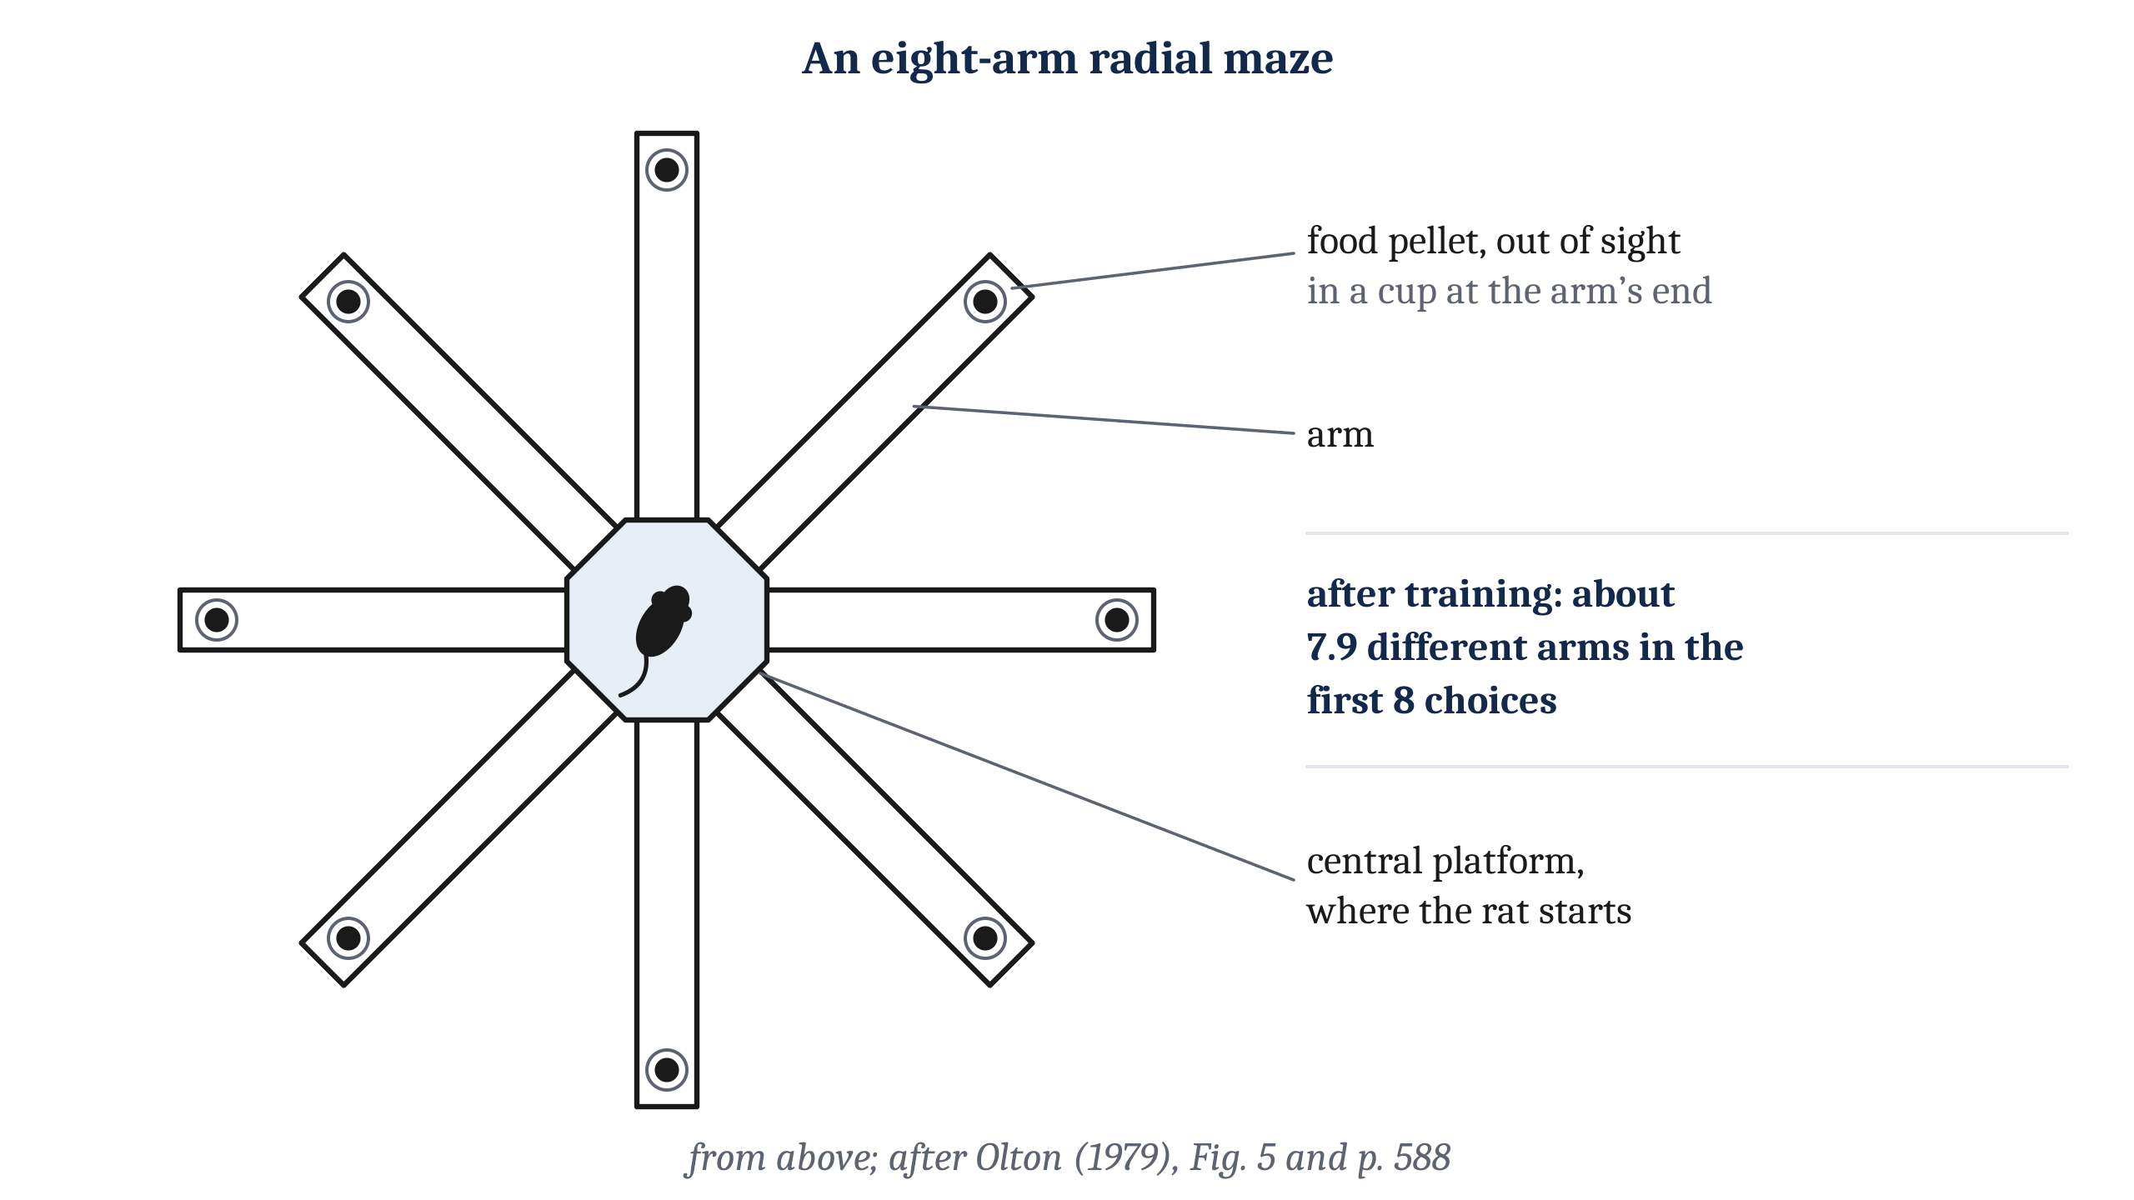
The Radial Maze
After training, rats entered about 7.9 different arms in their first 8 choices, and not by going around in a fixed order.
Notes:
Rats are very good at remembering where they have already taken food, and the radial maze tests it. A radial maze has eight arms extending outward from a central platform. A food pellet sits out of sight at the end of each arm. A rat placed at the center can collect all eight pellets, and the most efficient way to do it is to enter each arm once.
After training, rats chose on average about 7.9 different arms in their first 8 choices. On a maze with 17 arms, they chose about 15 different arms in their first 17. The rats did not do it by going around the maze in order. The rats did not enter each next arm clockwise, or follow any other fixed sequence.
Researchers also asked what the rats were using to tell the arms apart. The rats ignored cues inside the maze, such as the smell of an arm, and chose by landmarks in the room instead. They still remembered well where they had and had not been. On each run, the rat has to avoid the arms it has entered on this run, not the arms it usually enters. That is a fact true for one run only, the same kind of fact as the beetles eaten under one log.
It is worth asking what the rat would need to do this, before we name anything. It needs information about where it has already been on this run, from the last few minutes. And that information has to stop guiding its choices when the next run starts, since every arm has food again. We return to what that requires later in this lecture.

Slide 10
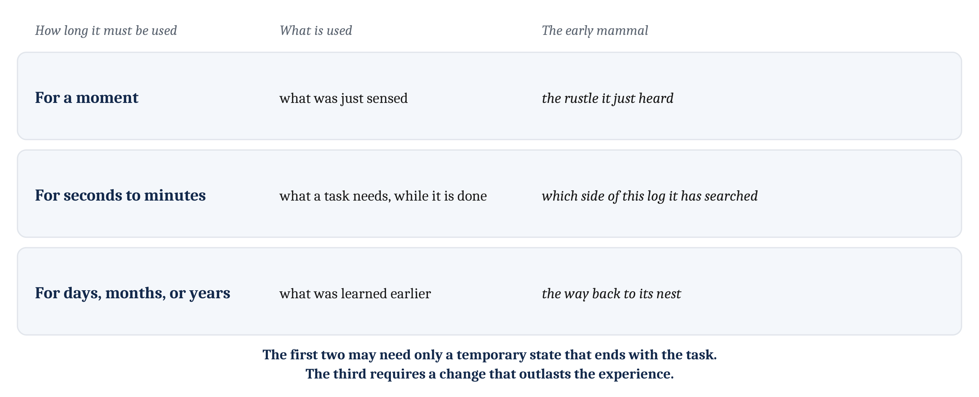
For a Moment, for a Task, for a Lifetime
Three problems differ in how long, and for what, an animal must be able to use what it learned.
Notes:
An animal needs to use some of what it learns for a moment, some for minutes, and some for the rest of its life. We can distinguish three problems by how long the animal must be able to use what it learned, and what it uses it for.
The first is using what was just sensed, for the moment it takes to use it. The early mammal hears a rustle in the leaves, and turns toward it. The second is using what a task needs while the task is being done, for seconds to minutes. At a log, the animal needs to know which side it has already searched, but only while it is still at that log. The radial-maze rats have this problem too, for one run of the maze. The third is using what was learned days, months, or years earlier. The way back to its nest is something the animal uses for its whole life.
The three differ in what they demand. Using what was just sensed, or what a task needs while it is being done, may depend only on a temporary state that ends when the task does. Once the animal leaves the log, which side it searched no longer matters. But using what was learned days or years earlier requires a change in the animal that outlasts the experience.
These are three problems, not three answers. Whether an animal solves them with three different mechanisms, or with one, is a question about procedures and about brains. In the second lecture, we name the kinds of memory that researchers distinguish along these lines, and ask how well the boundaries hold.

Slide 11
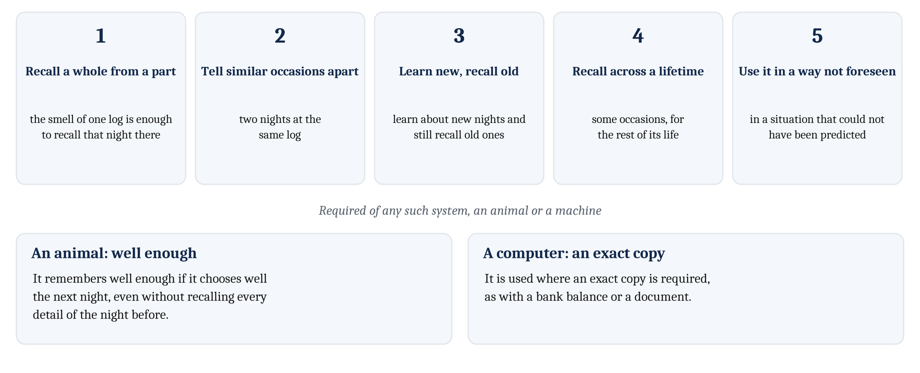
What Remembering Requires
Five things any system that learns particular occasions must do, whether it is an animal or a machine.
Notes:
Some requirements apply to any system that learns about particular occasions, whether it is an animal or a machine.
The system must be able to recall a whole occasion from part of it. The smell of one log should be enough for the animal to recall the rest of one particular night at that log. The system must also tell two similar occasions apart, such as two nights at the same log.
The system must be able to learn about new occasions and still recall old ones. It must be able to recall some occasions across a lifetime. And it must be able to use what it learned in a situation that could not have been predicted when it learned it. That last requirement is the problem we started from with the night of the two logs: the use of a fact is often not known when the fact is learned.
How well must an animal remember? An animal uses what it learned about the past to choose what to do next. So it remembers well enough if it chooses well the next night, even if it cannot recall every detail of the night before. A computer is different. It is used where an exact copy is required, as with a bank balance or a document. A bank balance that was approximately right would be useless.
That difference will matter later in the module. The machines we compare with animals do not all work like an ordinary computer. Some of them generate new examples from what they learned, and those machines resemble animals in some ways, and differ in others.

Slide 12
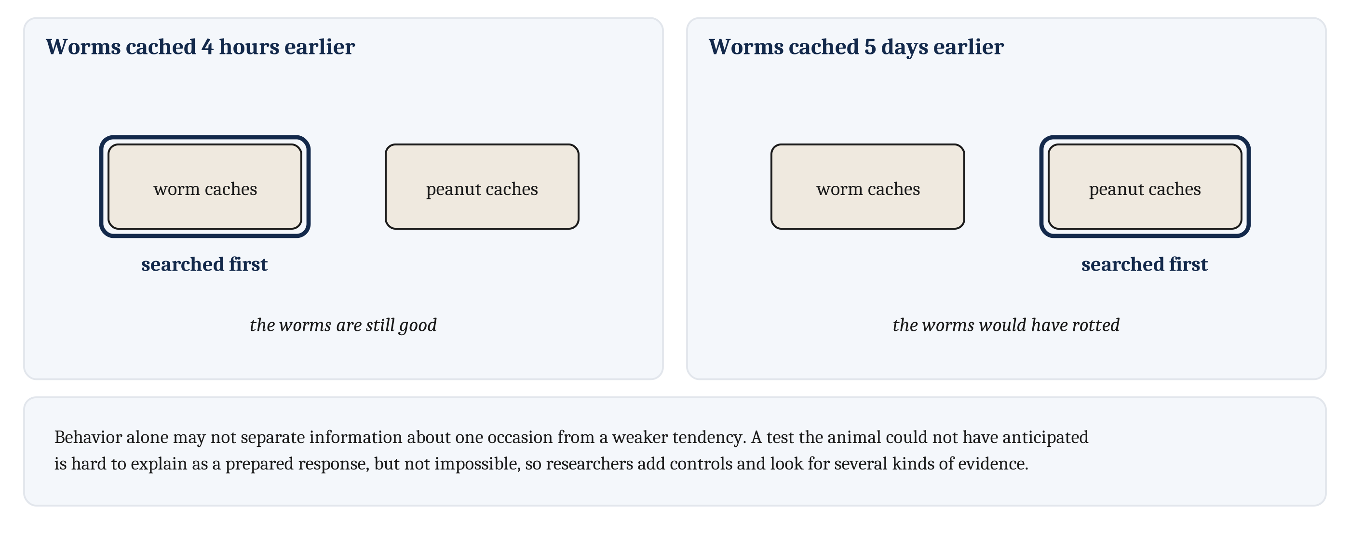
Testing for One Occasion
A test the animal could not have anticipated is hard to explain as a prepared response. After four hours, scrub jays searched first for worms; after five days, for peanuts.
Notes:
How can we tell whether an animal used one earlier occasion, and how? From behavior alone, it can be hard. Suppose an animal avoids a log the night after it emptied that log. It may have information about that night, which it combines with how hungry it now is. Or it may only have a weaker tendency to go to that log. A choice on the next night does not distinguish the two.
Tests that an animal could not have anticipated when the occasion happened are especially useful. A correct choice on such a test is hard to explain as a response the animal prepared in advance. It is not impossible, though. So such tests need controls, and researchers look for several kinds of evidence together.
Scrub jays give a clear case. They cache both worms, which rot, and peanuts, which do not. When the worms had been cached four hours earlier, the jays searched first where they had cached worms. When the worms had been cached five days earlier, and would have rotted, the jays searched first where they had cached peanuts.
The jays’ choice depended on how long ago the worms had been cached, which is a fact about one occasion, the occasion of caching. In the second lecture, we ask whether that is the same as remembering the occasion the way a person does, and why researchers disagree.

Slide 13
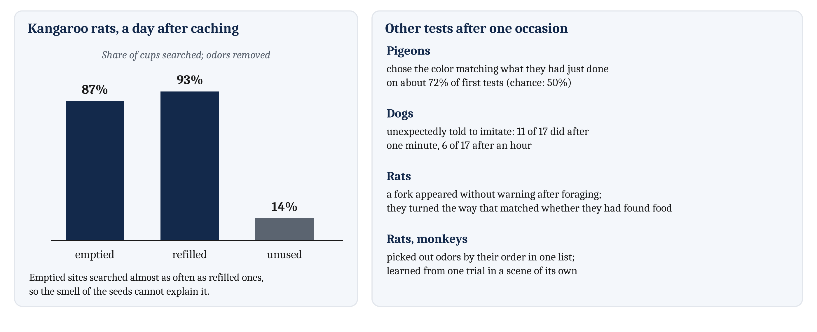
What Animals Do After One Occasion
In each study, behavior depended on one particular occasion after it was over.
Notes:
Caching rodents also find food they hid on one occasion. Lucia Jacobs and her colleagues tested gray squirrels in an outdoor arena. Each squirrel buried ten nuts, near places where other squirrels had buried nuts too. Before each test, every nut was replaced with a fresh one that no squirrel had handled, so no nut smelled of the squirrel that buried it. Two to twelve days later, the squirrels dug up more of their own nuts than of the other squirrels’ nuts.
Jacobs also tested Merriam’s kangaroo rats, which cached seeds in sand-filled cups set among many identical cups. Before the test, the odors at the cache sites were removed, and half of the caches were emptied. A day later, the kangaroo rats searched 87% of the emptied sites and 93% of the refilled ones, but only 14% of the unused cups. They searched emptied sites almost as often as full ones, so the smell of the seeds cannot explain where they searched.
In other studies, an animal is tested on an occasion of a kind it was never tested on in training. Pigeons were trained to choose one color after they had pecked a key, and the other color after they had not. Then they were shown something new, which they either pecked or did not, and then the colors. On these first tests, they chose the color that matched what they had just done on about 72% of trials, where choosing at random would give 50%.
Dogs trained to imitate their owners on command were then trained to lie down after every demonstration. When an owner unexpectedly gave the command to imitate instead, 11 of 17 dogs reproduced the action after a delay of one minute, and 6 of 17 after an hour. Rats were also trained to turn one way at a fork after food, and the other way after none. Then, without warning, they were given the fork right after foraging in a separate maze. They turned the way that matched whether they had just found food, about as accurately as in training.
Rats can also pick out the order in which odors were presented on one occasion, in lists of up to twelve odors, each smelled once. And monkeys learned about as much from one trial, when each pair of objects appeared in a scene of its own, as from about ten trials without the scenes.
Look at what all of these share. In each study, the animal’s behavior depended on one particular occasion after it was over: one caching, one action, one foraging trip, one list, or one scene. And in several of them, the test came in a form the animal could not have anticipated when the occasion happened.

Slide 14
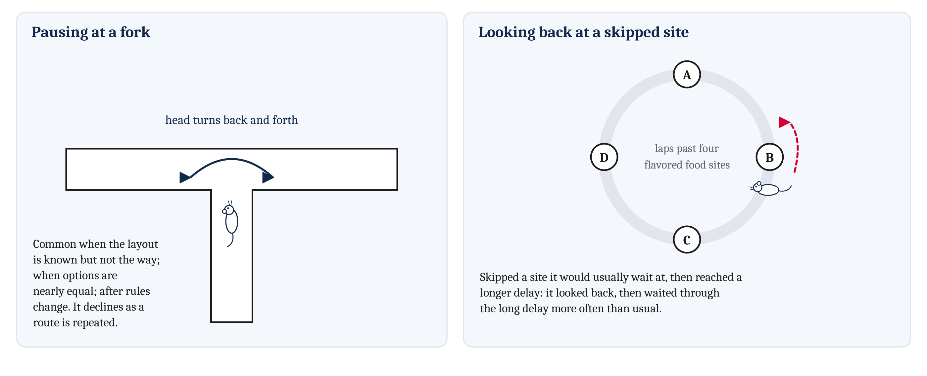
Acting on What Has Not Happened
Vicarious trial and error: a rat pausing at a fork and turning its head back and forth between the paths before it chooses.
Notes:
An animal also faces a problem about events that have not happened. To judge an option without taking it, it must use what it already knows to predict what would happen if the animal took that option. And an animal never observes the outcome of an option it did not take. So it can learn from that option only by using what it already knows.
At a fork in a maze, a rat often pauses and turns its head back and forth between the paths before it chooses one. In the 1930s, Muenzinger and Gentry named this pausing and turning **vicarious trial and error**. It is common when rats know the layout of a maze but not yet which way to go in it. It is common when the two options are nearly equally good. And rats show it again after the rules of a task change. As a rat runs the same route over many trials, it pauses at the fork less and less.
Rats also look back toward food sites they skipped. In one task, rats ran laps past four food sites, each with its own flavor. At each site, a tone signaled how long the rat would have to wait for food there, and the rat could wait or move on. Sometimes a rat left a site whose delay it would usually have waited through, and then reached a site with a longer delay. On those occasions, it paused and looked back toward the site it had left. Then it waited through the long delay more often than usual, and ate the food more quickly.
So the rat’s behavior depended on an option it had not taken, whose outcome it never observed. That is the computational problem: choices depend on the predicted outcomes of options not taken. Notice what we have not said. We have not said what, if anything, the pausing rat imagines. Behavior alone probably cannot show that, and we come back to the question with procedures in the second lecture and with recordings in the third. How animals choose among options, once the outcomes are predicted, we take up in Module 12.

Slide 15
To Discuss: Did the Dog Remember?
In your group, five minutes.
A friend says her dog remembers where she hid a treat yesterday.
The dog might be using that one occasion. Or it might be following a habit, or simply the smell of the treat.
Design a test that would tell these apart. What would the dog have to do, on a test it could not have anticipated? What control would you add?
Notes:
We can apply the logic of testing for one occasion to an animal many people live with.
Groups usually start with smell. One answer comes from the kangaroo-rat study: hide treats in several places, and empty some. If the dog searches emptied hiding places as often as full ones, the smell of the treat cannot explain where it searched.
Habit is harder. A dog that always finds treats behind the couch could pass by habit alone. So the treat has to go somewhere new on the occasion being tested, and the test has to come in a form the dog could not have prepared for. One design hides two kinds of treat, one of which goes stale quickly, and tests after different delays, as in the scrub-jay study. Another shows the dog a hiding place it would not otherwise search, and tests later from a different starting point.
Even a good design leaves something open. A correct choice on an unanticipated test is hard to explain as a prepared response, but not impossible. That is why researchers add controls and look for several kinds of evidence together. And even a dog that passes every test has shown us that its behavior depended on one occasion. Whether it recalls that occasion the way a person might is a different question, which we take up in the second lecture.

Slide 16
Image Sources (1 of 2)
Slide | Image | File | License | Source
3 | One night, and what its use depends on | fig-one-night.png | CC BY 4.0 | Jon Willits — drawn for this lecture · own work
4 | Facts true night after night, and for one night only | fig-two-kinds.png | CC BY 4.0 | Jon Willits — drawn for this lecture · own work
5 | An eight-arm radial maze | fig-radial-maze.png | CC BY 4.0 | Jon Willits — from the Module 10 reading, after Olton (1979) · own work
6 | When mammals arose and spread | fig-mammal-timeline.png | CC BY 4.0 | Jon Willits — drawn for this lecture · own work
7 | Time spent dependent on a parent, as a share of a lifetime | fig-dependence.png | CC BY 4.0 | Jon Willits — from the Module 10 reading; data from the AnAge database and published field studies · own work
8 | Four features of a mammal's life | fig-mammal-life.png | CC BY 4.0 | Jon Willits — drawn for this lecture · own work
9 | Three time scales | fig-time-scales.png | CC BY 4.0 | Jon Willits — drawn for this lecture · own work
10 | Five requirements, and how well is well enough | fig-requirements.png | CC BY 4.0 | Jon Willits — drawn for this lecture · own work

Slide 17
Image Sources (2 of 2)
Slide | Image | File | License | Source
11 | Scrub jays' worms and peanuts | fig-jays.png | CC BY 4.0 | Jon Willits — drawn for this lecture · own work
12 | Caches, and tests of a kind never trained | fig-one-occasion-tests.png | CC BY 4.0 | Jon Willits — drawn for this lecture · own work
13 | Pausing at a fork, and looking back | fig-vte.png | CC BY 4.0 | Jon Willits — drawn for this lecture · own work

