Slide 1

BCOG 100
Memory, Imagination, and Generative Models
Lecture 10.3 — Memory Systems in the Brain
Notes:
This third lecture is the implementational level. In the second lecture, we described procedures for storing, reconstructing, and simulating that could run in any substrate. Here we look for them in the brain: in patients whose memory was damaged, in recordings of cells, and in comparisons across animals.
From each kind of evidence, we can learn some things and not others. From a lesion, we learn what an ability needs, not what a structure does. From a recording, we learn what cells represent, not whether the animal uses it. And from a comparison across species, we learn what goes together, not what caused what. We say which kind of evidence each claim rests on as we go.

Slide 2
To Start: Remembered Differently
In your group, three minutes.
Think of an event you and someone else both remember, such as a family trip or a game, that the two of you remember differently.
What might each of you have filled in? Which of you is more confident, and does that tell you who is right?
Notes:
We start from the main theme of the second lecture of this module: remembering reconstructs an occasion from general knowledge and a few specific details, rather than playing back a copy.
Groups usually find that the disagreements are about details that were never checked at the time: who was driving, what the weather was, who said the funny thing. Each person tends to fill those in with what usually happens, or with what fits the story as they now tell it. And confidence is a poor guide. The man who retold *The War of the Ghosts* after six and a half years was most certain about exactly the details he had invented.
If memory is rebuilt rather than replayed, where in the brain does the rebuilding happen, and what is needed for it? That is the question for this lecture. We start with a man who could no longer form new memories of facts and events, and with what he could still do.

Slide 3
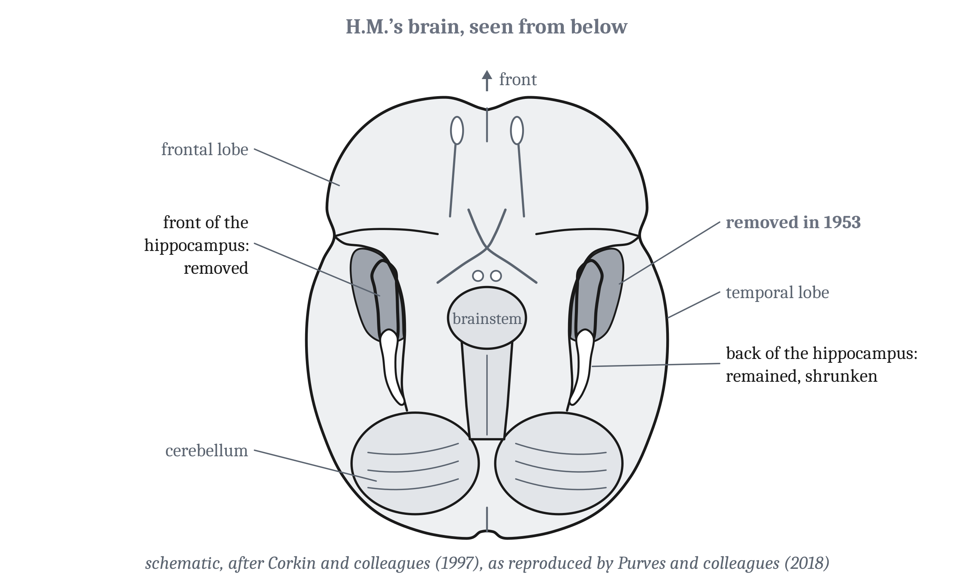
H.M.
Amnesia: a severe loss of memory caused by brain damage or disease. A dissociation is the loss of one ability with another spared, after damage to one part of the brain.
Notes:
In 1953, a 27-year-old man had surgery to stop seizures that had disabled him. A surgeon removed tissue from the inner surface of both temporal lobes, including much of the **hippocampus** on each side. The hippocampus is the old part of the pallium we described in Modules 6 and 9. The inner part of each temporal lobe, which includes the hippocampus and the cortex beside it, is the **medial temporal lobe**. When his brain was scanned decades later, less tissue was missing than the surgeon had estimated. The back of each hippocampus remained, though shrunken.
The man was Henry Molaison, known as H.M. Brenda Milner and Suzanne Corkin studied him for decades. After the operation, he could learn almost no new events or facts. His intelligence, perception, and understanding of language were normal. He could remember a three-digit number for 15 minutes by rehearsing it, though his short-term memory was not entirely normal.
His memory from before the operation was only partly spared. He recalled facts from his distant past, but his old memories had become general knowledge: he could not describe any single event from a specific time and place. Memory for the years just before the operation was impaired.
And he learned a skill. He learned to trace a shape seen only in a mirror, and improved over three days. He improved, in one researcher’s words, “in the absence of any memory of having practiced the task before”. In later tests of skills, he started below people without brain damage, and then improved.
H.M. had **amnesia**. His pattern of loss is a **dissociation**, the loss of one ability with another spared, after damage to one part of the brain. A **double dissociation** pairs two patients, or two groups, with opposite losses. Researchers treat a double dissociation as the strongest lesion evidence that two abilities depend on different parts of the brain. Semantic dementia and hippocampal amnesia form one.

Slide 4
Losing the Past and the Future Together
Four amnesic patients, with different damage.
Patient | Damage | Lost | Spared
H.M. | Inner temporal lobes, both sides, including the front of the hippocampus | New facts and events; single past events | Intelligence, perception, language, learning skills (starting below normal)
R.B. | Cells in CA1, both sides, after blood flow was interrupted | New facts and events, profoundly | —
N.A. | Thalamus, from a fencing foil | New facts and events, less severely than H.M. | —
K.C. | Many regions, including the hippocampus, both sides | Every event of his life; new facts came slowly | Knowledge from before, including a machinist’s terms
Notes:
Two other patients, with different damage, had losses like H.M.’s. R.B. lost cells only in CA1, one region of the hippocampus, on both sides, after blood flow to his brain was interrupted during heart surgery. His loss of new memory for facts and events was profound. N.A. had a similar, milder loss after a fencing foil, entering through a nostril, damaged his thalamus. So forming new memories of facts and events requires the hippocampus, and other structures too.
K.C., whose pattern we described in the second lecture as a possible criticism of the bundle view, was injured in a motorcycle accident at 30. The damage included many regions, among them the hippocampus and the cortex beside it on both sides. After the injury, he learned new facts over weeks, without remembering any of the sessions.
Neither K.C. nor N.N., the young man Tulving described, could recall a single event from his past. And neither could describe his own future. Asked what he would do later, K.C. could not say. N.N., asked what he would do the next day, called his state of mind “Blank”.
In one study, five patients with damage to the hippocampus on both sides heard a short spoken cue. One cue described lying on a beach. The patients were asked to imagine a new scene, not to recall one. Four described only fragments, not a scene whose parts were laid out in space. One said, “the only thing I can see is blue”. The fifth, who may have had some hippocampal function left, was unimpaired.
Eleanor Maguire and her colleagues proposed that the hippocampus provides a spatial setting for the parts of an experience, remembered or imagined. They linked that setting to the hippocampal map from Module 9. Other researchers have reported hippocampal patients who imagined future events normally. So the proposal is still argued.

Slide 5
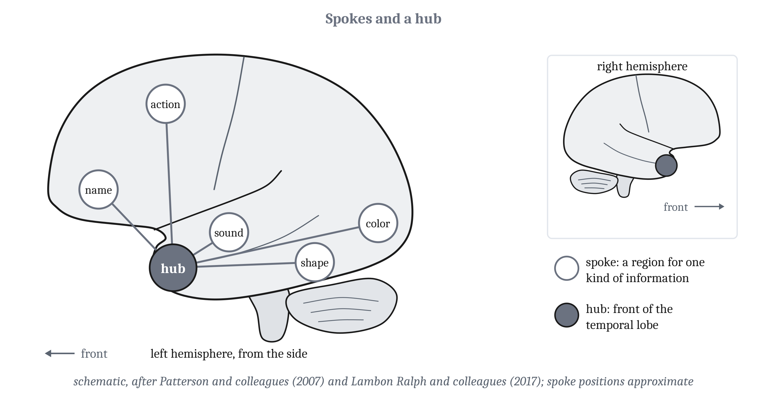
The Semantic Hub
Semantic dementia destroys old knowledge of what things are and spares recent occasions: the opposite of hippocampal amnesia.
Notes:
One patient could still remind his wife where to turn on a route he had not traveled recently. Then he pointed at some sheep and asked, “What are those things?” He had **semantic dementia**, a degenerative disease that wastes the front and underside of both temporal lobes. Patients gradually lose knowledge of what things are, whether the task uses pictures, words, or sounds. Specific knowledge is lost before general knowledge, the same order of loss as in the damaged network model from the second lecture, and knowledge of rare and atypical things is lost first. The people from the second lecture who drew camels without humps had this disease. Early on, memory for recent events, finding the way, and skills are spared.
Karalyn Patterson and her colleagues proposed how such knowledge is organized. A concept’s shape, color, sound, actions, and name are represented in the regions that process each kind of information, called spokes. A **semantic hub** in the front of both temporal lobes links them all, whatever the kind of information. On this account, a hub is needed because similar things often share few sensory properties. By shape alone, a pear is more like a light bulb than a banana. With only direct links between spokes, the pear would be represented as more like the bulb. A hub that every spoke reaches can represent pears and bananas as alike. A separate control network, in frontal, parietal, and posterior temporal cortex, selects the knowledge each task needs.
In healthy people, magnetic stimulation over the front of the temporal lobe slows judgments of meaning, but not judgments of number. People whose damage is mostly limited to the language network lose language, but not their knowledge of what things are. On a rival account, knowledge is combined in several convergence zones across the temporal and parietal lobes.
Semantic dementia and hippocampal amnesia form a double dissociation. Hippocampal amnesia impairs learning about new occasions and new facts, and spares old knowledge. Semantic dementia destroys old knowledge, and spares memory for recent occasions. Learning differs too. People with hippocampal damage learn new facts only slowly, by repetition. People with semantic dementia learn new items quickly, but lose them without practice, and generalize them poorly. That is the pair complementary learning systems would produce, if the fast learner depended on the hippocampus and the slow learner on the front of the temporal lobes.

Slide 6
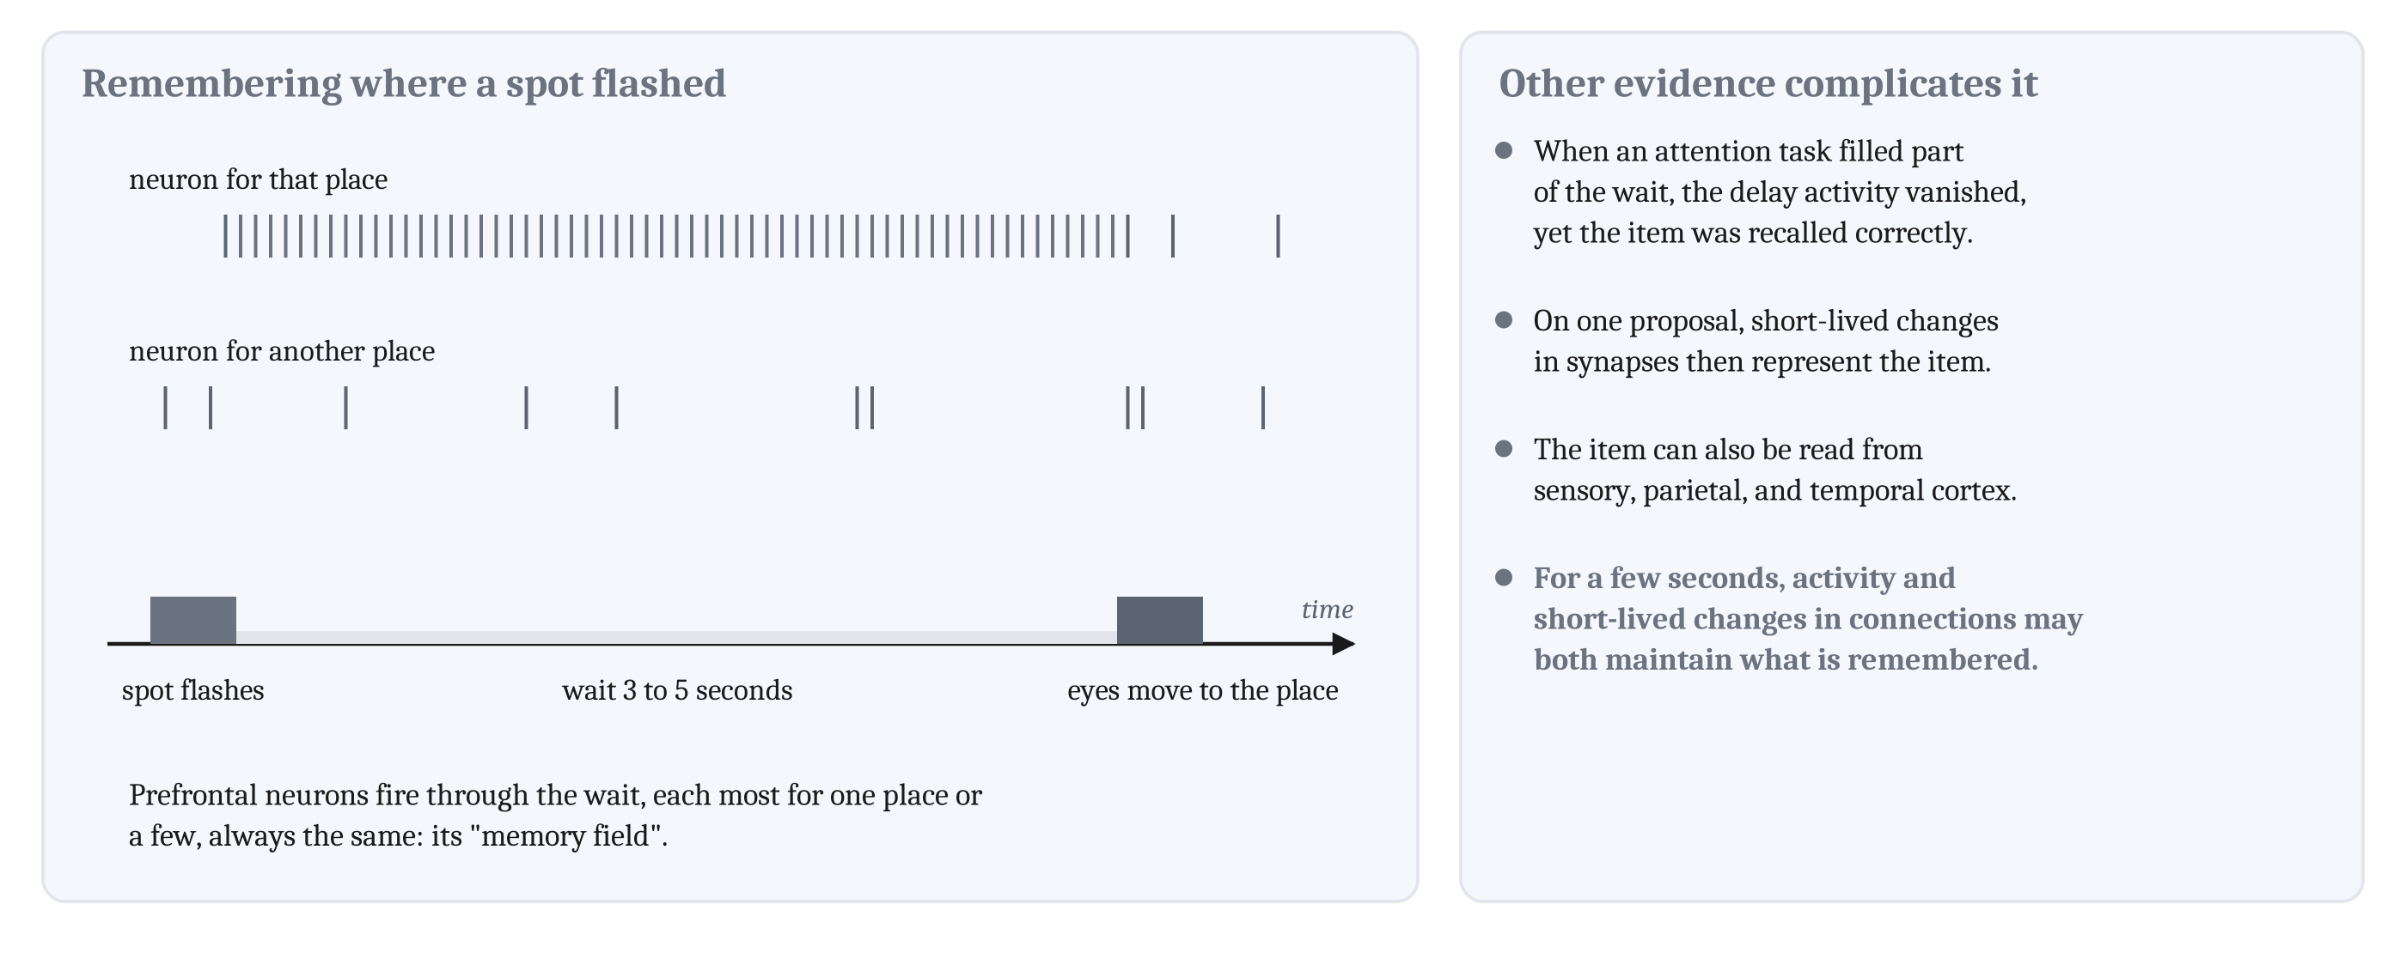
Persistent Activity
Persistent activity: activity that continues through a delay after a stimulus has gone, and codes what must be remembered.
Notes:
In one task, a monkey watches a spot flash briefly, waits 3 to 5 seconds, and then moves its eyes to where the spot was. During the wait, neurons in the prefrontal cortex fire. Each fires most when one place, or a few, must be remembered, and always for the same places. Patricia Goldman-Rakic called those places the neuron’s “memory field”. Firing of this kind is **persistent activity**.
In the second lecture, we described two ways a system can make a state last: in continuing activity, or in a changed connection. Persistent activity is the first way, since the neurons keep firing. The fly’s heading ring from Module 9 is a second case: its single bump of activity stays in place while the fly stands still. Goldman-Rakic argued that what is remembered for longer than tens of seconds depends on other mechanisms, such as the long-term potentiation from Module 5.
But in one study, when an attention task filled part of the wait, the delay activity vanished, and the remembered item was still recalled correctly. On one proposal, the item is then represented by short-lived changes in synapses, a pattern of weights “analogous to long-term memory”.
Two more complications. Researchers can tell what is being remembered from activity in sensory, parietal, and temporal cortex, not only prefrontal cortex. And on one view, prefrontal firing reflects control over representations elsewhere, rather than the remembered content itself.
So working memory is not simply continuing activity. For a few seconds, activity and short-lived changes in connections may both maintain what is remembered.

Slide 7
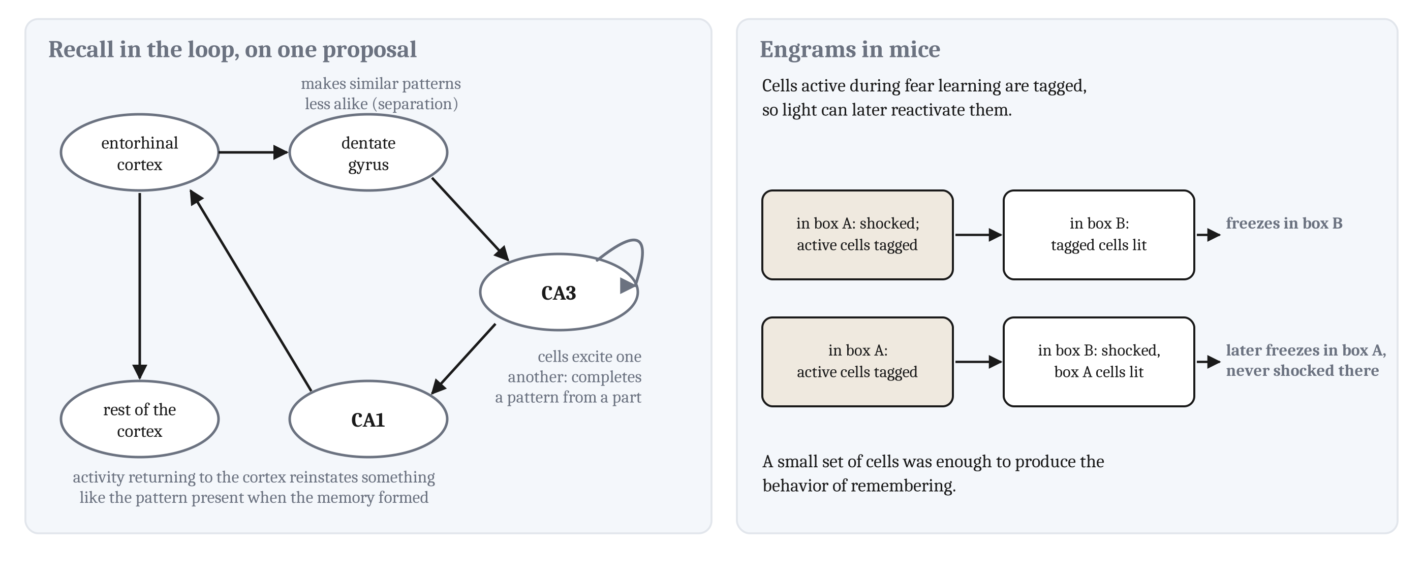
Recall in the Circuit, and Engrams
An engram is the lasting physical change that learning makes in the brain.
Notes:
In Module 9, we described chickadees whose hippocampal activity for each hidden seed returned when the bird came back for that seed. On one proposal, recall of this kind depends on the loop through the hippocampus that we described in Module 9. The loop runs from the entorhinal cortex to the dentate gyrus and CA3, then to CA1 and back.
On that proposal, the loop carries out pattern separation and pattern completion, which we described in the second lecture. The dentate gyrus makes similar patterns less alike, which is pattern separation. CA3 completes a pattern from part of it, which is pattern completion. CA3 cells excite one another, and connections of that kind are what auto-association requires. Then activity returning through CA1 and the entorhinal cortex to the rest of the cortex reinstates something like the pattern that was present when the memory formed.
The lasting physical change that learning makes in the brain is called an **engram**. In mice, cells active during learning can be tagged, so that light later reactivates them. Mice were shocked in one box. Later, in a different box, reactivating the tagged cells made the mice freeze, as mice do when afraid. So reactivating a small set of cells was enough to produce the behavior of remembering.
The second experiment is stranger. Cells tagged while the mice were in box A were reactivated while the mice were shocked in box B. Afterward, the mice froze in box A, where they had never been shocked. On one interpretation, what those cells represent about box A was combined with the shock. That interpretation is consistent with reconstructive memory, which we described from behavior in the second lecture.

Slide 8
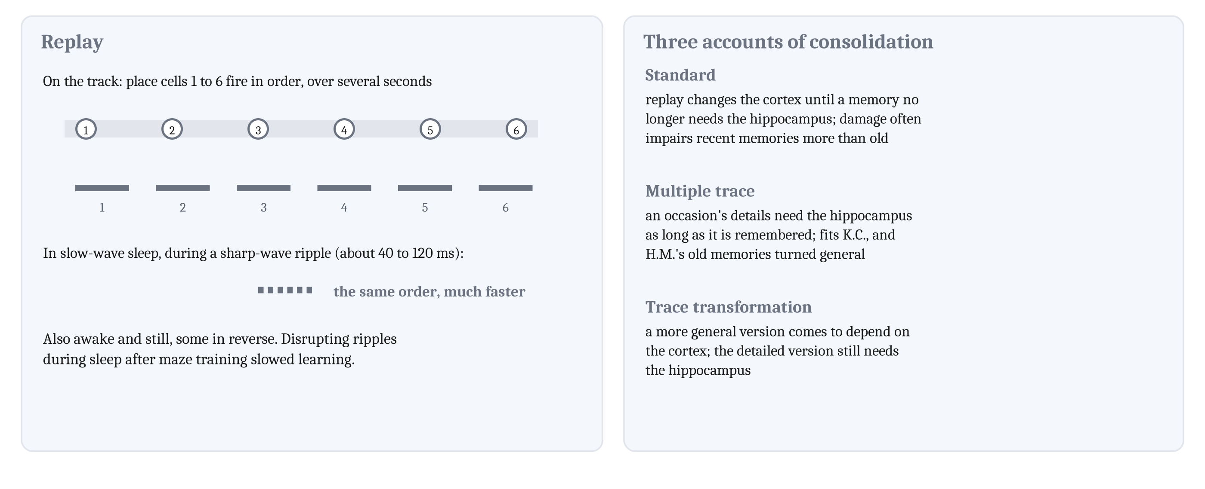
Replay and Consolidation
A sharp-wave ripple is a brief burst of fast, synchronized hippocampal activity, about 40 to 120 milliseconds long.
Notes:
The two states of sleep we described from outside in the first lecture also differ in recordings of the brain’s electrical activity. In the quiet state, called slow-wave sleep, large, slow waves make up most of the recording.
In a classic study, researchers recorded many CA1 cells while three rats searched for food, and during sleep before and after. Many were place cells. A **place cell**, from Module 9, fires when the animal is in one part of its surroundings, whichever way it is facing. Pairs of place cells that fired together during the task fired together more often in slow-wave sleep after it than before it. That measure could not reveal order. Researchers later found the order too. In slow-wave sleep, place-cell sequences from a run recurred, in order, much faster than the run, during **sharp-wave ripples**. Complementary learning systems propose replay of this kind.
Replay also happens while a rat is awake and still, as when it pauses to eat, and some awake replay runs in reverse. In one study, rats ran a track for sweet foods. On the track, some place cells fired together with reward-related cells in the ventral striatum. During rest afterward, those pairs fired together again, usually with the hippocampal cell first, about ten times faster than on the track.
When ripples were disrupted while rats slept after training on a maze, the rats learned the maze more slowly. So the ripples, or the replay during them, appear to contribute to spatial learning.
Consolidation, the gradual process we described in the second lecture, has three rival accounts. In the standard account, replay gradually changes connections in the cortex until a memory no longer depends on the hippocampus. That fits the finding that hippocampal damage often impairs recent memories more than old ones. In multiple trace theory, the details of an occasion depend on the hippocampus for as long as the occasion is remembered. K.C.’s loss of events from his whole life fits multiple trace theory, and so do H.M.’s old memories, which had become general knowledge. The researcher who studied H.M. longest judged that her preliminary results favor multiple trace theory. In trace transformation theory, a changed, more general version comes to depend on the cortex, while the detailed version still needs the hippocampus. The authors of one review call consolidation “a dynamic, generative, transformative, and lingering process”.

Slide 9
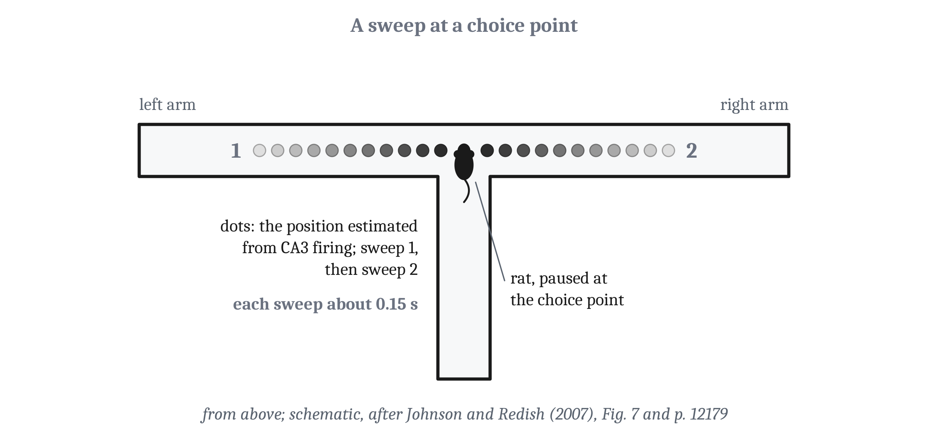
Running Ahead at a Choice Point
When a rat paused at a fork, the place estimated from its CA3 cells sometimes shifted ahead, down one arm and then the other.
Notes:
In one study of vicarious trial and error, rats ran a maze ending in a T-shaped choice. From which CA3 cells were firing, researchers estimated the place the cells represented. When a rat paused at the choice, the estimated place sometimes shifted ahead of the rat, down one arm and then the other. These shifts are called *sweeps*. They came during the theta rhythm, a steady oscillation of the hippocampus, not during sharp-wave ripples.
Their limits matter as much as the finding. Sweeps were rare, about 9% of the time the rats were at the choice point. Each covered one arm at a time. And no relation has been found between the arm a sweep covered and the arm the rat then chose. The authors proposed that the hippocampus represents where each option leads, and that other structures evaluate each option. During vicarious trial and error, reward-related cells in the ventral striatum fire before the rat turns toward its goal. Cells in the orbitofrontal cortex, just above the eyes, fire after the turn.
In another study, rats in an open arena returned to a home well that moved each day. While a rat was still, during ripples, brief sequences of place cells represented paths from where it was to the remembered home well, and matched the paths it then took. They matched even when the rat had never traveled from that start to that goal, in an arena it knew well. Sequences for a track not yet entered, called *preplay*, have been reported in mice, but the result is disputed.
When the four-site rats from the first lecture looked back toward a skipped site, cells in the orbitofrontal cortex and the ventral striatum represented that site. The researchers wrote that the results were consistent with “something akin to human regret”. Simulations of the model from the second lecture, which ranks which experiences to simulate, produce forward sequences before runs. They produce reverse sequences after runs, and more of them when the reward is larger, as researchers have found in rats.
Across these studies, rat brains produced sequences of activity for places and outcomes that were not present, at the moments when a learner like Dyna would run them. But no one has yet found a rat whose choice was changed by a sequence for something it never experienced. Learning from simulation is consistent with this evidence, but has not been demonstrated.

Slide 10
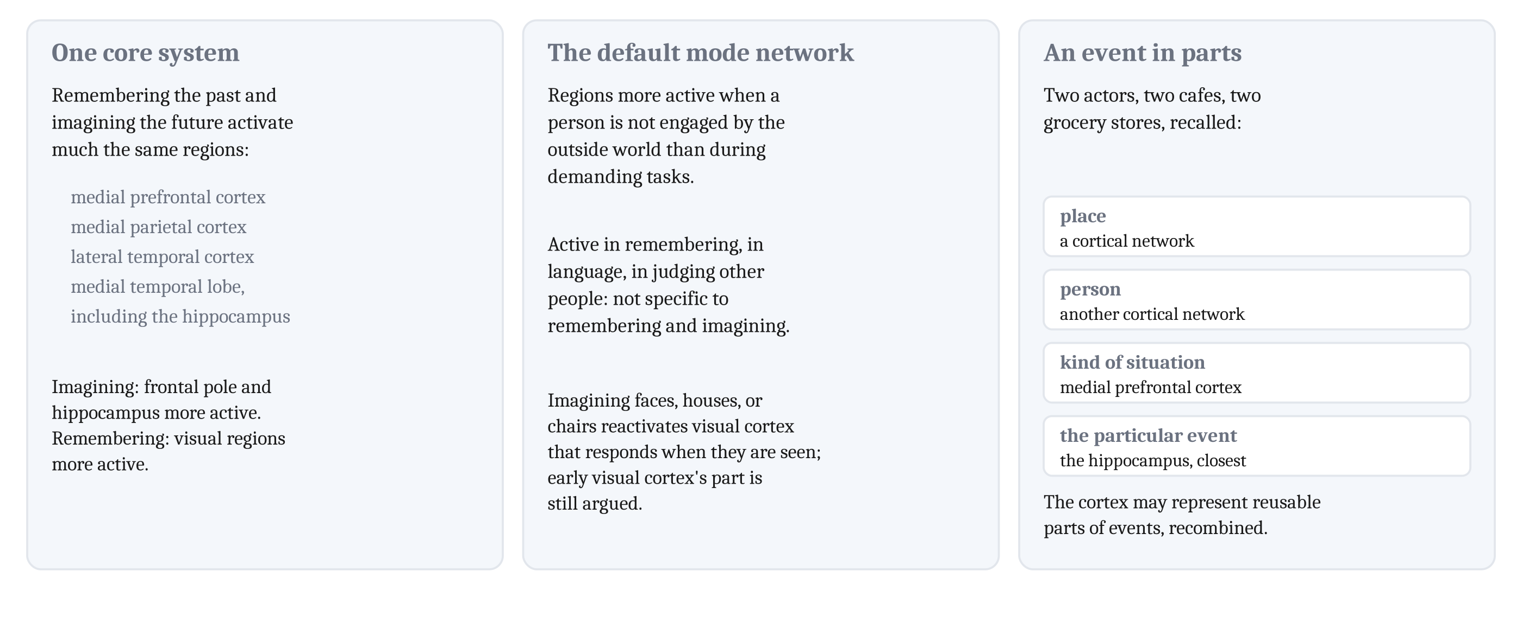
Remembering, Imagining, and the Default Network
The default mode network: regions more active when a person is not engaged by the outside world than during demanding tasks.
Notes:
When people in a brain scanner remember past events and imagine future ones, much the same regions become active. These include medial prefrontal and parietal cortex, lateral temporal cortex, and the medial temporal lobe, including the hippocampus. Daniel Schacter and Donna Rose Addis, with a colleague, called these regions a “core brain system”. The two tasks also differ. When people imagine the future, the hippocampus and the frontal pole, the very front of the frontal lobe, are more active. When they remember, visual regions are more active.
These regions overlap the **default mode network**. But the network’s regions are active in many tasks, from remembering to language to judging other people. So the network is not specific to remembering and imagining, and finding it active does not show that someone is doing either.
When people imagine faces, houses, or chairs, parts of visual cortex that respond when those things are seen become active again. Some researchers take this to settle the imagery debate from the second lecture in favor of Kosslyn’s account. How much early visual cortex contributes to imagery is still argued.
In one study, people watched and then recalled short films of two actors in four places, two cafés and two grocery stores. One cortical network represented the place, and another the person. The medial prefrontal cortex represented the kind of situation, café or store. The hippocampus came closest to representing each particular event. The researchers propose that the cortex represents reusable parts of events, which can be recombined. That fits the idea from the second lecture that an occasion is rebuilt from general parts plus a few specifics.

Slide 11
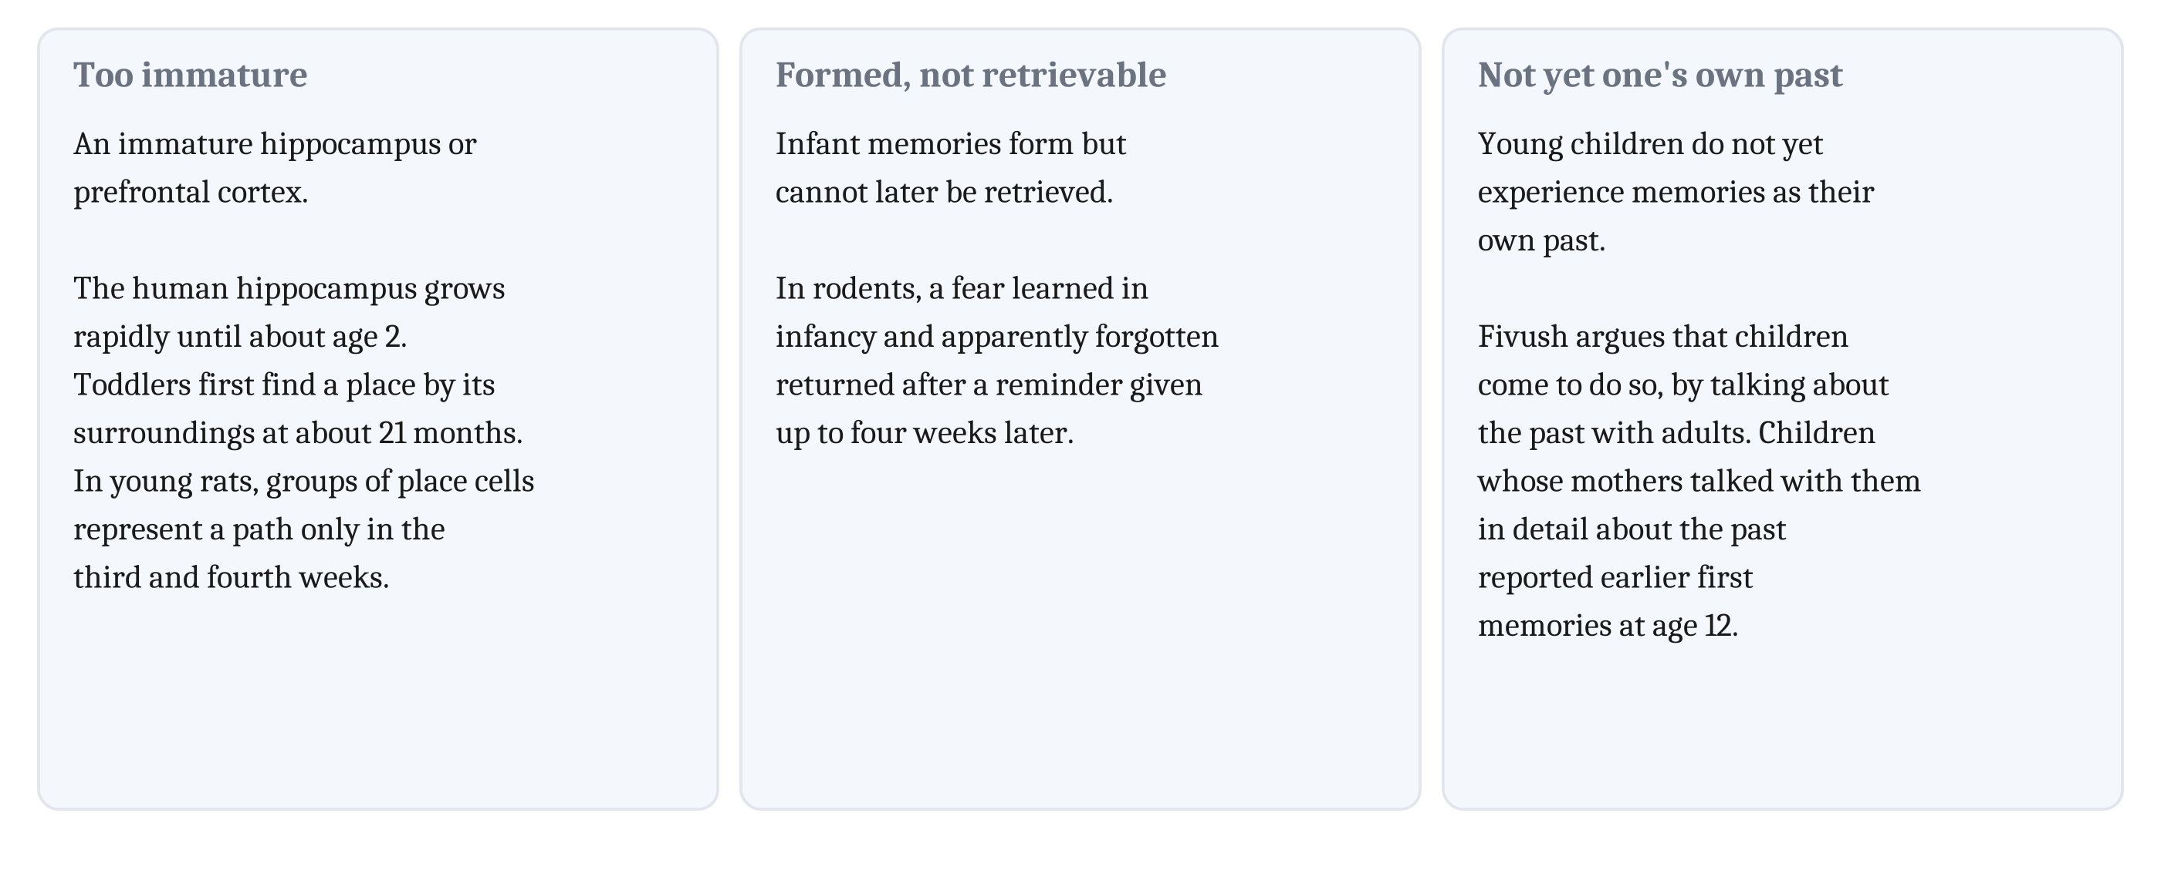
Infantile Amnesia
Infantile amnesia: adults recall almost nothing from their first years. Three proposed causes.
Notes:
Adults recall almost nothing from their first years, a loss called **infantile amnesia**. Three causes have been proposed.
One is an immature hippocampus or prefrontal cortex. The human hippocampus grows rapidly in volume until about age 2. Toddlers first learn to find a place by its surroundings, a task that requires the hippocampus, at about 21 months. In young rats, groups of place cells that fire together at first represent only single locations. Groups that represent a path appear only in the third and fourth weeks after birth.
A second proposal is that infant memories form but cannot later be retrieved. In rodents, a fear learned in infancy and apparently forgotten returned after a reminder given up to four weeks later.
A third proposal is that young children do not yet experience memories as their own past. Robyn Fivush argues that children come to do so by talking about the past with adults. She reviews studies of children whose mothers had talked with them in detail about the past in the preschool years. At age 12, those children reported earlier first memories. Notice that this proposal rests on the same idea as Tulving’s later definition of episodic memory, the experience of re-living an occasion as part of one’s own past.

Slide 12
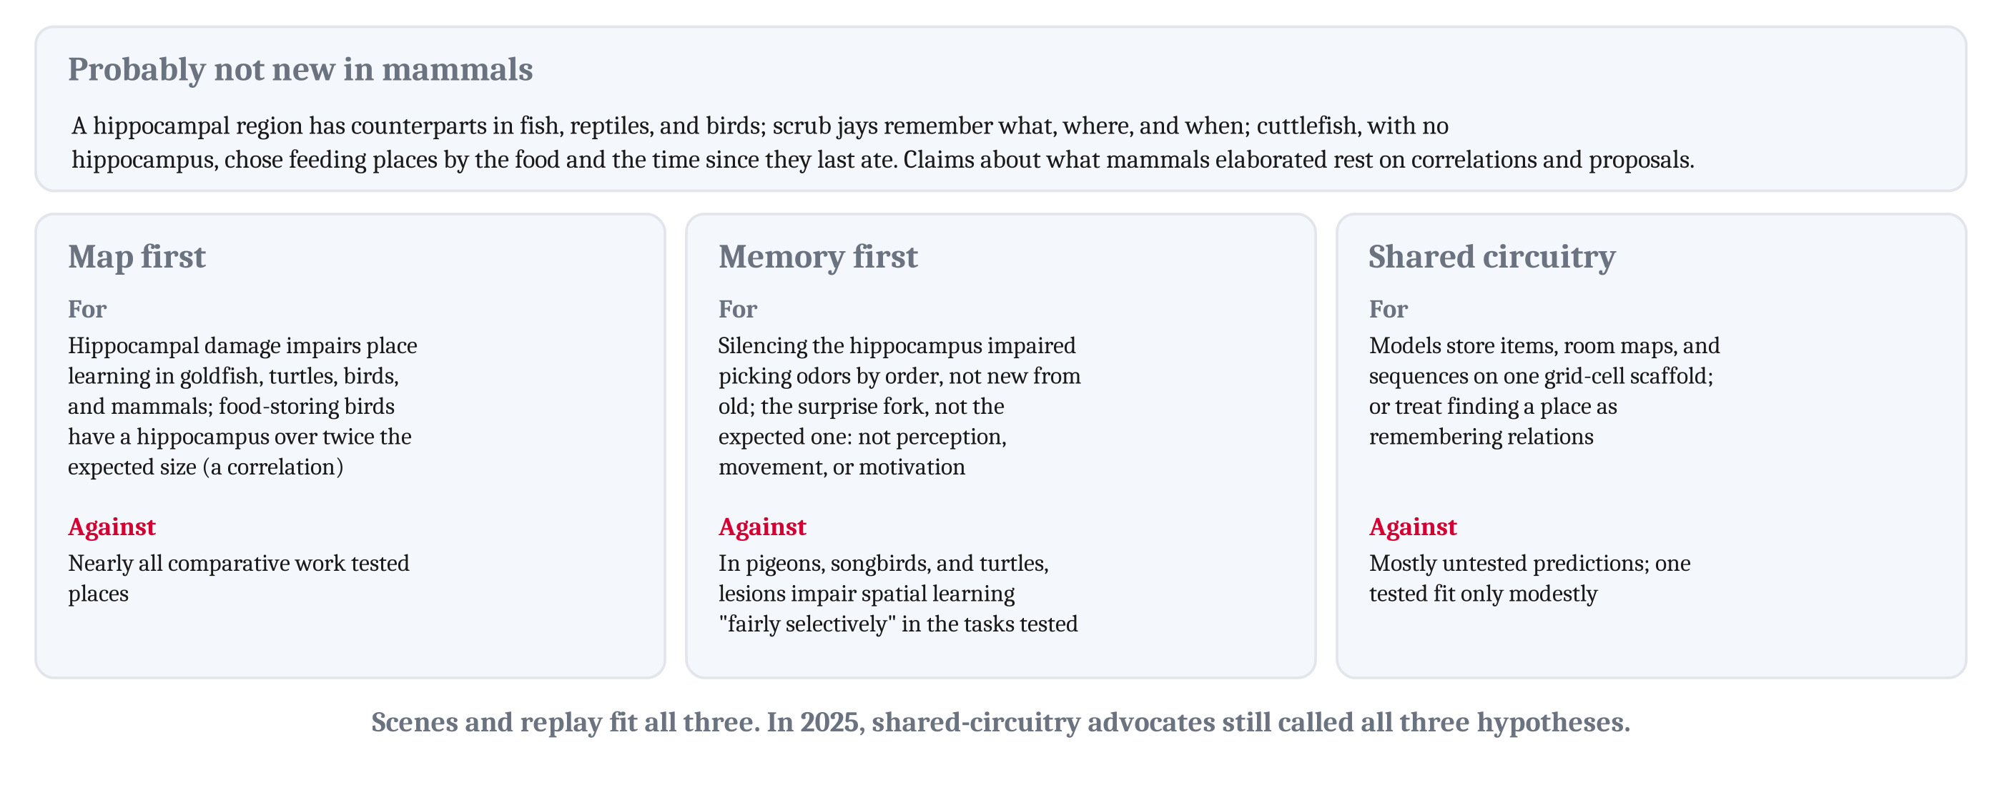
What May Be New in Mammals, and What the Hippocampus Is For
Memory for particular occasions, in some form, is probably not new in mammals. Three views of what the hippocampus is for remain open.
Notes:
A reminder first of how claims like these are made. Nobody can record from an extinct animal. What is old is inferred by comparing living species: a capacity found in fish, birds, and mammals was probably present in their common ancestor. What is elaborated in one group is inferred from correlations across species, which cannot show what caused what.
Memory for particular occasions, in some form, is probably not new in mammals. In Module 9, we described a hippocampal region with counterparts in fish, reptiles, and birds. Scrub jays remember what they cached, where, and when. And common cuttlefish, which are mollusks with no hippocampus, chose between two feeding places by which food each offered and how long ago they had last eaten.
So claims about what mammals elaborated rest on correlations and proposals. Nocturnal mammals tend to have relatively larger smell regions and a relatively larger hippocampus. A long youth, heavy parental care, and reliance on learning tend to occur together, and a large brain tends to occur with them, across birds and mammals. Two-state sleep, found in mammals and birds, has also been reported in one lizard, with contradictory results in other reptiles, so its origin is open. And whether simulation is new depends on which kind is meant: predicting from a model, reconstructing an occasion, and imagining a scene may have different histories.
In Module 9, we described three views of what the hippocampus is for. For the map-first view, hippocampal damage impairs place learning in goldfish, turtles, birds, and mammals, and food-storing birds have a hippocampus more than twice the expected size. The size difference is a correlation. Against it, nearly all comparative work has tested memory for places, so the evidence partly reflects what was tested.
For the memory-first view, in rats on the odor-list task from the first lecture, silencing the dorsal hippocampus impaired picking out odors by their order, but not telling new odors from old. In rats on the fork task, silencing part of the hippocampus impaired the choice that came without warning, and spared the expected one, which rules out effects on perception, movement, or motivation. Against it, if space were only one relation among many, hippocampal damage should impair learning of other relations as much. But in pigeons, songbirds, and turtles, hippocampal lesions impair spatial learning “fairly selectively” in the tasks tested.
For the shared-circuitry view, the evidence is from models. One model stores items, maps of rooms, and sequences on one scaffold driven by grid cells. Another treats finding a place as remembering relations. Against it, most of their predictions are untested, and one tested prediction fit only modestly.
Scenes and replayed sequences fit all three views. Researchers writing in 2025, who argue for the shared-circuitry view, still describe all three as hypotheses. Which is right remains open.

Slide 13
Two Ways to Sort Memory Systems
The machines we described mostly store what they learn in one network, sometimes with one added store. The brain, on either scheme, has several systems.
Scheme | Kind of memory, or system | Depends on, or first appeared in
Standard | Declarative: facts and events | Medial temporal lobe, midline diencephalon
Standard | Nondeclarative: skills and habits | Striatum
Standard | Nondeclarative: priming, perceptual learning | Neocortex
Standard | Nondeclarative: simple conditioning | Amygdala, cerebellum
Accretion | Reinforcement | Early animals
Accretion | Navigation | Early vertebrates (in the hippocampus)
Accretion | Biased competition | Early mammals
Accretion | Manual foraging | Early primates
Accretion | Feature and goal | Anthropoid primates
Accretion | Social-subjective | The human line
Notes:
The standard taxonomy sorts long-term memory by kind, according to what patients and animals can still learn after damage. H.M. improved at a skill while failing to learn new facts. Declarative memory, of facts and events, depends on the medial temporal lobe and the midline diencephalon, which includes the thalamus. Skills and habits depend on the striatum. Priming and perceptual learning depend on the neocortex. Simple conditioning depends on the amygdala and the cerebellum.
Elisabeth Murray, Steven Wise, and Kim Graham sort memory instead by what each system represents, and by the ancestor in which it first appeared. Their systems run from reinforcement memory in early animals to social-subjective memory in the human line. They call the scheme an *evolutionary accretion model*, since each system was added to those before it. They are the research group from the second lecture who conclude that only humans have explicit memory. On their account, explicit memory arises when a representation of oneself becomes part of what is remembered. They call the model a “first word” rather than a “last word”, and it has not replaced the standard taxonomy.
On either scheme, the brain has several systems, with different contents and different speeds of learning. The machines from the second lecture mostly store what they learn in the weights of one network, sometimes with one added store. That contrast may be the largest difference we have found between memory in machines and memory in animals.
Now back to the early mammal in its nest before dawn, with one log emptied, a second log with beetles left, and something large at the edge of a clearing. Experience can change an animal in two ways, and the two can coexist. It can change a tendency to respond. And it can leave accessible content, information that can be accessed later and combined with whatever the animal then needs. The animal needs learned tendencies to respond, such as avoiding a food that once made it sick. And it needs accessible content about which log it emptied, for a choice that depends on how hungry it is the next night.
In people, remembering turned out not to reproduce a copy. People reconstruct an occasion from general knowledge and a few specific details, which is why they form false memories, and why a witness can be confident and wrong. On one proposal, the same processes let people, and perhaps other animals, construct occasions that have not happened. Machines that generate new examples reconstruct toward what was typical in their training, as people reconstruct toward what they know, but most machines retrieve a stored example the same way each time.
Several questions are left for later modules. How people represent what other people know comes in Module 11. How an animal chooses among options once it has predicted their outcomes comes in Module 12. How machines that generate text are trained comes in Module 13. And whether some of what people know requires symbols, along with the imagery debate, returns in Module 14.

Slide 14
To Discuss: Is Memory a Recording?
In your group, five minutes.
A friend says memory works like a video recording: an event is stored in one place, and played back when you remember it.
Using the evidence from this lecture, what would you tell them? Which piece of evidence would you start with?
Notes:
Groups can argue against the recording view from several directions, each resting on a different kind of evidence.
From patients: H.M. could learn a skill while failing to learn new facts, and semantic dementia and hippocampal amnesia form a double dissociation. So memory is not stored in one place. Several systems, with different contents and speeds of learning, depend on different parts of the brain.
From cells: the mice that froze in box A, where they had never been shocked, suggest that a reactivated memory can be combined with a new experience, which a recording could not be. And replay runs an occasion much faster than it happened, during sleep and rest.
From the behavioral evidence in the second lecture, which the brain evidence fits: people recalled *sleep*, which they never heard, and some reported broken glass that was not in the film. Remembering reconstructs. K.C. and N.N. could not recall their past, and could not describe their future either. On one proposal, the same processes that reconstruct a past occasion also construct ones that have not happened. But other hippocampal patients have imagined future events normally.
Some groups also defend the friend a little. A computer really does store exact copies, and most of the machines from the second lecture retrieve a stored example the same way each time. The point is not that recording is impossible. It is that brains do something else.

Slide 15
Image Sources (1 of 2)
Slide | Image | File | License | Source
3 | H.M.'s brain, seen from below | fig-hm-lesion.png | CC BY 4.0 | Jon Willits — from the Module 10 reading, after Corkin and colleagues (1997), via Purves and colleagues (2018) · own work
5 | Spokes and a hub | fig-hub-spoke.png | CC BY 4.0 | Jon Willits — from the Module 10 reading, after Patterson and colleagues (2007) and Lambon Ralph and colleagues (2017) · own work
6 | Persistent activity, and its limits | fig-persistent.png | CC BY 4.0 | Jon Willits — drawn for this lecture; rasters schematic · own work
7 | The loop as recall, and engrams in mice | fig-loop-and-engram.png | CC BY 4.0 | Jon Willits — drawn for this lecture · own work
8 | Replay, and three accounts of consolidation | fig-replay.png | CC BY 4.0 | Jon Willits — drawn for this lecture; schematic · own work
9 | Sweeps at a choice point | fig-sweep.png | CC BY 4.0 | Jon Willits — from the Module 10 reading, after Johnson and Redish (2007) · own work
10 | Shared regions, and an event in parts | fig-default-network.png | CC BY 4.0 | Jon Willits — drawn for this lecture · own work
11 | Three proposed causes of infantile amnesia | fig-infantile.png | CC BY 4.0 | Jon Willits — drawn for this lecture · own work

Slide 16
Image Sources (2 of 2)
Slide | Image | File | License | Source
12 | What is probably old, and three views | fig-three-views.png | CC BY 4.0 | Jon Willits — drawn for this lecture · own work

