Slide 1
PSYC 496
Lecture 2: Language Models

Slide 2
What Are Language Models?
Three frames we’ll toggle between:
Engineering/tool: does it predict & generate text effectively/safely?
Cognitive science/Psychology: does it explain/predict human behavior or representations?
Linguistics: does it elucidate rules/structure the way linguists often want?
Three Questions
What is a language model?
What are they good and bad at?
How do we judge?
Success criteria aren’t interchangeable. “Outstanding” by one standard can be “uninformative” or ”unhelpful” by another. ￼

Slide 3
Big picture: LLMs Sit at an Intersection
Language Models
Artificial Neural Networks
Distributional Knowledge

Slide 4
Big picture: LLMs Sit at an Intersection
Language Models
Artificial Neural Networks
Distributional Knowledge

Slide 5
Example: Prediction is Useful, and Risky
Consider the fragments:
The farmer milked the...
The CEO said she would...
Every time the rooster crowed, the sun...
She put the watermelon into her...
He used a candle to see better in the bright...
Some of the students passed the exam. In fact, all of them…

Slide 6
Example: Prediction is Useful, and Risky
Humans often have one set of expectations that may differ strongly from what a language model expects.
LMs let us talk about linguistic knowledge operationally (do model probabilities track human judgments?). ￼
Skeptical worry: prediction can be “right for the wrong reasons” (frequency/correlation vs richer understanding). ￼
Three course-long questions to keep active:
What is a “language model,” exactly (across fields)? ￼
What does a language distribution tell us about meaning—and where does it break? ￼
Why did neural networks matter here? ￼

Slide 7
Defining Language Models
Discussion Question 1
When someone says “ChatGPT is a language model,” what do you think that commits you to?
In groups, produce:
• a 1–2 sentence definition
• one prediction that should be true if that definition is right
• one thing it does NOT imply (a common over-interpretation)

Slide 8
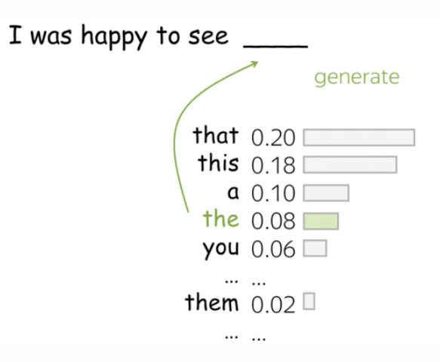
Defining Language Models
language model: a probability distribution over tokens in a text
token: the elements or vocabulary of a language model
A language model assigns probabilities to sequences of tokens, or to possible continuations given a context.
It outputs a distribution over next tokens, not just a single best guess.
This definition is deliberately minimal and doesn’t yet claim anything about meaning or understanding.

Slide 9
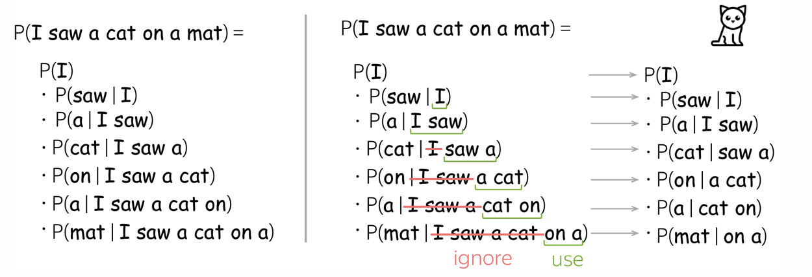
Defining Language Models

Slide 10
How Large Language Models Work
Tokenization: The First Structural Choice
Breaks text into subword units
Creates manageable vocabulary
Shapes all later representations
Tokenization Scheme | Example Tokenization
Word-Level | ["The", "singing", "children", "were", "happily", "playing", "outside", "."]
Character-Level | ["T","h","e"," ","s","i","n","g","i","n","g"," ","c","h","i","l","d","r","e","n"," ","w","e","r","e"," ","h","a","p","p","i","l","y"," ", "p","l","a","y","i","n","g"," ","o","u","t","s","i","d","e","."]
Morpheme-Like Subwords (Idealized) | ["The", "sing", "ing", "child", "ren", "were", "happi", "ly", "play", "ing", "outside", "."]
LLM-Style BPE / Subword Tokens | ["The", "sing", "ing", "children", "were", "happ", "ily", "play", "ing", "outside", "."] or ["The", "singing", "child", "ren", "were", "happily", "play", "ing", "outside", "."] or ["The", "sing", "##ing", "child", "##ren", "were", "ha", "##pp", "##ily", "play", "##ing", "outside", "."]
Notes:
Before an LLM can learn grammar or meaning, raw text must be chopped into discrete units the model will treat as its basic alphabet.
Modern systems typically use subword tokens—fragments like “play,” “##ing,” “un,” or “bio”—rather than whole words or characters.
This approach keeps the vocabulary small enough for efficient computation while still capturing meaningful pieces of language.
Tokenization is not an afterthought—it is the first structural decision that shapes everything the model can learn.
Subword tokenization works by scanning huge corpora to find frequently occurring fragments.
Common words become single tokens; uncommon or morphologically complex words are broken into parts.
This allows the system to represent any text, including rare names or scientific terms, without needing an enormous vocabulary.
At the same time, it introduces a representational bias: the model’s understanding of morphology and word structure comes from these token boundaries.
Tokenization also introduces subtle distortions and asymmetries.
For example, “running” might split into “run + ##ing,” while “singing” might split into “sing + ##ing,” but “having” may tokenize as “hav + ##ing,” which loses the underlying root form.
These small inconsistencies ripple through training, affecting how the model clusters related words, forms analogies, and composes meaning.
In this sense, tokenization is a partly symbolic scaffold placed under what is often described as a purely neural system.
Finally, tokenization reminds us that LLMs do not learn language exactly the way humans do.
Children do not have pre-segmented linguistic units—they discover them through multimodal input, joint attention, and interaction.
LLMs, by contrast, receive a fixed menu of representational chunks engineered before learning begins.
Recognizing this difference helps explain why LLMs excel at some kinds of generalization while failing at others.

Slide 11
How Large Language Models Work
Limits and Biases of Tokenization
Fragmentation alters meaning signals
Rare words handled inconsistently
Symbolic scaffolding shapes learning
Dialect & Sentence | Tokenization (LLM-Style Subwords)
SAE: “I’m going to finish this later.” | ["I","’m","going","to","finish","this","later","."]
AAE: “I’m gon’ finish this later.” | ["I","’m","g","##on","’","finish","this","later","."]
Type of Issue | Word | Likely Tokenization | Why It Matters
Splitting compounds | 电脑 (computer) | ["电","脑"] | Loses lexical identity; weakens semantic representation
Splitting compounds | 手机 (cell phone) | ["手","机"] | Forces model to infer meaning from parts
Splitting inflected words | jumping, jumped | [“jumping”] or [“jump”, “ing”] [“jumped”] or [“jump”, “ed”] | learning to track parts separately vs. being told the whole thing matters
Notes:
Tokenization is an engineering solution, not a linguistic discovery procedure, and it introduces systematic quirks into how LLMs represent language.
Because subword units reflect statistical frequency rather than true morphological boundaries, common words receive clean representations while rare ones are chopped into arbitrary fragments.
This unevenness affects how easily the model can learn relationships among words, especially for infrequent vocabulary.
In practice, tokenization can amplify or dampen semantic signals in ways that do not reflect human intuitions.
One consequence is fragmentation that splits meaningful units apart.
Highly regular endings like “-ing” or “-ed” tend to appear as separate tokens, enabling the model to learn morphological patterns.
But irregular or less frequent forms may be split inconsistently (“hav + ing,” “go + ##ne,” “bio + ##logy”), which disrupts similarity relations the model might otherwise infer.
These artifacts are byproducts of algorithmic compression, not linguistic theory.
Tokenization also encodes biases from the training corpus.
If certain dialects, technical terms, or minority languages appear rarely, they become heavily fragmented, making them harder for the model to learn well.
This leads to reduced fluency or accuracy in those linguistic varieties, mirroring representational inequities in the data.
Thus, tokenization participates in shaping the model’s strengths and weaknesses long before learning begins.
Finally, tokenization reveals a deeper point: LLMs are not blank-slate learners.
They begin with a human-designed symbolic scaffold that determines what counts as a “unit” of language.
This differs from human learners, who infer categories through perceptual, social, and interactive cues.
Recognizing the constraints introduced by tokenization prepares us to understand how LLMs build internal representations on top of these artificial units.

Slide 12
Defining Language Models
What counts as a “good” model:
Engineering/CS: does the model predict and generate text effectively for useful tasks.
Psychology and Cognitive Science: is the model is a plausible mechanism for human language behavior and representations.
Linguistics: does the model capture systematic structure and generalization in ways that inform theories of grammar.

Slide 13
Defining Language Models
Discussion Question 2
If someone says “ChatGPT understands language” or that “ChatGPT doesn’t understand language”, what are they actually claiming?
How does the claim change depending on whether we’re coming from engineering, cognitive science, or linguistics?
Give two concrete tests that would count as evidence and one plausible right-for-the-wrong-reasons explanation.

