Slide 1
PSYC 496
Lecture 3: Distributional Learning

Slide 2
Distributional Knowledge
Discussion Question 3
Can meaning be learned from text alone? In your group:
pick one word you think could be learned well from text-only exposure and one word you think could not.
For each word, say what kinds of evidence in language use would help and what kinds of evidence would be missing.
Then state your current position: text is mostly sufficient, partly sufficient, or mostly insufficient, and why.

Slide 3
Big picture: LLMs Sit at an Intersection
Language Models
Artificial Neural Networks
Distributional Knowledge

Slide 4
Distributional Knowledge
Distributional information: words live in contexts
Words appear in regular distributions of surrounding contexts rather than in isolation.
Overlapping context neighborhoods often signal some kind of semantic relatedness, but not a single pure relation.
What you get depends heavily on how you define context, such as window-based context versus grammatical-role context.
dog
cat
shoe
sock
chase
sleep
wear
buy

Slide 5
Distributional Knowledge
The Distributional Hypothesis: One claim, several interpretations
Distributional Hypothesis: ”You shall know a word by the company it keeps”. More formally, words with similar contexts tend to have similar meanings.
A methodological reading says usage patterns provide useful evidence about meaning even if meaning is more than usage.
A stronger reading treats meaning as constituted by use, which raises classic objections from grounding and formal semantics.
A representational reading treats meanings as points in a similarity space, evaluated by how well the format explains behavior.

Slide 6
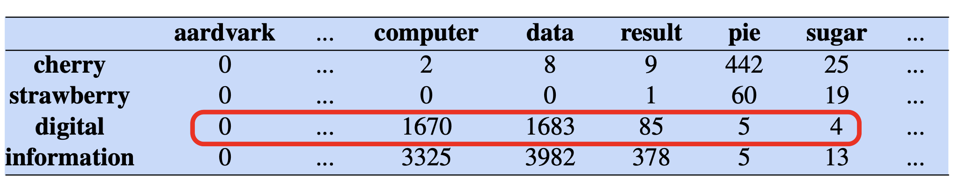
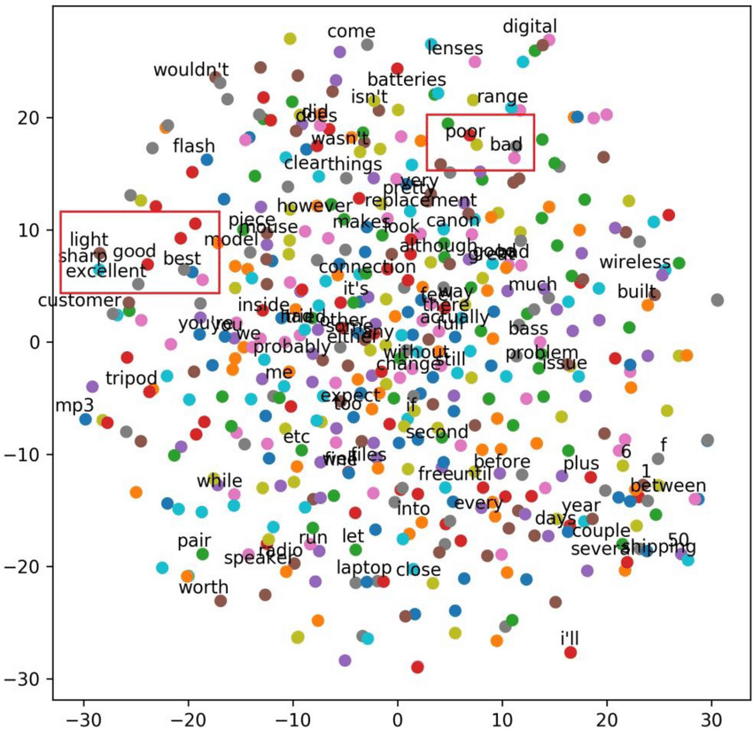
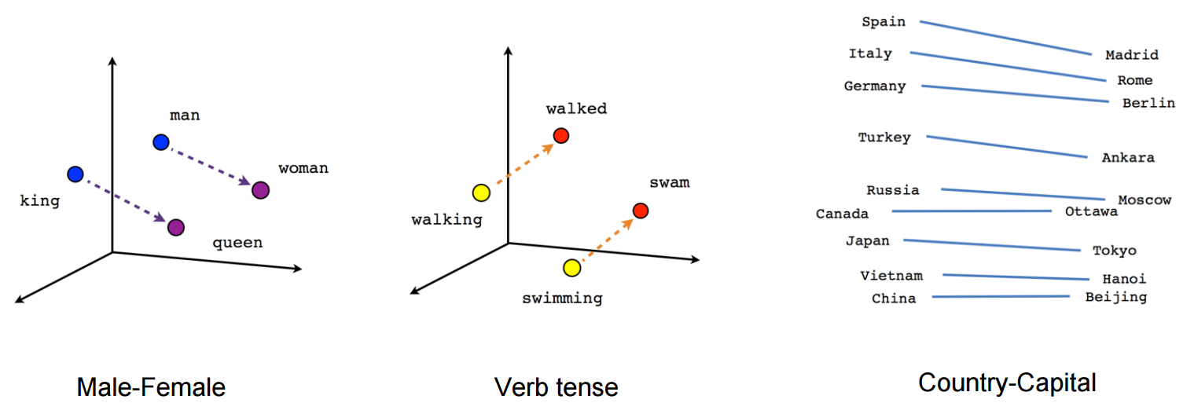
Distributional Knowledge
From Counts to Geometry: Semantic Spaces and Embeddings

Slide 7
Distributional Knowledge
From Counts to Geometry: Semantic Spaces and Embeddings

Slide 8
Distributional Knowledge
From Counts to Geometry: Semantic Spaces and Embeddings
Start with a context profile for each word, built from co-occurrence patterns in a corpus.
Treat each word as a vector and compare words by distances or angles that reflect similarity of context profiles.
Embeddings are compact numerical points whose geometry summarizes distributional structure, with strengths and blind spots that depend on data and objective.

Slide 9
Distributional Knowledge
Why cognitive science cares: graded structure and retrieval
Human semantic behavior is often graded, including typicality judgments and fuzzy category boundaries.
Semantic priming and expectation effects look naturally compatible with distance-sensitive representations.
A key caution is that “closeness” blends multiple relations, so the same geometry can be a feature or a limitation depending on the question.

