Slide 1
PSYC 496
Lecture 4: Artificial Neural Networks

Slide 2
Distributional Knowledge
Discussion Question 5
If a learning system (human or AI) had memorized every sequence of language ever produced by all human beings who ever existed, would it be:
good at predicting new sequences of words?
good at answering all questions you could ask it?
good at problems that require intelligence or reasoning?
Why or why not?

Slide 3
Big picture: LLMs Sit at an Intersection
Language Models
Artificial Neural Networks
Distributional Knowledge

Slide 4
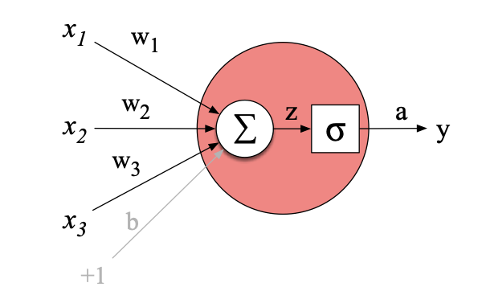
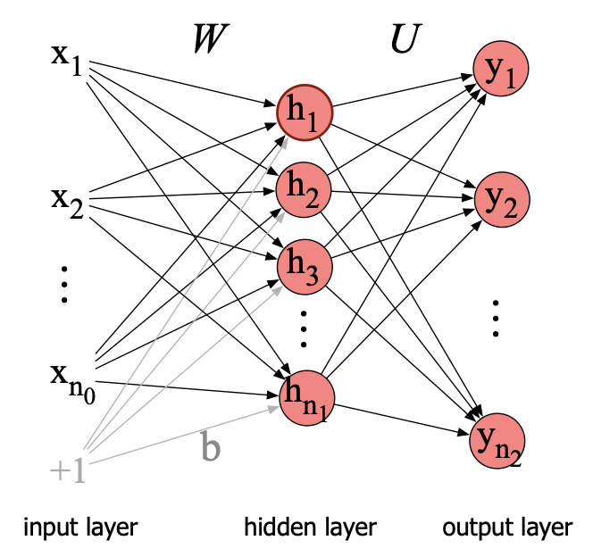
Artificial Neural Networks
Neural networks as function learners
A neural network is a parameterized function that maps inputs to outputs.
Learning means adjusting many weights to reduce prediction error on a training objective.
The key shift is that the system can learn intermediate representations that make the task easier.

Slide 5
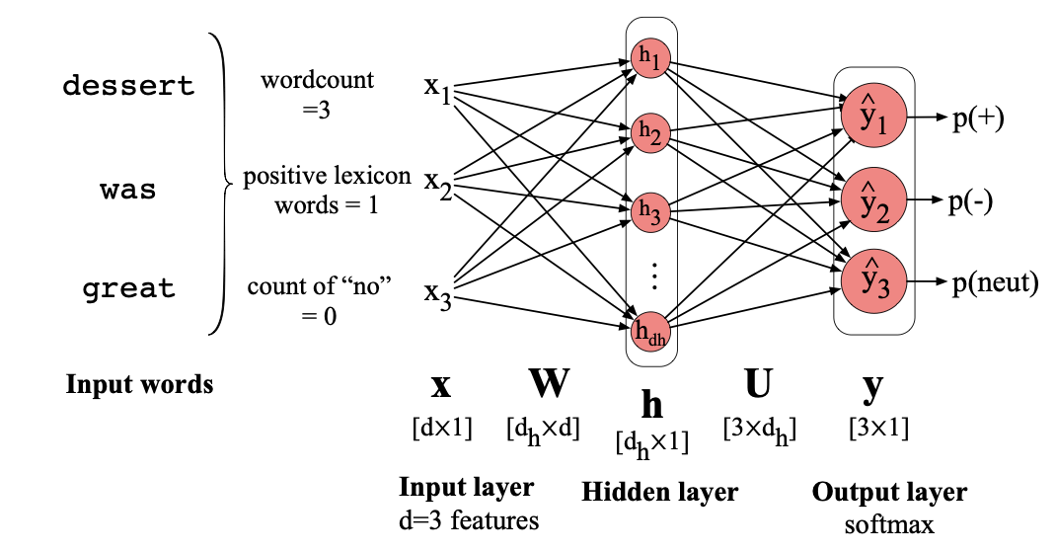
Artificial Neural Networks
Example: Sentiment Analysis
Take a passage of text, and give it a score for positive or negative sentiment.
The dessert was great.
The dessert was not so great.
He didn’t think that the dessert was great.
The liar said the dessert was great.

Slide 6
Artificial Neural Networks
Example: Sentiment Analysis
Hidden layer
A set of intermediate units between input and output that learns internal features of the data, transforming the input into a representation that makes prediction easier.
Distributed representation
A way of encoding information as a pattern of activation across many units (or dimensions), so no single unit corresponds to a whole concept and similarity reflects overlap in patterns.
Error-driven learning
A learning process that updates parameters to reduce a measured mismatch between the model’s output and a target signal, using that error as the feedback signal for improvement.

Slide 7
Artificial Neural Networks
Example: Sentiment Analysis
Hidden layer
A set of intermediate units between input and output that learns internal features of the data, transforming the input into a representation that makes prediction easier.
Distributed representation
A way of encoding information as a pattern of activation across many units (or dimensions), so no single unit corresponds to a whole concept and similarity reflects overlap in patterns.
Error-driven learning
A learning process that updates parameters to reduce a measured mismatch between the model’s output and a target signal, using that error as the feedback signal for improvement.

Slide 8
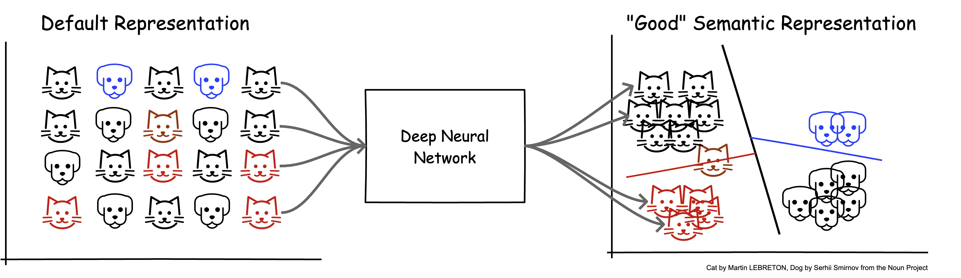
Artificial Neural Networks
Representation learning: hidden layers do work you didn’t hand-code
Instead of specifying features by hand, networks can learn internal features that are useful for the objective.
Those internal features can be reused across many contexts and tasks, which supports generalization.
This changes what “knowledge” looks like: it is often distributed across many weights rather than stored as explicit rules.

Slide 9
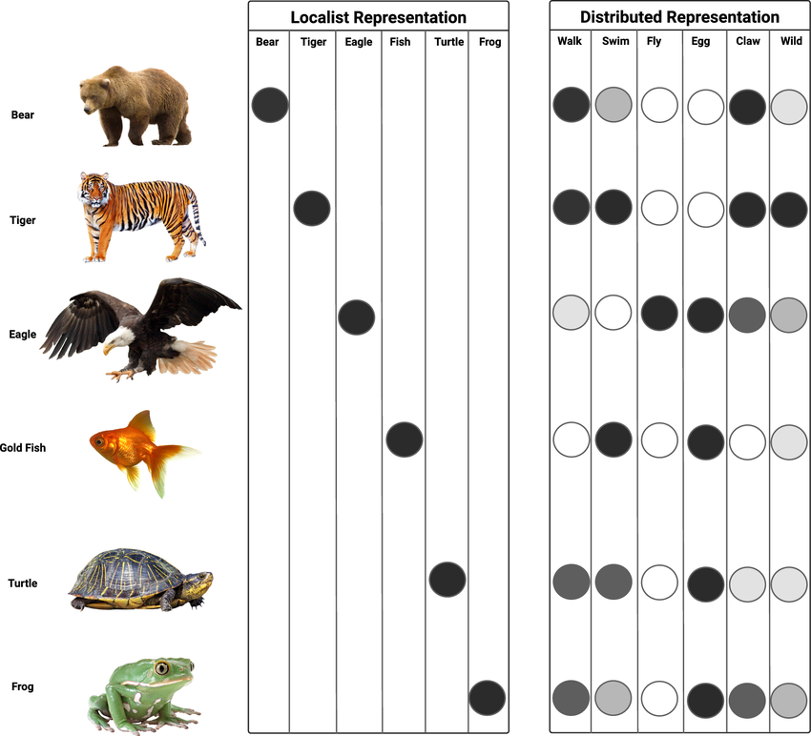
Artificial Neural Networks
Distributed representations and graded similarity
Neural nets naturally encourage distributed codes where concepts are patterns across units, not single symbols.
This supports graded similarity and partial overlap, which fits many cognitive phenomena.
But it also makes interpretation harder because there may be no single “place” where a rule or concept lives.

Slide 10
Artificial Neural Networks
Generalization, inductive bias, and what error-driven learning buys you
Networks generalize by exploiting regularities and compressing patterns, but what they generalize depends on architecture and training.
Error-driven learning gives a clear metric for improvement, but it can reward shortcuts that fit the data without capturing the intended structure.
This sets up a recurring question: when is performance evidence of the right internal structure versus an accidental heuristic?

Slide 11
Artificial Neural Networks
Connectionism and the symbolic challenge
Connectionist models historically competed with symbolic accounts about whether rules and compositional structure require explicit symbols.
Neural systems can show systematic behavior, but the conditions under which they do are an empirical question.
The modern view often treats this as a spectrum: explicit symbolic structure is one possible solution, learned distributed structure is another.

