Slide 1
PSYC 496
Lecture 5: Combining the Three Legs

Slide 2
Bringing the Three Together
Language Models
Artificial Neural Networks
Distributional Knowledge
Discussion Question 6
In your group, discuss the relationship between the three paradigms we’ve discussed.
Come up with an example of a system or algorithm in all 7 parts of the Venn diagram.

Slide 3
Bringing the Three Together
One unifying idea: learn representations by predicting contexts
A language model training objective gives a clear target: predict what comes next from context.
To do that well, a system benefits from building internal representations that compress and organize contextual regularities.
So distributional structure and learned representations can be understood as what you get when a neural network optimizes prediction.

Slide 4
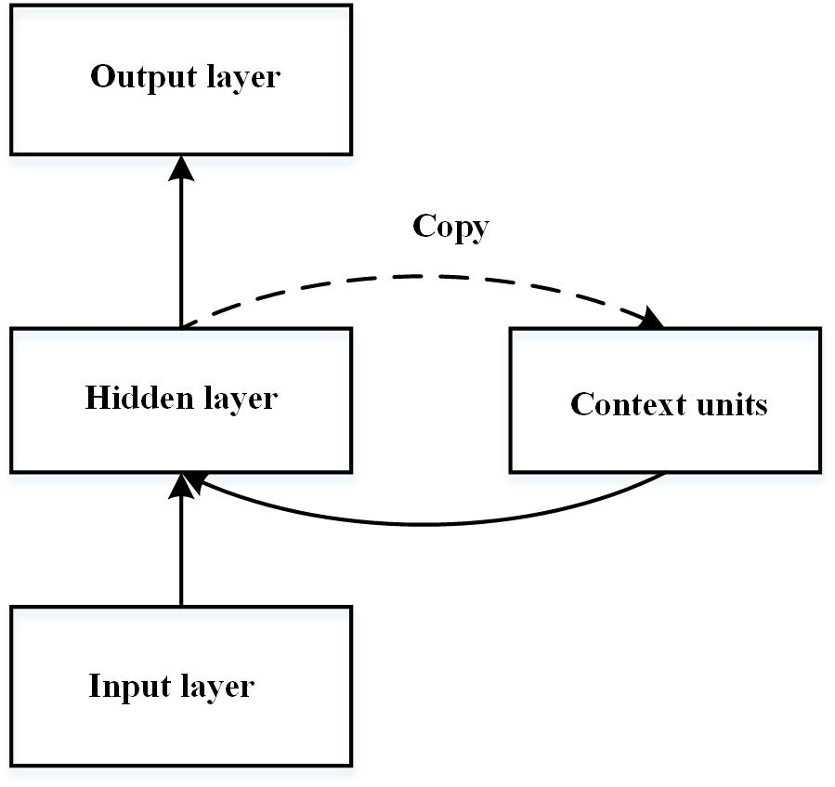
Bringing the Three Together
Simple Recurrent Networks as the first bridge
SRNs take word inputs over time and maintain a hidden state that summarizes prior context.
They are neural networks trained with error-driven learning to predict the next word, making them both neural and language models.
Because the hidden state must carry forward useful information, it can become a learned representation of sequential and syntactic/semantic regularities.

Slide 5
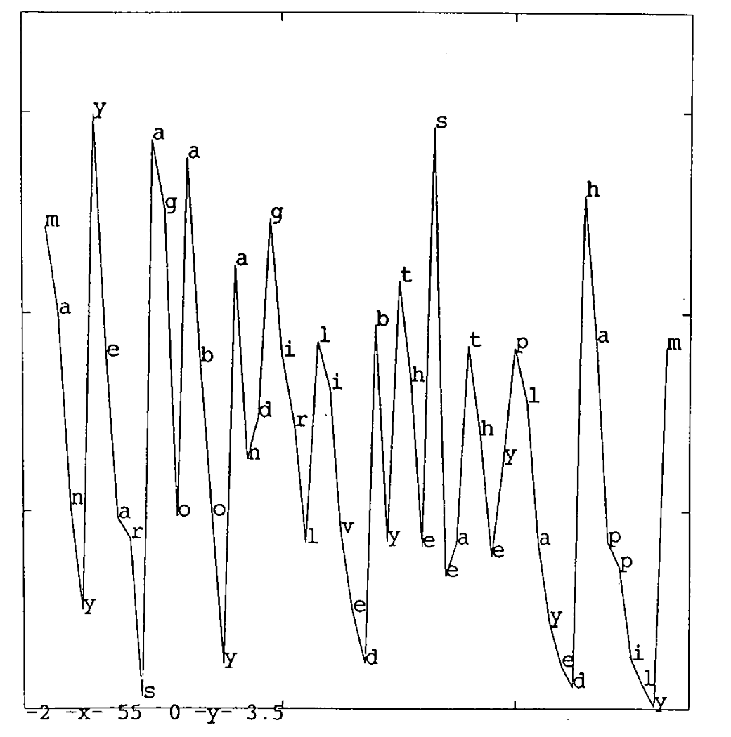
Bringing the Three Together
Simple Recurrent Networks as the first bridge
SRNs take word inputs over time and maintain a hidden state that summarizes prior context.
They are neural networks trained with error-driven learning to predict the next word, making them both neural and language models.
Because the hidden state must carry forward useful information, it can become a learned representation of sequential and syntactic/semantic regularities.

Slide 6
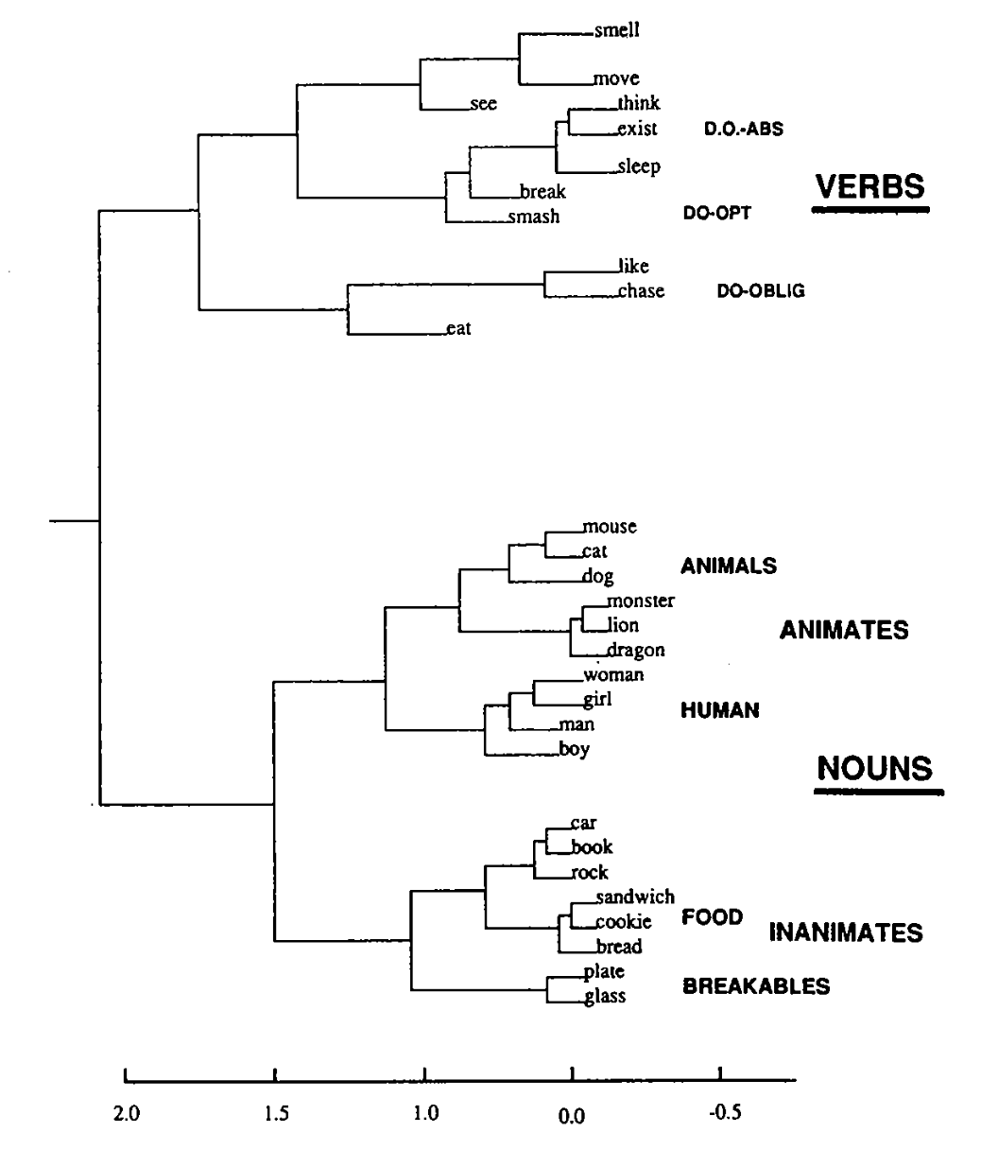
Bringing the Three Together
Simple Recurrent Networks as the first bridge
SRNs take word inputs over time and maintain a hidden state that summarizes prior context.
They are neural networks trained with error-driven learning to predict the next word, making them both neural and language models.
Because the hidden state must carry forward useful information, it can become a learned representation of sequential and syntactic/semantic regularities.

Slide 7
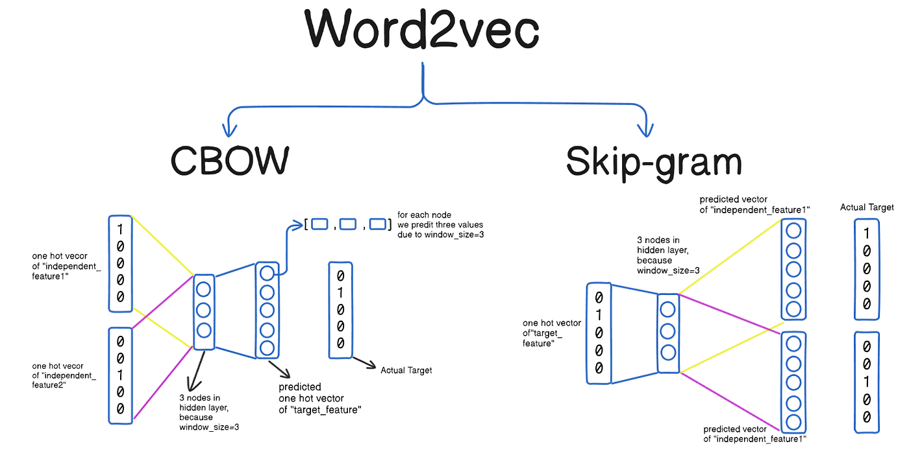
Bringing the Three Together
Word2Vec: distributional vectors trained as prediction
Word2Vec reframes distributional learning as a lightweight prediction task: predict a word from its context or predict context words from a target.
Even without full sentence modeling, the training objective pushes the model to place words in a vector space where similar contexts yield similar vectors.
This helped make embeddings mainstream by giving an efficient way to learn useful semantic geometry from large corpora.

Slide 8
Bringing the Three Together
A short synthesis: two routes to distributional meaning
SRNs learn representations as a byproduct of sequence prediction across time, emphasizing order and context dependence.
Word2Vec learns representations as a byproduct of local context prediction, emphasizing co-occurrence neighborhoods.
Both show the same general pattern: prediction objectives plus neural learning can produce distributional representations with useful semantic structure.

Slide 9
Bringing the Three Together
Looking ahead: why transformers change the picture
Recurrent models compress past context into a single evolving state, which can be a bottleneck for long-range dependencies.
Transformers keep broader access to context and compute context-sensitive representations more directly, scaling much better with data and model size.
This sets up the next step in the course: modern LLMs combine large-scale next-token training with architectures that handle long context and rich representations.

