Slide 1
PSYC 496
Lecture 6: The Transformer Architecture

Slide 2
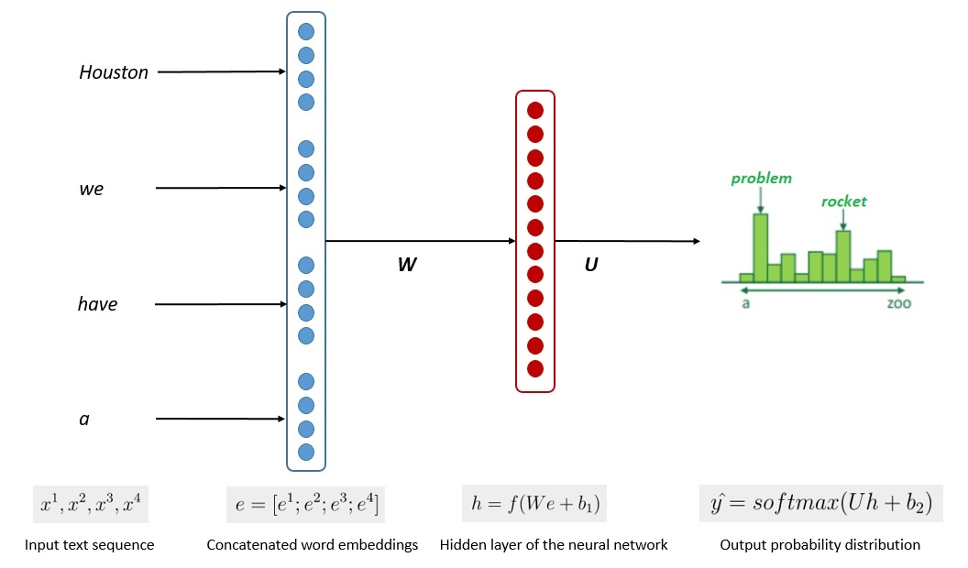
How Large Language Models Work
What Problem Do LLMs Actually Solve?
Reveal limits of human assumptions
Show prediction as powerful mechanism
Test theories of mind and language
An
eagle
is
a
very
bird
Notes:
At their core, large language models are trained to perform one task: predict the next token in a sequence of text.
The model sees a string of words or subwords and assigns probabilities to what is most likely to come next.
This objective is deceptively simple, but language is richly structured, so solving it well requires capturing syntax, semantics, and discourse patterns.
This means LLMs learn much more than surface-level associations when optimizing for prediction accuracy.
This task forces the model to internalize patterns of grammar.
To predict the next word in a sentence, the model must learn agreement, ordering, and the dependencies that connect distant parts of a phrase.
It discovers these features implicitly, not through explicit rules but by minimizing prediction error across enormous text corpora.
In this sense, the learning process resembles earlier material we covered on distributed representations and learned feature hierarchies.
Prediction also requires the model to develop approximate semantic knowledge.
If a sentence begins with “The doctor examined the…,” predicting the next tokens requires understanding roles, contexts, and common continuations.
The model learns associations among words, topics, and events simply because these relationships support accurate next-token predictions.
This leads to behavior that resembles understanding, despite being grounded in pattern learning rather than explicit reasoning.
This predictive objective helps explain both the strengths and limitations of LLMs.
They are excellent at tasks that align with language patterns but struggle
when deep reasoning or real-world grounding is needed.
Understanding this training goal clarifies why LLMs excel at fluency and generalization
yet can fail unexpectedly at tasks requiring external reference or causal inference.
Grasping this fundamental objective prepares us to examine the architectures that support it.

Slide 3
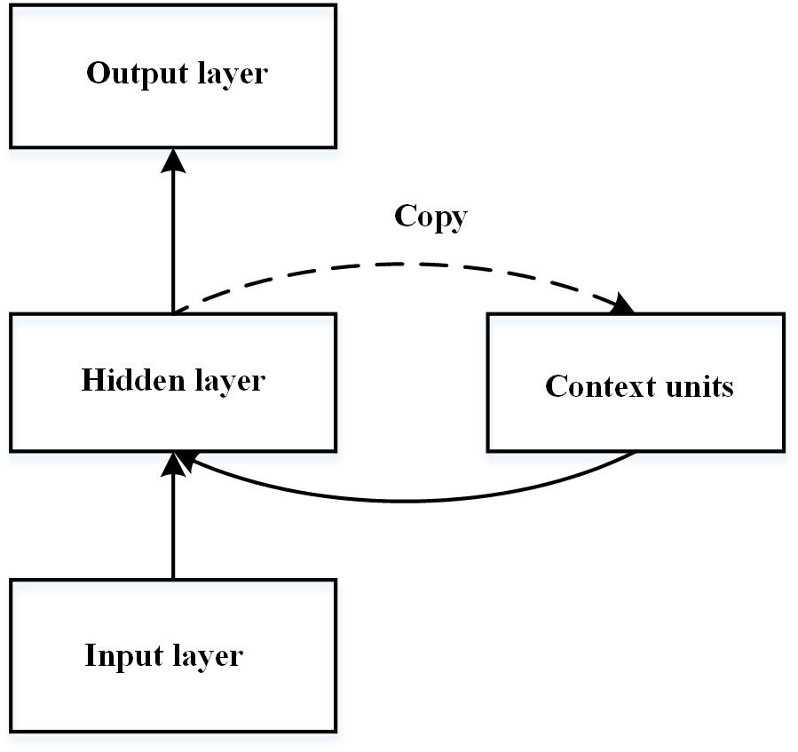
How Large Language Models Work
RNNs and Their History in Cognitive Science
Models with recurrent connections
Long tradition in cog sci
Sequential processing like human memory
Notes:
Tokenization gives us the basic units an LLM learns over, but the architecture determines how relationships among those units are actually represented.
Different architectures impose different constraints on what kinds of patterns can be learned—syntactic, semantic, or long-range contextual.
Before transformers, the dominant architecture for sequence learning was the Recurrent Neural Network (RNN), which processes information one step at a time.
Understanding RNNs helps us see why later architectures were needed to scale to modern language modeling.
RNNs were influential because they maintain an internal state that evolves with each new input.
This made them appealing as models of human cognitive processes like working memory, temporal context, and incremental interpretation.
In cognitive science, researchers used them to study sentence comprehension, phonology, category learning, and developmental sequences.
RNNs represented one of the first serious attempts to capture the dynamics of cognition using connectionist models.
Gated variants such as LSTMs and GRUs emerged to address the core limitation of basic RNNs: difficulty carrying information across long distances in a sequence.
These architectures incorporated explicit control mechanisms to preserve or forget information, making them better at modeling language-like dependencies.
This allowed them to handle longer sentences, nested structure, and more complex tasks than simple RNNs could.
For many years, LSTMs were state-of-the-art in both AI and cognitive modeling.
But despite their cognitive plausibility, RNNs had practical shortcomings that became severe as datasets and model sizes grew.
They process sequences strictly in order, which limits parallelization and makes training extremely slow at scale.
They still struggled with very long-range dependencies, even with gating mechanisms.
These limitations set the stage for the transformer architecture, which took a fundamentally different approach to sequence modeling.

Slide 4
How Large Language Models Work
Why RNNs Struggled in Practice
Slow, sequential processing
Limited long-range memory
Hard to scale to big data
The key(s) to the cabinet(s) was/were on the table
Notes:
Despite their cognitive appeal, RNNs turned out to be poorly suited for the scale and speed needed in modern AI systems.
Because they process tokens one at a time, information flows only forward through the sequence, creating a strict bottleneck.
This sequential dependency makes training extremely slow—every step must wait for the one before it.
As data and models grew, this limitation became a major barrier.
RNNs also struggled with long-range dependencies, even with enhancements like LSTMs or GRUs.
Information from early in a sequence decayed or was overwritten as new inputs arrived, making it difficult for the model to use distant context.
Many linguistic phenomena—coreference, discourse structure, long-distance agreement—require integrating information across large spans of text.
RNNs could approximate this, but not reliably or efficiently.
Another challenge was the instability of training.
RNNs often suffered from vanishing or exploding gradients, requiring careful initialization, clipping, or gating mechanisms to maintain stability.
This made them difficult to scale to very deep models or very long sequences.
The engineering effort needed to keep them functioning well increased dramatically with model size.
These issues mattered precisely because tokenization gives the system discrete units, but the architecture must learn relationships between those units.
RNNs were good at modeling local dependencies but poor at handling global ones, and their sequential bottleneck made large-scale training impractical.
Researchers needed an architecture that could use long-range context, train in parallel, and scale smoothly with increasing data.
That solution was the transformer, which we introduce next.

Slide 5
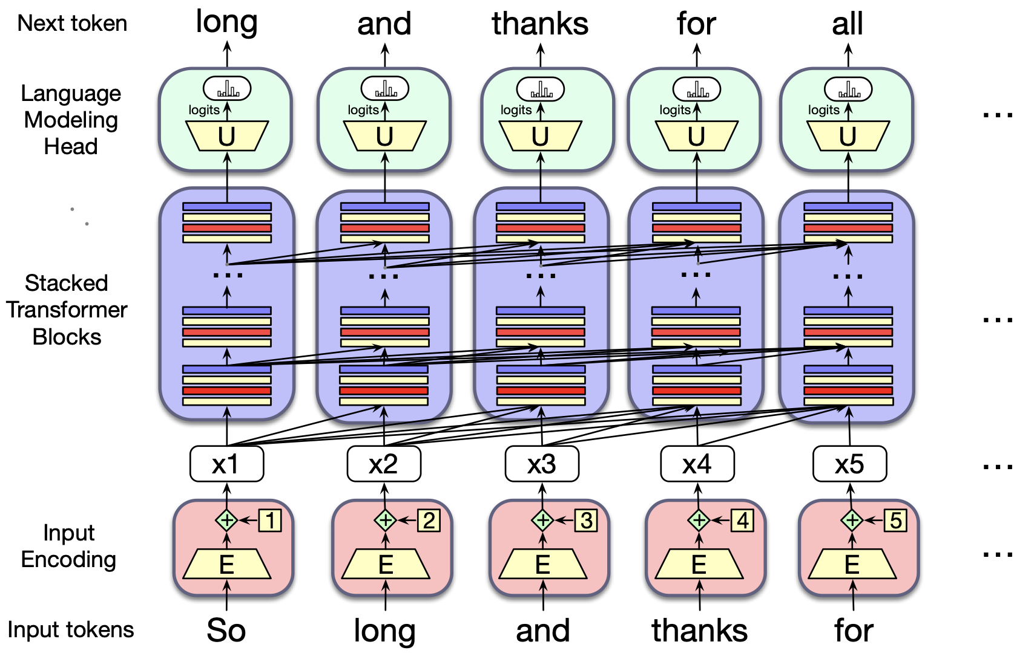
How Large Language Models Work
The Transformer Architecture
Processes all tokens in parallel
Uses attention to link context
Designed to scale efficiently
Notes:
The transformer architecture was introduced as a solution to the bottlenecks and memory limits of recurrent networks.
Instead of processing tokens one by one, transformers take in an entire sequence at once, allowing the model to compute relationships among all positions simultaneously.
This parallel processing makes training dramatically faster on modern hardware and enables much larger models.
It was this shift—from sequential to parallel computation—that unlocked the current wave of large-scale language models.
In a transformer, the core operation is attention, a mechanism that determines how much each token should focus on every other token in the sequence.
This allows the model to integrate information from anywhere in the input, regardless of distance.
Long-range dependencies, such as subject–verb agreement across clauses or resolving pronouns in earlier sentences, become far easier to represent.
Transformers thus overcome the memory and scaling limitations inherent in RNN-based architectures.
A key consequence of this design is that transformers operate over extremely large context windows—thousands or even tens of thousands of tokens—far larger than what human working memory can maintain.
Humans rely on compressed, structured representations, chunking, and active maintenance of only a few items at a time.
Transformers, by contrast, can access all prior tokens simultaneously, using brute-force parallel computation to track patterns across vast spans of text.
This makes them powerful predictors, but also highlights how computationally un-human their memory systems really are.
A transformer layer also includes a feedforward component that applies learned transformations to each token’s representation.
Stacked layers alternate between attention blocks and feedforward networks, gradually building up abstractions.
Lower layers focus more on surface structure, while higher layers encode more semantic or discourse-level patterns.
This hierarchical organization resembles what we saw in CNNs, but applied to text rather than images.
Importantly, transformers are not cognitively realistic in many respects: they do not use recurrence, they process entire sequences simultaneously, and they require enormous computational resources.
But they are extremely effective engineering solutions to the scaling demands of modern AI.
Their success underscores a recurring theme across the course: biological plausibility and computational efficiency do not always align.
Next, we explore attention—the mechanism that makes transformers powerful.

Slide 6
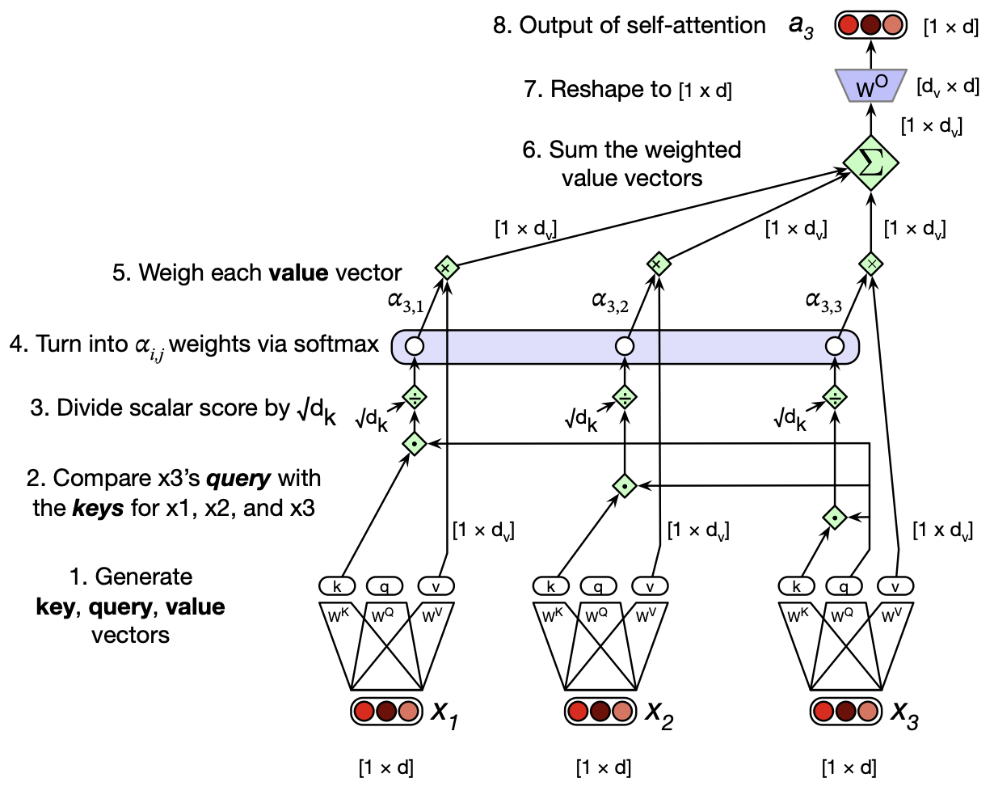
How Large Language Models Work
Attention in Large Language Models
Tokens “look at” relevant context
Weighted connections shape meaning
Enables long-range relationships
Notes:
Attention is the mechanism that lets each token decide which other tokens matter for interpreting the current one.
Instead of treating all context as equally important, the model assigns weights that reflect relevance—much like how people focus selectively on certain words when interpreting a sentence.
These weights determine how information flows across the sequence and how each token updates its representation.
At a high level, attention is a learned pattern of “who should listen to whom.”
A useful metaphor is that each token asks a question (“What am I trying to understand?”), compares itself to other tokens (“Who can help me answer it?”), and gathers weighted information from those that match.
This allows the model to integrate syntax, semantics, and discourse cues flexibly.
Pronouns can attend to their antecedents; verbs can attend to subjects; adjectives can attend to the nouns they modify.
RNNs struggled with these long-distance patterns, but attention handles them naturally.
Attention is also context-sensitive.
The relevance of a token can shift depending on what the model is trying to predict.
For example, “bank” in “the boat drifted toward the bank” will attend to different context words than “bank” in “she cashed a check at the bank.”
This dynamic re-weighting gives transformers a powerful ability to represent ambiguity and resolve it based on surrounding cues.
An important contrast with humans, however, is that transformer attention is massively parallel.
Humans can shift attention, but we cannot simultaneously compute relevance across hundreds of words.
Transformers can evaluate these relationships all at once, using computational resources unavailable to biological systems.
This difference helps explain their fluid long-context processing—and also why they sometimes fail at tasks requiring structured, human-like reasoning.

Slide 7
How Large Language Models Work
Stacking Layers Builds Abstractions
Lower layers track surface patterns
Higher layers encode structure
Depth enables complex behavior
Notes:
Transformers consist of many repeated layers, each containing attention and feedforward components.
Early layers tend to represent more local, surface-level patterns: token identity, adjacent word relationships, and simple syntactic cues.
As information flows upward, layers progressively refine these patterns into richer abstractions.
This layered processing mirrors how deep networks in vision build edges → shapes → objects, but here it applies to linguistic structure.
In the middle layers, the model begins to capture broader syntactic dependencies.
These layers can represent grammatical roles, constituent boundaries, and patterns like agreement or subcategorization.
Because each attention block can connect distant parts of a sentence, these representations integrate both local and global cues.
This makes middle layers especially important for behaviors like translation, summarization, or question answering.
Higher layers encode patterns that resemble semantics, discourse structure, topic, and even elements of pragmatic inference.
They integrate multiple levels of information from earlier layers, producing representations that correlate with meaning or conceptual similarity.
The model does not “understand” these patterns the way humans do, but it organizes language into abstract structures that support fluent prediction.
These emergent abstractions are a key reason transformers outperform earlier architectures.
Depth also supports flexible generalization.
Because each layer transforms the representation in different ways, the model can reuse lower-level features for many tasks while refining higher-level features for context-specific behavior.
This is analogous to how cognitive systems reuse perceptual or syntactic representations across different linguistic or conceptual tasks.
Understanding this flow of abstraction sets the stage for examining how training shapes these layers and the behaviors they enable.

Slide 8
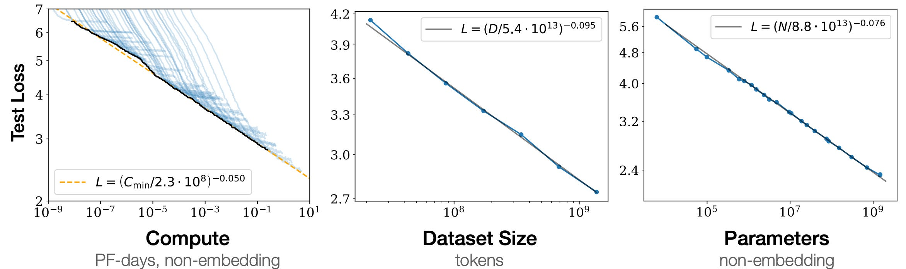
How Large Language Models Work
Scaling Laws
Self-supervised learning from text
Error signals update weights
Simple rule drives complex behavior
Notes:
One of the most surprising discoveries in modern AI is that performance follows predictable scaling laws.
As model size, dataset size, and compute increase, error rates decrease along remarkably smooth curves.
This empirical regularity holds across many architectures, datasets, and tasks, suggesting that model capacity and data volume interact in systematic ways.
Scaling laws helped shift the field toward building very large models rather than focusing solely on algorithmic innovations.
Scaling also changes the kind of patterns a model can learn.
Smaller models capture local statistics but struggle with longer-range dependencies or more abstract regularities.
As capacity grows, models can store richer representations, integrate broader context, and model more complex distributions.
These improvements occur even when the training objective remains the same simple next-token prediction.
An especially striking outcome is the emergence of qualitatively new abilities at certain scales.
Models suddenly begin handling arithmetic-like tasks, analogy-making, multi-step reasoning, or syntactic repair that smaller models fail to exhibit.
These “emergent abilities” are not explicitly programmed; they arise from the accumulation of representational capacity and training data.
This challenges long-standing assumptions about how much structure must be built into a cognitive or linguistic system.
Scaling also reinforces a major theme from Lecture 2: the role of data is as important as the architecture.
Even the most powerful model cannot exceed the limits of its training corpus, and many weaknesses stem from gaps in the kinds of input available.
Understanding scaling helps us see why larger models behave differently—not because their mechanisms change, but because the scope of what they can encode expands.
With that in mind, we now turn to the nature of the data these models actually train on.

Slide 9
How Large Language Models Work
The Role of Data
Internet text dominates training
Missing everyday interactions
Data shapes what models learn
Notes:
LLMs learn only from the text they are exposed to, which means the training corpus plays a central role in determining their strengths and weaknesses.
Most modern models are trained primarily on large collections of internet text, books, and other publicly available written sources.
This provides immense linguistic diversity, but it also reflects the biases, omissions, and distortions of online language.
The model therefore learns a world filtered through the lens of what people choose to write and publish.
Crucially, this text-based training regime excludes enormous portions of human experience.
Models do not see the perceptual, spatial, emotional, or sensory contexts that ground meaning in real life.
They also do not participate in dialogue the way children do—they receive no gestures, prosody, shared attention, or physical environment.
As a result, their understanding of language is shaped entirely by statistical patterns in text, not by interactions with the world.
Another limitation is that the data is highly curated relative to everyday experience.
Images and videos used in multimodal models tend to be polished, framed, and centered on salient objects, rather than the messy stream of sensorimotor data a child encounters.
Robotic experience data is scarce, meaning models lack grounding in action, manipulation, and physics.
This limits their ability to generalize to embodied tasks, even though they may describe such tasks fluently.
Finally, the distribution of data strongly influences model behavior.
Common topics receive disproportionately rich representation, while marginalized dialects, rare technical vocabularies, or informal speech varieties may be fragmented or underrepresented.
These gaps affect fluency, bias patterns, and the robustness of downstream applications.
Understanding how data shapes learning prepares us to discuss fine-tuning, alignment, and methods for reshaping model behavior after initial training.

Slide 10
How Large Language Models Work
Fine-Tuning and Reinforcement Learning with Human Feedback (RLHF)
Specializes models after pretraining
Aligns behavior with human norms
Feedback reshapes model responses
Notes:
After large-scale pretraining, LLMs undergo additional steps to adapt them for real-world use.
Fine-tuning trains the model on smaller, curated datasets to specialize it for tasks like question answering, summarization, or dialogue.
This step adjusts the pretrained representations without starting learning from scratch.
Fine-tuning allows models to acquire task-specific behavior that the general-purpose training objective cannot provide.
Another critical method is Reinforcement Learning from Human Feedback (RLHF).
Here, human evaluators rank multiple model outputs, and a reward model is trained to predict which responses humans prefer.
The LLM is then optimized to produce outputs that maximize predicted human approval.
This process helps reduce harmful content, increase helpfulness, and shape the model’s tone and style.
RLHF profoundly alters how the model behaves.
It shifts the system from raw next-token prediction toward producing responses that align with human conversational norms.
In practice, RLHF teaches the model to avoid certain failure modes, such as rambling, refusal to answer simple questions, or giving unsafe content.
However, it also introduces a layer of human subjectivity, making the model reflect the values, biases, and preferences of annotators.
These methods highlight that LLMs are not “finished” after pretraining.
They undergo significant transformation through targeted updates designed to make them safer, more useful, and more agreeable.
Fine-tuning and RLHF demonstrate how post-training interventions can reshape a model’s behavior without altering the underlying architecture.
Next, we examine chain-of-thought prompting, another important technique that modifies how models generate reasoning-like responses.

Slide 11
How Large Language Models Work
Time Step | Word | Hidden State Summary (Conceptual) | Issue
t₁ | “The” | Initializes representation | —
t₂ | “trophy” | Encodes object A | Representation is weak, easily overwritten
t₃ | “didn’t” | Adds negation cue | Earlier noun decays
t₄ | “fit” | Verb cue dominates state | Long-range memory begins degrading
t₅ | “into” | Prepositional structure | RNN is now mostly encoding position in the sentence
t₆ | “the” | New noun phrase begins | Earlier noun nearly gone
t₇ | “suitcase” | Encodes object B | Object A (trophy) largely forgotten
t₈ | “because” | Causal clause cue | Memory of both nouns partially collapsed
t₉ | “it” | Pronoun requiring reference | RNN hidden state does not reliably maintain two noun candidates
t₁₀ | “was too small” | Model must choose antecedent | RNN often predicts “trophy” (wrong) because size associates with objects more than containers
Chain of Thought and Other Optimizations
Prompts elicit stepwise reasoning
Techniques improve reliability
Shapes how models generate answers
Notes:
Chain-of-thought prompting is a technique that encourages LLMs to produce intermediate reasoning steps rather than jumping directly to a final answer.
By asking the model to “think step by step,” we nudge it to unfold its internal associations in a more structured way.
This often improves performance on math problems, logic puzzles, and multi-step reasoning tasks.
Importantly, the model is not actually reasoning in a human sense—it is learning a pattern of producing explanations that correlate with correct answers.
This method works because LLMs have implicitly learned statistical regularities from examples of human explanations in their training data.
When prompted to elaborate, they draw on these patterns to produce sequences that resemble justification, decomposition, or intermediate inference.
These stepwise outputs help the model avoid premature commitments to incorrect answers.
In effect, chain-of-thought exposes some of the model’s internal heuristics in a more interpretable form.
There are also other prompting strategies that shape model behavior.
“Few-shot prompting” gives examples to guide the model’s pattern of response, while “self-consistency” methods sample multiple chains of thought and choose the most common answer.
Techniques like “Tree-of-Thought” prompting or “deliberate decoding” push the model toward more structured exploration of solution spaces.
These methods operate at the interface between user and model rather than inside the training pipeline.
Taken together, these optimizations illustrate how much control we have over how models generate answers without changing the underlying architecture.
They also highlight a broader theme: model performance depends heavily on how we interact with it, not just on its internal mechanisms.
Prompt engineering can bring out latent capabilities or suppress unhelpful tendencies.
With the foundations of architecture and training now established, we turn to what emerges from these systems at scale.

