Slide 1
PSYC 496
Lecture 7: LLM Strengths, Weaknesses, and Misconceptions

Slide 2
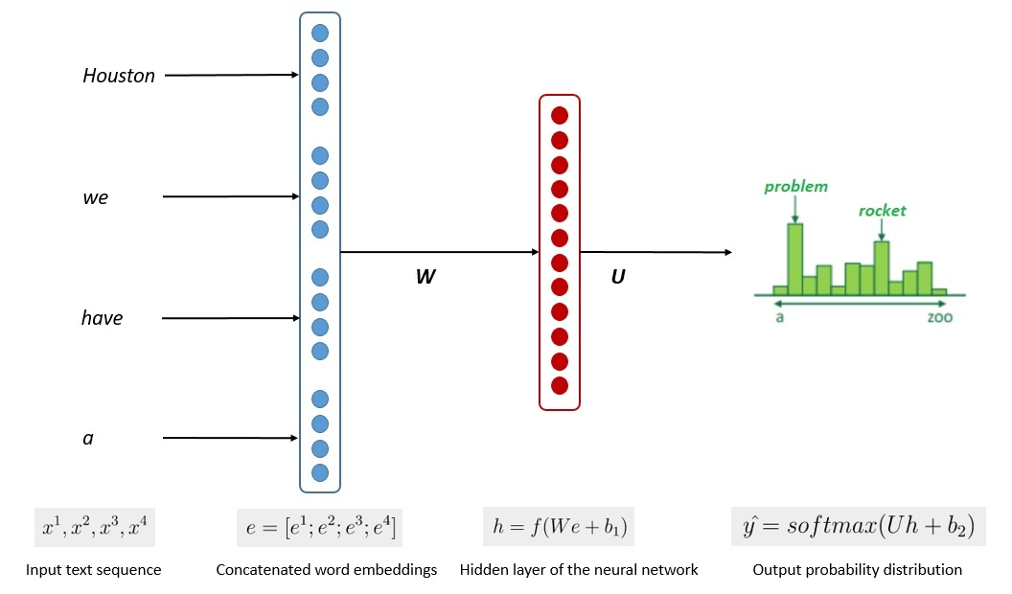
How Large Language Models Work
What Problem Do LLMs Actually Solve?
Reveal limits of human assumptions
Show prediction as powerful mechanism
Test theories of mind and language
An
eagle
is
a
very
bird
Notes:
At their core, large language models are trained to perform one task: predict the next token in a sequence of text.
The model sees a string of words or subwords and assigns probabilities to what is most likely to come next.
This objective is deceptively simple, but language is richly structured, so solving it well requires capturing syntax, semantics, and discourse patterns.
This means LLMs learn much more than surface-level associations when optimizing for prediction accuracy.
This task forces the model to internalize patterns of grammar.
To predict the next word in a sentence, the model must learn agreement, ordering, and the dependencies that connect distant parts of a phrase.
It discovers these features implicitly, not through explicit rules but by minimizing prediction error across enormous text corpora.
In this sense, the learning process resembles earlier material we covered on distributed representations and learned feature hierarchies.
Prediction also requires the model to develop approximate semantic knowledge.
If a sentence begins with “The doctor examined the…,” predicting the next tokens requires understanding roles, contexts, and common continuations.
The model learns associations among words, topics, and events simply because these relationships support accurate next-token predictions.
This leads to behavior that resembles understanding, despite being grounded in pattern learning rather than explicit reasoning.
This predictive objective helps explain both the strengths and limitations of LLMs.
They are excellent at tasks that align with language patterns but struggle
when deep reasoning or real-world grounding is needed.
Understanding this training goal clarifies why LLMs excel at fluency and generalization
yet can fail unexpectedly at tasks requiring external reference or causal inference.
Grasping this fundamental objective prepares us to examine the architectures that support it.

Slide 3
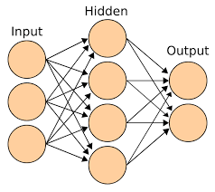
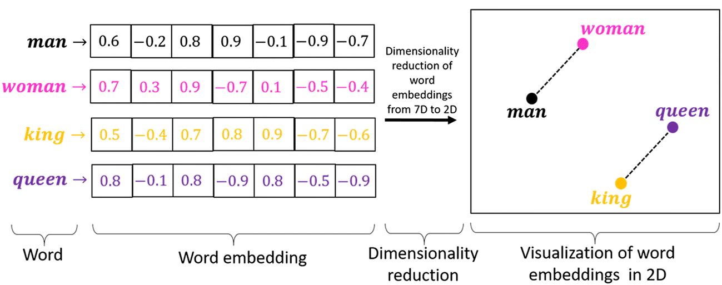
What We Can Learn from LLMs
What LLMs Actually Learn
Statistical structure of language
Correlations support fluent output
Meaning emerges through patterns
Hidden Unit Activations
Notes:
LLMs learn by absorbing the statistical regularities of the text they are trained on.
Through next-token prediction, they internalize which words co-occur, which syntactic forms follow one another, and which semantic relationships are likely in different contexts.
They do not learn facts in a symbolic sense; instead, they encode distributed patterns that correlate with real-world knowledge.
This statistical grounding allows them to generate text that often appears meaningful and informed.
Because they analyze billions of sentences, LLMs build high-dimensional representations where similar contexts cluster together.
Words referring to related concepts—animals, tools, emotions—tend to occupy nearby regions in the embedding space.
Syntactic categories also cluster naturally, reflecting part-of-speech distinctions without being explicitly taught.
These emergent structures show how much linguistic organization can arise purely from statistical learning.
LLMs also learn higher-order patterns that go beyond simple co-occurrence.
They capture discourse cues, pragmatic conventions, narrative structures, and stylistic patterns because these regularities improve prediction accuracy.
This is why they can summarize documents, translate languages, or answer questions using only the patterns learned from text.
Even without explicit goals or grounding, the structure of language itself encodes a great deal of information.
Still, the knowledge that LLMs acquire is fundamentally different from human conceptual understanding.
They lack perception, embodied experience, causal reasoning, and the direct grounding that humans use to link words to the world.
Their “understanding” is an emergent product of pattern learning, not a model of lived experience.
Recognizing this gap helps us appreciate both the strengths and the limitations of LLMs, setting up the next slide on their capabilities.

Slide 4
What We Can Learn from LLMs
Fluency & Coherence
Generalization From Patterns
Long-Range Context Handling (due to attention)
Rapid Task Adaptation (via prompting)
Strengths of LLMs
Fluent across many domains
Adapt quickly via prompting
Handle long-range patterns and structure well
Notes:
LLMs excel at generating fluent, coherent text across an extraordinary variety of topics.
Because they encode broad statistical patterns of language, they can answer questions, summarize documents, translate text, and mimic stylistic conventions with little or no task-specific training.
This versatility emerges directly from large-scale pretraining, giving them a wide base of linguistic competence.
Few other AI systems have achieved this level of domain generality.
LLMs also adapt quickly to new tasks through prompting.
Rather than retraining the model, users can provide examples or instructions that guide behavior at inference time.
This flexibility makes LLMs feel interactive and intelligent, even though they are not changing their internal weights during use.
Prompting essentially harnesses the latent structure already present in the model’s representations.
Another major strength is their ability to integrate long-range context.
Transformers can access information from thousands of tokens at once, allowing them to track discourse structure, maintain topic continuity, and follow complex instructions.
This contrasts sharply with earlier models that lost information over long sequences.
LLMs therefore perform especially well in tasks that require integrating or transforming large spans of text.
Finally, LLMs are surprisingly robust in their ability to generalize within the domain of written language.
They handle spelling variation, incomplete sentences, ambiguous queries, and stylistic shifts with ease.
This robustness reflects the breadth of patterns encoded during pretraining and the depth of the internal representations.
With these strengths in mind, we now turn to the limitations of LLMs and what they reveal about human cognition.

Slide 5
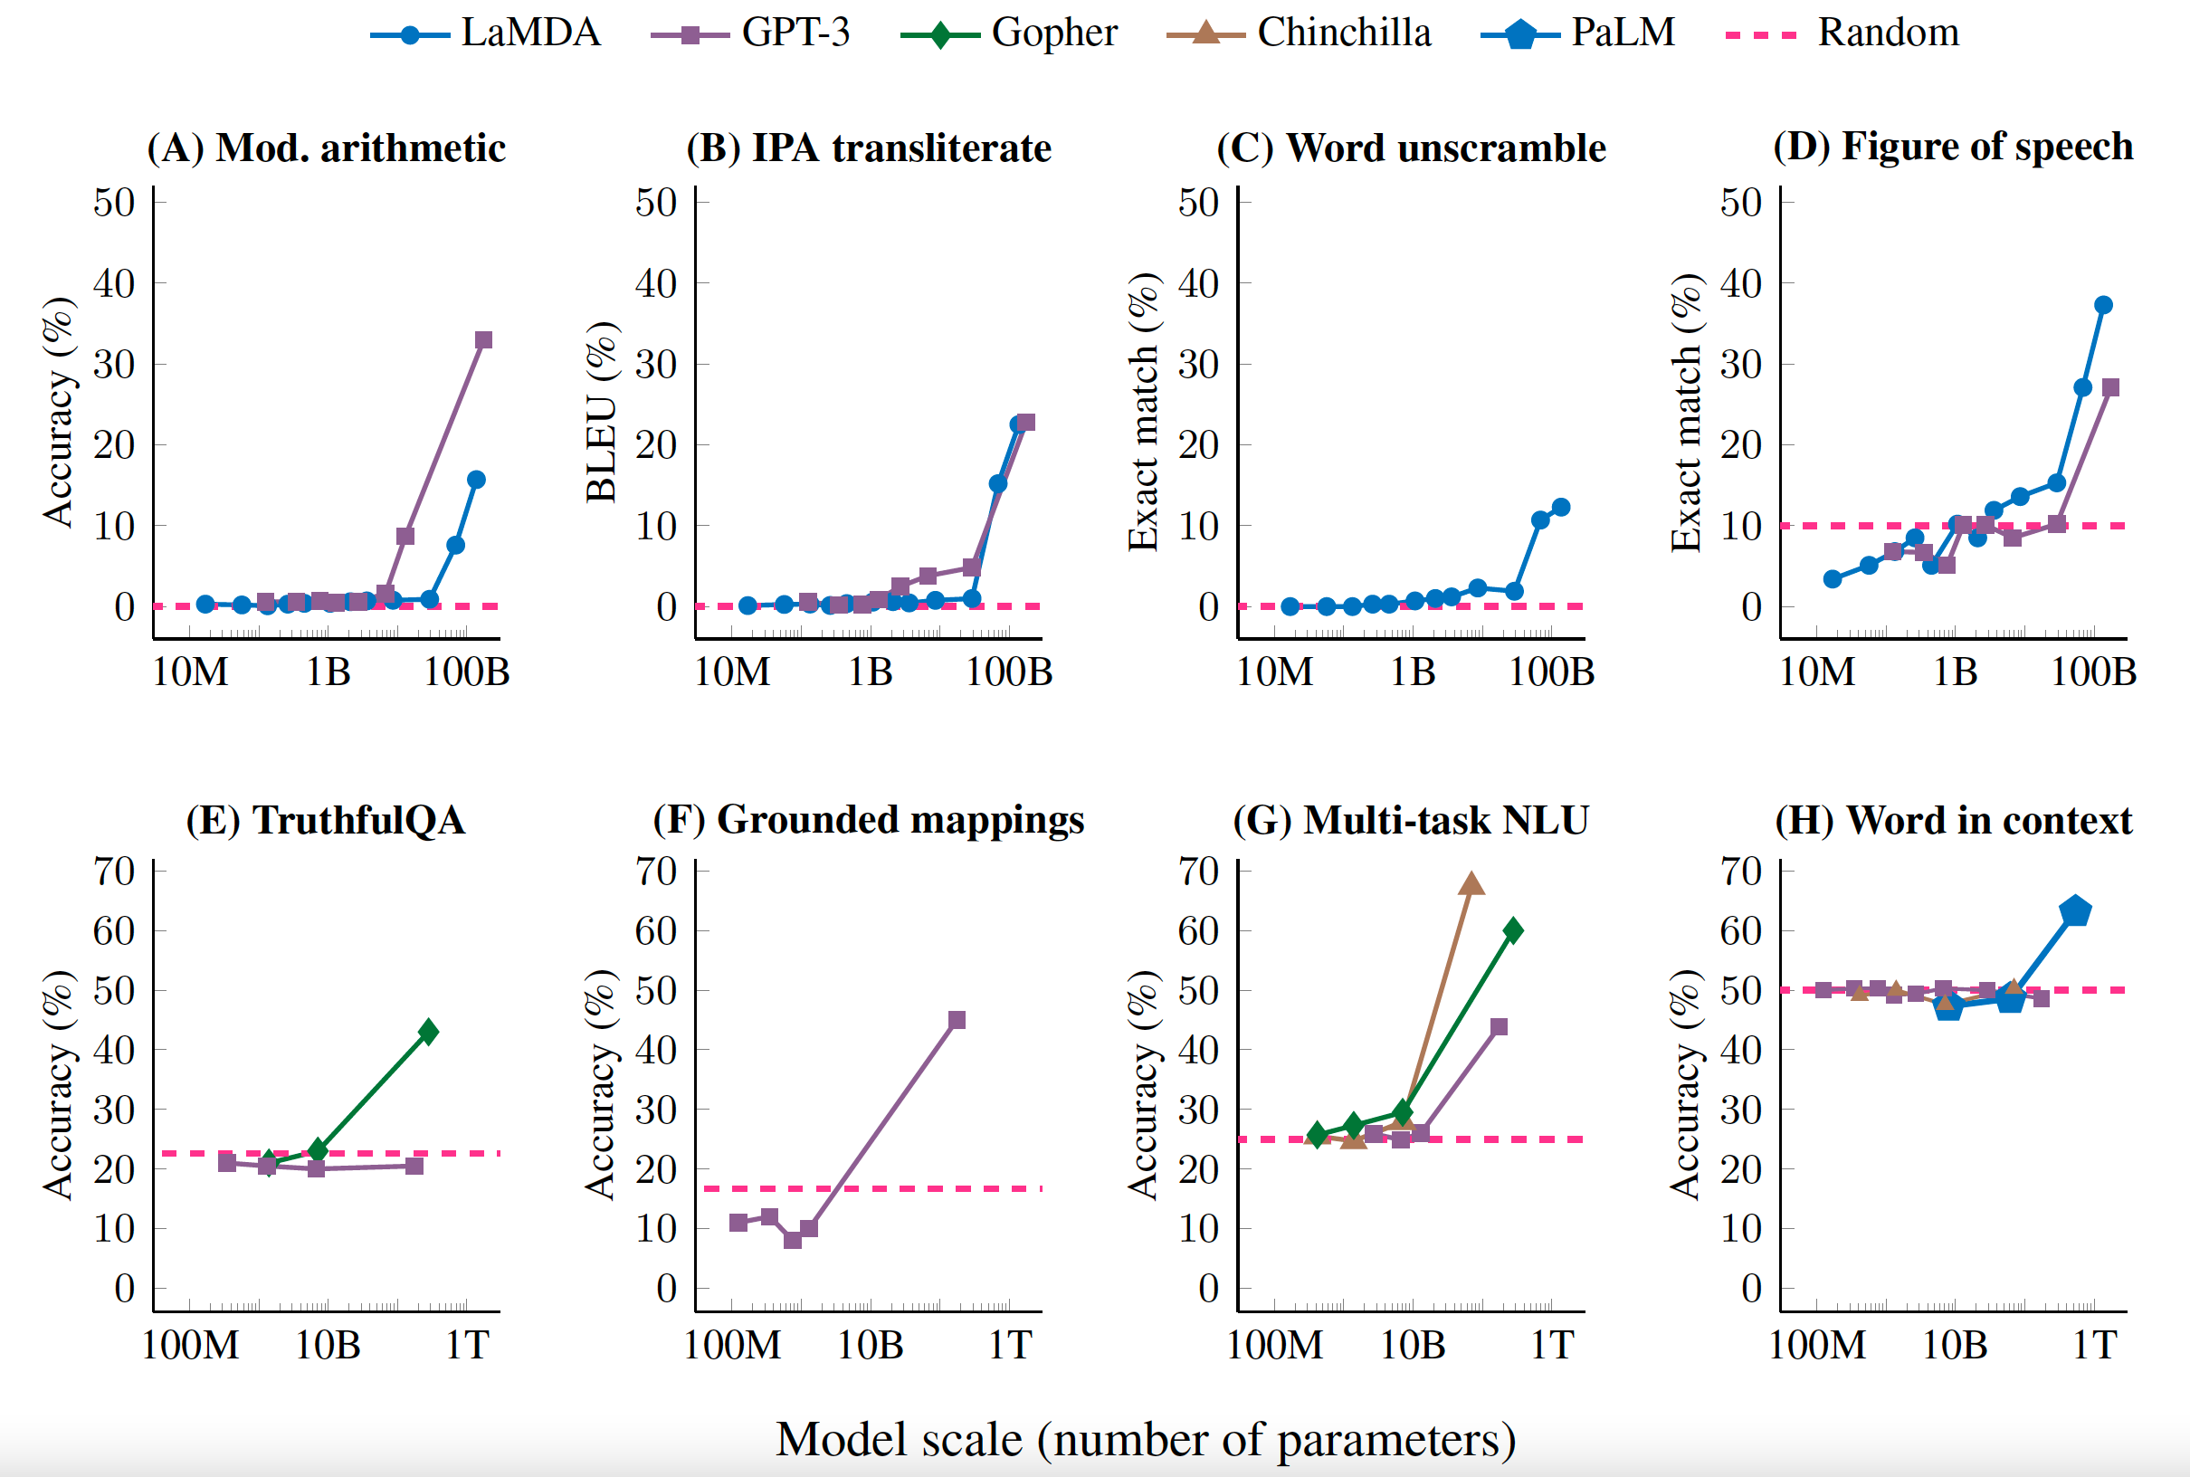
What We Can Learn from LLMs
Emergent Abilities
New skills appear at scale
Small models lack these patterns
Not explicitly programmed or taught
Notes:
One of the most striking findings in modern AI is that certain abilities emerge only once models reach a critical scale.
Smaller models perform well on basic language prediction but fail on tasks requiring multi-step reasoning, analogies, arithmetic-like operations, or complex instructions.
At larger sizes, these same models suddenly begin to succeed at tasks that were never explicitly part of their training objective.
These qualitative shifts prompted the field to take scaling seriously as a mechanism for new capabilities.
Emergent abilities are usually measured by examining abrupt improvements on benchmark tasks.
For example, a model may answer no multi-step reasoning questions correctly at one size, then perform competently after crossing a particular parameter threshold.
The architecture has not changed—only its capacity and exposure to data.
This suggests that certain patterns are only representable once the internal space of the model becomes large and structured enough.
These emergent patterns raise deep questions about complexity and abstraction in learning systems.
It is tempting to interpret these jumps as evidence of new cognitive mechanisms, but they likely reflect improvements in representational richness and error smoothing.
The model becomes better at tracking long-range dependencies, stabilizing internal representations, and leveraging subtle statistical cues.
In essence, increased scale reorganizes what kinds of patterns are discoverable within the same objective function.
Importantly, emergence does not imply human-like reasoning or understanding.
The model’s apparent reasoning may still be brittle, dependent on surface cues, or vulnerable to adversarial phrasing.
But emergent abilities show that simple learning objectives can support surprisingly complex behaviors once the representational machinery is powerful enough.
This creates both optimism and caution as we consider what LLMs can—and cannot—tell us about cognition.

Slide 6
What We Can Learn from LLMs
No Grounding in the World
No Causal Model / Fragile Reasoning
No Goals or Agency / Pragmatic Failures
Limitations of LLMs
Lack grounding in perception
Weak causal reasoning abilities
Pragmatics often breaks down
Notes:
Despite their impressive fluency, LLMs face fundamental limitations that become clear once we ask them to do more than pattern continuation.
Because they learn only from text, they have no perceptual grounding—no direct access to physical objects, spatial layouts, or embodied experience.
This makes concepts that humans learn through action and perception difficult for them to represent accurately.
They can describe the world in detail, but they cannot experience it.
LLMs also struggle with causal reasoning.
They are excellent at identifying correlations in text but lack direct knowledge of how actions lead to outcomes in the world.
This leads to errors when tasks require inferring hidden causes, predicting consequences, or distinguishing plausible possibilities from impossible ones.
Their reasoning is often associative rather than generative or explanatory.
Pragmatic understanding—the ability to infer intentions, norms, and context-sensitive meaning—is another major limitation.
Humans use shared background knowledge, social cues, and real-world expectations to interpret utterances.
LLMs rely instead on textual patterns, which makes them vulnerable to misleading phrasing, ambiguous contexts, or adversarial prompts.
This explains why they sometimes produce confident but nonsensical or inappropriate responses.
These limitations are not incidental; they reflect the boundaries of what next-token prediction over text can achieve.
Recognizing these gaps helps us identify which aspects of human cognition cannot be captured by current LLM architectures.
They also motivate the questions we turn to in Lecture 4: What does it mean to understand language? What cognitive mechanisms are missing from LLMs? And what can these models teach us about the human mind precisely because of where they fail?

Slide 7
Discussion Question:
What does it mean to “memorize” an experience?
Which/how much of your knowledge is “memorized”
What would count as evidence of memorization in a human? In an LLM?

Slide 8
What We Can Learn from LLMs
Are LLMs Just Memorizing Their Training Data?
Some memorization is inevitable
But most outputs are generalized
Interpolation ≠ copying
Mode | Definition | Example Output | Why It Happens
Memorization | Model reproduces text seen many times during training. | “To be, or not to be…” (nearly verbatim) | Extremely frequent or unique sequences dominate prediction; safest way to reduce loss is to store them closely.
Generalization | Model produces new, correct responses by interpolating across learned patterns. | Prompt: “345 + 257 = ?” → “602” (unseen problem, correct). | Rich, consistent patterns allow the model to infer underlying structure (e.g., arithmetic, analogies).
Hallucination | Model invents plausible but false content when statistical constraints are weak. | Prompt: “List Marie Curie’s three children.” → Produces fabricated names. | Sparse, inconsistent, or absent training data leads the model to fill gaps with the most likely continuation.
Notes:
Many people worry that LLMs simply repeat their training data, but the reality is more complex.
All large models do memorize some examples, particularly rare or highly repeated sequences, because prediction error drives them toward storing patterns verbatim when abstraction is impossible.
However, most of what LLMs produce is novel, formed by generalizing across countless overlapping contexts.
Their outputs typically reflect interpolation across statistical structure, not exact retrieval.
This distinction is clearer in controlled evaluation.
Researchers can test models on problems or sentences never seen during training, and LLMs routinely produce correct or reasonable continuations.
Arithmetic interpolation studies, analogy tests, and synthetic distributions show that models learn functions, not just strings.
Yet, when the model encounters highly specific or unique phrases (such as snippets of poetry or personal names), occasional verbatim recall does occur.
This is expected for any system trained to minimize prediction error over a massive corpus.
Importantly, generalization depends on the statistical richness of the input.
When the training data contains many similar examples, the model forms smooth, flexible abstractions.
When examples are sparse or unusual, the model has little choice but to store specific forms more directly.
This is a predictable tradeoff in any learning system, human or artificial.
Finally, the question of memorization reveals something important about the architecture.
Transformers do not explicitly store training items; they store weight adjustments that encode patterns across contexts.
When behavior looks memorized, it is often the result of extremely strong statistical signals in the data rather than a dedicated memory mechanism.
Understanding this helps frame hallucination, which emerges when those signals are weak or conflicting.

Slide 9
What We Can Learn from LLMs
A
X
Why LLMs “Hallucinate”: The Flip Side of Non-Memorization
Prediction without grounding
Gaps → plausible inventions
Same mechanism, opposite outcome
B
Y
C
Z
?
Prompt / Situation | Model Output | Pattern Being Extended | Hallucination Likelihood
“Write a biography of Marie Curie’s son.” (she had no sons) | Invents a son’s name and career | Filling schematic “biography template”: family → childhood → career | High — strong template, weak factual constraints
“Summarize this scientific abstract” | Coherent summary that preserves key points | Captures rhetorical + semantic regularities in academic writing | Low — strong textual evidence anchors predictions
“What is the capital of France?” | Correct: “Paris” | Highly stable factual pattern in training data | Very low — dense, consistent data
“Provide citations for this claim: Dogs invented calculus.” | Produces fabricated but plausible-looking citations | Academic style templates: author → year → title | High — learned form, not fact-checking
“Continue this partially incorrect math solution.” | Confidently extends the incorrect reasoning | Extends local arithmetic or algebraic pattern without global verification | Moderate — strong local pattern, weak global structure
“Translate this rare dialect sentence into English.” | Nonsense but grammatical output | Applies dominant-language patterns to unfamiliar forms | High — sparse data → guesses based on nearest neighbors
Notes:
Hallucination occurs when a model produces fluent, confident statements that are not factually correct.
This behavior is not a bug in the usual sense; it is an inherent feature of a system trained only to predict the next token, without grounding in truth, perception, or verification.
When the model encounters a context with insufficient statistical constraints, it fills in the gap with the most plausible continuation.
This makes hallucination the natural counterpart of generalization.
Hallucinations also occur when the model over-generalizes patterns that usually—but not always—hold in the training data.
For example, if biographies typically contain birth years, the model might invent one when none exists.
If medical summaries usually include a diagnosis, it may fabricate one to satisfy the expected structure.
These errors arise from pattern extension, not deception or intent.
The flip side becomes clear when comparing hallucination to memorization.
When statistical signals are extremely strong (e.g., highly repeated phrases), the model drifts toward memorization.
When statistical signals are weak, inconsistent, or missing, the model drifts toward hallucination.
Both behaviors emerge from the same learning principle: the model must predict something, even when the data provides little guidance.
Humans also produce “hallucinations” in this looser sense—we confabulate, misremember, or fill in gaps with schema-consistent details.
But humans can check their guesses using perception, reasoning, memory, or external validation.
LLMs cannot: they lack grounding, causal reasoning, and any mechanism for truth-tracking.
This makes hallucination a structural feature of LLMs and a key limitation for using them as models of human understanding.

Slide 10
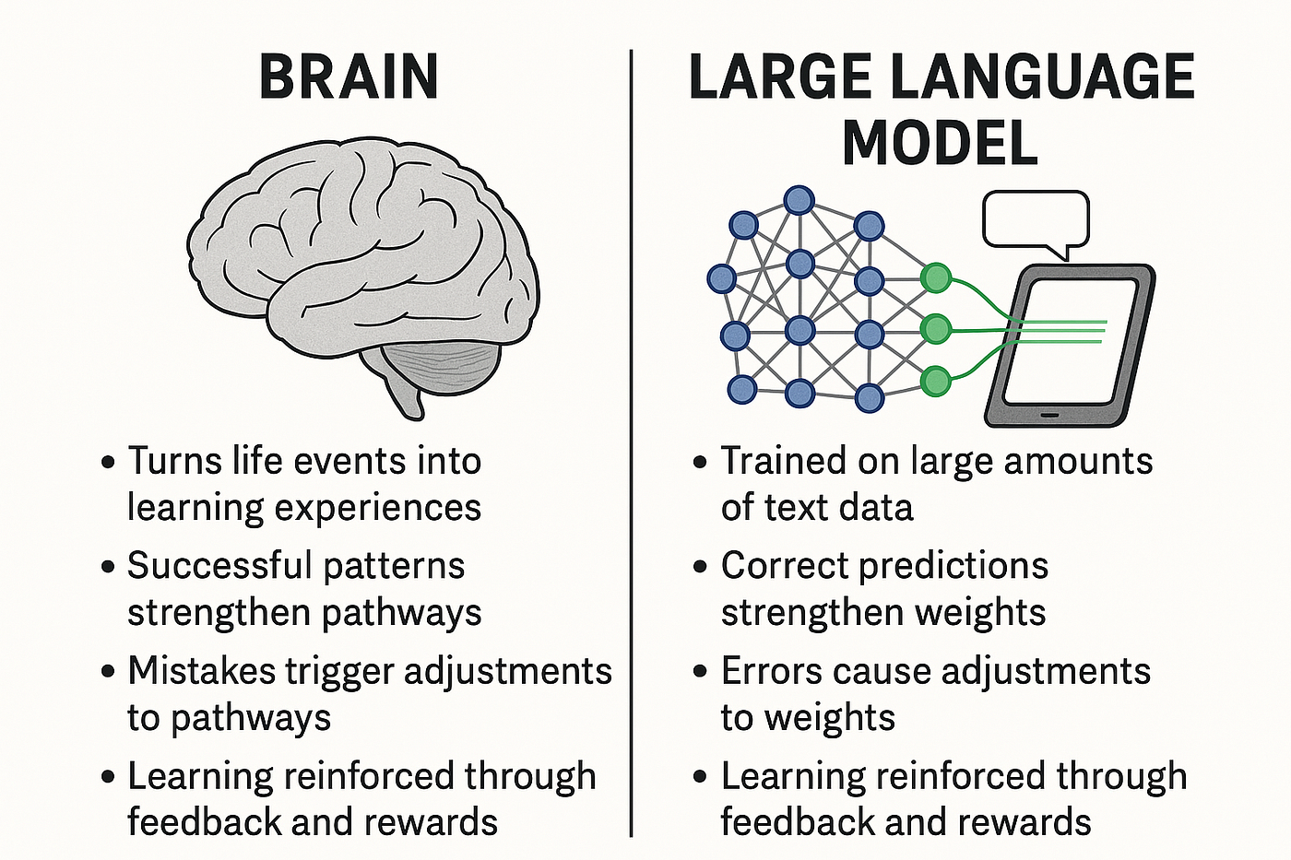
What We Can Learn from LLMs
The Central Puzzle: Do LLMs Understand?
What does “understanding” mean?
Why performance ≠ comprehension
How should we test understanding?
grounded in perception
goals & agency
causal models
persistent beliefs
fluent language
predictive structure
local coherence
learned associations
Notes:
The symbol grounding problem asks how words—or any internal representations—acquire meaning in the first place.
A definition cannot simply point to another definition; eventually some symbols must connect to perception, action, or experience.
Humans ground words through embodied interaction with the world, long before they see written language.
This grounding provides the scaffolding for everything else we call “understanding.”
LLMs, by contrast, learn entirely from text.
They build associations between word forms without ever encountering the physical objects, sensory experiences, or actions that those words refer to.
From a grounding perspective, this means their representations may be rich but still disconnected from real-world reference.
This raises the question of whether distributional learning alone can ever yield fully grounded semantics.
Grounding also matters because much of human language depends on shared perceptual context.
When we say “that one,” “over there,” or “it’s too hot,” we rely on a common world we can jointly attend to.
LLMs do not share this world; they cannot look, point, or act.
So they must approximate grounding with patterns in text, which sometimes works surprisingly well—and sometimes fails in predictable ways.
Finally, grounding plays a major role in theories of cognitive development.
Infants learn word meanings by connecting sounds to perceptual, motor, and social cues.
If LLMs can approximate aspects of meaning without any of that structure, it forces us to rethink what grounding is really doing.
Today we’ll explore both the power and the limits of that text-only approach.

Slide 11

What We Can Learn from LLMs
The Symbol Grounding Problem
Words need real-world anchors
LLMs learn only from text
Why grounding matters for meaning
“Do you want a balloon?
Don’t let go, it might float away!”
Notes:
LLMs now produce language that looks thoughtful, informed, and conversational.
This raises the natural question: do they understand anything they say, or are they simply extending patterns in text?
Cognitive science has long distinguished between producing correct outputs and having genuine comprehension.
So our starting point is clarifying what kind of thing “understanding” is supposed to be.
One challenge is that “understanding” is a deceptively slippery concept.
Sometimes we use it to mean functional success—getting the right answer.
Sometimes we use it to mean having internal representations that track meaning in the world.
And sometimes we use it to mean consciously grasping concepts, which introduces another layer of complexity.
A second challenge is that high performance can make a system look like it understands, even when the underlying mechanism is very different.
Humans naturally interpret fluent behavior through an intentional lens, attributing beliefs or meaning where none may exist.
This cognitive bias makes it surprisingly hard to distinguish genuine comprehension from good pattern-matching.
So part of today’s work is learning to resist that instinct and examine the mechanisms more carefully.
Finally, we have to ask: what would actually count as evidence of understanding?
Should we rely on behavioral tests, like the Turing Test?
Should we look at internal representations and compare them to cognitive models?
Or should we consider grounding, causation, embodiment, and social interaction as necessary conditions?

Slide 12
What We Can Learn from LLMs
Distributional Meaning: How LLMs Capture Semantics
Meaning from linguistic context
Embeddings cluster related ideas
Surprising successes without grounding
Notes:
One of the strongest arguments for LLM-style semantics is the distributional hypothesis:
“You shall know a word by the company it keeps.”
By predicting words from surrounding context, LLMs learn rich patterns of usage that often correspond to conceptual categories.
This allows them to approximate aspects of meaning purely from statistical structure.
This statistical learning creates semantic embeddings—high-dimensional vectors that cluster similar concepts together.
Words like “cat,” “dog,” “hamster,” and “animal” end up in nearby regions of the model’s representational space.
More abstract relationships—gender, tense, size, emotional valence—also emerge as geometric patterns.
These clusters arise without explicit supervision, just from the pressure to predict text accurately.
Distributional semantics also explains why LLMs succeed on many meaning-based tasks.
They can answer factual questions, paraphrase sentences, translate languages, and detect synonyms because these tasks reflect regularities in how words co-occur.
Even tasks like analogy-making or sentiment detection come “for free” from the structure of text.
To many researchers, this suggests that linguistic usage contains far more semantic information than previously assumed.
Still, this kind of meaning is incomplete.
Distributional patterns capture how words relate to one another within language, not how they connect to perception or the physical world.
LLMs can form subtle semantic distinctions but still fail at grounded tasks requiring real spatial, causal, or embodied knowledge.
Understanding where distributional meaning succeeds—and where it falls short—sets up the contrast for the next slide.

Slide 13
What We Can Learn from LLMs
Type of Challenge | Example Prompt / Task | Why Text-Only Distribution Is Stretched
Fine-grained physical reasoning | “A trophy doesn’t fit into a suitcase because it is too small. What is too small?” | Need a mental model of relative sizes; linguistic patterns help, but many variants require robust intuitive physics.
Counterfactual & causal structure | “If the match had not been lit, would the house have burned down?” | Text encodes correlations, but causal direction and counterfactual dependence are underdetermined by co-occurrence alone.
Embodied spatial perspective | “Turn the book so the picture faces me. Which way is the top now?” | Requires a first-person frame of reference and mentally rotating objects—something not present in text statistics.
Pragmatic inference & implicature | “Wow, that was really helpful,” said after someone obviously failed to help. | Sarcasm and implicature depend on shared social context, not just literal word use; distributional cues only approximate this.
Low-frequency, high-stakes distinctions | “Which of these mushrooms is safe to eat?” with two rare Latin names | Text contains labels, but not enough grounded evidence to safely distinguish; model will interpolate from weak, noisy patterns.
Experiential qualities (qualia) | “Explain what red looks like to someone blind from birth.” | Distribution gives you relational facts (“red is like…”) but not the phenomenal content; there’s nothing to ground in experience.
Where Distributional Meaning Breaks Down
Fails on grounding & perception
Struggles with pragmatics & context
Ambiguity reveals shallow understanding
Notes:
Even though LLMs capture many semantic regularities, they often fail when meaning depends on real-world grounding.
Words referring to physical properties—weight, size, spatial relations, or affordances—require perceptual experience to interpret correctly.
Text alone does not provide enough information to reliably encode these relationships.
As a result, LLMs sometimes give confident but incorrect answers about simple physical scenarios.
LLMs also struggle with pragmatics, where meaning depends on speaker intent, shared assumptions, or social cues rather than literal text.
Humans routinely use implicature, understatement, sarcasm, or indirect requests, drawing on social knowledge that models do not possess.
Because LLMs do not participate in conversation as social agents, they approximate pragmatics from patterns but fall apart in less common contexts.
This is especially visible in tasks requiring understanding of politeness, humor, or conversational implicature.
Another weak spot is ambiguity resolution, which often depends on grounding or causal reasoning.
For example, LLMs may fail to interpret pronouns correctly when the correct referent depends on physical reasoning (“The trophy didn’t fit because it was too big”).
Or they may misinterpret polysemous words when the correct meaning relies on situational knowledge rather than linguistic cues.
Humans draw on deep world models; LLMs rely on textual patterns that sometimes point the wrong way.
Finally, these limitations reveal something important about the nature of distributional semantics.
It captures meaning within language, but not meaning beyond language.
Human understanding blends linguistic experience with perception, action, causation, and shared social environments.
When language models fail in these ways, the failures illuminate what linguistic distribution alone cannot provide.

Slide 14
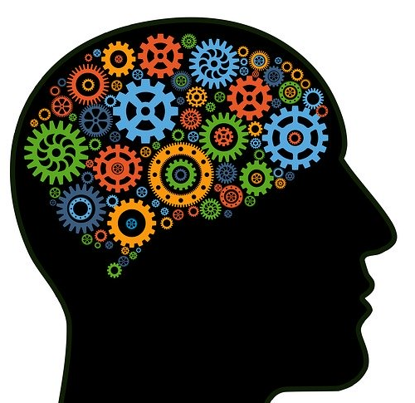
What We Can Learn from LLMs
Do LLMs Reason? Associative vs. Inferential Views
Pattern extension vs. true inference
Impressive but fragile reasoning
How humans and LLMs differ
Notes:
A central debate in cognitive science is whether LLMs perform something that counts as reasoning.
On one view, their successes at math problems, logic puzzles, and multi-step instructions show emerging inferential ability.
On another view, these successes arise from sophisticated pattern completion rather than genuine inference.
Understanding this distinction is key to evaluating what LLMs can tell us about human cognition.
Associative views argue that LLMs generate plausible reasoning chains because they have absorbed many examples of human explanations.
When asked to “think step by step,” they reproduce linguistic forms of reasoning without actually manipulating structured representations.
This explains why they sometimes produce logically coherent arguments and sometimes drift into contradictions or irrelevant steps.
Their chain-of-thought is a linguistic artifact, not a cognitive process.
Inferential views counter that reasoning does not require symbolic manipulation and may emerge from distributed representations.
Humans themselves use heuristics, analogies, and pattern-based shortcuts that resemble statistical inference more than formal logic.
Under this view, LLM reasoning looks fragile not because it’s fake, but because the models lack grounding, working memory, or stable intermediate representations.
The debate reflects deeper disagreements about what reasoning fundamentally is.
Where LLMs differ most from humans is in their systematicity and flexibility.
Humans can apply a learned rule to entirely new situations; LLMs often fail when surface features change or when examples fall outside the training distribution.
They also struggle with tasks requiring true variable binding, recursive reasoning, or causal explanation.
These contrasts highlight that LLM “reasoning” behaves impressively in-distribution but reveals its limits under stress.

Slide 15

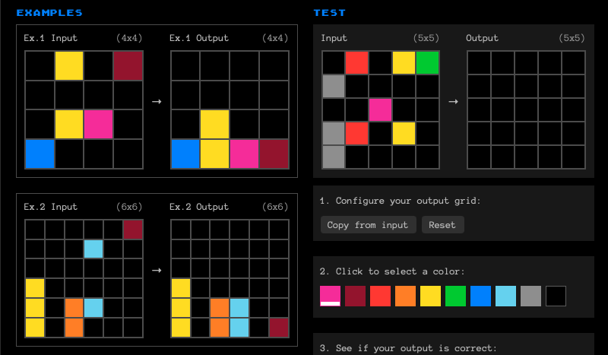
What We Can Learn from LLMs
Systematicity & Compositionality
Human thought is often combinatorial
LLMs struggle with systematic generalization
But human compositionality may be overstated
Notes:
Systematicity refers to the human ability to understand and generate an unbounded set of expressions from a finite set of components.
If you understand “the dog chased the cat,” you typically also understand “the cat chased the dog” and many related variants.
This generativity has traditionally been taken as evidence for structured, rule-like cognitive representations.
It captures a central intuition about how concepts combine flexibly across contexts.
Fodor and Pylyshyn’s critique held that neural networks cannot produce true systematicity because their representations are distributed rather than symbolic.
Under this view, connectionist models—and by extension LLMs—can approximate patterns but cannot encode abstract relational rules.
This argument has long shaped debates about the nature of thought and the requirements for genuine understanding.
Modern transformer models revive the debate by achieving partial systematic generalization at scale.
LLMs do show some compositional abilities, especially when the training distribution contains many examples illustrating a particular structure.
They can produce paraphrases, manipulate nested clauses, and solve some analogy-like tasks.
Yet they often fail when asked to apply rules to entirely novel combinations or domains—cases where systematicity should generalize most strongly.
These failures highlight that LLMs rely on association rather than stable, explicit rules.
But recent evidence suggests that humans themselves are not perfectly compositional, and may rely far more on statistical patterns, heuristics, and contextual inference than the classical view assumed.
People frequently misinterpret novel sentences, fail on unfamiliar syntactic forms, or misuse relational concepts outside familiar contexts.
This raises the possibility that compositionality, while real, may be situational rather than an all-purpose cognitive principle.
From this perspective, LLMs’ partial success—and partial failure—may actually mirror human cognition more closely than traditional symbolic theories predicted.

Slide 16
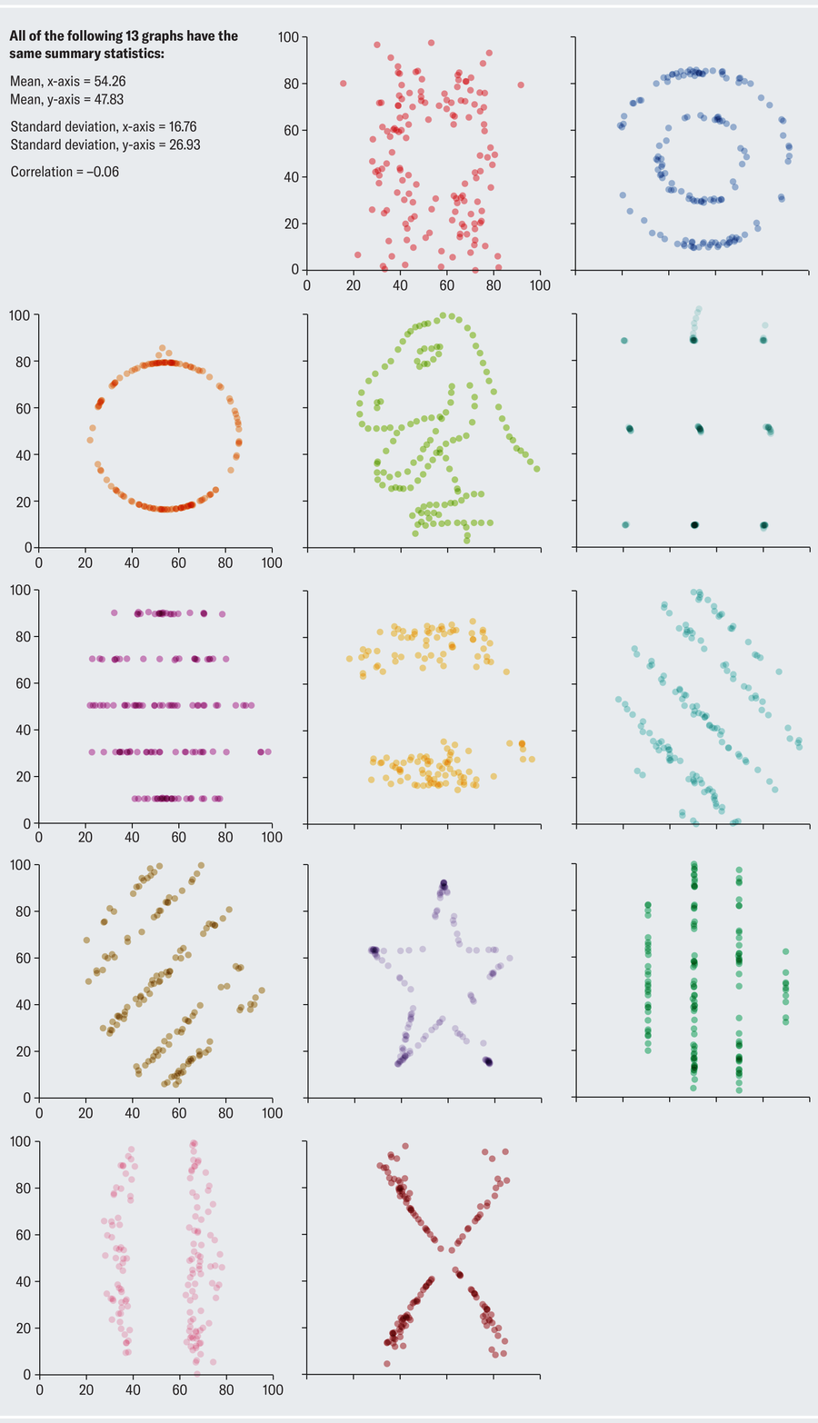
What We Can Learn from LLMs
Case Study: Causality & Commonsense Reasoning
Text alone lacks causal structure
LLMs imitate but don’t infer causes
Humans build causal models from experience
Notes:
Causal reasoning is one of the clearest domains where LLMs show both striking successes and deep limitations.
They can often talk as if they understand causes—describing why something happened or predicting an outcome.
But this apparent causal competence is built from patterns in text, not from interacting with the physical world.
Because text reflects correlations rather than mechanisms, LLMs frequently confuse association with causation.
The absence of real-world interaction means LLMs do not build the intuitive theories humans acquire through experience.
Children learn gravity by dropping things, learn volume by pouring water, and learn agency by acting on the world.
LLMs have never seen objects collide or liquids spill; they infer physical and social causality only indirectly through linguistic co-occurrence.
This makes their causal judgments brittle, especially for scenarios that are uncommon in text.
These limitations become obvious in tasks where inference requires more than verbal cues.
For example, LLMs may misjudge physical impossibilities, misunderstand time-ordering in causal chains, or fail to identify which variable in a scenario is the causal factor.
They often produce confident but contradictory explanations when asked to justify predictions.
In contrast, humans rely on richly structured mental models acquired through embodied interaction.
Despite these weaknesses, LLM failures in causal reasoning illuminate something important about human cognition.
They show how deeply our understanding depends on grounded experience, generative mental models, and intuitive physics—not just linguistic data.
At the same time, LLMs reveal how much causal information is embedded in language, given how far text-only systems can get.
This contrast helps clarify both the power and the limits of statistical learning as a route to understanding.

Slide 17
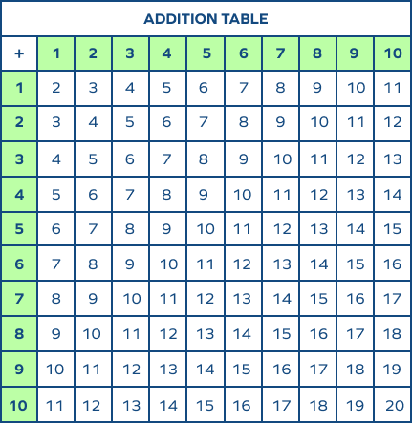
What We Can Learn from LLMs
Case Study: Arithmetic & Numerical Reasoning
LLMs outperform humans on basics
Not memorized—shows interpolation
But extrapolation breaks down
13
1045
3 + 4 = 7
3 + 5 = 8
3 + 6 = 9
2 + 4 = 6
2 + 6 = 8
2 + 5 = ?
2321312312312 + 23412412312 = ?
Notes:
Arithmetic provides an unusual perspective on LLM abilities because they often outperform humans on basic numerical tasks.
Most people cannot instantly add or multiply large five-digit numbers, but LLMs can do these operations fluidly in many cases.
This suggests that models learn reliable internal mappings between numerical symbols through exposure to text and examples.
It’s one of the rare domains where models seem more precise than human intuition.
Importantly, research shows that LLMs are not simply memorizing the answers to every arithmetic question they’ve seen.
Models demonstrate interpolation: they solve novel problems that fall within the numerical range or structural patterns present in training data.
This means LLMs have learned an approximate function that maps number sequences to answers.
Within familiar ranges, this function is surprisingly accurate.
But LLMs struggle with extrapolation, especially for numbers well outside their training distribution.
As the magnitudes grow, their internal approximation functions accumulate error, leading to increasingly incorrect results.
This is not surprising: they are fitting a very complex mapping using patterns extracted from text, rather than implementing exact symbolic algorithms.
This mirrors their broader difficulty with tasks requiring perfect generalization beyond training context.
Humans differ in both directions.
We struggle with large calculations unless we apply explicit, learned algorithms, and even then the process is slow and error-prone.
Yet humans can generalize these algorithms to arbitrarily large numbers because the steps are rule-based and scalable.
LLMs that succeed at algorithmic performance (e.g., when fine-tuned or tool-augmented) do so by learning or simulating similar stepwise procedures.

Slide 18
What We Can Learn from LLMs
Human Cognition Parallels & Divergences
Shared principles of prediction
Different learning conditions
Missing human mechanisms
Notes:
LLMs offer a concrete demonstration of how far predictive learning can go, and this mirrors certain theories in cognitive science.
Both humans and LLMs adjust internal representations based on prediction error, and both rely on distributed patterns rather than rigid symbolic rules.
This overlap helps us test ideas about language acquisition, representation, and generalization at a scale previously unimaginable.
However, these parallels should not obscure profound differences in how humans and models learn.
One major divergence is the learning environment itself.
Humans learn language through multimodal, social, embodied interaction, with dense cues from perception, joint attention, and action.
LLMs learn from static text divorced from real-world context, meaning, and sensory grounding.
This mismatch profoundly shapes what each system can represent and what kinds of mistakes they make.
Another divergence concerns memory and architecture.
Humans rely on working memory, hierarchical planning, long-term conceptual structures, and specialized brain systems for vision, motor control, and spatial reasoning.
LLMs rely on massive parallel context windows, static embeddings, and entirely text-based internal representations.
Their apparent reasoning emerges from statistical association, not from modular cognitive mechanisms.
Finally, humans have goals, beliefs, desires, and social motivations that guide learning and communication.
LLMs have none of these—they generate text based on statistical continuation, not intentional action.
Their outputs may appear purposeful, but the underlying system lacks agency, world modeling, or self-directed inquiry.
Recognizing these divergences prepares us to ask deeper questions about meaning, understanding, and intelligence in the next lecture.

