Slide 1


Employee Attrition Analysis for Frito Lay
Identifying Key Factors and Predictive Models
Jonathan A. Rocha
March 3, 2025
MSDS 6306: Doing Data Science

Slide 2
Executive Summary
Problem: High cost of employee turnover (50-400% of annual salary)
Approach: Data analysis and predictive modeling to identify at-risk employees
Key findings: Top 3 factors driving attrition
Results: Predictive model with >60% sensitivity and specificity
Value: Potential cost savings of approximately $5 million (69% reduction)

Slide 3
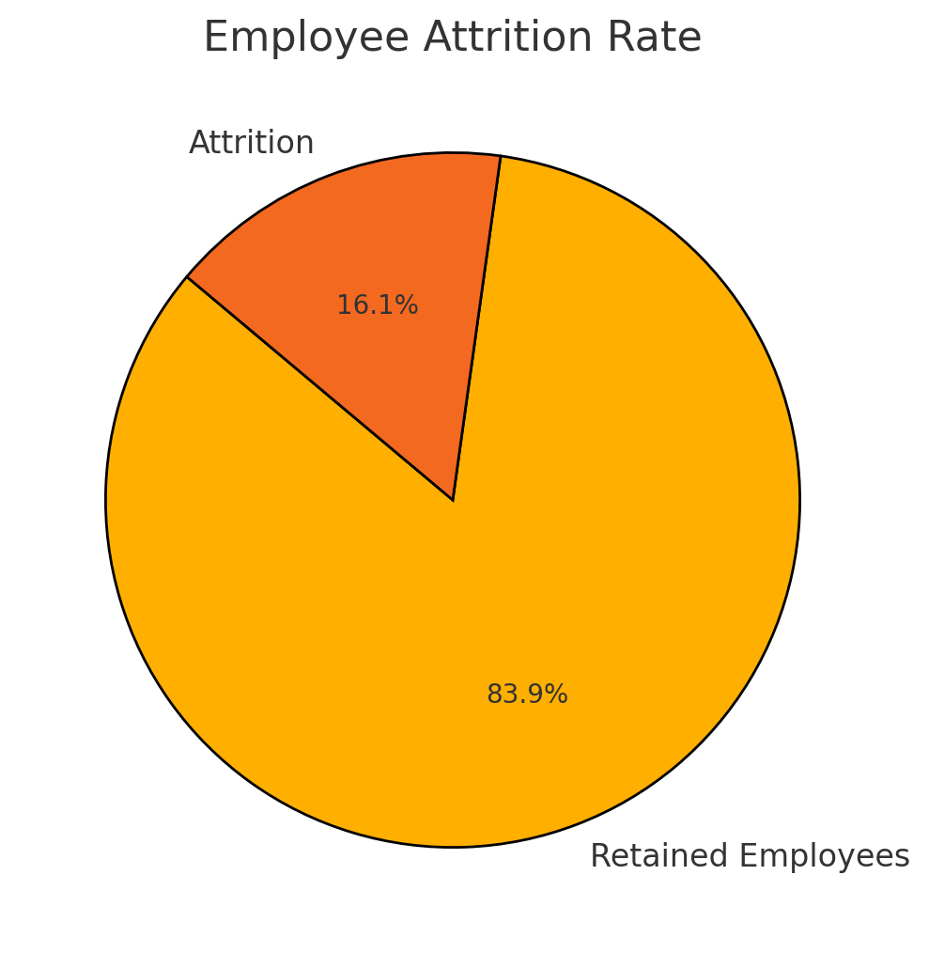
Attrition Overview
Overall attrition rate: 16.1% (140 of 870 employees)

Slide 4
Exploratory Analysis Approach
Data cleaning and preparation steps
Variables examined
Analysis methods
Brief note on feature engineering

Slide 5
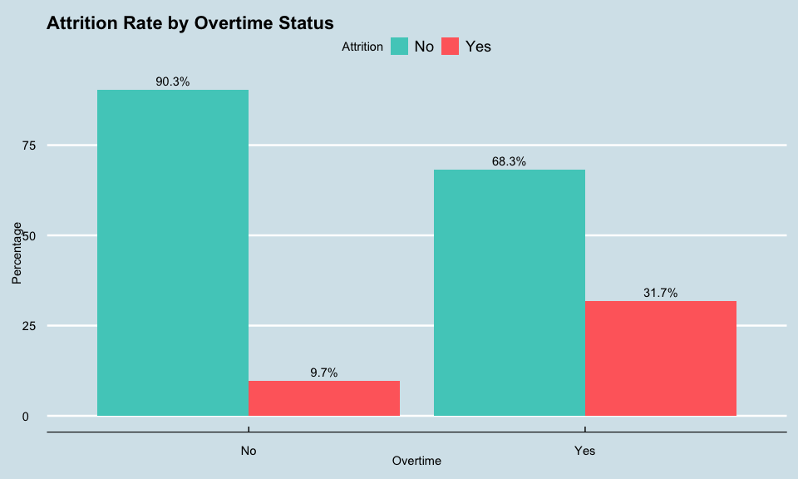
Top Factors Driving Attrition
Factor #1 - Overtime
31.7% attrition for employees working overtime vs. 9.7% for those who don’t
This represents a 3.3× higher attrition risk
The results suggest that employees who work overtime are at higher risk for attrition, regardless of role. More analysis is required, however, for a deeper understanding of the overtime and attrition relationship.

Slide 6
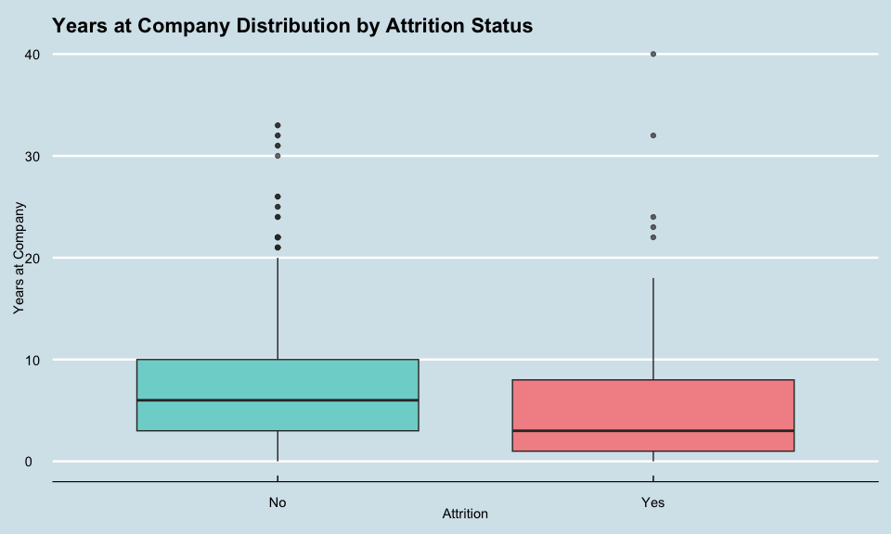
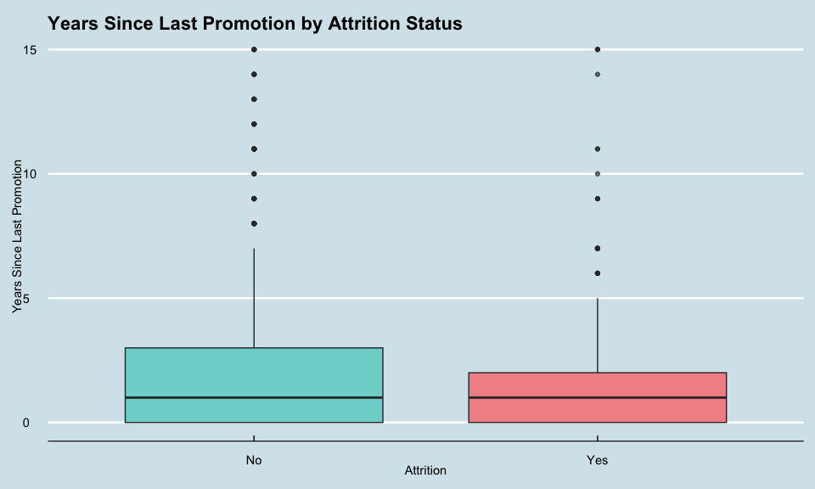
Top Factors Driving Attrition
These visualizations show the relationship between experience and attrition
Correlation analysis results (-0.167)
Less experienced employees are significantly more likely to leave
Factor #2 - Total Working Years

Slide 7
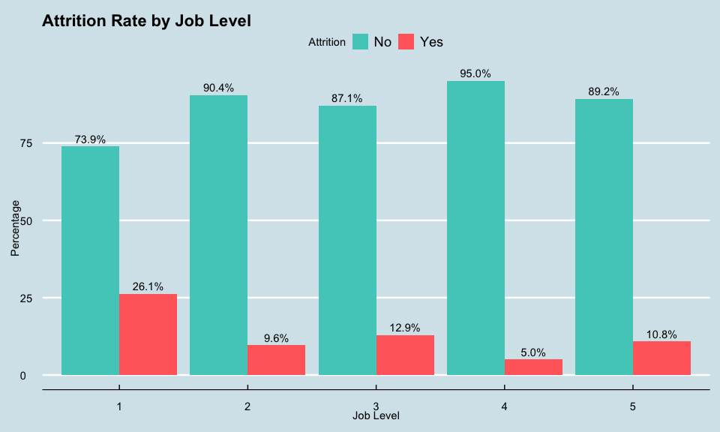
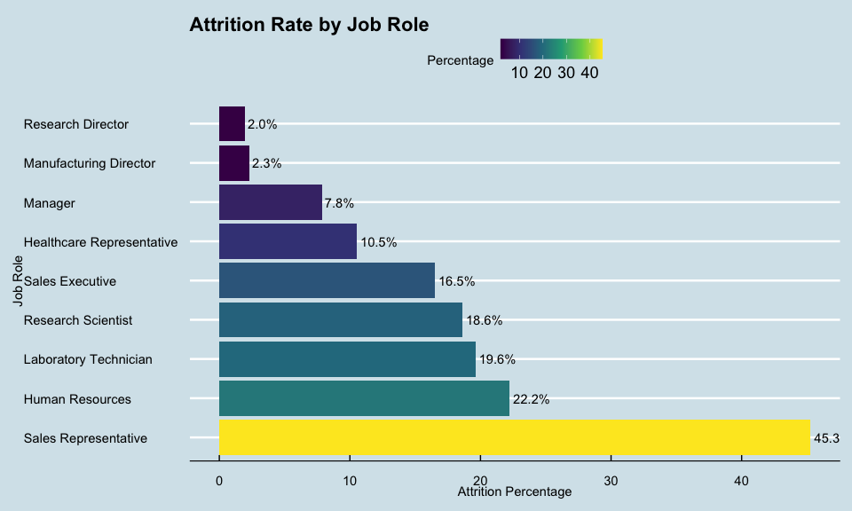
Top Factors Driving Attrition
These charts show the relationship between job level and attrition
Entry-level positions (Level 1) have 26.1% attrition vs. 5-10% at higher levels
Monthly income correlation with attrition (-0.155)
Factor #3 - Job Level/Income

Slide 8
Additional Insights
Marital status (singles have higher attrition)
Work-life balance (poor balance increases attrition)
Job roles (Sales Representatives have highest attrition at 45.3%)
Other notable factors:

Slide 9
Modeling Approach
Goal: Build models with at least 60% sensitivity and specificity
Data preparation: Train/test split, feature engineering
Models developed: KNN, Naive Bayes, Random Forest, Gradient Boosting
Optimization technique: ROSE for class imbalance, threshold adjustment

Slide 10
Modeling Approach
Model | Sensitivity | Specificity | Accuracy
KNN | 55.2% | 62.1% | 60.8%
Naive Bayes | 58.0% | 65.3% | 63.4%
Both models approach but don't yet meet our 60% sensitivity/specificity target
Naive Bayes currently showing better overall performance
Class imbalance (16% attrition vs 84% retention) affecting model sensitivity

Slide 11
Thank You / Q&A
For further questions or comments: jarocha@smu.edu
Link to repository used for analysis: https://github.com/jonx0037/ds6306-project

