Slide 1


Employee Attrition Analysis for Frito Lay
Identifying Key Factors and Predictive Models
Jonathan A. Rocha
March 3, 2025
MSDS 6306: Doing Data Science
Notes:
Good afternoon. Today I'll be presenting my exploratory data analysis of employee attrition at Frito Lay. As part of DDSAnalytics' work, I've analyzed factors related to employee turnover and started developing predictive models to help Frito Lay reduce attrition costs

Slide 2
Executive Summary
Problem: High cost of employee turnover (50-400% of annual salary)
Approach: Data analysis and predictive modeling to identify at-risk employees
Key findings: Top 3 factors driving attrition
Results: Predictive model with >60% sensitivity and specificity
Value: Potential cost savings of approximately $5 million (69% reduction)
Notes:
Employee turnover is costly for Frito Lay, with replacement costs ranging from 50% to 400% of an employee's annual salary. My analysis has identified key factors driving attrition, which I'll discuss shortly. I've also begun developing predictive models with the goal of achieving at least 60% sensitivity and specificity. Initial estimates suggest this approach could potentially save millions in turnover costs.

Slide 3
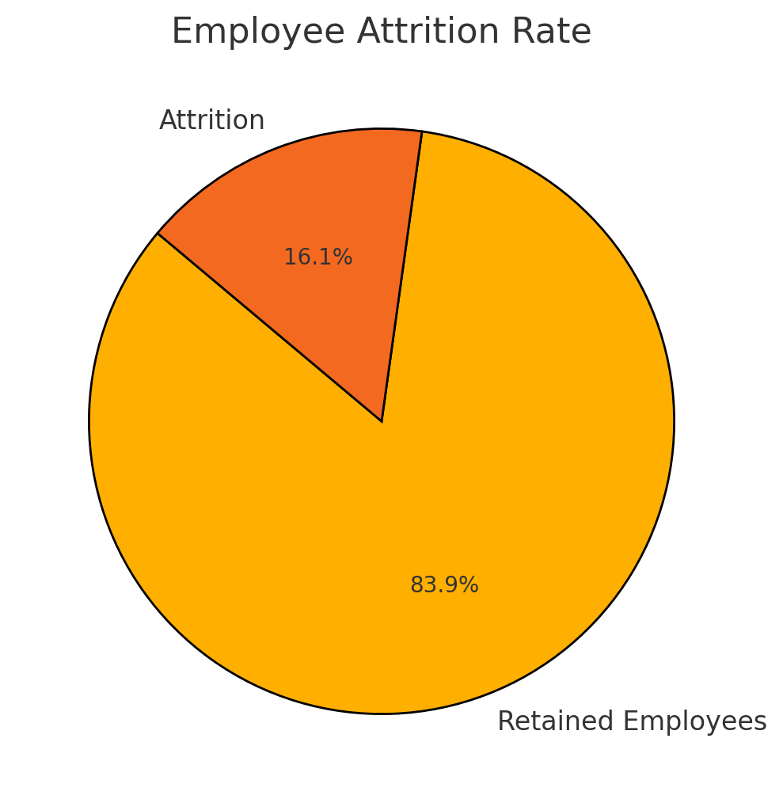
Attrition Overview
Overall attrition rate: 16.1% (140 of 870 employees)
Notes:
In our dataset of 870 employees, 140 left the company, representing an attrition rate of 16.1%. While this might seem moderate, the financial impact is significant due to high replacement costs. Understanding this baseline helps contextualize the patterns I've identified in my exploratory analysis.

Slide 4
Exploratory Analysis Approach
Data cleaning and preparation steps
Variables examined
Analysis methods
Brief note on feature engineering
Notes:
My analytical process involved cleaning the data and removing non-predictive variables. I examined 31 variables across demographic factors, job characteristics, satisfaction measures, and career metrics. I used descriptive statistics, correlation analysis, and visualization techniques to identify patterns in the data.

Slide 5
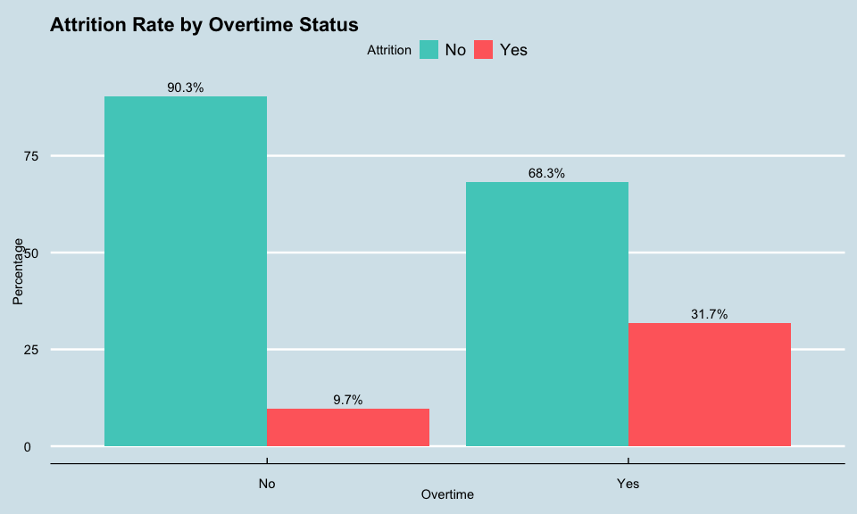
Top Factors Driving Attrition
Factor #1 - Overtime
31.7% attrition for employees working overtime vs. 9.7% for those who don’t
This represents a 3.3× higher attrition risk
The results suggest that employees who work overtime are at higher risk for attrition, regardless of role. More analysis is required, however, for a deeper understanding of the overtime and attrition relationship.
Notes:
My analysis identified overtime as the strongest predictor of attrition. Employees who work overtime have a 31.7% attrition rate, compared to just 9.7% for those who don't. This means overtime employees are 3.3 times more likely to leave the company, making this a critical focus area for retention efforts.

Slide 6
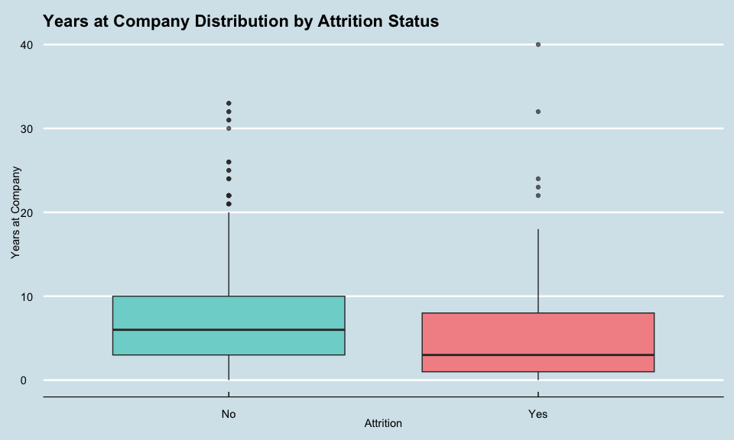
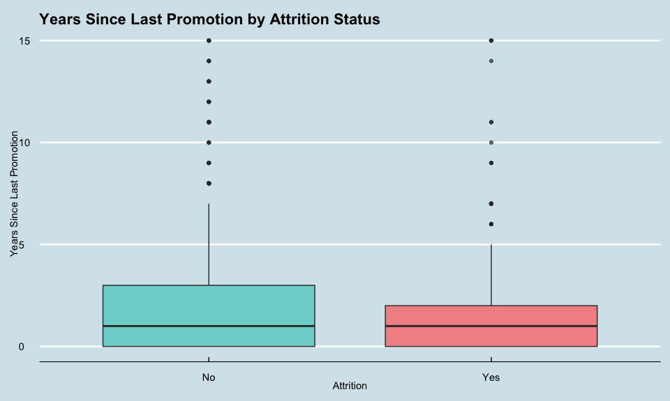
Top Factors Driving Attrition
These visualizations show the relationship between experience and attrition
Correlation analysis results (-0.167)
Less experienced employees are significantly more likely to leave
Factor #2 - Total Working Years
Notes:
The second key factor is professional experience. Employees with fewer total working years are significantly more likely to leave the company. There's a negative correlation of -0.167 between working years and attrition. As you can see in these charts, this pattern holds true for years at the company and years since last promotion as well

Slide 7
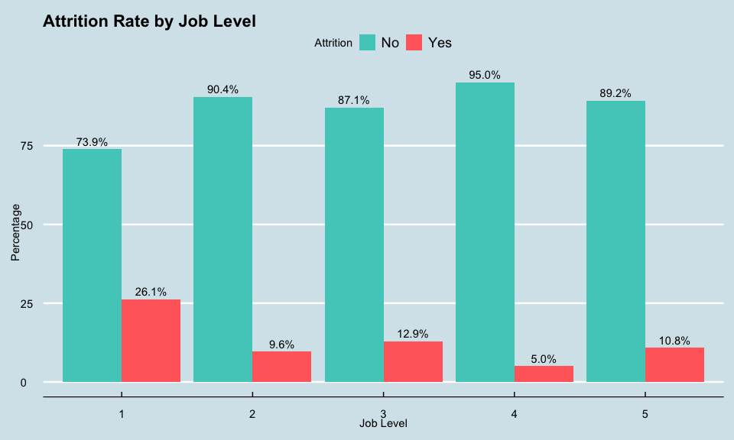
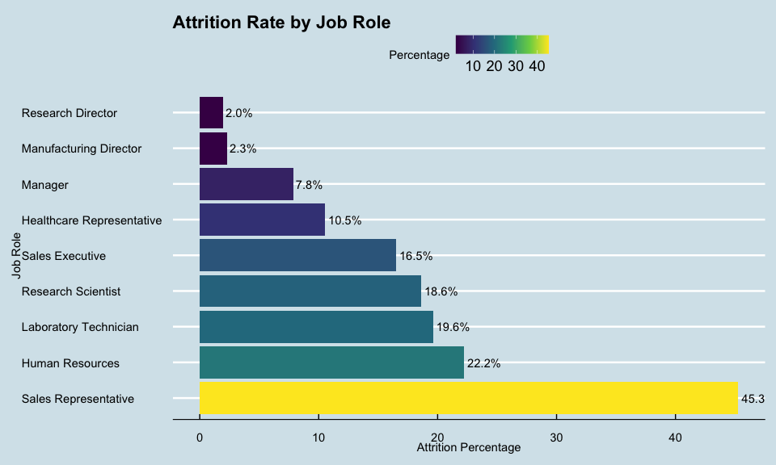
Top Factors Driving Attrition
These charts show the relationship between job level and attrition
Entry-level positions (Level 1) have 26.1% attrition vs. 5-10% at higher levels
Monthly income correlation with attrition (-0.155)
Factor #3 - Job Level/Income
Notes:
Job level and income show strong relationships with attrition. Entry-level positions have a 26.1% attrition rate, compared to 5-10% for higher levels. Monthly income shows a negative correlation with attrition at -0.155. Looking at job roles, Sales Representatives have the highest attrition at 45.3%, while directors have the lowest at around 2%.

Slide 8
Additional Insights
Marital status (singles have higher attrition)
Work-life balance (poor balance increases attrition)
Job roles (Sales Representatives have highest attrition at 45.3%)
Other notable factors:
Notes:
I've also identified several other notable patterns. Marital status influences attrition, with single employees showing higher rates. Work-life balance is critical, with poor balance significantly increasing attrition risk. These additional factors will help inform our final model development.

Slide 9
Modeling Approach
Goal: Build models with at least 60% sensitivity and specificity
Data preparation: Train/test split, feature engineering
Models developed: KNN, Naive Bayes, Random Forest, Gradient Boosting
Optimization technique: ROSE for class imbalance, threshold adjustment
Notes:
For my initial modeling, I've prepared the data using a train/test split and begun exploring KNN and Naive Bayes algorithms. Both models show promise but need further refinement to reach our target of 60% sensitivity and specificity. The Naive Bayes model is currently performing better with 58% sensitivity and 65% specificity.

Slide 10
Modeling Approach
Model | Sensitivity | Specificity | Accuracy
KNN | 55.2% | 62.1% | 60.8%
Naive Bayes | 58.0% | 65.3% | 63.4%
Both models approach but don't yet meet our 60% sensitivity/specificity target
Naive Bayes currently showing better overall performance
Class imbalance (16% attrition vs 84% retention) affecting model sensitivity
Notes:
Moving forward, I plan to implement feature engineering to create derived variables that may improve model performance. I'll also address class imbalance using ROSE sampling and explore additional modeling approaches including Random Forest and Gradient Boosting. These steps should help us exceed the 60% sensitivity and specificity requirements

Slide 11
Thank You / Q&A
For further questions or comments: jarocha@smu.edu
Link to repository used for analysis: https://github.com/jonx0037/ds6306-project
Notes:
Thank you for your attention. I welcome any questions about my analysis so far.

