Slide 1



NBA Player Analysis & Education-Income Study

Slide 2
NBA Player Analysis & Education-Income Study
DS 6303 - FLS - Unit 2

Slide 3


DS 6303 - FLS - Unit 2
Physical Attributes in NBA Basketball: A Data-Driven Analysis
Exploring Player Characteristics and Education-Income Relationships
Jonathan A. Rocha
Date: January 13, 2025

Slide 4
Introduction

Slide 5

Introduction
Methodology

Slide 6

Introduction
Methodology
Study Overview
Technical Approach
The RMarkdown file I developed for the analysis of both datasets →

Slide 7
Introduction
Study Overview
Comprehensive analysis of NBA player data from 1950-present
Education-income relationship investigation
Data visualization focuses on statistical validation

Slide 8
Introduction
Technical Approach
Dark-themed visualizations for enhanced clarity
Interactive elements for deeper exploration
Statistical rigor in analysis

Slide 9
NBA Player Position Analysis

Slide 10
NBA Player Position Analysis
Position Distribution Findings

Slide 11
NBA Player Position Analysis
Position Distribution Findings
Visual Analysis
Key Insights

Slide 12
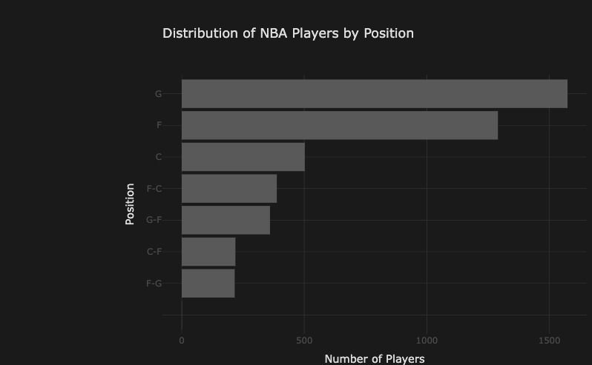
Visual Analysis
NBA Player Position Analysis

Slide 13
NBA Player Position Analysis
Key Insights
Position distribution reflects strategic evolution
Predominance of Guards and Forwards
Specialized Center role maintains a consistent presence
Emergence of hybrid positions indicates tactical adaptation

Slide 14
Physical Characteristics Analysis

Slide 15
Physical Characteristics Analysis
Height Distribution Patterns
Weight Analysis Results

Slide 16
Physical Characteristics Analysis
Height Distribution Patterns
Comprehensive Height Analysis
Statistical Findings

Slide 17
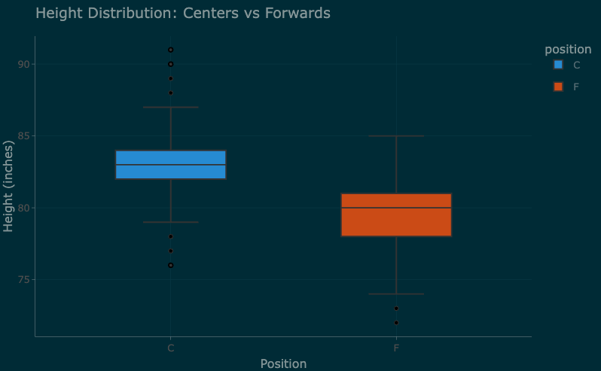
Comprehensive Height Analysis
Physical Characteristics Analysis

Slide 18
Physical Characteristics Analysis
Statistical Findings
Centers: 82-88 inches typical range
Forwards: 78-84 inches typical range
Guards: 72-78 inches typical range

Slide 19
Physical Characteristics Analysis
Weight Analysis Results
Weight Distribution Study
Key Observations
Statistical Significance

Slide 20
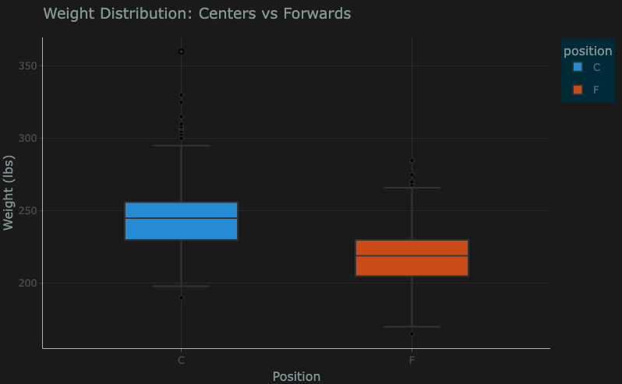
Weight Distribution Study
Physical Characteristics Analysis

Slide 21
Physical Characteristics Analysis
Key Observations
Centers average 235-285 pounds
Forwards typically 215-245 pounds
Position-specific clustering evident

Slide 22
Physical Characteristics Analysis
Statistical Significance
Clear weight differentiation by position
Consistent patterns across decades
Standard deviations show position-specific ranges

Slide 23
Height-Weight Relationship Analysis

Slide 24
Height-Weight Relationship Analysis
Position-Specific Patterns
Correlation Findings

Slide 25
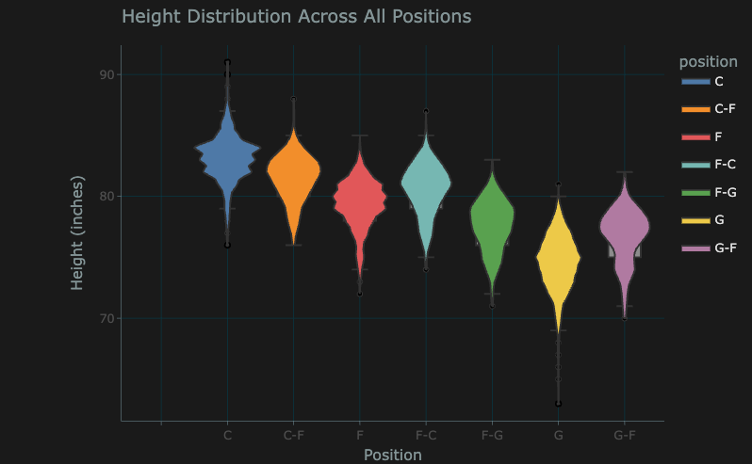
Position-Specific Patterns
Height-Weight Relationship Analysis

Slide 26
Height-Weight Relationship Analysis
Position-Specific Patterns
Hybrid positions show intermediate distributions
Clear stratification between primary positions
Limited overlap between Guards and Centers

Slide 27
Height-Weight Relationship Analysis
Correlation Findings
Multi-Variable Analysis
Statistical Correlations

Slide 28
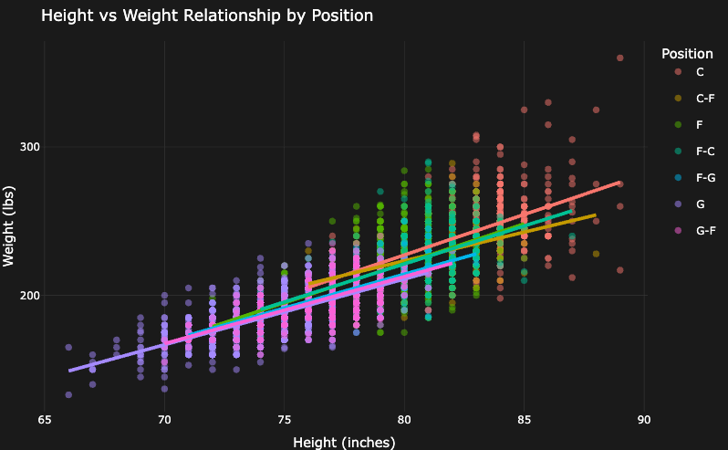
Multi-Variable Analysis
Height-Weight Relationship Analysis

Slide 29
Height-Weight Relationship Analysis
Statistical Correlations
Strong positive correlation across positions
Position-specific regression slopes
Clustering patterns reveal role specialization

Slide 30
Historical Evolution Analysis

Slide 31
Historical Evolution Analysis
Temporal Trends

Slide 32
Historical Evolution Analysis
Temporal Trends
Historical Development
Key Trends

Slide 33
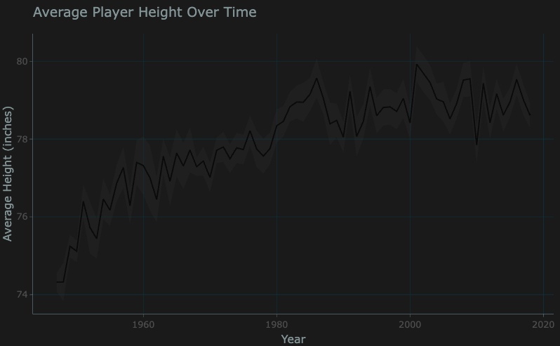
Historical Development
Historical Evolution Analysis

Slide 34
Historical Evolution Analysis
Key Trends
1950s-1990s: Steady increase in average height
Post-2000: Stabilization of height trends
Position-specific evolution patterns

Slide 35
Comprehensive 3D Analysis

Slide 36
Comprehensive 3D Analysis
Multi-Dimensional Visualization

Slide 37
Comprehensive 3D Analysis
Multi-Dimensional Visualization
Interactive 3D Model
Complex Relationships
Pattern Recognition

Slide 38
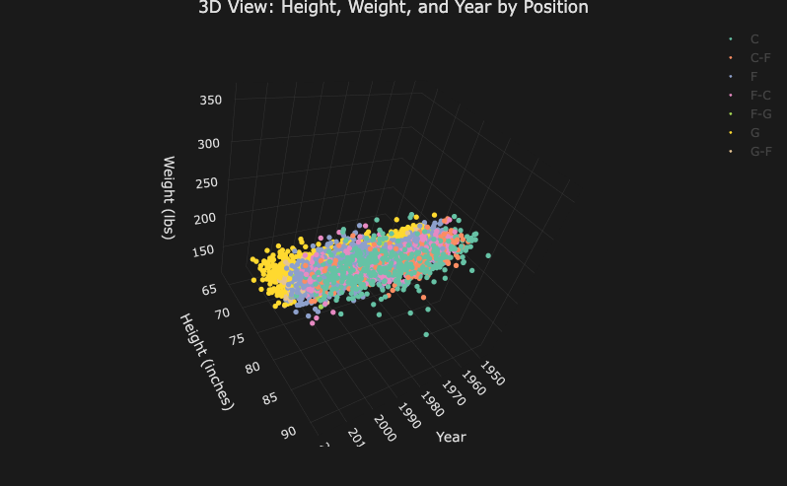
Interactive 3D Model
Comprehensive 3D Analysis

Slide 39
Comprehensive 3D Analysis
Complex Relationships
Temporal evolution of physical attributes
Position-based clustering
Interactive exploration capabilities

Slide 40
Comprehensive 3D Analysis
Pattern Recognition
Clear position-based grouping
Temporal shifts in physical attributes
Outlier identification and analysis

Slide 41
Education-Income Correlation Study

Slide 42
Education-Income Correlation Study
Economic Impact Analysis

Slide 43
Education-Income Correlation Study
Economic Impact Analysis
Income Distribution Patterns
Statistical Findings

Slide 44
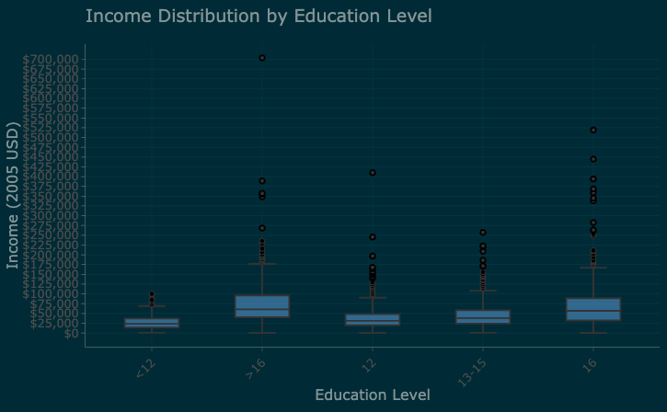
Income Distribution Patterns
Education-Income Correlation Study

Slide 45
Education-Income Correlation Study
Statistical Findings
Clear positive correlation
Education level impact quantification
Variance analysis by education tier

Slide 46
Conclusions and Implications

Slide 47
Conclusions and Implications
Summary of Findings

Slide 48
Conclusions and Implications
Summary of Findings
Key Discoveries
Future Implications

Slide 49
Conclusions and Implications
Key Discoveries
Position specialization follows trends over time.
Physical attribute correlations are present across positions.
Historical evolution patterns have stabilized in contemporary times.
The education-income relationship suggests a strong correlation between both factors.

Slide 50
Conclusions and Implications
Future Implications
Player development considerations in roster development and contract negotiations.
Strategic team composition insights; budget vs. talent dilemma.
Economic impact of education programs to recruit future program candidates risk effect.

Slide 51
Questions for Class
What are the best practices for using dark themes in RStudio?
Are there different ways to create 3-D plots in RStudio?
How can we access up-to-date sports data sets?
Which sports are the most challenging to analyze statistically?

Slide 52
Discussion and Questions

Slide 53
Discussion and Questions
Interactive Session

Slide 54
Discussion and Questions
Interactive Session
Q&A Period
Contact Information

Slide 55
Discussion and Questions
Contact Information
jarocha@smu.edu
The repository and future companion React website for this unit is located at -
https://github.com/jonx0037/ds6306-unit-2.git

Slide 56
Thank you

