Slide 1
Cross-Asset Sentiment
Regime Detector
Automating Market Psychology Analysis Through Multi-Source NLP
Jonathan Rocha
SMU Master of Science in Data Science | Capstone Project | Spring 2026

Slide 2
Problem & Motivation
The Challenge
Financial markets generate massive unstructured text daily — news, social media, analyst reports
Sentiment shifts across asset classes often precede regime transitions
Manual monitoring is impossible at scale across multiple markets simultaneously
Research Gap
Existing approaches focus on single-asset sentiment — no cross-asset regime detection
No unified framework integrating NLP sentiment with volatility regime models
Goal: Build an automated system that detects market regime transitions using cross-asset NLP sentiment signals

Slide 3
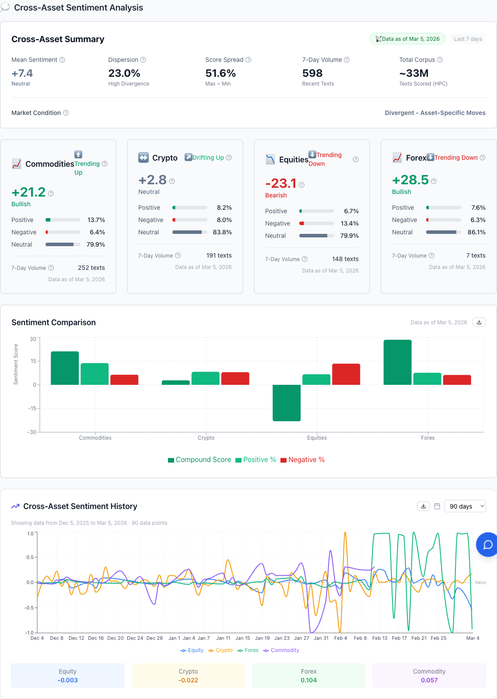
Data & NLP Pipeline
~33 Million Documents
Equities (SPY) — News & earnings
Crypto (BTC) — Social media & Reddit
Forex (EUR/USD) — Central bank comms
Commodities (Gold) — Reports & news
NLP Pipeline
FinBERT ensemble transformer
Daily aggregation per asset
4,490 observations (2005–2025)
→ 22 engineered features

Slide 4
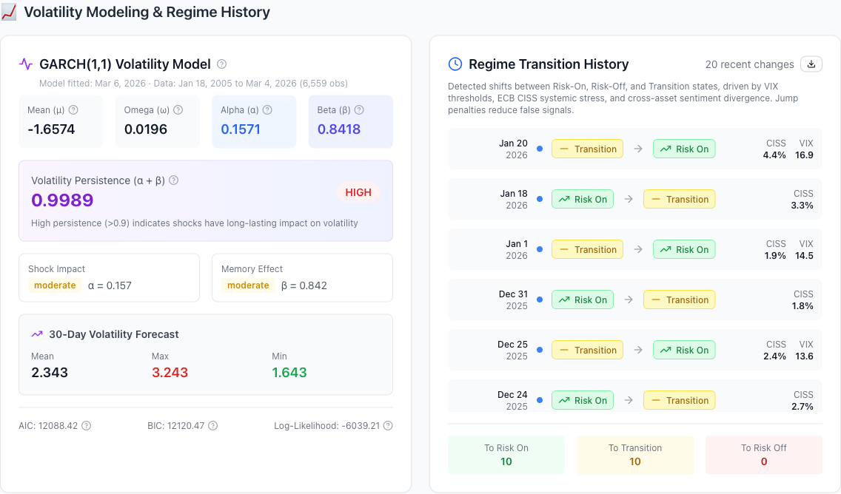
Two-Layer Architecture
Layer 1: GARCH(1,1)
Conditional variance per asset
Volatility clustering + persistence
Layer 2: Jump Model
Data-driven jump penalty (CV)
Detects structural regime breaks
4 Regime States
Low Volatility
Normal
Elevated
High Volatility
Network: Transfer Entropy for cross-asset information flow (H3)

Slide 5
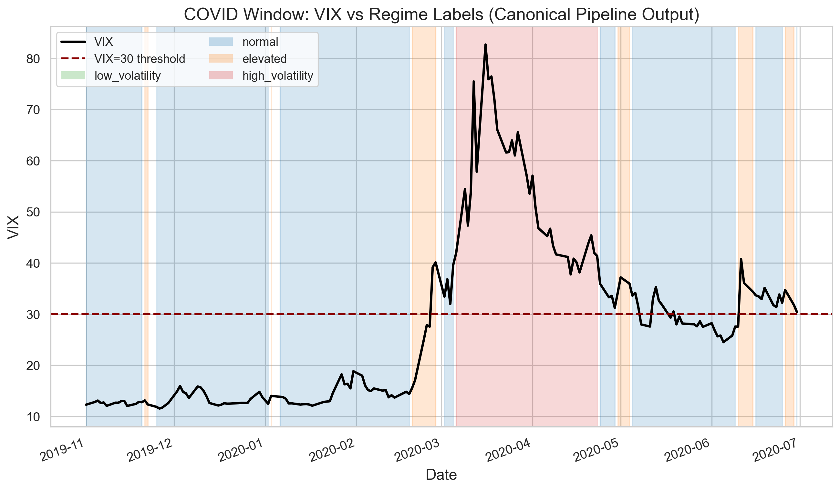
Validation Framework
Walk-Forward CV
756-day training window
63-day test window
5-day purge gap
Pre-Registered Hypotheses
H1: Sentiment leads regime transitions
H2: Divergence increases before transitions
H3: Network connectedness rises pre-crisis

Slide 6
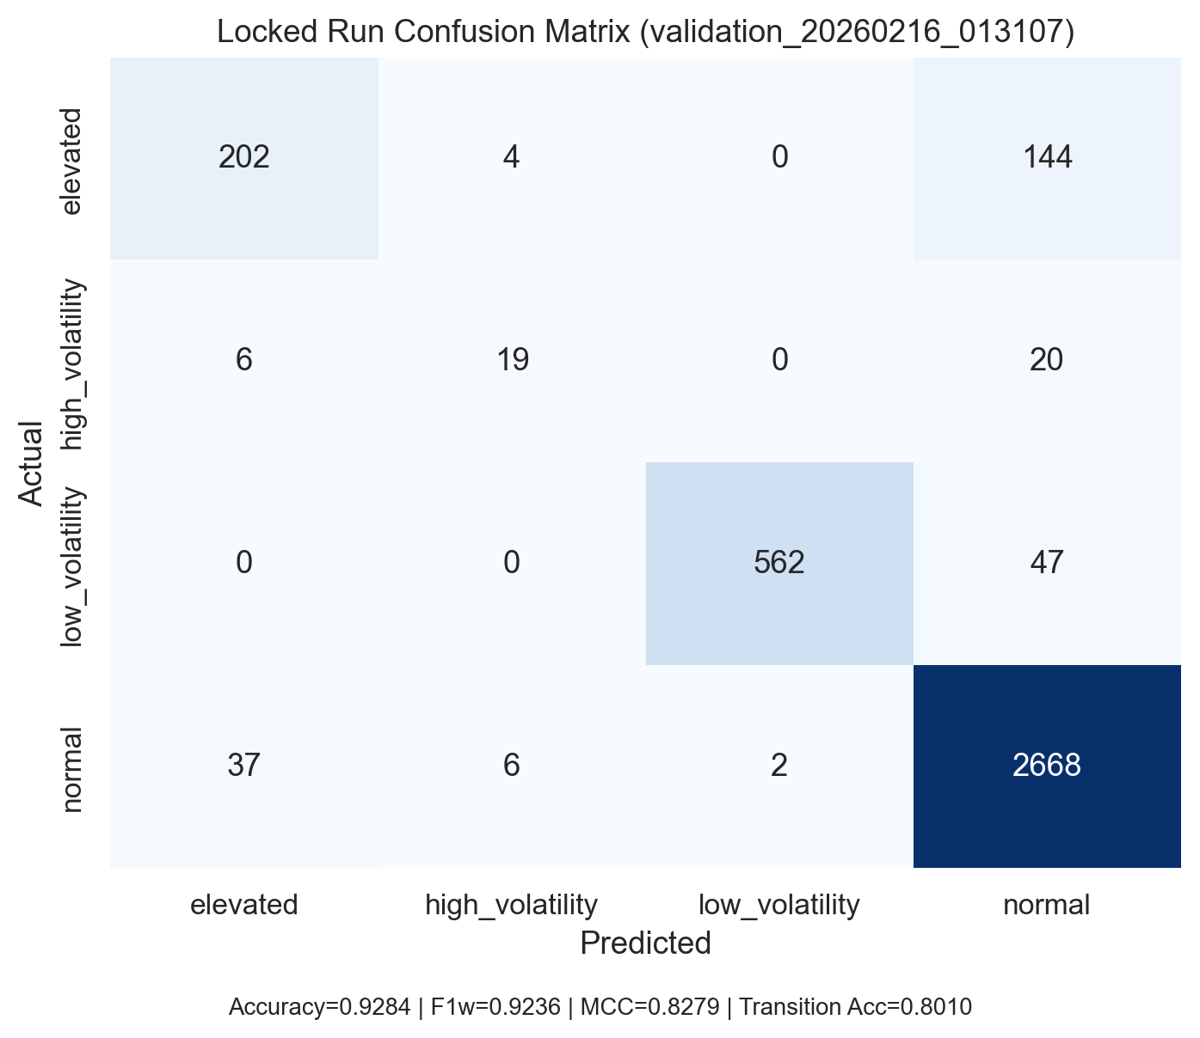
Classification Performance
Key Metrics
Accuracy: 92.84%
F1 Weighted: 0.9236
MCC: 0.8279
Transition Acc.: 80.10%
MCC is primary metric — accounts for class imbalance across 4 regime states

Slide 7
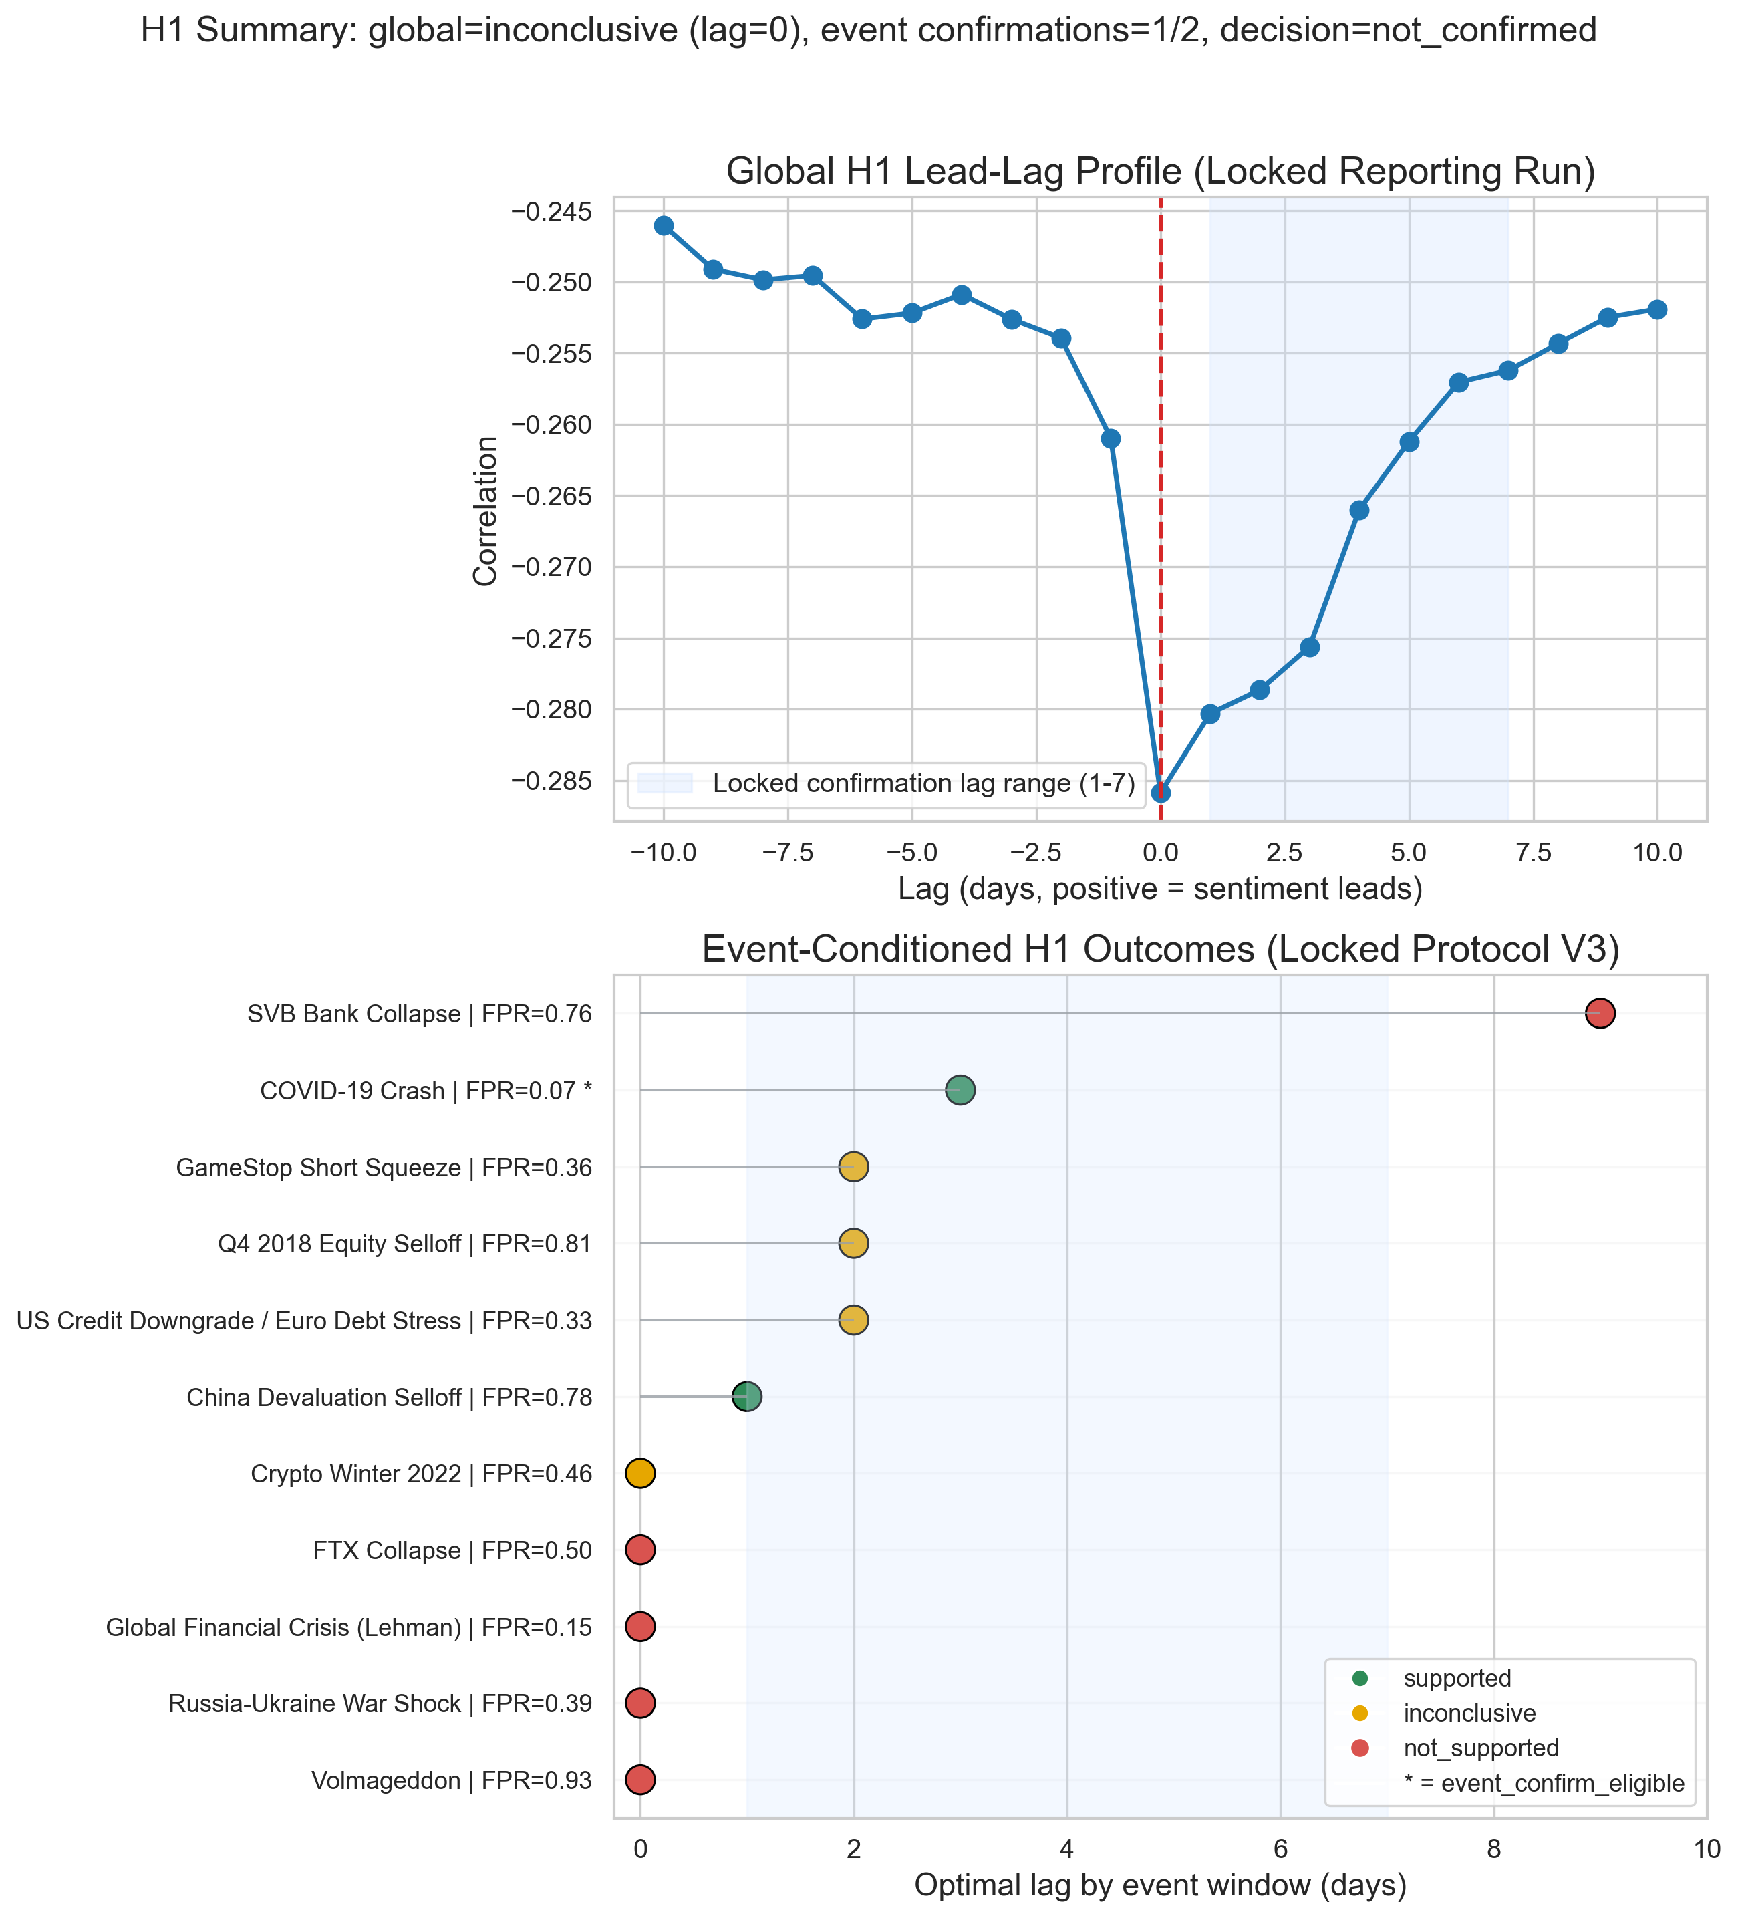
H1: Sentiment Lead Time
H1 — NOT CONFIRMED
Does sentiment lead regime transitions by 1–5 days?
Results
Peak alignment at lag 0 — no 1-5 day lead detected globally
Only 1 event window confirmed (needed ≥2 for project-level support)
COVID-19 showed localized lead, but not generalizable
→ Standalone sentiment is not a reliable leading indicator

Slide 8
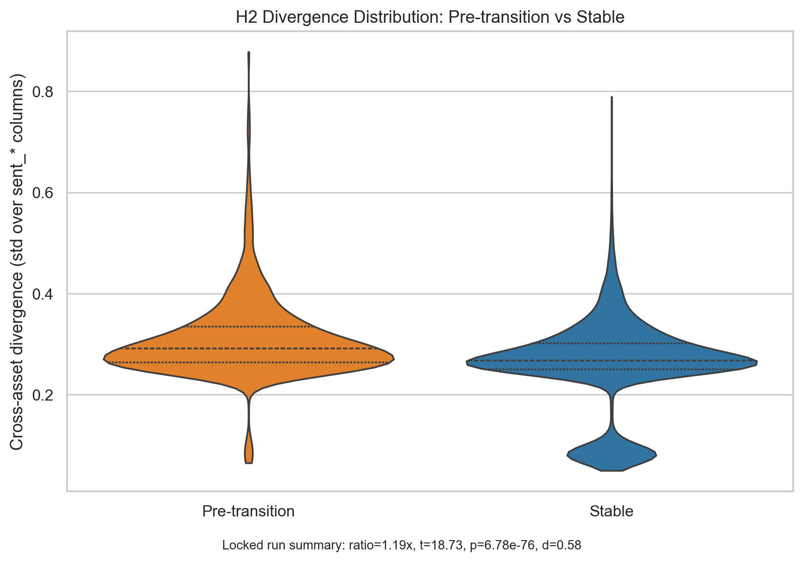
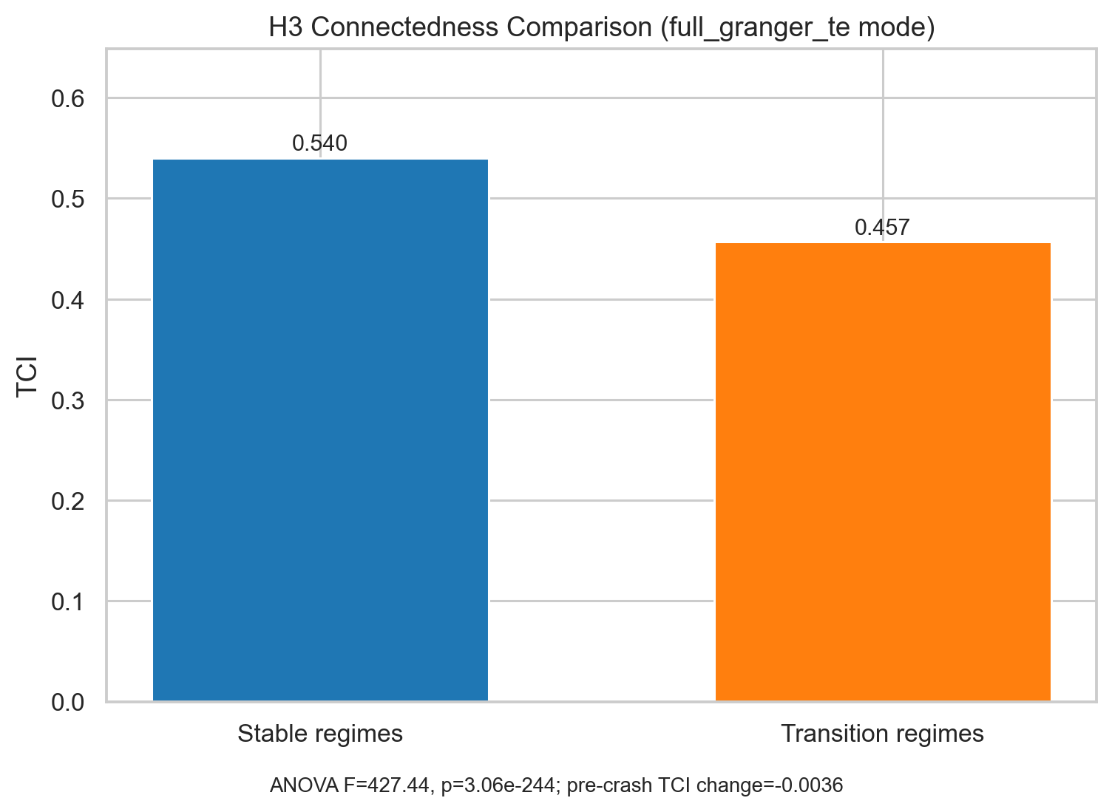
H2 & H3: Divergence & Network Effects
H2 — SUPPORTED ✓
Cross-asset divergence increases before transitions
Ratio = 1.19× | t = 18.73
p < 0.001 | Cohen's d = 0.58
H3 — SUPPORTED ✓
Network connectedness differs across regimes
TCI: 0.5402 (stable) vs 0.4569 (trans.)
ANOVA F = 427.44 | p < 0.001
→ Market disagreement (not level) signals regime shifts

Slide 9
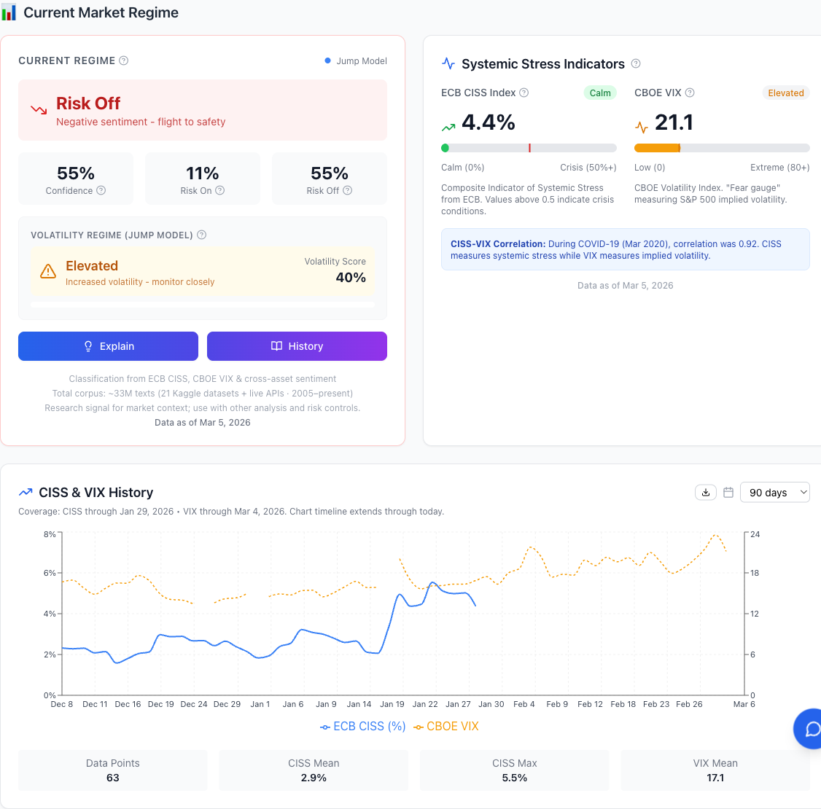
Live Production Dashboard
Backend
FastAPI (Python)
PostgreSQL database
Railway hosting
Daily CRON refresh
Frontend
Next.js + TypeScript
Recharts visualization
Vercel deployment
www.market-sentiment.io

Slide 10
Discussion & Limitations
Key Findings
Cross-asset sentiment divergence (H2) is the strongest predictive signal
Network effects (H3) confirm information cascades during regime transitions
Individual sentiment-to-regime lag (H1) is not reliable as standalone indicator
Limitations
Computational cost — repeated CV tuning and rolling validation are expensive
Transformer inference latency — may limit near-real-time operation on large streams
Mixed-frequency alignment noise — irregular text vs. regular market bars
Data quality — bots, sarcasm, selection bias in public discourse
Correlational design — observed relationships may not be causal

Slide 11
Conclusion & Future Work
Contributions
First unified framework combining NLP sentiment with volatility regime detection across asset classes
Novel cross-asset divergence metric as regime transition signal (H2)
Production-grade dashboard with daily automated updates
92.84% accuracy, 0.8279 MCC on 4-class regime classification
Future Directions
Adaptive model weighting (IMCA-style recalibration)
Multimodal signals (earnings-call audio) and high-frequency decomposition
Expand to additional asset classes (bonds, REITs) and multilingual discourse
Causal identification to distinguish sentiment-to-price from reverse causality
Thank You — Questions?

