Slide 1



XML, XSL, and XSLT
7/27/2006

Slide 2
Definitions
XML: Extensible Markup Language
  “A…general-purpose markup language for creating special-purpose markup languages, capable of describing many different kinds of data.” (Wikipedia, http://en.wikipedia.org/wiki/XML, accessed 7/26/2006)
XSL: Extensible Stylesheet Language
  “A family of languages which allows one to describe how files encoded in the XML standard are to be formatted or transformed.” (Wikipedia, http://en.wikipedia.org/wiki/Xsl, accessed 7/26/2006)
    Includes:
      XSLT: XSL Transformations, an XML language for transforming documents.
      XSL-FO: XSL Formatting Objects, an XML language for specifying the visual formatting of XML documents.
      XPath: XML Path Language, a non-XML language used by XSLT and also available for use in non-XSLT contexts for addressing certain parts of XML documents.

Slide 3
Rationale
Why use XSLT to format and display XML documents?
  Data-oriented
    Designed to display data
    Able to extract attribute information and element content
    Features include calculation and data sorting functions
  Client-side
    Distributed computing
    Alleviate workload from servers
  Semantic
    Discrete separation of data and display layers
    Content and style divorced, allows for a much more modular approach to development
  Standards-compliant
    Strictly enforced code standards in both XML and XSL
    Open standard, portable across platforms and well-documented

Slide 4
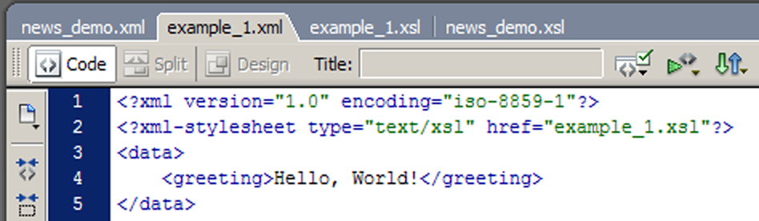
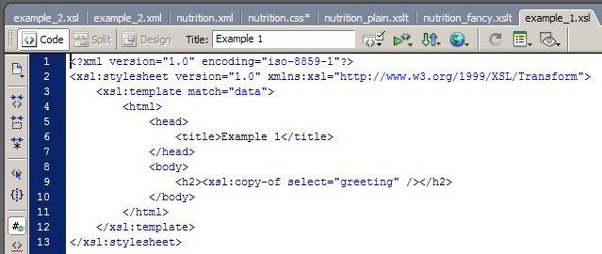
Example 1
  XML:
  XSLT:

Slide 5
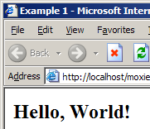
Example 1
  Result:

Slide 6
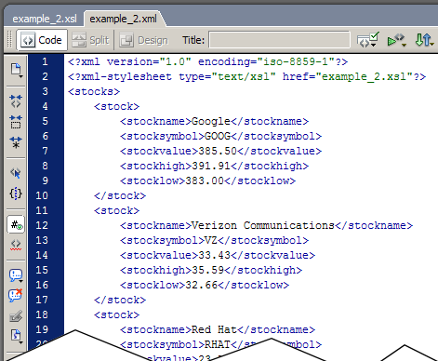
Example 2
  XML:

Slide 7
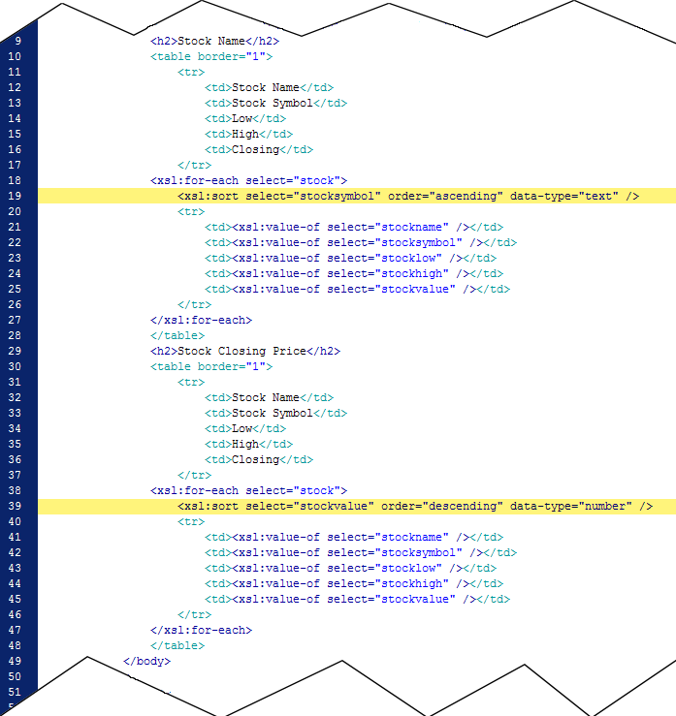
Example 2
  XSLT:

Slide 8
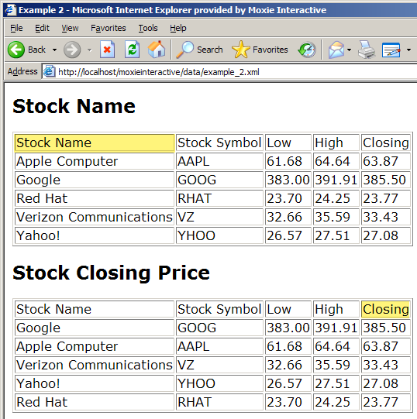
Example 2
  Result:

Slide 9
Example 3
Excerpts from “Using XML” by J. David Eisenberg (7/19/2002, http://www.alistapart.com/articles/usingxml/)
  Concepts:
    Using XML to define a custom markup language
    Formatting XML data using CSS
    Formatting XML data using XSLT
    Processing data and making calculations using XSLT
    Converting data from XML to formats other than HTML

Slide 10
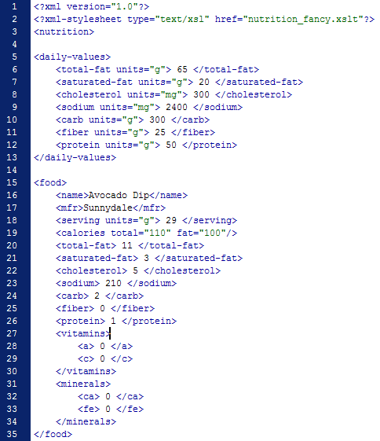
Example 3 - XML

Slide 11
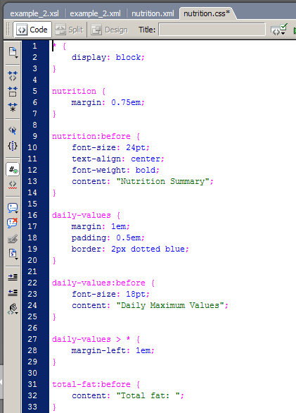
Example 3 – Simple CSS Formatting

Slide 12
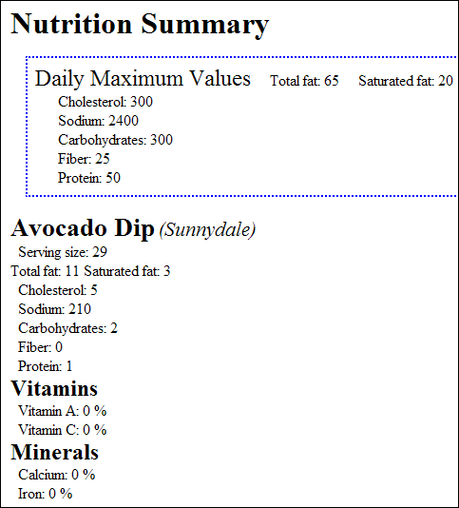
Example 3 – Simple CSS Formatting

Slide 13
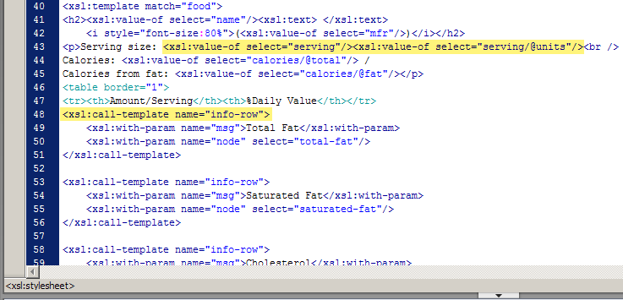
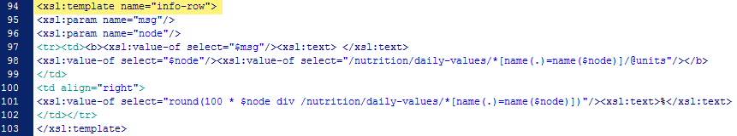
Example 3 – Simple XSL Transformation

Slide 14
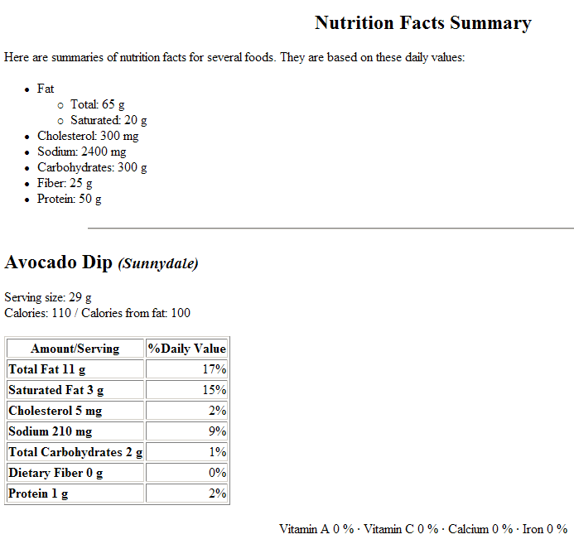
Example 3 – Simple XSL Transformation

Slide 15
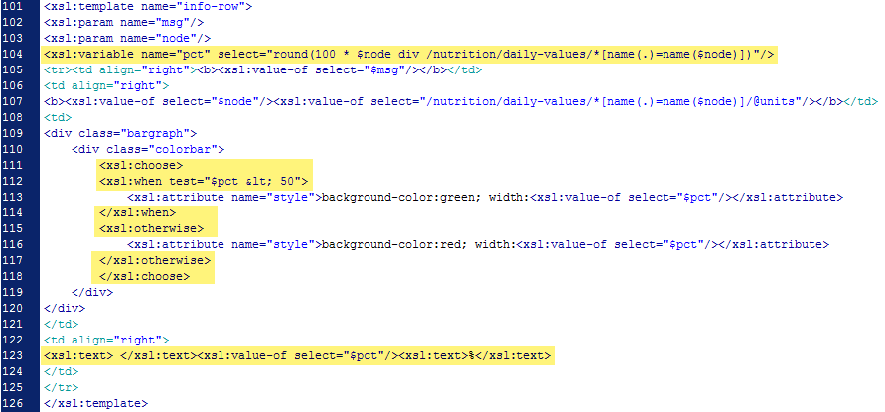
Example 3 – Complex XSL Transformation

Slide 16
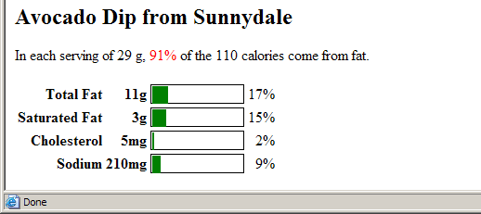
Example 3 – Complex XSL Transformation

Slide 17
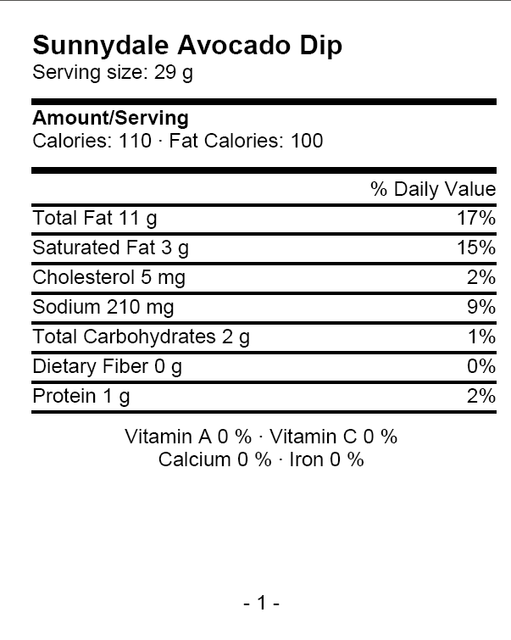
Example 4 – Format Conversions Using XSLT

Slide 18
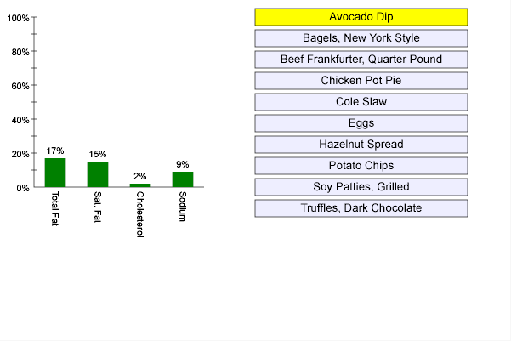
Example 4 – Format Conversions Using XSLT

