Slide 1
Whatsup - SNA

Slide 2
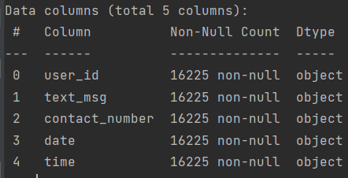
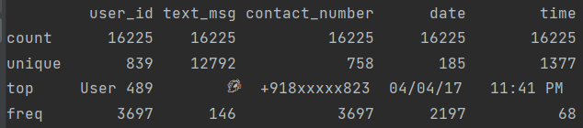
Dataset
This is a whatsup group conversation found online
Source – sqlite DB / csv file
Columns: ['user_id', 'text_msg', 'contact_number', 'date', 'time']
Details:

Slide 3
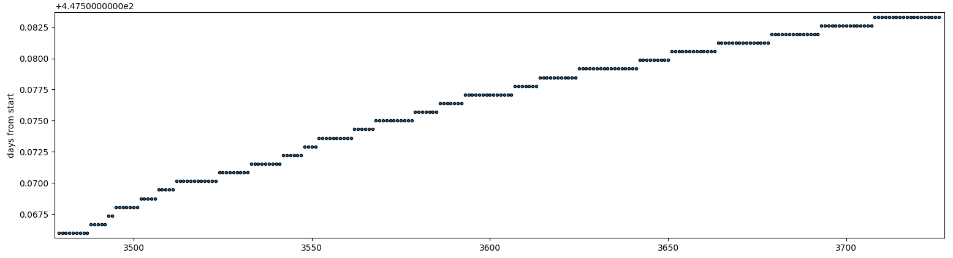
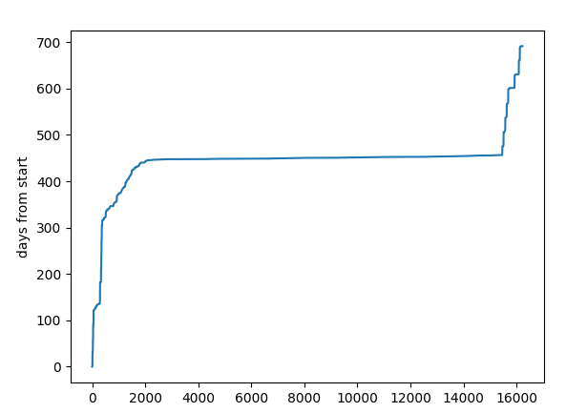
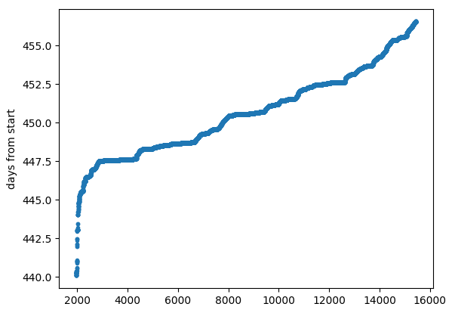
Dataset
Sorting and plotting the time from beginning:\
Two options: either discard the middle part or use it only
Most of the activity

Slide 4
Dataset
The flat parts look like this
Within one minuet (the time resolution) there are several messeges – a conversation

