Slide 1
Channel Decoding and Peripheral Configuration (Porting) for DRM Receiver
by
M.SHARON PREETHI,
UR11EC239,
KARUNYA UNIVERSITY.
External guide:
Mrs. Padmavathi R (Project manager) Mr. Buvaneswaran (System Engineer)
Internal guide:
Dr. Shobha Rekh
Director
Department of Electrical Sciences

Slide 2
OBJECTIVE:
To perform channel decoding and to configure the peripherals (EDMA, McASP) for DRM Receiver implementation in J5 platform

Slide 3
HARDWARE REQUIRED:
TMS320DM814x DaVinci Digital Media Processors.
Signal Generator.
Spectrum digital emulator for debugging.
SOFTWARE REQUIRED:
CODE COMPOSER STUDIO 5.1

Slide 4
INTRODUCTION
DRM is a set of digital audio broadcasting technologies design to work over the frequency bands currently used for AM.
It can fit more channels than AM using various MPEG 4 codecs.
It can deliver FM comparable sound quality on frequencies below 30MHz.
It is a system that complements and works seamlessly with other digital standards and DAB.

Slide 5
Advantages of DRM over Analog Radio
Near FM quality audio can be transmitted.
Image, text and HTML can be transmitted.
Multilingual programs are possible.
Reduce power consumption (40-50%).
Automatic tuning by station name , not by frequency and re-tunes when leaving a coverage area.
It has good coverage area and employs a single frequency network.

Slide 6
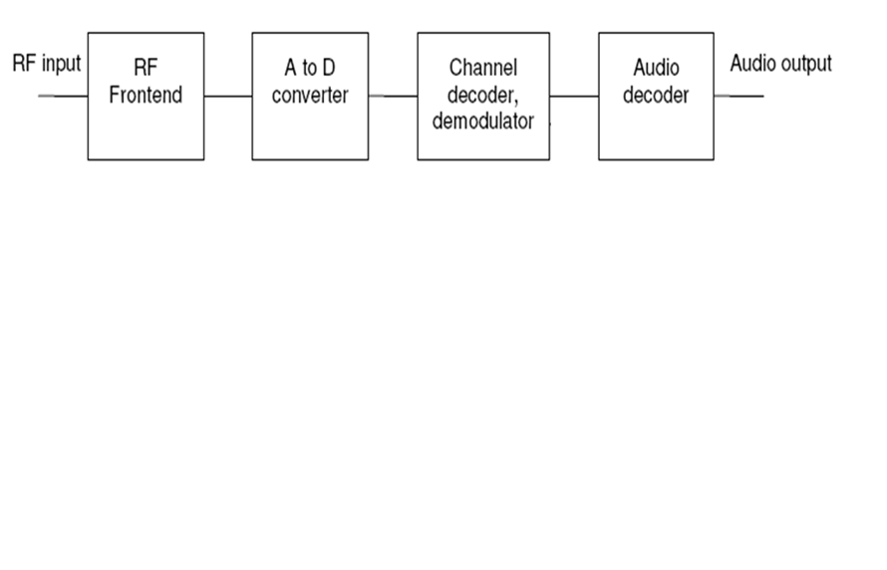
DRM Radio Receiver – Block Diagram

Slide 7
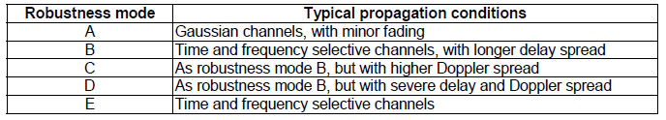
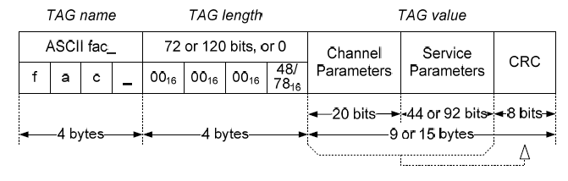
ROBESTNESS MODE
In a given bandwidth, the different robustness modes provide different available data rates
Tags:
Fast Access Channel (fac_):

Slide 8
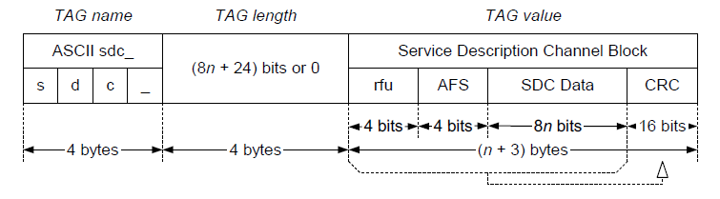
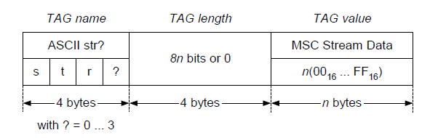
Service Description Channel (sdc_):
MSC stream data <n>(str0, str1, str2 and str3):

Slide 9
FLOWCHART(Channel Decoding)
Main file
START
Create File_in, File_out,chaninput_buffer,chanoutput_buffer
Open the input file and store it in File_in
File_in=0
yes
Display Error
no
1
Copy the File_in data to input_buffer
2
Invoke ProcessBlock (using input buffer and the buffers size)

Slide 10
Write the content of the output buffer into the output file using File_out pointer
no
EOF = 1
1
yes
STOP
Process file
2
Invoke MainProcess (using data_in and the samplerate)
Drm_block=TRUE
no
1
yes
Invoke prefftprocess function to get number of symbols per frame

Slide 11
modedetect=TRUE
no
yes
Invoke gaurdremove function (guard interval is removed from data)
Invoke FFTProcess function (using data_in)
fftperformed=TRUE
no
yes
Invoke postfftprocess function (get the symbols)
Invoke ChannelProcess function (using fft_data_out)

Slide 12
no
Error flag = 0
Error handling function
yes
Invoke MscProcess function(chan_data_out)
Find fac_cell_index,sdc_cell_index,frame_num,sym_num
fac_cell_index = 0
yes
yes
sdc_cell_index = 0
no
no
Invoke facdatadecode function
Invoke sdcdatadecode function
no
decode= 0
2
yes
1

Slide 13
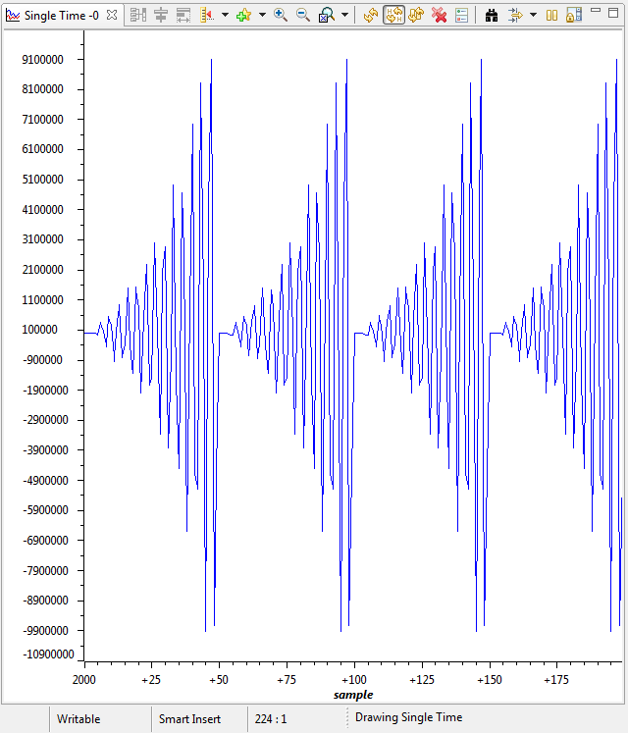
OUTPUT:
Input Waveform:

Slide 14
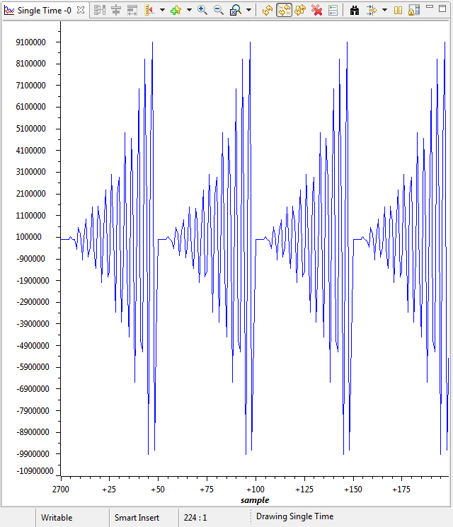
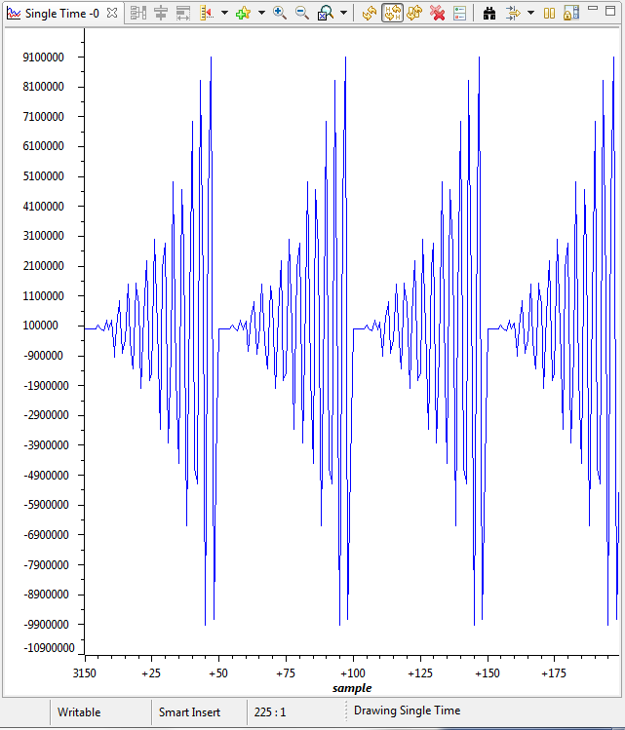
RESAMPLE (Step by Step Process):

Slide 15
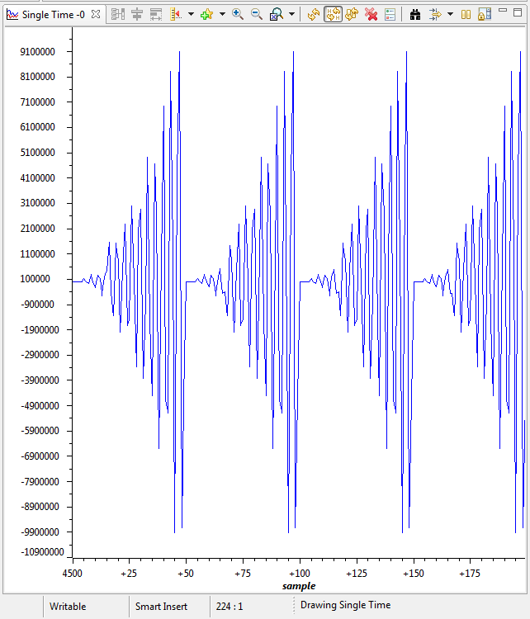
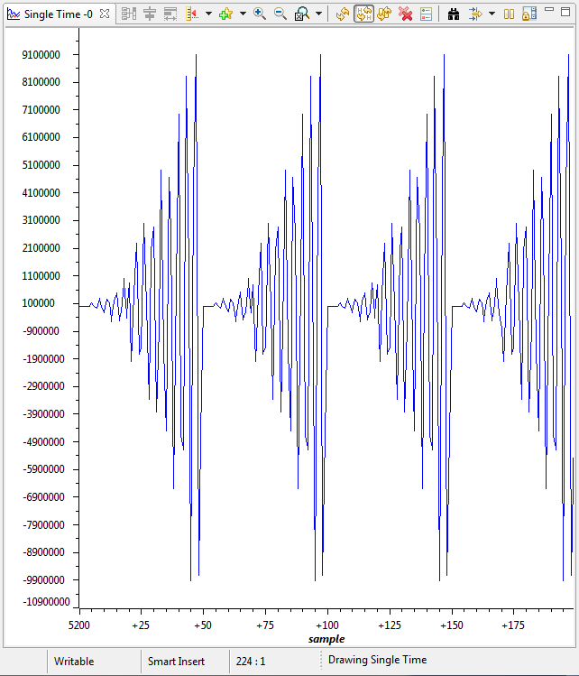

Slide 16
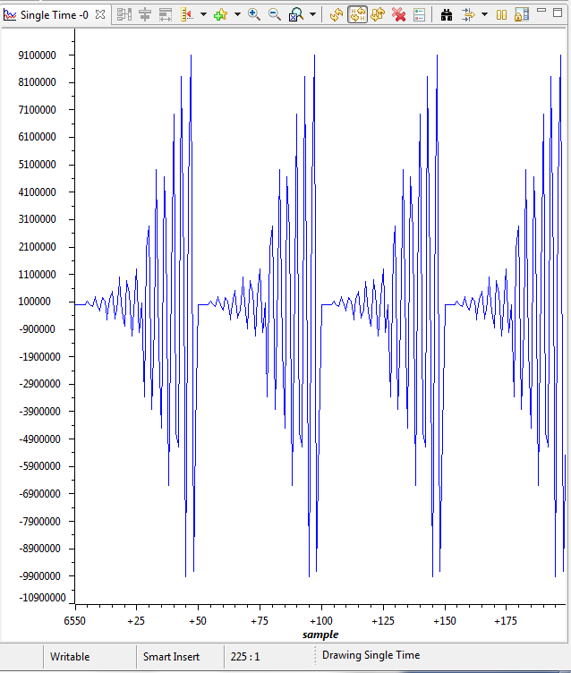
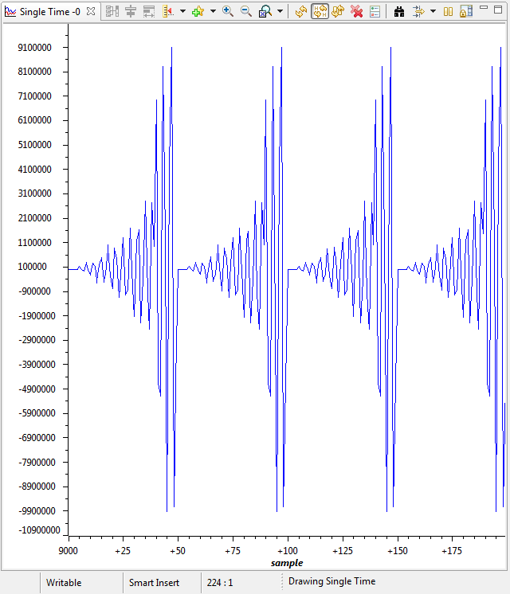

Slide 17
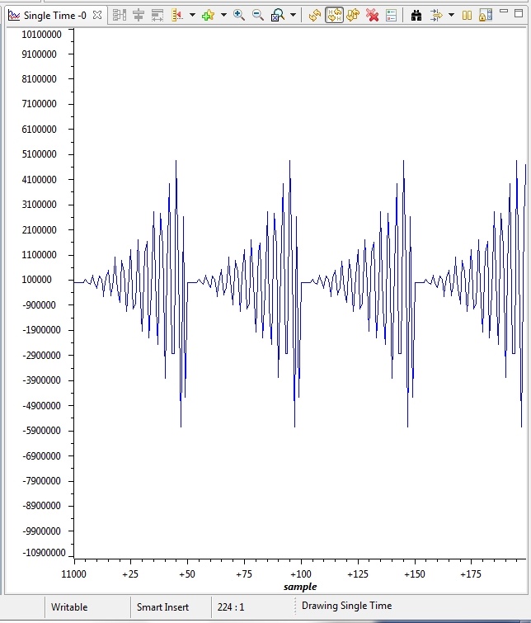
FINAL RESAMPLE OUTPUT:

Slide 18
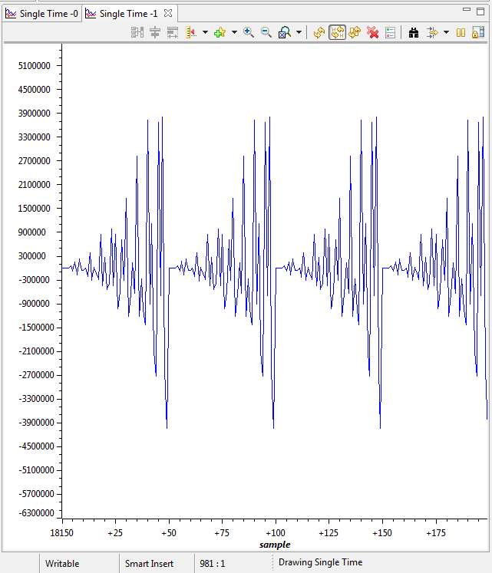
FILTERING:

Slide 19
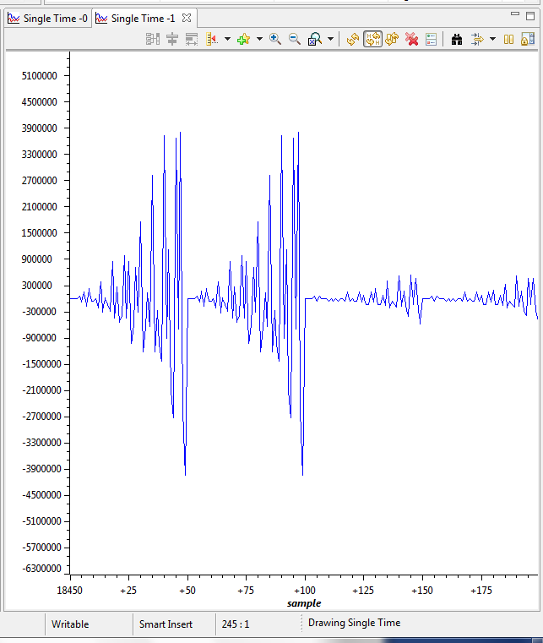
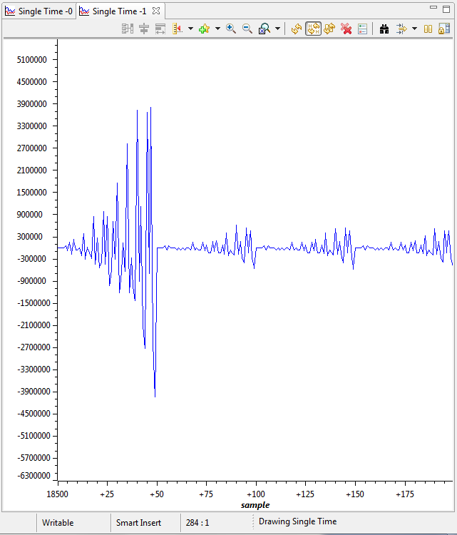
GUARD REMOVAL:

Slide 20
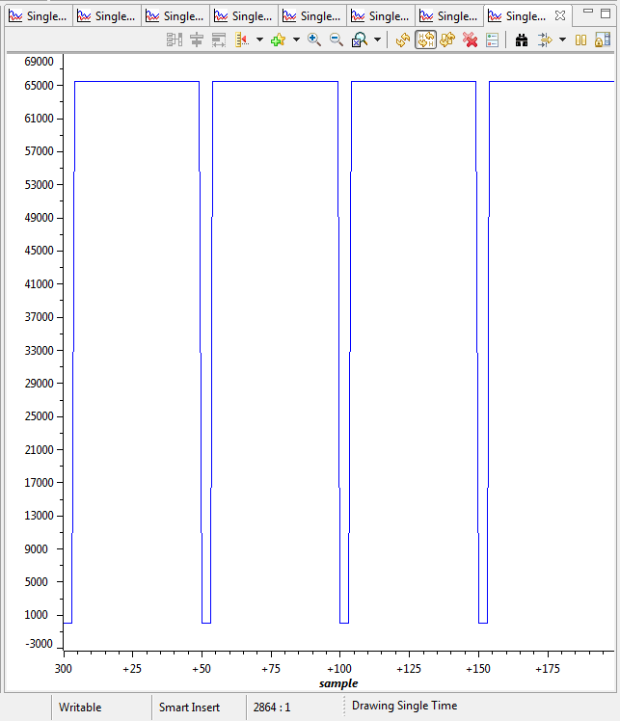
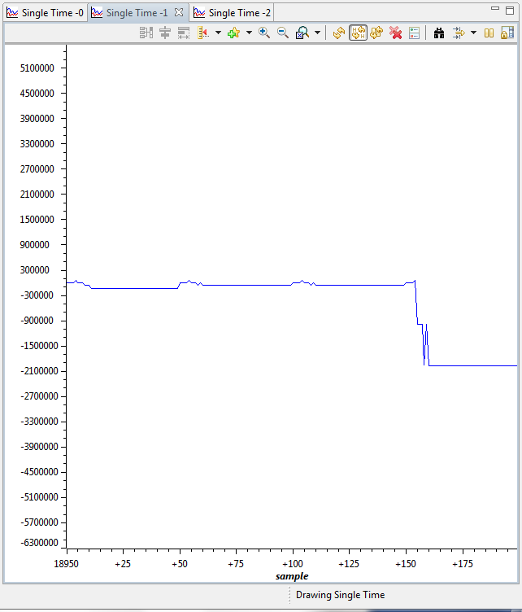
MULTIPLIER VALUE:
CHANNEL PROCESS:

Slide 21
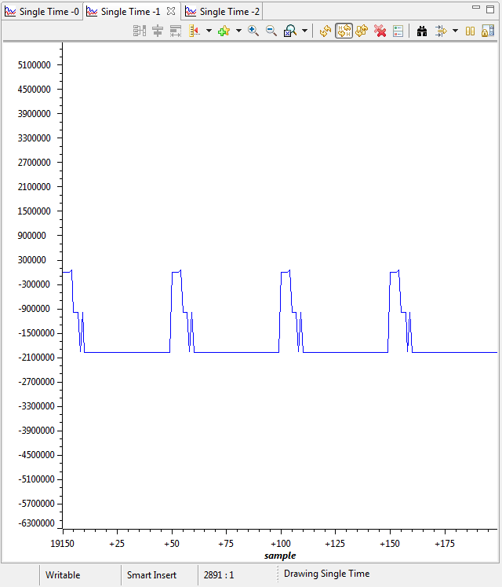
CHANNEL PROCESS OUTPUT:

Slide 22
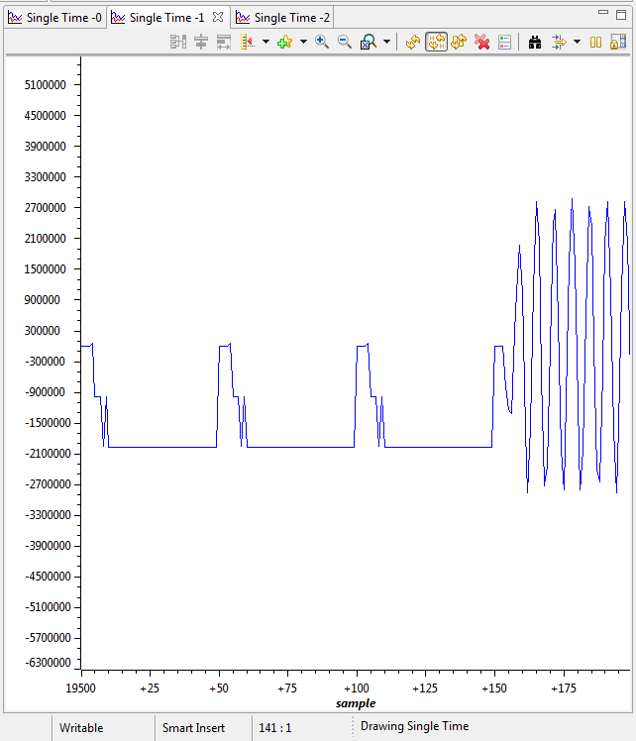
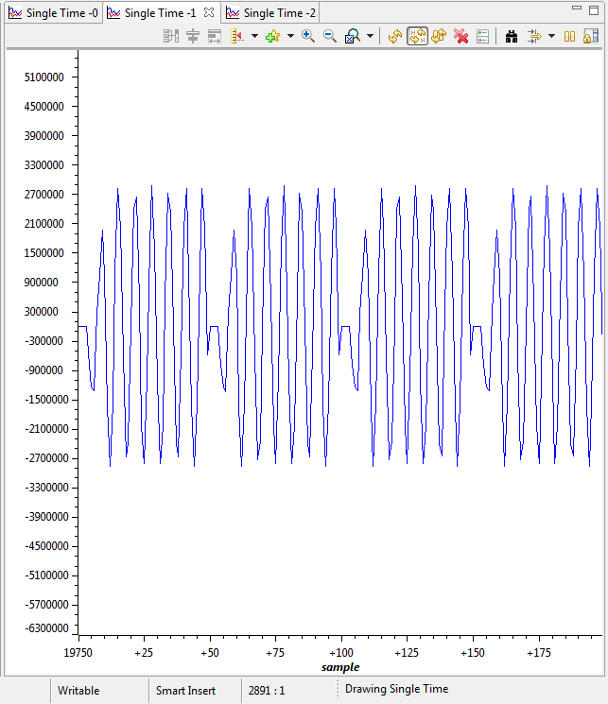
MLC PROCESS:

Slide 23
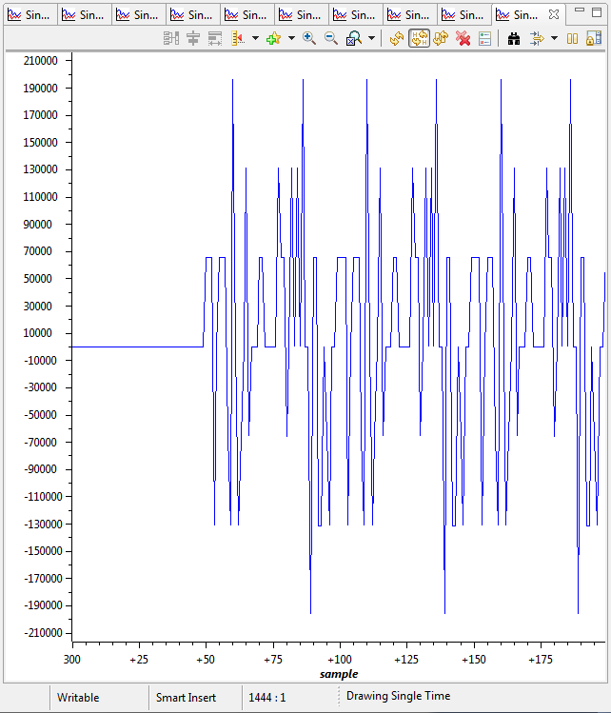
Decoded output:

Slide 24
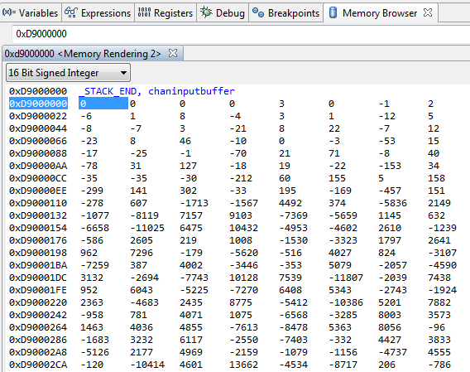
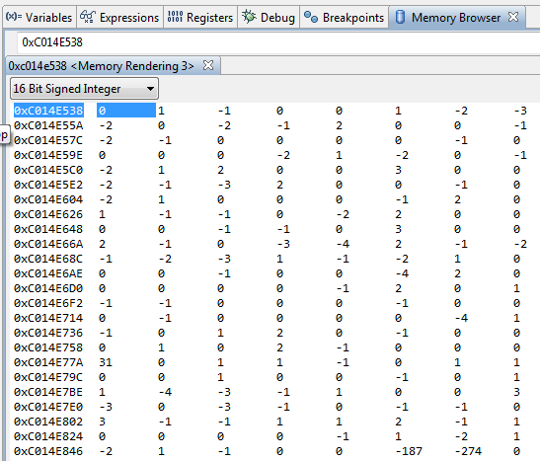
Memory browser:
For the clear understanding purpose, the Memory browser output screen shots are attached. Because, interpretation of the audio decoding cannot entirely be dependent on the output waveforms.
Input Buffer:
Output Buffer:

Slide 25
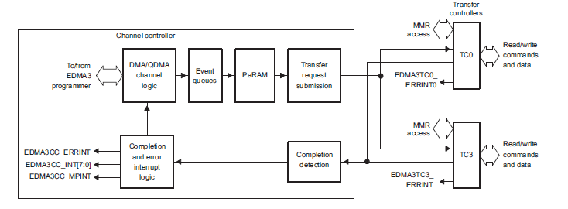
EDMA (Enhanced Direct Memory Access):
The primary function of DMA is to move data without direct CPU involvement.
The data can be source address, destination address or length of the data

Slide 26
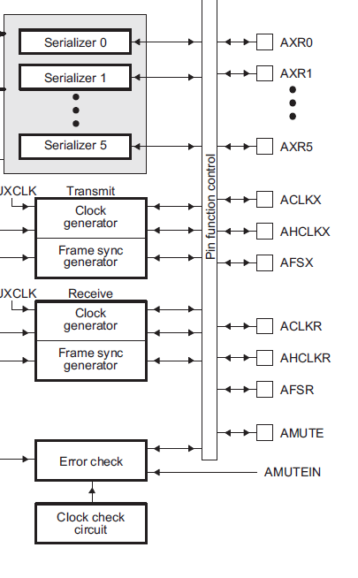
McASP:
The multichannel audio serial port (McASP) functions as a general-purpose audio serial port
Two independent clock generator modules for transmit and receive
The McASP is useful for time-division multiplexed (TDM) stream

Slide 27
REFERENCES:
http://www.etsi.org// Spec_es_201980v030201p.pdf
http://www.ti.com/general/docs/lit/DM814x Technical Ref. Manual.pdf
ISO/IEC 8859-1: "Information technology - 8-bit single-byte coded graphic character sets - Part 1:Latin alphabet No. 1".

