Slide 1
Channel Decoding and Peripheral Configuration (Porting) for DRM Receiver
by
M.SHARON PREETHI,
UR11EC239,
KARUNYA UNIVERSITY.
External guide:
Mrs. Padmavathi R (Project manager) Mr. Buvaneswaran (System Engineer)
Internal guide:
Dr. Shobha Rekh
Director
Department of Electrical Sciences

Slide 2
OBJECTIVE:
To perform channel decoding and to configure the peripherals (EDMA, McASP) for DRM Receiver implementation in J5 platform

Slide 3
HARDWARE REQUIRED:
TMS320DM814x DaVinci Digital Media Processors.
Signal Generator.
Spectrum digital emulator for debugging.
SOFTWARE REQUIRED:
CODE COMPOSER STUDIO 5.1

Slide 4
INTRODUCTION
DRM is a set of digital audio broadcasting technologies design to work over the frequency bands currently used for AM.
It can fit more channels than AM using various MPEG 4 codecs.
It can deliver FM comparable sound quality on frequencies below 30MHz.
It is a system that complements and works seamlessly with other digital standards and DAB.

Slide 5
Advantages of DRM over Analog Radio
Near FM quality audio can be transmitted.
Image, text and HTML can be transmitted.
Multilingual programs are possible.
Reduce power consumption (40-50%).
Automatic tuning by station name , not by frequency and re-tunes when leaving a coverage area.
It has good coverage area and employs a single frequency network.

Slide 6
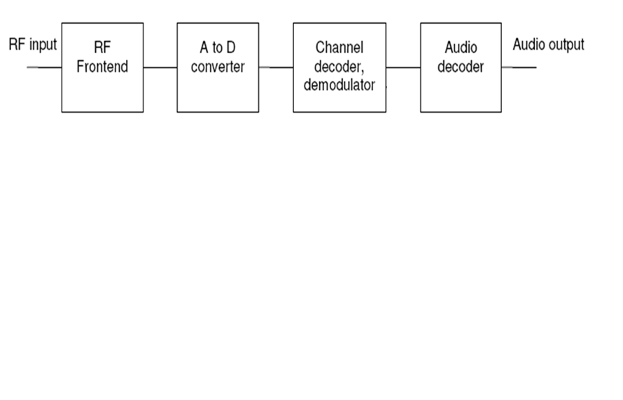
DRM Radio Receiver – Block Diagram

Slide 7
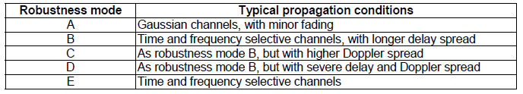
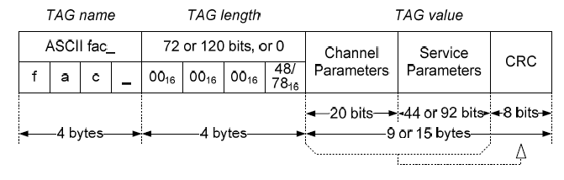
ROBESTNESS MODE
In a given bandwidth, the different robustness modes provide different available data rates
Tags:
Fast Access Channel (fac_):

Slide 8
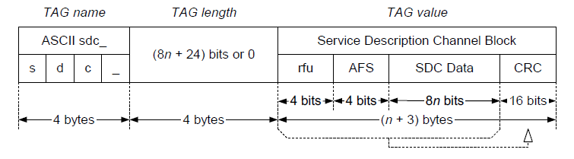
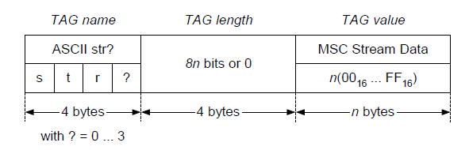
Service Description Channel (sdc_):
MSC stream data <n>(str0, str1, str2 and str3):

Slide 9
FLOWCHART(Channel Decoding)
Main file
START
Create File_in, File_out,chaninput_buffer,chanoutput_buffer
Open the input file and store it in File_in
File_in=0
yes
Display Error
no
1
Copy the File_in data to input_buffer
2
Invoke ProcessBlock (using input buffer and the buffers size)

Slide 10
Write the content of the output buffer into the output file using File_out pointer
no
EOF = 1
1
yes
STOP
Process file
2
Invoke MainProcess (using data_in and the samplerate)
Drm_block=TRUE
no
1
yes
Invoke prefftprocess function to get number of symbols per frame

Slide 11
modedetect=TRUE
no
yes
Invoke gaurdremove function (guard interval is removed from data)
Invoke FFTProcess function (using data_in)
fftperformed=TRUE
no
yes
Invoke postfftprocess function (get the symbols)
Invoke ChannelProcess function (using fft_data_out)

Slide 12
no
Error flag = 0
Error handling function
yes
Invoke MscProcess function(chan_data_out)
Find fac_cell_index,sdc_cell_index,frame_num,sym_num
fac_cell_index = 0
yes
yes
sdc_cell_index = 0
no
no
Invoke facdatadecode function
Invoke sdcdatadecode function
no
decode= 0
2
yes
1

Slide 13
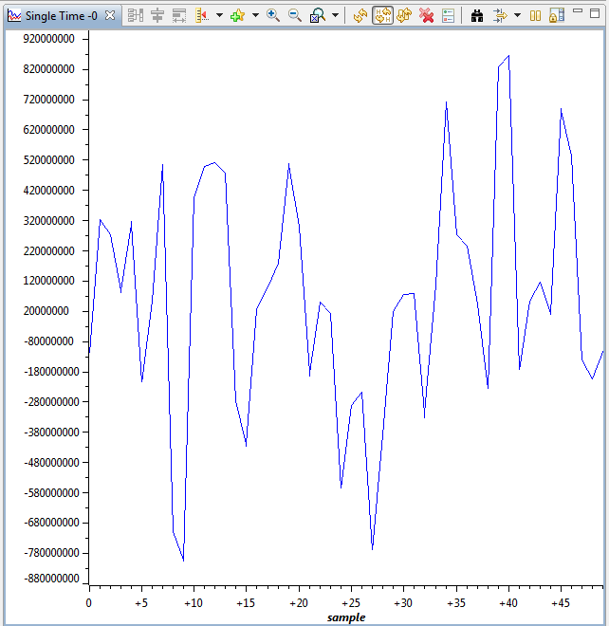
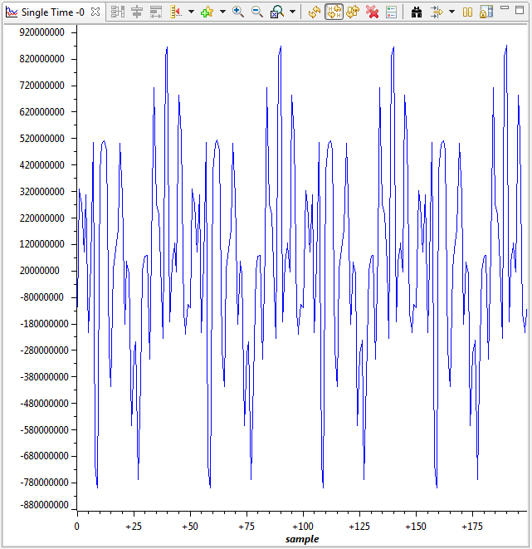
OUTPUT:

Slide 14
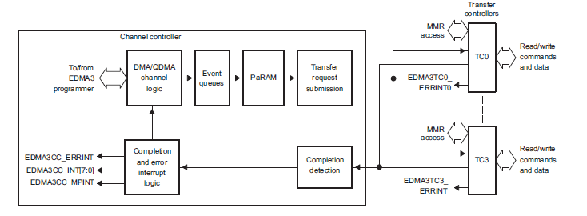
EDMA (Enhanced Direct Memory Access):
The primary function of DMA is to move data without direct CPU involvement.
The data can be source address, destination address or length of the data

Slide 15
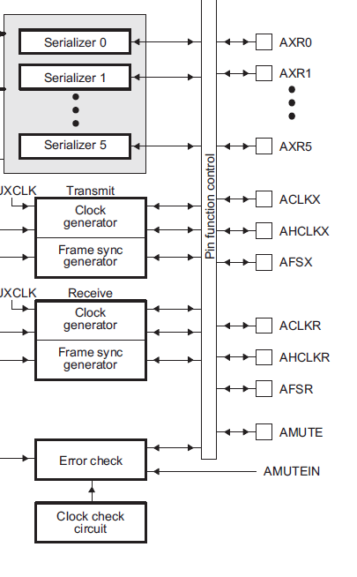
McASP:
The multichannel audio serial port (McASP) functions as a general-purpose audio serial port
Two independent clock generator modules for transmit and receive
The McASP is useful for time-division multiplexed (TDM) stream

Slide 16
WORK DONE:
Study of Digital Radio and Demodulation concepts.
Study of DRM Specifications and Standards.
Study of Jacinto 5 platform and its peripherals(Radio Manager, OutputManager, Supervisor).
Learning the basics of Code Composer Studio.
Implementation of FIR Filter in Code Composer Studio
Offline DRM code with Dummy Channel Decoder.
Study of Sample codes for Blackfin Processor.
Compiling the channel decoder module.

Slide 17
Pending Work:
J5 Peripheral Configuration.
Channel Decoder Porting.

Slide 18
REFERENCES:
http://www.etsi.org// Spec_es_201980v030201p.pdf
http://www.ti.com/general/docs/lit/DM814x Technical Ref. Manual.pdf

