Slide 1
Rockbuster Stealth LLC
Jon Yoo

Slide 2
Background Info
Rockbuster Stealth LLC wants to launch a new online video rental service.
To prepare for this new endeavor, we will discuss the potential effective strategies to maximize profits in a saturated market.

Slide 3
Key Questions
1. Which movies contributed most and least to revenue earned?
2. What is the average duration of rentals for all movies?
3. Which countries have the most Rockbuster customers?
4. Where do ‘high lifetime value’ customers live?
5. How much do sales vary by geographical region?

Slide 4
Data Overview
‘film’ table:
min, max, & average values

Slide 5
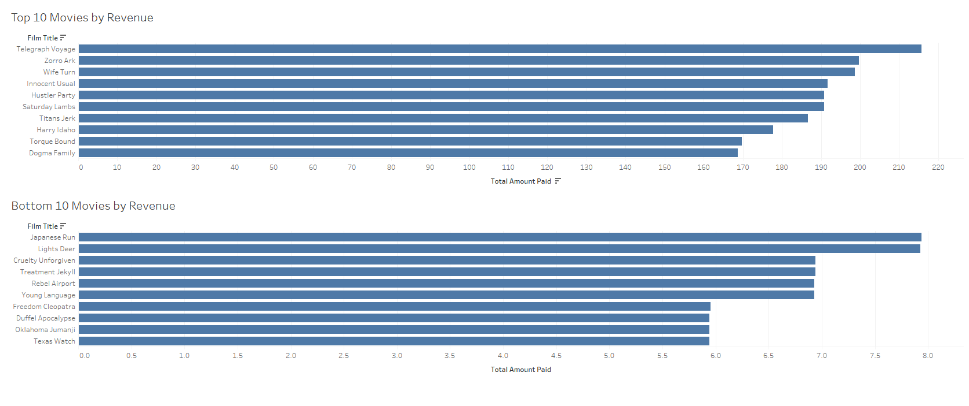
Which movies contributed most and least to revenue earned?

Slide 6
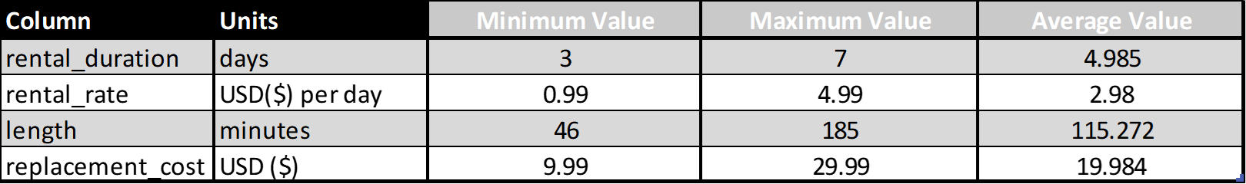
What is the average duration of rentals for all movies?
‘film’ table:
min, max, & average values
Average rental duration was about 4.985 days

Slide 7
Which countries have the most Rockbuster customers?
Top 10 countries:
(by customer count)

Slide 8
Where do ‘high lifetime value’ customers live?
Top 10 cities where ‘high lifetime value’ customers live:

Slide 9
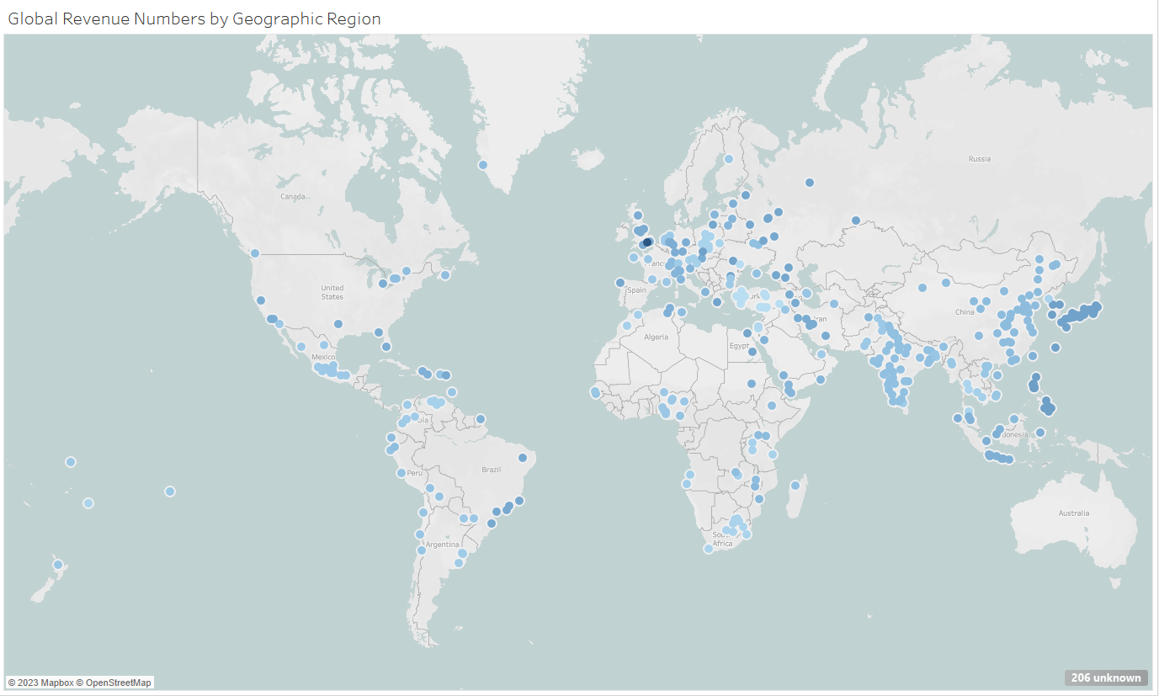
How much do sales vary by geographical region?
Top 10 countries that generate the most revenue from customers:

Slide 10
Recommendations:
I recommend that Rockbuster focus on the international market, as most movie rental revenue come from outside the United States. In particular, focus on researching movie trends in China, India, and Japan.
Focus on licensing of non-English language content due to large international movie rental market.
Produce a rental pricing structure that will maximize the revenue made from 5 day rentals.

Slide 11

Conclusion

