Slide 1
Beginning Frontend Development with React

Slide 2
Lesson 1
Introducing React and UI Design

Slide 3
Lesson Objectives
In this lesson, we will cover the following topics:
Describe what React is and where it fits in the development of your applications
Set up the infrastructure of a React-based application
Design the UI of your application, optimizing it for use in React

Slide 4
Topic A: What is React?
React is a JavaScript library for building composable user interfaces
A component is an element that contributes to building the user interface
React components have the ability to present data that changes over time
React implements the View part of the most common presentational design patterns

Slide 5








Topic B: How to Set up a React-Based Application
Setting up a modern JavaScript development environment requires the installation and configuration of a few tools:
Package managers
Transpilers
Module bundlers
Task runners
Scaffolding tools
Test runners

Slide 6
Installing create-react-app
create-react-app is a command-line interface (CLI) that allows us to set up a React-based application without needing to configure any of the aforementioned tools:
npm install -g create-react-app
create-react-app --version

Slide 7
Creating Your First React Application
Set up all the stuff for a React-based application named hello-react:
create-react-app hello-react

Slide 8
Activity A: Creating an Application with create-react-app
Aim The aim of the activity is to start becoming familiar with create-react-app and the content it creates. Scenario We need to set up a development environment in order to create a product catalog application built with React.
Step for Completion
Use create-react-app to create the development environment, and give the name my-shop to the sample application.

Slide 9
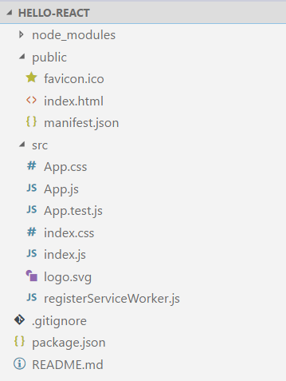
Exploring the Generated Content
Let's take a look at the files generated by create-react-app, so that we can get an understanding of the structure of a React-based application.

Slide 10
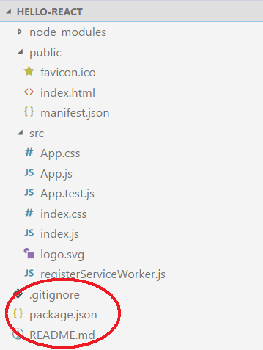
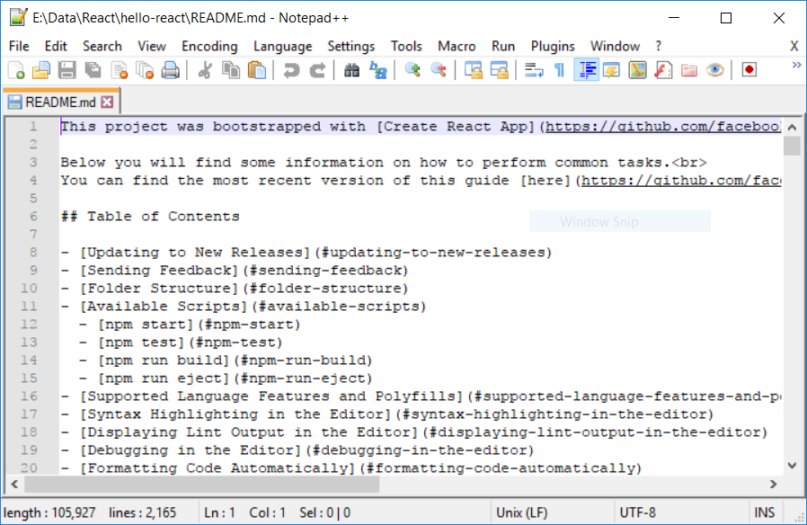
Exploring the Generated Content
In the root folder, we can see a README.md file, the package.json file, and the .gitignore file:

Slide 11
Exploring the Generated Content
The package.json file contains information about the project, such as the name, the version, and so on, and references to all the npm packages used by the current project
{
"name": "hello-react",
"version": "0.1.0",
"private": true,
"dependencies": {
"react": "^16.0.0",
"react-dom": "^16.0.0",
"react-scripts": "1.0.14"
},
"scripts": {
"start": "react-scripts start",
"build": "react-scripts build",
"test": "react-scripts test --env=jsdom",
"eject": "react-scripts eject"
}
}

Slide 12

Exploring the Generated Content
Nowadays, it is essential to have a project under version control:

Slide 13
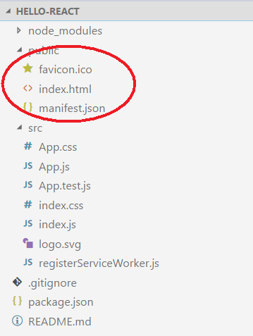
Exploring the Generated Content
These are the static parts of our application

Slide 14
Exploring the Generated Content
Keras has two methods for evaluating a mode: either using parameters during training:
index.html
<!doctype html>
<html lang="en">
<head>
<meta charset="utf-8">
<meta name="viewport" content="width=device-width, initial-scale=1, shrink-to-fit=no">
<meta name="theme-color" content="#000000">
<link rel="manifest"
href="%PUBLIC_URL%/manifest.json">
<link rel="shortcut icon"
href="%PUBLIC_URL%/favicon.ico">
<title>React App</title>
</head>
<body>
<noscript>
You need to enable JavaScript to run this app.
</noscript>
<div id="root"></div>
</body>
</html>

Slide 15
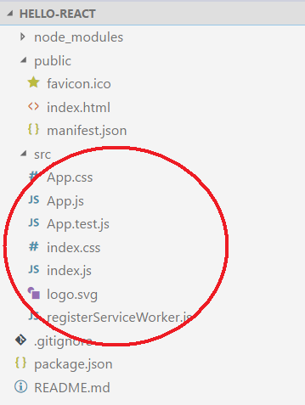
Exploring the Generated Content
The source folder contains the basic files, with the code that we can modify for our purposes:

Slide 16
Exploring the Generated Content
Let's understand the code of the index.js file:
index.js
import React from 'react';
import ReactDOM from 'react-dom';
import './index.css';
import App from './App';
import registerServiceWorker from './registerServiceWorker';
ReactDOM.render(<App />, document.getElementById('root'));
registerServiceWorker();

Slide 17
Exploring the Generated Content
App.js
import React, { Component } from 'react';
import logo from './logo.svg';
import './App.css';
class App extends Component {
render() {
return (
<div className="App">
<header className="App-header">
<img src={logo} className="App-logo" alt="logo" />
<h1 className="App-title">Welcome to React</h1>
</header>
<p className="App-intro">
To get started, edit <code>src/App.js</code> and save to reload.
</p>
</div>
);
}
}
export default App;

Slide 18
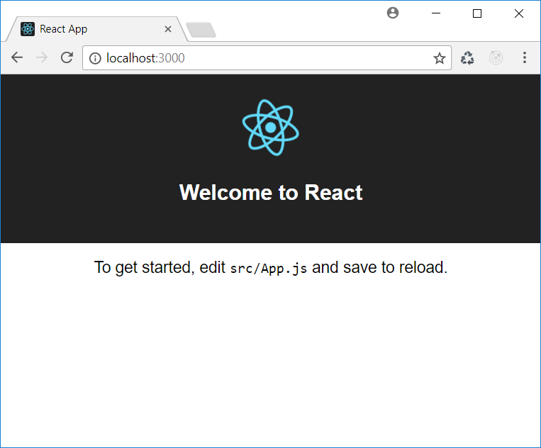
Topic B: How to Set up a React-based Application
npm start

Slide 19
Activity B: Starting and Changing the Application
Aim The aim of the activity is to become familiar with launching an application and appreciating the hot reloading feature. Scenario We want to change the title of the application that was created in the previous activity.
Step for Completion Start the application so that you can see it in a browser, then edit the App.js file and set the title to My Shop.

Slide 20
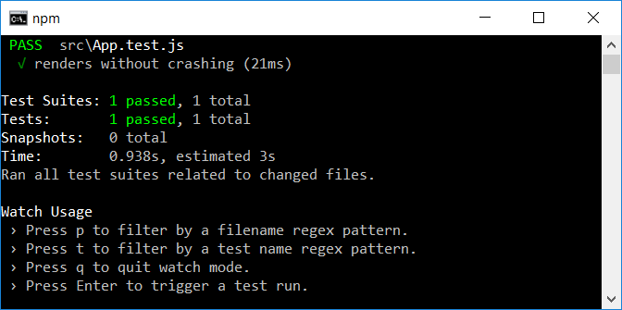
Activity B: Starting and Changing the Application
npm test

Slide 21
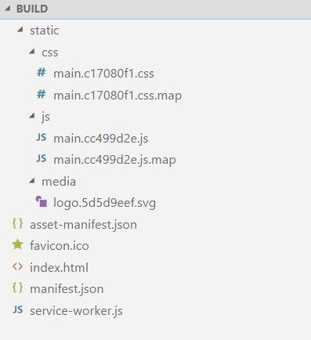
Activity B: Starting and Changing the Application
npm run build

Slide 22
Activity B: Starting and Changing the Application
npm run eject
It put our application out of the CLI context
It gives us the power and the responsibility to manage it
This is a one-way process

Slide 23
Topic C: How to Design a UI
A user interface is an aggregate of components
The whole React application is an aggregate of components
From a design point of view, we can say that a component is a part of the user interface, having a specific role
A hierarchy of components is often called a component tree

Slide 24
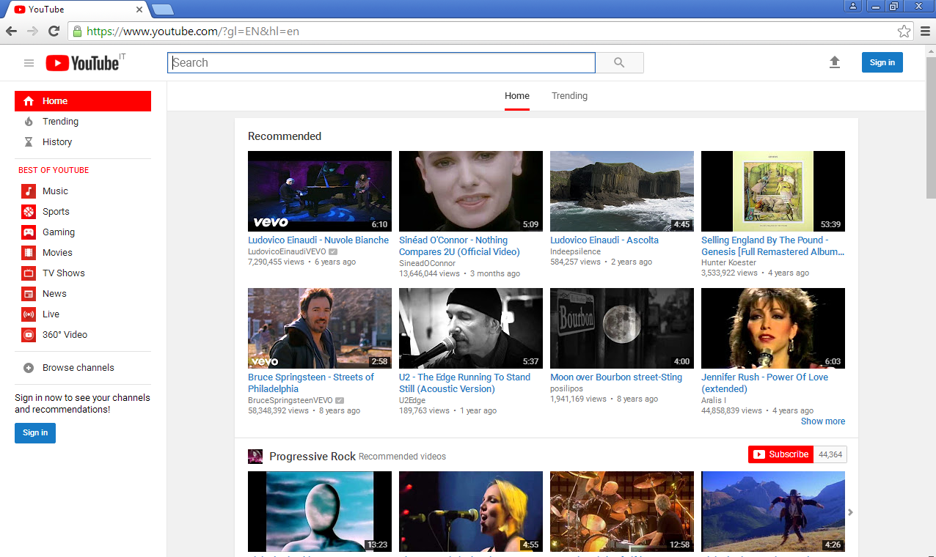
Decompose a User Interface

Slide 25
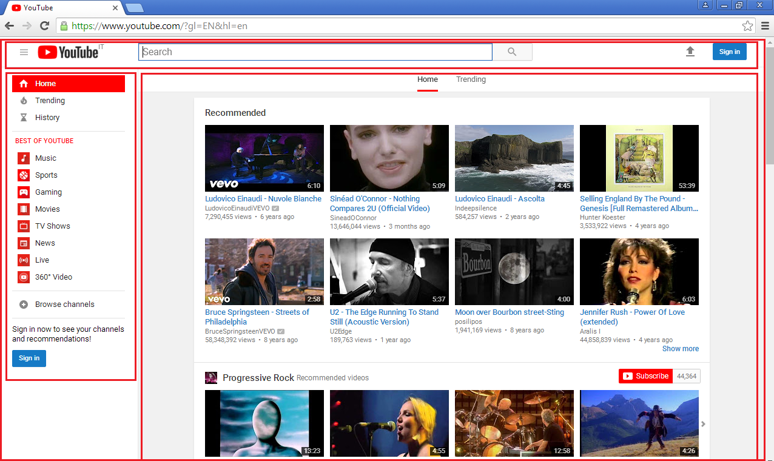
Decompose a User Interface

Slide 26

Decompose a User Interface

Slide 27
Container and Presentational Components
Container components are components that have not a relevant visual effect. Their role is mainly to group together other components.
Presentational components are components that display data in a graphical form.

Slide 28
Activity C: Detecting Components in a Web User Interface
Aim
The aim of the activity is to address the design process when implementing React-based user interfaces.
Scenario
We need to convert the Wikipedia website's user interface (https://en.wikipedia. org) into React components.
Steps for Completion
Analyze its current structure and detect the items you can implement as components.
Indicate which would be container and which would be presentational components.

Slide 29
Summary
In this lesson, we started to explore the React world. In particular, we
Established that React is a user interface library, used to implement the View part of various MV* design patterns
Introduced the create-react-app tool, which helps us to set up a development environment to build React-based applications
Explored the items comprising a typical React-based application
Analyzed the approach to design user interfaces that best suits the React world

