Slide 1
Beginning Frontend Development with React
Notes:
<number>

Slide 2
Lesson 2
Creating Components
Notes:
<number>

Slide 3
Lesson Objectives
By the end of this lesson, you will be able to:
Create basic React components
Use JSX to define a component's markup
Combine multiple React components in order to create complex UI elements
Manage the internal state of React components

Slide 4
Topic A: Definition of a Component
import React from 'react';
class Catalog extends React.Component {
render() {
return <div><h2>Catalog</h2></div>;
}
}
export default Catalog;

Slide 5
Topic A: Definition of a Component
The render() method must comply with a few constraints
It is mandatory; that is, any React component must implement it
It must return one React element; that is, a single markup item with any nested elements
It should be a pure function; that is, it should not change the internal state of the component
It should not directly interact with the browser; that is, it shouldn't contain statements that try to access the DOM

Slide 6
Topic A: Definition of a Component
import React, { Component } from 'react';
import logo from './logo.svg';
import './App.css';
class App extends Component {
render() {
return (
<div className="App">
<header className="App-header">
<img src={logo} className="App-logo" alt="logo" />
<h1 className="App-title">Welcome to React</h1>
</header>
<p className="App-intro">
To get started, edit <code>src/App.js</code> and save to reload.
</p>
</div>
);
}
}
export default App;

Slide 7
Topic A: Definition of a Component
import React, { Component } from 'react';
import './App.css';
import Catalog from './Catalog';
class App extends Component {
render() {
return (
<div className="App">
<header className="App-header">
<h1 className="App-title">The Catalog App</h1>
</header>
<Catalog />
</div>
);
}
}
export default App;

Slide 8
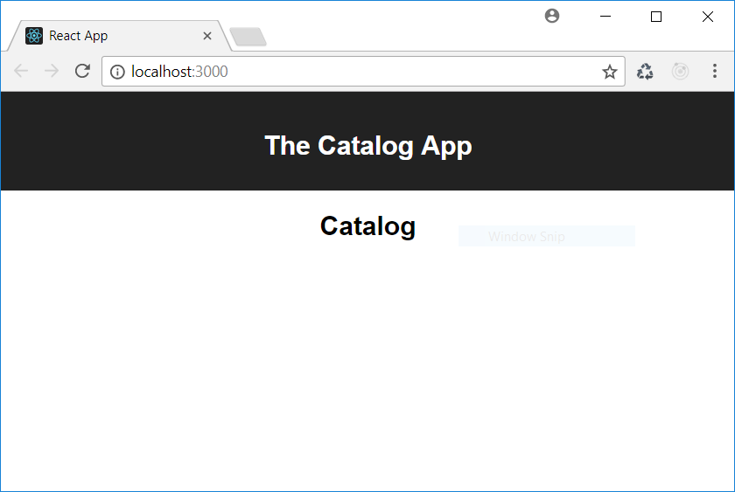
Topic A: Definition of a Component

Slide 9
Managing Styles
We notice an import statement concerning a CSS file in the App component module.
This allows us to use inside our component the classes and other CSS definitions defined in App.css.
import React, { Component } from 'react';
import './App.css';
import Catalog from './Catalog';

Slide 10
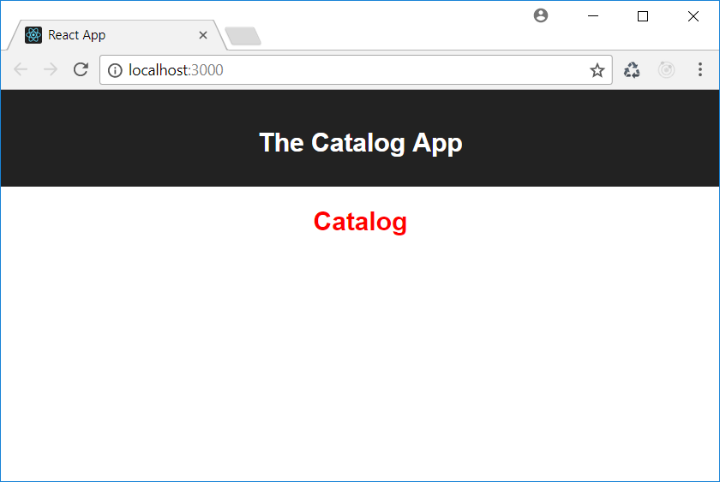
Managing Styles

Slide 11
Activity A: Defining a Shopping Cart
Aim The aim of this activity is to start using React to define a component. Scenario We need a shopping cart for our e-shop.
Steps for Completion 1. We should define a React component that acts as the basis of a shopping cart. 2. It should be a component that simply shows the string Cart.

Slide 12
Topic B: Using JSX
import React from 'react';
import './Catalog.css';
class Catalog extends React.Component {
render() {
return <div><h2>Catalog</h2></div>;
}
}
export default Catalog;

Slide 13
Topic B: Using JSX
JSX extends JavaScript with XML expressions in order to simplify the creation of HTML elements within JavaScript code:
//Valid
<div><h2>Catalog</h2></div>
//Not Valid
<div><h2>Catalog</h2></div>
<div><img src="image.png" /></div>

Slide 14
Topic B: Using JSX
JSX expressions must be compliant with XML syntax:
//Valid
<img src="image.png" />
//Not Valid
<img src="image.png">

Slide 15
Topic B: Using JSX
We can assign a JSX expression to a variable:
import React from 'react';
import './Catalog.css';
class Catalog extends React.Component {
render() {
let output = <div><h2>Catalog</h2></div>;
return output;
}
}
export default Catalog;

Slide 16
Topic B: Using JSX
We can embed any JavaScript expression inside a JSX expression:
import React from 'react';
import './Catalog.css';
class Catalog extends React.Component {
render() {
let title = "Catalog";
return <div><h2>{title}</h2></div>;
}
}
export default Catalog;

Slide 17
Topic B: Using JSX
The JavaScript expression can be as complex as we need:
import React from 'react';
import './Catalog.css';
class Catalog extends React.Component {
render() {
let title = "The Catalog of today " + new Date().toDateString();
return <div><h2>{title}</h2></div>;
}
}

Slide 18
Topic B: Using JSX
A common usage of a combination of JavaScript and JSX expressions is called conditional rendering:
render() {
let message;
let today = new Date().getDay();
if (today == 0) {
message = <div className="sorry">We are closed on Sunday...</div>;
} else {
message = <div className="happy">How can we help you?</div>
}
return message;
}

Slide 19
Topic B: Using JSX
You can put a JSX expression in multiple lines:
import React from 'react';
import './Catalog.css';
class Catalog extends React.Component {
render() {
let title = "Catalog";
return (<div>
<h2>{title}</h2>
</div>);
}
}

Slide 20
Topic B: Using JSX
You can put comments inside a JSX expression by using the JavaScript syntax wrapped in curly brackets:
<div>
<h2>Catalog</h2>
{//This is a comment}
{/* This is a comment, too */}
</div>;

Slide 21
Topic B: Using JSX
JSX has a few restrictions:
All HTML tags are in lowercase
You need to use className instead of the class attribute
You need to use htmlFor instead of the for attribute

Slide 22
Activity B: Translating HTML into JSX
Aim
The aim of this activity is to understand the difference between HTML and JSX.
Scenario
The Graphics department has provided you with an HTML snippet and you need to translate it into JSX in order to create a React component.
Steps for Completion
Open the Code02.txt file.
Transform the HTML code it contains into JSX.

Slide 23
Topic C: Composing Components
We can use the ProductList component as a tag in the JSX markup of the Catalog component:
import React from 'react';
import ProductList from './ProductList';
class Catalog extends React.Component {
render() {
return <div>
<h2>Catalog</h2>
<ProductList />
</div>;
}
}
export default Catalog;

Slide 24
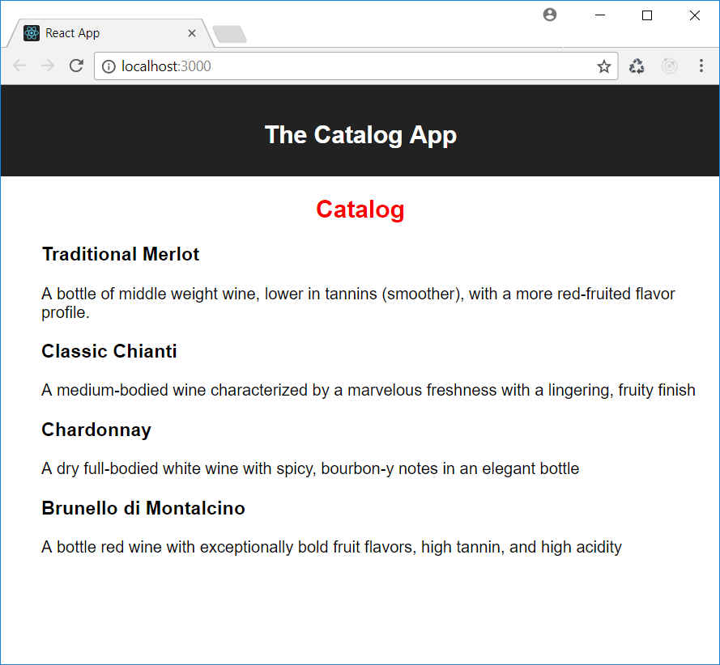
Composing Components

Slide 25
Activity C: Defining a Composed Cart
Aim
The aim of this activity is to compose React components.
Scenario
We want to create some content for our shopping cart.
Step for Completion
Integrate the previously created Cart component in order to contain a CartList component showing two items.

Slide 26
Topic D: Data Propagation
Create a Product component that acts as a template for each list item:
import React from 'react';
class Product extends React.Component {
render() {
return <li>
<h3>Product name</h3>
<p>Product description</p>
</li>;
}
}
export default Product;

Slide 27
Topic D: Data Propagation
We can dynamically build our product list:
class ProductList extends React.Component {
render() {
let products = [{name: "Traditional Merlot", description: "..."}, ...];
let productComponents = [];
for (let product of products) {
productComponents.push(<Product/>);
}
return <ul>{productComponents}</ul>;
}
}

Slide 28
Topic D: Data Propagation
We need a way to pass the data of each product to the component class: component attributes:
class ProductList extends React.Component {
render() {
let products = [{name: "Traditional Merlot", description: "..."}, ...];
let productComponents = [];
for (let product of products) {
productComponents.push(<Product item={product} />);
}
return <ul>{productComponents}</ul>;
}
}

Slide 29
Topic D: Data Propagation
We need a way to receive and manage the passed data: component props:
import React from 'react';
class Product extends React.Component {
render() {
return <li>
<h3>{this.props.item.name}</h3>
<p>{this.props.item.description}</p>
</li>;
}
}
export default Product;

Slide 30
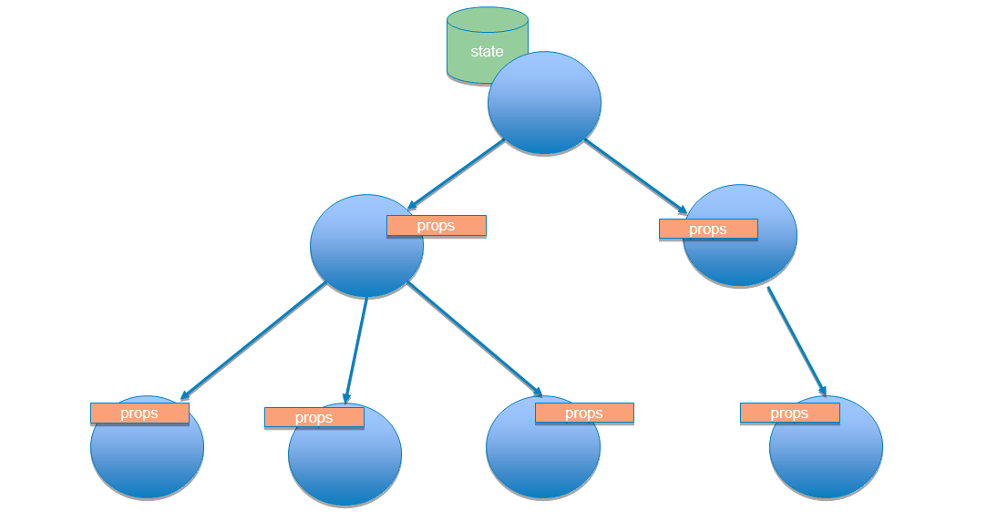
Topic D: Data Propagation
Data passes from a component to another in a unidirectional data flow, from the parent component towards the children components:

Slide 31
Activity D: Creating a Cart Item Component
Aim
The aim of this activity is to compose React components and pass data between them.
Scenario
We want to make the CartList component a dynamic component, so that it can adapt its content to received data.
Steps for Completion
Create a CartItem component showing the name of an item.
Change the previously created CartList component so that it is dynamically composed of CartItem instances based on an items array.

Slide 32
Topic E: Managing the Internal State
React state is a property that represents data that changes over time
Components that store data that can change over time are called stateful components
To inform a component that the state has changed, we use the setState() method

Slide 33
Topic E: Managing the Internal State
State initialization is the only case where you can assign a value to the this.state property without using setState():
class ProductList extends React.Component {
constructor() {
super();
this.state = { products: [] };
fetch("products.json")
.then(response => response.json())
.then(json => {this.setState({products: json})})
.catch(error => console.log(error));
}

Slide 34
Topic E: Managing the Internal State
Changes to the state trigger the component's rendering, that is, the automatic execution of the render() method:
class ProductList extends React.Component {
...
render() {
let productComponents = [];
for (let product of this.state.products) {
productComponents.push(<Product item={product}/>);
}
return <ul>{productComponents}</ul>;
}
}

Slide 35
Topic E: Managing the Internal State
setState() merges new data with old data already contained in the state and overwrites the previous state
setState() triggers the execution of the render() method, so you should never call render() explicitly

Slide 36
Topic E: Managing the Internal State
State should contain the minimum data needed to represent data that can change over time in your UI; any information that can be derived from this minimal data should be computed inside the render() method
State should be avoided as much as possible, since it adds complexity to a component
Stateful components should be located high up in the component hierarchy of a UI

Slide 37
Topic E: Managing the Internal State
We move the logic of getting data inside the Catalog component:
class Catalog extends React.Component {
constructor() {
super();
this.state = { products: [] };
fetch("products.json")
.then(response => response.json())
.then(json => {this.setState({products: json})})
.catch(error => console.log(error));
}
render() {
return <div><h2>Wine Catalog</h2><ProductList items={this.state.products}/></div>;
}
}

Slide 38
Activity E: Adding State Management to the Cart Component
Aim
The aim of this activity is to become familiar with component state management.
Scenario
In order to make the Cart component production ready, we add state management and dynamic data loading.
Step for Completion
Change the previously created Cart component and add state management so that data is loaded via HTTP requests and the contents of the Cart are automatically updated.

Slide 39
Summary
In this lesson, we started to create React components and explored their basic
features. In particular, we:
Learned how to define a component as a class derived from React.Component and how to import specific CSS styles
Explored the syntax of JSX, which allows us to quickly define the graphical aspect of a component and to use React components defined elsewhere
Combined React components in order to build other components
Used state management features so that React components automatically update their look when data changes

