Slide 1
Beginning Frontend Development with React
Notes:
<number>

Slide 2
Lesson 3
Managing User Interactivity
Notes:
<number>

Slide 3
Lesson Objectives
By the end of this lesson, you will be able to:
Handle events generated by user interaction
Change a component's state on event triggering
Use the component's lifecycle events for a better user experience
Configure routing to allow navigation through components

Slide 4
Topic A: Managing User Interaction
[
{"code":"P01",
"name": "Traditional Merlot",
"description": "A bottle of middle weight wine...",
"price": 4.5},
{"code":"P02",
"name": "Classic Chianti",
"description": "A medium-bodied wine...",
"price": 5.3},
{"code":"P03",
"name": "Chardonnay",
"description": "A dry full-bodied white wine...",
"price": 4.0},
{"code":"P04",
"name": "Brunello di Montalcino",
"description": "A bottle of red wine...",
"price": 7.5}
]

Slide 5
Topic A: Managing User Interaction
Showing price on click event
import React from 'react';
class Product extends React.Component {
showPrice() {
alert(this.props.item.price);
}
render() {
return <li onClick={() => this.showPrice()}>
<h3>{this.props.item.name}</h3>
<p>{this.props.item.description}</p>
</li>;
}
}
export default Product;

Slide 6
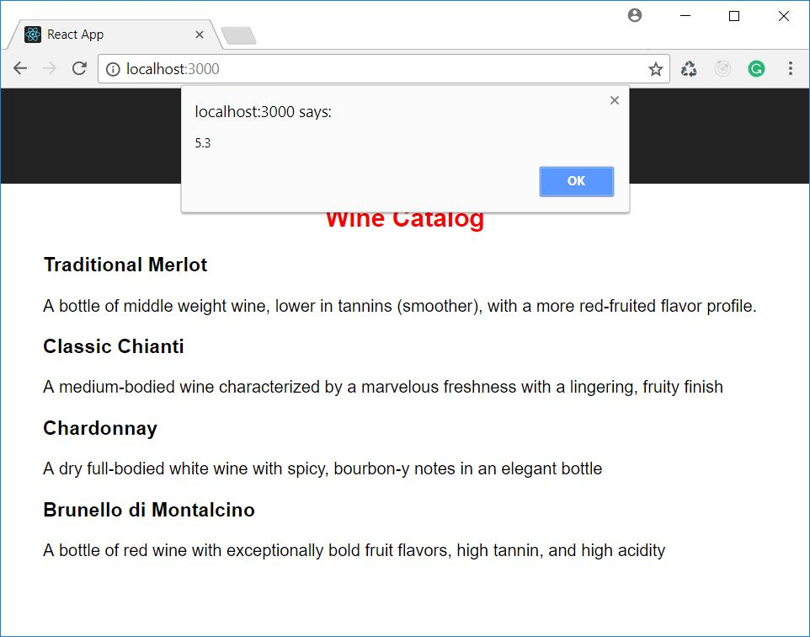
Topic A: Managing User Interaction
Showing price on click event

Slide 7
HTML Events versus React Events
HTML | React
<li onclick="...">...</li> | <li onClick=...>...</li>
<li onclick="showPrice()">...</li> | <li onClick={showPrice}>...</li> <li onClick={() => this.showPrice()}>
<a href="#" onclick={(e) => { console.log("Clicked"); return false;}}>Click</a> | <a href="#" onClick={(e) => { e.preventDefault(); console.log("Clicked");}}>Click</a>

Slide 8
Event Handlers and the this Keyword
<li onClick={() => this.showPrice()}>
<li onClick={this.showPrice.bind(this)}>
constructor() {
this.showPrice = this.showPrice.bind(this);
}
...
<li onClick={this.showPrice}>

Slide 9
Changing the State
[
{"code":"P01",
"name": "Traditional Merlot",
"description": "A bottle of middle weight wine...",
"price": 4.5,
"selected": false},
{"code":"P02",
"name": "Classic Chianti",
"description": "A medium-bodied wine...",
"price": 5.3,
"selected": false},
{"code":"P03",
"name": "Chardonnay",
"description": "A dry full-bodied white wine...",
"price": 4.0,
"selected": false},
{"code":"P04",
"name": "Brunello di Montalcino",
"description": "A bottle of red wine...",
"price": 7.5,
"selected": false}
]

Slide 10
Changing the State
Change background color on click
import React from 'react';
import './Product.css'
class Product extends React.Component {
select() { this.props.item.selected = !this.props.item.selected; }
render() {
let classToApply = this.props.item.selected? "selected": "";
return <li onClick={() => this.select()} className={classToApply}>
<h3>{this.props.item.name}</h3>
<p>{this.props.item.description}</p>
</li>;
}
}
export default Product;

Slide 11
Changing the State
In a React component hierarchy, data flows in a unidirectional way
state
props
props
props
props
props
props

Slide 12
Changing the State
The parent component must provide methods to its children via props property
class Catalog extends React.Component {
constructor() { ... }
select(productCode) {
let productList = this.state.products.map(function(p) {
if (p.code === productCode) {
p.selected = (!p.selected);
}
return p;
});
this.setState({products: productList});
}
render() {
return <div><h2>Wine Catalog</h2><ProductList items={this.state.products} selectHandler={this.select}/></div>;
}
}

Slide 13
Changing the State
The method is propagate to children
class ProductList extends React.Component {
render() {
let products = [];
for (let product of this.props.items) {
products.push(<Product item={product} selectHandler={this.props.selectHandler}/>);
}
return <ul>{products}</ul>;
}
}

Slide 14
Changing the State
The target component handles the event by calling the passed method
class Product extends React.Component {
render() {
let classToApply = this.props.item.selected? "selected": "";
return <li onClick={() => this.props.selectHandler (this.props.item.code)} className={classToApply}>
<h3>{this.props.item.name}</h3>
<p>{this.props.item.description}</p>
</li>;
}
}

Slide 15
Changing the State
An event on a child component triggers the execution of a parent component method passed via props
state
setState()
props
props
User interaction
props
props
props
props

Slide 16
Activity A: Adding Items to the Shopping Cart
Aim
The aim of this activity is to become familiar with event management in React.
Scenario
We want to allow the user to add items to the shopping cart by picking them from the product catalog.
Steps for Completion
Consider the existing project in my-cart-01 folder.
Handle the click event of the Add to cart button of the Product component in order to add that product to the cart.

Slide 17
Topic B: Component Lifecycle Events
Component’s constructor execution
DOM is not available
It is not possible to access any child component
It is the right time to perform those initializations not involving graphic rendering or child manipulation

Slide 18
Topic B: Component Lifecycle Events
Lifecycle events
componentWillMount
componentWillReceiveProps
shouldComponentUpdate
componentWillUpdate
componentDidUpdate
componentDidMount
componentWillUnmount

Slide 19
Topic B: Component Lifecycle Events
Grouping lifecycle events
mounting componentWillMount, componentDidMount, componentWillUnmount
updating via props componentWillReceiveProps, shouldComponentUpdate, componentWillUpdate, componentDidUpdate
updating via setState() shouldComponentUpdate, componentWillUpdate, componentDidUpdate

Slide 20
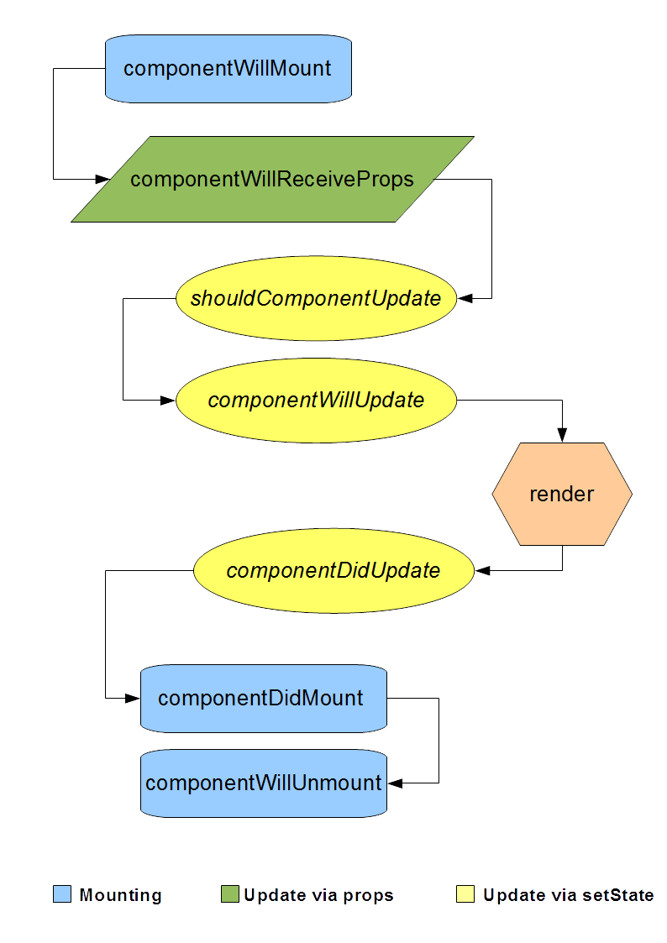
Topic B: Component Lifecycle Events
Events flow

Slide 21
Activity B: Showing the Quantity of Items Added to the Cart
Aim
The aim of this activity is to exploit the lifecycle events of React components
Scenario
We want to avoid multiple occurrences of the same product appearing in the cart. So we want the cart showing a single occurrence of the product and its quantity.
Steps for Completion
Use the project changed in the previous activity (or the existing project in my-cart-02 folder).
Change the Cart component in order to show a list of non-duplicated products and their related number of occurrences.
Tip: Handle the componentWillReceiveProps event to prepare data for the internal state of the Cart component.

Slide 22
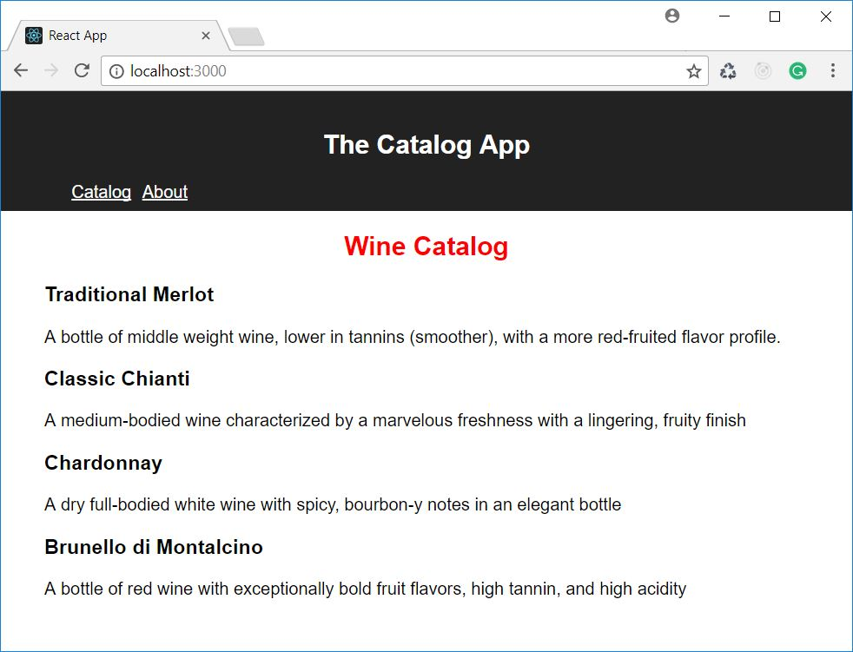
Topic C: Managing Routing
A view is a placeholder in the UI where we can dynamically render one component or another in an exclusive way

Slide 23
Installing React Router
react-router
react-router-dom
react-router-native
npm install --save react-router-dom

Slide 24
Using the Router
Adding routing capabilities to our application
import React from 'react';
…
import { BrowserRouter } from 'react-router-dom'
ReactDOM.render(
<BrowserRouter>
<App />
</BrowserRouter>
, document.getElementById('root'));
registerServiceWorker();

Slide 25
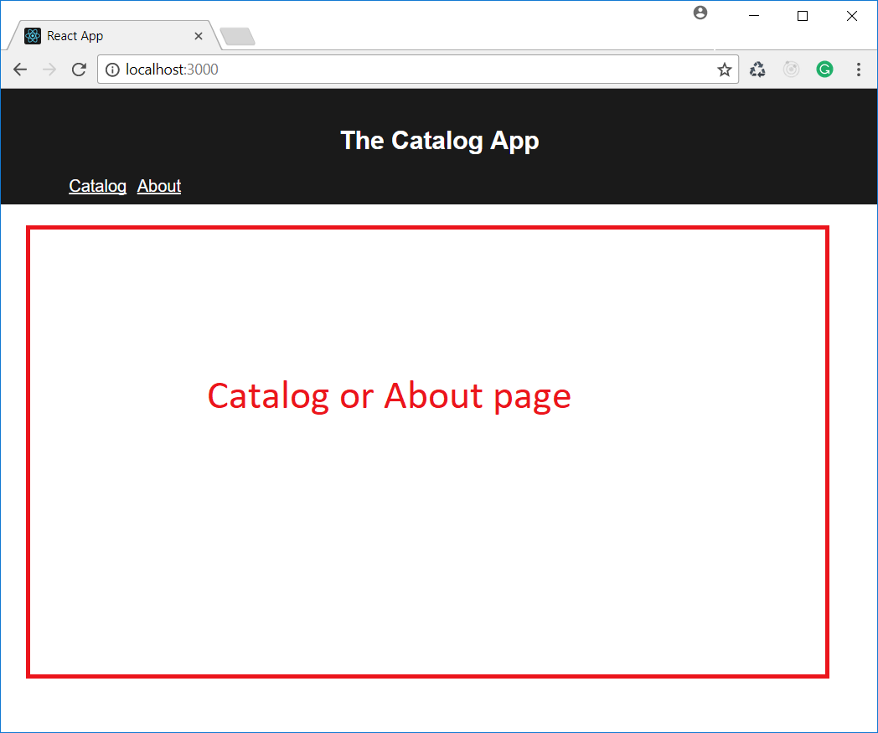
Defining Views
Adding routing capabilities to our application

Slide 26
Defining Views
Creating a view to display components
...
import { Switch, Route } from 'react-router-dom'
class App extends Component {
render() {
return (
<div className="App">
<header className="App-header">...</header>
<Switch>
<Route exact path='/' component={Catalog}/>
<Route path='/about' component={About}/>
</Switch>
</div>
);
}
}

Slide 27
Defining Views
Defining the navigation bar
...
import { Switch, Route, Link } from 'react-router-dom'
class App extends Component {
render() {
return (
<div className="App">
<header className="App-header">…
<nav>
<ul>
<li><Link to='/'>Catalog</Link></li>
<li><Link to='/about'>About</Link></li>
</ul>
</nav>
</header>
<Switch>...</Switch>
</div>
);
}
}

Slide 28
Some Notes about the Route Component
The path attribute
The path value that matches the starting part of the URL
<Switch>
<Route path='/' component={Catalog}/>
<Route path='/about' component={About}/>
</Switch>

Slide 29
Some Notes about the Route Component
The path attribute
The exact attribute forces a strict comparison between the path attribute's value and the URL
<Switch>
<Route exact path='/' component={Catalog}/>
<Route path='/about' component={About}/>
</Switch>

Slide 30
Some Notes about the Route Component
The path attribute
The component attribute maps a route to a component
The render attribute maps a route to a function returning a React element
The children attribute always renders a function returning a React element
<Switch>
<Route exact path='/' component={Catalog}/>
<Route path='/about' render={() => (<About data={someData}/>)}/>
<Route path='/footer' children={() => (<Footer />)}/>
</Switch>

Slide 31
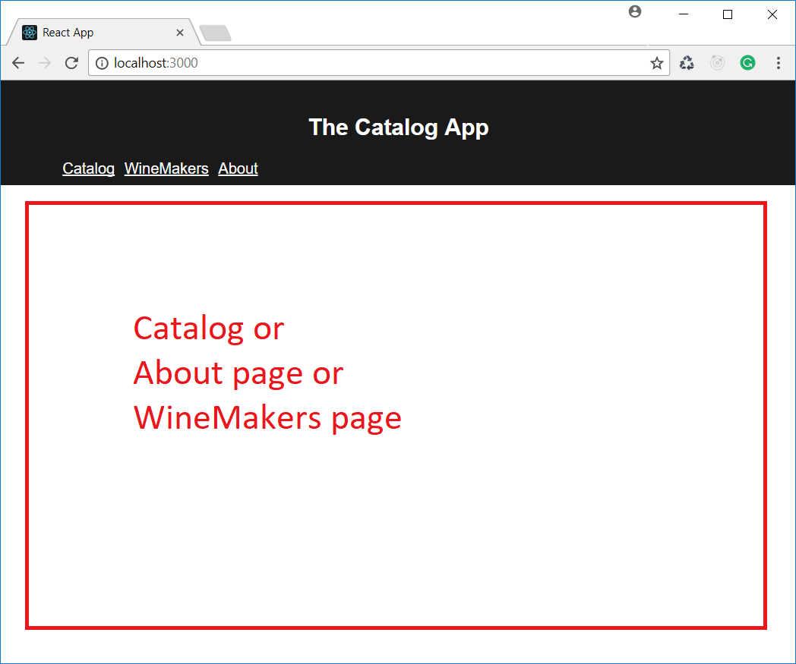
Some Notes about the Route Component
Nested views: the navigation bar

Slide 32
Some Notes about the Route Component
Nested views: the navigation bar
...
import WineMakers from './WineMakers';
class App extends Component {
render() {
return (
<div className="App">
<header className="App-header">...
<nav>
<ul> ...
<li><Link to='/winemakers'>WineMakers</Link></li>
</ul>
</nav>
</header>
<Switch> ...
<Route path='/winemakers' component={WineMakers}/>
</Switch>
</div>
);
}
}

Slide 33
Some Notes about the Route Component
Nested views: the nested routes
...
import WineMaker from './WineMaker';
class WineMakers extends React.Component {
renderWineMakersList() {
return <ul>
<li><Link to="/winemakers/WM1">Wine & Wine</Link></li>
<li><Link to="/winemakers/WM2">Wine & Co</Link></li>
</ul>;
}
render() {
return <Switch>
<Route exact path='/winemakers' render={this.renderWineMakersList}/>
<Route path='/winemakers/WM1' render={() => (<WineMaker code='WM1' />}/>
<Route path='/winemakers/WM2' render={() => (<WineMaker code='WM2' />}/>
</Switch>;
}
}

Slide 34
Path Parameters
Defining parameters
render() {
return <Switch>
<Route exact path='/winemakers' render={this.renderWineMakersList}/>
<Route path='/winemakers/:code' component={WineMaker}/>
</Switch>;
}

Slide 35
Path Parameters
Using parameters
class WineMaker extends React.Component {
constructor() {
super();
this.wineMakers = [...];
}
render() {
let wineMaker = this.wineMakers.find(wm => wm.code === this.props.match.params.code);
return <div>
<h2>{wineMaker.name}</h2>
<h3>{wineMaker.country}</h3>
<p>{wineMaker.description}</p>
</div>;
}
}

Slide 36
Path Parameters
Properties of the this.props.match object:
params: this is an object whose properties match the parameters in the path; that is, the dynamic parts preceded by colons
isExact: this is a Boolean indicating that the URL matches the path
Path: this is the string assigned to the path attribute of the selected Route
url: this is the URL that matched the Route's path

Slide 37
Activity C: Adding a View About Shipping Methods
Aim
The aim of this activity is to explore the components provided by React Routing.
Scenario
We want to add a section to our catalog app containing information about the available shipping methods.
Steps for Completion
Use the project changed in previous activity (or the existing project in my-cart-03 folder).
Create a ShippingMethods component, showing the list of available shipping methods, and a ShippingMethod component, showing the details of each shipping method according to the code passed via props (available shipping methods: ECO - Economic delivery, STD - Standard delivery, EXP - Express delivery).
Create a navigation bar and a routing configuration that allows us to navigate through the Catalog and the Shipping method views.

Slide 38
Summary
In this lesson, we learned how to manage user interaction. In particular, we:
We managed events that don't involve changes to a component's state
We handled events that involve changes to a component's state
We explored the component lifecycle and learned how to customize each phase
We used React Router's components to configure navigation between components

