Slide 1
Proactive Network Defence 7CS017 Case Study: Targeted attacks on Critical National Infrastructure and Associated Risks
By
Jones Tobi Ogidiagba
Student ID: 2056237
January, 2022

Slide 2

Introduction
The case study refers to the impact of targeted cyber-attacks and associated threats and vulnerabilities in Critical National Infrastructure (CNI)
It considers an example case study of converged integrated IT and industrial control systems (ICS).
ICS include supervisory control and data acquisition (SCADA) systems
Microsoft threat modelling technique is employed to model the threats in this case study

Slide 3
Trust Domains
Three Trust Domains selected are:
1
Corporate Trust Domain
2
Control System Trust Domain
3
Instrument/Devices Trust Domain

Slide 4
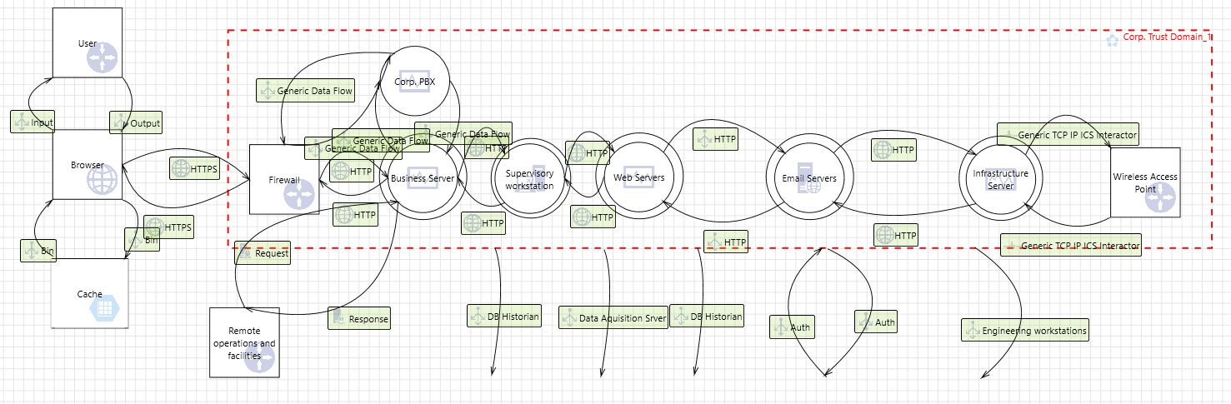
Corporate Trust Domain DFD Modelling

Slide 5
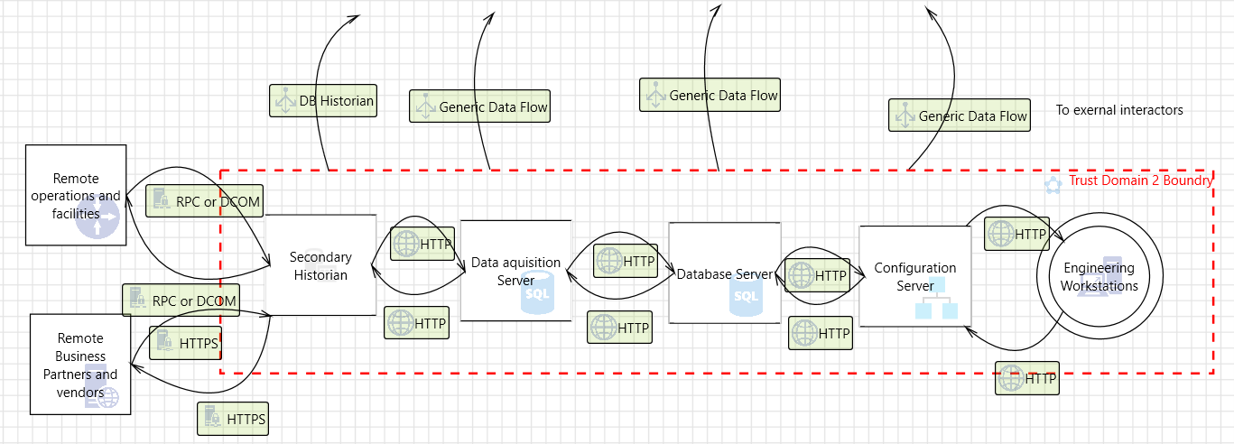
Control system Trust Domain DFD Modelling

Slide 6
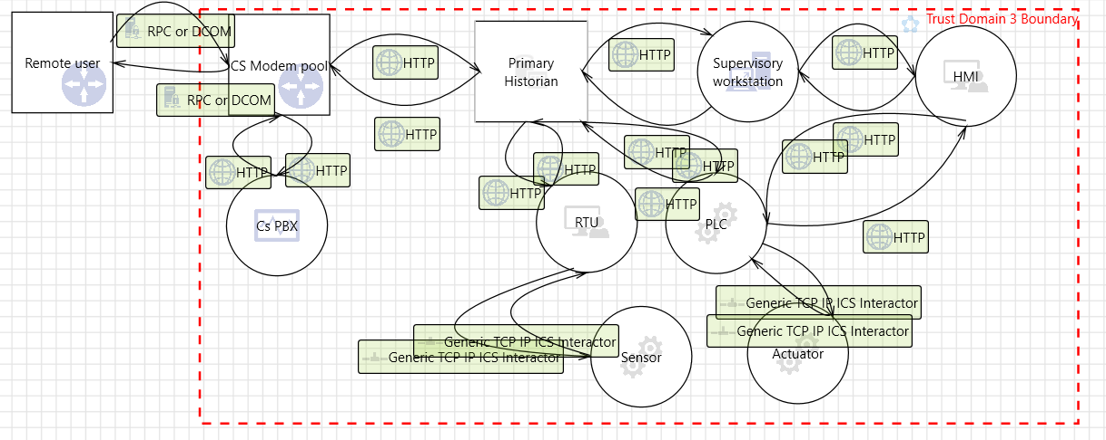
Instrument/Devices Trust Domain DFD Modelling

Slide 7
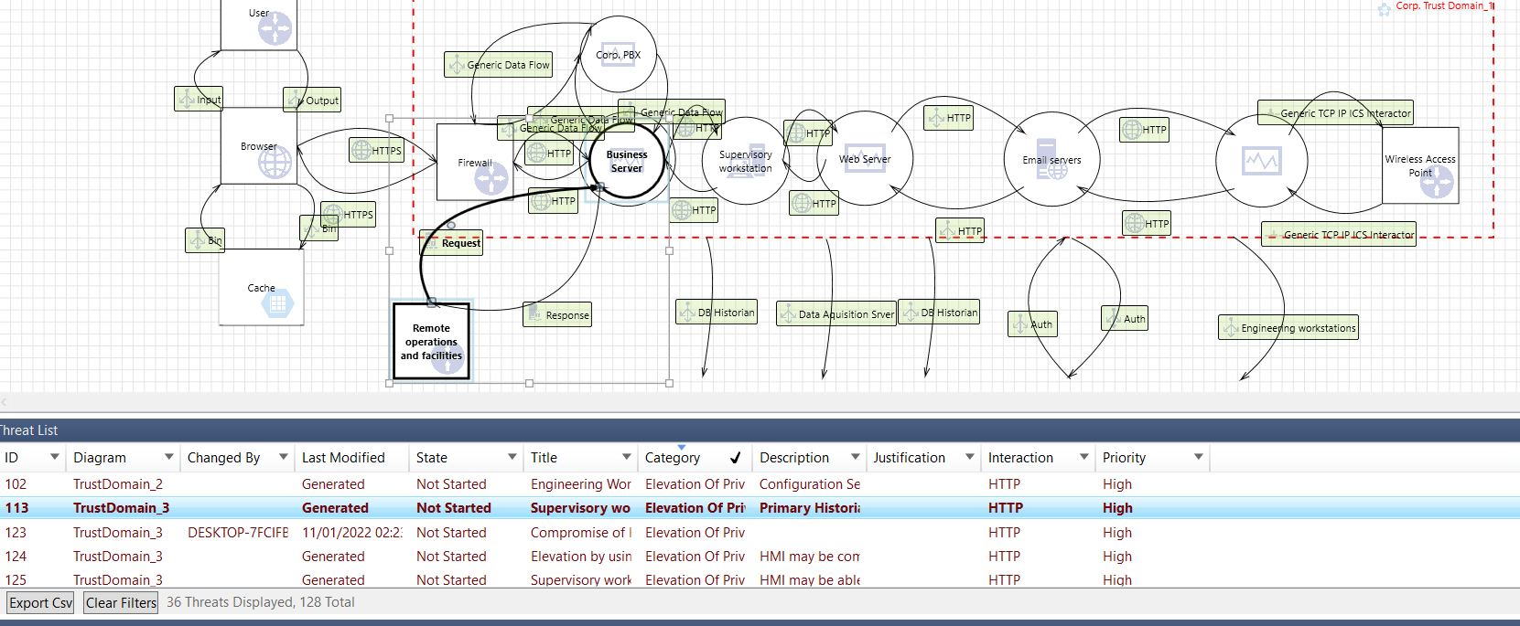
Threat Identification

Slide 8
Threats Identification continue
STRIDE used to classify threats in each Trust Domain according to the following.
Spoofing
Tampering
Repudiation
Information Disclosure
Denial of Service
Elevation of Privilege

Slide 9
Mitigation plans
Network
ICS communication traffic should be encrypted.
TCP/lP traffic within VPN tunnels should also be encrypted.
Shielded twisted pair cables should be used in sensitive areas.
Physical security preventing unauthorised access.
Use role-based logical access control, staff-vetting procedures to minimise insider attacks.
Non-integrity removable storage media should be discouraged.
Provide redundant critical network components for fail-over.
WiFi traffic should be securely encrypted and authenticated:
Use port blocking on network switches.
Establish DMZ between ICS and corporate network, and
employ honeypots and honeynets.

Slide 10
Mitigation plans cont.
Processes
Vetting staffs to mitigate insider attacks.
Incident response for ICS should be implemented.
There should be a disaster recovery and continuity plan in place.
Data historian should be situated within DMZ, and
Environmental-based control systems should be implemented.
Routine software patches should be carried out
Defence in diversity
Use of antimalware

Slide 11
Legal and Ethical Consideration
.
As ICSs are susceptible to attacks and are very important national asset, there are various regulations in place by different nations in order to avoid these catastrophic attacks. It is ensured that these regulations are considered in suggesting mitigating solutions. Regulations such as NIS Directives and Passport to Good Security

Slide 12
Conclusions
.
This report presented an overview and security analysis of national critical infrastructures. The case study was based on a converged IT and ICS environment. Microsoft threat modelling tool was used based on STRIDE methodology to analyse the system. The highlighted threats alongside suggestions for the mitigations were based on the data flow diagram derived from the case study.

