Slide 1
CASA VERDE STUDIO
Austin sustainable
interiors
A positioning story for the team
The strongest opening is a consistent project record around provenance, retention, care, and scope.
Internal working deck, 22 September 2026
01
Notes:
Sources: docs/reports/comparison.md and brand/casa_verde_brand_bible.md.
Research cutoff: 16 September 2026. Website recaptures: 17 September 2026.

Slide 2
Austin’s proof gap
Reuse appears across the field. Public proof varies from broad claims to recurring project records.
5
0
2
1
provisional competitors with unverified price fit
comparable public price ranges confirmed
firms with reuse documented across projects
named project with outside corroboration
What matters for Casa Verde
A client should be able to trace what stayed, where additions came from, how finishes were chosen, and how the room will age.
02
Notes:
Source: docs/reports/comparison.md.
All five firms are provisional fits because comparable pricing remains unverified.
Recurring project-linked reuse is documented for Stelly Selway and Studio Ferme. AIA corroborates Studio Ferme's Theresa project only.

Slide 3
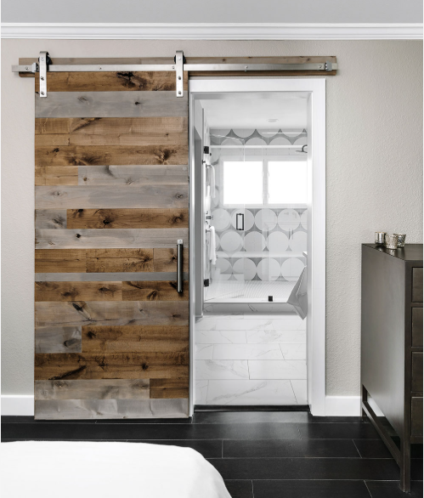
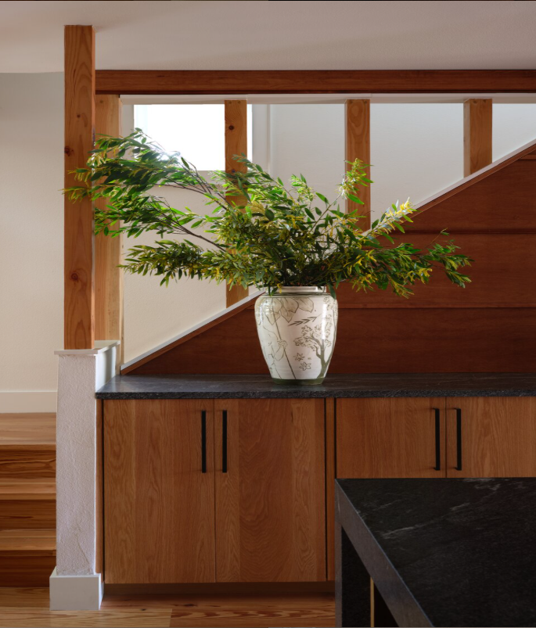
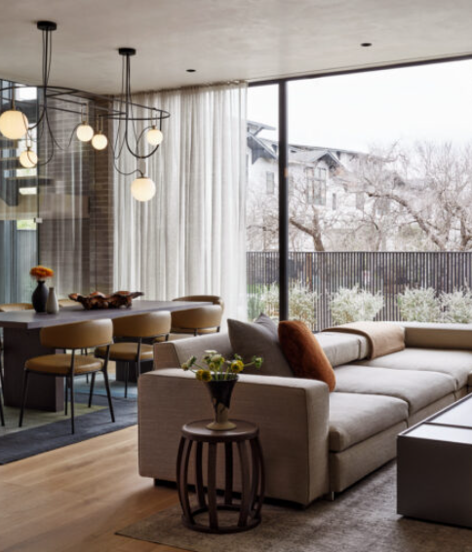
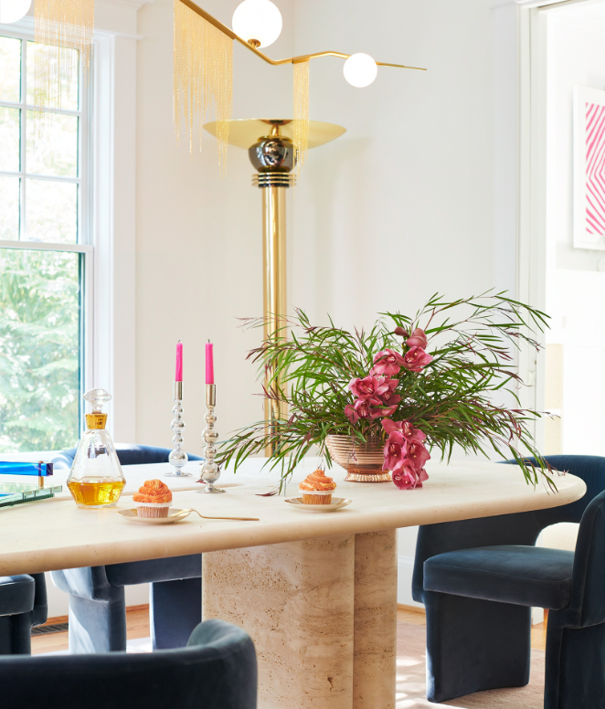
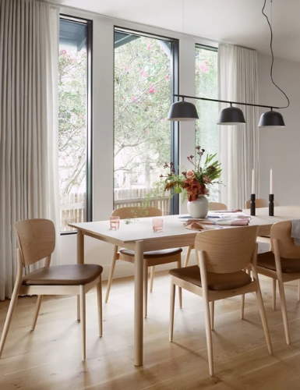
Five firms, five different kinds of proof
Urbane Design
Stelly Selway
Urbanspace
J.Fisher
Studio Ferme
Personal remodeling. Reuse appears in isolated cases.
Maker-led older homes. Reuse appears across projects.
Broad service range. One detailed sustainable case.
Personal homes and close guidance. General low-VOC claims.
Material life cycles and preservation. Availability unknown.
All five firms remain provisional because comparable pricing is unknown.
03
Notes:
Sources: docs/reports/comparison.md and the five competitor profiles.
Images: 17 September 2026 website recaptures from the five firm folders under assets/screenshots/websites.

Slide 4
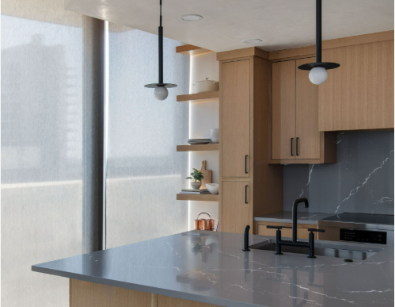
Urbane Design
POSITION
Personal Austin interiors across construction, remodeling, and furniture.
MATERIALS
Reclaimed doors appear at Misty Hill. White oak, stone, and tile appear at Big View. Recurrence remains unknown.
OPEN QUESTION
Newer cases offer less written context, so documentation continuity is difficult to assess.
WEBSITE RECAPTURE, 17 SEP 2026
04
Notes:
Sources: https://urbanedesignstudios.com/
https://urbanedesignstudios.com/project/misty-hill-remodel/
https://urbanedesignstudios.com/project/big-view-remodel/
Profile: docs/reports/competitors/urbane-design.md
Image source: C:\Users\jooar\ds\projects\marketing-and-competitive-analisys-casa-verde\assets\screenshots\websites\urbane-design\recapture-2026-09-17\360-condo_gallery-01.png

Slide 5
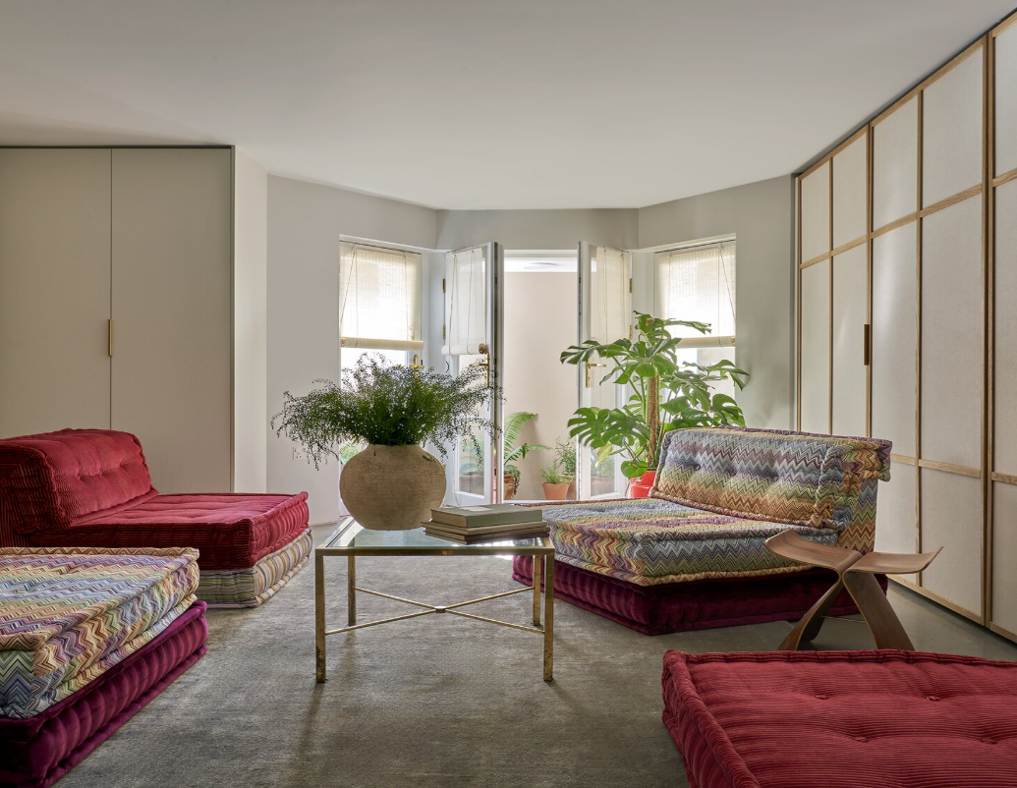
Stelly Selway
POSITION
Austin and London interiors shaped by durable materials, vintage pieces, and maker relationships.
MATERIALS
Oak recurs in two cases. Reclaimed pine, soapstone, dead-stock canvas, and vintage pieces have named examples.
OPEN QUESTION
Previous use, quantities, finish records, and care guidance vary by project.
WEBSITE RECAPTURE, 17 SEP 2026
05
Notes:
Sources: https://www.stellyselway.com/about
https://www.stellyselway.com/project/rosedale
https://www.stellyselway.com/project/lafayette-avenue-austin
Profile: docs/reports/competitors/stelly-selway.md
Image source: C:\Users\jooar\ds\projects\marketing-and-competitive-analisys-casa-verde\assets\screenshots\websites\stelly-selway\recapture-2026-09-17\upper-mall_gallery-03.png

Slide 6
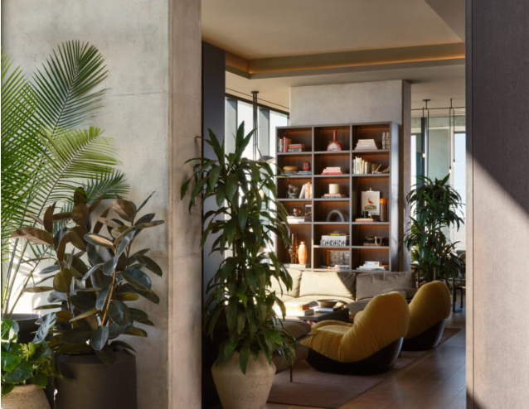
Urbanspace Design Studio
POSITION
Residential and commercial interiors shaped around how people use a space.
MATERIALS
East Residence names a reclaimed-wood handle, Taj Mahal stone, and panels matched to the existing kitchen.
OPEN QUESTION
Evidence of recurring sustainable practice remains unknown beyond East Residence.
WEBSITE RECAPTURE, 17 SEP 2026
06
Notes:
Sources: https://urbanspacedesign.com/about/
https://urbanspacedesign.com/project/eastresidence/
Profile: docs/reports/competitors/urbanspace-design-studio.md
Image source: C:\Users\jooar\ds\projects\marketing-and-competitive-analisys-casa-verde\assets\screenshots\websites\urbanspace-design-studio\recapture-2026-09-17\modern-penthouse_gallery-03.png

Slide 7
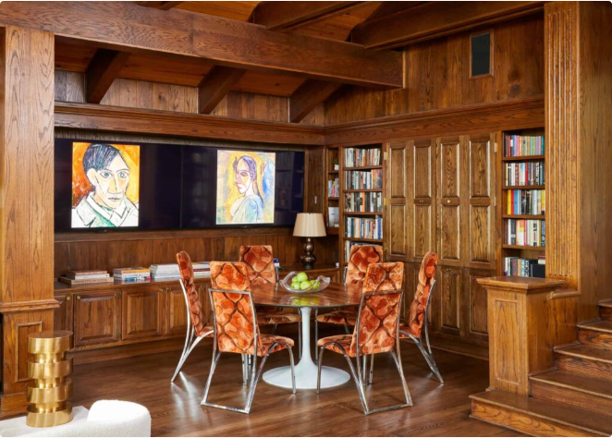
J.Fisher Interiors
POSITION
Personal homes shaped by craftsmanship, art, and close designer involvement.
MATERIALS
White oak and soapstone recur in two cases. Existing pieces were reused at Judges Hill.
OPEN QUESTION
Public pages do not connect broad low-VOC claims to named product or finish records.
WEBSITE RECAPTURE, 17 SEP 2026
07
Notes:
Sources: https://jfisherinteriors.com/about/
https://jfisherinteriors.com/portfolio/judges-hill/
https://jfisherinteriors.com/portfolio/hyde-park/
Profile: docs/reports/competitors/j-fisher-interiors.md
Image source: C:\Users\jooar\ds\projects\marketing-and-competitive-analisys-casa-verde\assets\screenshots\websites\j-fisher-interiors\recapture-2026-09-17\judges-hill_gallery-03.png

Slide 8
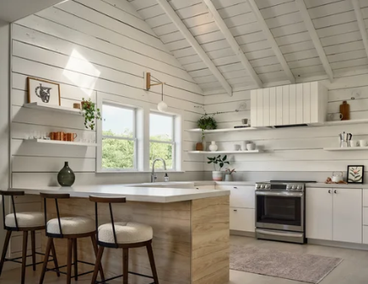
Studio Ferme
POSITION
Residential interiors guided by material life cycles, climate resilience, and daily comfort.
MATERIALS
The 7th Street Cottage reuses original shiplap. AIA corroborates the Theresa project and Studio Ferme’s interior-design credit.
OPEN QUESTION
A sabbatical has no public return date. Comparable price and current intake remain unknown.
WEBSITE RECAPTURE, 17 SEP 2026
08
Notes:
Sources: https://www.studioferme.com/about
https://www.studioferme.com/7th-street-cottage
https://www.aia.org/design-excellence/award-winners/theresa-passive-house
Profile: docs/reports/competitors/studio-ferme.md
Image source: C:\Users\jooar\ds\projects\marketing-and-competitive-analisys-casa-verde\assets\screenshots\websites\studio-ferme\recapture-2026-09-17\7th-street-cottage_gallery-01.png

Slide 9
Positioning map
Major work
Studio Ferme
Urbane
J.Fisher
Stelly
Demonstrated residential scope
Whole home
CASA VERDE TARGET
Urbanspace
Repeatable provenance, retention, care, and scope records
Room
Broad claim
Recurring project records
Outside check
Public evidence depth
Proposed target based on brand intent. Casa Verde has no observed coordinate in this study.
09
Notes:
Source: docs/reports/comparison.md#positioning-map.
Horizontal axis: public material and sustainability evidence depth.
Vertical axis: demonstrated residential engagement scope.
Positions are categorical summaries of reviewed public evidence. They are not environmental scores or service rankings.

Slide 10
Spaces Casa Verde can test and own
01
Material ledgers
02
Investment clarity
For every project, show what remained, where additions came from, the finish used, and care guidance.
Explain what the USD 40k to 300k band includes. Separate design, procurement, furnishings, and construction.
03
Native planting records
04
Visible capacity
Name species, site fit, care needs, and the reason each plant belongs in the room.
Publish start windows, team roles, and the decisions clients make at each stage.
These are positioning hypotheses. Casa Verde should publish only what its project records can support.
10
Notes:
Source: docs/reports/comparison.md#positioning-hypotheses-for-elenas-team.
Brand intent: brand/casa_verde_brand_bible.md.
These opportunities are hypotheses about communication. They do not prove unmet demand or absent competitor capability.

Slide 11
The next 30 days
Audit three completed projects
Week 1
Gather invoices, finish schedules, retained elements, supplier notes, and care guidance.
Set one case study template
Week 2
Use the same fields for brief, scope, original fabric, new materials, sources, finish, and care.
Clarify the investment band
Week 3
Write two or three scope examples inside USD 40k to 300k. Keep fees and construction distinct.
Test the story with clients
Week 4
Ask which records build trust, which details help self-selection, and what still feels unclear.
Owner: Elena with one designer and the project coordinator
11
Notes:
Recommendations synthesize docs/reports/comparison.md and brand/casa_verde_brand_bible.md.
Before publication, verify every material, supplier, cost, and availability claim against Casa Verde project records.

Slide 12
Casa Verde can make
the material story
easier to verify.
The room keeps its grain. The project record explains why it stayed.
Design that breathes.
12
Notes:
Closing sign-off from the Casa Verde brand skill. Used once across the deck.

