Slide 1
F
FleetOps AI
An AI Operations Agent for Construction Equipment
Track: AI + Construction Machinery → AI + Operation
15th China International College Students' Innovation & Entrepreneurship Competition
Prepared by: FleetOps AI Team
Raghad Altrisy (Project Leader) • Taif Alharbi (Core Member) • Jood Alwajeeh (Core Member)

Slide 2
The Problem
Fleet managers still fight spreadsheets instead of managing equipment
1
Manual & slow
Managers manually cross-reference hours, downtime, and fuel logs to answer basic operational questions.
2
Issues found too late
Downtime spikes and fuel waste are often discovered only after they've already cost money.
3
No natural access
There is no simple way to just ask “which equipment needs attention?” and get an instant, data-grounded answer.
FleetOps AI — AI Operations Agent for Construction Equipment
2

Slide 3
The Solution
Ask your fleet a question in plain language — get an instant, actionable answer
What you get
Which equipment has the highest downtime?
Instant natural-language answers
EQ-024, EQ-013, and EQ-026 show 17-21% downtime — more than double the fleet average. Recommend priority inspection.
Automatic priority flagging
Root-cause explanations, not just numbers
What's causing the fuel spike on EQ-008?
One-click fleet performance reports
Fuel use jumped 47% over the last 14 days vs. its own baseline — consistent with a leak or clogged filter.
FleetOps AI — AI Operations Agent for Construction Equipment
3

Slide 4
System Architecture
A five-stage pipeline from raw fleet data to an operational decision
→
→
→
→
Data Input
Processing
AI Agent
Dashboard
Output
Daily equipment logs
Cleaning & KPI calc
LLM + tool calling
Streamlit UI
Insights & actions
Tool Library (AI Agent Functions)
get_top_downtime_equipment
get_equipment_needing_attention
explain_utilization_trend
analyze_fuel_consumption
generate_fleet_report
compute_attention_scores (ML)
FleetOps AI — AI Operations Agent for Construction Equipment
4

Slide 5
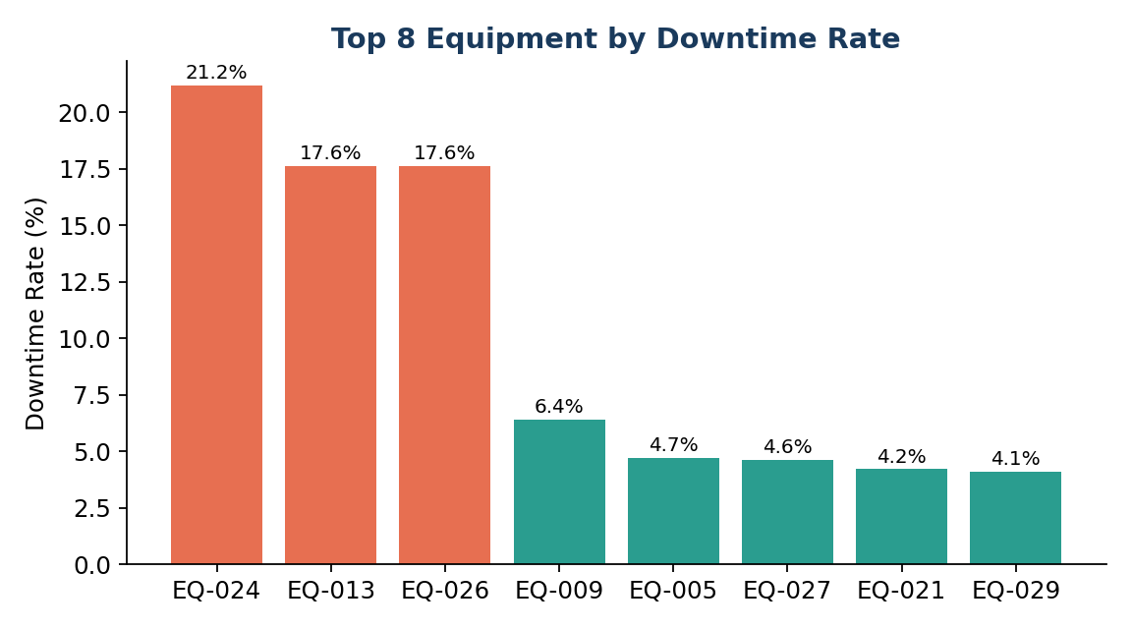
Validated Insights
Tested against a realistic synthetic dataset with known embedded issues
21.2%
Highest downtime rate found (EQ-024) — more than double the fleet average.
47%
Fuel-consumption spike detected on EQ-008 vs. its own baseline.
3
Units flagged with statistically abnormal maintenance frequency.
FleetOps AI — AI Operations Agent for Construction Equipment
5

Slide 6
One Score to Prioritize the Fleet
Attention Score (0-100) combines downtime, fuel deviation, maintenance frequency, and ML anomaly detection (Isolation Forest)
Why it matters
A manager doesn't need five separate charts — just one ranked list telling them exactly which unit to check first, and why.
FleetOps AI — AI Operations Agent for Construction Equipment
6

Slide 7
Tech Stack & Project Status
Tech Stack
10-Day Roadmap
Core & Data
Python, Pandas, NumPy
✓
Day 1-2 — Setup & data
AI / LLM
OpenAI API (Function Calling)
✓
Day 3 — KPI calculation
✓
Day 4-5 — AI agent + LLM
ML
Scikit-learn (Isolation Forest)
✓
Day 6 — Streamlit dashboard
Visualization
Plotly, Matplotlib
✓
Day 7 — ML anomaly detection
Web Interface
Streamlit
✓
Day 8 — Testing & refinement
Deployment
GitHub, Streamlit Community Cloud
✓
Day 9 — Docs & presentation
○
Day 10 — Final review & submission
FleetOps AI — AI Operations Agent for Construction Equipment
7

Slide 8
From Data to Smarter Operations Decisions
FleetOps AI proves that a small team can build a working AI operations agent in 10 days — one that turns raw construction-fleet data into a decision a manager can act on today.
Thank you

