Slide 1
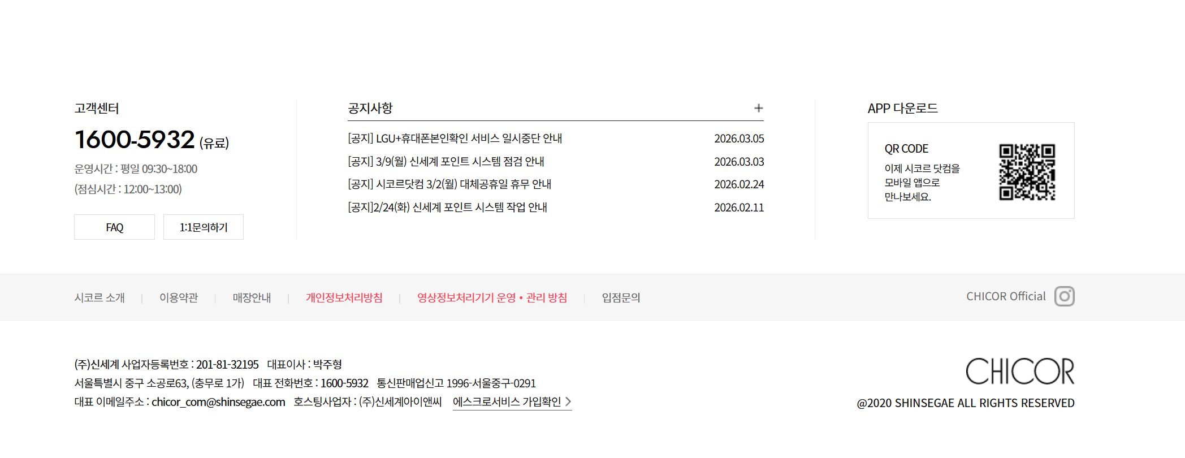
Main Page 구조
HEADER
Business Intro Image
User Intro Image
Operation Flow Image
FOOTER

Slide 2
Logo Image
About Us
Products
Brands
Log In I Sign Up
한국어
Logo Image
About Us
Products
Brands
My Page I Log Out
한국어

