Slide 1

Copy right @ 404NOTFOUND

Slide 2




MEMBERS
> Jung Hye Rin (정혜린)
- Level designer
> Kim Ha Gyeong (김하경)
- Producer
> Shon Hae Won (손해원)
- Technical Director
> Son Ju Hye (손주혜)
- Level designer

Slide 4
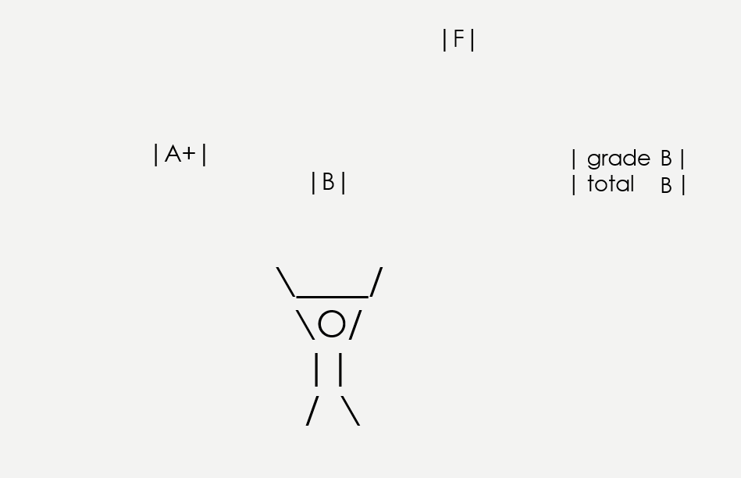
* DIGI-GO is arcade catching game about student's effort to graduate Digipen.

Slide 5

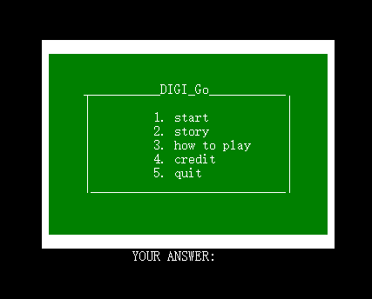
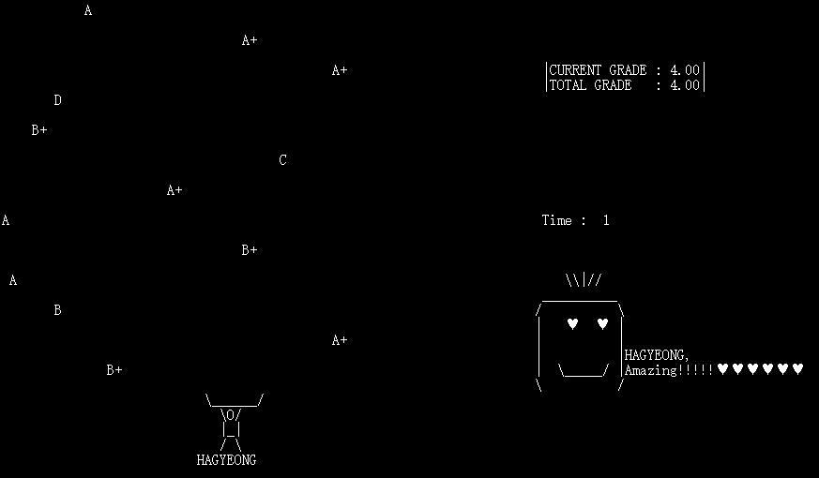

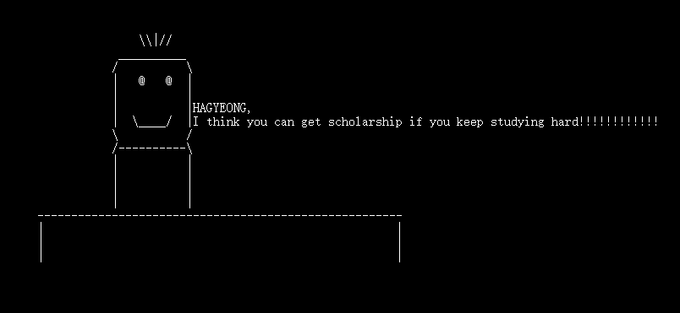


Slide 6
experience
* we was surprised by an unexpected error.
* We found that cooperation was important in game production.
* we realized that games include both visual and auditory elements
* We realized that even simple things took a lot of effort.
* Next time, we want to make a game with more complex functions.

Slide 7
Copy right @ 404NOTFOUND

