Slide 1

























































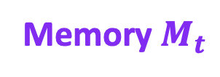






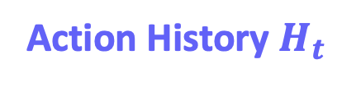















(a)
$$q_{t}$$
?
$$τ_{t}$$
$$𝒟_{anc}$$
Failure is Feedback
$$Q$$
?
Orchestrator
$$Traverse$$
$$𝒢$$
$$𝒟_{anc}$$
$$q_{t}$$
$$τ_{t}$$
$$Stop$$
?
$$𝓖$$
$$Plan$$
$$M_{t}$$
$$𝓐$$
Document-level Traverser
Subquery Planner
Reranker
Multi-Strategy
Traverser
Hop Scope
Vector Search
LLM Rerank
$$𝒞_{R}$$
$$Update$$
Traversal
Evaluator
new subqueries
Vector Search
LLM Rerank
$$M_{t+1}$$
$$o_{t}$$
$$𝒞_{t},𝒟_{t}$$
Component-level Traverser
(b)
$$D_{1}$$
$$D_{4}$$
$$𝓖$$
(c)
$$𝓠_{t}$$
$$Q$$
?
Action History $H_{t}$
Memory $M_{t}$
$$D_{2}$$
$$D_{5}$$
?
$$Solved$$
A
$$h_{1}$$
?
?
?
$$h_{4}$$
$$q_{4}$$
$$τ_{4}$$
$$D_{3}$$
$$V_{0}$$
?
$$D_{3}$$
$$C_{3,1}$$
?
$$Solved$$
A
$$q_{2}$$
$$τ_{2}$$
$$h_{2}$$
?
$$C_{1,2}$$
$$C_{1,3}$$
$$h_{5}$$
?
$$C_{1,1}$$
$$C_{1,2}$$
$$C_{1,3}$$
$$C_{4,1}$$
$$D_{1}$$
?
$$Deprecated$$
$$C_{2,1}$$
$$C_{2,2}$$
$$C_{2,3}$$
$$q_{3}$$
$$τ_{3}$$
$$q_{6}$$
$$τ_{6}$$
$$C_{5,1}$$
$$C_{5,2}$$
$$V_{1}$$
?
A
$$h_{3}$$
?
$$D_{2}$$
$$C_{2,2}$$
$$C_{2,1}$$
$$C_{2,3}$$
$$h_{6}$$
?
$$D_{4}$$
$$C_{4,1}$$
$$D_{5}$$
$$C_{5,2}$$
$$C_{3,1}$$
$$C_{3,2}$$
$$Solved$$

Slide 2

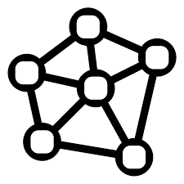
Target
Subquery
Document Traverser
Component Traverser
Vector Search
LLM Rerank
Retrieval Evaluator
Vector Search
LLM Rerank
Parameters
Layered
Document
Graph

