Slide 1
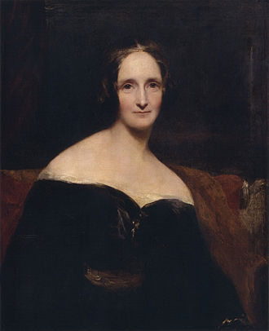
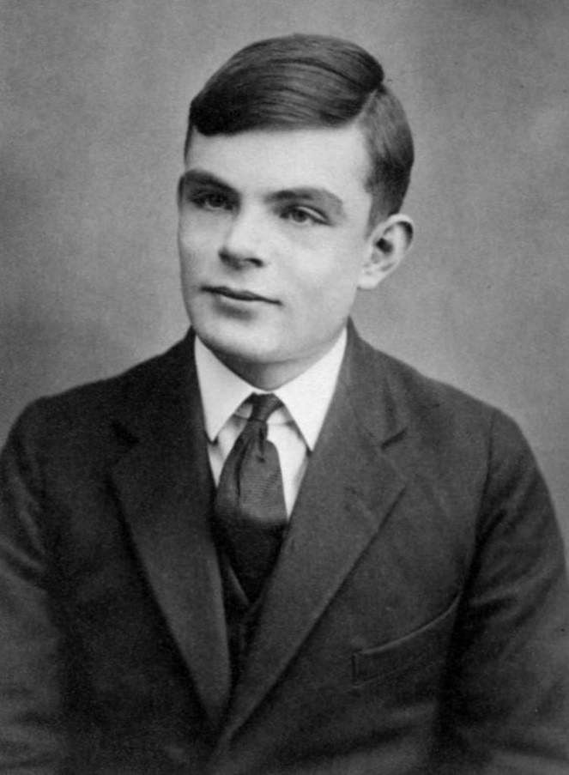
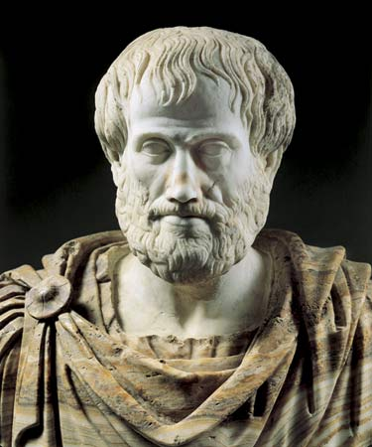
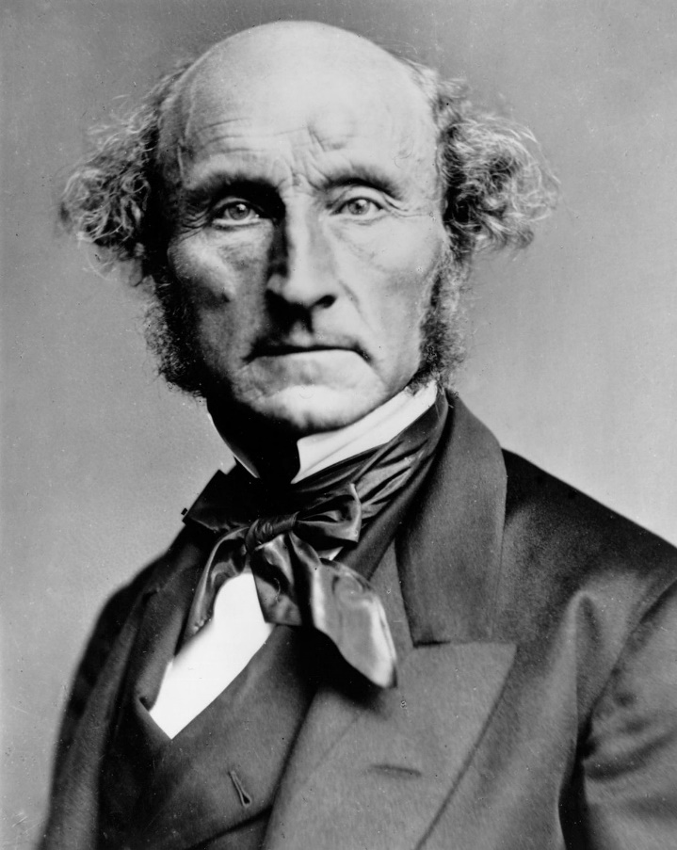
CS440/ECE448: Artificial Intelligence Lecture 1: Course Intro

Slide 2
Course Intro: Syllabus
Web page: https://courses.engr.illinois.edu/ece448/sp2020/
Grading
Homework
Apps
Textbook

Slide 3
Grading
3-credit and 4-credit sections will be graded on separate curves.
3-credit: 60% homework, 40% exams.
4-credit: 50% homework, 40% exams, 10% review papers.
Grade cutoffs: 90% will get you at least an A-, 80% will get you at least a B-, 70% will get you at least a C-. Curves are likely to reduce the B- and C- thresholds.

Slide 4
Homework
7 machine problems, mostly autograded, at gradescope.com.
MP1 (search): released Monday 1/22, due Monday 2/5 by 11:59pm.
Most MPs are released two weeks before they are due.
Plan in advance! Deadline extensions are not given for routine causes like being sick, having an on-site job interview, etc.

Slide 5
Apps
All homework and exams graded and submitted at: https://www.gradescope.com/
We will copy your grades to either https://learn.illinois.edu or https://compass2g.illinois.edu (not sure which, yet) so you can see where you stand relative to class average and standard deviation.
Q/A forum: https://piazza.com
Videos of lectures: https://echo360.org
Searchable lecture videos? https://classtranscribe.ncsa.illinois.edu

Slide 6
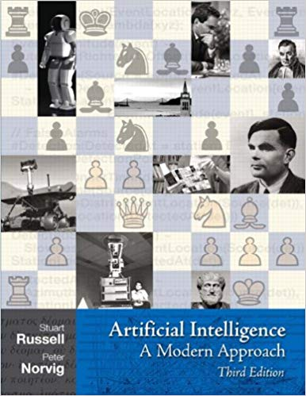
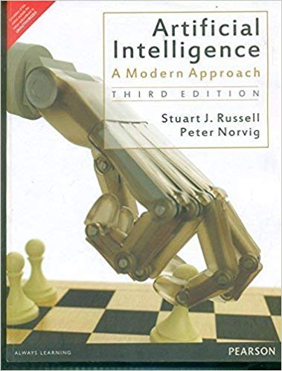
Textbook
Artificial Intelligence, A Modern Approach: Third Edition by Russell & Norvig
Pretty good listing of the topics covered in this course
In-depth treatment of knowledge-based/expert-system AI; introduces probabilistic and learning-based methods
Sample problems and readings will be specified when applicable
Hardcover
Paperback

Slide 7
Outline, Remainder of Today’s Lecture
What is AI? What is Intelligence?
Russell & Norvig’s “four approaches to AI” (chapter 1)
Brief history of AI (chapter 2)

Slide 8
What is Intelligence?
The word “intelligence” is surprisingly recent. Ancients used it to mean “the universal mind.” Early moderns (e.g., Bacon, Hobbes; 1500s) ridiculed it, and stopped using it. It was then repurposed to its current meaning by psychologists and eugenicists in the early 20th century.

Slide 9
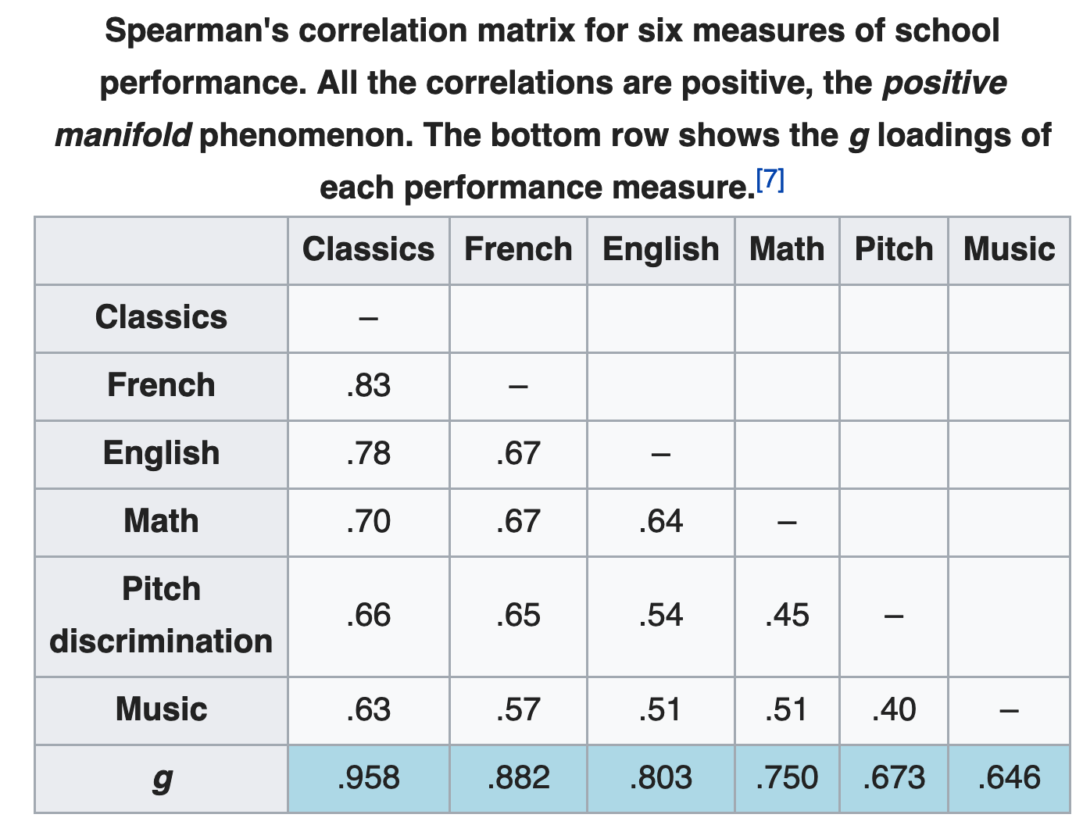
What is Intelligence?
Charles Spearman popularized the modern definition in his paper “General intelligence objectively determined and measured,” American Journal of Psychology 15(2):201-292.
He showed that test scores are correlated across many subjects and proposed “general intelligence” as the faculty that unifies them.
https://en.wikipedia.org/wiki/G_factor_(psychometrics)

Slide 10
What is “Artificial Intelligence”?
The term was invented in (John McCarthy, Marvin Minsky, Nathaniel Rochester, and Claude Shannon, “A Proposal for the Dartmouth Summer Research Project on Artificial Intelligence,” August 1955):
“We propose that a 2-month, 10-man study of artificial intelligence be carried out during the summer … An attempt will be made to find how to make machines
use language,
form abstractions and concepts,
solve kinds of problems now reserved for humans
improve themselves.”

Slide 11
What is Artificial Intelligence?
Russell & Norvig’s “four approaches to AI” (chapter 1): Intelligence means…
1. Thinking like a Human | 2. Acting like a Human
3. Thinking Rationally | 4. Acting Rationally

Slide 12
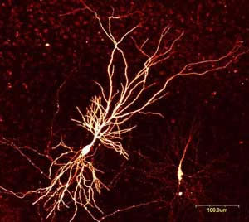
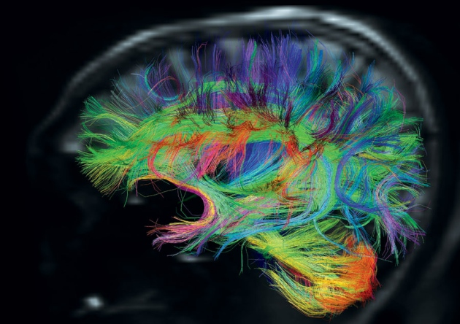
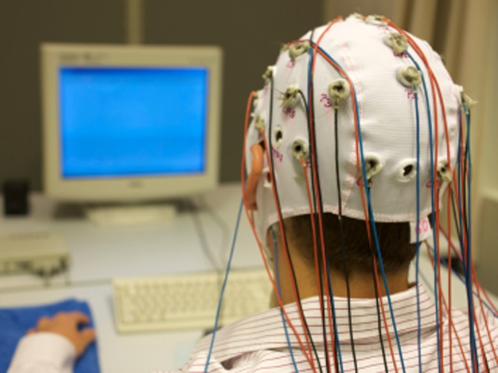
1. Thinking like a Human
Mary Shelley, author of Frankenstein: The Modern Prometheus; Neuron, showing branching of the dendrites; EEG cap; Cortical connectivity map, computed using diffusion tensor MRI

Slide 13
Can we simulate a human brain?
How many binary computations per second can the brain perform?
Spatial scale: there are 100 trillion neurons (10^14).
Numerical precision: each neuron either generates an action potential or doesn’t (binary!).
Temporal scale: Other neurons are sensitive to timing with a resolution of perhaps roughly 1 millisecond (1000 bits/second).
Answer: if each neuron performs 1000 binary computations/second, then the brain performs up to (100 trillion)X(1000) = 10^17 binary computations/second (100 Peta-ops: about 100,000 GPUs)

Slide 14
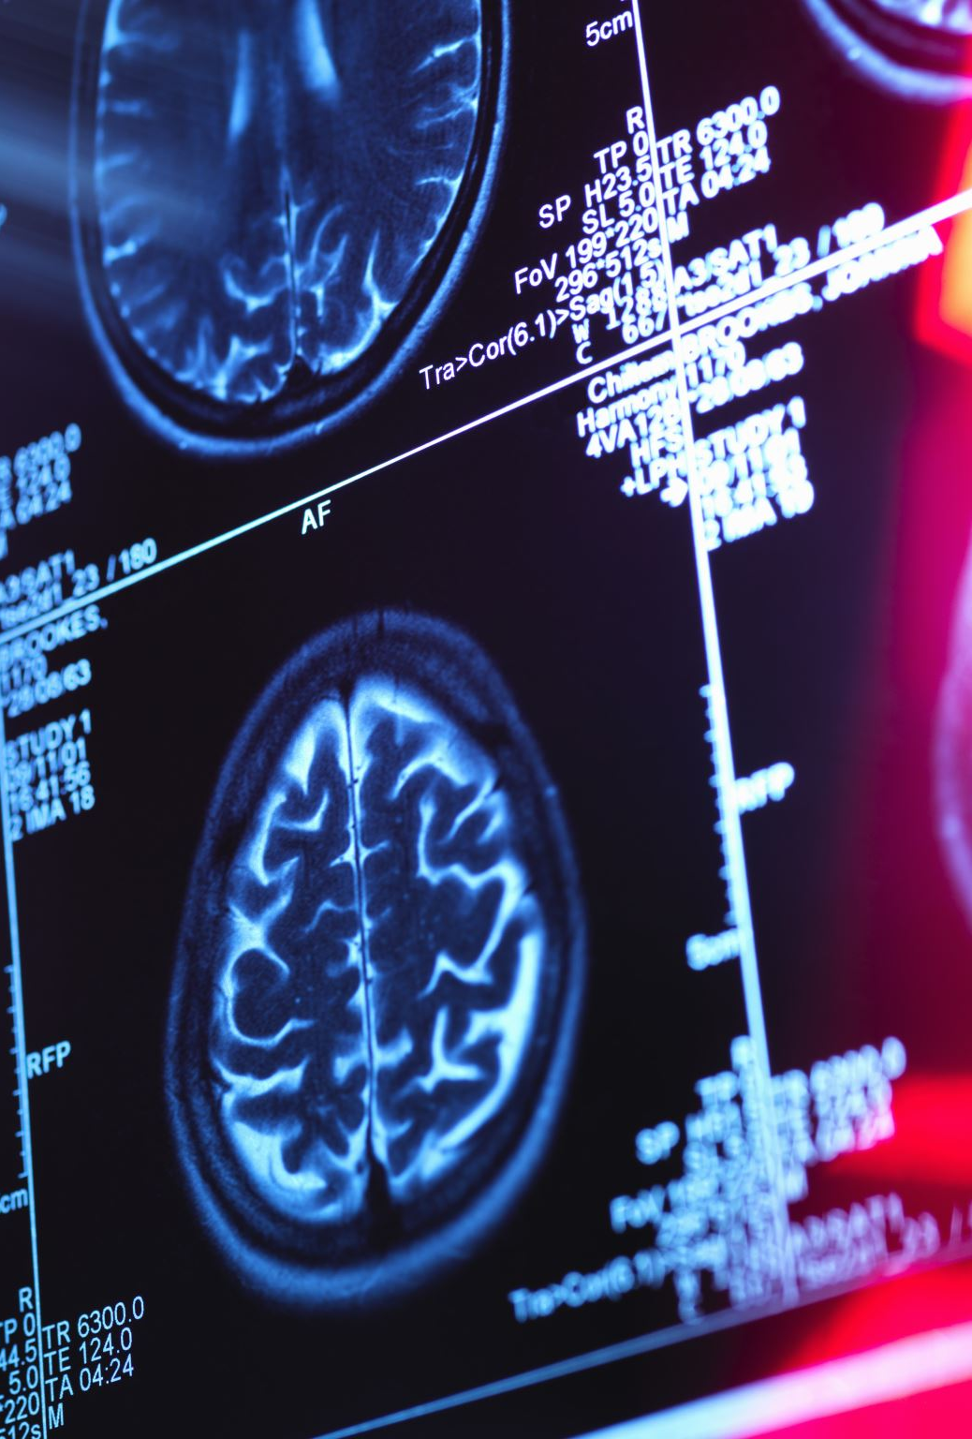
Then why can’t we simulate a human brain?
How many brain computations can we IMAGE?
Temporal scale: no problem, EEG (electroencephalography) gets ~5000 samples/second
Spatial scale is the problem:
EEG: 100 pixels/brain
fMRI and ECOG: 1mm scale (~10^5 voxels/brain)
Versus 10^14 neurons/brain

Slide 15
Then why can’t we simulate a human brain?
The short answer: we can’t find out what computations a living human brain is performing, because any current imaging modality that precise would kill it.
…and we are currently about 9 orders of magnitude (10^9) away from the necessary level of precision (volume).
MRI improved by roughly 2 orders of magnitude per decade from 1970 to 2000, then slowed significantly, has improved perhaps 1 o.o.m. per two decades since then. So perhaps this approach will be possible in 180 years.

Slide 16
What is Artificial Intelligence?
Russell & Norvig’s “four approaches to AI” (chapter 1): Intelligence means…
1. Thinking like a Human | 2. Acting like a Human
3. Thinking Rationally | 4. Acting Rationally

Slide 17
What is Artificial Intelligence?
Russell & Norvig’s “four approaches to AI” (chapter 1):
1. Thinking humanly | 2. Acting humanly
3. Thinking rationally | 4. Acting rationally

Slide 18
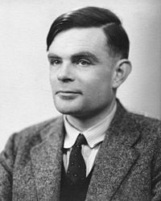
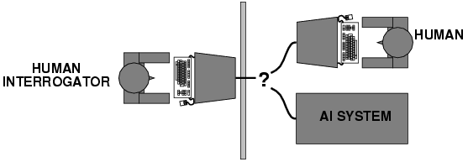
2. Acting like a Human
Schematic of the Turing test; Alan Turing

Slide 19
The Turing Test
Alan Turing, “Intelligent Machinery,” 1947:
“Now get three men as subjects for the experiment. A, B and C. A and C are to be rather poor chess players, B is the operator who works the paper machine… a game is played between C and either A or the paper machine.
C may find it quite difficult to tell which he is playing...
These questions replace our original, ‘Can machines think?’”

Slide 20
Practical Problems with the Turing Test
Can’t be automated (you need human judges).
Human judges can be fooled by misdirection, e.g., by a chatbot that pretends to be a paranoid schizophrenic (https://en.wikipedia.org/wiki/PARRY) or a 13-year-old Ukrainian boy (https://en.wikipedia.org/wiki/Eugene_Goostman)

Slide 21
Winograd Schema
Winograd schema (H. Levesque, On our best behaviour, IJCAI 2013) attempts to solve the practical problems with the Turing test
Multiple choice questions that can be easily answered by people but cannot be answered by computers using “cheap tricks”
Always arranged in pairs:
The trophy would not ﬁt in the brown suitcase because it was so small. What was so small?
The trophy
The brown suitcase

Slide 22
Winograd Schema
Winograd schema (H. Levesque, On our best behaviour, IJCAI 2013) attempts to solve the practical problems with the Turing test
Multiple choice questions that can be easily answered by people but cannot be answered by computers using “cheap tricks”
Always arranged in pairs:
The trophy would not ﬁt in the brown suitcase because it was so large. What was so large?
The trophy
The brown suitcase

Slide 23
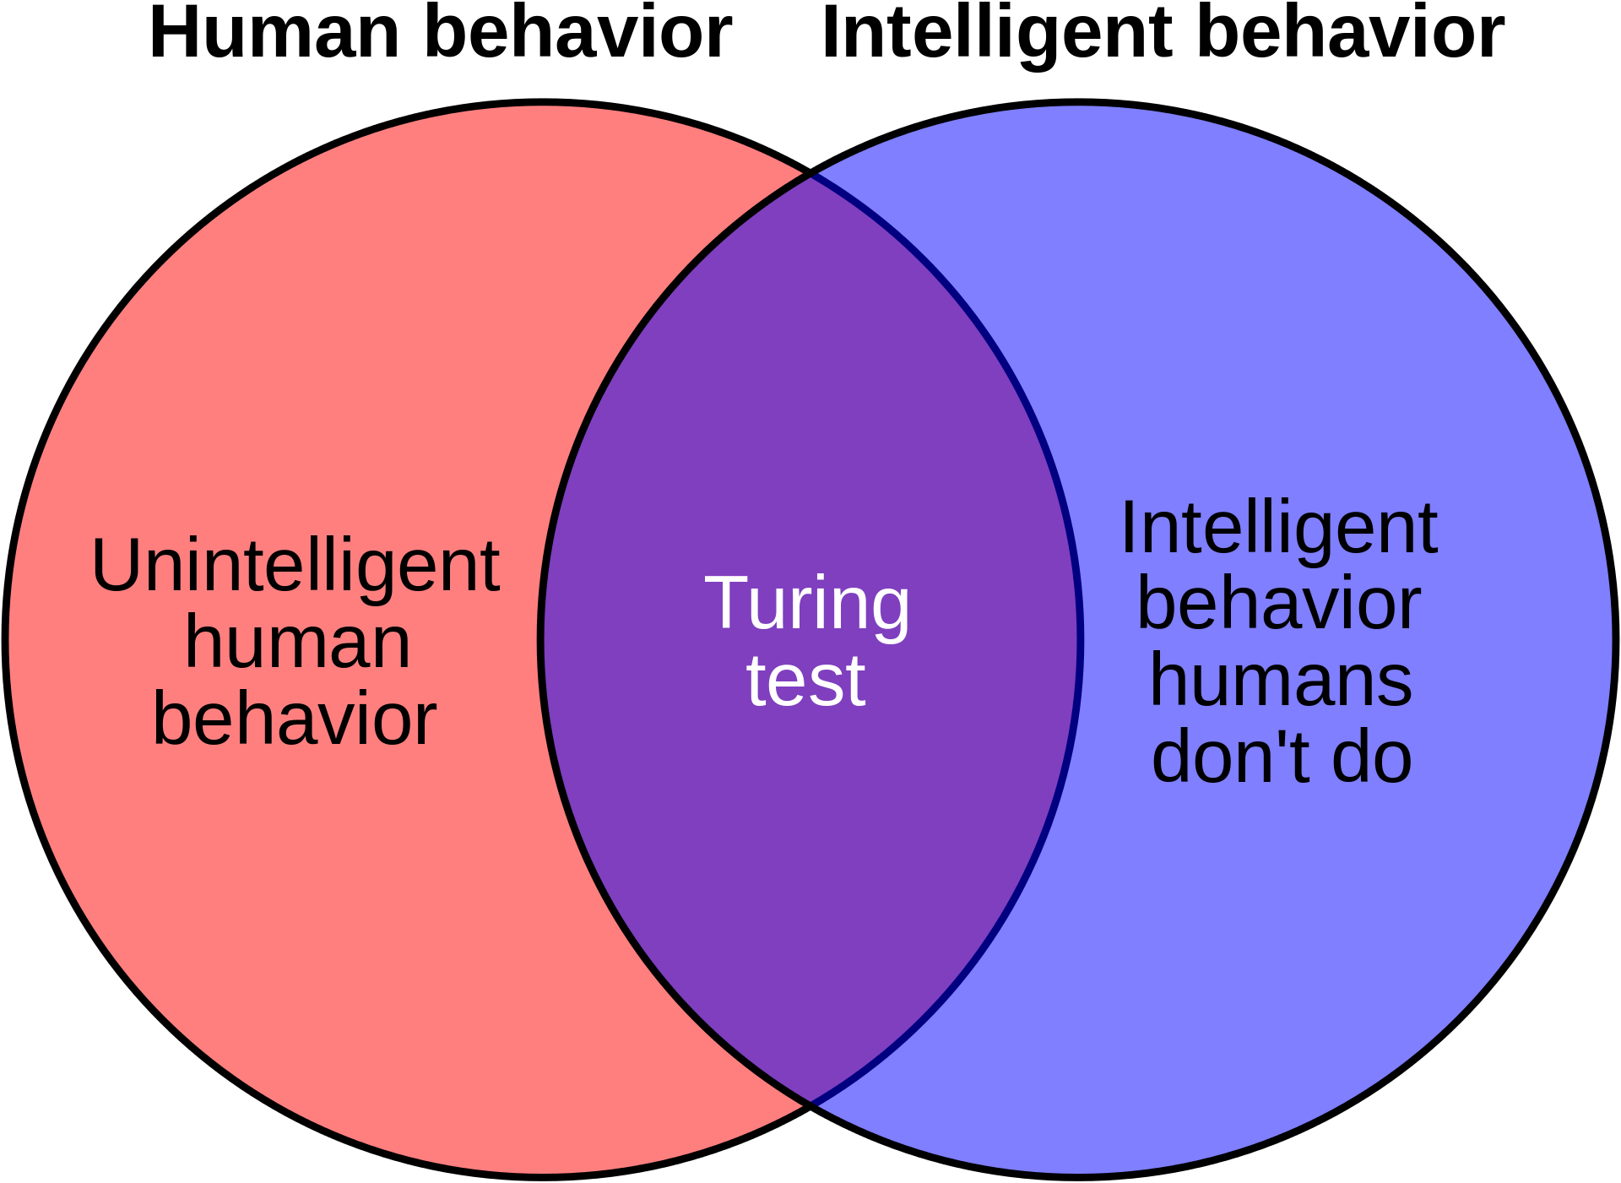
A theoretical problem with the Turing test
Why is human behavior the standard?
By en:User:CharlesGillingham, User:Stannered - en:Image:Weakness of Turing test 1.jpg, Public Domain, https://commons.wikimedia.org/w/index.php?curid=3457053

Slide 24
What is Artificial Intelligence?
Russell & Norvig’s “four approaches to AI” (chapter 1): Intelligence means…
1. Thinking like a Human | 2. Acting like a Human
3. Thinking Rationally | 4. Acting Rationally

Slide 25

AI definition 3: Thinking rationally
Aristotle, 384-322 BC

Slide 26
AI definition 3: Thinking rationally
Idealized or “right” way of thinking
Logic: patterns of argument that always yield correct conclusions when supplied with correct premises
“Socrates is a man; all men are mortal; therefore Socrates is mortal.”
Logicist approach to AI: describe problem in formal logical notation and apply general deduction procedures to solve it

Slide 27
Successes of Logicist Approach: Expert Systems
Expert system = (knowledge base) + (logical rules)
Knowledge base = easy to collect from human judges and/or encyclopedia
Logical rules = easy to deduce from examples, and easy to verify by asking human judges
Combination of the two: able to analyze never-before-seen examples of complicated problems, and generate the correct answer
Example: speed control system of the https://en.wikipedia.org/wiki/Sendai_Subway_Namboku_Line. “This system (developed by Hitachi) accounts for the relative smoothness of the starts and stops when compared to other trains, and is 10% more energy efficient than human-controlled acceleration.”

Slide 28
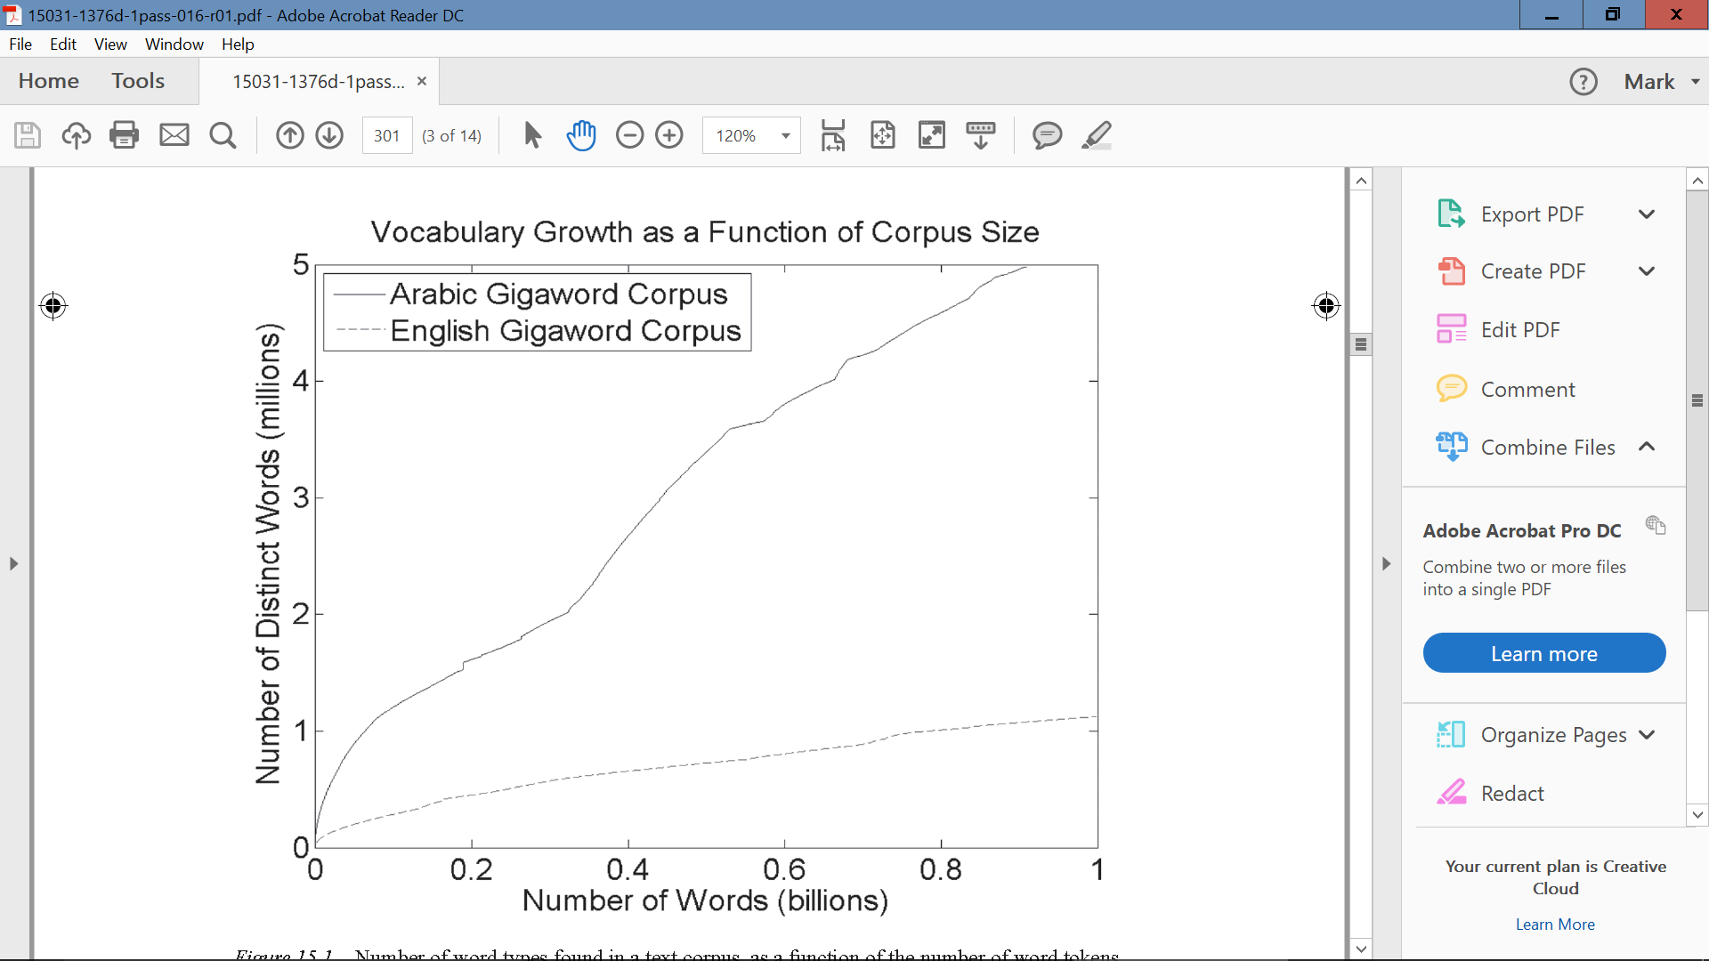
Failures of Logicist Approach: Robust AI
Humans commonly believe that there are a finite number of facts that must be entered into a knowledge base. Evidence suggests that this is incorrect.
Example (Hasegawa-Johnson, Elmahdy & Mustafawi, “Arabic Speech and Language Technology,” 2017): the number of distinct words in any corpus of text is linearly proportional to the number of words. In English, a never-before-seen word occurs ~once/1000 words; in Arabic, ~once/180 words.

Slide 29
What is Artificial Intelligence?
Russell & Norvig’s “four approaches to AI” (chapter 1): Intelligence means…
1. Thinking like a Human | 2. Acting like a Human
3. Thinking Rationally | 4. Acting Rationally

Slide 30

AI definition 4: Acting rationally
John Stuart Mill, 1806-1873

Slide 31
AI definition 4: Acting rationally
Rational agent = acts to optimally achieve its goals
Goals are application-dependent and are expressed in terms of the utility of outcomes
Being rational means maximizing your (expected) utility
This definition of rationality only concerns the decisions/actions that are made, not the cognitive process behind them
An unexpected step: rational agent theory was originally developed in the field of economics
Norvig and Russell: “most people think Economists study money. Economists think that what they study is the behavior of rational actors seeking to maximize their own happiness.”

Slide 32
Russell & Norvig’s “four approaches to AI”
Intelligence is…
Thinking like a human
Sometimes called “grounded AI” – create an AI with neurons like ours
Acting like a human
Turing’s definition of AI; ignores the underlying thought process
Might include acting irrationally
Thinking rationally
Logicist AI: must use a rational/logical thought process
Acting rationally
Utilitarianism: act in order to maximize your own benefit, regardless of the thought process you use

Slide 33
Outline, Remainder of Today’s Lecture
What is AI? What is Intelligence?
Russell & Norvig’s “four approaches to AI” (chapter 1)
Brief history of AI (chapter 2)

Slide 34
A very brief history of AI
Decade | Symbolic AI | Neural AI
1943 |  | McCulloch-Pitts
1956 | Logic Theorist
1966 | ALPAC Report
1986 |  | Back-propagation
1996 | Deep Blue
2016 |  | AlphaGo

Slide 35
1956: Logic Theorist
Socrates is a man
Men are male
Men are human
Reasoning as search:
Root of the search tree: initial hypothesis
Branch: a deduction based on the rules of logic
Goal state: the theorem to be proven
Proved 38 of the first 52 theorems in chapter 2 of the Principia Mathematica.
Socrates is male
Socrates is human
Humans are mortal
Socrates is mortal

Slide 36
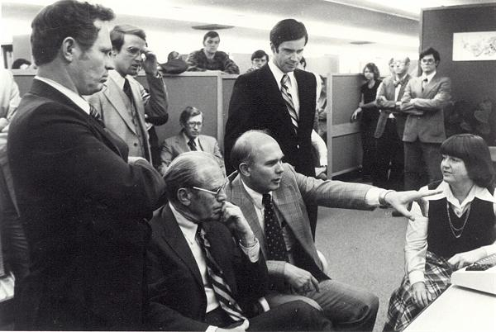
The ALPAC Report of 1966
“They concluded, in a famous 1966 report, that machine translation was more expensive, less accurate and slower than human translation.”
Photo: Eldon Lyttle,
https://commons.wikimedia.org/wiki/File:Computer-translation_Briefing_for_Gerald_Ford.jpg

Slide 37

AI Winter

Slide 38
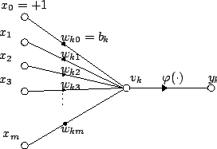
1943: McCulloch-Pitts Neuron Model
Attribution: Plarroy, https://commons.wikimedia.org/wiki/File:Artificial_neuron.png

Slide 39
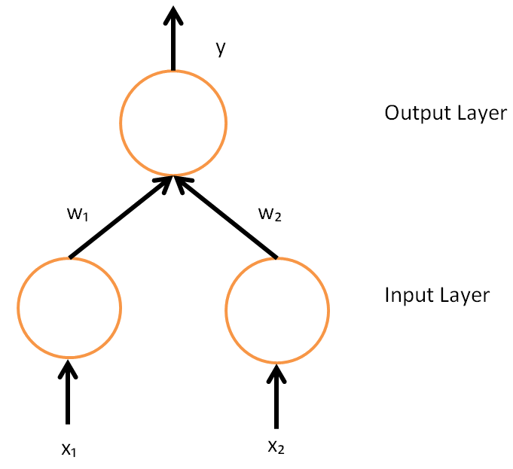
1986: Invention of back-propagation makes multi-layer neural networks practical
David E Rumelhart, Geoffrey E Hinton, Ronald J Williams, “Learning internal representations by error-propagation,” in Parallel Distributed Processing: Explorations in the Microstructure of Cognition 1:318-362
By AI456 - Created using Microsoft Excel 2007, CC BY-SA 3.0, https://commons.wikimedia.org/w/index.php?curid=24621216

Slide 40
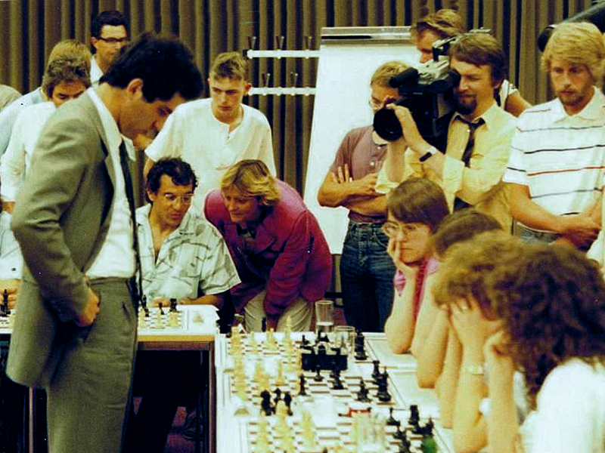
1996: Deep Blue beats Gary Kasparov
By Kasparov_Magath_1985_Hamburg.jpg: GFHundderivative work: Hardy Linke (talk) - Kasparov_Magath_1985_Hamburg.jpg, CC BY 3.0, https://commons.wikimedia.org/w/index.php?curid=14640503

Slide 41
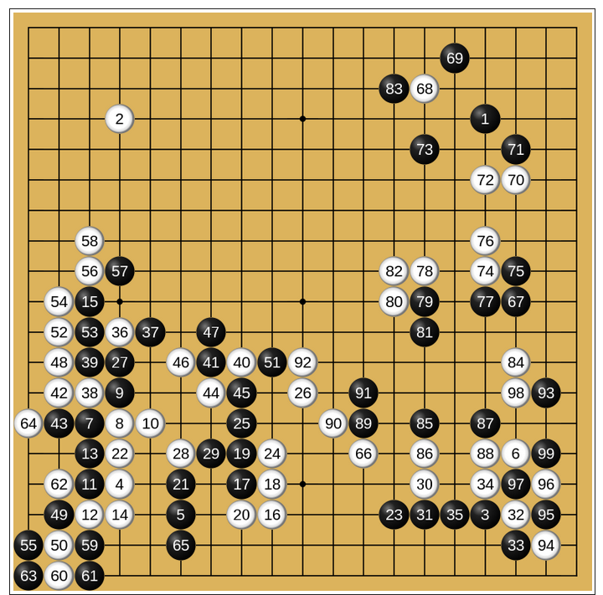
2016: AlphaGo

Slide 42
A very brief history of AI
Decade | Symbolic AI | Neural AI
1943 |  | McCulloch-Pitts
1956 | Logic Theorist
1966 | ALPAC Report
1986 |  | Back-propagation
1996 | Deep Blue
2016 |  | AlphaGo
A modern research problem: how to best combine these two approaches in order to make really “thinking” machines.

Slide 43
Upcoming: course outline
Thinking rationally: search and planning (weeks 1-4)
Acting rationally: probability (weeks 5-8)
Thinking like a human: neural nets (weeks 9-11)
Acting like a human: reinforcement learning, games, and vector semantics (weeks 12-14)

