Slide 1

CS440/ECE448 Lecture 3: Search Order
Slides by Mark Hasegawa-Johnson, 1/2020
Including some slides written by Svetlana Lazebnik, 9/2016
CC-BY 4.0: You are free to: copy and redistribute the material in any medium or format, remix, transform, and build upon the material for any purpose, even commercially, if you give appropriate credit.

Slide 2
Outline
Uniform cost search (UCS) = slightly different implementation of Dijkstra’s Algorithm
Breadth-first search (BFS) = special case of UCS
Depth-first search (DFS)

Slide 3
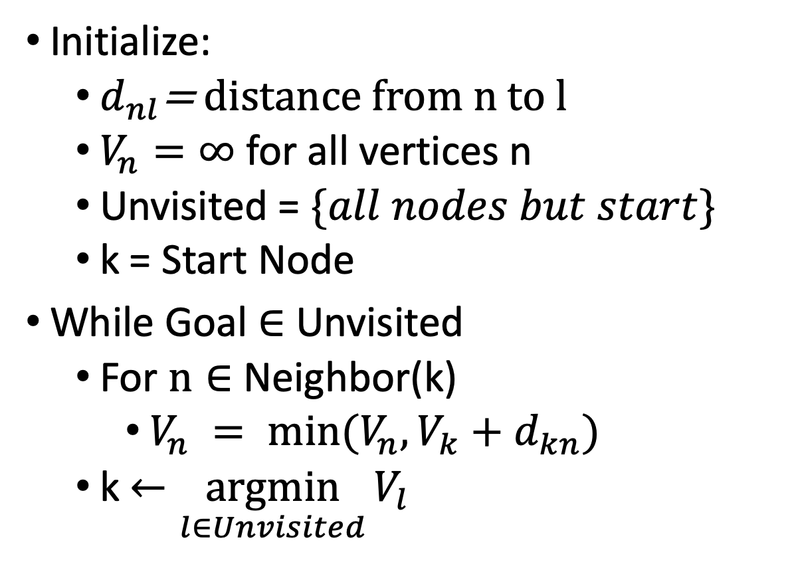
Dijkstra’s Shortest Path Algorithm
Initialize:
$d_{nl}$= distance from n to l
$V_{n}=∞$ for all vertices n
Unvisited = $\{all nodes but start\}$
k = Start Node
While Goal $∈$ Unvisited
For $n∈$ Neighbor(k)
$V_{n} = min⁡(V_{n},V_{k}+d_{kn})$
k $←\underset{l∈Unvisited}{argmin}{V_{l}}$
By Subh83 - Own work, CC BY 3.0, https://commons.wikimedia.org/w/index.php?curid=14916867

Slide 4
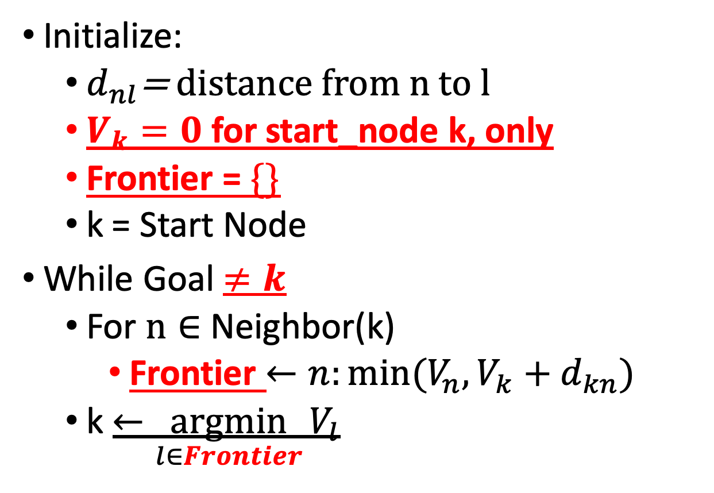
Uniform Cost Search
Initialize:
$d_{nl}$= distance from n to l
$V_{k}=0$ for start_node k, only
Frontier = $\{\}$
k = Start Node
While Goal $≠k$
For $n∈$ Neighbor(k)
Frontier $←n:min⁡(V_{n},V_{k}+d_{kn})$
k $←\underset{l∈Frontier}{argmin}{V_{l}}$
By Subh83 - Own work, CC BY 3.0, https://commons.wikimedia.org/w/index.php?curid=14916867

Slide 5
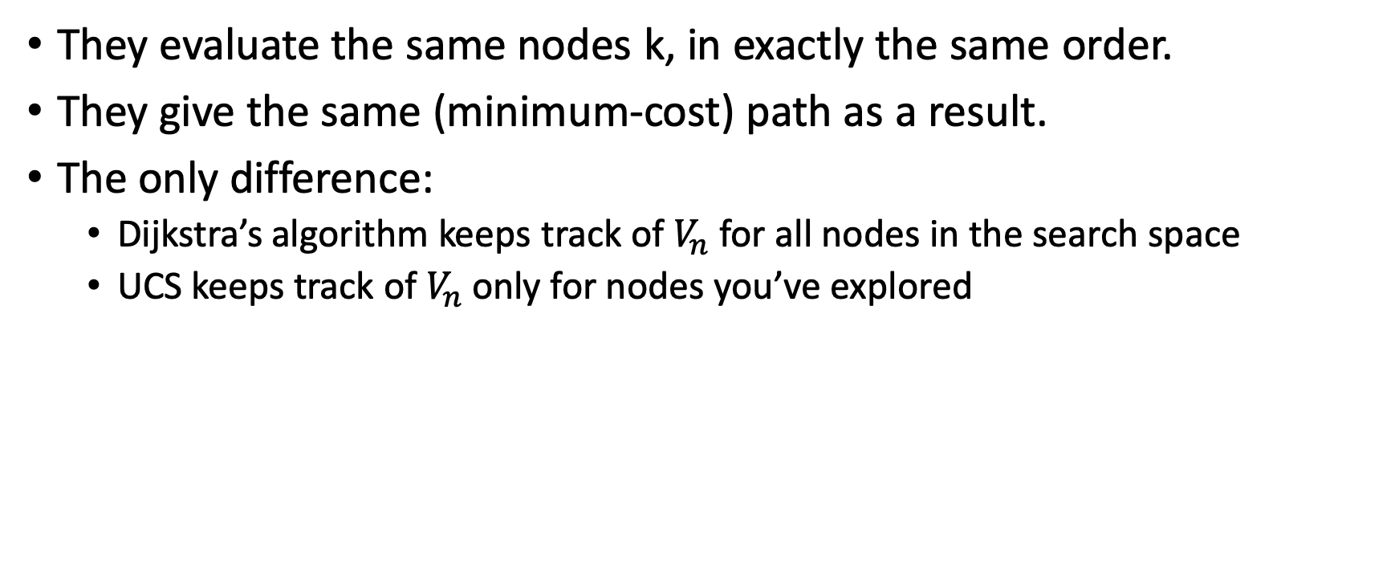
Dijkstra’s algorithm vs. Uniform Cost Search
They evaluate the same nodes k, in exactly the same order.
They give the same (minimum-cost) path as a result.
The only difference:
Dijkstra’s algorithm keeps track of $V_{n}$ for all nodes in the search space
UCS keeps track of $V_{n}$ only for nodes you’ve explored

Slide 6
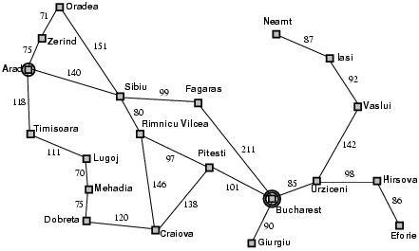
Example: Romania
Frontier: { Zerind:75, Timisoara:118, Oradea:291, Rimnicu Vilcea:220, Fagaras:239 }
Explored: { Arad:0, Sibiu:140, Zerind:75, Timisoara:118, Oradea:291, Rimnicu Vilcea:220, Fagaras:239 }
Arad, 0
Sibiu, 140
Timisoara, 118
Zerind, 75
Oradea, 291
Rimnicu Vilcea, 220
Fagaras, 239

Slide 7

Why it Works
Arad, 0
Sibiu, 140
$d_{nl}≥0$ means that every node on the best path to the Goal, $G$, has a cost, $V_{n}$, less than or equal the cost of the goal, $V_{n}≤V_{G}$
RV, 220
Fagaras, 239

Slide 8

Why it Works
Arad, 0
Sibiu, 140
k $←\underset{l∈Frontier}{argmin}{V_{l}}$ means that the lowest-cost nodes are expanded first
RV, 220
Fagaras, 239
Pitesti, 317

Slide 9
Why it Works
Arad, 0
Sibiu, 140
We don’t end when Goal is placed on the Frontier, we only end when Goal is expanded
RV, 220
Fagaras, 239
Pitesti, 317
Bucharest, 450

Slide 10

Why it Works
Arad, 0
Sibiu, 140
k $←\underset{l∈Frontier}{argmin}{V_{l}}$ means that every predecessor with a cost less than $V_{G}$ is expanded before the goal is expanded
RV, 220
Fagaras, 239
Pitesti, 317
Bucharest, 418

Slide 11
Why it Works
Arad, 0
Sibiu, 140
Therefore we always find the shortest path
RV, 220
Fagaras, 239
Pitesti, 317
Bucharest, 418

Slide 12
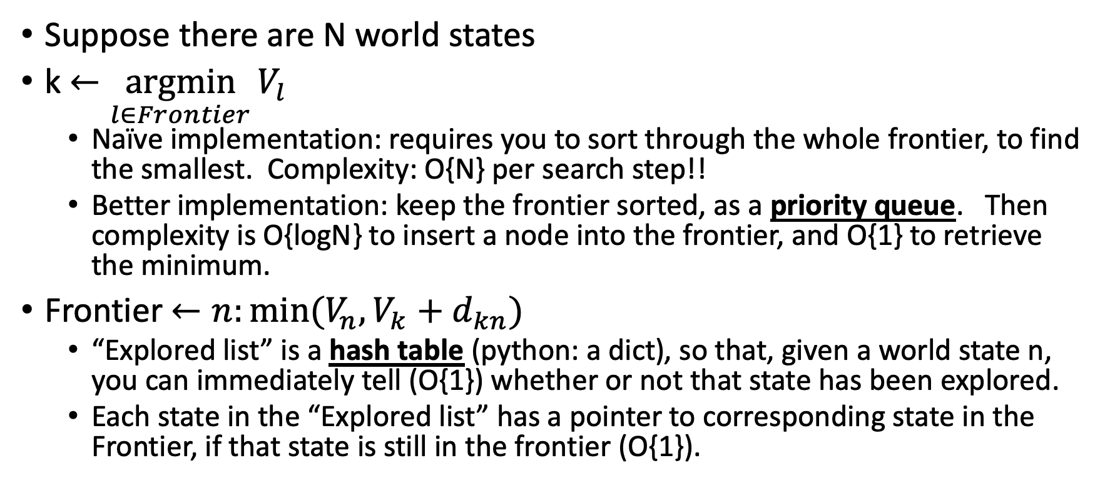
Computational Considerations
Suppose there are N world states
k $←\underset{l∈Frontier}{argmin}{V_{l}}$
Naïve implementation: requires you to sort through the whole frontier, to find the smallest. Complexity: O{N} per search step!!
Better implementation: keep the frontier sorted, as a priority queue. Then complexity is O{logN} to insert a node into the frontier, and O{1} to retrieve the minimum.
Frontier $←n:min⁡(V_{n},V_{k}+d_{kn})$
“Explored list” is a hash table (python: a dict), so that, given a world state n, you can immediately tell (O{1}) whether or not that state has been explored.
Each state in the “Explored list” has a pointer to corresponding state in the Frontier, if that state is still in the frontier (O{1}).

Slide 13
Outline
Uniform cost search (UCS) = slightly different implementation of Dijkstra’s Algorithm
Breadth-first search (BFS) = special case of UCS
Depth-first search (DFS)

Slide 14

Breadth-first search (BFS) = special case of UCS
… when every step has exactly the same cost, $d_{nl}=1$
Example: solving a maze
 |  | S
 |  |  |  | G

Slide 15
BFS Computational Savings
Frontier doesn’t have to be a priority queue
It can just be a regular first-in, first-out (FIFO) queue
Example: Frontier = {S}
 |  | S
 |  |  |  | G

Slide 16
BFS Computational Savings
Frontier doesn’t have to be a priority queue
It can just be a regular first-in, first-out (FIFO) queue
Example: Frontier = {A,B}
Pop A from the queue, expand it
 | A | S | B
 |  |  |  | G

Slide 17
BFS Computational Savings
Frontier doesn’t have to be a priority queue
It can just be a regular first-in, first-out (FIFO) queue
Example: Frontier = {B,C}
Pop B from the queue, expand it
 | A | S | B
 | C |  |  | G

Slide 18
BFS Computational Savings
Frontier doesn’t have to be a priority queue
It can just be a regular first-in, first-out (FIFO) queue
Example: Frontier = {C,D}
Pop C from the queue, expand it
 | A | S | B
 | C |  | D | G

Slide 19
BFS Computational Savings
Frontier doesn’t have to be a priority queue
It can just be a regular first-in, first-out (FIFO) queue
Example: Frontier = {D,E}
Pop D from the queue, expand it
 | A | S | B
 | C |  | D | G
 | E

Slide 20
BFS Computational Savings
Frontier doesn’t have to be a priority queue
It can just be a regular first-in, first-out (FIFO) queue
Example: Frontier = {E,G}
Pop E from the queue, expand it
 | A | S | B
 | C |  | D | G
 | E

Slide 21
BFS Computational Savings
Frontier doesn’t have to be a priority queue
It can just be a regular first-in, first-out (FIFO) queue
Example: Frontier = {G,F}
Pop G from the queue, expand it
 | A | S | B
 | C |  | D | G
 | E | F

Slide 22
BFS Computational Savings
Frontier doesn’t have to be a priority queue
It can just be a regular first-in, first-out (FIFO) queue
Example: G expanded, we learn that it’s the goal, we found the best path
 | A | S | B
 | C |  | D | G
 | E | F

Slide 23
Analysis of search strategies
Strategies are evaluated along the following criteria:
Completeness: does it always find a solution if one exists?
Optimality: does it always find a least-cost solution?
Time complexity: number of nodes generated
Space complexity: maximum number of nodes in memory
Time and space complexity are measured in terms of
b: maximum branching factor of the search tree
d: depth of the optimal solution
m: maximum length of any path in the state space (may be infinite)

Slide 24
Properties of breadth-first search
Complete?
Yes (if branching factor b is finite).
Even w/o explored-set checking, it still works!
Optimal?
Yes – if cost = 1 per step (uniform cost search will fix this)
Time?
Number of nodes in a b-ary tree of depth d: O(b^{d})
(d is the depth of the optimal solution)
Space?
O(b^{d})
Space is the bigger problem (more than time)

Slide 25
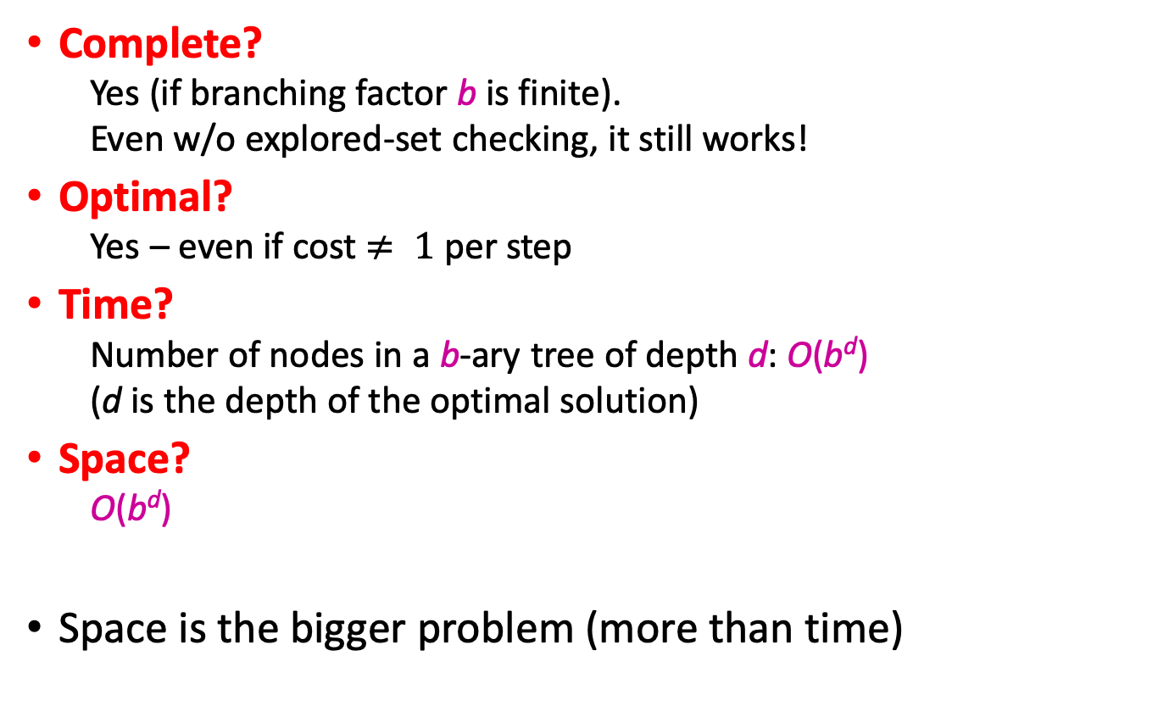
Properties of uniform-cost search
Complete?
Yes (if branching factor b is finite).
Even w/o explored-set checking, it still works!
Optimal?
Yes – even if cost $≠ 1$ per step
Time?
Number of nodes in a b-ary tree of depth d: O(b^{d})
(d is the depth of the optimal solution)
Space?
O(b^{d})
Space is the bigger problem (more than time)

Slide 26
Outline
Uniform cost search (UCS) = slightly different implementation of Dijkstra’s Algorithm
Breadth-first search (BFS) = special case of UCS
Depth-first search (DFS)

Slide 27
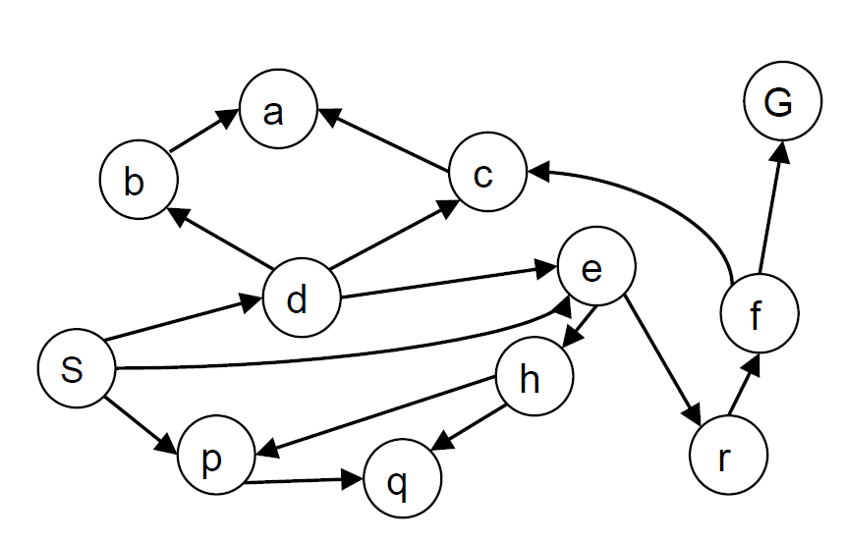
Depth-first search
Expand deepest unexpanded node (BFS: shallowest)
Implementation: Frontier is a last-in-first-out (LIFO) stack (BFS:FIFO)
Example state space graph for a tiny search problem
Example from P. Abbeel and D. Klein

Slide 28
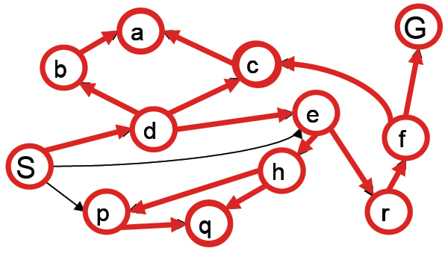
Depth-first search
Frontier:
Step 0: {S}
Step 1: {d,e,p}
Step 2: {b,c,e,p} – FIFO
Step 3: {a,c,e,p}
Step 4: {c,e,p}
S
d
e
p
b
c
e
a
Example from P. Abbeel and D. Klein

Slide 29
The reason DFS is useful: Space
When we know that Sdba is a dead end, we can remove it from the tree!
S
d
e
p
b
c
e
a
Example from P. Abbeel and D. Klein

Slide 30
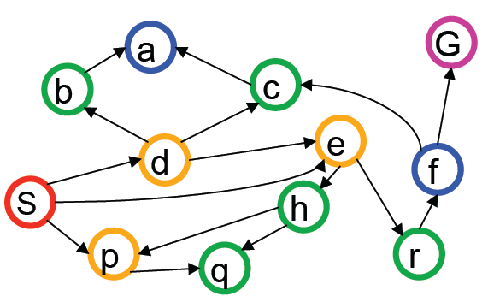
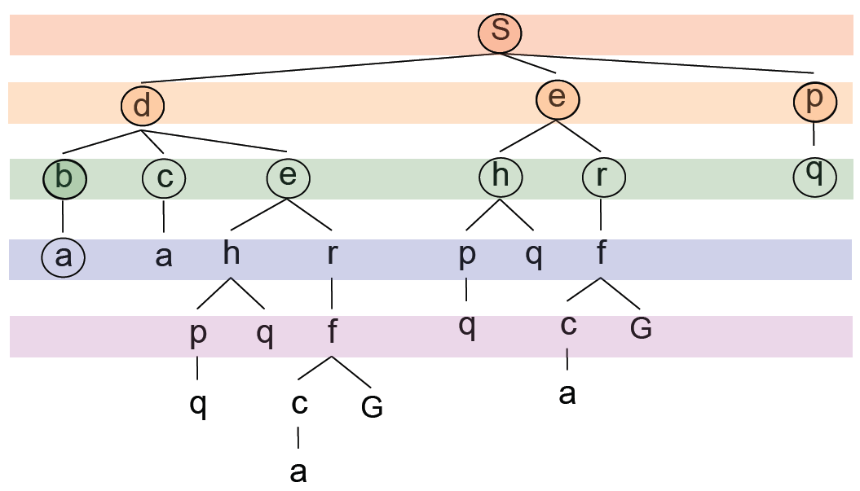
Breadth-first search
Computational complexity:
(s,
d,e,p,
b,c,e,h,r,q,
a,a,h,r,p,q,f,
p,q,f,q,c,G)
Space complexity:
We have to store the whole tree!
Example from P. Abbeel and D. Klein

Slide 31
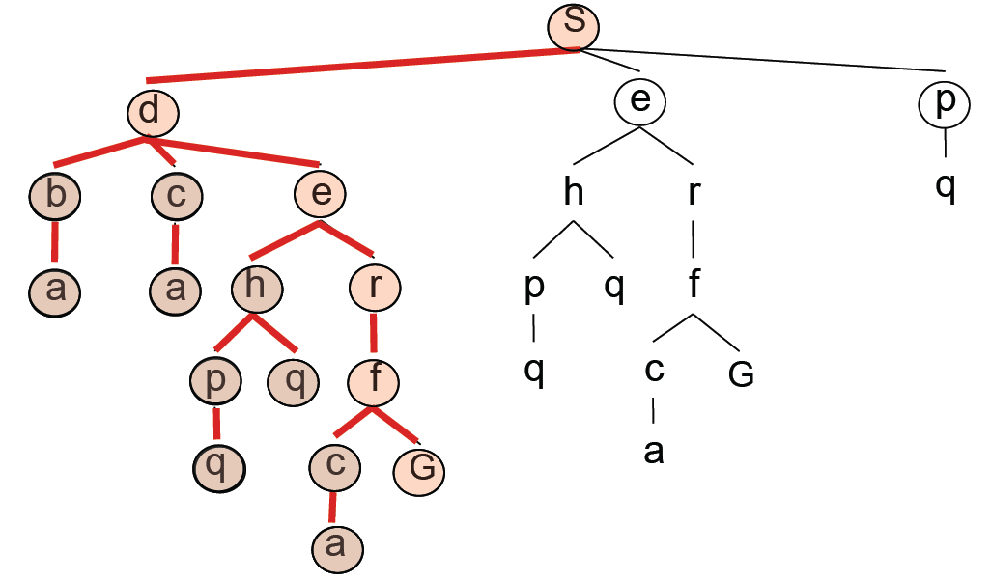
Depth-first search
Computational complexity: here are the nodes we expanded
Space complexity: here’s the part of the tree that we still have in memory
S
d
e
p
b
c
e
h
r
f
c
G
Example from P. Abbeel and D. Klein

Slide 32
Analysis of search strategies
Strategies are evaluated along the following criteria:
Completeness: does it always find a solution if one exists?
Optimality: does it always find a least-cost solution?
Time complexity: number of nodes generated
Space complexity: maximum number of nodes in memory
Time and space complexity are measured in terms of
b: maximum branching factor of the search tree
d: depth of the optimal solution
m: maximum length of any path in the state space (may be infinite)

Slide 33
Properties of depth-first search
Complete? (always finds a solution if one exists?)
Fails in infinite-depth spaces
Fails if there are loops (unless you keep an “Explored Set”)
Optimal? (always finds an optimal solution?)
No – returns the first solution it finds
Time? (how long does it take, in terms of b, d, m?)
O(b^{m}) (remember BFS was O(b^{d}))
Terrible if m is much larger than d
Space? (how much storage space?)
O(bm), i.e., linear space!
The frontier doesn’t need to keep track of failed paths, only the currently active path

Slide 34
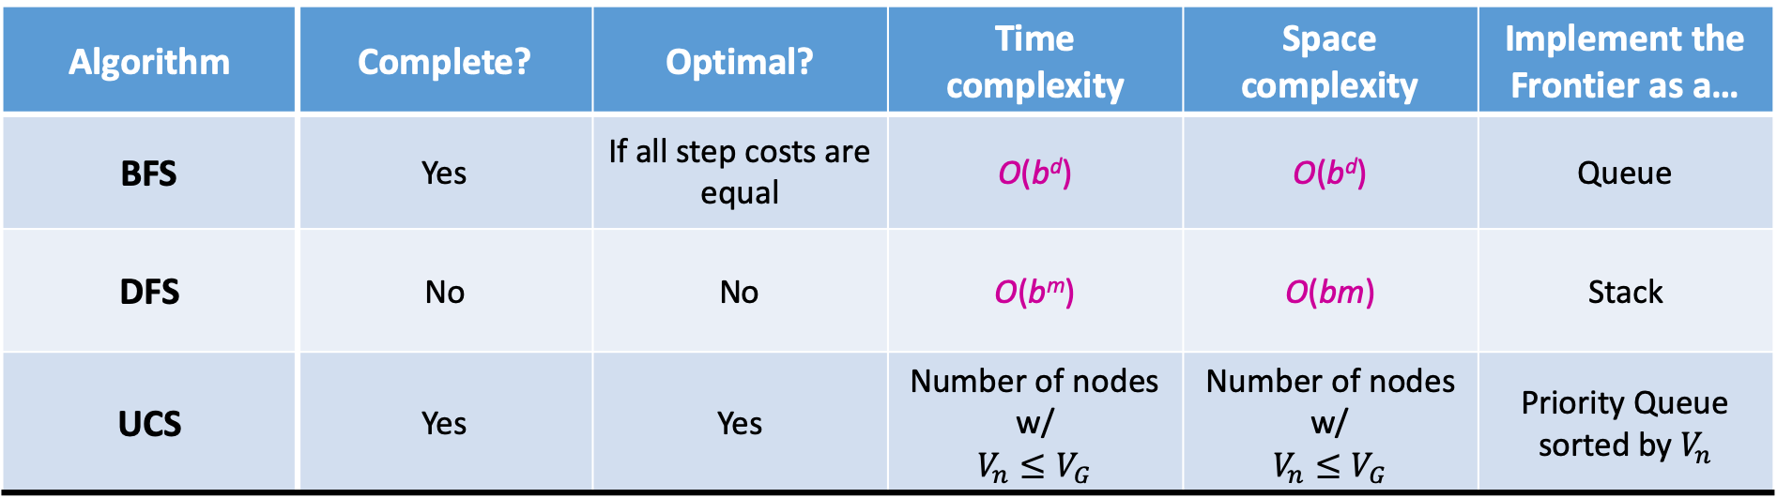
Comparison of Search Strategies
Algorithm | Complete? | Optimal? | Time complexity | Space complexity | Implement the Frontier as a…
BFS | Yes | If all step costs are equal | O(b^{d}) | O(b^{d}) | Queue
DFS | No | No | O(b^{m}) | O(bm) | Stack
UCS | Yes | Yes | Number of nodes w/ $$V_{n}≤V_{G}$$ | Number of nodes w/ $$V_{n}≤V_{G}$$ | Priority Queue sorted by $V_{n}$

