Slide 1

Lecture 5: The ”animal kingdom” of heuristics: Admissible, Consistent, zero, Relaxed, Dominant
Mark Hasegawa-Johnson, January 2020
With some slides by Svetlana Lazebnik, 9/2016
Distributed under CC-BY 3.0
Title image: By Harrison Weir - From reuseableart.com, Public Domain, https://commons.wikimedia.org/w/index.php?curid=47879234

Slide 2
Outline of lecture
Admissible heuristics
Consistent heuristics
The zero heuristic: Dijkstra’s algorithm
Relaxed heuristics
Dominant heuristics

Slide 3

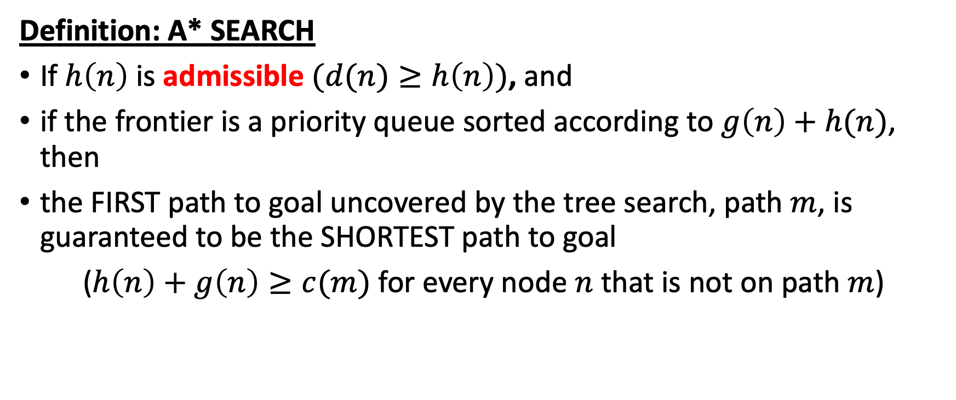


A* Search
$$c\left(m\right)$$
m
S
G
n
$$g\left(n\right)$$
$$≥h\left(n\right)$$
Definition: A* SEARCH
If $h\left(n\right)$ is admissible $(d(n)≥h\left(n\right))$, and
if the frontier is a priority queue sorted according to $g\left(n\right)+h(n)$, then
the FIRST path to goal uncovered by the tree search, path $m$, is guaranteed to be the SHORTEST path to goal
($h\left(n\right)+g\left(n\right)≥c(m)$ for every node $n$ that is not on path $m$)

Slide 4
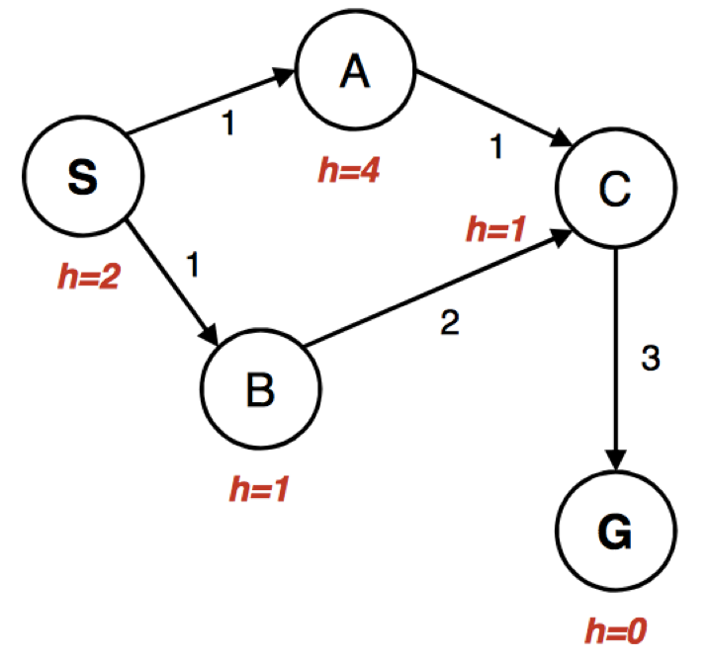
Bad interaction between A* and the explored set
Frontier
S: g(n)+h(n)=2, parent=none
Explored Set
Select from the frontier: S

Slide 5
Bad interaction between A* and the explored set
Frontier
A: g(n)+h(n)=5, parent=S
B: g(n)+h(n)=2, parent=S
Explored Set
S
Select from the frontier: B

Slide 6
Bad interaction between A* and the explored set
Frontier
A: g(n)+h(n)=5, parent=S
C: g(n)+h(n)=4, parent=B
Explored Set
S, B
Select from the frontier: C

Slide 7
Bad interaction between A* and the explored set
Frontier
A: g(n)+h(n)=5, parent=S
G: g(n)+h(n)=6, parent=C
Explored Set
S, B, C
Select from the frontier: A

Slide 8
Bad interaction between A* and the explored set
Frontier
G: g(n)+h(n)=6, parent=C
Now we would place C in the frontier, with parent=A and h(n)+g(n)=3, except that C was already in the explored set!
Explored Set
S, B, C
Select from the frontier: Would be C, but instead it’s G

Slide 9
Bad interaction between A* and the explored set
Return the path S,B,C,G
Path cost = 6
OOPS

Slide 10
Bad interaction between A* and the explored set: Three possible solutions
Don’t use an explored set
This option is OK for any finite state space, as long as you check for loops.
Nodes on the explored set are tagged by their h(n)+g(n). If you find a node that’s already in the explored set, test to see if the new h(n)+g(n) is smaller than the old one.
If so, put the node back on the frontier
If not, leave the node off the frontier
Use a heuristic that’s not only admissible, but also consistent.

Slide 11
Outline of lecture
Admissible heuristics
Consistent heuristics
The zero heuristic: Dijkstra’s algorithm
Relaxed heuristics
Dominant heuristics

Slide 12
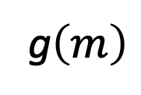
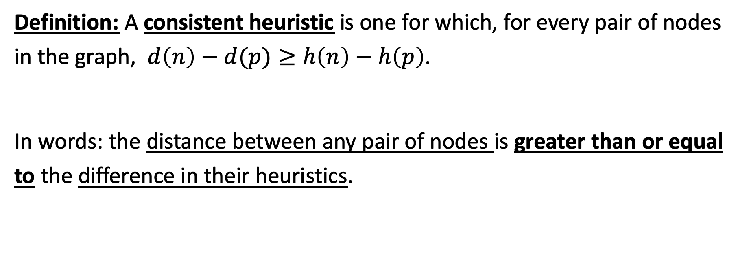
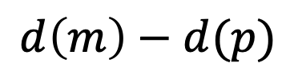

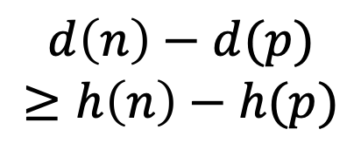
Consistent (monotonic) heuristic
g$\left(m\right)$
$$d\left(m\right)−d(p)$$
m
S
p
n
$$g\left(n\right)$$
$$d\left(n\right)−d(p)$$
$$≥h\left(n\right)−h(p)$$
Definition: A consistent heuristic is one for which, for every pair of nodes in the graph, $d\left(n\right)−d(p)≥h\left(n\right)−h\left(p\right)$.
In words: the distance between any pair of nodes is greater than or equal to the difference in their heuristics.

Slide 13
A* with an inconsistent heuristic
Frontier
A: g(n)+h(n)=5, parent=S
C: g(n)+h(n)=4, parent=B
Explored Set
S, B
Select from the frontier: C

Slide 14
A* with a consistent heuristic
Frontier
A: g(n)+h(n)=2, parent=S
C: g(n)+h(n)=4, parent=B
Explored Set
S, B
Select from the frontier: A
h=1

Slide 15
A* with a consistent heuristic
Frontier
.
C: g(n)+h(n)=2, parent=A
Explored Set
S, B, A
Select from the frontier: C
h=1

Slide 16
A* with a consistent heuristic
Frontier
.
G: g(n)+h(n)=5, parent=C
Explored Set
S, B, A, C
Select from the frontier: G
h=1

Slide 17
Bad interaction between A* and the explored set: Three possible solutions
Don’t use an explored set.
This works for the MP!
If you find a node that’s already in the explored set, test to see if the new h(n)+g(n) is smaller than the old one.
Most students find that this is the most computationally efficient solution to the multi-dots problem.
Use a consistent heuristic.
Do this too. Consistent: heuristic difference <= actual distance between two nodes. It’s easy to do, because 0 <= d.

Slide 18
Outline of lecture
Admissible heuristics
Consistent heuristics
The zero heuristic: Dijkstra’s algorithm
Relaxed heuristics
Dominant heuristics

Slide 19
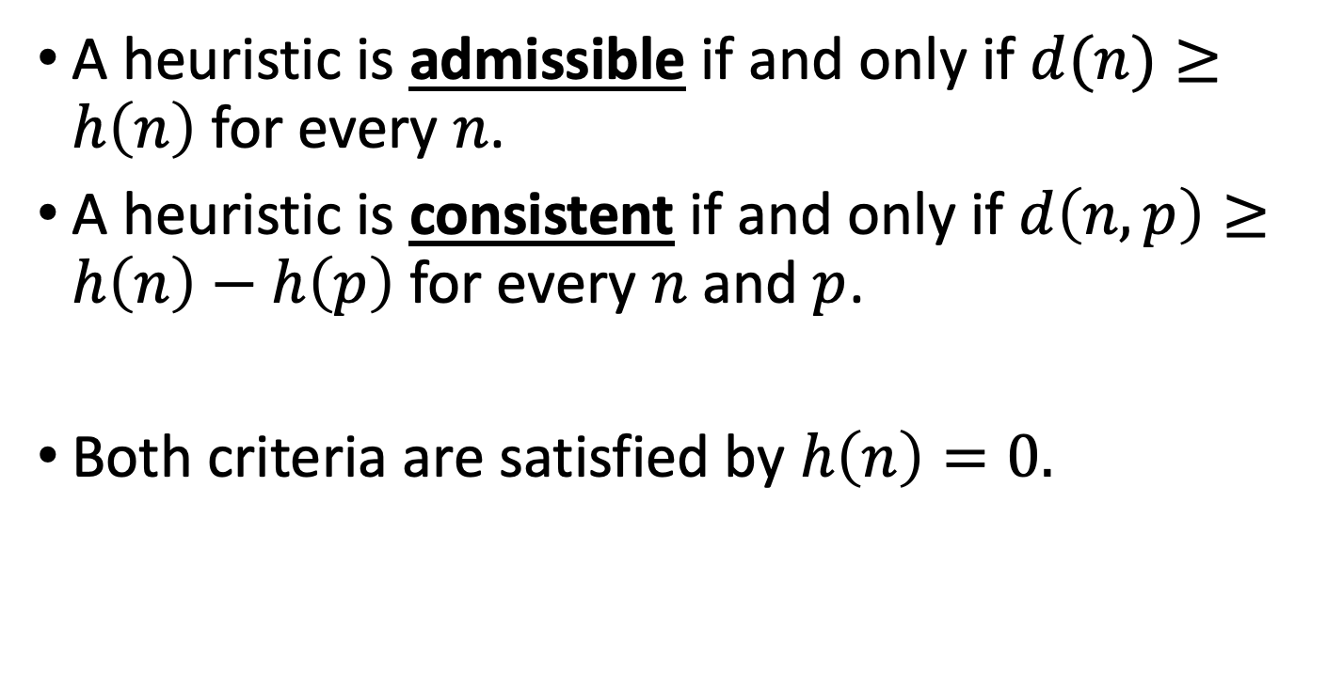
The trivial case: h(n)=0
A heuristic is admissible if and only if $d(n)≥h\left(n\right)$ for every $n$.
A heuristic is consistent if and only if $d\left(n,p\right)≥h\left(n\right)−h\left(p\right)$ for every $n$ and $p$.
Both criteria are satisfied by $h\left(n\right)=0.$

Slide 20
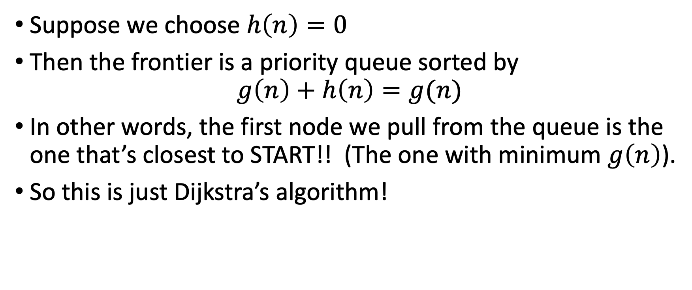
Dijkstra = A* with h(n)=0
Suppose we choose $h\left(n\right)=0$
Then the frontier is a priority queue sorted by
$$g\left(n\right)+h\left(n\right)=g(n)$$
In other words, the first node we pull from the queue is the one that’s closest to START!! (The one with minimum $g\left(n\right)$).
So this is just Dijkstra’s algorithm!

Slide 21
Outline of lecture
Admissible heuristics
Consistent heuristics
The zero heuristic: Dijkstra’s algorithm
Relaxed heuristics
Dominant heuristics

Slide 22
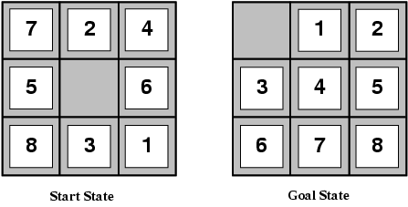
Designing heuristic functions Now we start to see things that actually resemble the multi-dot problem…
Heuristics for the 8-puzzle
h₁(n) = number of misplaced tiles
h₂(n) = total Manhattan distance (number of squares from desired location of each tile)
h₁(start) = 8
h₂(start) = 3+1+2+2+2+3+3+2 = 18
Are h₁ and h₂ admissible?

Slide 23
Heuristics from relaxed problems
A problem with fewer restrictions on the actions is called a relaxed problem
The cost of an optimal solution to a relaxed problem is an admissible heuristic for the original problem
If the rules of the 8-puzzle are relaxed so that a tile can move anywhere, then h₁(n) gives the shortest solution
If the rules are relaxed so that a tile can move to any adjacent square, then h₂(n) gives the shortest solution

Slide 24
Heuristics from subproblems This is also a trick that many students find useful for the multi-dot problem.
Let h₃(n) be the cost of getting a subset of tiles (say, 1,2,3,4) into their correct positions
Can precompute and save the exact solution cost for every possible subproblem instance – pattern database
If the subproblem is O{9^4}, and the full problem is O{9^9}, then you can solve as many as 9^5 subproblems without increasing the complexity of the problem!!

Slide 25
Outline of lecture
Admissible heuristics
Consistent heuristics
The zero heuristic: Dijkstra’s algorithm
Relaxed heuristics
Dominant heuristics

Slide 26
Dominance
If h₁ and h₂ are both admissible heuristics and h₂(n) ≥ h₁(n) for all n, (both admissible) then h₂ dominates h₁
Which one is better for search?
A* search expands every node with f(n) < C* or h(n) < C* – g(n)
Therefore, A* search with h₁ will expand more nodes = h₁ is more computationally expensive.

Slide 27
Dominance
Typical search costs for the 8-puzzle (average number of nodes expanded for different solution depths):
d=12 BFS expands 3,644,035 nodes A*(h₁) expands 227 nodes A*(h₂) expands 73 nodes
d=24 BFS expands 54,000,000,000 nodes A*(h₁) expands 39,135 nodes A*(h₂) expands 1,641 nodes

Slide 28
Combining heuristics
Suppose we have a collection of admissible heuristics h₁(n), h₂(n), …, h_{m}(n), but none of them dominates the others
How can we combine them?
h(n) = max{h₁(n), h₂(n), …, h_{m}(n)}

Slide 29
All search strategies. C*=cost of best path.
Algorithm | Complete? | Optimal? | Time complexity | Space complexity | Implement the Frontier as a…
BFS | Yes | If all step costs are equal | O(b^d) | O(b^d) | Queue
DFS | No | No | O(b^m) | O(bm) | Stack
UCS | Yes | Yes | Number of nodes w/ g(n) ≤ C* | Number of nodes w/ g(n) ≤ C* | Priority Queue sorted by g(n)
Greedy | No | No | Worst case: O(b^m) Best case: O(bd) | Worse case: O(b^m) Best case: O(bd) | Priority Queue sorted by h(n)
A* | Yes | Yes | Number of nodes w/ g(n)+h(n) ≤ C* | Number of nodes w/ g(n)+h(n) ≤ C* | Priority Queue sorted by h(n)+g(n)

