Slide 1
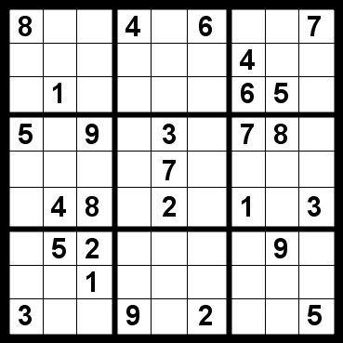
CS440/ECE 448, Lecture 6: Constraint Satisfaction Problems
Slides by Mark Hasegawa-Johnson, 1/2020
Including some slides written by Svetlana Lazebnik, 9/2016
CC-BY 4.0: You are free to: copy and redistribute the material in any medium or format, remix, transform, and build upon the material for any purpose, even commercially, if you give appropriate credit.
8
 | 1
8
5 | 1
8
4 | 1
8
3 | 1
8 | 5
 | 1
8 | 4
 | 1
8 | 3
 | 1
8
2
5 | 1
8
5 | 1 | 9

Slide 2

Content
What is a CSP? Why is it search? Why is it special?
Backtracking Search
$O\{1\}$ heuristics to improve backtracking search
$O\{N\}$ and $O\{N^{2}\}$ heuristics: early detection of failure

Slide 3
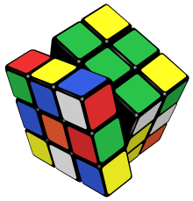
What is search for?
Assumptions: single agent, deterministic, fully observable, discrete environment
Search for planning
The path to the goal is the important thing
Paths have various costs, depths
Search for assignment
Assign values to variables while respecting certain constraints
The goal (complete, consistent assignment) is the important thing

Slide 4
Why are Constraint satisfaction problems (CSPs) just a special case of generic search problems?
State is defined by N variables, each takes one of D possible values
Goal test is a set of constraints specifying allowable combinations of values for subsets of variables.
Solution is a complete, consistent assignment

Slide 5
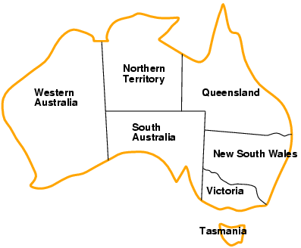
Example: Map Coloring
Variables: WA, NT, Q, NSW, V, SA, T
Domains: {red, green, blue}
Constraints: adjacent regions must have different colors
Logical representation: WA ≠ NT
Set representation: (WA, NT) in {(red, green), (red, blue), (green, red), (green, blue), (blue, red), (blue, green)}

Slide 6
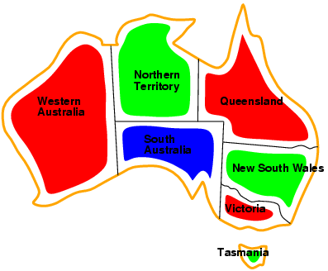
Example: Map Coloring
Solutions are complete and consistent assignments, e.g., WA = red, NT = green, Q = red, NSW = green, V = red, SA = blue, T = green

Slide 7
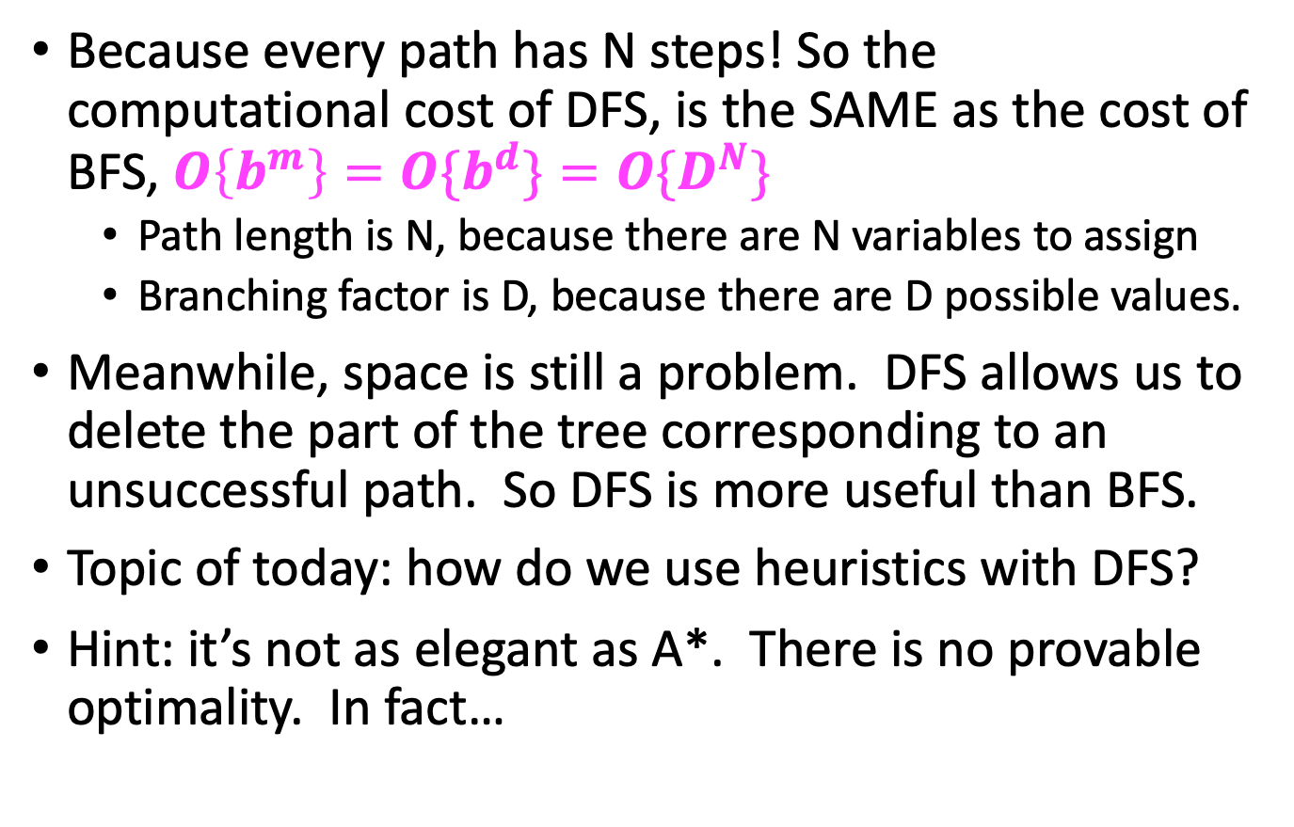
Why are Constraint satisfaction problems (CSPs) different from generic search problems?
Because every path has N steps! So the computational cost of DFS, is the SAME as the cost of BFS, $O\left\{b^{m}\right\}=O\{b^{d}\}=O\{D^{N}\}$
Path length is N, because there are N variables to assign
Branching factor is D, because there are D possible values.
Meanwhile, space is still a problem. DFS allows us to delete the part of the tree corresponding to an unsuccessful path. So DFS is more useful than BFS.
Topic of today: how do we use heuristics with DFS?
Hint: it’s not as elegant as A*. There is no provable optimality. In fact…

Slide 8

Computational complexity of CSPs
The satisfiability (SAT) problem:
Given a Boolean formula, is there an assignment of the variables that makes it evaluate to true?
SAT and CSP are NP-complete
NP: a class of decision problems for which
the “yes” answer can be verified in polynomial time
no known algorithm can find a “yes” answer, from scratch, in polynomial time
An NP-complete problem is in NP and every other problem in NP can be efficiently reduced to it (Cook, 1971)
Other NP-complete problems: graph coloring, n-puzzle, generalized sudoku
It is not known whether P = NP, i.e., no efficient algorithms for solving SAT in general are known

Slide 9

Content
What is a CSP? Why is it search? Why is it special?
Backtracking Search
$O\{1\}$ heuristics to improve backtracking search
$O\{N\}$ and $O\{N^{2}\}$ heuristics: early detection of failure

Slide 10
Backtracking search
In CSP’s, variable assignments are commutative
For example, [WA = red then NT = green] is the same as [NT = green then WA = red]
We only need to consider assignments to a single variable at each level (i.e., we fix the order of assignments)
There are N! different orderings of the variables. If we choose a particular ordering, and then never change it, we reduce computational complexity by a factor of N!
With a fixed order, there are still D^{N} possible paths.
At each level, choose one of the D possible assignments, and explore to see if it gives you a solution. If not, backtrack: delete the whole sub-tree, and try something different.
Depth-first search for CSPs with single-variable assignments is called backtracking search

Slide 11

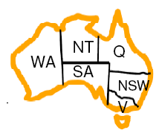
Example

Slide 12
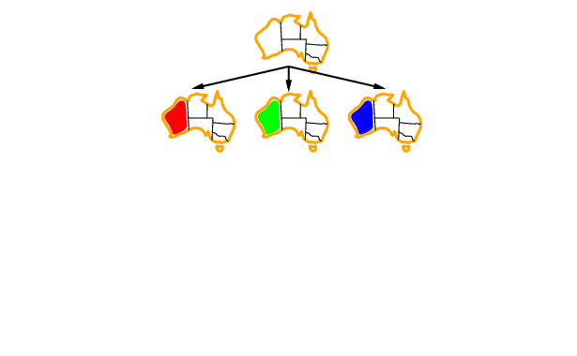
Example

Slide 13
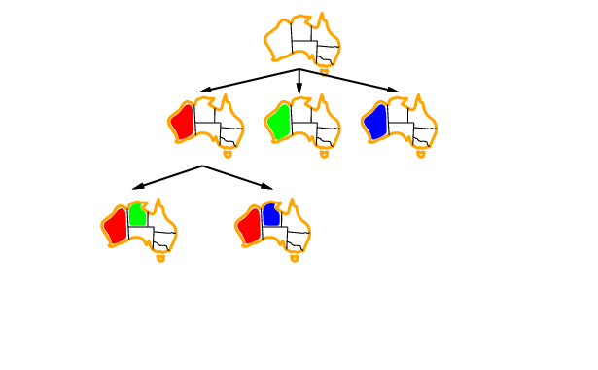
Example

Slide 14
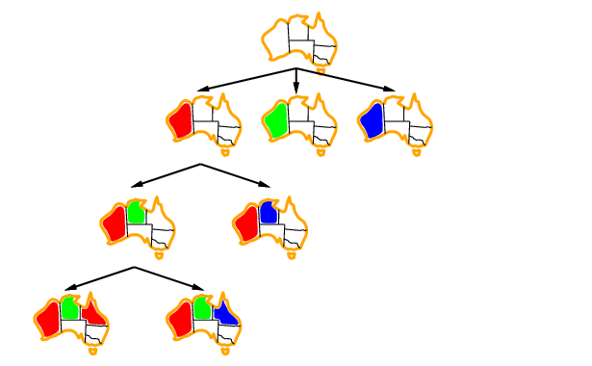
Example

Slide 15
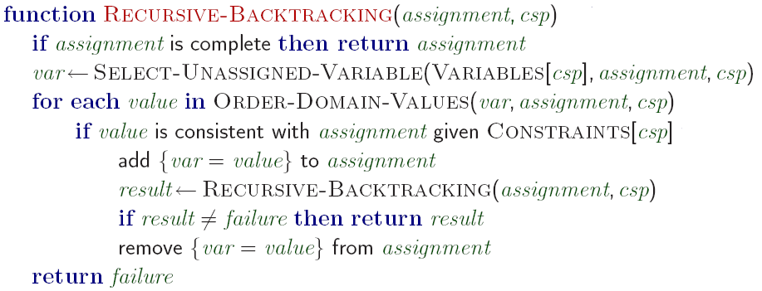
Backtracking search algorithm
Making backtracking search efficient:
Which variable should be assigned next?
In what order should its values be tried?
Can we detect inevitable failure early?

Slide 16

Content
What is a CSP? Why is it search? Why is it special?
Backtracking Search
$O\{1\}$ heuristics to improve backtracking search
$O\{N\}$ and $O\{N^{2}\}$ heuristics: early detection of failure

Slide 17
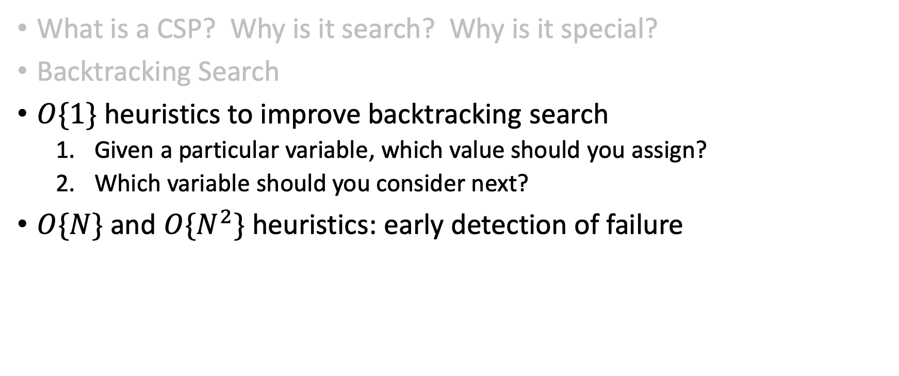
Content
What is a CSP? Why is it search? Why is it special?
Backtracking Search
$O\{1\}$ heuristics to improve backtracking search
Given a particular variable, which value should you assign?
Which variable should you consider next?
$O\{N\}$ and $O\{N^{2}\}$ heuristics: early detection of failure

Slide 18
Given a variable, in which order should its values be tried?
Making backtracking search efficient:
Which variable should be assigned next?
In what order should its values be tried?
Can we detect inevitable failure early?

Slide 19
Given a variable, in which order should its values be tried?
Least Constraining Value (LCV) Heurstic:
Try the following assignment first: to the variable you’re studying, the value that rules out the fewest values in the remaining variables
Key intuition: maximize the probability of success.

Slide 20
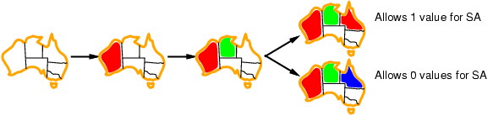
Given a variable, in which order should its values be tried?
Least Constraining Value (LCV) Heurstic:
Try the following assignment first: to the variable you’re studying, the value that rules out the fewest values in the remaining variables
Which assignment for Q should we choose?

Slide 21
Which variable should be assigned next?
Making backtracking search efficient:
Which variable should be assigned next?
In what order should its values be tried?
Can we detect inevitable failure early?

Slide 22
Which variable should be assigned next?
Key intuitions:
If there is a solution possible, it will still be possible, regardless of the order in which you study the variables.
So choosing a VARIABLE is easier than choosing a VALUE. Just minimize the branching factor.
Least Remaining Values (LRV) Heuristic:
Choose the variable with the fewest legal values
Most Constraining Variable (MCV) Heuristic:
Choose the variable that imposes the most constraints on the remaining variables

Slide 23
Which variable should be assigned next?
Least Remaining Values (LRV) Heuristic:
Choose the variable with the fewest legal values
??

Slide 24
Which variable should be assigned next?
Most Constraining Variable (MCV) Heuristic:
Choose the variable that imposes the most constraints on the remaining variables
Tie-breaker among variables that have equal numbers of LRV

Slide 25
Which variable should be assigned next?
Most Constraining Variable (MCV) Heuristic:
Choose the variable that imposes the most constraints on the remaining variables
Tie-breaker among variables that have equal numbers of MRV
??

Slide 26

Content
What is a CSP? Why is it search? Why is it special?
Backtracking Search
$O\{1\}$ heuristics to improve backtracking search
$O\{N\}$ and $O\{N^{2}\}$ heuristics: early detection of failure

Slide 27
Early detection of failure: O{N} checking
Forward Checking:
Check to make sure that every variable still has at least one possible assignment

Slide 28


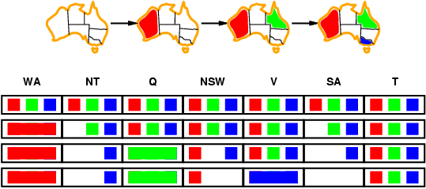
Early detection of failure: O{N} checking Forward checking
Keep track of remaining legal values for unassigned variables
Terminate search when any variable has no legal values
WA T NT NSW Q SA V

Slide 29
Early detection of failure: O{N} checking Forward checking
Keep track of remaining legal values for unassigned variables
Terminate search when any variable has no legal values
WA T NT NSW Q SA V

Slide 30
Early detection of failure: O{N} checking Forward checking
Keep track of remaining legal values for unassigned variables
Terminate search when any variable has no legal values
WA T NT NSW Q SA V

Slide 31
Early detection of failure: O{N} checking Forward checking
Keep track of remaining legal values for unassigned variables
Terminate search when any variable has no legal values
WA T NT NSW Q SA V

Slide 32
Early detection of failure: O{N^2} checking
Arc consistency:
Check to make sure that every PAIR of variables (every “arc”) still has a pair-wise assignment that satisfies all constraints

Slide 33
Does arc consistency always detect the lack of a solution?
B
A
D
B
A
D
C
C
There exist stronger notions of consistency (path consistency, k-consistency), but we won’t worry about them

Slide 34
Summary
CSPs are a special kind of search problem:
States defined by values of a fixed set of variables
Goal test defined by constraints on variable values
Backtracking = depth-first search where successor states are generated by considering assignments to a single variable
Variable ordering (LRV, MCV) and value selection (LCV) heuristics can help significantly
Forward checking says: don’t consider an assignment if it leaves any variable with no remaining possible values
Arc consistency says: don’t consider an assignment if it leaves any pair of variables with no remaining mutually compatible pair of values
Complexity of CSPs
NP-complete in general (exponential worst-case running time)
Typical run-time can be reduced substantially using polynomial-complexity forward-checking and arc-consistency heuristics

