Slide 1
CS440/ECE448 Lecture 7: Robots
Mark Hasegawa-Johnson, 2/2020
Including slides by Svetlana Lazebnik and Margaret Fleck
CC-BY 4.0: You are free to: copy and redistribute the material in any medium or format, remix, transform, and build upon the material for any purpose, even commercially, if you give appropriate credit.

Slide 2
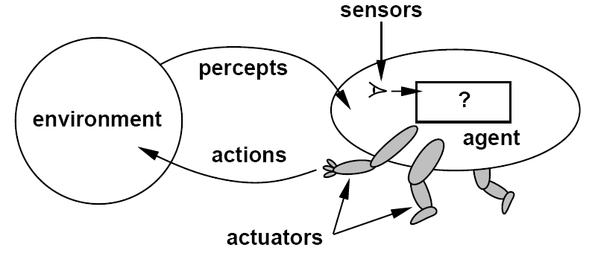
Agents (textbook chapter 2)
An agent is anything that can be viewed as perceiving its environment through sensors and acting upon that environment through actuators
sensations

Slide 3
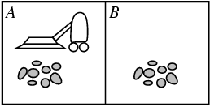
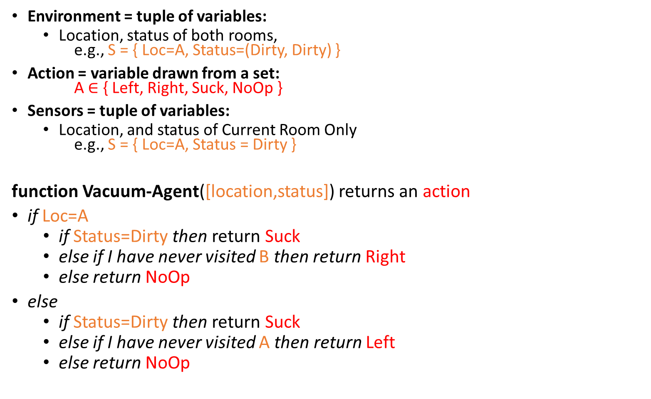
Example: Vacuum-Agent
Environment = tuple of variables:
Location, status of both rooms, e.g., S = { Loc=A, Status=(Dirty, Dirty) }
Action = variable drawn from a set: A$∈$ { Left, Right, Suck, NoOp }
Sensors = tuple of variables:
Location, and status of Current Room Only e.g., S = { Loc=A, Status = Dirty }
function Vacuum-Agent([location,status]) returns an action
if Loc=A
if Status=Dirty then return Suck
else if I have never visited B then return Right
else return NoOp
else
if Status=Dirty then return Suck
else if I have never visited A then return Left
else return NoOp

Slide 4
Specifying the task environment
PEAS: Performance, Environment, Actions, Sensors
P: a function the agent is maximizing (or minimizing)
Assumed given
E: a formal representation for world states
For concreteness, a tuple (var₁=val₁, var₂=val₂, … ,var_{n}=val_{n})
A: actions that change the state according to a transition model
Given a state and action, what is the successor state (or distribution over successor states)?
S: observations that allow the agent to infer the world state
Often come in very different form than the state itself
E.g., in tracking, observations may be pixels and state variables 3D coordinates

Slide 5
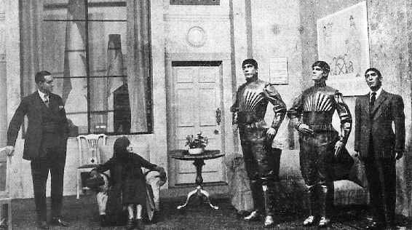
What is a “Robot”? A scene from “Rossum’s Universal Robots,” Karel Čapek, 1921 http://www.umich.edu/~engb415/literature/pontee/RUR/RURsmry.html

Slide 6
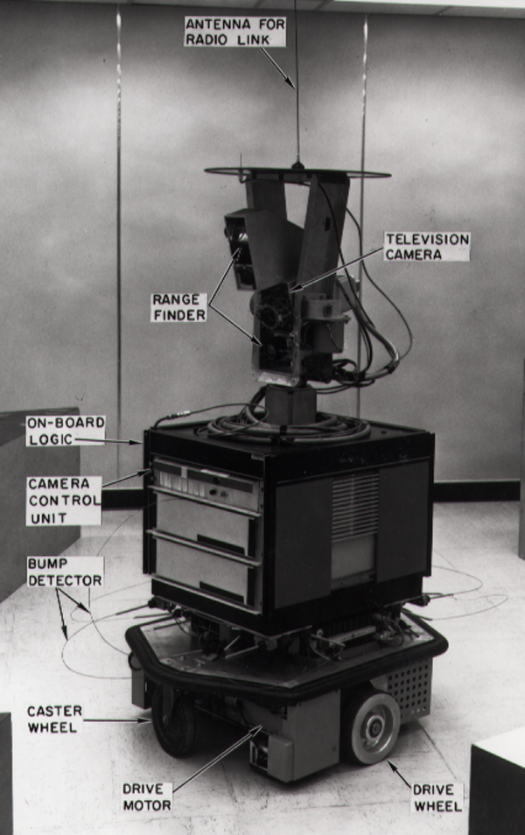
What is a “Robot”? Example: Shaky the robot, 1972 https://en.wikipedia.org/wiki/Shakey_the_robot
PEAS:
Performance
Antenna for radio link
On-board logic
Camera control unit
Environment
Actuators
Caster wheel
Drive motor
Drive wheel
Sensors
Range finder
Television camera
Bump detector

Slide 7
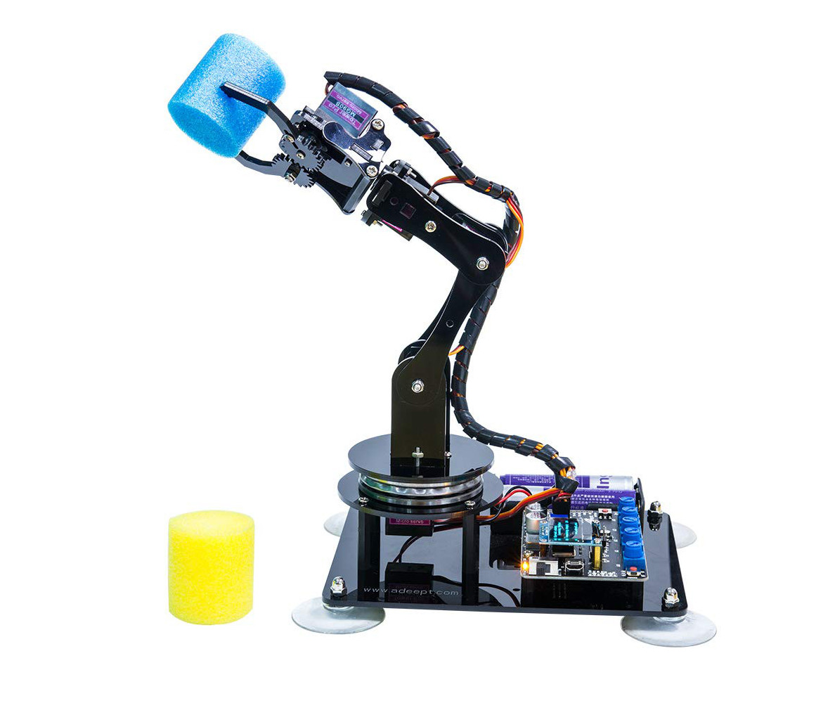
Performance Adeept robot arm for Arduino (from Amazon)
How does the robot arm decide when it has successfully grasped a cup?
How does it find the shortest path for its hand?

Slide 8
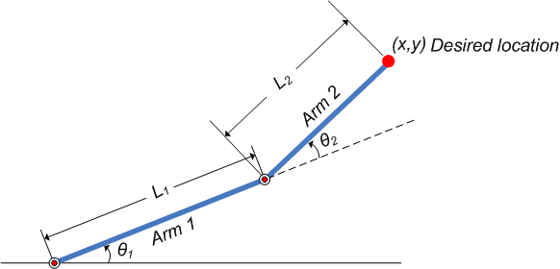

The Robot Arm Reaching Problem https://www.mathworks.com/help/fuzzy/modeling-inverse-kinematics-in-a-robotic-arm.html
Our goal is to reach a particular location (x,y)
But we can’t control (x,y) directly! What we actually control is $(θ_{1},θ_{2})$.

Slide 9
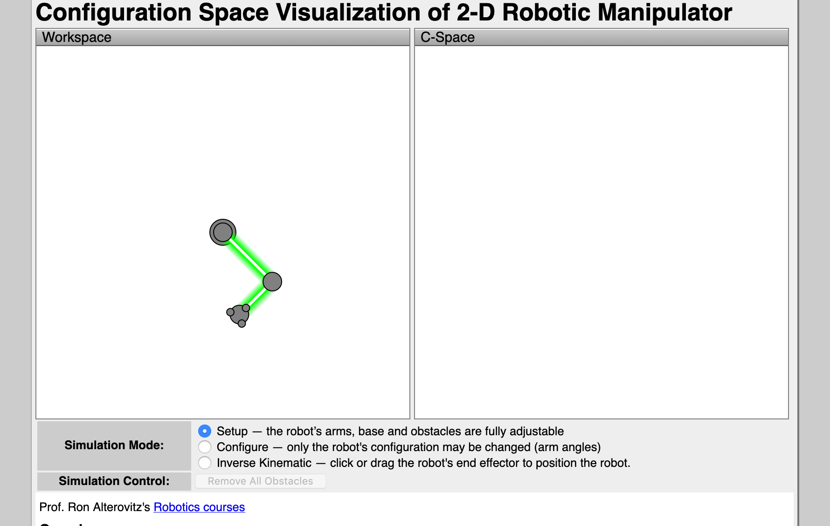
The Robot Arm Reaching Problem Jeff Ichnowski, University of North Carolina, https://www.cs.unc.edu/~jeffi/c-space/robot.xhtml

Slide 10
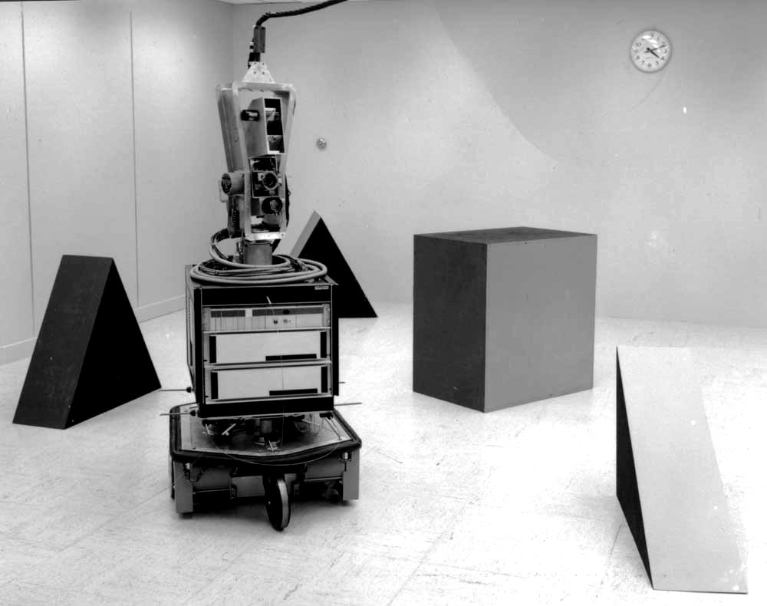
The Environment From https://newatlas.com/shakey-robot-sri-fiftieth-anniversary/37668/#gallery

Slide 11
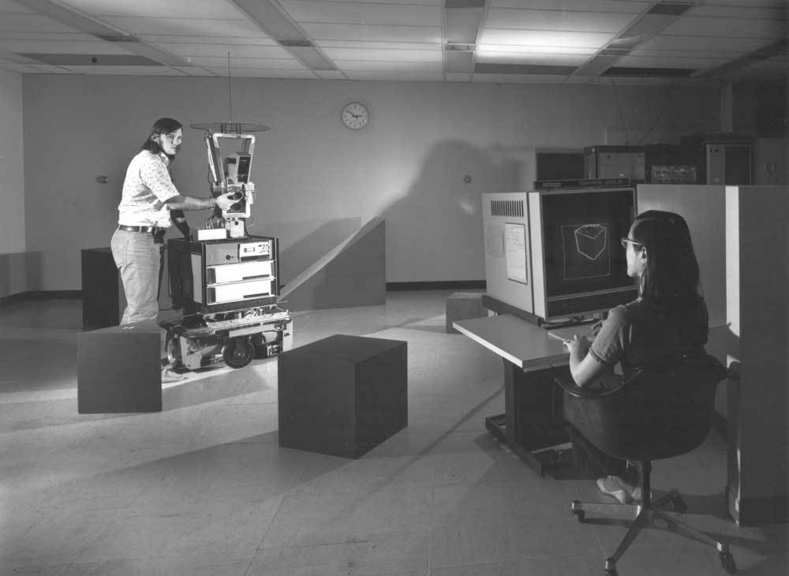
The Environment From https://newatlas.com/shakey-robot-sri-fiftieth-anniversary/37668/#gallery

Slide 12
Properties of Environments (Textbook, Chapter 2)
Fully Observable vs. Partially Observable
Deterministic vs. Stochastic
Episodic vs. Sequential
Static vs. Dynamic
Discrete vs. Continuous
Single agent vs. Multi-agent
Known vs. Unknown

Slide 13
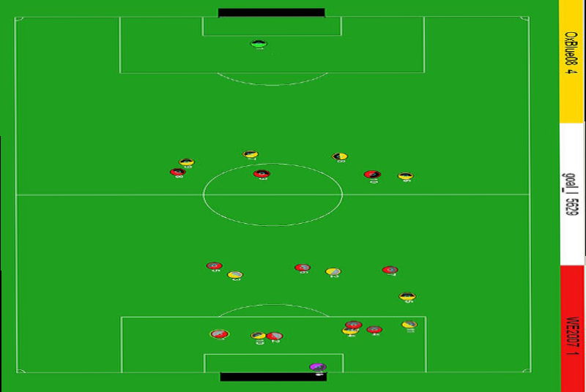
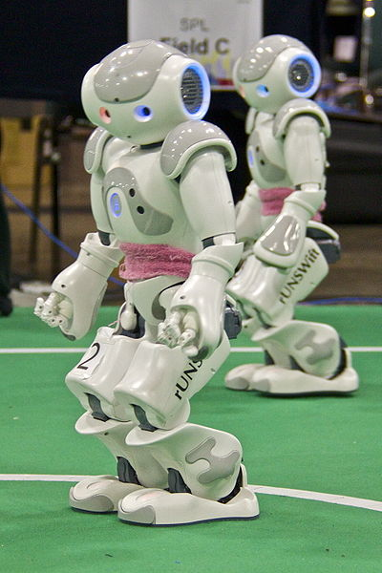
Fully observable vs. partially observable
Do the agent's sensors give it access to the complete state of the environment?
For any given world state, are the values of all the variables known to the agent?
vs.
Source: L. Zettlemoyer

Slide 14
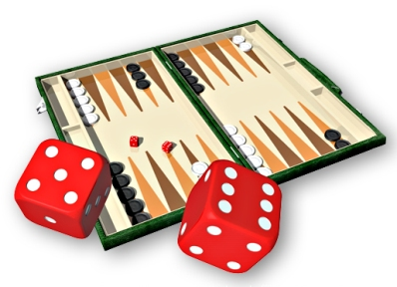
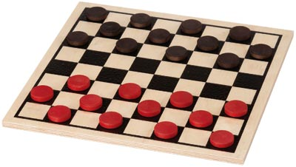
Deterministic vs. stochastic
Is the next state of the environment completely determined by the current state and the agent’s action?
Is the transition model deterministic (unique successor state given current state and action) or stochastic (distribution over successor states given current state and action)?
strategic: the environment is deterministic except for the actions of other agents
vs.

Slide 15
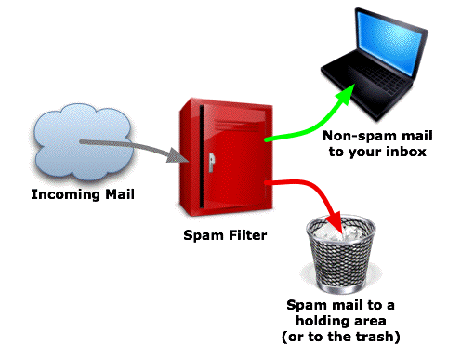
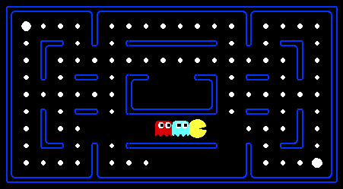
Episodic vs. sequential
Is the agent’s experience divided into unconnected episodes, or is it a coherent sequence of observations and actions?
Does each problem instance involve just one action or a series of actions that change the world state according to the transition model?
vs.
Notes:
Episodic: The agent's experience is divided into atomic “episodes,” and the choice of action in each episode depends only on the episode itself

Slide 16

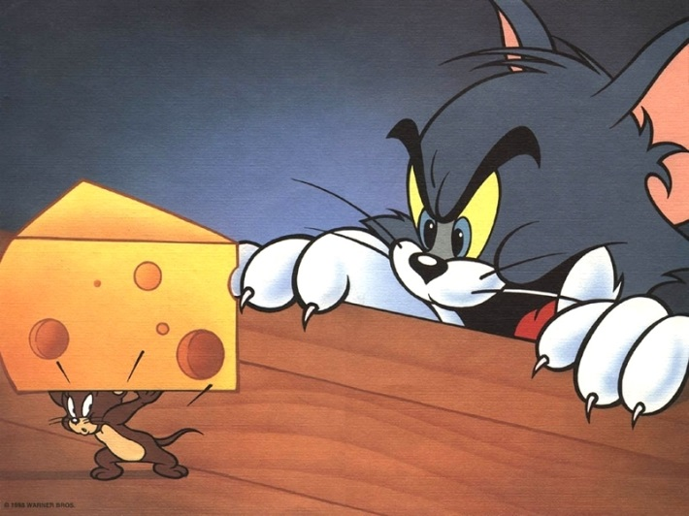
Static vs. dynamic
Is the world changing while the agent is thinking?
Semidynamic: the environment does not change with the passage of time, but the agent's performance score does
vs.

Slide 17
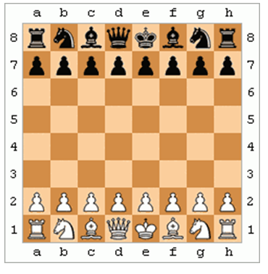
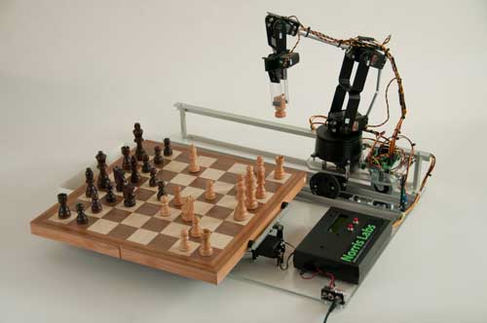
Discrete vs. continuous
Does the environment provide a countable (discrete) or uncountably infinite (continuous) number of distinct percepts, actions, and environment states?
Are the values of the state variables discrete or continuous?
Time can also evolve in a discrete or continuous fashion
“Distinct” = different values of utility
vs.

Slide 18
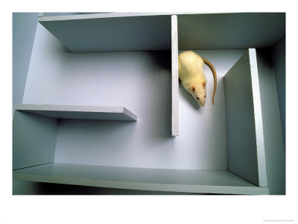
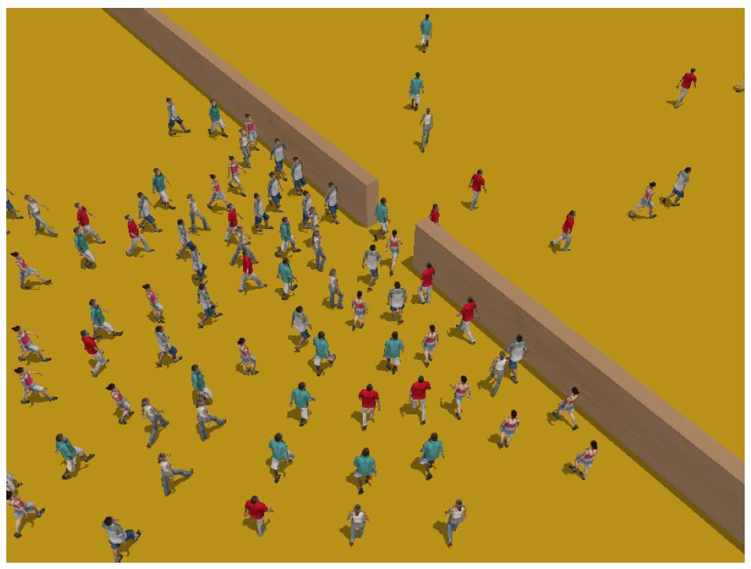
Single-agent vs. multiagent
Is an agent operating by itself in the environment?
vs.

Slide 19
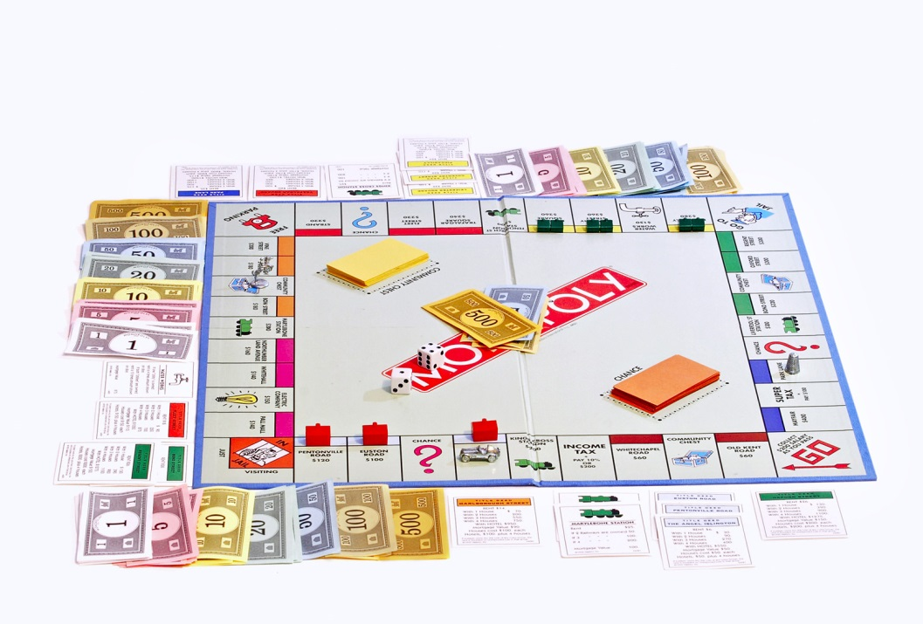
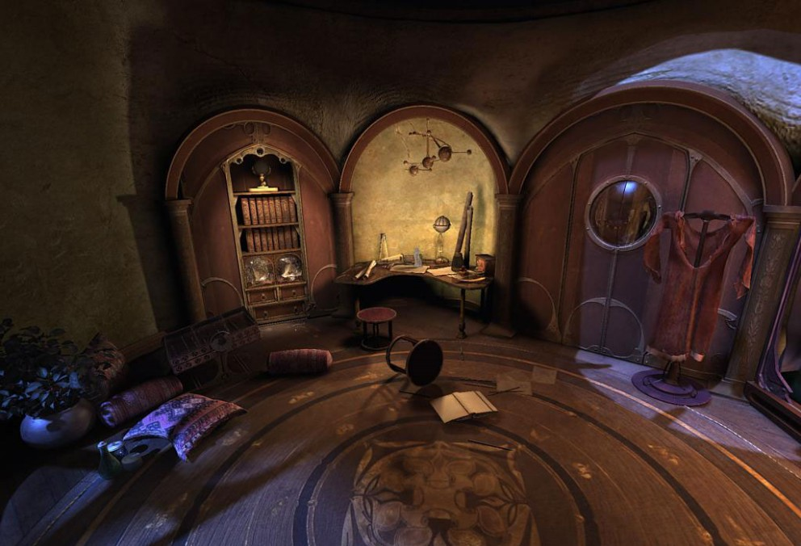
Known vs. unknown
Are the rules of the environment (transition model and rewards associated with states) known to the agent?
Strictly speaking, not a property of the environment, but of the agent’s state of knowledge
vs.

Slide 20
Types of Environments
Shakey’s environment is:
Partially observable (not Fully)
Deterministic (not Stochastic)
Sequential (not Episodic)
Static (not Dynamic)
Continuous (not Discrete)
Single-agent (not Multi-agent)
Known (not Unknown)

Slide 21
Types of Environments
Shakey’s environment is:
Partially observable
Deterministic
Sequential
Static Dynamic?
Continuous
Single-agent
Known

Slide 22
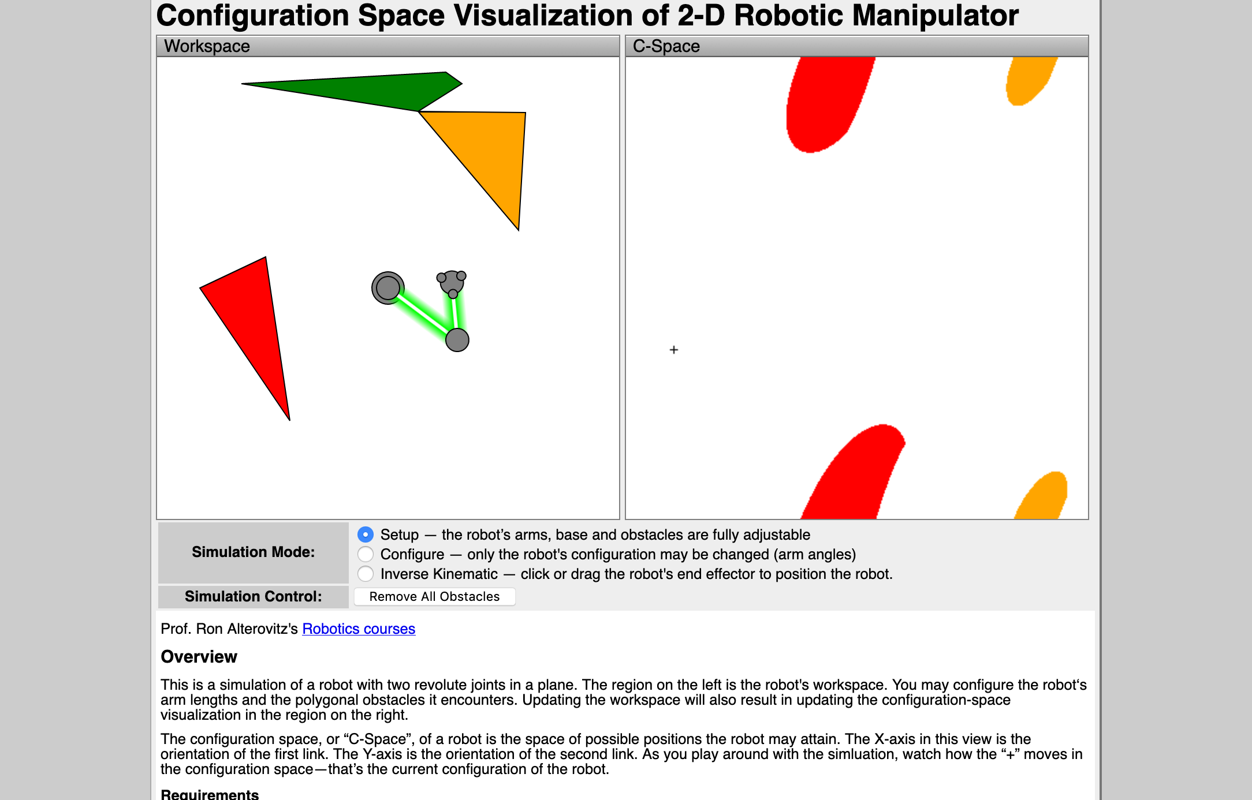
Types of Environments
Jeff Ichnowski’s environment is:
Partially Fully observable
Deterministic
Sequential
Static
Continuous
Single-agent
Known

Slide 23
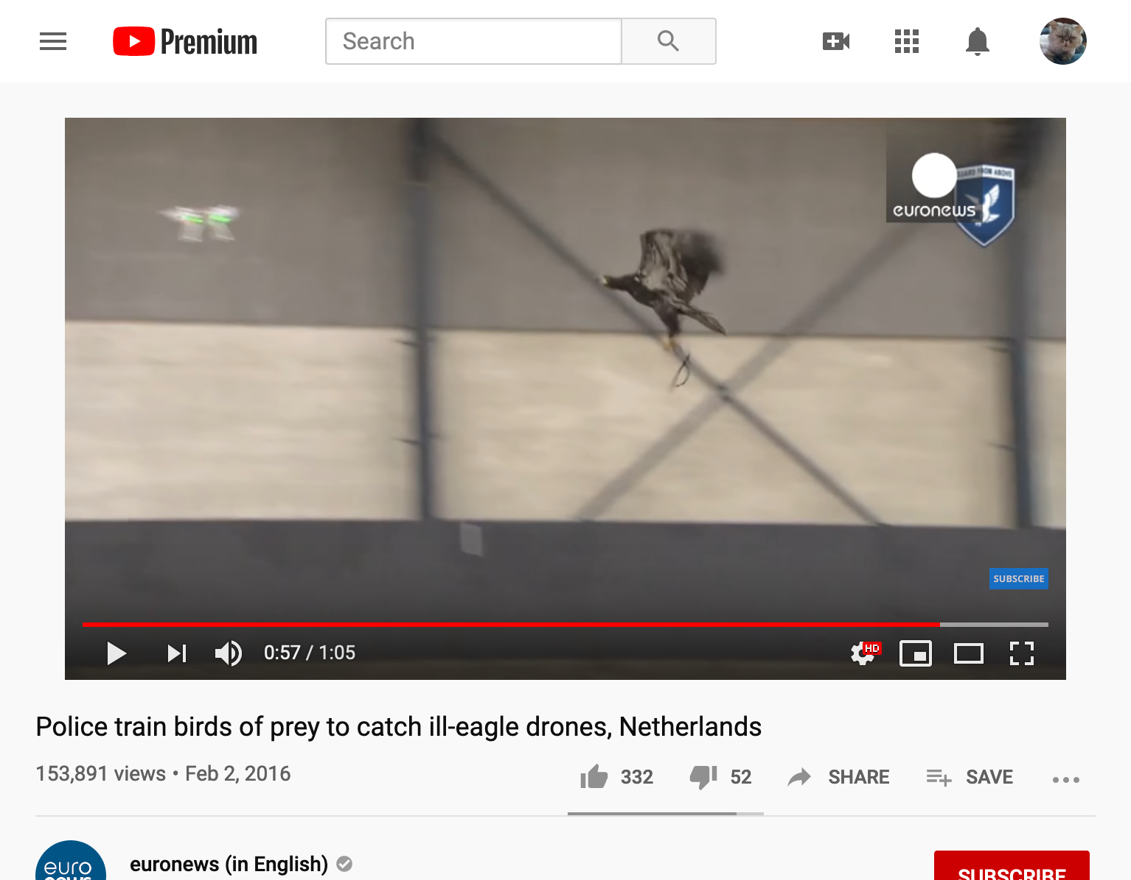
Types of Environments Euronews, https://www.youtube.com/watch?v=b5DEg2qZzkU
The drone’s environment is:
Partially observable
Deterministic
Sequential
Static Dynamic?
Continuous
Single Multi-agent
Known (?)

Slide 24
Conclusions
A robot, like any other agent, is characterized by its PEAS:
Performance
Environment
Actions
Sensors
Environments are characterized as:
Fully Observable vs. Partially Observable
Deterministic vs. Stochastic
Episodic vs. Sequential
Static vs. Dynamic
Discrete vs. Continuous
Single agent vs. Multi-agent
Known vs. Unknown

