Slide 1
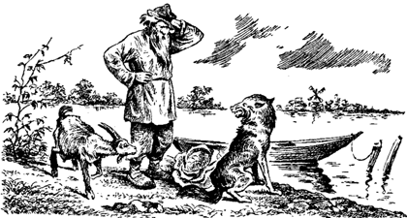
Planning and Theorem Proving Slides by Svetlana Lazebnik, 9/2016 with modifications by Mark Hasegawa-Johnson, 2/2020
CC BY-SA 3.0, https://commons.wikimedia.org/w/index.php?curid=18656684

Slide 2
Planning and Theorem Proving
Examples
Automatic Theorem Proving: forward-chaining, backward-chaining
Planning: forward-chaining, backward-chaining
Admissible Heuristics for Planning and Theorem Proving
Number of Steps
Planning Graph
Computational Complexity

Slide 3
Example: River Crossing Problems https://en.wikipedia.org/wiki/River_crossing_puzzle
A farmer has a fox, a goat, and a bag of beans to get across the river
His boat will only carry him + one object
He can’t leave the fox with the goat
He can’t leave the goat with the bag of beans

Slide 4
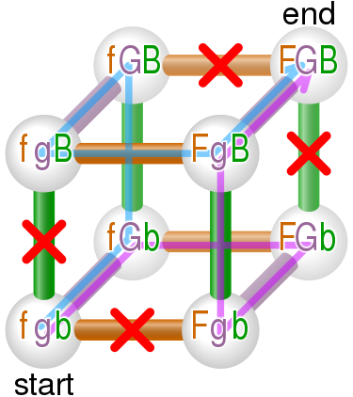
Solution https://en.wikipedia.org/wiki/River_crossing_puzzle
fgb -----(farmer, goat)----→ fGb
fGb ←-----(farmer)-----------
-----(farmer,fox)-----→ FGb
Fgb ←--(farmer,goat)------
-----(farmer,beans)---→ FgB
FgB ←-------(farmer)--------
-----(farmer,goat)----→ FGB

Slide 5
Example: Cargo delivery problem
You have packages waiting for pickup at Atlanta, Boston, Charlotte, Denver, Edmonton, and Fairbanks
They must be delivered to Albuquerque, Baltimore, Chicago, Des Moines, El Paso, and Frisco
You have two trucks. Each truck can hold only two packages at a time.

Slide 6
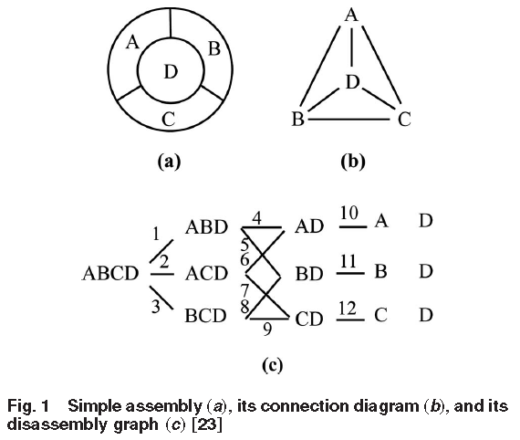
Example: Design for Disassembly ”Simultaneous Selective Disassembly and End-of-Life Decision Making for Multiple Products That Share Disassembly Operations,” Sara Behdad, Minjung Kwak, Harrison Kim and Deborah Thurston. J. Mech. Des 132(4), 2010, doi:10.1115/1.4001207
Design decisions limit the sequence in which you can disassemble a product at the end of its life
Problem statement: design the product in order to make disassembly as cheap as possible

Slide 7
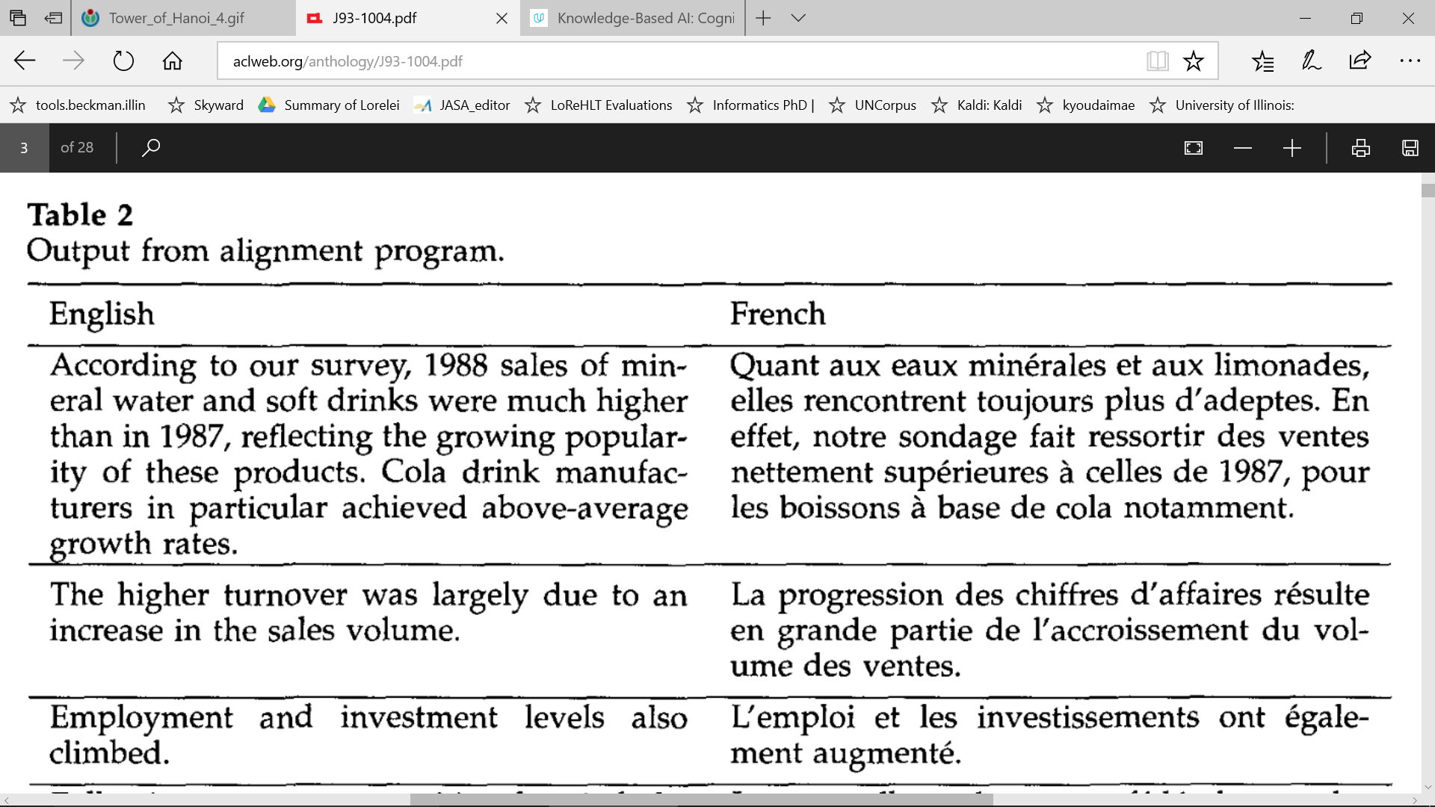
Application of planning: the Gale-Church alignment algorithm for machine translation

Slide 8
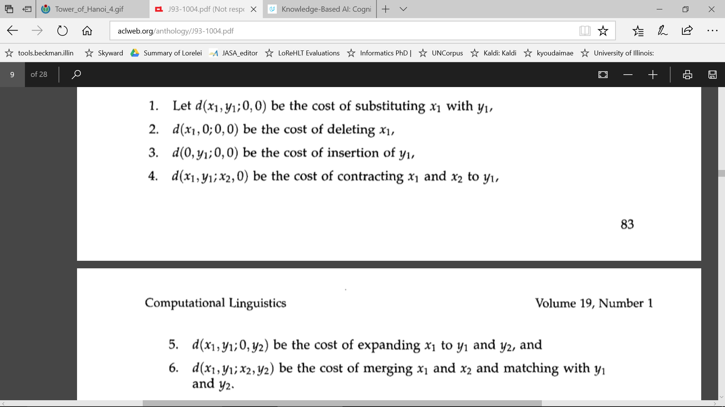
Application of planning: the Gale-Church alignment algorithm for machine translation

Slide 9
Example: Tower of Hanoi https://en.wikipedia.org/wiki/Tower_of_Hanoi
Description | English: This is a visualization generated with the walnut based on my implementation at [1] of the iterative algorithm described in Tower of Hanoi
Date | 30 April 2015
Source | I designed this using http://thewalnut.io/
Author | Trixx

Slide 10
Planning and Theorem Proving
Examples
Automatic Theorem Proving: forward-chaining, backward-chaining
Planning: forward-chaining, backward-chaining
Admissible Heuristics for Planning and Theorem Proving
Number of Steps
Planning Graph
Computational Complexity

Slide 11
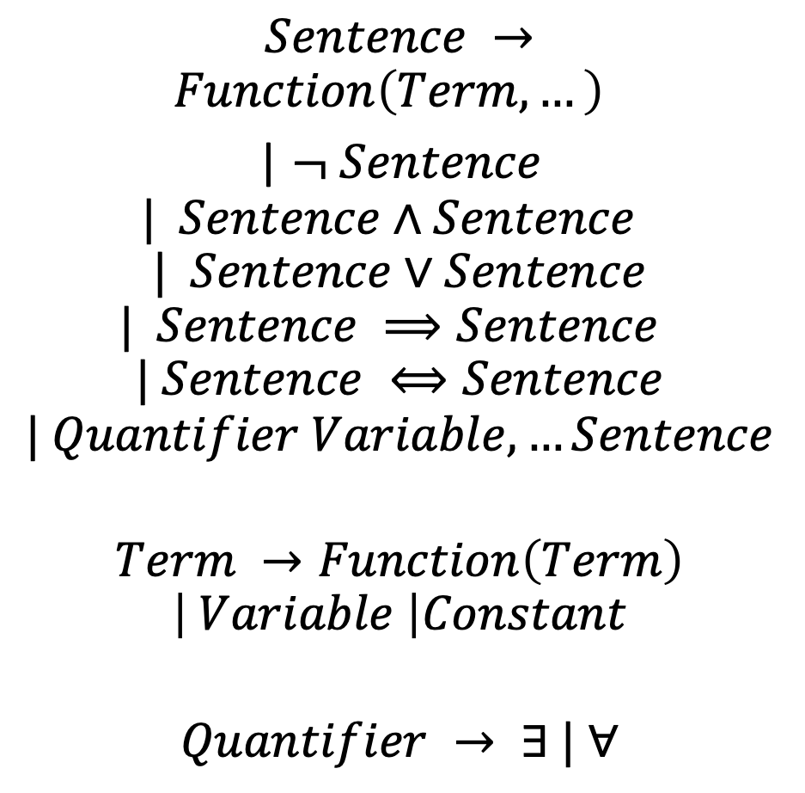
The Syntax of First-Order Logic (Textbook p. 293)
$$Sentence →$$
$$Function\left(Term,…\right)$$
| $¬ Sentence$
$$| Sentence∧Sentence$$
$$| Sentence∨Sentence$$
$$| Sentence ⟹Sentence$$
$$| Sentence ⟺Sentence$$
$$| Quantifier Variable, …Sentence$$
$$Term →Function\left(Term\right)$$
$$\left| Variable \right|Constant$$
$$Quantifier → ∃ | ∀$$
A “sentence” is
an evaluated function, or
a negated sentence, or
the conjunction of 2 sentences, or
the disjunction of 2 sentences, or
an implication, or
an equivalence, or
a sentence with a quantified variable.
A “term” is an evaluated function, or a variable, or a constant.
A “quantifier” is “there exists,” or “for all.”

Slide 12
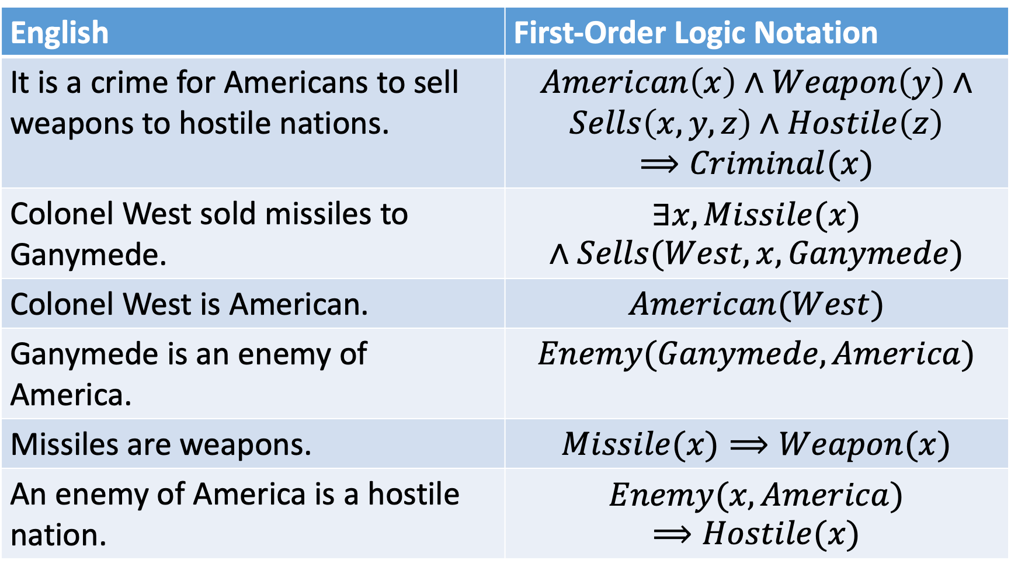
Examples (Textbook, p. 330)
English | First-Order Logic Notation
It is a crime for Americans to sell weapons to hostile nations. | $$American\left(x\right)∧Weapon\left(y\right)∧$$ $$Sells\left(x,y,z\right)∧Hostile\left(z\right)$$ $$⟹Criminal(x)$$
Colonel West sold missiles to Ganymede. | $$∃x, Missile(x)∧Sells(West,x,Ganymede)$$
Colonel West is American. | $$American(West)$$
Ganymede is an enemy of America. | $$Enemy(Ganymede,America)$$
Missiles are weapons. | $$Missile(x)⟹Weapon(x)$$
An enemy of America is a hostile nation. | $$Enemy(x,America)⟹Hostile(x)$$

Slide 13
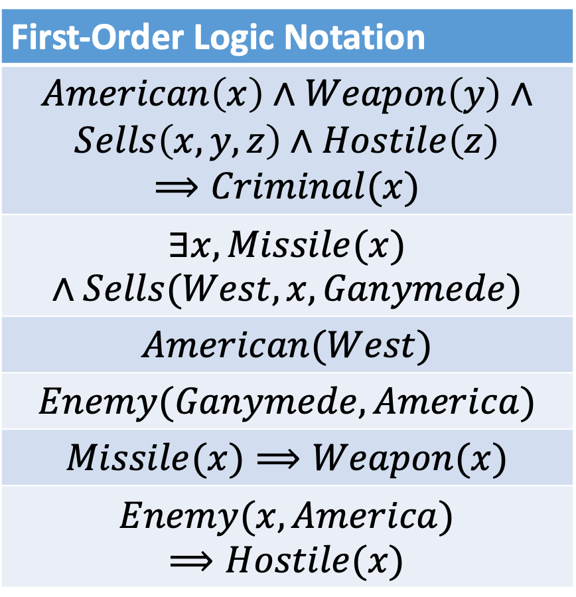
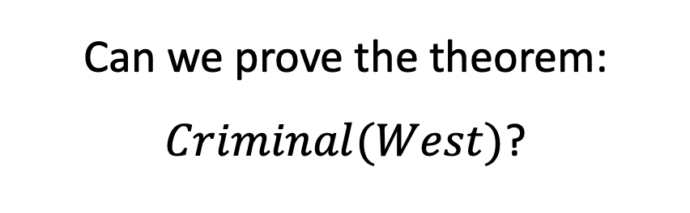
Automatic Theorem Proving
First-Order Logic Notation
$$American\left(x\right)∧Weapon\left(y\right)∧$$ $$Sells\left(x,y,z\right)∧Hostile\left(z\right)$$ $$⟹Criminal(x)$$
$$∃x, Missile(x)∧Sells(West,x,Ganymede)$$
$$American(West)$$
$$Enemy(Ganymede,America)$$
$$Missile(x)⟹Weapon(x)$$
$$Enemy(x,America)⟹Hostile(x)$$
Can we prove the theorem: $Criminal(West)$?

Slide 14
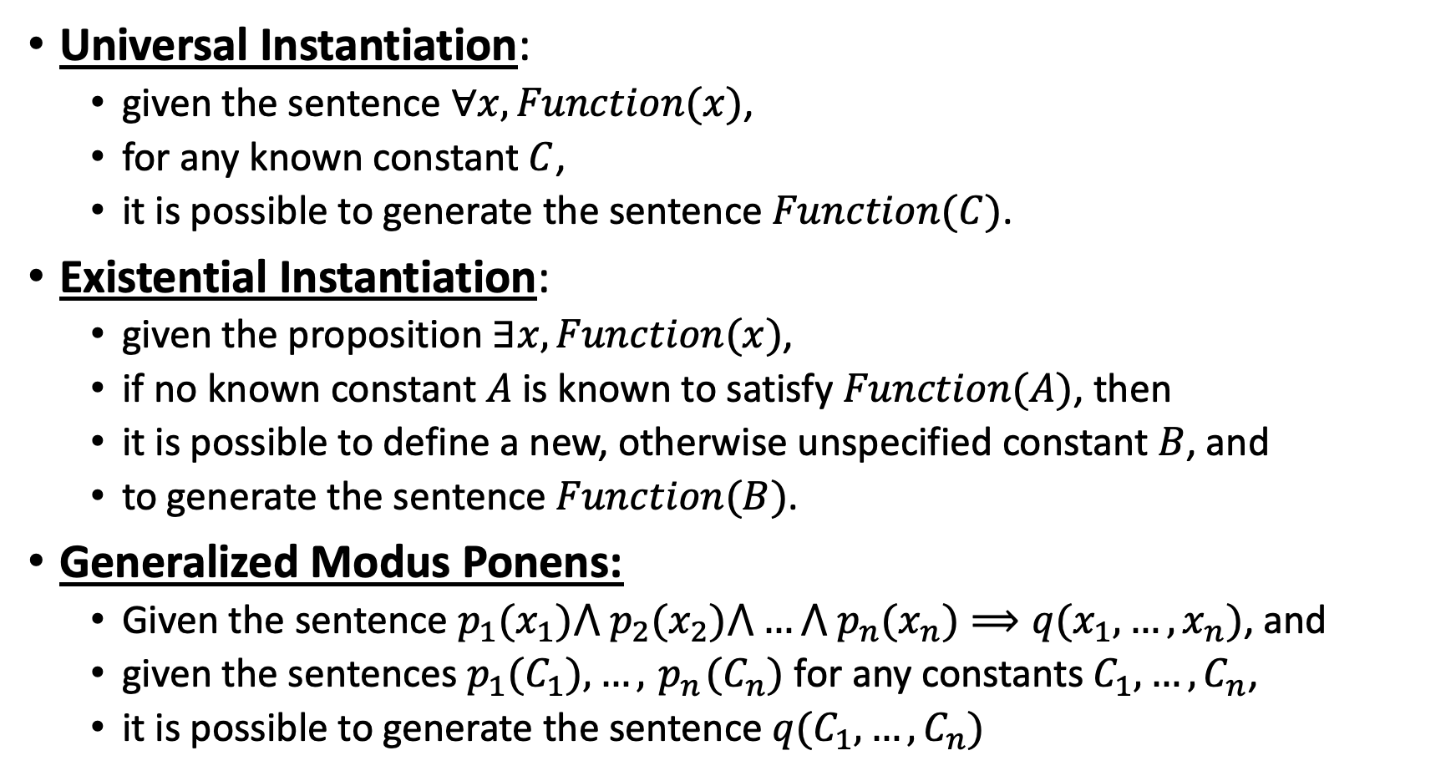
Actions that a Theorem Prover can Take
Universal Instantiation:
given the sentence $∀x, Function(x)$,
for any known constant $C$,
it is possible to generate the sentence $Function(C)$.
Existential Instantiation:
given the proposition $∃x, Function(x)$,
if no known constant $A$is known to satisfy $Function(A)$, then
it is possible to define a new, otherwise unspecified constant $B$, and
to generate the sentence $Function(B)$.
Generalized Modus Ponens:
Given the sentence $p_{1}(x_{1})⋀{ p}_{2}(x_{2})⋀…⋀{ p}_{n}(x_{n})⟹q(x_{1},…,x_{n})$, and
given the sentences $p_{1}(C_{1}), …,{ p}_{n}(C_{n})$ for any constants $C_{1},…,C_{n}$,
it is possible to generate the sentence $q(C_{1},…,C_{n})$

Slide 15
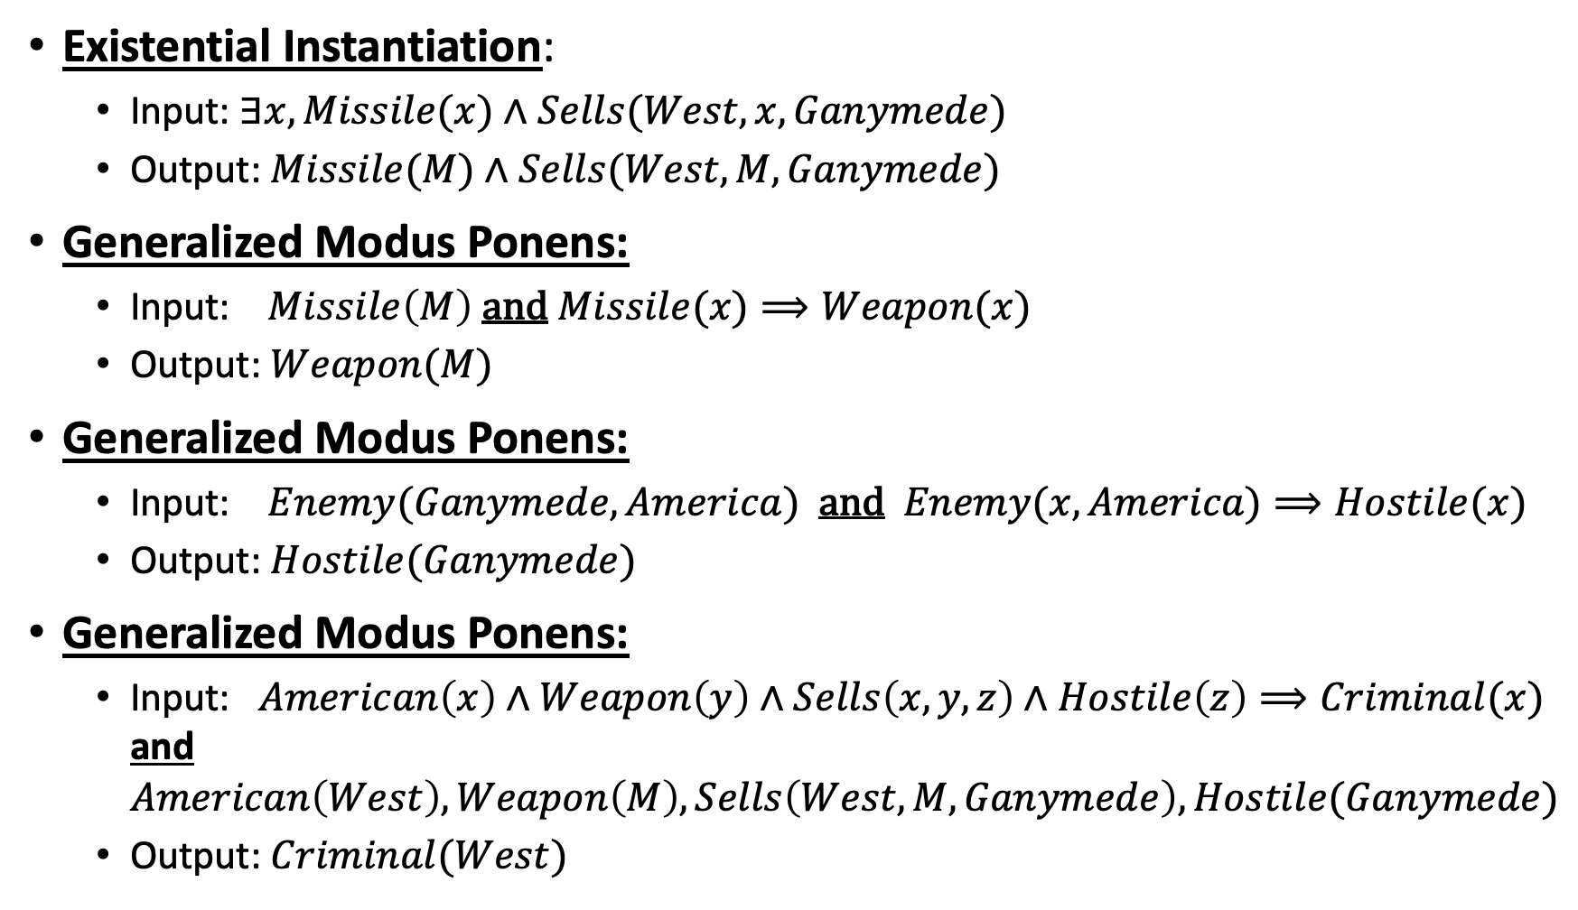
Automatic Theorem Proving Example
Existential Instantiation:
Input: $∃x, Missile(x)∧Sells(West,x,Ganymede)$
Output: $Missile(M)∧Sells(West,M,Ganymede)$
Generalized Modus Ponens:
Input: $Missile\left(M\right)$ and $Missile(x)⟹Weapon(x)$
Output: $Weapon(M)$
Generalized Modus Ponens:
Input: $Enemy(Ganymede,America)$ and $Enemy(x,America)⟹Hostile(x)$
Output: $Hostile(Ganymede)$
Generalized Modus Ponens:
Input: $American\left(x\right)∧Weapon\left(y\right)∧Sells\left(x,y,z\right)∧Hostile\left(z\right)⟹Criminal(x)$ and $American\left(West\right),Weapon\left(M\right),Sells\left(West,M,Ganymede\right),Hostile(Ganymede)$
Output: $Criminal(West)$

Slide 16
Automatic Theorem Proving as Search
State = the set of all currently known sentences
Action = generate a new sentence
Goal State = a set of sentences that includes the target sentence
(Question to ponder: how do you disprove a target sentence?)

Slide 17
Forward Chaining
What’s Special About Theorem Proving:
A state, at level n, can be generated by the combination of several states at level n-1.
Definition: Forward Chaining is a search algorithm in which each action
generates a new sentence,
by combining as many different preceding states as necessary.

Slide 18

Example: Forward Chaining to prove $q_{3}$
$$\left\{p_{1},p_{2},p_{1}⟹q_{1},p_{2}⟹q_{2},q_{1}∧q_{2}⟹q_{3}\right\}$$
Initial State
Search ”Tree” Level 1
$$\left\{p_{1},p_{2},p_{1}⟹q_{1},p_{2}⟹q_{2},q_{1}∧q_{2}⟹q_{3},q_{1}\right\}$$
$$\left\{p_{1},p_{2},p_{1}⟹q_{1},p_{2}⟹q_{2},q_{1}∧q_{2}⟹q_{3},q_{2}\right\}$$
Search ”Tree” Level 2:
Goal Achieved
$$\left\{p_{1},p_{2},p_{1}⟹q_{1},p_{2}⟹q_{2},q_{1}∧q_{2}⟹q_{3},q_{1},q_{2},q_{3}\right\}$$

Slide 19
Backward Chaining
What Else is Special About Theorem Proving:
The ”Goal State” is defined to be any set of sentences that includes the target sentence
Definition: Backward Chaining is a search algorithm in which
State = {set of known sentences}, {set of desired sentences}
Action = apply a known sentence, backward, to a target sentence, in order to generate a new set of desired sentences
Goal = all “desired sentences” are part of the set of “known sentences”

Slide 20
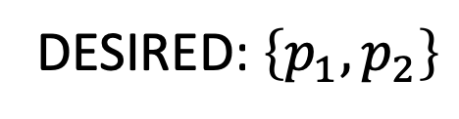
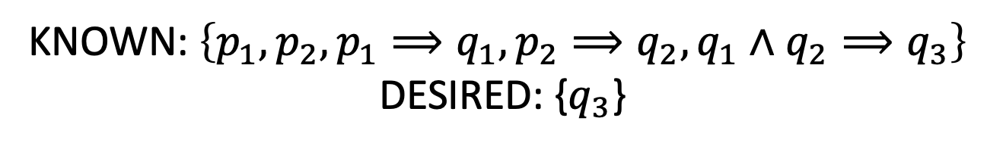
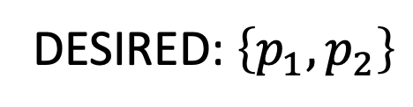

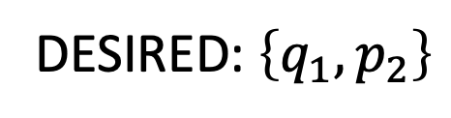
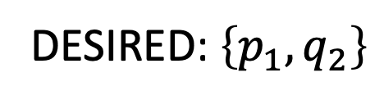
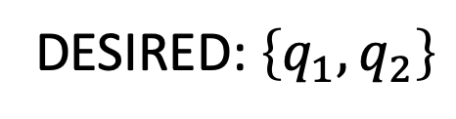
Example: Backward Chaining to prove $q_{3}$
KNOWN: $\left\{p_{1},p_{2},p_{1}⟹q_{1},p_{2}⟹q_{2},q_{1}∧q_{2}⟹q_{3}\right\}$
DESIRED: {$q_{3}$}
Initial State
DESIRED: $\left\{q_{1},q_{2}\right\}$
Search Tree Level 1
DESIRED: $\left\{p_{1},q_{2}\right\}$
DESIRED: $\left\{q_{1},p_{2}\right\}$
Search Tree Level 2
DESIRED: $\left\{p_{1},p_{2}\right\}$
DESIRED: $\left\{p_{1},p_{2}\right\}$
Search Tree Level 3:
Goal Achieved

Slide 21
Planning and Theorem Proving
Examples
Automatic Theorem Proving: forward-chaining, backward-chaining
Planning: forward-chaining, backward-chaining
Admissible Heuristics for Planning and Theorem Proving
Number of Steps
Planning Graph
Computational Complexity

Slide 22
Search review
A search problem is defined by:
Initial state
Goal state
Actions
Transition model
Cost

Slide 23
A representation for planning
STRIPS (Stanford Research Institute Problem Solver): classical planning framework from the 1970s
States are specified as conjunctions of predicates
Start state: At(home) ∧ Sells(SM, Milk) ∧ Sells(SM, Bananas) ∧ Sells(HW, drill)
Goal state: At(home) ∧ Have(Milk) ∧ Have(Banana) ∧ Have(drill)
Actions are described in terms of preconditions and effects:
Go(x, y)
Precond: At(x)
Effect: ¬At(x) ∧ At(y)
Buy(x, store)
Precond: At(store) ∧ Sells(store, x)
Effect: Have(x)
Planning is “just” a search problem

Slide 24
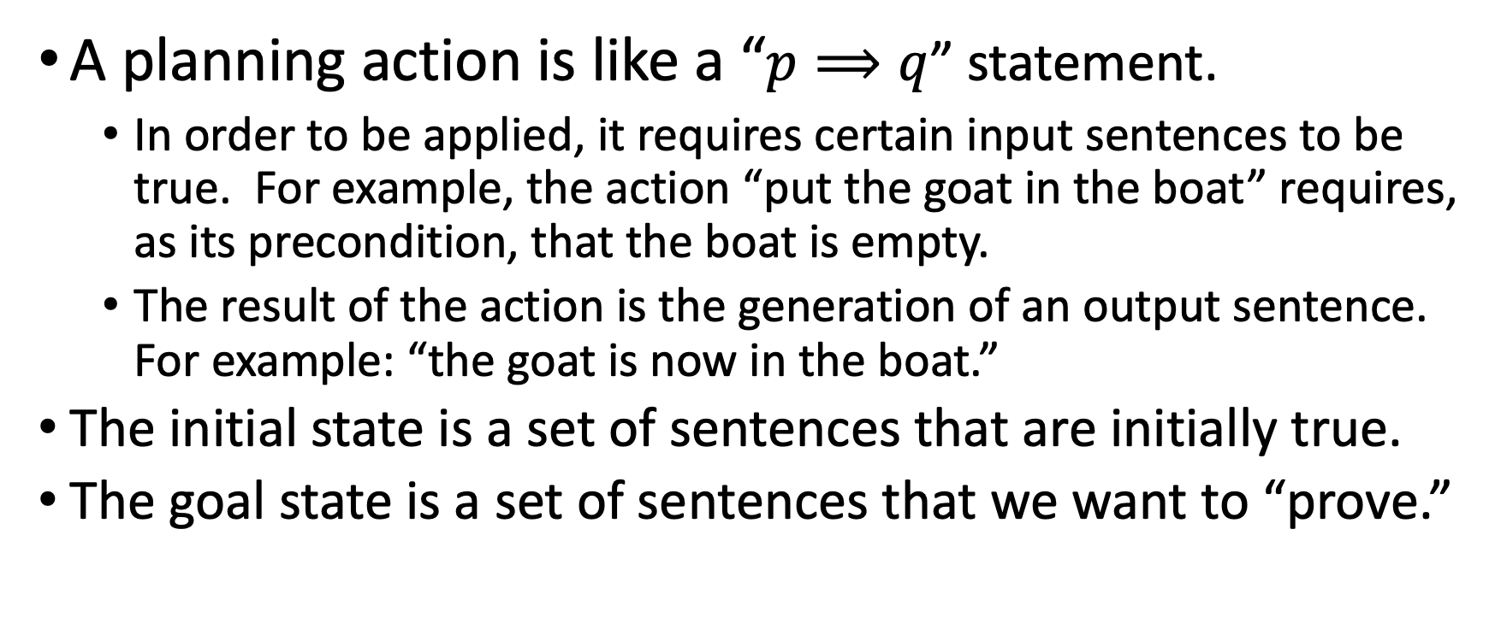
Planning as Theorem Proving
A planning action is like a “$p⟹q$” statement.
In order to be applied, it requires certain input sentences to be true. For example, the action “put the goat in the boat” requires, as its precondition, that the boat is empty.
The result of the action is the generation of an output sentence. For example: “the goat is now in the boat.”
The initial state is a set of sentences that are initially true.
The goal state is a set of sentences that we want to “prove.”

Slide 25
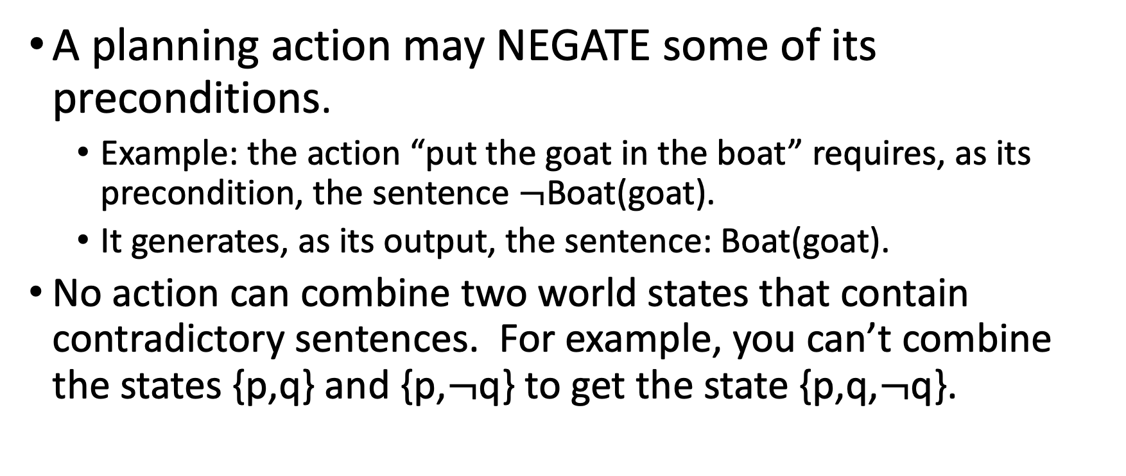
Important differences between Planning and Theorem Proving, #1: Negating your preconditions
A planning action may NEGATE some of its preconditions.
Example: the action “put the goat in the boat” requires, as its precondition, the sentence $¬$Boat(goat).
It generates, as its output, the sentence: Boat(goat).
No action can combine two world states that contain contradictory sentences. For example, you can’t combine the states {p,q} and {p,$¬$q} to get the state {p,q,$¬$q}.

Slide 26
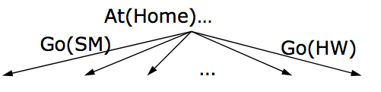
Algorithms for planning: Forward Chaining
Starting with the start state, find all applicable actions (actions for which preconditions are satisfied), compute the successor state based on the effects, keep searching until goals are met
Can work well with good heuristics

Slide 27
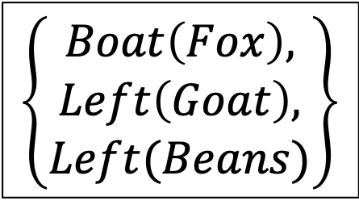
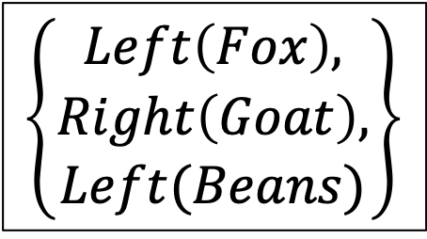
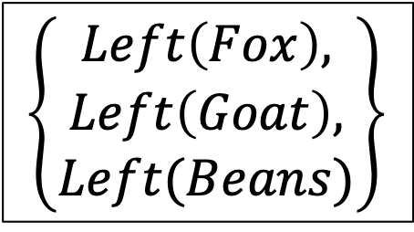
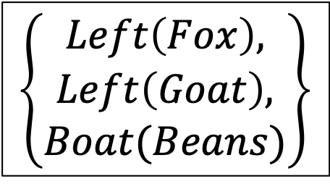
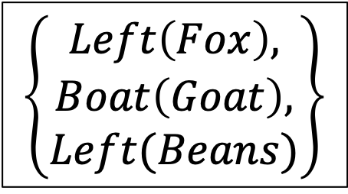
Forward-Chaining Example: Fox, Goat & Beans
$$\left\{Left\left(Fox\right),Left\left(Goat\right),Left(Beans)\right\}$$
$$\left\{\begin{aligned}Boat\left(Fox\right), \\ Left\left(Goat\right), \\ Left(Beans)\end{aligned}\right\}$$
$$\left\{\begin{aligned}Left\left(Fox\right), \\ Boat\left(Goat\right), \\ Left(Beans)\end{aligned}\right\}$$
$$\left\{\begin{aligned}Left\left(Fox\right), \\ Left\left(Goat\right), \\ Boat(Beans)\end{aligned}\right\}$$
X
X
$$\left\{\begin{aligned}Left\left(Fox\right), \\ Left\left(Goat\right), \\ Left(Beans)\end{aligned}\right\}$$
$$\left\{\begin{aligned}Left\left(Fox\right), \\ Right\left(Goat\right), \\ Left(Beans)\end{aligned}\right\}$$
…
…

Slide 28
Algorithms for planning: Backward Chaining
Starting with the goal state (a set of target sentences),
find all applicable actions (actions that would generate a sentence in the goal state).
For each, generate the predecessor state as a new set of target sentences.
Keep searching until all target sentences are in the initial state.

Slide 29
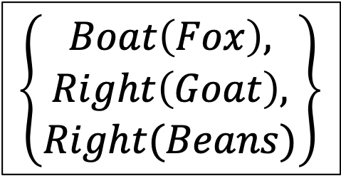
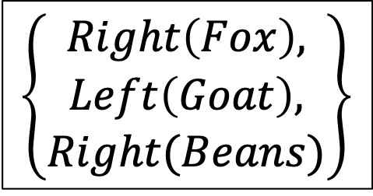
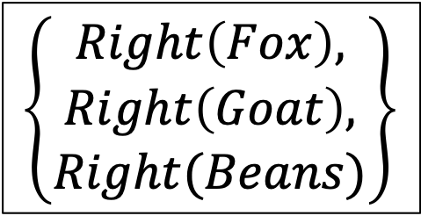
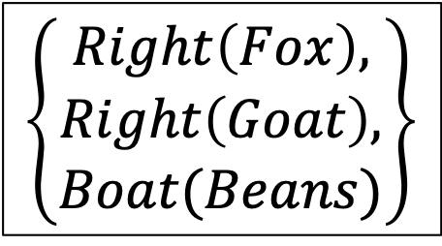
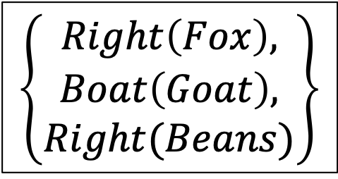
Backward-Chaining Example: Fox, Goat & Beans
$$\left\{Right\left(Fox\right),Right\left(Goat\right),Right(Beans)\right\}$$
X
X
$$\left\{\begin{aligned}Boat\left(Fox\right), \\ Right\left(Goat\right), \\ Right(Beans)\end{aligned}\right\}$$
$$\left\{\begin{aligned}Right\left(Fox\right), \\ Boat\left(Goat\right), \\ Right(Beans)\end{aligned}\right\}$$
$$\left\{\begin{aligned}Right\left(Fox\right), \\ Right\left(Goat\right), \\ Boat(Beans)\end{aligned}\right\}$$
$$\left\{\begin{aligned}Right\left(Fox\right), \\ Right\left(Goat\right), \\ Right(Beans)\end{aligned}\right\}$$
$$\left\{\begin{aligned}Right\left(Fox\right), \\ Left\left(Goat\right), \\ Right(Beans)\end{aligned}\right\}$$
…
…

Slide 30
Planning and Theorem Proving
Examples
Automatic Theorem Proving: forward-chaining, backward-chaining
Planning: forward-chaining, backward-chaining
Admissible Heuristics for Planning and Theorem Proving
Number of Steps
Planning Graph
Computational Complexity

Slide 31

A* Heuristics by Constraint Relaxation
Heuristics from Constraint Relaxation: The heuristic h(n) is the number of steps it would take to get from n to G, if problem constraints were relaxed --- this guarantees that h(n) is admissible
$h_{1}(n)$ dominates $h_{2}(n)$ ($h_{1}(n)≥h_{2}(n)$) if $h_{1}(n)$ is computed by relaxing fewer constraints.

Slide 32
First heuristic: number of goal sentences left to achieve
Heuristic #1: Count the number of actions necessary to generate all of the sentences in the goal state that aren’t already true.
What got relaxed: we ignore action pre-requisites.
Example: 6 people on left side of the river, we want 6 people on the right side, we have a 2-person boat. Minimum # actions: h(n) = 3.

Slide 33
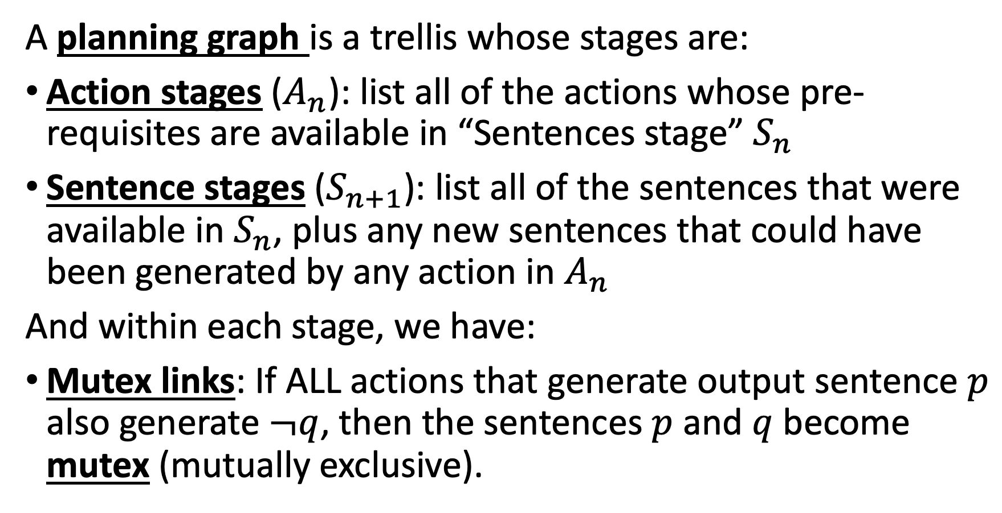
Second heuristic: planning graph
A planning graph is a trellis whose stages are:
Action stages ($A_{n}$): list all of the actions whose pre-requisites are available in “Sentences stage” $S_{n}$
Sentence stages ($S_{n+1}$): list all of the sentences that were available in $S_{n}$, plus any new sentences that could have been generated by any action in $A_{n}$
And within each stage, we have:
Mutex links: If ALL actions that generate output sentence $p$ also generate $¬q$, then the sentences $p$ and $q$ become mutex (mutually exclusive).

Slide 34
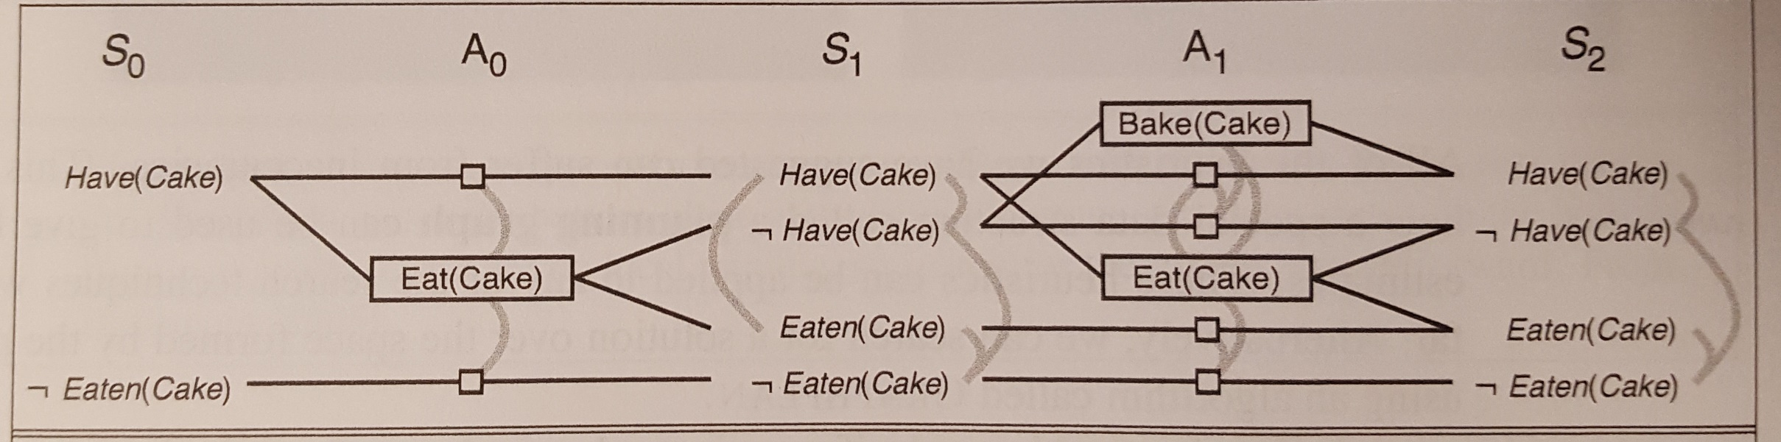
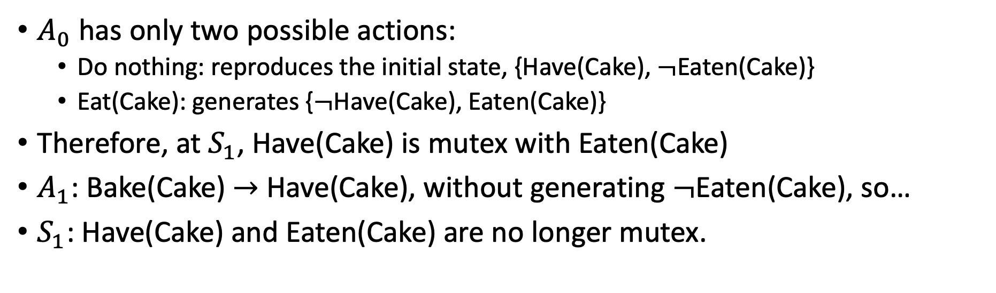
Example planning graph
$A_{0}$ has only two possible actions:
Do nothing: reproduces the initial state, {Have(Cake), $¬$Eaten(Cake)}
Eat(Cake): generates {$¬$Have(Cake), Eaten(Cake)}
Therefore, at $S_{1}$, Have(Cake) is mutex with Eaten(Cake)
$A_{1}$: Bake(Cake) $→$ Have(Cake), without generating $¬$Eaten(Cake), so…
$S_{1}$: Have(Cake) and Eaten(Cake) are no longer mutex.

Slide 35
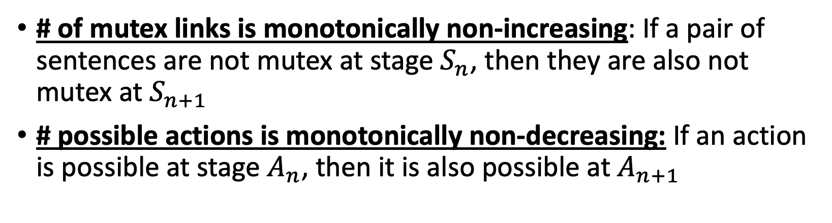
Convergence of the Planning Graph
# of mutex links is monotonically non-increasing: If a pair of sentences are not mutex at stage $S_{n}$, then they are also not mutex at $S_{n+1}$
# possible actions is monotonically non-decreasing: If an action is possible at stage $A_{n}$, then it is also possible at $A_{n+1}$

Slide 36
Heuristic #2: Number of stages until target sentences are non-mutex
Heuristic: # stages between the current stage and the first stage at which all of the goal-state sentences are no longer mutex

Slide 37
Planning and Theorem Proving
Examples
Automatic Theorem Proving: forward-chaining, backward-chaining
Planning: forward-chaining, backward-chaining
Admissible Heuristics for Planning and Theorem Proving
Number of Steps
Planning Graph
Computational Complexity

Slide 38
Complexity
Planning is PSPACE-complete > NP-complete
The computational complexity of finding a plan is exponential
The length of the plan is exponential
Space necessary to represent it
Time necessary to implement it
The only thing that’s polynomial: the amount of space necessary to represent the world state while finding or implementing a plan
Example: towers of Hanoi

Slide 39
Complexity of planning
Planning is PSPACE-complete
The length of a plan can be exponential in the number of “objects” in the problem!
So is game search
Archetypal PSPACE-complete problem: quantified boolean formula (QBF)
Example: is this formula true? ∃x₁∀x₂ ∃x₃∀x₄ (x₁∨¬x₃∨x₄)∧(¬x₂∨x₃∨¬x₄)
Compare to SAT: ∃x₁ ∃x₂ ∃x₃ ∃x₄ (x₁∨¬x₃∨x₄)∧(¬x₂∨x₃∨¬x₄)
Relationship between SAT and QBF is akin to the relationship between puzzles and games

Slide 40
Real-world planning
Resource constraints
Instead of “static,” the world is “semidynamic:” we can’t think forever
Actions at different levels of granularity: hierarchical planning
In order to make the depth of the search smaller, we might convert the world from “fully observable” to “partially observable”
Contingencies: actions failing
Instead of being “deterministic,” maybe the world is “stochastic”
Incorporating sensing and feedback
Possibly necessary to address stochastic or multi-agent environments

