Slide 1
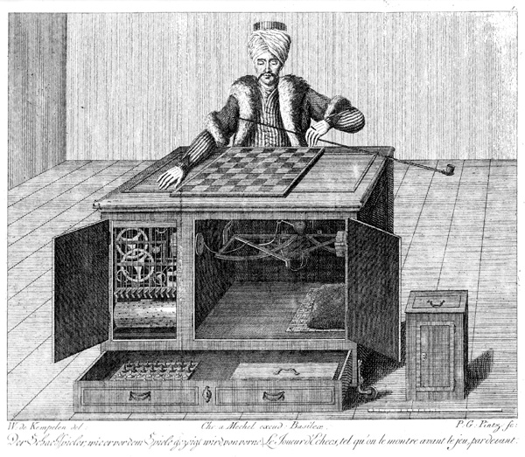
CS440/ECE448 Lecture 11: Alpha-Beta Pruning; Limited Horizon
Slides by Mark Hasegawa-Johnson & Svetlana Lazebnik, 2/2020
Distributed under CC-BY 4.0 (https://creativecommons.org/licenses/by/4.0/). You are free to share and/or adapt if you give attribution.
By Karl Gottlieb von Windisch - Copper engraving from the book: Karl Gottlieb von Windisch, Briefe über den Schachspieler des Hrn. von Kempelen, nebst drei Kupferstichen die diese berühmte Maschine vorstellen. 1783.Original Uploader was Schaelss (talk) at 11:12, 7. Apr 2004., Public Domain, https://commons.wikimedia.org/w/index.php?curid=424092

Slide 2
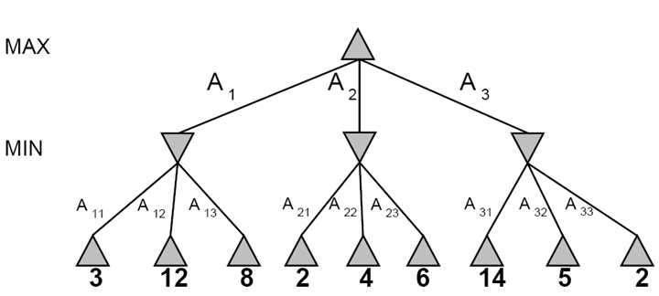
Minimax Search
3
3
2
2
Minimax(node) =
Utility(node) if node is terminal
max_{action} Minimax(Succ(node, action)) if player = MAX
min_{action} Minimax(Succ(node, action)) if player = MIN

Slide 3
Alpha-Beta Pruning

Slide 4
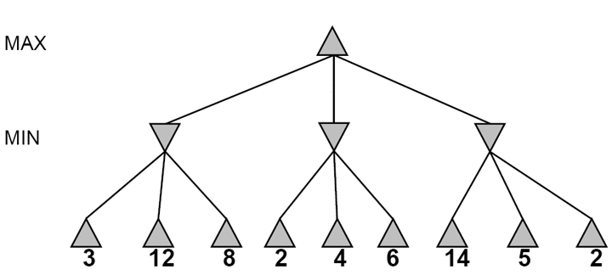
Alpha-beta pruning
It is possible to compute the exact minimax decision without expanding every node in the game tree

Slide 5
Alpha-beta pruning
It is possible to compute the exact minimax decision without expanding every node in the game tree
≥3
3

Slide 6
Alpha-beta pruning
It is possible to compute the exact minimax decision without expanding every node in the game tree
≥3
3
≤2

Slide 7
Alpha-beta pruning
It is possible to compute the exact minimax decision without expanding every node in the game tree
≥3
3
≤2
≤14

Slide 8
Alpha-beta pruning
It is possible to compute the exact minimax decision without expanding every node in the game tree
≥3
3
≤2
≤5

Slide 9
Alpha-beta pruning
It is possible to compute the exact minimax decision without expanding every node in the game tree
3
3
≤2
2
Notes:
Could we have done better with the right branch?

Slide 10
Alpha-Beta Pruning
Key point that I find most counter-intuitive:
If MIN discovers that, at a particular node in the tree, she can make a move that’s REALLY REALLY GOOD for her…
She can assume that MAX will never let her reach that node.
… and she can prune it away from the search, and never consider it again.

Slide 11
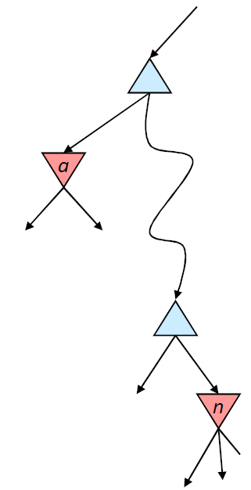

Alpha pruning: Nodes MIN can’t reach
α is the value of the best choice for the MAX player found so far at any choice point above node n
More precisely: α is the highest number that MAX knows how to force MIN to accept
We want to compute the MIN-value at n
As we loop over n’s children, the MIN-value decreases
If it drops below α, MAX will never choose n, so we can ignore n’s remaining children

Slide 12
Beta pruning: Nodes MAX can’t reach
β is the value of the best choice for the MIN player found so far at any choice point above node m
More precisely: β is the lowest number that MIN know how to force MAX to accept
We want to compute the MAX-value at m
As we loop over m’s children, the MAX-value increases
If it rises above β, MIN will never choose m, so we can ignore m’s remaining children
β
m

Slide 13
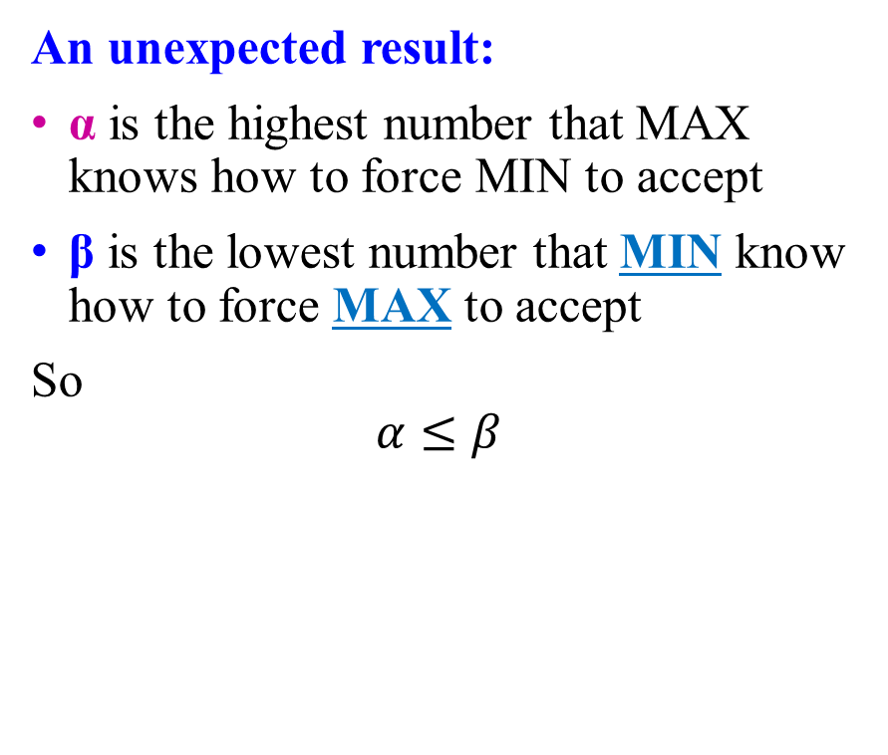
Alpha-beta pruning
An unexpected result:
α is the highest number that MAX knows how to force MIN to accept
β is the lowest number that MIN know how to force MAX to accept
So
$$α≤β$$
β
m

Slide 14
Alpha-beta pruning
Function action = Alpha-Beta-Search(node)
v = Min-Value(node, −∞, ∞)
return the action from node with value v
α: best alternative available to the Max player
β: best alternative available to the Min player
Function v = Min-Value(node, α, β)
if Terminal(node) return Utility(node)
v = +∞
for each action from node
v = Min(v, Max-Value(Succ(node, action), α, β))
if v ≤ α return v
β = Min(β, v)
end for
return v
node
action
…
Succ(node, action)

Slide 15
Alpha-beta pruning
Function action = Alpha-Beta-Search(node)
v = Max-Value(node, −∞, ∞)
return the action from node with value v
α: best alternative available to the Max player
β: best alternative available to the Min player
Function v = Max-Value(node, α, β)
if Terminal(node) return Utility(node)
v = −∞
for each action from node
v = Max(v, Min-Value(Succ(node, action), α, β))
if v ≥ β return v
α = Max(α, v)
end for
return v
node
action
…
Succ(node, action)

Slide 16


Alpha-beta pruning is optimal!
5
Pruning does not affect final result
5
$$≤2$$
$$≤1$$
X
X
X
X
5
6
8
2
1

Slide 17
Alpha-beta pruning: Complexity
5
Amount of pruning depends on move ordering
Should start with the “best” moves (highest-value for MAX or lowest-value for MIN)
With perfect ordering, I have to evaluate:
ALL OF THE GRANDCHILDREN who are daughters of my FIRST CHILD, and
The FIRST GRANDCHILD who is a daughter of each of my REMAINING CHILDREN
5
$$≤2$$
$$≤1$$
X
X
X
X
5
6
8
2
1

Slide 18
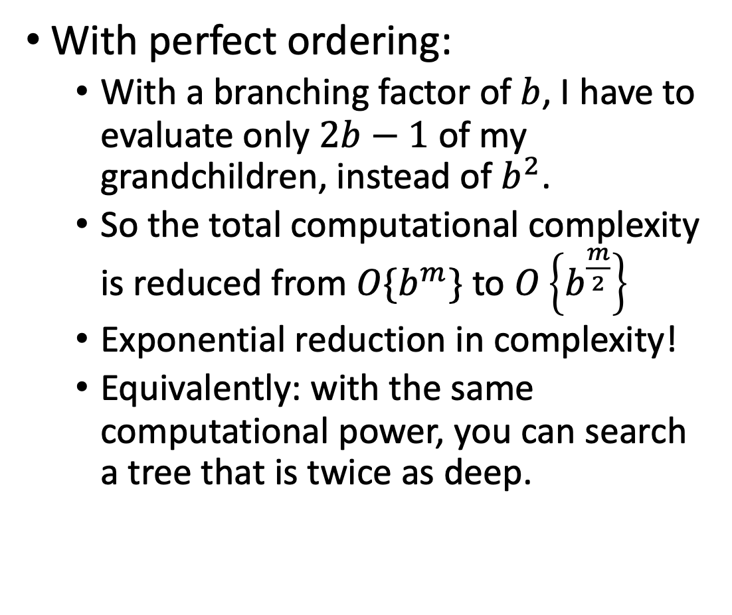
Alpha-beta pruning: Complexity
5
With perfect ordering:
With a branching factor of $b$, I have to evaluate only $2b−1$ of my grandchildren, instead of $b^{2}$.
So the total computational complexity is reduced from $O\{b^{m}\}$ to $O\left\{b^{\frac{m}{2}}\right\}$
Exponential reduction in complexity!
Equivalently: with the same computational power, you can search a tree that is twice as deep.
5
$$≤2$$
$$≤1$$
X
X
X
X
5
6
8
2
1

Slide 19
Limited-Horizon Computation

Slide 20
Games vs. single-agent search
We don’t know how the opponent will act
The solution is not a fixed sequence of actions from start state to goal state, but a strategy or policy (a mapping from state to best move in that state)

Slide 21

Computational complexity…
In order to decide how to move at node $n$, we need to search all possible sequences of moves, from $n$ until the end of the game

Slide 22
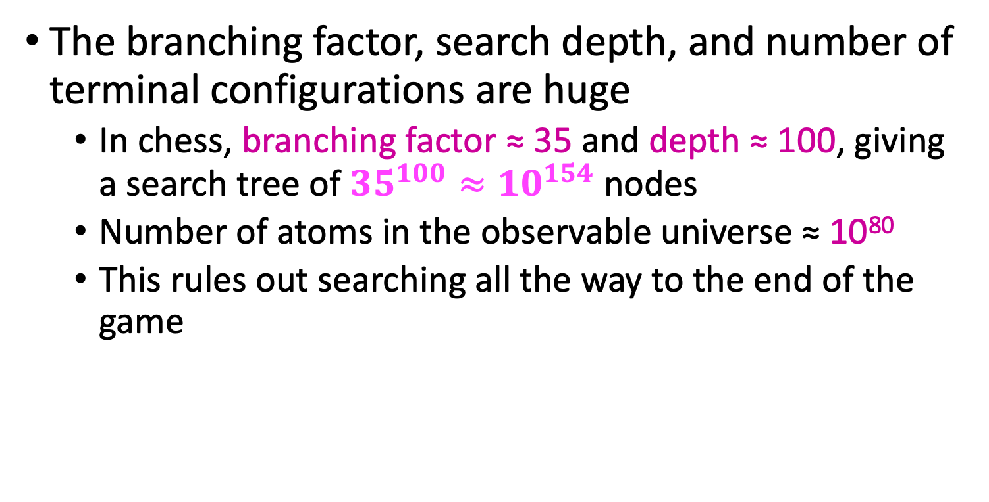
Computational complexity…
The branching factor, search depth, and number of terminal configurations are huge
In chess, branching factor ≈ 35 and depth ≈ 100, giving a search tree of ${35}^{100}≈{10}^{154}$ nodes
Number of atoms in the observable universe ≈ 10⁸⁰
This rules out searching all the way to the end of the game

Slide 23
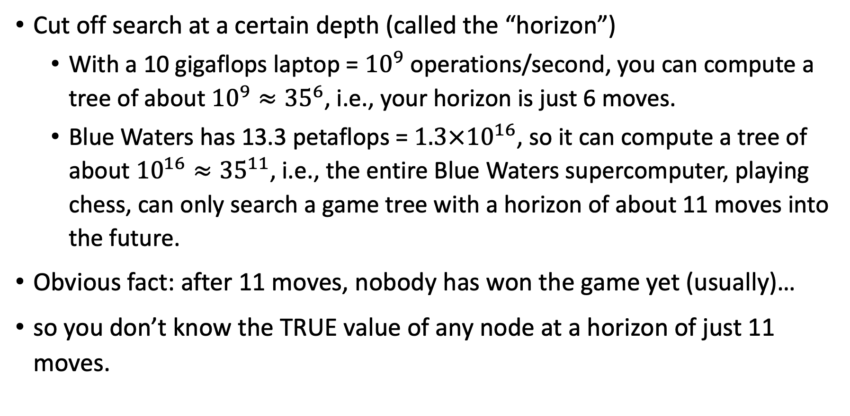
Limited-horizon computing
Cut off search at a certain depth (called the “horizon”)
With a 10 gigaflops laptop = ${10}^{9}$ operations/second, you can compute a tree of about ${10}^{9}≈{35}^{6}$, i.e., your horizon is just 6 moves.
Blue Waters has 13.3 petaflops = $1.3×{10}^{16}$, so it can compute a tree of about ${10}^{16}≈{35}^{11}$, i.e., the entire Blue Waters supercomputer, playing chess, can only search a game tree with a horizon of about 11 moves into the future.
Obvious fact: after 11 moves, nobody has won the game yet (usually)…
so you don’t know the TRUE value of any node at a horizon of just 11 moves.

Slide 24
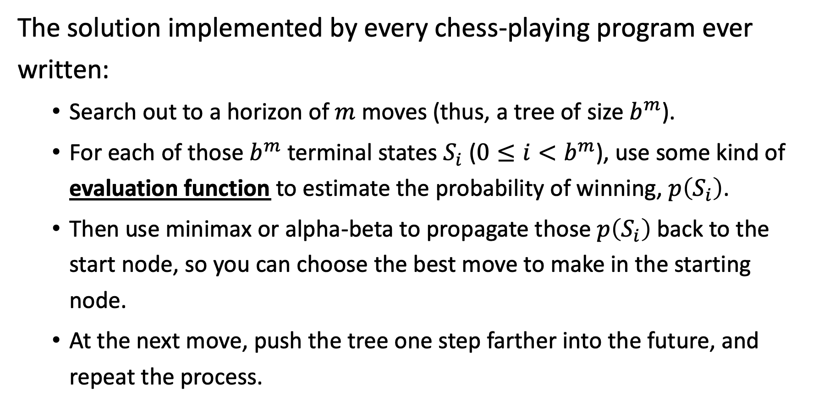
Limited-horizon computing
The solution implemented by every chess-playing program ever written:
Search out to a horizon of $m$ moves (thus, a tree of size $b^{m}$).
For each of those $b^{m}$ terminal states $S_{i}$ ($0≤i<b^{m}$), use some kind of evaluation function to estimate the probability of winning, $p\left(S_{i}\right)$.
Then use minimax or alpha-beta to propagate those $p\left(S_{i}\right)$ back to the start node, so you can choose the best move to make in the starting node.
At the next move, push the tree one step farther into the future, and repeat the process.

Slide 25
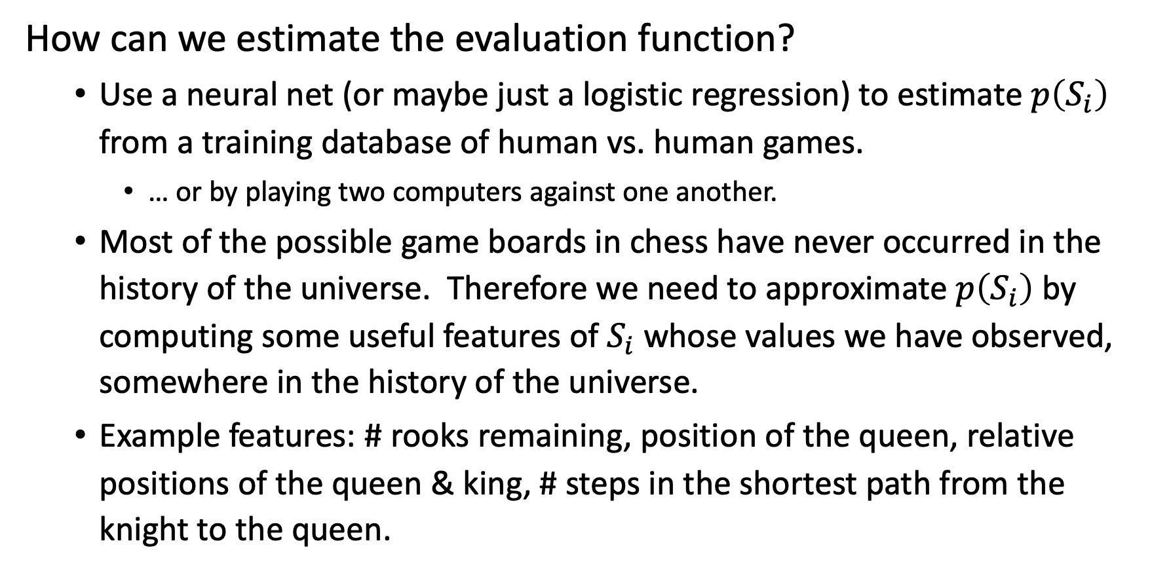
Evaluation functions
How can we estimate the evaluation function?
Use a neural net (or maybe just a logistic regression) to estimate $p\left(S_{i}\right)$ from a training database of human vs. human games.
… or by playing two computers against one another.
Most of the possible game boards in chess have never occurred in the history of the universe. Therefore we need to approximate $p\left(S_{i}\right)$ by computing some useful features of $S_{i}$ whose values we have observed, somewhere in the history of the universe.
Example features: # rooks remaining, position of the queen, relative positions of the queen & king, # steps in the shortest path from the knight to the queen.

Slide 26
Cutting off search
Horizon effect: you may incorrectly estimate the value of a state by overlooking an event that is just beyond the depth limit
For example, a damaging move by the opponent that can be delayed but not avoided
Possible remedies
Quiescence search: do not cut off search at positions that are unstable – for example, are you about to lose an important piece?
Singular extension: a strong move that should be tried when the normal depth limit is reached

Slide 27
Chess playing systems
Baseline system: 200 million node evaluations per move, minimax with a decent evaluation function and quiescence search
5-ply ≈ human novice
Add alpha-beta pruning
10-ply ≈ typical PC, experienced player
Deep Blue: 30 billion evaluations per move, singular extensions, evaluation function with 8000 features, large databases of opening and endgame moves
14-ply ≈ Garry Kasparov
More recent state of the art (Hydra, ca. 2006): 36 billion evaluations per second, advanced pruning techniques
18-ply ≈ better than any human alive?

Slide 28
Summary
A zero-sum game can be expressed as a minimax tree
Alpha-beta pruning finds the correct solution. In the best case, it has half the exponent of minimax (can search twice as deeply with a given computational complexity).
Limited-horizon search is always necessary (you can’t search to the end of the game), and always suboptimal.
Estimate your utility, at the end of your horizon, using some type of learned utility function
Quiescence search: don’t cut off the search in an unstable position (need some way to measure “stability”)
Singular extension: have one or two “super-moves” that you can test at the end of your horizon

