Slide 1
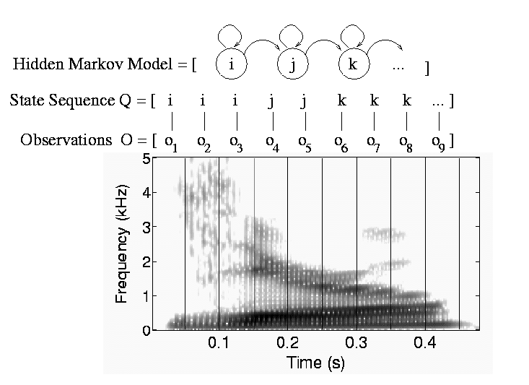
CS440/ECE448 Lecture 18: Hidden Markov Models
Mark Hasegawa-Johnson, 3/2020
Including slides by Svetlana Lazebnik
CC-BY 3.0
You may remix or redistribute if you cite the source.

Slide 2
Probabilistic reasoning over time
So far, we’ve mostly dealt with episodic environments
Exceptions: games with multiple moves, planning
In particular, the Bayesian networks we’ve seen so far describe static situations
Each random variable gets a single fixed value in a single problem instance
Now we consider the problem of describing probabilistic environments that evolve over time
Examples: robot localization, human activity detection, tracking, speech recognition, machine translation,

Slide 3
Hidden Markov Models
At each time slice t, the state of the world is described by an unobservable variable X_{t} and an observable evidence variable E_{t}
Transition model: distribution over the current state given the whole past history: P(X_{t} | X₀, …, X_{t-1}) = P(X_{t} | X_{0:t-1})
Observation model: P(E_{t} | X_{0:t}, E_{1:t-1})
…
X₀
X₁
X₂
X_{t-1}
X_{t}
E₁
E₂
E_{t-1}
E_{t}

Slide 4
Hidden Markov Models
Markov assumption (first order)
The current state is conditionally independent of all the other states given the state in the previous time step
What does P(X_{t} | X_{0:t-1}) simplify to?
P(X_{t} | X_{0:t-1}) = P(X_{t} | X_{t-1})
Markov assumption for observations
The evidence at time t depends only on the state at time t
What does P(E_{t} | X_{0:t}, E_{1:t-1}) simplify to?
P(E_{t} | X_{0:t}, E_{1:t-1}) = P(E_{t} | X_{t})
…
X₀
X₁
X₂
X_{t-1}
X_{t}
E₁
E₂
E_{t-1}
E_{t}

Slide 5
Example Scenario: UmbrellaWorld Characters from the novel Hammered by Elizabeth Bear, Scenario from chapter 15 of Russell & Norvig
Elspeth Dunsany is an AI researcher at the Canadian company Unitek.
Richard Feynman is an AI, named after the famous physicist, whose personality he resembles.
To keep him from escaping, Richard’s workstation is not connected to the internet. He knows about rain but has never seen it.
He has noticed, however, that Elspeth sometimes brings an umbrella to work. He correctly infers that she is more likely to carry an umbrella on days when it rains.

Slide 6
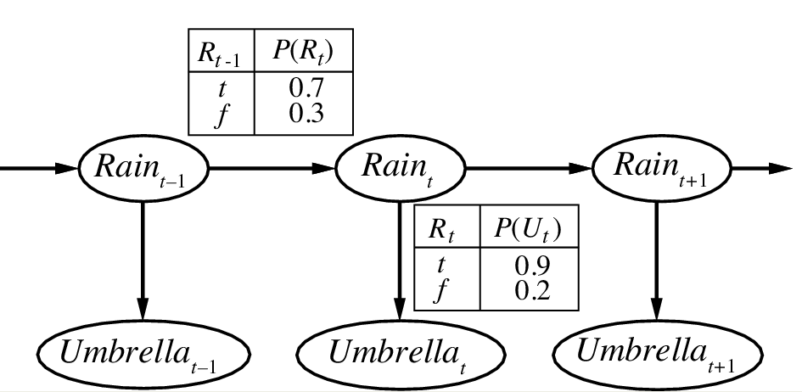
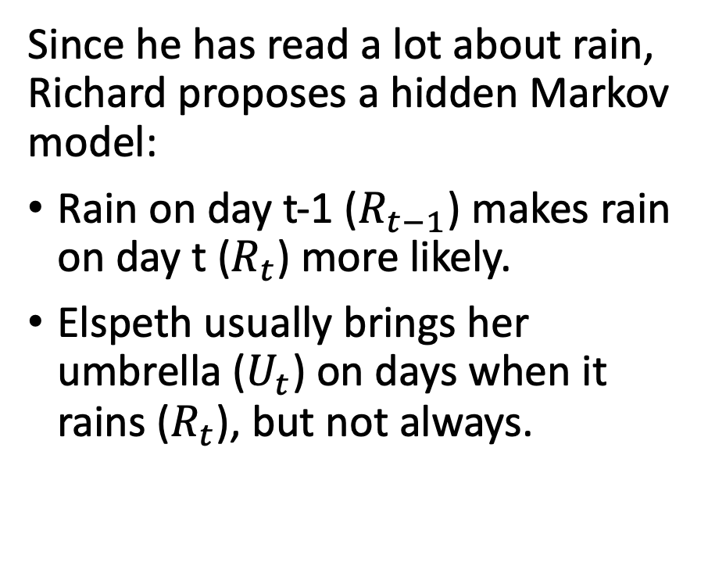
Example Scenario: UmbrellaWorld Characters from the novel Hammered by Elizabeth Bear, Scenario from chapter 15 of Russell & Norvig
Since he has read a lot about rain, Richard proposes a hidden Markov model:
Rain on day t-1 ($R_{t−1}$) makes rain on day t ($R_{t}$) more likely.
Elspeth usually brings her umbrella ($U_{t}$) on days when it rains ($R_{t}$), but not always.
state
observation
Notes:
The example is described in Section 15.1.1

Slide 7
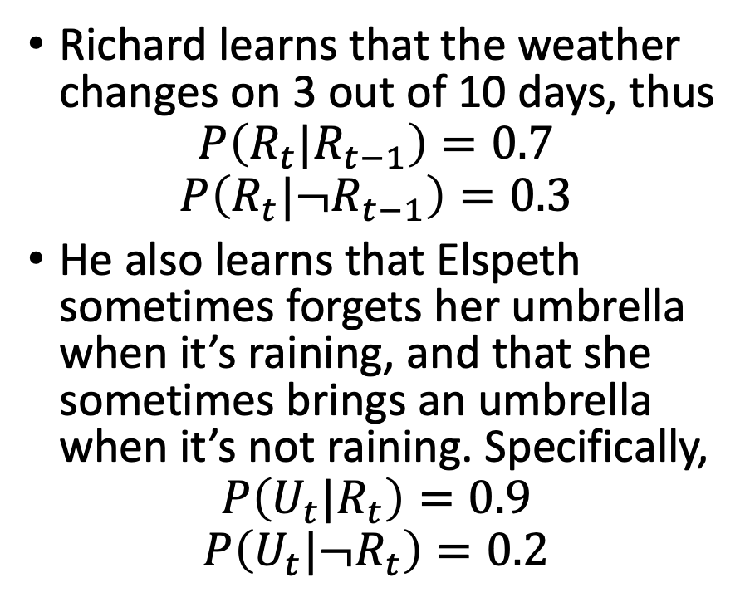
Example Scenario: UmbrellaWorld Characters from the novel Hammered by Elizabeth Bear, Scenario from chapter 15 of Russell & Norvig
Richard learns that the weather changes on 3 out of 10 days, thus
$$P\left(R_{t}|R_{t−1}\right)=0.7$$
$$P\left(R_{t}|{¬R}_{t−1}\right)=0.3$$
He also learns that Elspeth sometimes forgets her umbrella when it’s raining, and that she sometimes brings an umbrella when it’s not raining. Specifically,
$$P\left(U_{t}|R_{t}\right)=0.9$$
$$P\left(U_{t}|{¬R}_{t}\right)=0.2$$
Transition model
state
observation
Observation model
Notes:
The example is described in Section 15.1.1

Slide 8
HMM as a Bayes Net
This slide shows an HMM as a Bayes Net. You should remember the graph semantics of a Bayes net:
Nodes are random variables.
Edges denote stochastic dependence.
Transition model
state
observation
Observation model
Notes:
The example is described in Section 15.1.1

Slide 9
HMM as a Finite State Machine
U=T: 0.9
U=F: 0.1
This slide shows exactly the same HMM, viewed in a totally different way. Here, we show it as a finite state machine:
Nodes denote states.
Edges denote possible transitions between the states.
Observation probabilities must be written using little table thingies, hanging from each state.
0.3
0.7
R=T
R=F
0.7
0.3
U=T: 0.2
U=F: 0.8
Transition probabilities
Observation probabilities
 | R_{t} = T | R_{t} = F
R_{t-1} = T | 0.7 | 0.3
R_{t-1} = F | 0.3 | 0.7
 | U_{t} = T | U_{t} = F
R_{t} = T | 0.9 | 0.1
R_{t} = F | 0.2 | 0.8
Notes:
The example is described in Section 15.1.1

Slide 10
Bayes Net vs. Finite State Machine
Finite State Machine:
Lists the different possible states that the world can be in, at one particular time.
Evolution over time is not shown.
Bayes Net:
Lists the different time slices.
The various possible settings of the state variable are not shown.
0.3
0.7
R=T
R=F
0.7
0.3

Slide 11
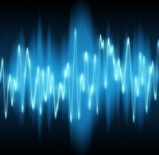

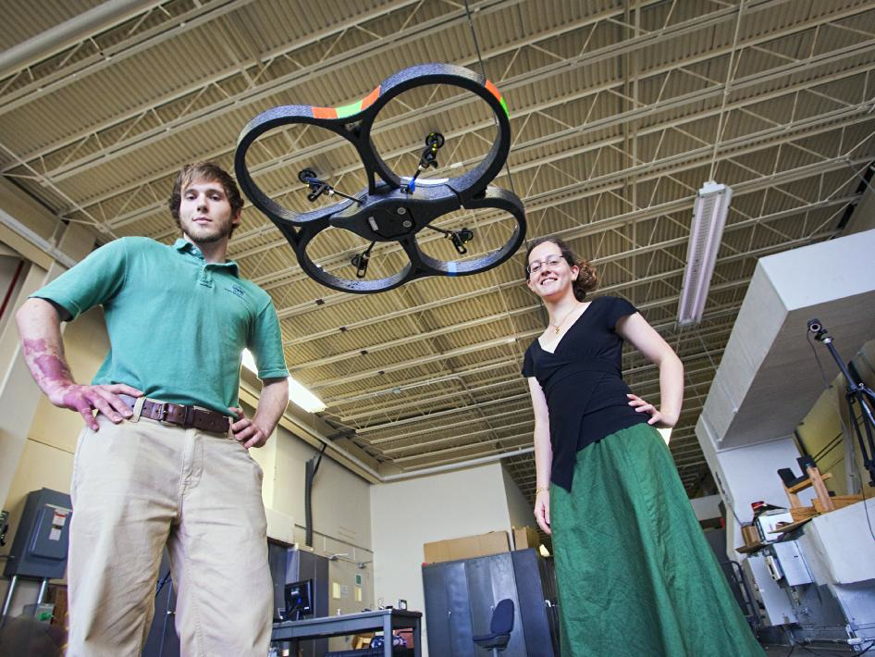
Applications of HMMs
Speech recognition HMMs:
Observations are acoustic signals (continuous valued)
States are specific positions in specific words (so, tens of thousands)
Machine translation HMMs:
Observations are words (tens of thousands)
States are translation options
Robot tracking:
Observations are range readings (continuous)
States are positions on a map (continuous)
Source: Tamara Berg
Notes:
HMMs are used all over the place. They’re used for speech recognition in HMMs. Here observations are acoustic signals, states are phonemes in words. HMMs are used for machine translation where observations are words and states are translation options (ie what word in german should we translate this word in english to?) in robot tracking hmm’s are used to localize where the robot is located in space. Here observations are range readings and states are positions on a map. We’ll see some of these examples in a little more depth later.

Slide 12
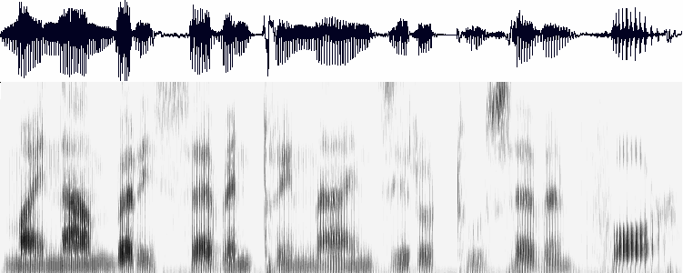

Example: Speech Recognition
Acoustic wave form
Sampled at 16KHz, quantized to 8-12 bits
Observations: $E_{t}$= FFT of 10ms “frame” of the speech signal.
Fast Fourier Transform (FFT), once per 10ms, computes a ”picture” whose axes are time and frequency
Frequency
Time
FFT of one frame (10ms)
is the HMM observation, once per 10ms
Observation = compressed version of the log magnitude FFT, from one 10ms frame

Slide 13
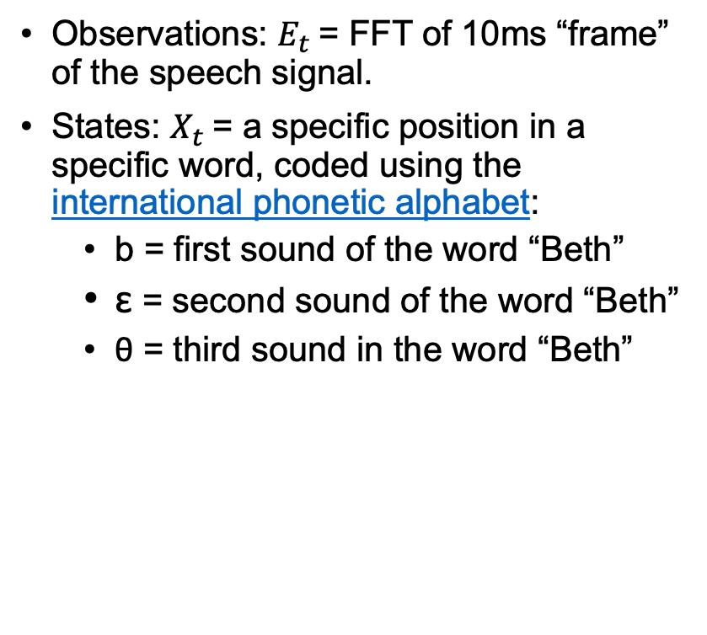
Example: Speech Recognition
Observations: $E_{t}$= FFT of 10ms “frame” of the speech signal.
States: $X_{t}$= a specific position in a specific word, coded using the international phonetic alphabet:
b = first sound of the word “Beth”
ɛ = second sound of the word “Beth”
θ = third sound in the word “Beth”
Finite State Machine model of the word “Beth”
0.05
0.5
0.1
0.2
SIL
b
ɛ
θ
SIL
0.95
0.5
0.9
0.8
1.0

Slide 14
The Joint Distribution
Transition model: P(X_{t} | X_{0:t-1}) = P(X_{t} | X_{t-1})
Observation model: P(E_{t} | X_{0:t}, E_{1:t-1}) = P(E_{t} | X_{t})
How do we compute the full joint probability table P(X_{0:t}, E_{1:t})?
…
X₀
X₁
X₂
X_{t-1}
X_{t}
E₁
E₂
E_{t-1}
E_{t}

Slide 15
HMM inference tasks
Filtering: what is the distribution over the current state X_{t} given all the evidence so far, E_{1:t} ? (example: is it currently raining?)
Query variable
…
…
X₀
X₁
X_{k}
X_{t-1}
X_{t}
E₁
E_{k}
E_{t-1}
E_{t}
Evidence variables

Slide 16
HMM inference tasks
Filtering: what is the distribution over the current state X_{t} given all the evidence so far, E_{1:t} ?
Smoothing: what is the distribution of some state X_{k} (k<t) given the entire observation sequence E_{1:t}? (example: did it rain on Sunday?)
Query variable
…
…
X₀
X₁
X_{k}
X_{t-1}
X_{t}
E₁
E_{k}
E_{t-1}
E_{t}

Slide 17
HMM inference tasks
Filtering: what is the distribution over the current state X_{t} given all the evidence so far, E_{1:t} ?
Smoothing: what is the distribution of some state X_{k} (k<t) given the entire observation sequence E_{1:t}?
Evaluation: compute the probability of a given observation sequence E_{1:t} (example: is Richard using the right model?)
Query:
Is this the right model for these data?
…
…
X₀
X₁
X_{k}
X_{t-1}
X_{t}
E₁
E_{k}
E_{t-1}
E_{t}

Slide 18
HMM inference tasks
Filtering: what is the distribution over the current state X_{t} given all the evidence so far, E_{1:t}
Smoothing: what is the distribution of some state X_{k} (k<t) given the entire observation sequence E_{1:t}?
Evaluation: compute the probability of a given observation sequence E_{1:t}
Decoding: what is the most likely state sequence X_{0:t} given the observation sequence E_{1:t}? (example: what’s the weather every day?)
Query variables: all of them
…
…
X₀
X₁
X_{k}
X_{t-1}
X_{t}
E₁
E_{k}
E_{t-1}
E_{t}

Slide 19
HMM Learning and Inference
Inference tasks
Filtering: what is the distribution over the current state X_{t} given all the evidence so far, E_{1:t}
Smoothing: what is the distribution of some state X_{k} (k<t) given the entire observation sequence E_{1:t}?
Evaluation: compute the probability of a given observation sequence E_{1:t}
Decoding: what is the most likely state sequence X_{0:t} given the observation sequence E_{1:t}?
Learning
Given a training sample of sequences, learn the model parameters (transition and emission probabilities)

Slide 20
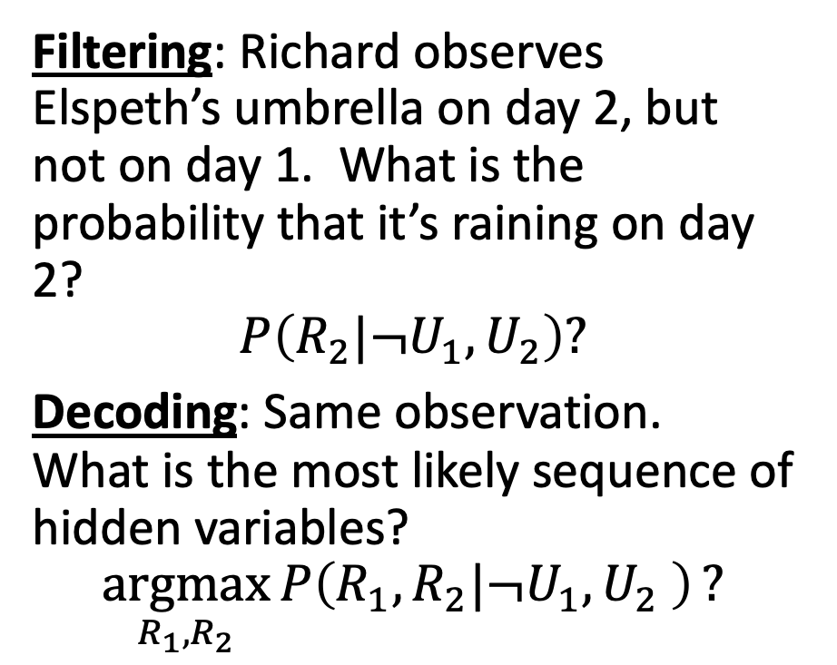
Filtering and Decoding in UmbrellaWorld
Filtering: Richard observes Elspeth’s umbrella on day 2, but not on day 1. What is the probability that it’s raining on day 2?
$$P\left(R_{2}|¬U_{1},U_{2}\right)?$$
Decoding: Same observation. What is the most likely sequence of hidden variables?
$$\underset{R_{1},R_{2}}{argmax}{P\left(R_{1},R_{2}|¬U_{1},U_{2} \right)}?$$
Transition model
state
R₀
R₁
R₂
observation
U₁
U₂
Transition probabilities
Observation probabilities
 | R_{t} = T | R_{t} = F
R_{t-1} = T | 0.7 | 0.3
R_{t-1} = F | 0.3 | 0.7
 | U_{t} = T | U_{t} = F
R_{t} = T | 0.9 | 0.1
R_{t} = F | 0.2 | 0.8
Notes:
The example is described in Section 15.1.1

Slide 21
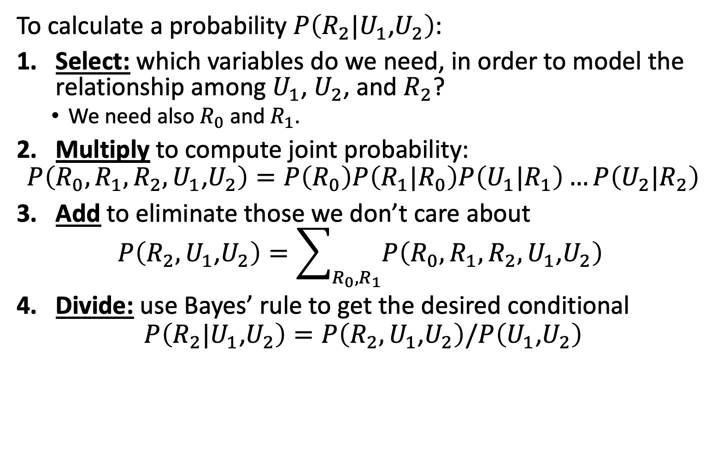
Bayes Net Inference for HMMs
To calculate a probability $P\left(R_{2}|U_{1}\text{,}U_{2}\right)$:
Select: which variables do we need, in order to model the relationship among $U_{1}$, $U_{2}$, and $R_{2}$?
We need also $R_{0}$ and $R_{1}$.
Multiply to compute joint probability:
$$P\left(R_{0},R_{1},R_{2},U_{1}\text{,}U_{2}\right)=P\left(R_{0}\right)P\left(R_{1}|R_{0}\right)P\left(U_{1}|R_{1}\right)…P\left(U_{2}|R_{2}\right)$$
Add to eliminate those we don’t care about
$$P\left(R_{2},U_{1}\text{,}U_{2}\right)=\sum_{R_{0},R_{1}}{P\left(R_{0},R_{1},R_{2},U_{1}\text{,}U_{2}\right)}$$
Divide: use Bayes’ rule to get the desired conditional
$$P\left(R_{2}|U_{1}\text{,}U_{2}\right)=P\left(R_{2},U_{1}\text{,}U_{2}\right)/P\left(U_{1}\text{,}U_{2}\right)$$
…
R₀
R₁
R₂
R_{t-1}
R_{t}
U₁
U₂
U_{t-1}
U_{t}

Slide 22
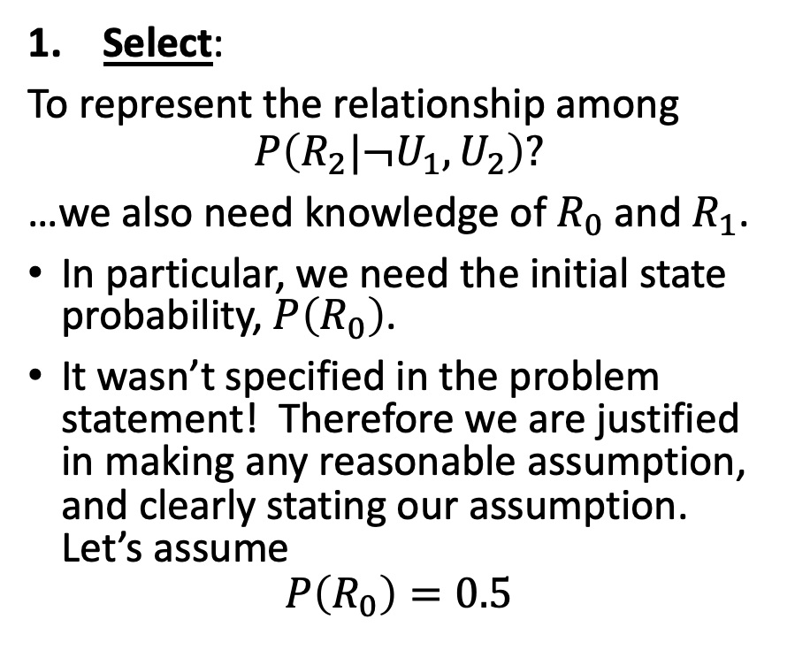
Filtering and Decoding in UmbrellaWorld
Select:
To represent the relationship among
$$P\left(R_{2}|¬U_{1},U_{2}\right)?$$
…we also need knowledge of $R_{0}$ and $R_{1}$.
In particular, we need the initial state probability, $P\left(R_{0}\right)$.
It wasn’t specified in the problem statement! Therefore we are justified in making any reasonable assumption, and clearly stating our assumption. Let’s assume
$$P\left(R_{0}\right)=0.5$$
Transition model
state
R₀
R₁
R₂
observation
U₁
U₂
Transition probabilities
Observation probabilities
 | R_{t} = T | R_{t} = F
R_{t-1} = T | 0.7 | 0.3
R_{t-1} = F | 0.3 | 0.7
 | U_{t} = T | U_{t} = F
R_{t} = T | 0.9 | 0.1
R_{t} = F | 0.2 | 0.8
Notes:
The example is described in Section 15.1.1

Slide 23
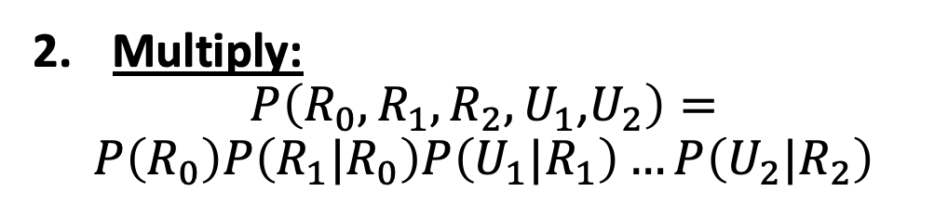
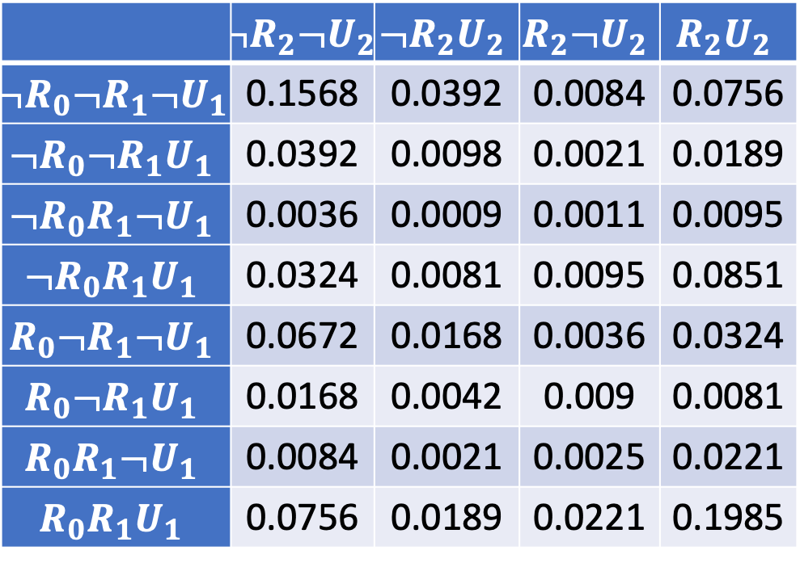
Filtering and Decoding in UmbrellaWorld
Multiply:
$$P\left(R_{0},R_{1},R_{2},U_{1}\text{,}U_{2}\right)=$$
$$P\left(R_{0}\right)P\left(R_{1}|R_{0}\right)P\left(U_{1}|R_{1}\right)…P\left(U_{2}|R_{2}\right)$$
Transition model
 | $$¬R_{2}¬U_{2}$$ | $$¬R_{2}U_{2}$$ | $$R_{2}¬U_{2}$$ | $$R_{2}U_{2}$$
$$¬R_{0}¬R_{1}{¬U}_{1}$$ | 0.1568 | 0.0392 | 0.0084 | 0.0756
$$¬R_{0}¬R_{1}U_{1}$$ | 0.0392 | 0.0098 | 0.0021 | 0.0189
$$¬R_{0}R_{1}¬U_{1}$$ | 0.0036 | 0.0009 | 0.0011 | 0.0095
$$¬R_{0}R_{1}U_{1}$$ | 0.0324 | 0.0081 | 0.0095 | 0.0851
$$R_{0}¬R_{1}¬U_{1}$$ | 0.0672 | 0.0168 | 0.0036 | 0.0324
$$R_{0}¬R_{1}U_{1}$$ | 0.0168 | 0.0042 | 0.009 | 0.0081
$$R_{0}R_{1}¬U_{1}$$ | 0.0084 | 0.0021 | 0.0025 | 0.0221
$$R_{0}R_{1}U_{1}$$ | 0.0756 | 0.0189 | 0.0221 | 0.1985
state
R₀
R₁
R₂
observation
U₁
U₂
Transition probabilities
Observation probabilities
 | R_{t} = T | R_{t} = F
R_{t-1} = T | 0.7 | 0.3
R_{t-1} = F | 0.3 | 0.7
 | U_{t} = T | U_{t} = F
R_{t} = T | 0.9 | 0.1
R_{t} = F | 0.2 | 0.8
Notes:
The example is described in Section 15.1.1

Slide 24
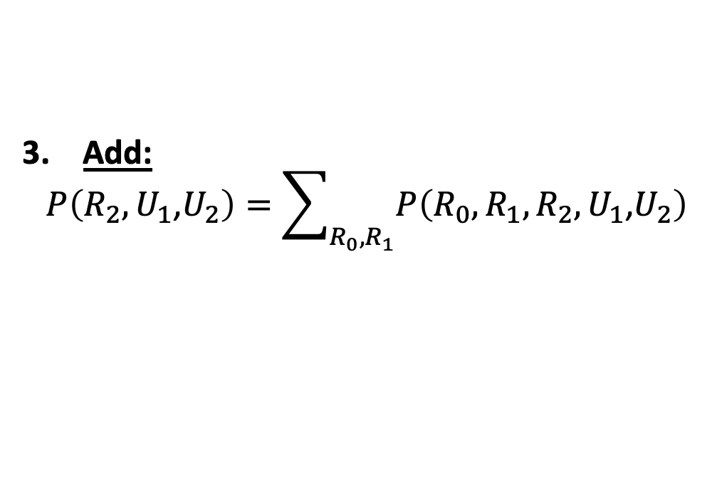
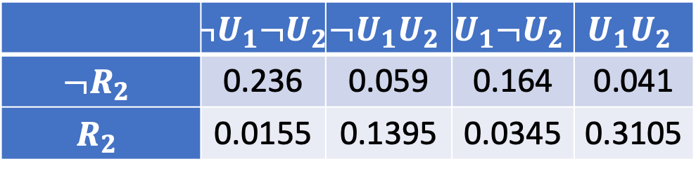
Filtering and Decoding in UmbrellaWorld
Add:
$$P\left(R_{2},U_{1}\text{,}U_{2}\right)=\sum_{R_{0},R_{1}}{P\left(R_{0},R_{1},R_{2},U_{1}\text{,}U_{2}\right)}$$
Transition model
 | $$¬U_{1}¬U_{2}$$ | $$¬U_{1}U_{2}$$ | $$U_{1}¬U_{2}$$ | $$U_{1}U_{2}$$
$$¬R_{2}$$ | 0.236 | 0.059 | 0.164 | 0.041
$$R_{2}$$ | 0.0155 | 0.1395 | 0.0345 | 0.3105
state
R₀
R₁
R₂
observation
U₁
U₂
Transition probabilities
Observation probabilities
 | R_{t} = T | R_{t} = F
R_{t-1} = T | 0.7 | 0.3
R_{t-1} = F | 0.3 | 0.7
 | U_{t} = T | U_{t} = F
R_{t} = T | 0.9 | 0.1
R_{t} = F | 0.2 | 0.8
Notes:
The example is described in Section 15.1.1

Slide 25
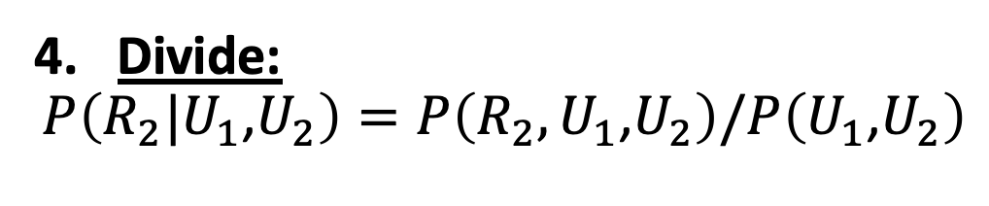
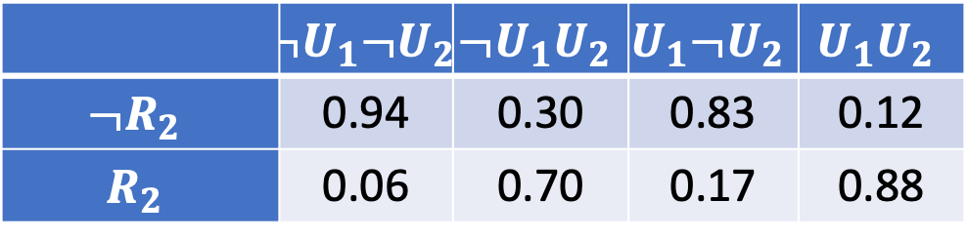
Filtering and Decoding in UmbrellaWorld
Divide:
$$P\left(R_{2}|U_{1}\text{,}U_{2}\right)=P\left(R_{2},U_{1}\text{,}U_{2}\right)/P\left(U_{1}\text{,}U_{2}\right)$$
Transition model
 | $$¬U_{1}¬U_{2}$$ | $$¬U_{1}U_{2}$$ | $$U_{1}¬U_{2}$$ | $$U_{1}U_{2}$$
$$¬R_{2}$$ | 0.94 | 0.30 | 0.83 | 0.12
$$R_{2}$$ | 0.06 | 0.70 | 0.17 | 0.88
state
R₀
R₁
R₂
observation
U₁
U₂
Transition probabilities
Observation probabilities
 | R_{t} = T | R_{t} = F
R_{t-1} = T | 0.7 | 0.3
R_{t-1} = F | 0.3 | 0.7
 | U_{t} = T | U_{t} = F
R_{t} = T | 0.9 | 0.1
R_{t} = F | 0.2 | 0.8
Notes:
The example is described in Section 15.1.1

Slide 26
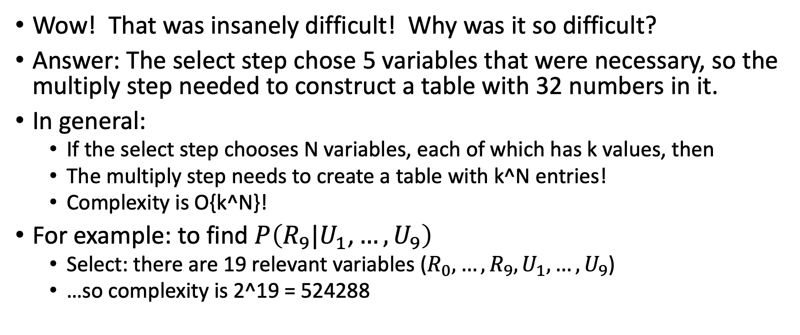
Filtering and Decoding in UmbrellaWorld
Wow! That was insanely difficult! Why was it so difficult?
Answer: The select step chose 5 variables that were necessary, so the multiply step needed to construct a table with 32 numbers in it.
In general:
If the select step chooses N variables, each of which has k values, then
The multiply step needs to create a table with k^N entries!
Complexity is O{k^N}!
For example: to find $P\left(R_{9}|U_{1}\text{,}…,U_{9}\right)$
Select: there are 19 relevant variables ($R_{0},…,R_{9},U_{1},…,U_{9}$)
…so complexity is 2^19 = 524288

Slide 27
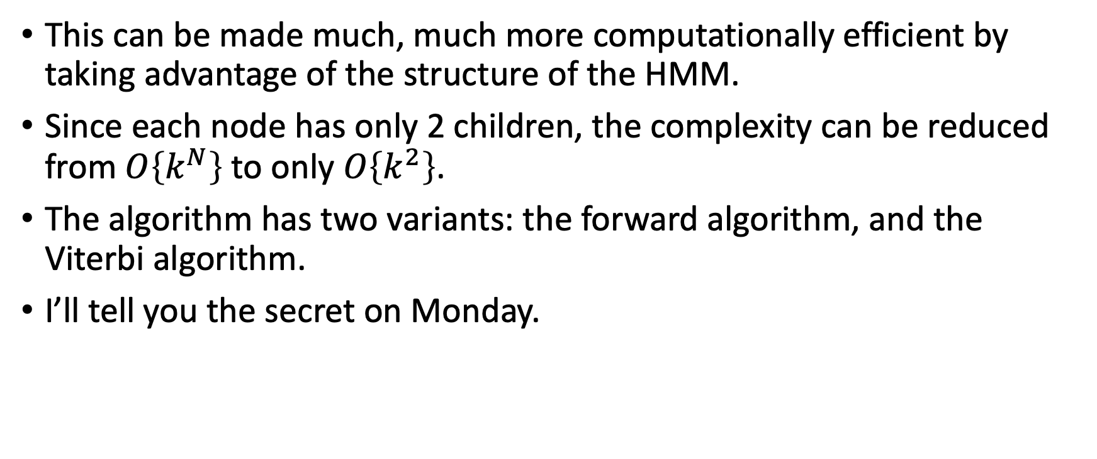
Better Algorithms for HMM Inference
This can be made much, much more computationally efficient by taking advantage of the structure of the HMM.
Since each node has only 2 children, the complexity can be reduced from $O\left\{k^{N}\right\}$ to only $O\left\{k^{2}\right\}$.
The algorithm has two variants: the forward algorithm, and the Viterbi algorithm.
I’ll tell you the secret on Monday.

