Slide 1
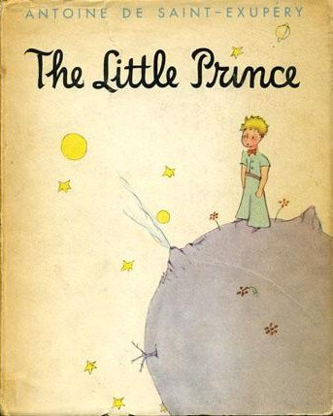
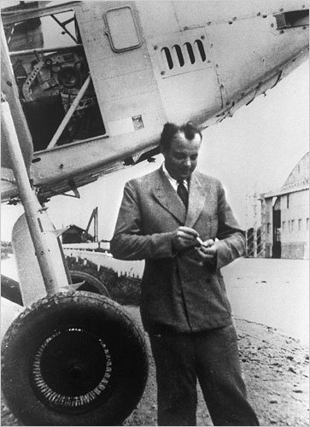
CS440/ECE448 Lecture 17: Natural Language Processing
By Mark Hasegawa-Johnson, 3/2020
License: CC-BY 4.0
You may redistribute or remix if you cite the source.
Watercolor, Antoine de Saint-Exupery, 1944. Public domain (copyright expired).
Photo, NYT Online, 1933. Public domain (copyright expired).

Slide 2
Outline
Information Extraction
Semantics
predicates, entities, and propositions
Syntax
context-free grammar
parts of speech
Training parsers: the Penn Treebank

Slide 3
Information Extraction
The prince loves his rose.
Who?
What?
Where?
When?
Why?

Slide 4
Information Extraction
The prince loves his rose.
Who? The prince and the rose.
What? Love.
Where? Not specified.
When? Not specified.
Why? Not specified.

Slide 5
Information Extraction
Information Extraction (IE) seeks to
Read free-form texts, like “the prince loves his rose.”
Extract facts in a form that can be used for automatic reasoning processes.

Slide 6
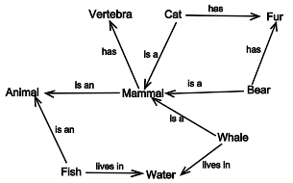
Example: Semantic Network
One possible target of IE is a semantic network, like the one shown at right
The goal is to learn typed edges (relationships) connecting nodes (entities)
Public Domain, https://commons.wikimedia.org/w/index.php?curid=1353062

Slide 7
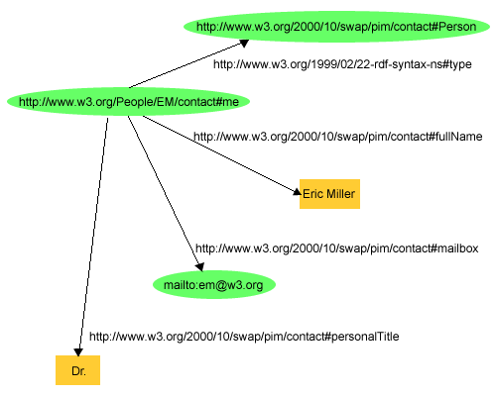
Example: RDF
Resource Description Framework (RDF) is a series of standards of the WWW consortium, in which facts are represented as triples:
Subject
Object
Predicate
By W3C - http://www.w3.org/TR/rdf-primer/fig1dec16.png, Attribution, https://commons.wikimedia.org/w/index.php?curid=6218192

Slide 8
Outline
Information Extraction
Semantics
predicates, entities, and propositions
Syntax
context-free grammar
parts of speech
Training parsers: the Penn Treebank

Slide 9
Semantics
Semantics = The study of natural language meanings
Semantics considers that natural language is fundamentally about two types of things:
Entities: objects, people, animals, ideas, places, organizations…
Predicates: attributes, relationships, actions
By applying a predicate to a set of entities, we get a proposition.
The proposition is, itself, an idea, which can therefore, itself, be treated as an entity:
Antoine said that the prince loves his rose.

Slide 10
Predicates, Entities, and Propositions
A predicate is like a function, that can be applied to some arguments.
Love(x,y)
An entity is like a constant, which can be the value of the argument of a function:
Love(“The prince”, “his rose”)
When the arguments have been evaluated to constants, we get a proposition. For example, an RDF triple is a proposition with only two arguments: Subject and Object.

Slide 11
The Syntax-Semantics Interface
Suppose we are given the text
The prince loves his rose.
How can we get the propositional form
Love(the prince, his rose)
This problem is called the “syntax-semantics” interface, because one way to solve it is as follows:
Parse the sentence into noun phrases and verb phrases.
Map each noun phrase to an entity, each verb phrase to a predicate.

Slide 12
Outline
Information Extraction
Semantics
predicates, entities, and propositions
Syntax
context-free grammar
parts of speech
Training parsers: the Penn Treebank

Slide 13
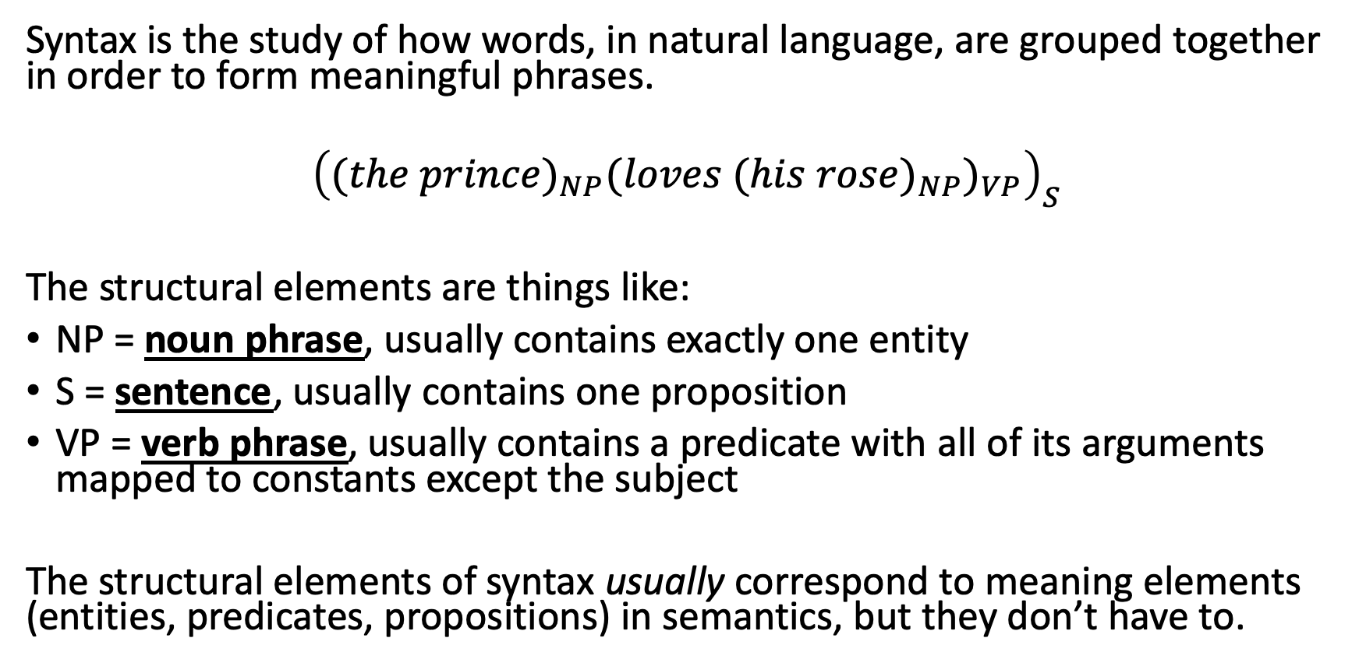
Syntax
Syntax is the study of how words, in natural language, are grouped together in order to form meaningful phrases.
$${\left({(the prince)}_{NP}{(loves {(his rose)}_{NP})}_{VP}\right)}_{S}$$
The structural elements are things like:
NP = noun phrase, usually contains exactly one entity
S = sentence, usually contains one proposition
VP = verb phrase, usually contains a predicate with all of its arguments mapped to constants except the subject
The structural elements of syntax usually correspond to meaning elements (entities, predicates, propositions) in semantics, but they don’t have to.

Slide 14
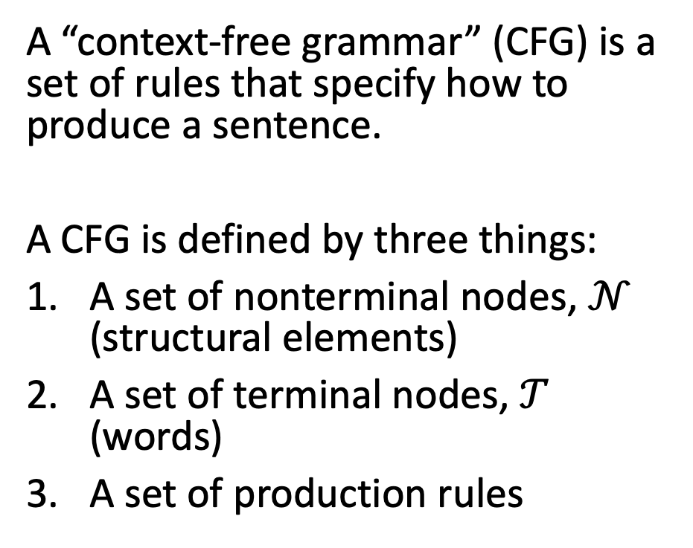
Context-Free Grammar (CFG)
A “context-free grammar” (CFG) is a set of rules that specify how to produce a sentence.
A CFG is defined by three things:
A set of nonterminal nodes, $𝒩$ (structural elements)
A set of terminal nodes, $𝒯$ (words)
A set of production rules
S
VP
NP
NP
The prince loves his rose

Slide 15
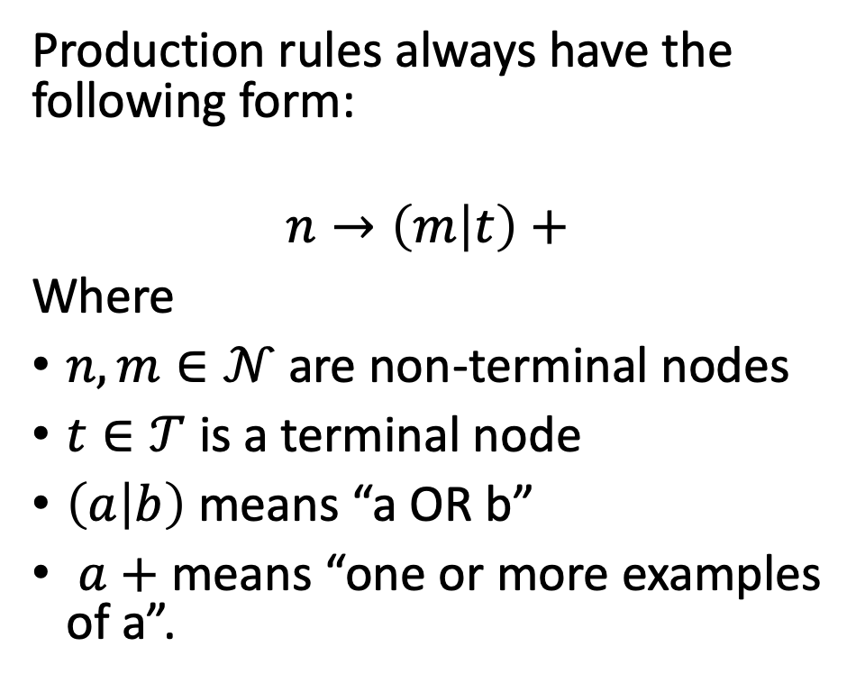
Context-Free Grammar (CFG)
Production rules always have the following form:
$$n→\left(m | t\right)+$$
Where
$n,m∈𝒩$ are non-terminal nodes
$t∈𝒯$ is a terminal node
$\left(a | b\right)$ means “a OR b”
$a+$ means “one or more examples of a”.
S
VP
NP
NP
The prince loves his rose

Slide 16
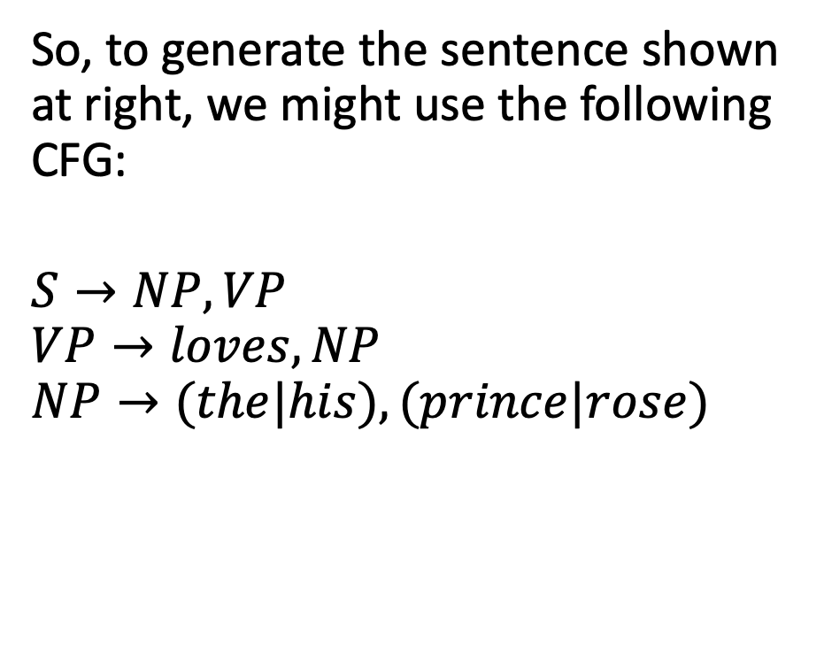
Context-Free Grammar (CFG)
So, to generate the sentence shown at right, we might use the following CFG:
$$S→NP, VP$$
$$VP→loves, NP$$
$$NP→(the|his), (prince|rose)$$
S
VP
NP
NP
The prince loves his rose

Slide 17
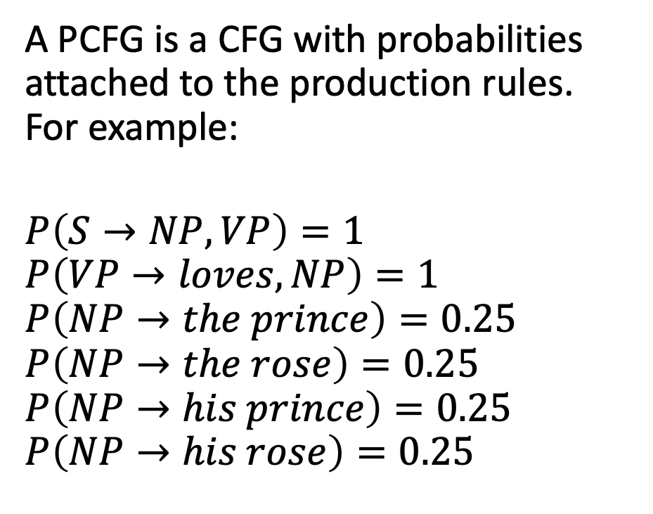
Probabilistic Context-Free Grammar (PCFG)
S
A PCFG is a CFG with probabilities attached to the production rules. For example:
$$P\left(S→NP, VP\right)=1$$
$$P\left(VP→loves, NP\right)=1$$
$$P\left(NP→the prince\right)=0.25$$
$$P\left(NP→the rose\right)=0.25$$
$$P\left(NP→his prince\right)=0.25$$
$$P\left(NP→his rose\right)=0.25$$
VP
NP
NP
S
The prince loves his rose
VP
S
NP
NP
VP
NP
NP
The rose loves the prince
…
His prince loves the rose

Slide 18
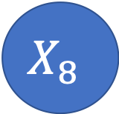
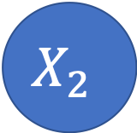
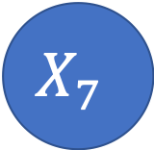
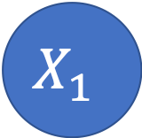

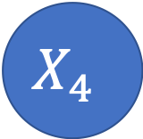
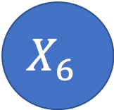
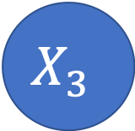
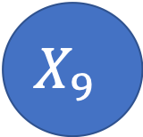
Probabilistic Context-Free Grammar (PCFG)
A PCFG can be written as a Bayes net!
Every Nonterminal has 2 children.
$$X_{1}$$
Child1 | Child2 | Parent | P(C|P)
NP |  | S | 1.0
 | VP | S | 1.0
the |  | NP | 0.5
his |  | NP | 0.5
 | prince | NP | 0.5
 | rose | NP | 0.5
… | … | … | …
$$X_{2}$$
$$X_{3}$$
$$X_{4}$$
$$X_{5}$$
$$X_{6}$$
$$X_{7}$$
$$X_{8}$$
$$X_{9}$$

Slide 19
Outline
Information Extraction
Semantics
predicates, entities, and propositions
Syntax
context-free grammar
parts of speech
Training parsers: the Penn Treebank

Slide 20
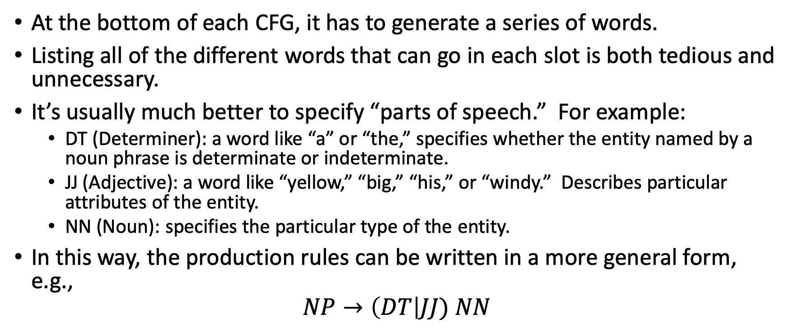
Parts of Speech
At the bottom of each CFG, it has to generate a series of words.
Listing all of the different words that can go in each slot is both tedious and unnecessary.
It’s usually much better to specify “parts of speech.” For example:
DT (Determiner): a word like “a” or “the,” specifies whether the entity named by a noun phrase is determinate or indeterminate.
JJ (Adjective): a word like “yellow,” “big,” “his,” or “windy.” Describes particular attributes of the entity.
NN (Noun): specifies the particular type of the entity.
In this way, the production rules can be written in a more general form, e.g.,
$$NP→\left(DT\right|JJ) NN$$

Slide 21

Normal-Form CFG
A Normal-Form CFG has just two types of rules:
$n_{1}→n_{2}$ $n_{3}$, where $n_{1}, n_{2},$ and $n_{3}$ are all Nonterminals.
$n→t$, where $n$ is a Nonterminal and $t$ is a Terminal (a word).

Slide 22
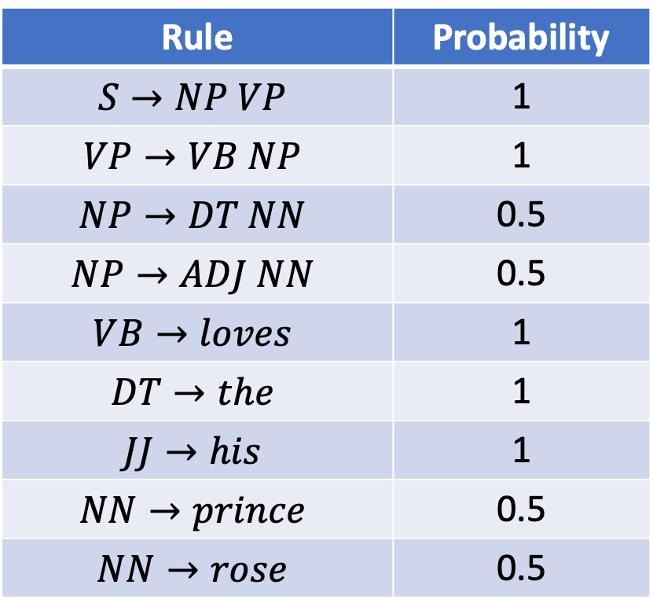
Example PCFG in Normal Form
S
VP
Rule | Probability
$$S→NP VP$$ | 1
$$VP→VB NP$$ | 1
$$NP→DT NN$$ | 0.5
$$NP→ADJ NN$$ | 0.5
$$VB→loves$$ | 1
$$DT→the$$ | 1
$$JJ→his$$ | 1
$$NN→prince$$ | 0.5
$$NN→rose$$ | 0.5
NP
NP
DT
NN
VB
JJ
NN
The prince loves his rose

Slide 23
How to use PCFGs in practice
POS TAGGING: Figure out the part of speech of every word in the sentence.
PARSING: Use a Bayes net or some other parsing algorithm in order to figure out the structure of the sentence, i.e., which words belong to the first NP, which belong to the second NP.
INFORMATION EXTRACTION: Map each NP to an entity, and each VP to a predicate. Put the corresponding fact triple into your semantic net.

Slide 24
Outline
Information Extraction
Semantics
predicates, entities, and propositions
Syntax
context-free grammar
parts of speech
Training parsers: the Penn Treebank

Slide 25
Data: The Penn Treebank
A “Treebank” is a database of
naturally occurring sentences,
marked up by linguists to show the phrase structure, using Nonterminal symbols (like NP and VP) and parts of speech (like NN, JJ, DT, and VB).
Algorithms can then be trained to accept word strings as input, and generate parse structure as output.
The Penn Treebank was the first large-scale publicly available treebank, created at the University of Pennsylvania in the early 1990s, using sentences from the Wall Street Journal.

Slide 26
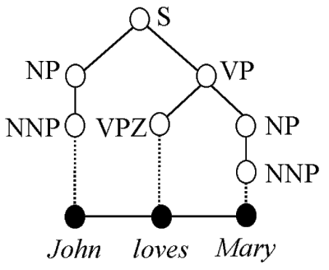
Data: The Penn Treebank
(S (NP (NNP John))
(VP (VPZ loves)
(NP (NNP Mary)))
(. .))
CC BY-SA 3.0, https://en.wikipedia.org/w/index.php?curid=19519892

Slide 27
The Penn Treebank Parts of Speech (Complete Listing, from https://www.ling.upenn.edu/courses/Fall_2003/ling001/penn_treebank_pos.html)
Verbs: VB (verb), VBD (past), VBG (gerund), VBN (past participle), VBP (non-3rd person singular present), VBZ (3rd person singular present), MD (modal)
Nouns and pronouns: NN (noun), NNS (plural), NNP (proper), NNPS (proper plural), PRP (personal pronoun), FW (foreign word), WP (wh-pronoun)
Adjectives and determiners: JJ (adjective), JJR (comparative), JJS (superlative), CD (cardinal number), DT (determiner), PDT (predeterminer), POS (possessive ending), PRP$ (possessive pronoun), WDT (wh-determiner), WP$ (possessive wh-pronoun)
Adverbs: RB (adverb), RBR (comparative), RBS (superlative), RP (particle), UH (interjection), WRB (wh-adverb)
Conjunctions & prepositions: CC (coordinating conjunction), EX (existential there), IN (preposition or subordinating conjunction), LS (list item marker), TO (to)

Slide 28
What type of algorithms are trained using the Penn Treebank?
Bayes nets or similar types of probabilistic algorithms
Input: word strings
Output:
For each word, what is its POS (part of speech)
For each POS, which phrase generated it
For each phrase, which phrase or sentence generated it … all the way back to the S (sentence) node, which governs the whole sentence

Slide 29

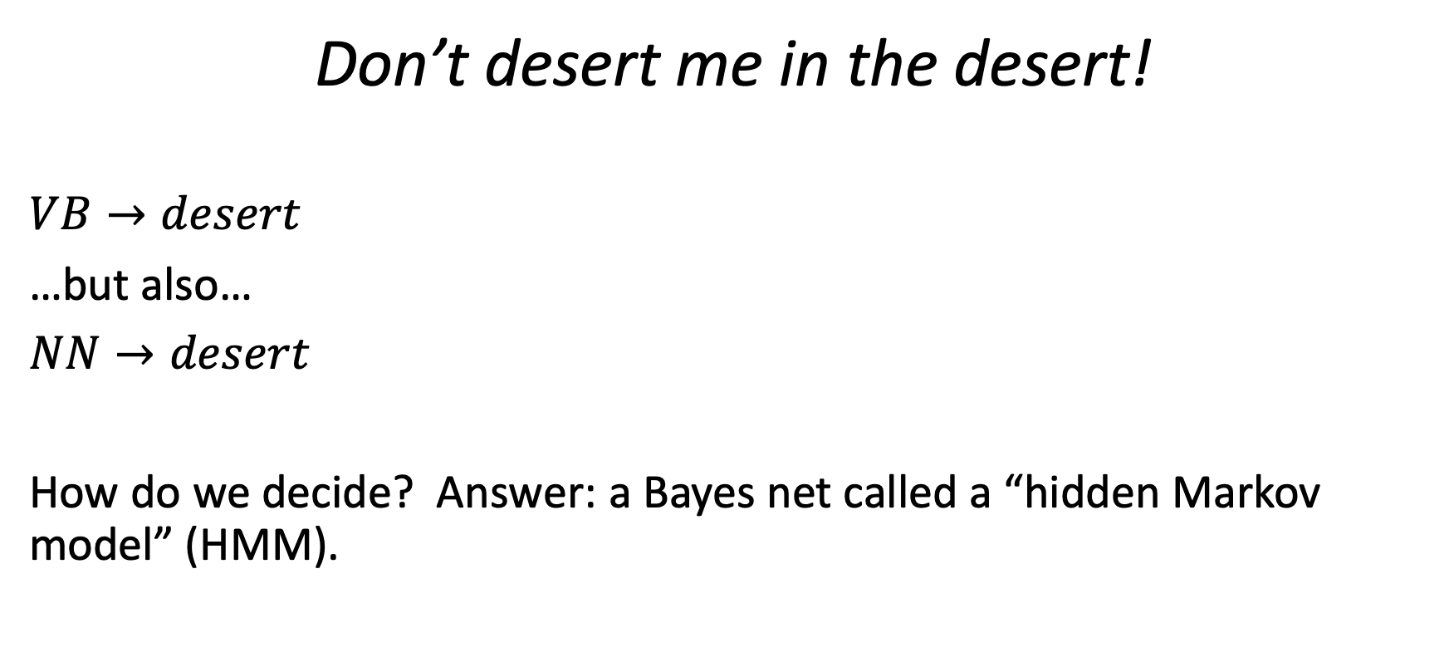
Next time: POS ambiguity
Don’t desert me in the desert!
$VB→desert$
…but also…
$NN→desert$
How do we decide? Answer: a Bayes net called a “hidden Markov model” (HMM).
By Nepenthes - Own work, CC BY-SA 3.0, https://commons.wikimedia.org/w/index.php?curid=5623273

