Slide 1
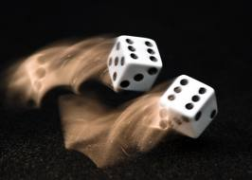
CS 440/ECE 448 Lecture 12: Probability
Slides by Svetlana Lazebnik, 9/2016
Modified by Mark Hasegawa-Johnson, 2/2019

Slide 2
Outline
Motivation: Why use probability?
Review of Key Concepts
Outcomes, Events
Joint, Marginal, and Conditional
Independent vs. Conditionally Independent events
Classification Using Probabilities

Slide 3
Outline
Motivation: Why use probability?
Review of Key Concepts
Outcomes, Events
Joint, Marginal, and Conditional
Independence and Conditional Independence
Classification Using Probabilities

Slide 4
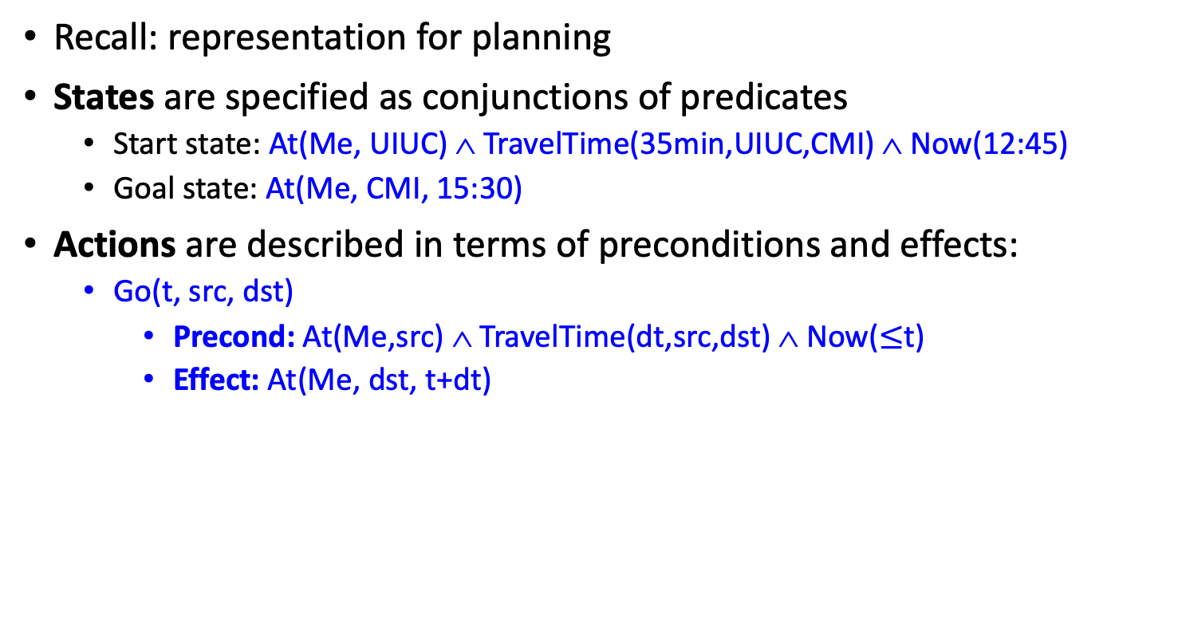
Motivation: Planning under uncertainty
Recall: representation for planning
States are specified as conjunctions of predicates
Start state: At(Me, UIUC) ∧ TravelTime(35min,UIUC,CMI) ∧ Now(12:45)
Goal state: At(Me, CMI, 15:30)
Actions are described in terms of preconditions and effects:
Go(t, src, dst)
Precond: At(Me,src) ∧ TravelTime(dt,src,dst) ∧ Now($≤$t)
Effect: At(Me, dst, t+dt)

Slide 5
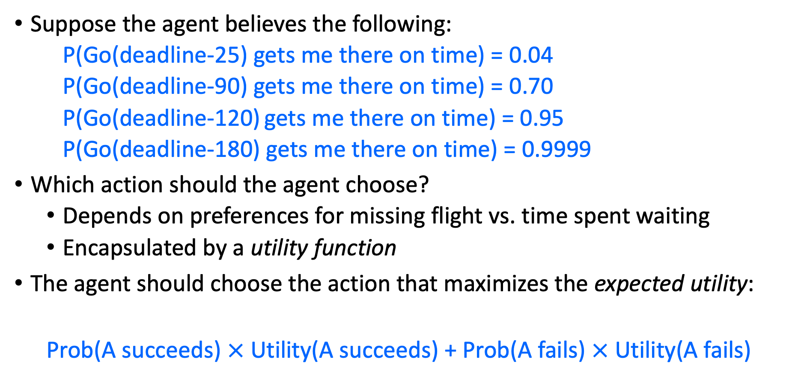
Making decisions under uncertainty
Suppose the agent believes the following:
P(Go(deadline-25) gets me there on time) = 0.04
P(Go(deadline-90) gets me there on time) = 0.70
P(Go(deadline-120) gets me there on time) = 0.95
P(Go(deadline-180) gets me there on time) = 0.9999
Which action should the agent choose?
Depends on preferences for missing flight vs. time spent waiting
Encapsulated by a utility function
The agent should choose the action that maximizes the expected utility:
Prob(A succeeds) $×$ Utility(A succeeds) + Prob(A fails) $×$ Utility(A fails)

Slide 6
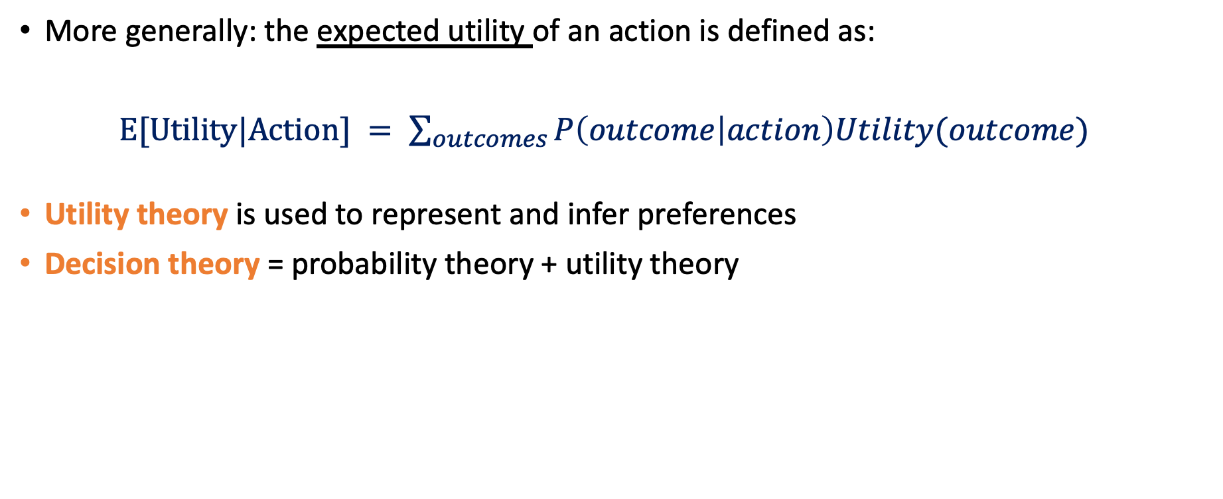
Making decisions under uncertainty
More generally: the expected utility of an action is defined as:
$E[Utility|Action] = \sum_{outcomes}{P\left(outcome | action\right)Utility(outcome)}$
Utility theory is used to represent and infer preferences
Decision theory = probability theory + utility theory

Slide 7
Where do probabilities come from?
Frequentism
Probabilities are relative frequencies
For example, if we toss a coin many times, P(heads) is the proportion of the time the coin will come up heads
But what if we’re dealing with an event that has never happened before?
What is the probability that the Earth will warm by 0.15 degrees this year?
Subjectivism
Probabilities are degrees of belief
But then, how do we assign belief values to statements?
In practice: models. Represent an unknown event as a series of better-known events
A theoretical problem with Subjectivism:
Why do “beliefs” need to follow the laws of probability?

Slide 8
The Rational Bettor Theorem
Why should a rational agent hold beliefs that are consistent with axioms of probability?
For example, P(A) + P(¬A) = 1
Suppose an agent believes that P(A)=0.7, and P(¬A)=0.7
Offer the following bet: if A occurs, agent wins $100. If A doesn’t occur, agent loses $105. Agent believes P(A)>100/(100+105), so agent accepts the bet.
Offer another bet: if ¬A occurs, agent wins $100. If ¬A doesn’t occur, agent loses $105. Agent believes P(¬A)>100/(100+105), so agent accepts the bet. Oops…
Theorem: An agent who holds beliefs inconsistent with axioms of probability can be convinced to accept a combination of bets that is guaranteed to lose them money
Notes:
If A occurs, the agent wins $6. If A does not occur, the agend loses $4. EU(bet) = 0.4 * 6 – 0.6 * 4 = 0

Slide 9
Outline
Motivation: Why use probability?
Review of Key Concepts
Outcomes, Events
Joint, Marginal, and Conditional
Independence and Conditional Independence
Classification Using Probabilities

Slide 10
Events
Probabilistic statements are defined over events, or sets of world states
A = “It is raining”
B = “The weather is either cloudy or snowy”
C = “I roll two dice, and the result is 11”
D = “My car is going between 30 and 50 miles per hour”
An EVENT is a SET of OUTCOMES
B = { outcomes : cloudy OR snowy }
C = { outcome tuples (d1,d2) such that d1+d2 = 11 }
Notation: P(A) is the probability of the set of world states (outcomes) in which proposition A holds

Slide 11
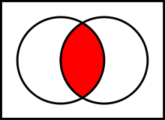
Kolmogorov’s axioms of probability
For any propositions (events) A, B
0 ≤ P(A) ≤ 1
P(True) = 1 and P(False) = 0
P(A ∨ B) = P(A) + P(B) – P(A ∧ B)
Subtraction accounts for double-counting
Based on these axioms, what is P(¬A)?
These axioms are sufficient to completely specify probability theory for discrete random variables
For continuous variables, need density functions
A
A∧B
B

Slide 12
Outcomes = Atomic events
OUTCOME or ATOMIC EVENT: is a complete specification of the state of the world, or a complete assignment of domain values to all random variables
Atomic events are mutually exclusive and exhaustive
E.g., if the world consists of only two Boolean variables Cavity and Toothache, then there are four outcomes: Outcome #1: ¬Cavity ∧ ¬Toothache Outcome #2: ¬Cavity ∧ Toothache Outcome #3: Cavity ∧ ¬Toothache Outcome #4: Cavity ∧ Toothache

Slide 13
Outline
Motivation: Why use probability?
Review of Key Concepts
Outcomes, Events
Joint, Marginal, and Conditional
Independence and Conditional Independence
Classification Using Probabilities

Slide 14
Joint probability distributions
A joint distribution is an assignment of probabilities to every possible atomic event
Why does it follow from the axioms of probability that the probabilities of all possible atomic events must sum to 1?
Atomic event | P
¬Cavity ∧ ¬Toothache | 0.8
¬Cavity ∧ Toothache | 0.1
Cavity ∧ ¬Toothache | 0.05
Cavity ∧ Toothache | 0.05

Slide 15
Joint probability distributions
Suppose we have a joint distribution of N random variables, each of which takes values from a domain of size D:
What is the size of the probability table?
Impossible to write out completely for all but the smallest distributions

Slide 16
Marginal distributions
The marginal distribution of event X_{k} is just its probability, P(X_{k}).
If you’re given the joint distribution, P(X₁, X₂, …, X_{N}) , from it, how can you calculate P(X_{k})?
You calculate P(X_{k}) from P(X₁, X₂, …, X_{N}) by marginalizing.

Slide 17
Marginal probability distributions
From the joint distribution p(X,Y) we can find the marginal distributions p(X) and p(Y)
P(Cavity, Toothache)
¬Cavity ∧ ¬Toothache | 0.8
¬Cavity ∧ Toothache | 0.1
Cavity ∧ ¬Toothache | 0.05
Cavity ∧ Toothache | 0.05
P(Cavity)
¬Cavity | 0.9
Cavity | 0.1
P(Toothache)
¬Toothache | 0.85
Toochache | 0.15

Slide 18
Conditional distributions
The conditional probability of event X_{k}, given event X_{j}, is the probability that X_{k} has occurred if you already know that X_{j} has occurred.
The conditional distribution is written P(X_{k}| X_{j}).
The probability that both X_{j} and X_{k} occurred was, originally, P(X_{j}, X_{k}).
But now you know that X_{j} has occurred. So all of the other events are no longer possible.
Other events: probability used to be P(¬X_{j}), but now their probability is 0.
Events in which X_{j} occurred: probability used to be P(X_{j}), but now their probability is 1.
So we need to renormalize: the probability that both X_{j} and X_{k} occurred, GIVEN that X_{j} has occurred, is P(X_{k}| X_{j})=P(X_{j}, X_{k})/P(X_{j}).

Slide 19
Conditional Probability: renormalize (divide)
Probability of cavity given toothache: P(Cavity = true | Toothache = true)
For any two events A and B,
Now that we know B has occurred, the set of all possible events = the set of events in which B occurred. So we renormalize to make the area of this circle = 1.
P(A ∧ B)
The set of all possible events used to be this rectangle, so the whole rectangle used to have probability=1.
P(A)
P(B)

Slide 20
Conditional probability
P(Cavity, Toothache)
¬Cavity ∧ ¬Toothache | 0.8
¬Cavity ∧ Toothache | 0.1
Cavity ∧ ¬Toothache | 0.05
Cavity ∧ Toothache | 0.05
P(Cavity)
¬Cavity | 0.9
Cavity | 0.1
P(Toothache)
¬Toothache | 0.85
Toochache | 0.15
What is p(Cavity = true | Toothache = false)?
p(Cavity|¬Toothache) = 0.05/0.85 = 1/17
What is p(Cavity = false | Toothache = true)?
p(¬Cavity|Toothache) = 0.1/0.15 = 2/3

Slide 21
Conditional distributions
A conditional distribution is a distribution over the values of one variable given fixed values of other variables
P(Cavity, Toothache)
¬Cavity ∧ ¬Toothache | 0.8
¬Cavity ∧ Toothache | 0.1
Cavity ∧ ¬Toothache | 0.05
Cavity ∧ Toothache | 0.05
P(Cavity | Toothache)
¬Cavity | 0.667
Cavity | 0.333
P(Cavity|¬Toothache)
¬Cavity | 0.941
Cavity | 0.059
P(Toothache | Cavity)
¬Toothache | 0.5
Toochache | 0.5
P(Toothache | ¬Cavity)
¬Toothache | 0.889
Toochache | 0.111

Slide 22
Normalization trick
To get the whole conditional distribution p(X | Y = y) at once, select all entries in the joint distribution table matching Y = y and renormalize them to sum to one
P(Cavity, Toothache)
¬Cavity ∧ ¬Toothache | 0.8
¬Cavity ∧ Toothache | 0.1
Cavity ∧ ¬Toothache | 0.05
Cavity ∧ Toothache | 0.05
Select
Toothache, Cavity = false
¬Toothache | 0.8
Toochache | 0.1
Renormalize
P(Toothache | Cavity = false)
¬Toothache | 0.889
Toochache | 0.111

Slide 23
Normalization trick
To get the whole conditional distribution p(X | Y = y) at once, select all entries in the joint distribution table matching Y = y and renormalize them to sum to one
Why does it work?
P(x|y)=
by marginalization

Slide 24
Product rule
Definition of conditional probability:
Sometimes we have the conditional probability and want to obtain the joint:
The chain rule:

Slide 25
Outline
Motivation: Why use probability?
Review of Key Concepts
Outcomes, Events, and Random Variables
Joint, Marginal, and Conditional
Independence and Conditional Independence
Classification Using Probabilities

Slide 26
Independence ≠ Mutually Exclusive
Two events A and B are independent if and only if p(A ∧ B) = p(A, B) = p(A) p(B)
In other words, p(A | B) = p(A) and p(B | A) = p(B)
This is an important simplifying assumption for modeling, e.g., Toothache and Weather can be assumed to be independent?
Are two mutually exclusive events independent?
No! Quite the opposite! If you know A happened, then you know that B _didn’t_ happen!! p(A ∨ B) = p(A) + p(B)

Slide 27
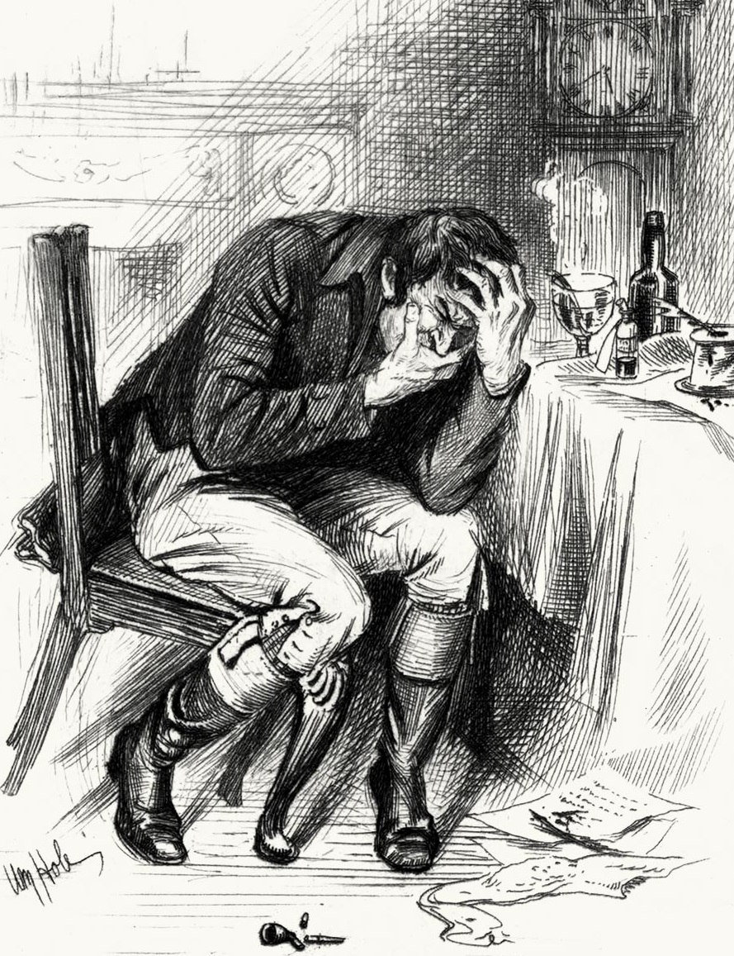

Independence ≠ Conditional Independence
Cavity: Boolean variable indicating whether the patient has a cavity
Toothache: Boolean variable indicating whether the patient has a toothache
Catch: whether the dentist’s probe catches in the cavity
By Aduran, CC-SA 3.0
By William Brassey Hole(Died:1917)
By Dozenist, CC-SA 3.0

Slide 28
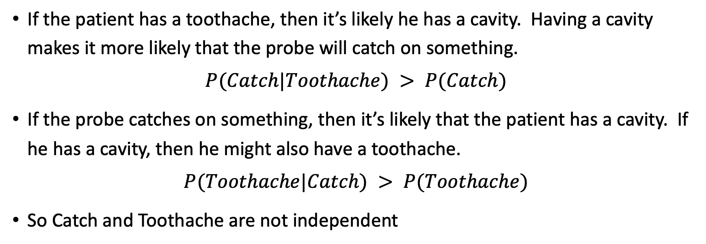
These Events are not Independent
If the patient has a toothache, then it’s likely he has a cavity. Having a cavity makes it more likely that the probe will catch on something.
$$P(Catch|Toothache) > P(Catch)$$
If the probe catches on something, then it’s likely that the patient has a cavity. If he has a cavity, then he might also have a toothache.
$$P(Toothache|Catch) > P(Toothache)$$
So Catch and Toothache are not independent

Slide 29
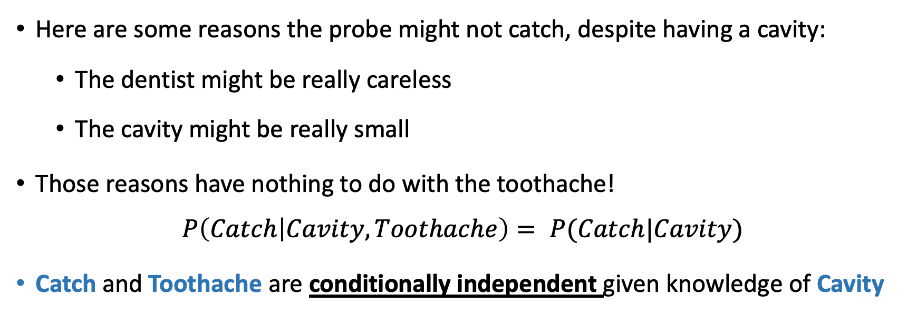
…but they are Conditionally Independent
Dependent
Dependent
Conditionally Dependent given knowledge of Cavity
Here are some reasons the probe might not catch, despite having a cavity:
The dentist might be really careless
The cavity might be really small
Those reasons have nothing to do with the toothache!
$$P\left(Catch | Cavity,Toothache\right)= P(Catch|Cavity)$$
Catch and Toothache are conditionally independent given knowledge of Cavity

Slide 30
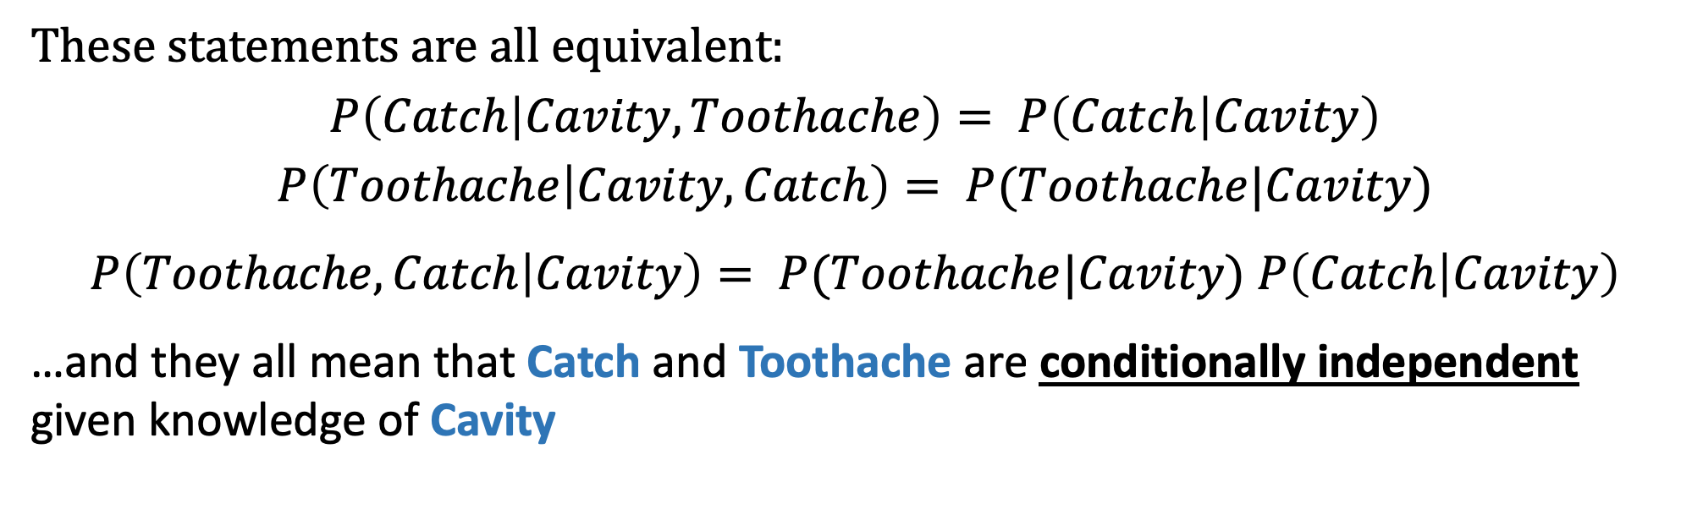
…but they are Conditionally Independent
Dependent
Dependent
Conditionally Dependent given knowledge of Cavity
These statements are all equivalent:
$$P\left(Catch | Cavity,Toothache\right)= P\left(Catch | Cavity\right)$$
$$P\left(Toothache | Cavity,Catch\right)= P(Toothache|Cavity)$$
$P\left(Toothache,Catch | Cavity\right)= P(Toothache|Cavity)$ $P\left(Catch | Cavity\right)$
…and they all mean that Catch and Toothache are conditionally independent given knowledge of Cavity

Slide 31
Outline
Motivation: Why use probability?
Review of Key Concepts
Outcomes, Events
Joint, Marginal, and Conditional
Independent vs. Conditionally Independent events
Classification Using Probabilities

Slide 32
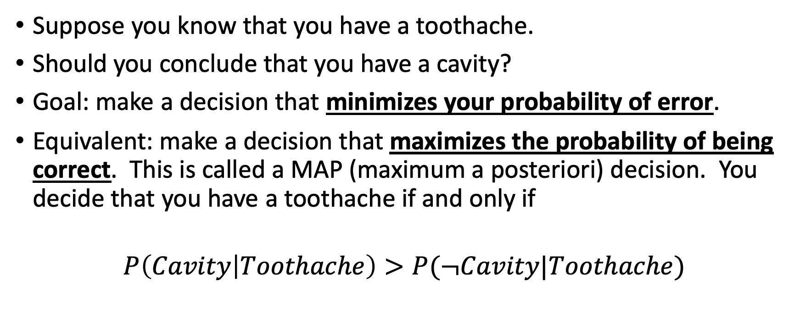
Classification using probabilities
Suppose you know that you have a toothache.
Should you conclude that you have a cavity?
Goal: make a decision that minimizes your probability of error.
Equivalent: make a decision that maximizes the probability of being correct. This is called a MAP (maximum a posteriori) decision. You decide that you have a toothache if and only if
$$P\left(Cavity | Toothache\right)>P(¬Cavity|Toothache)$$

Slide 33
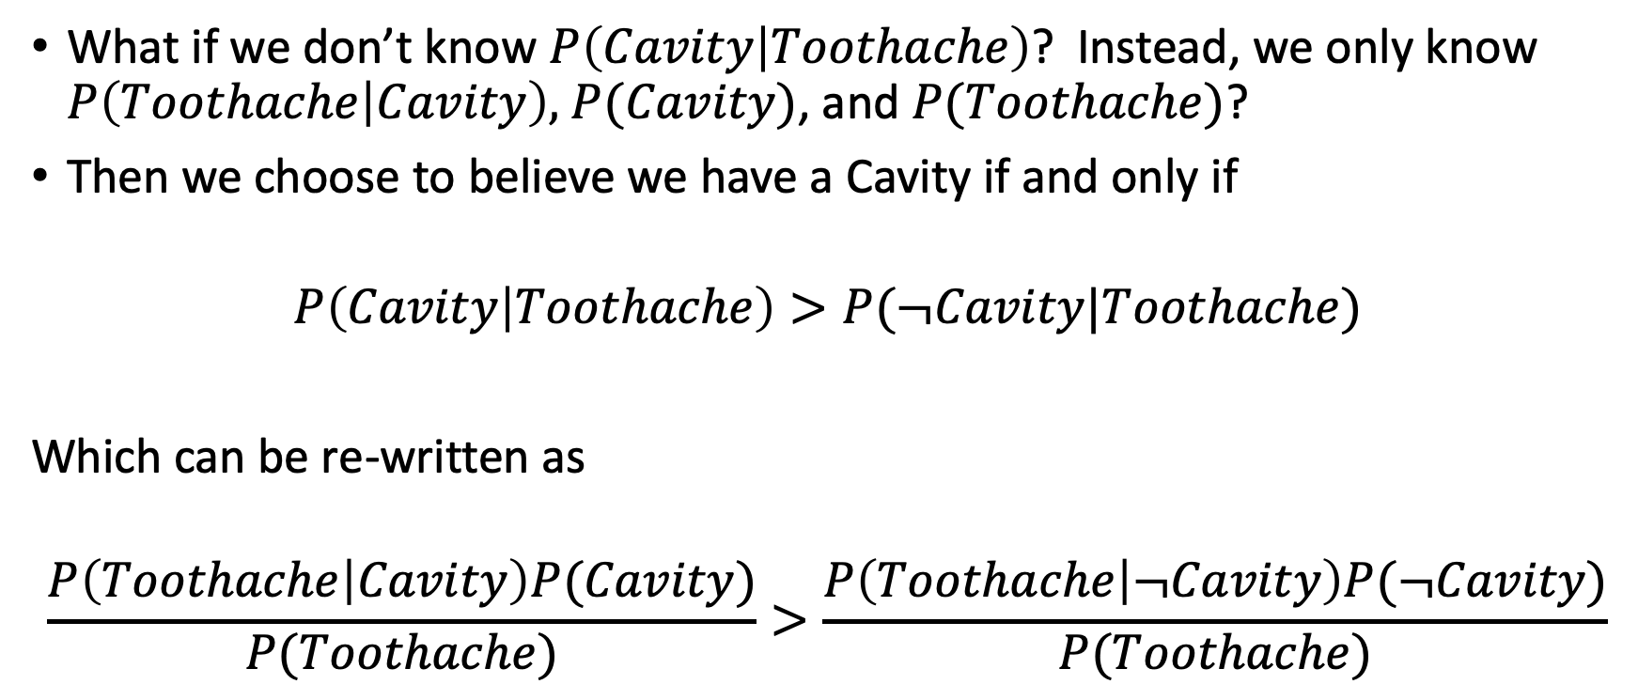
Bayesian Decisions
What if we don’t know $P\left(Cavity | Toothache\right)$? Instead, we only know $P\left(Toothache | Cavity\right),$ $P(Cavity)$, and $P(Toothache)$?
Then we choose to believe we have a Cavity if and only if
$$P\left(Cavity | Toothache\right)>P(¬Cavity|Toothache)$$
Which can be re-written as
$$\frac{P\left(Toothache | Cavity\right)P(Cavity)}{P(Toothache)}>\frac{P\left(Toothache | ¬Cavity\right)P(¬Cavity)}{P(Toothache)}$$

Slide 34
Outline
Motivation: Why use probability?
Review of Key Concepts
Outcomes, Events
Joint, Marginal, and Conditional
Independent vs. Conditionally Independent events
Classification Using Probabilities

