Slide 1
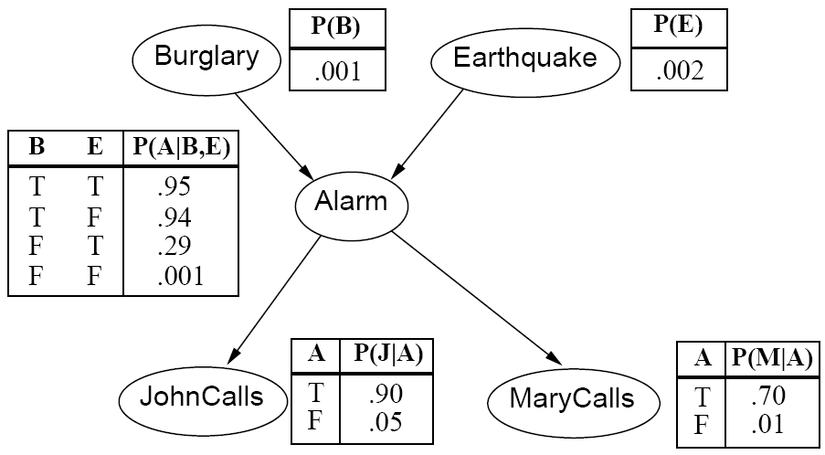
CS440/ECE448 Lecture 15: Bayesian Networks
By Mark Hasegawa-Johnson, 2/2020
With some slides by Svetlana Lazebnik, 9/2017
License: CC-BY 4.0
You may redistribute or remix if you cite the source.

Slide 2
Review: Bayesian inference
A general scenario:
Query variables: X
Evidence (observed) variables and their values: E = e
Inference problem: answer questions about the query variables given the evidence variables
This can be done using the posterior distribution P(X | E = e)
Example of a useful question: Which X is true?
More formally: what value of X has the least probability of being wrong?
Answer: MPE = MAP (argmin P(error) = argmax P(X=x|E=e))
Notes:
2

Slide 3
Today: What if P(X,E) is complicated?
Very, very common problem: P(X,E) is complicated because both X and E depend on some hidden variable Y
SOLUTION:
Draw a bunch of circles and arrows that represent the dependence
When your algorithm performs inference, make sure it does so in the order of the graph
FORMALISM: Bayesian Network

Slide 4
Hidden Variables
A general scenario:
Query variables: X
Evidence (observed) variables and their values: E = e
Unobserved variables: Y
Inference problem: answer questions about the query variables given the evidence variables
This can be done using the posterior distribution P(X | E = e)
In turn, the posterior needs to be derived from the full joint P(X, E, Y)
Bayesian networks are a tool for representing joint probability distributions efficiently
Notes:
4

Slide 5

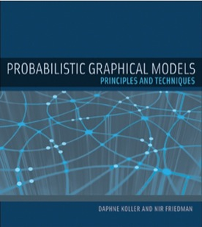
Bayesian networks
More commonly called graphical models
A way to depict conditional independence relationships between random variables
A compact specification of full joint distributions

Slide 6
Outline
Review: Bayesian inference
Bayesian network: graph semantics
The Los Angeles burglar alarm example
Inference in a Bayes network
Conditional independence ≠ Independence

Slide 7
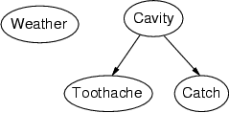
Bayesian networks: Structure
Nodes: random variables
Arcs: interactions
An arrow from one variable to another indicates direct influence
Must form a directed, acyclic graph

Slide 8
Example: N independent coin flips
Complete independence: no interactions
…
X₁
X₂
X_{n}

Slide 9
Example: Naïve Bayes document model
Random variables:
X: document class
W₁, …, W_{n}: words in the document
X
…
W₁
W₂
W_{n}

Slide 10
Outline
Review: Bayesian inference
Bayesian network: graph semantics
The Los Angeles burglar alarm example
Inference in a Bayes network
Conditional independence ≠ Independence

Slide 11

Example: Los Angeles Burglar Alarm
I have a burglar alarm that is sometimes set off by minor earthquakes. My two neighbors, John and Mary, promised to call me at work if they hear the alarm
Example inference task: suppose Mary calls and John doesn’t call. What is the probability of a burglary?
What are the random variables?
Burglary, Earthquake, Alarm, JohnCalls, MaryCalls
What are the direct influence relationships?
A burglar can set the alarm off
An earthquake can set the alarm off
The alarm can cause Mary to call
The alarm can cause John to call

Slide 12
Example: Burglar Alarm

Slide 13
Conditional independence and the joint distribution
Key property: each node is conditionally independent of its non-descendants given its parents
Suppose the nodes X₁, …, X_{n} are sorted in topological order
To get the joint distribution P(X₁, …, X_{n}), use chain rule:

Slide 14
Conditional probability distributions
To specify the full joint distribution, we need to specify a conditional distribution for each node given its parents: P (X | Parents(X))
…
Z₁
Z₂
Z_{n}
X
P (X | Z₁, …, Z_{n})

Slide 15





Example: Burglar Alarm
$$P(E)$$
$$P(B)$$
$$P(A|B,E)$$
$$P(M|A)$$
$$P(J|A)$$

Slide 16



Example: Burglar Alarm
$$P(B)$$
$$P(E)$$
A “model” is a complete specification of the dependencies.
The conditional probability tables are the model parameters.
$$P(A|B,E)$$
$$P(J|A)$$
$$P(M|A)$$

Slide 17
Outline
Review: Bayesian inference
Bayesian network: graph semantics
The Los Angeles burglar alarm example
Inference in a Bayes network
Conditional independence ≠ Independence

Slide 18
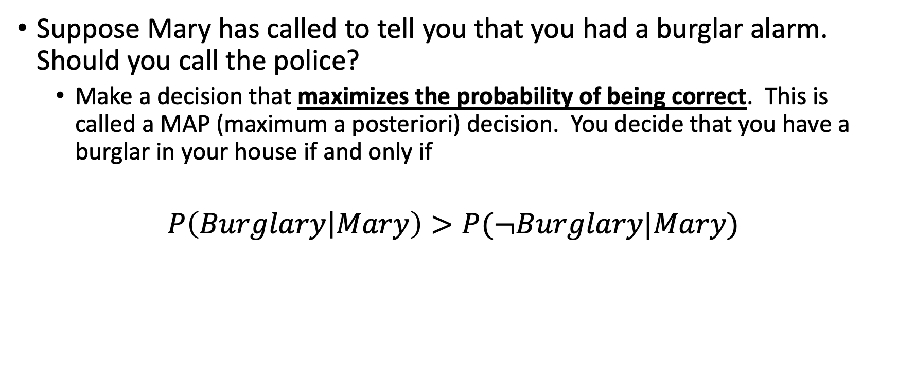
Classification using probabilities
Suppose Mary has called to tell you that you had a burglar alarm. Should you call the police?
Make a decision that maximizes the probability of being correct. This is called a MAP (maximum a posteriori) decision. You decide that you have a burglar in your house if and only if
$$P\left(Burglary | Mary\right)>P(¬Burglary|Mary)$$

Slide 19
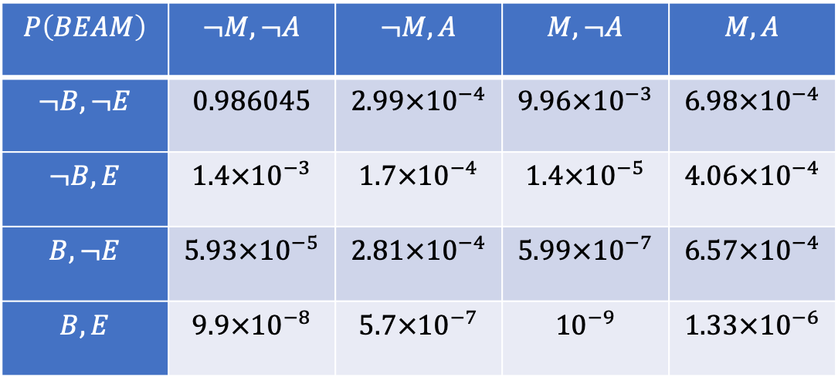
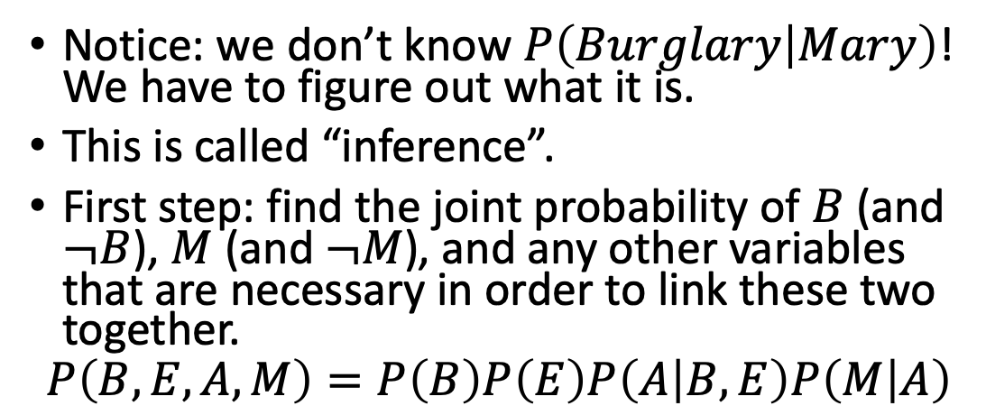
Using a Bayes network to estimate a posteriori probabilities
Notice: we don’t know $P\left(Burglary | Mary\right)$! We have to figure out what it is.
This is called “inference”.
First step: find the joint probability of $B$ (and $¬B$), $M$ (and $¬M$), and any other variables that are necessary in order to link these two together.
$$P\left(B,E,A,M\right)=P\left(B\right)P\left(E\right)P\left(A | B,E\right)P\left(M | A\right)$$
$$P\left(BEAM\right)$$ | $$¬M,¬A$$ | $$¬M,A$$ | $$M,¬A$$ | $$M,A$$
$$¬B,¬E$$ | $$0.986045$$ | $$2.99×{10}^{−4}$$ | $$9.96×{10}^{−3}$$ | $$6.98×{10}^{−4}$$
$$¬B,E$$ | $$1.4×{10}^{−3}$$ | $$1.7×{10}^{−4}$$ | $$1.4×{10}^{−5}$$ | $$4.06×{10}^{−4}$$
$$B,¬E$$ | $$5.93×{10}^{−5}$$ | $$2.81×{10}^{−4}$$ | $$5.99×{10}^{−7}$$ | $$6.57×{10}^{−4}$$
$$B,E$$ | $$9.9×{10}^{−8}$$ | $$5.7×{10}^{−7}$$ | $${10}^{−9}$$ | $$1.33×{10}^{−6}$$

Slide 20
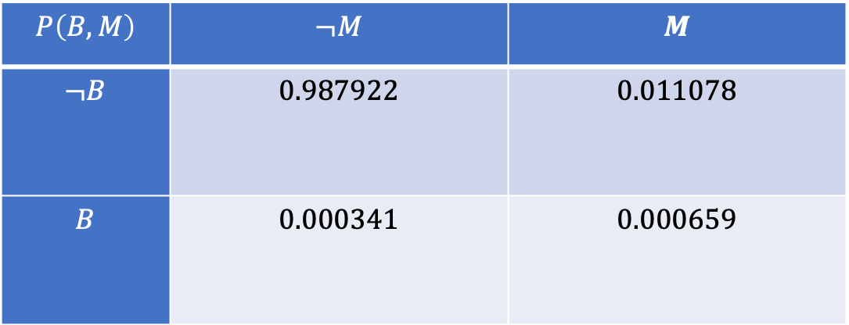
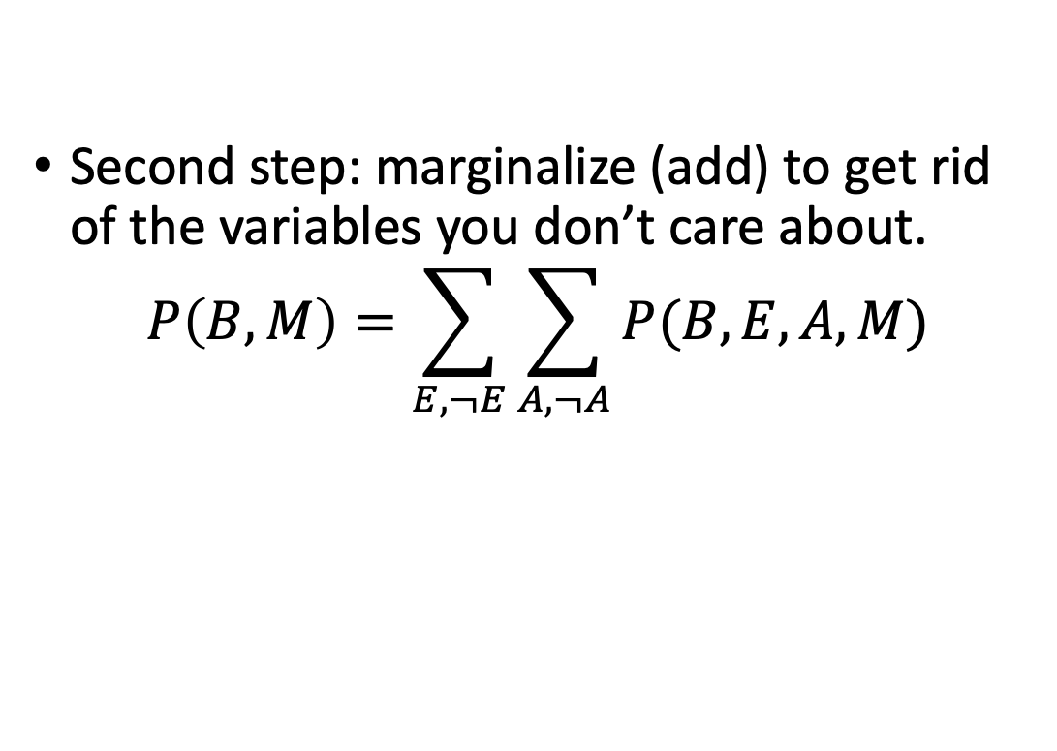
Using a Bayes network to estimate a posteriori probabilities
Second step: marginalize (add) to get rid of the variables you don’t care about.
$$P\left(B, M\right)=\sum_{E,¬E}{\sum_{A,¬A}{P(B,E,A,M)}}$$
$$P\left(B,M\right)$$ | $$¬M$$ | $$M$$
$$¬B$$ | $$0.987922$$ | $$0.011078$$
$$B$$ | $$0.000341$$ | $$0.000659$$

Slide 21
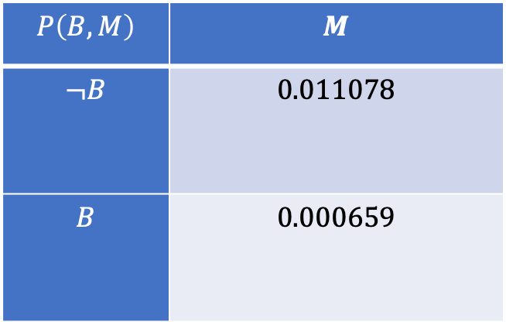
Using a Bayes network to estimate a posteriori probabilities
Third step: ignore (delete) the column that didn’t happen.
$$P\left(B,M\right)$$ | $$M$$
$$¬B$$ | $$0.011078$$
$$B$$ | $$0.000659$$

Slide 22
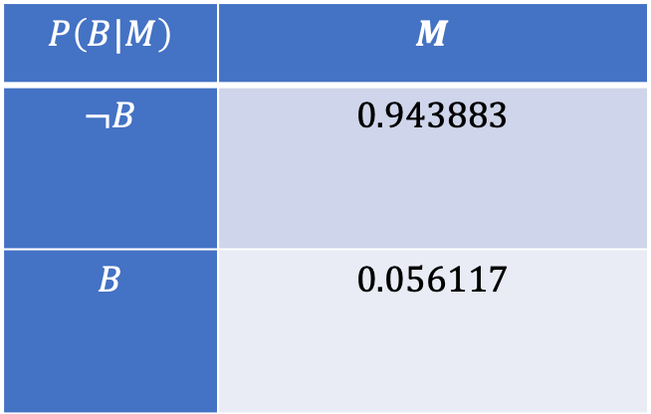
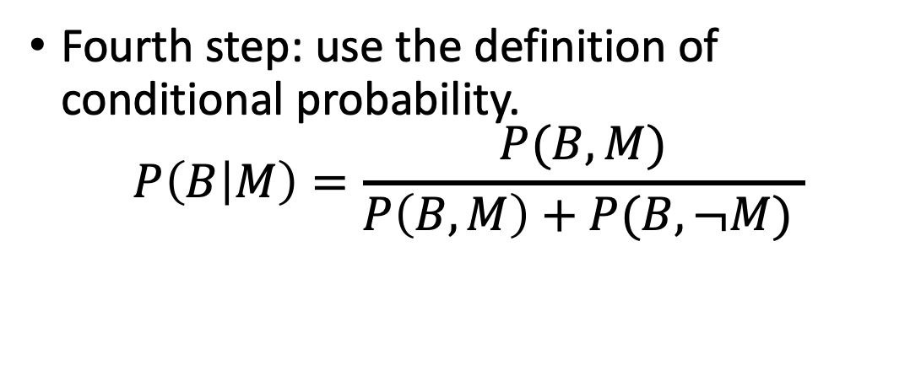
Using a Bayes network to estimate a posteriori probabilities
Fourth step: use the definition of conditional probability.
$$P\left(B | M\right)=\frac{P(B,M)}{P\left(B,M\right)+P(B,¬M) }$$
$$P\left(B|M\right)$$ | $$M$$
$$¬B$$ | $$0.943883$$
$$B$$ | $$0.056117$$

Slide 23
Some unexpected conclusions
Burglary is so unlikely that, if only Mary calls or only John calls, the probability of a burglary is still only about 5%.
If both Mary and John call, the probability is ~50%.
unless …

Slide 24
Some unexpected conclusions
Burglary is so unlikely that, if only Mary calls or only John calls, the probability of a burglary is still only about 5%.
If both Mary and John call, the probability is ~50%.
unless …
If you know that there was an earthquake, then the probability is, the alarm was caused by the earthquake. In that case, the probability you had a burglary is vanishingly small, even if twenty of your neighbors call you.
This is called the “explaining away” effect. The earthquake “explains away” the burglar alarm.

Slide 25
Outline
Review: Bayesian inference
Bayesian network: graph semantics
The Los Angeles burglar alarm example
Inference in a Bayes network
Conditional independence ≠ Independence

Slide 26
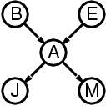
The joint probability distribution
For example,
$$\text{P}\text{(}\text{j}\text{, }\text{m}\text{, }\text{a}\text{, }¬\text{b}\text{,}¬\text{e}\text{) = }\text{P}\text{(}¬\text{b}\text{) }\text{P}\text{(}¬\text{e}\text{) }\text{P}\text{(}\text{a}\text{|}¬\text{b}\text{,}¬\text{e}\text{) }\text{P}\text{(}\text{j}\text{|}\text{a}\text{) }\text{P}\text{(}\text{m}\text{|}\text{a}\text{)}$$

Slide 27
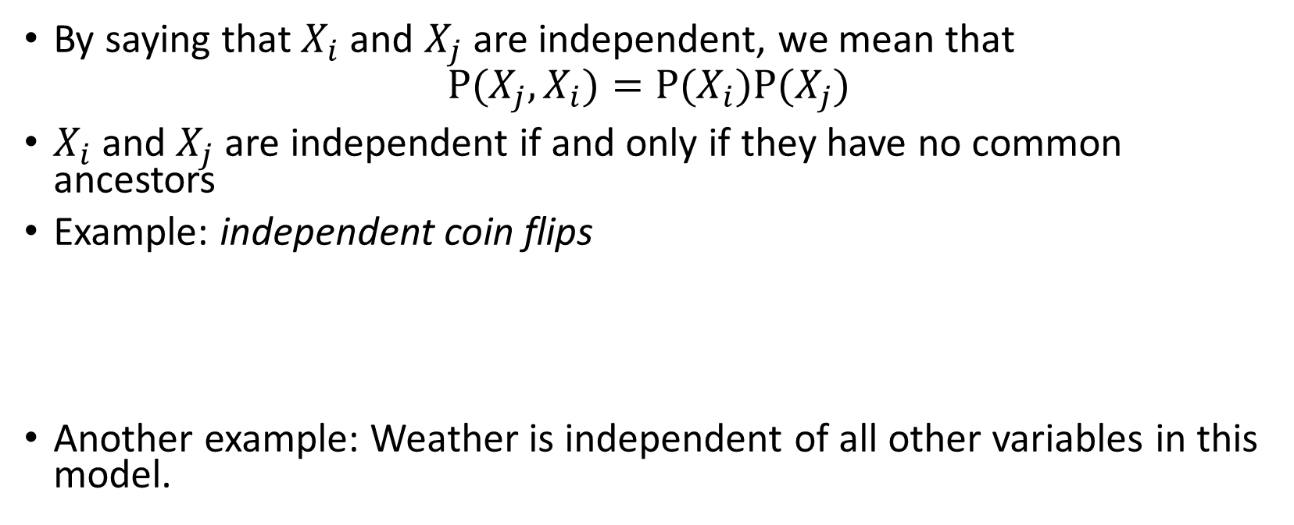
Independence
By saying that $X_{i}$and $X_{j}$are independent, we mean that
$$P(X_{j},X_{i})=P(X_{i})P(X_{j})$$
$X_{i}$and $X_{j}$ are independent if and only if they have no common ancestors
Example: independent coin flips
Another example: Weather is independent of all other variables in this model.
…
X₁
X₂
X_{n}

Slide 28
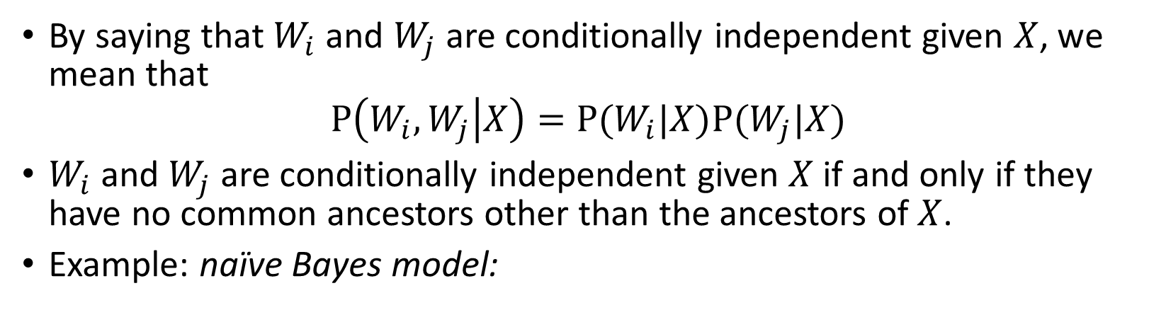
Conditional independence
By saying that $W_{i}$and $W_{j}$are conditionally independent given $X$, we mean that
$$P\left(W_{i},W_{j} | X\right)=P(W_{i}|X)P(W_{j}|X)$$
$W_{i}$and $W_{j}$are conditionally independent given $X$ if and only if they have no common ancestors other than the ancestors of $X$.
Example: naïve Bayes model:
X
…
W₁
W₂
W_{n}

Slide 29
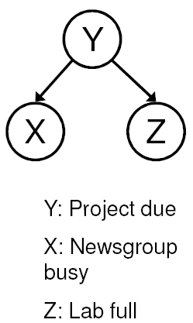
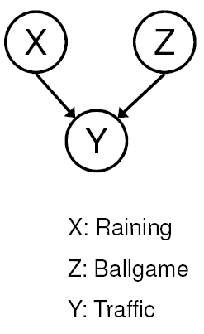
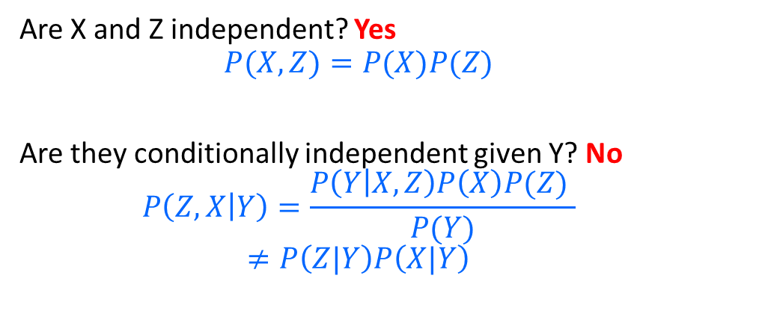

Conditional independence ≠ Independence
Common cause: Conditionally Independent
Common effect: Independent
Are X and Z independent? No
$$P\left(Z,X\right)=\sum_{Y}{P\left(Z | Y\right)P\left(X | Y\right)P(Y)}$$
$$P\left(Z\right)P\left(X\right)=\left(\sum_{Y}{P\left(Z | Y\right)P(Y)}\right)\left(\sum_{Y}{P\left(X | Y\right)P(Y)}\right)$$
Are they conditionally independent given Y? Yes
$$P\left(Z,X | Y\right)=P(Z|Y)P(X|Y)$$
Are X and Z independent? Yes
$$P(X,Z)=P(X)P(Z)$$
Are they conditionally independent given Y? No
$$P\left(Z,X | Y\right)=\frac{P\left(Y | X,Z\right)P\left(X\right)P(Z) }{P(Y)}$$
$$≠P\left(Z|Y\right)P\left(X|Y\right)$$
Notes:
Is P(Raining | Traffic) the same as P(Raining | Traffic, Ballgame)?

Slide 30
Conditional independence ≠ Independence
Common cause: Conditionally Independent
Common effect: Independent
Are X and Z independent? No
Knowing X tells you about Y, which tells you about Z.
Are they conditionally independent given Y? Yes
If you already know Y, then X gives you no useful information about Z.
Are X and Z independent? Yes
Knowing X tells you nothing about Z.
Are they conditionally independent given Y? No
If Y is true, then either X or Z must be true.
Knowing that X is false means Z must be true.
We say that X “explains away” Z.
Notes:
Is P(Raining | Traffic) the same as P(Raining | Traffic, Ballgame)?

Slide 31
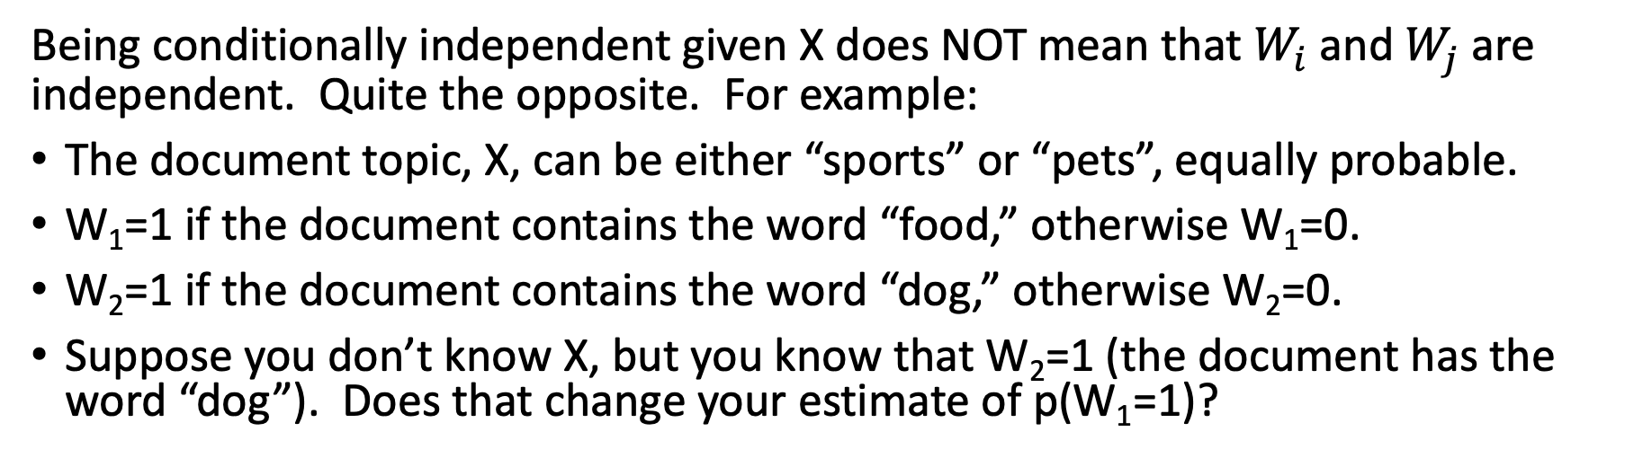
Conditional independence ≠ Independence
X
…
W₁
W₂
W_{n}
Being conditionally independent given X does NOT mean that $W_{i}$and $W_{j}$are independent. Quite the opposite. For example:
The document topic, X, can be either “sports” or “pets”, equally probable.
W₁=1 if the document contains the word “food,” otherwise W₁=0.
W₂=1 if the document contains the word “dog,” otherwise W₂=0.
Suppose you don’t know X, but you know that W₂=1 (the document has the word “dog”). Does that change your estimate of p(W₁=1)?

Slide 32
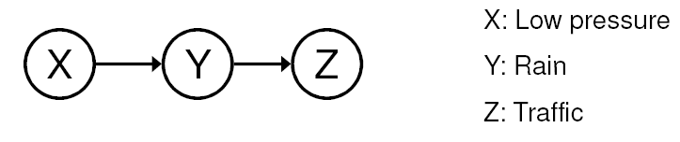
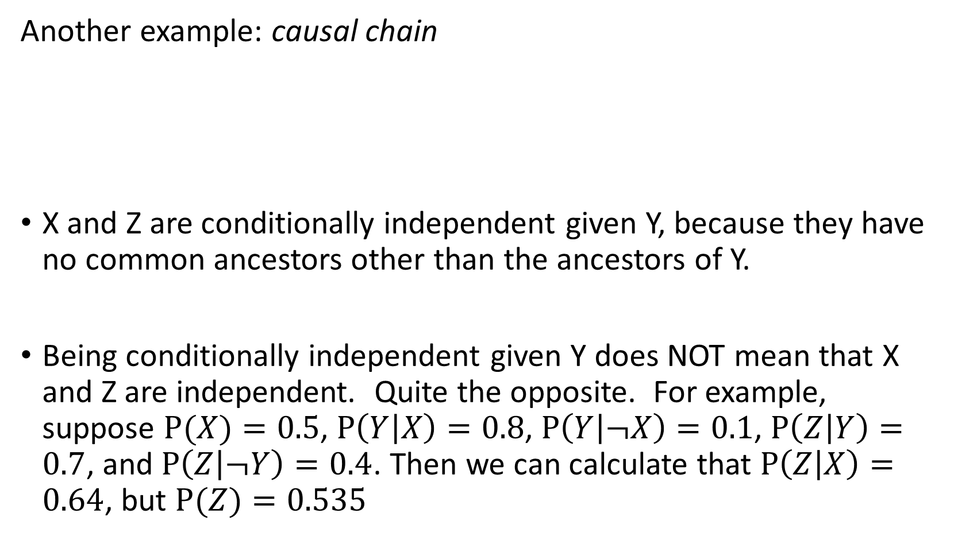
Conditional independence
Another example: causal chain
X and Z are conditionally independent given Y, because they have no common ancestors other than the ancestors of Y.
Being conditionally independent given Y does NOT mean that X and Z are independent. Quite the opposite. For example, suppose $P(X)=0.5$, $P\left(Y | X\right)=0.8$, $P\left(Y | ¬X\right)=0.1$, $P\left(Z | Y\right)=0.7$, and $P\left(Z | ¬Y\right)=0.4$. Then we can calculate that $P\left(Z | X\right)=0.64$, but $P(Z)=0.535$

Slide 33
Outline
Review: Bayesian inference
Bayesian network: graph semantics
The Los Angeles burglar alarm example
Inference in a Bayes network
Conditional independence ≠ Independence

